Slide 1

Engaging & Inspiring
Gen Y as Staff
(& Customers)
Notes:
(1) Telling Great Stories
Story/Stitching -- Hugo Boss
It’s the story that drives the behaviour
We know about this in purchasing: power of story and identity
Harley Davidson, Apple
It’s also true in where we work:
NZ Trades Association
Consulting Engineers of Australia
Law Firm → ‘whats your carbon footprint’
Telling Great Stories for Gen Y
Valued @ Work: ‘I help make the car go faster’; ‘I cure cancer’; Inside my own business: Change Agents
Superficial statements of value → ACEL and toilet paper
Meaningful contribution to the world
(2) Be Nice
The new journey of growing up: moving home; at school; university … INTEL
Right/Wrong/Useful → we have two choices; rail against how ‘wrong’ it is VS slowly adjust and come to the table a bit.
Soften the process – AAR
Right/Wrong/Useful – Phone VS Text
Never drop standards – TAP
(3) leverage technology & unleash collaboration
Gen Y ‘digital natives’ – mobility, social and always on is the name of the game
Duke University
Opportunity for financial: NCVER → financial technologies
The power of technology today is in the power of collaboration
Collaboration drives innovation → Best Buy
Technology enables always-on collaboration: IBM Innovation Jam; AIDS research; InnoCentive
Unleash Gen Y and collaborative technology to drive innovation
(4) create fast pathways
Book on generational change: FAST. Gen Y think fast.
Maccas VS Home Cooked Meal
Reality: Gen Y have massively compressed expecatations of time.
New Gen Y career
What to do about it
Do NOT promote before they’re ready. People get promote to their level of incompetence.
Always, always building experiences → new psychological contract; divisional rotations, intra-firm swapping, new projects. Anything to build CVs
Sideways ladders
Tailored tastes – ADF, GAP Year
Love them when they leave – and build infrastructure to support (alumni networks etc)

Slide 2



Four Big Ideas for Today…
Telling Stories
Being Nice
Unleashing Collaboration
[Building Pathways]

Slide 3


Telling inspiring STORIES

Slide 4




Stories in
Markets

Slide 7




Stories in
Employment

Slide 8




Connect-2-Value
Superficial Statements

Slide 9

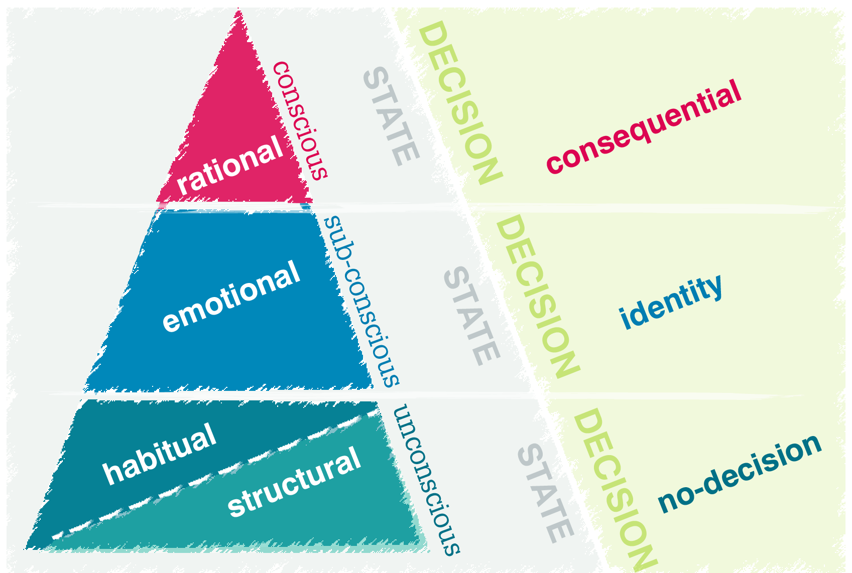
How to make people DO STUFF

Slide 10

Be NICE

Slide 12

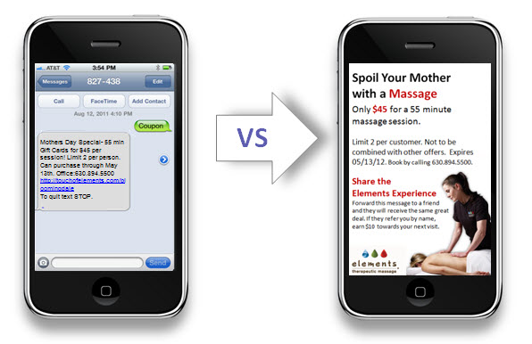
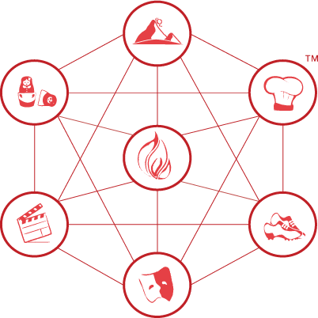
Soften The Process
Right/Wrong/Useful
Never Drop Standards

Slide 13
Leverage TECHNOLOGY
&
Unleash COLLABORATION

Slide 14





Collaboration drives Innovation…
Technology drives Collaboration…
Gen Y drives Technology…

Slide 15
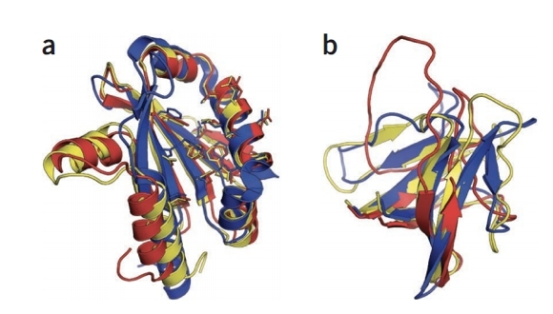
Retroviral Protease
Mason-Pfizer Monkey Virus → Simian AIDS

Slide 16
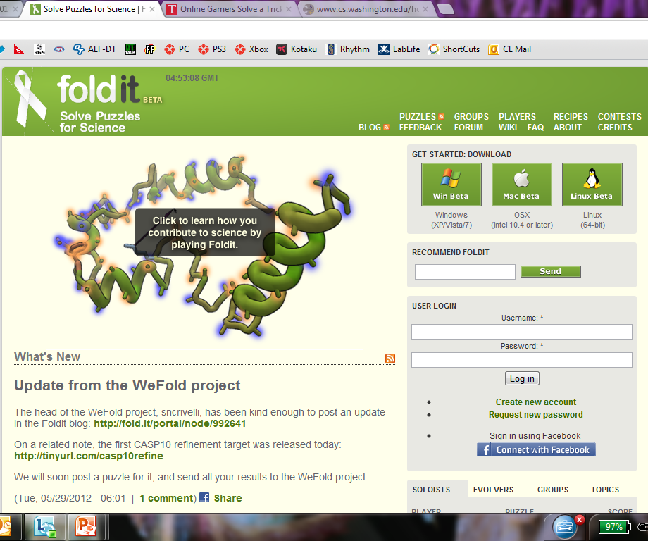


Slide 17
Always, always
ON

Slide 18
Building PATHWAYS

Slide 19






Tailored Taste
Think Fast
Love them when they Leave
Go to their World

Slide 21
dom.thurbon@changelabs.net

