Slide 1
Successful Writing for an NCDA CCSP
Credential Application

Slide 2
PREPARING for your ASSESSMENT
This powerpoint has two main sections:
Section 1 will help you understand how to write a successful response for an NCDA credential assessment
Section 2 provides details concerning the CCSP assessment, a sample response with comments, and some practice scenarios for you.

Slide 3
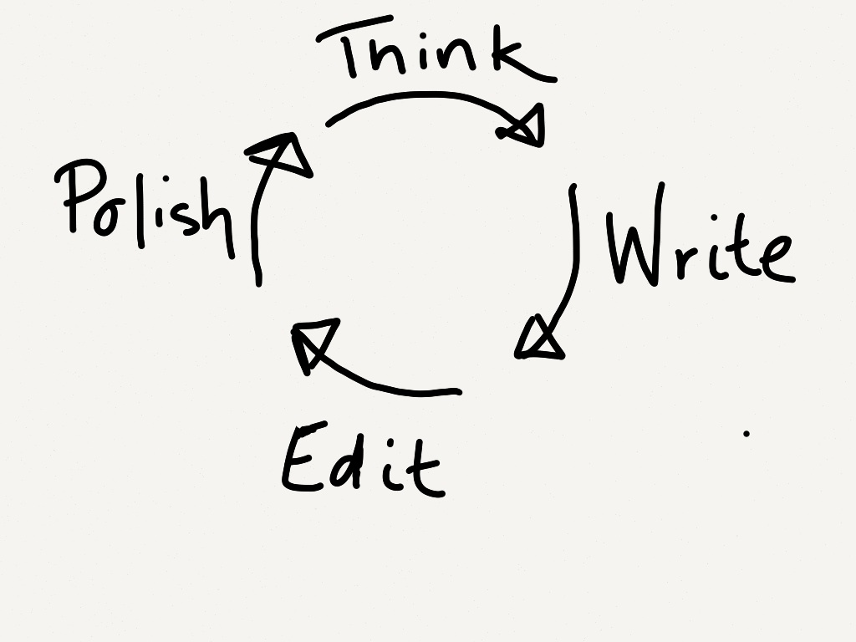
SECTION 1
Writing a successful response for an NCDA credential assessment

Slide 4
Before you Begin. . .
Read all the information provided for you and the instructions carefully to understand the format, the question, and the time limit. All of the credential assessments have a time limit.

Slide 5
Refresh yourself on Career Content
Study the information about the assessment on the credentialing website. You will find detailed explanations and information, including topics that are the focus of the scenarios. If necessary, go back and review these topics (generally this is especially true about theory and assessment). Each scenario will be focused on specific credential competencies.

Slide 6
When you are ready to begin
Once you click on your 1st scenario (case) you have 60 minutes to write your response.
Read the scenario and question carefully. What is the question? What are the key words (discuss, compare/contract, provide examples).
Look closely at what the question is directing you to do, and determine what specific information you need to provide.

Slide 7
REMEMBER THE STRUCTURE OF A GOOD RESPONSE
Introduce your main idea
Have 1-3 paragraphs of support—each with a single point defended by specific examples
Conclude with a restatement of your main point and its significance

Slide 8
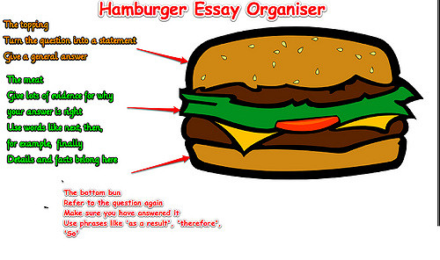

Slide 9
Follow these writing tips
Plan your time.
Take a few minutes (3-4) and jot down some ideas.
About 6 minutes (1/10 of your time) to plan your response w/ a brief outline. Save about 10 min of your time to edit, tighten, and proofread your response.

Slide 10
You are not Hemingway. . .
Perhaps the most important thing to keep in mind in writing your response is that you have a limited amount of time and space in which to get across the knowledge you have acquired and your ability to use it.
Now is not the place to be subtle or vague.

Slide 11
Follow basic writing structure
Each paragraph supports 1 main idea – stated in the 1st sentence, then explanation (detail) about that idea, and then a summary sentence (re-starting main idea).
Your intro says what you are going to cover in your response.
Your last paragraph reminds the reader of what you have said.

Slide 12
DETAILS MATTER!
Always assume that you should explain your answer. Just writing “I would assist this client by listening.” will not earn you a pass. Always explain the why/how or rationale behind your response.

Slide 13
After Ideas flow . . . Then Organize
Once you have a sense of what you will say, then organize your answer.
For answers that require a paragraph or two, jot down several important ideas or specific examples for each paragraph that will focus your thoughts.
Then briefly outline how you will organize this information. Check back to be sure that you are answering the question you were asked.

Slide 14
You are not writing a Dissertation!
Your outline will have to be selective—not everything you know, but clearly state clearly what you are saying, keep to the point in the time available, and address the question.
Follow clear paragraph structure:
Each paragraph supports 1 main idea – stated in the 1st sentence, then explanation (detail) about that idea, and then a summary sentence (re-starting main idea).

Slide 15
DREAMS ARE FINE BUT NOT HERE!
REMEMBER: Answer the question you are asked.
Be careful not to stray off topic by exploring too many options.
Read the question carefully and address the core of what is being asked!
Reviewers use a grading grid that is matched to the question!!

Slide 16
NOW WRITE . . .
You DON’T have to start by writing your introduction
Use your outline to begin with the substance of your response
THEN LATER write the intro and conclusion

Slide 17
KEEPING IDEAS flowing. . .
Follow your outline. If you draw a blank, move on to the next point – perhaps leave some space. And then come back.
Watch the clock carefully to ensure that you do not spend too much time on only one part of your answer. If you write one dazzling answer on a question with three parts, you earn only 33 points, but not enough to pass.
Don’t try to edit AND get ideas out at the same time. Get ideas out, organize, write, and then EDIT!

Slide 18
ONCE your draft is written. . .
Make your reader’s job easier!
If the scenario has specific subparts (or required components), clearly identify what you are addressing in each subpart.
You might use a header to introduce a paragraph or point you want to make.
Write sentences and paragraphs, but if you run out of time switch to point form. ONLY DO this if you must – it is a save the day strategy only.

Slide 19
BEFORE YOU ARE DONE: edit
Add a 1-3 sentence introduction and concluding paragraph. In both, preview (or remind) about the key points.
Review your response to make sure you have answered the questions and your response matches your topic sentences. Make clear connections among the question and your response.

Slide 20
WHEN YOU ARE DONE. . .
Click SUBMIT and you have submitted your response.
You DON’T have to go onto the next scenario immediately, but when you do, you will have 60 minutes for each scenario.

Slide 21
SECTION 2
About the CCSP assessment, a sample response with comments, and some practice scenarios.

Slide 22
A SAMPLE RESPONSE & ANALYSIS

Slide 23
Before you Begin. . .
Carefully read all the information provided for you and the instructions to understand the format, the question, and the time limit. All of the credential assessments have a time limit.
You will be responding to scenarios that are tied to the competencies of each credential.

Slide 24
Refresh yourself on Career Content
Study the information about the assessment on the credentialing website. You will find detailed explanations and information, including topics that are the focus of the scenarios. If necessary, go back and review these topics (generally this is especially true about theory and assessment). Each scenario will be focused on specific credential competencies.

Slide 25
Before you Begin. . .
Read all the information provided for you and the instructions carefully to understand the format, the question, and the time limit. All of the credential assessments have a time limit.
Review the powerpoints in your course for the topics that are the focus of the assessment. If necessary, go back and review the chapter itself (generally this is especially true about theory and assessment):
Helping skills
Theory
Assessment
Job Search (Career Info)

Slide 26
You will choose a setting. . .
You will make a decision about the setting for your scenarios. Choose the setting where you work or want to work. It should be one where you have some knowledge or experience.
Here are the choices for your setting:
K-12 education
Higher education
Private practice
Workforce
Business

Slide 27
When you are ready to begin
Once you click on your 1st scenario (case) you have 60 minutes to write your response.
Read the scenario and question carefully. What is the question? What are the key words (discuss, compare/contract, provide examples).
Look closely at what the question is directing you to do, and determine what specific information you need to provide.

Slide 28
REMEMBER THE STRUCTURE OF A GOOD RESPONSE
Introduce your main idea
Have 1-3 paragraphs of support—each with a single point defended by specific examples
Conclude with a restatement of your main point and its significance

Slide 29
A sample: What you will see
In the next few slides, you will see a sample response (and its analysis as an answer) to a potential scenario. The analysis will be written in purple.
The sample response is written in red.

Slide 30
A sample: The Scenario
Setting is higher education
The Scenario: Presenting oneself to potential employers or positions within an organization can be difficult for many of our clients. Describe a 30-minute workshop, including handout materials, you would provide to your clients on conducting a job search.
Respond in 3 – 5 paragraphs addressing the following topics:
Identify resources for addressing the challenges the client may face during a job search
Describe components of the job search process pertinent to the client situation.
Describe how different informational resources can be used to help the client.

Slide 31
Before your write: Be clear about the questions
The questions that will organize the response about a 30 minute workshop on conducting a job search:
Identify resources for addressing the challenges the client may face during a job search
Describe components of the job search process pertinent to the client situation.
Describe how different informational resources can be used to help the client.

Slide 32
POSSIBILITIES FOR ORGANIZING A RESPONSE
Intro – something about workshops/delivery of services in the higher education setting
Body Paragraph (BP) 1: Identify resources for addressing the challenges the client may face during a job search
Body Paragraph 2: Describe components of the job search process pertinent to the client situation.
Body Paragraph 3: Describe how different informational resources can be used to help the client.
Conclusion: Wrap up of what is said, perhaps implications or reference back to intro
As you will see, the writer organized his/her response as follows:
Intro: the setting & response organization.
BP1: Challenges (topics to be addressed) & process for addressing
BP2: Info & resourses needed
BP3: Workshop Development

Slide 33
How the Writer Organized his/her Response
As you will see, the writer organized his/her response as follows:
Intro: the setting & response organization.
BP1: Challenges (topics to be addressed) & process for addressing
BP2: Info & recourses needed
BP3: Delivery of information and resource: workshop and beyond
Conclusion: 1 sentence summary about all 3 BPs.

Slide 34
SAMPLE RESPONSE: Intro
Now is a time in university career services when many offices are either planning new forms of information delivery or have already done so. I would take three major steps to revamp the delivery of career information resources: one, identify major information topic themes; two, determine what specific information needs to be provided and to whom; and three, select appropriate mediums for delivering the information.
The writer addresses all 3 questions clearly using transition words (one, two, three). The 1st sentence reminds the reader that much is happening in this sector concerning the delivery of information. Intro is 2 sentences.

Slide 35
SAMPLE RESPONSE: Body Paragraph #1
Major topics themes would included self awareness, the world of work and career exploration, gaining experience and learning how to market employment skills, and networking and job search. I would call my team together to break down each topic into smaller areas of information and inventory resources like assessment, videos, handouts, web-based tools career information delivery systems, classification systems (O*NET, OOH), online job boards (Indeed, school specific, etc...) and other sources of information that help students understand the importance of each theme and how and when to engage with each.
The writer begins with a clear transition, picking up on the language in the intro and the question: “Major topic themes.” She/he explains process for determining information and gives some examples of potential resources. The paragraph is summarized (see “other sources of information. . . “)

Slide 36
SAMPLE RESPONSE: Body Paragraph #2
In order to determine what information and resources need to be provided it will be necessary to conduct a needs assessment of our client population. Who our student are, and where their needs lie, must be understood. For instance, LGBTQ students will benefit from information on friendly employers and ways of being out in the work place. J1 visa students may want information on H1B visas and on employers who higher international workers. Similar information resources will benefit other populations with unique needs. A review of industry best practices through NACE will be helpful.
Again, the writer picks up on key words “what information and resources need. . . .” The writer then explains how he/she would gather that information and provides several specific examples of client situations. (a part of Item #2 in in the scenario).

Slide 37
SAMPLE RESPONSE: Body Paragraph #3
After conducting an inventory of resources, and an assessment of our population and its needs, I would create a strategy for providing information and resources in the most accessible, visible, and consumable way possible. Of course, one of these strategies would include traditional workshops focused on a particular high need topic (interviewing, elevator speech, LinkedIn profile). But delivery is far more diverse in higher education now. We would need to also consider delivery across a wide variety of platforms and settings. For example, our website would be reorganized to make content easier to find for all our constituents. Handouts and other physical resources would be placed conveniently on our website as well as remaining in physical locations around the office and school. Social media might be used to facilitate event promotion and to host career exploration through featured virtual speakers. A YouTube channel could provide information on common questions and topics to students in an on-demand development program. Vendors would be selected to provide services that are not possible to provide in house. Our events and service (like topic driven, population specific group work, and alumni speaker series) might even be organized around the established needs of our students.
The writer links BP 1 and BP 2 in the 1st sentence and then moves onto answering the 3rd part of the scenario. The writer responds to the particular scenario (workshop setting) and have makes the point that delivery in this setting is far more diverse than the single methodology of the scenario. The writer then describes how this information would be delivered across all relevant media.

Slide 38
SAMPLE RESPONSE: Conclusion
In summary, my goal would be to provide students with a frame work for understanding the role of career information resources, provide thorough and targeted resources based on needs, and deliver the resources to them in the most convenient, accessible ways possible.
This short paragraph serves for the response – and touches again on each of the 3 questions.

Slide 39
Observations: What makes this response Good!
The writer uses 3 detailed body paragraphs to respond to the specific questions. The applicant has short paragraphs (roughly 2 – 3 sentences per paragraph).
The introduction and conclusion clearly relate to the questions that are asked.
The response is organized in a logical fashion. The writer uses the 3 questions to organize his/her response.
Transition words (repetition of language or content) move the reader through the entire response.
Finally, paragraphs have a clear focus and tie back to the original questions.

Slide 40
NOW YOU TRY IT
The next four slides provide some sample questions for you to practice!

Slide 41
Let’s Give it a shot
THEORY QUESTION
Setting: Workforce
You are working with a client who wants a job. The individual is about 40, has work experience, few barriers, and a high school education. The client says she is not interested in doing some of the type of work she has done previously. She is open to learning about other possibilities and even training to gain entry to new kinds of work. What theory or theories will guide your work with this client?

Slide 42
Let’s Give it a shot
ASSESSMENT QUESTION
Setting: Private practice
You are working with a client who wants a job. The individual is about 40, has work experience, few barriers, and a high school education. The client says she is not interested in doing some of the type of work she has done previously. She is open to learning about other possibilities and even training to gain entry to new kinds of work. How would you use formal and/or informal assessments to help this client identify occupations to consider?

Slide 43
Let’s Give it a shot
HELPING QUESTION
Setting: K-12
You are working with a student who is wants an internship in an engineering firm. The individual is 16 and has work experience doing childcare and working in a family retail business. She excels in school, earning A’s and B’s and also does quite well in sciences and math. She is not certain about engineering, but wants to learn more. How would you use helping skills with this client?

Slide 44
Let’s Give it a shot
JOB SEARCH QUESTION
Setting: Business
You are working with an employee who is to advance. The individual is about 40, is an adequate to exceptional performer, has 15 years with the organization, and a high school education. The client says she is open to learning about other possibilities and even training to gain entry to new kinds of work. While she enjoys her work and team, she want to learn something new and grow. Describe how you would help this client think about possibilities.

Slide 45
GOOD LUCK!

