Slide 1



HORIZON BLUE CROSS BLUE SHIELD OF NEW JERSEY
NJSOM Conference 2013

Slide 2
AGENDA
Horizon Products
Policies
Navinet

Slide 3

Horizon Products

Slide 4

New SHBP and SEHBP Options
In 2013, Horizon BCSBNJ is offering the following health plan options under the State Health Benefits Program (SHBP) and School Employees’ Health Benefits Program (SEHBP).
  Horizon HMO - New for 2013
  Horizon HMO1525 – New for 2013
  Horizon HMO2030 – New for 2013
  NJ DIRECT10
  NJ DIRECT15
  NJ DIRECT1525
  NJ DIRECT2030
  NJ DIRECT HD1500
  NJ DIRECT HD4000

Slide 5
HMO Plans - Prefix SNJ
Key Features
PCP required.
Referrals required for specialist visits.
Preventive Services
When provided by a participating provider, no member cost share (no copayment).
Out-of-Network Benefits
No out-of-network benefits, except in an emergency.
Hospital Services
All inpatient admissions require authorization.
Advanced Imaging Services
CareCore National, LLC handles authorizations for radiology, cardiology and pain management.
Behavioral Health and Substance Abuse Benefits
Claims and authorizations are handled through Magellan Behavioral Health.
Notes:
Horizon offers 5 different HMO products:
Horizon HMO
Horizon HMO Access
Horizon HMO Access Value
Horizon HMO Coinsurance, and
Horizon HMO Coinsurance Plus
For the HMO product, members must choose a PCP who coordinates their
care with specialists and hospitals.
For visits to a specialist, referrals are required, except for the HMO Access
Product.

Slide 6
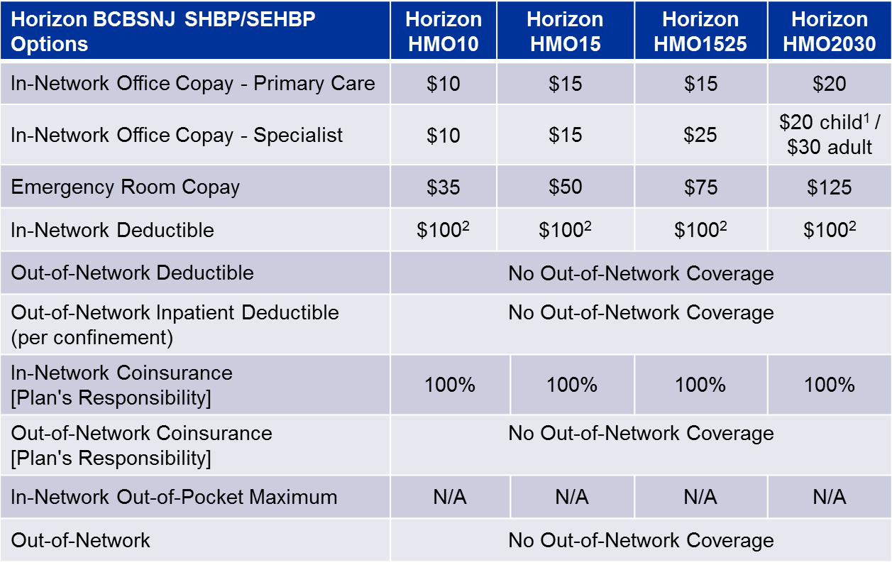
HMO Plans - benefit grid
Horizon BCBSNJ SHBP/SEHBP Options | NJ DIRECT10 | NJ DIRECT15 | NJ DIRECT1525 | NJ DIRECT2030
In-Network Office Copay - Primary Care | $10 | $15 | $15 | $20
In-Network Office Copay - Specialist | $10 | $15 | $25 | $20 child¹ / $30 adult
Emergency Room Copay | $25 | $50 | $75 | $125
In-Network Deductible | N/A | N/A | N/A | N/A
Out-of-Network Deductible | $100 Individual / $250 Family |  |  | $200 Individual / $500 Family
Out-of-Network Inpatient Deductible (per confinement) | $200² | $200² | $200 | $500
In-Network Coinsurance [Plan's Responsibility] | 100%³ | 100%³ | 100%³ | 100%³
Out-of-Network Coinsurance [Plan's Responsibility] | 80% | 70% | 70% | 70%
In-Network Out-of-Pocket Maximum | $400 Individual / $1,000 Family |  |  | $800 Individual / $2,000 Family
Out-of-Network | $2,000 Individual / $5,000 Family |  |  | $5,000 Individual / $12,500 Family
1 - Child is defined as up to 26th year.
2 - In-network Deductible applies to Durable Medical Equipment and Medical Appliances.

Slide 7
NJ DIRECT - Prefix NJX
Key Features
Members are not required to choose a PCP
Network Benefits
Plans offer in network or out of network benefits
Preventive Services
When provided by a participating provider, no member cost share (no copayment).
Advanced Imaging Services
CareCore National, LLC handles authorizations for radiology, cardiology and pain management.
Behavioral Health and Substance Abuse Benefits
Claims and authorizations are handled through Magellan Behavioral Health.
Out-of-Area Services
Members who have the PPO-in-the-suitcase logo on their ID card may have access to the BlueCard PPO network when services are rendered outside of their plan service area.
Notes:
Horizon offers 5 different HMO products:
Horizon HMO
Horizon HMO Access
Horizon HMO Access Value
Horizon HMO Coinsurance, and
Horizon HMO Coinsurance Plus
For the HMO product, members must choose a PCP who coordinates their
care with specialists and hospitals.
For visits to a specialist, referrals are required, except for the HMO Access
Product.

Slide 8
NJ DIRECT
Horizon BCBSNJ SHBP/SEHBP Options | NJ DIRECT10 | NJ DIRECT15 | NJ DIRECT1525 | NJ DIRECT2030
In-Network Office Copay - Primary Care | $10 | $15 | $15 | $20
In-Network Office Copay - Specialist | $10 | $15 | $25 | $20 child¹ / $30 adult
Emergency Room Copay | $25 | $50 | $75 | $125
In-Network Deductible | N/A | N/A | N/A | N/A
Out-of-Network Deductible | $100 Individual / $250 Family |  |  | $200 Individual / $500 Family
Out-of-Network Inpatient Deductible (per confinement) | $200² | $200² | $200 | $500
In-Network Coinsurance [Plan's Responsibility] | 100%³ | 100%³ | 100%³ | 100%³
Out-of-Network Coinsurance [Plan's Responsibility] | 80% | 70% | 70% | 70%
In-Network Out-of-Pocket Maximum | $400 Individual / $1,000 Family |  |  | $800 Individual / $2,000 Family
Out-of-Network | $2,000 Individual / $5,000 Family |  |  | $5,000 Individual / $12,500 Family
1 - Child is defined as up to 26th year.
2 - Out-of-network Inpatient Deductible does not apply to Local Education, i.e. SEHBP.
3 - In-network Coinsurance is 90% for Ambulance, PDN, DME, non-BBMI MH, Oxygen.

Slide 9
NJ DIRECT HDHP - Prefix NJX
Key Features
High-deductible health plans.
No referrals required for specialist visits.
PCP Selection
PCP selection is not required.
Preventive Services
When provided by a participating provider, no member cost share (not subject to deductible).
Network Benefits
Plans offer in-network or out-of-network benefits
Must access providers within the Horizon Managed Care network for in-network benefits.
Behavioral Health and Substance Abuse Benefits
Claims and authorizations are handled through Magellan Behavioral Health.
Out-of-Area Services
Members who have the PPO-in-the-suitcase logo on their ID card may have access to the BlueCard PPO network when services are rendered outside of their plan service area.
Notes:
Consumer Directed Healthcare, or CDH, plans are high-deductible health plans
designed to better engage the consumer in the purchase of health care services
and provide protection from catastrophic medical expenses.
For the Horizon HMO Access HSA My Way and Horizon MyWay HSA
(Direct Access) plans, PCP selection is optional; and for the NJ DIRECT
Plans and the Horizon MyWay HRA and HSA Plans, PCP selection is not
required.

Slide 10
NJ DIRECT HDHP – benefit grid
Horizon BCBSNJ SHBP/SEHBP Options | NJ DIRECT HD1500 | NJ DIRECT HD4000
In-Network Office Copay - Primary Care | N/A | N/A
In-Network Office Copay - Specialist | N/A | N/A
Emergency Room Copay | N/A | N/A
In-Network Deductible Out-of-Network Deductible | $1,500 Single / $3,000 Employee+ 1 or more combined INN / OON | $4,000 Single / $8,000 Employee+ 1 or more combined INN / OON
In-Network Coinsurance [Plan's Responsibility] | 80% | 80%
Out-of-Network Coinsurance [Plan's Responsibility] | 60% | 60%
In-Network Out-of-Pocket Maximum | $1,000 Single / $2,000 Employee+ 1 or more | $1,000 Single / $2,000 Employee+ 1 or more
Out-of-Network | $2,000 Single / $4,000 Employee+ 1 or more | $2,000 Single / $4,000 Employee+ 1 or more

Slide 11

Horizon Advantage EPO HSA/HRA plans
Beginning in January 2013, Horizon BCBSNJ began to offer versions of our popular Horizon Advantage Exclusive Provider Organization (EPO) plans that are compatible with a Health Savings Account (HSA) or Health Reimbursement Arrangement (HRA). These new Advantage EPO plans will be available to small, midsize, large and national account employers.
The Horizon Advantage EPO HSA/HRA plans combine a high-deductible Horizon Advantage EPO plan with a special savings/spending account. Members may use the accounts to pay for medical expenses not covered by their health plan, including deductible and coinsurance.

Slide 12
Prefix JGS, JGT, YKQ, YKL, JGU, YKJ
PCP Selections PCP selection not required, however members will have a lower copayment option if they choose a PCP. Copay information will appear on the ID cards.
Key Features Combines a high-deductible Horizon Advantage EPO plan with a special savings/spending account. Members may use the accounts to pay for medical expenses not covered by their health plan, including deductibles and coinsurance.
Network Benefits Members must utilize Managed Care Network (except in medical emergencies). There are no benefits for out-of-network services.
Out-of-Area Services Some versions of this plan will provide enrolled members with BlueCard® benefits for services received outside Horizon BCBSNJ’s service area. However, remember that when services are provided within the Horizon BCBSNJ local service area, members enrolled in Horizon Advantage EPO plans must use health care professionals who participate in our Horizon Managed Care Network.

Slide 13
Medicare Blue PPO
Plan Information
Beginning January 1, 2013, Horizon BCBSNJ is offering two new Medicare Advantage (MA) plans – MA PPO
  Horizon Medicare Blue Group (PPO) – Prefix YKK.
  Horizon Medicare Blue (PPO) – Prefix YKM.
MA PPO provides employer groups with the option to offer Medicare Advantage benefits to their retirees who travel or live out-of state.
In-network coverage is also available to members enrolled in other Blue Cross and/or Blue Shield MA PPO plans who reside or travel in our service area.
Horizon’s Managed Care Network.
Includes in network and out-of-network benefits
No PCP selection or referrals required.
Network
Key Features
Notes:
Beginning January 1, 2013, Horizon Blue Cross Blue Shield of New Jersey is offering a new Medicare Advantage (MA) plan – Horizon Medicare Blue Group (PPO).
This plan will enable enrolled members to obtain services outside our local service area at the in-network level of benefits.
This arrangement also makes Blue Plans’ provider networks available to other Blue Plans’ enrolled MA PPO members.
In our service area – the state of New Jersey – Horizon Medicare Blue Group (PPO) members receive care at the in-network level of benefits from participating Horizon Managed Care Network physicians and other health care professionals.

Slide 14
Medicare Blue PPO
New Eff. Jan. 2013
NO PCP or REFERRALS
Reimbursement
Services rendered in NJ to MA-PPO members by providers participating in the Horizon Managed Care Network will be reimbursed at our negotiated rates.
Services rendered in NJ to MA-PPO members by providers who only participate in the Horizon PPO Network will be calculated at the CMS allowance.
Provides all Medicare Part A & B benefits.
Coordination of Care
Preventive Services covered without copayment or coinsurance.
  Horizon follows all CMS mandated preventive services guidelines.
Member Benefits
Prescription Drug Options
Employers can add prescription drug options to convert their MA plan to Medicare Advantage Prescription Drug (MA-PD) plan.
Horizon Medicare Blue Group with Rx (PPO).
Notes:
For reimbursement, services rendered in NJ to MA-PPO members by providers participating in the Horizon Managed Care Network will be reimbursed at our negotiated rates.
Services rendered in NJ to MA-PPO members by providers who only participate in the Horizon PPO Network will be calculated at the CMS allowance.
For preventive services, Horizon follows all CMS mandated guidelines.
Employers can choose to add a prescription drug option to this plan. This will convert their Medicare Advantage Plan to a Medicare Advantage Prescription Drug plan.

Slide 15

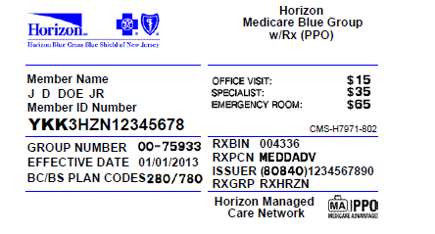
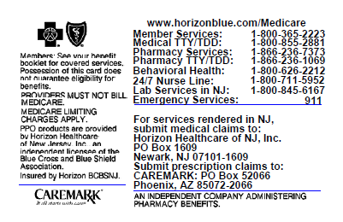

How to Identify MA PPO Members
  Horizon Medicare Blue Group (PPO) – Prefix YKK.
  Horizon Medicare Blue (PPO) – Prefix YKM.
All MA PPO ID cards will include the MA PPO suitcase
logo.
For Horizon BCBSNJ members residing in NJ, ID cards will reflect the Horizon Managed Care Network.
In addition, ID cards will include language stating “Providers must not bill Medicare. Medicare limiting charges apply”.
3
2
1
Notes:
You can recognize an MA PPO member when their Blue Cross Blue Shield member ID card has the MA PPO suitcase logo. The suitcase indicates that when traveling, members will have access to the provider network selected by participating Blues Plan.
For Horizon Blue Cross Blue Shield of NJ members residing in NJ, the ID cards reflect the Horizon Managed Care Network on the card.
Medicare Advantage PPO ID cards include language notifying providers not to bill and that Medicare charge limitations apply.

Slide 16
Horizon Medicare Blue TotalCare Key Features and Benefits
- Prefix YKI
Key Features
Must choose a Primary Care Physician (PCP) and coordinate all care with specialists through the PCP
Referrals required
Zero cost sharing – no premiums, deductibles, copayments, coinsurance
Member Benefits
The same services covered as under Medicare Advantage plans (Inpatient, Outpatient and Preventive Services)
Medicaid benefits
Dental services
Network
Providers who participate in the Horizon Managed Care network.
No out-of-network benefits
Notes:
____________________________________________________________________
____________________________________________________________________
____________________________________________________________________
____________________________________________________________________
____________________________________________________________________
____________________________________________________________________
____________________________________________________________________
____________________________________________________________________

Slide 17
Medicare Blue TotalCare (HMO SNP)
(continued)
Reimbursement
PCPs will be reimbursed on their existing payment methodology:
Fee-for-service.
Capitation.
Fee schedule exceptions – for services covered under Medicaid that Horizon does not cover under Medicare Advantage, reimbursement will be at the Medicaid rate.
Examples: Personal Care Assistant (PCA) services and Adult
and Pediatric Medical Day care.
Prescriptions
Must use the Horizon Medicare Advantage formulary for prescriptions.
Notes:
____________________________________________________________________
____________________________________________________________________
____________________________________________________________________
____________________________________________________________________
____________________________________________________________________
____________________________________________________________________
____________________________________________________________________
____________________________________________________________________

Slide 18
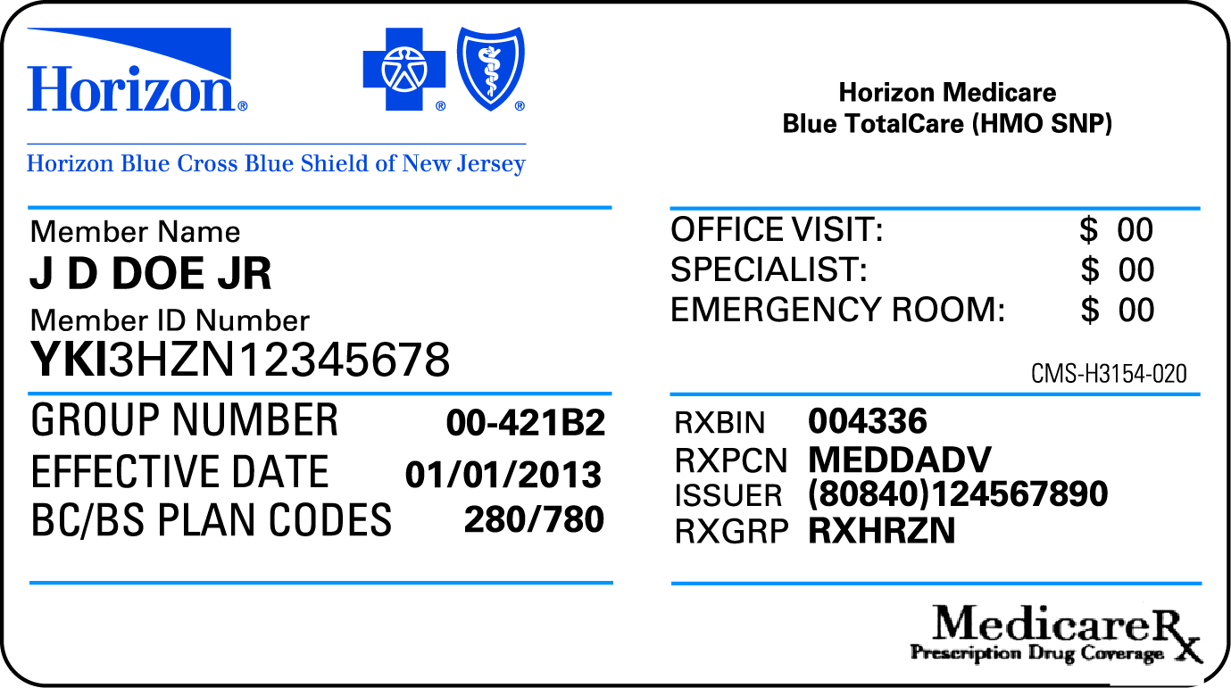
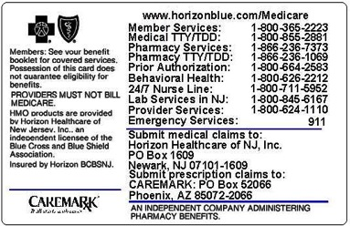
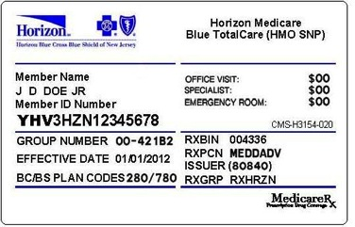
Horizon Medicare Blue TotalCare (HMO SNP)
Medicare Advantage Plan – offered as of 2012.
Horizon Medicare Blue TotalCare (HMO SNP) is a Special Needs Plan (SNP) available to New Jersey residents who are eligible for both Medicare and Medicaid coverage (Dual Eligible).
Notes:
____________________________________________________________________
____________________________________________________________________
____________________________________________________________________
____________________________________________________________________
____________________________________________________________________
____________________________________________________________________
____________________________________________________________________
____________________________________________________________________

Slide 19
Product Prefixes
Horizon has moved to an individual claim system which resulted in new prefix assignments for some of our products.
Product | Old Prefix | New Prefix |  | Product | Old Prefix | New Prefix
HMO | YHM | YHO |  | Medicare Blue PPO | YKK, YKM | No Change
POS | YHD, YHG, YHP | No Change |  | CDH | JGA, JGB, JGC, JGD, JGE, JGF, JGG, JGH, NJX | JGA, JGB, JGE, JGH, JGI, JGL, JGM, JGN, NJX, YHB, YKA
EPO | JGK, YKL, YKQ | JGO, YKL, YKQ |  | PPO | YHC, YHF, YHI, YHJ, YHK | YHB, YHF, YHL, YKA
Direct Access | NJX, YHQ, YHX, YKP | NJX, YHQ, YHX, YKR |  | Indemnity/ Traditional | YHC, YHN, YHS, YHU | YHL, YHN, YKE
NJ PROTECT | YKP | YKR |  | FEP | R + 8 digits | No Change
Medicare Advantage | YHT, YHV, YKN | YKB, YKD, YKI, YKO |  | Medigap | YHR, YHW | No Change
Medicare Blue TotalCare (HMO SNP) | YHV | YKI

Slide 20
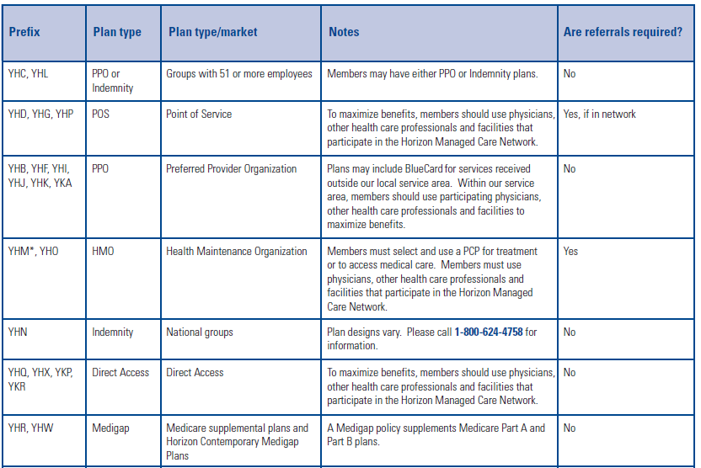
Referrals-at-a-Glance (arranged by prefix) cont.

Slide 21
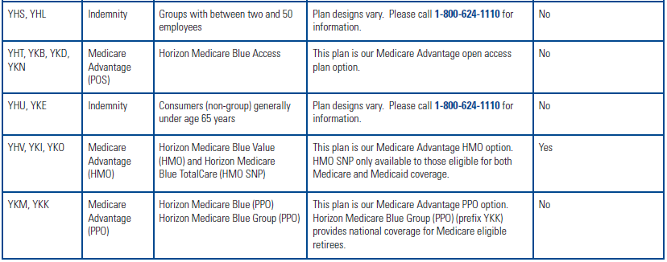
Referrals-at-a-Glance (arranged by prefix) cont.

Slide 22
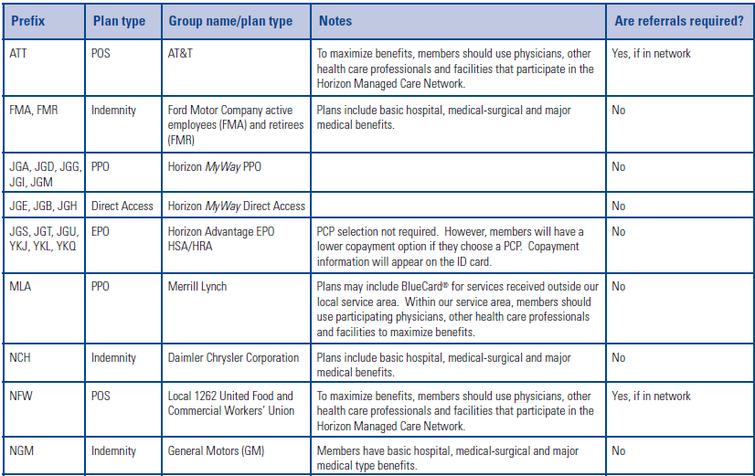
Referrals-at-a-Glance (arranged by prefix)

Slide 23
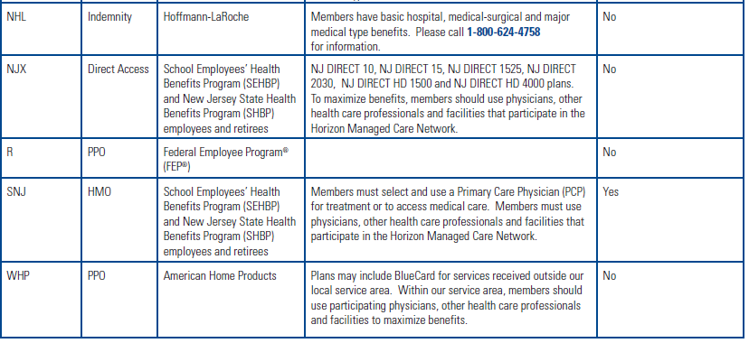
Referrals-at-a-Glance (arranged by prefix) cont.

Slide 24

POLICIES

Slide 25
Horizon’s Access Standards
Horizon Blue Cross Blue Shield of New Jersey has established access standards for PCPs and certain specialties.
We conduct an annual survey to assess compliance with:
appointment availability
wait times
and more
Any practice that is not compliant with a specific standard will be notified in writing detailing the specific standard(s) that were not met.
Each practice that is not complaint for the same standard for two consecutive years will be required to provide a written corrective action plan and would be expected to demonstrate standard compliance within a three-month period.
Notes:
Horizon has established access standards for behavioral health care
professional in the PPO network . These access standards identify how
quickly a member should be able to obtain services based on the patient’s condition.
Standards can be found in the Physician Manual which is located under the User Guide
section of the Provider
Reference Material page.
One of the forms we provided today gives you instructions on how to get to the
Provider Reference Material page.

Slide 26
Access Standards - All standards are available online
Access Standard | PCP or OB/GYN | Selected Specialties
Routine Preventive Care | Offer the patient an appointment within four months of the request. | Not Applicable
Routine Care | Offer the patient an appointment within two weeks of the request. | Offer the patient an appointment within three weeks of the request.
Urgent Care | Offer the patient an appointment within 24 hours of the request. | Offer the patient an appointment within 24 hours of the request.
Emergency Care | Respond to the patient’s call immediately (one hour) or be directed to an emergency room. | Respond to the patient’s call immediately (one hour) or be directed to an emergency room.
After Hours Care for Urgent or Emergent Care | Respond to the patient’s call for urgent or emergent care within 30 minutes of the call. | Respond to the patient’s call for urgent or emergent care within 30 minutes of the call.
Appointment Wait time | No patient is to wait more than 30 minutes for a scheduled appointment, or be offered the opportunity to reschedule. | No patient is to wait more than 30 minutes for a scheduled appointment, or be offered the opportunity to reschedule

Slide 27

Out-of-Network Consent Policy
Refer patients to par practitioners and/or facilities (including clinical labs and ASCs) unless the member:
    Wishes to use his or her out of network benefits and understands the higher out-of-pocket expense involved. Also available in Spanish.
  All Par providers are required to follow our Out-of-Network Consent Policy.
  Include completed/signed Out-of-Network Consent Forms in the patient’s medical record and provide copies within 10 business days if audited.
To access our Out-of-Network Consent Policy,
    Log in to www.NaviNet.net ,
    Plan Central ,
    References and Resources,
    Provider Reference Materials.
    Click Additional Information.
    Click Out-of-Network Consent Policy.
Notes:
The first part of the document is New Jersey Mandate. The second part of the form
is in place to protect both our member and our network provider. Mandatory audit
required after multiple complaints by our members.
Horizon BCBSNJ expects participating providers to ensure that, whenever possible,
their Horizon patients are referred to participating practitioners or facilities
(including clinical labs and ASCs (ambulatory surgery centers) unless the member:
Wishes to use their out of network benefits and
Understands that higher out of pocket expenses will be incurred.
All participating providers are required to follow our Out-of-Network Consent Policy*
to help ensure that members fully understand the increased out-of-pocket expense
they will incur for out-of-network care.
Following this discussion, participating providers are required to:
Have the member complete, sign and date an Out-of-Network Consent
Form (2180)
Forms must be retained as a part of the patient’s medical record.
In the event of an audit, this form must be provided within 10 business days.
Our Out-of-Network Consent form is now available online in Spanish also.
To access our Out-of-Network Consent Policy,
Log in to www.NaviNet.net , Plan Central , References and Resources,
Provider Reference Materials. Click Additional Information. Click Out-of-Network Consent Policy.
To access our Out-of-Network Consent Form, visit www.HorizonBlue.com/Providers and:
Mouse over Forms and Vouchers and click Downloadable Forms.
Click Out-of-Network Consent Form (2180) or Out-of-Network Consent Form in Spanish (2180S).

Slide 28
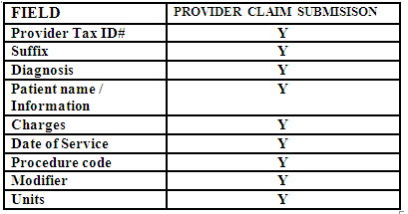
Corrected Claims
Beginning in June 2012, Physician and Institutional services representatives began accepting missing or corrected claim information over the telephone.
The table below illustrates the criteria considered a valid record for a corrected claim change.
Excluded
  Claims processed by CareCore National for radiology services when the provider is requesting to change their tax ID # or the POS on a claim, must be resubmitted with those corrections.
  BlueCard
Notes:
Do not use the 579 form for initial claims submissions.
Please use the 579 form to add multiple bill lines not included in the original claim submission.
Professional providers call 1-800-624-1110
Acute Care or ancillary facility call 1-888-666-2535

Slide 29


Laboratory Corporation of America
LabCorp (and its subsidiaries) is a preferred provider of clinical laboratory services for members enrolled in:
Horizon PPO and Indemnity Plans
Learn about LabCorp and all the services they provide by calling your LabCorp representative or LabCorp customer service at 1-800-745-0233.
Out of network consent form is required for those member who opt to choose their out of network benefits.
Notes:
The out of network consent form is what we will ask for when we receive a member complaint…..this will provide us the necessary proof that member was educated and made the choice to utilize his/her out of network option which in many cases leaves a deductible and co insurance responsibility that they were not depending on.

Slide 30

Laboratory Corporation of America
Laboratory Corporation of America Holdings (LabCorp), including DIANON, Esoterix and US LABS are the exclusive in-network clinical laboratory services provider for members enrolled in the following Horizon BCBSNJ managed care plans:
Managed Care Plans
Horizon HMO
Horizon Direct Access
Horizon Medicare Blue
Horizon NJ DIRECT (SHBP)
Horizon Advantage EPO
Horizon POS
Out of network consent form is required for those member who opt to choose their out of network benefits.
Notes:
You may be saying to yourself….we know this…….. why are you telling us again…….we continue to receive 10+ member complains per day advising us that they did not know LAB was being completed by non par provider leaving them with either a denial for those plans that have no out of network option or with an out of pocket expense for those with out of network options.

Slide 31
Navinet

Slide 32
NaviNet.net: Your source for important information
Log on to the Horizon BCBSNJ Plan Central page to access information on Navinet.net, including:
Virtual ID Card
• Mouse over Eligibility & Benefits and click Eligibility & Benefits Inquiry.
• Enter your Horizon BCBSNJ patient's ID number and click Search.
• Within the Member ID Card column, click View next to your patient's name.
Online Demographic Updates
• Select Provider Data Maintenance.
Online Credentialing
• Select Provider Data Maintenance.
• Select Join Our Network.
Clinical Practice Guidelines
• Select Provider Data Maintenance.
• Select Additional Information.
• Select Clinical Practice Guidelines.
Fees
• Select Claim Management.
• Select Fee Schedule Inquiry.
EFT Registration
• Select Claim Management.
• Select EFT Registration.
Webinars
• Select Provider Data Maintenance.
• Select Webinars.
Cover My Meds
• Access this from the main NaviNet page.
• Select Drug Auth.

Slide 33
NaviNet.net: Your source for important information cont.
Once you have logged on to the Horizon BCBSNJ Plan Central page, mouse over References and Resources and select Provider Reference Material for the following information:
Network Specialists
• Mouse over References and Resources.
• Select Provider Reference Materials.
• Select Service.
• Select Network Specialists.
Office Manual
• Mouse over References and Resources.
• Select Provider Reference Materials.
• Select Physician Manual under the User Guide section
on the right.
Medical Policies
• Mouse over References and Resources.
• Select Provider Reference Materials.
• Select Medical Policies and Pre Cert.
Benefits at a Glance and Referrals at a Glance
• Mouse over References and Resources.
• Select Provider Reference Materials.
• Select either Benefits at a Glance or Referrals at a
Glance under the User Guide section on the right.

Slide 34
Don’t Miss Our Physician Orientation Webinar
Our Physician Orientation Webinar is a valuable online resource available to our participating network, their office and billing offices.
This hour-long webinar provides a wealth of information, including:
    • An overview of Horizon BCBSNJ products.
    • Valuable BlueCard® program information.
    • How to access our online Provider Reference Materials page.
    • What you need to know about our recredentialing process.
    • How to use our new online credentialing application.
    • Tips on how to get the most from NaviNet®.
Join us at 9 a.m. on:
• October 3 • November 7 or
• December 5
Or at 12 p.m. on:
• October 17 • November 21 or
• December 19
Sessions are held twice a month on the first Thursday at 9 a.m., Eastern Time (ET) and the third Thursday at 12 p.m., ET.
How to participate
Registered users of NaviNet may log in to NaviNet.net a few minutes before the scheduled time on one of the dates listed above.
From the Horizon BCBSNJ Plan Central page:
• Mouse over References and Resources.
• Click Provider Reference Materials.
• Click Webinars.
• Click Physician Orientation Webinar.
• Click Join Our Webinar Session.
If you have questions, please contact your Network Specialist.

Slide 35

Questions

