Slide 1
1st Ohio Physician Assistant Student Conference
Presented by Lauren Wiley PA-S
Student Representative of OAPA

Slide 2
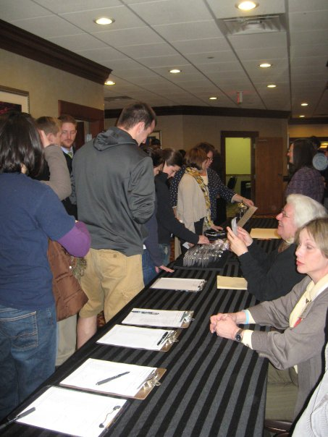
1st OAPA Student Conference
Conference was held April 26-27, 2010
At Columbus Airport Marriott
Cost: No fee for OAPA members ;
non-member $10

Slide 3
Schedule
Agenda Friday, February 26 5:00 Dinner 6:30 Challenge Bowl Saturday, February 27 9:00 Continental Breakfast and Registration 9:30 OAPA and AAPA Overview and Legislative Update 10:00 Medical Board Overview 11:00 Introduction to Specialties – Panel Presentation 12:00 Lunch and Presentation of Scholarship Awards
First Year Students 1:00 Technology in Clinical Practice 2:00 Preceptor Expectations – Panel Presentation 3:00 Student Society Round Tables
Second Year Students 1:00 Licensure and Certificate to Prescribe 2:00 Interviewing for a Job 3:00 Contracts and Negotiations 4:00 Adjourn

Slide 4
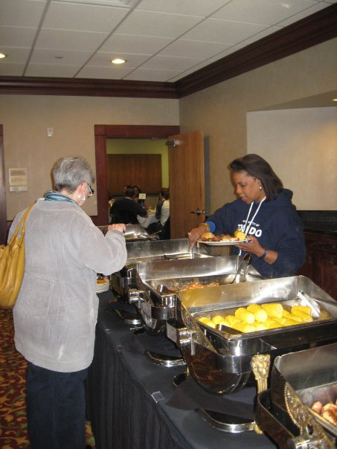
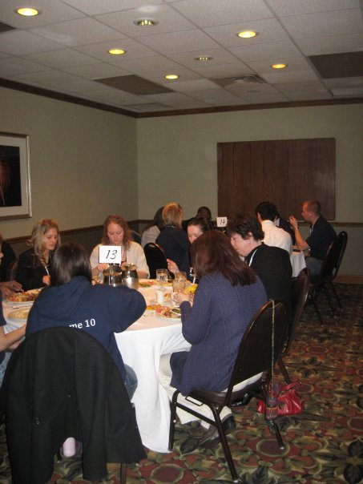
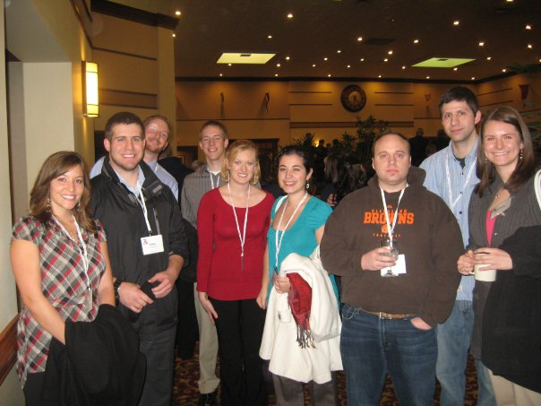
Networking

Slide 5
Challenge Bowl
The bowl consisted of 4 participating teams:
Represented by Toledo, Findlay, Mount Union, & Kettering college of Medical Arts
Toledo v. Findlay= Toledo
Mount Union v KCMA= Mt. Union
Championship- Toledo v Mt. Union

Slide 6
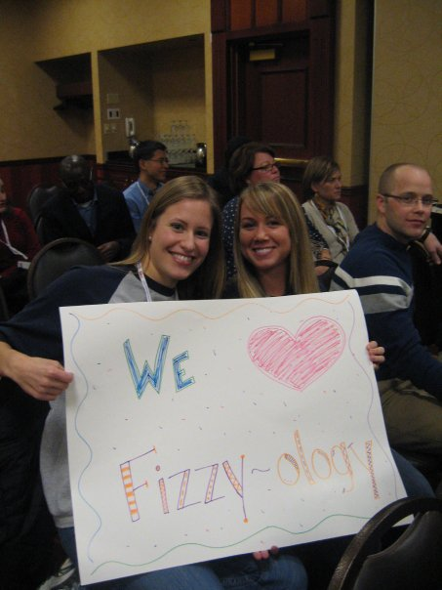
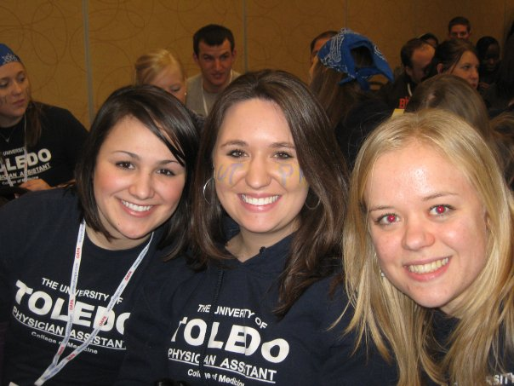
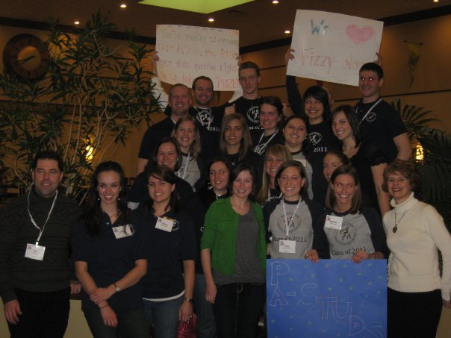
School Spirit

Slide 7
CHALLENGE BOWL WINNERS
Toledo won the 1st Annual Challenge Bowl

Slide 8
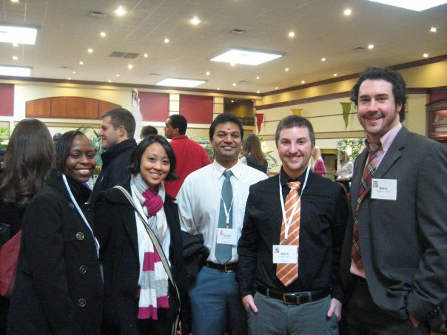
Morning Lectures
OAPA- President Elect: Douglas Eulberg PA-C
Introduced the students to OAPA and the 1st conference
SAAPA presentation- Christopher Roman
explained SAAPA and opened the door for thoughts on the current SAAPA state
Medical Board: Sally Debolt gave insight into function of medical issues dealing with Board
Highlighted board structure; # Ohio PAs (2,052) & disciplinary actions
Specialty panel (Spoke on behalf of their specialty and answered student ?s)
Cardiovascular: Peter Peifer PA-C
Pediatrics : Shannon Sander PA-C
Emergency Medicine: Scott Kravitz PA-C
Orthopedic Surgery: Jay Peterson PA-C

Slide 9
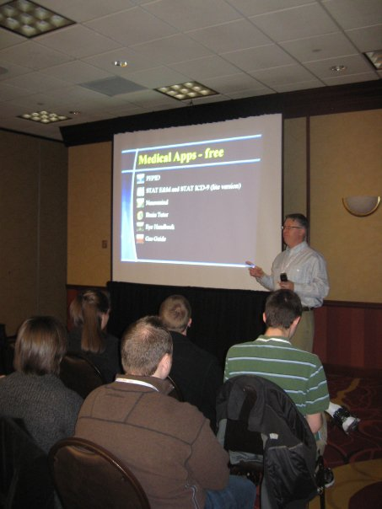
Afternoon Lecture Session 1st Years
Technology in Clinical Practice
Jeb Sheidler PA-C
Use of technology (smart phones, ipods on rotations and helpful resources)
Preceptor Expectations – Panel Presentation
What is expected during clinical rotations.
Student Society Round Tables
Beth Adamson

Slide 10
OAPA Student Conference SURVEY 2010
Name:
School:
Year in School:
For each item identified below, circle the number to the right that best fits evaluation of its quality.
Description/Identification of Survey Item | Scale
 | Poor | Good |  |  | Excellent
Challenge Bowl | 1 | 2 | 3 | 4 | 5
Facilities | 1 | 2 | 3 | 4 | 5
Accessibility (to Columbus location) | 1 | 2 | 3 | 4 | 5
Length of conference | 1 | 2 | 3 | 4 | 5
1st year Students: Quality of lecture content material | 1 | 2 | 3 | 4 | 5
2nd year Students: Quality of lecture content material | 1 | 2 | 3 | 4 | 5
Overall conference experience | 1 | 2 | 3 | 4 | 5

Slide 11
Written portion of Survey
If you are a 1st year student, do you plan to attend next year? Yes or No
Did the conference meet or exceed your expectations? Yes or No
Did you become more informed of OAPA and legislative updates? Yes or No
From your perspective will you be able to apply the knowledge gained at this conference and if so, please explain?
What is most important to you about the conference; networking, the date, the location, educational material?
What changes would you like to see implemented for future conferences (any additional topics)?
Any other comment/suggestions?
Thank you for your attendance! Good luck & happy studies!

Slide 12
OAPA Student Conference 2010
Name:1st Year Students (survey involved 55 students)
Description/Identification of Survey Item AVERAGES out of 5
Challenge Bowl 4.528
Facilities 4.618
Accessibility (to Columbus location) 4.182
Length of conference 3.537
1st year Students: Quality of lecture content material 4.020
Overall conference experience 4.580

Slide 13
If you are a 1st year student, do you plan to attend next year?
All 55 students said YES!
Did the conference meet or exceed your expectations?
All but 4 felt the conference met or exceeded expectations.
Did you become more informed of OAPA and legislative updates?
6 students felt the conference did not completely inform them of legislative updates. The remaining felt it did.
From your perspective will you be able to apply the knowledge gained at this conference ad if so, please explain?
The majority of students felt this was very beneficial. The number one reason was the specialty speakers. Two students felt the knowledge was repetitive from school, specifically the medical board.
What is most important to you about the conference; networking, the date, the location, educational material?
Most important to students was networking and meeting students.
Educational material was ranked second. With specialty speakers, preparing for clinicals and the technology information specifically written as being especially helpful.
Followed by the date; they felt a more conducive date could be chosen (away from exam time). A few specified either around a holiday or the beginning of the semester (4 specified January).
Columbus was unanimously a good location minus the weather of the weekend.
What changes would you like to see implemented for future conferences (any additional topics)?
1. Change the medical board lecture so that it is an introduction and not focusing on negative aspects.
2. Add PA job recruiters.
3. Board exam review.

Slide 14
1st Year Students Comments
Any other comment/suggestions?
1. Award program with best student % present.
2. Would like to have more specialty area representatives and more time to converse with them.
3. Information on Residency Programs or Career Options (military, national health service).
4. Enjoyed the social mixer on Friday. Would like to see ideas for socializing other than Friday’s dinner.
Others:
Hotel needs wireless access. (1 person)
Change scholarship requirements (1 person thought AAPA membership was required for 3 months, she felt this would be acceptable at 1 month.)

Slide 15
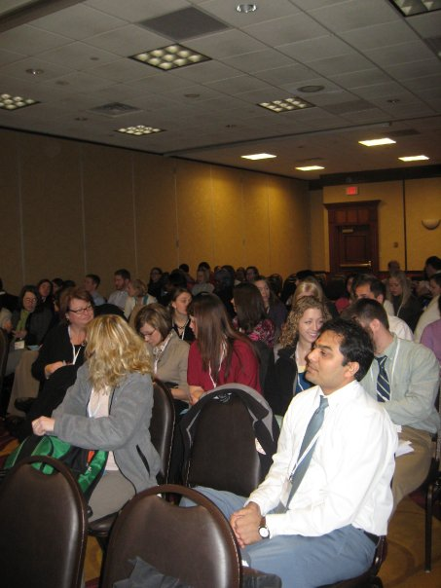
Afternoon Lecture Sessions 2nd year
Licensure and Certificate to Prescribe
Josanne Pagel PA-C
- focusing on our timeline to taking the PANCE & applying for a license
Interviewing for a Job
Jay Peterson PA-C
- interviewing etiquette, how to present yourself, & questions that need asked/answered from both your perspective and the employers
Contracts and Negotiations
Dan Goodrich PA-C
- learning negotiation tactics and important aspects of our contracts

Slide 16
OAPA Student Conference 2010
Name: 2nd Year Students (survey involved 39 students)
Description/Identification of Survey Item AVERAGES out of 5
Challenge Bowl 4.000
Facilities 4.385
Accessibility (to Columbus location) 4.103
Length of conference 3.730
2nd year Students: Quality of lecture content material 4.263
Overall conference experience 4.240

Slide 17
- Did the conference meet or exceed your expectations?
Only 3 students felt the conference did not meet their expectations. This was due to the fact that they felt information was repetitive/learned in their academic year and/or the conference was mandatory.
Did you become more informed of OAPA and legislative updates?
9 students felt the conference did not completely inform them of legislative updates. The remaining 30 felt legislation was well covered.
- From your perspective will you be able to apply the knowledge gained at this conference and if so, please explain?
Yes, especially the more pertinent, concrete information about the procedure of licensure/privileges and contract negotiations.
What is most important to you about the conference; networking, the date, the location, educational material?
The most important to 2nd year students was educational material. Many people wrote about the importance of the 2nd year sessions and how they will be beneficial in their transition.
Networking
The date was important in regards to clinicals. (When/if they could come.)
Columbus was unanimously a good location minus the weather of the weekend.
What changes would you like to see implemented for future conferences (any additional topics)?
1. Change the medical board lecture so that it is an introduction and not focusing on negative aspects. Students state it was far too long of lecture and was not beneficial to those who were not in trouble with the law.
2. Review supervisory agreements with OSMD in a little more detail.
2. Add PA job recruiters.
3. More specialty speakers (women’s health, pain management)
4. Controlled substance abuse lecture (using OARS)
5. More time to socialize with other PA students.
5. Add lecture about PANCE- review courses, test dates, preparation
Possibly do a mock interview.

Slide 18
2nd Year Students Response
Any other comment/suggestions?
Social for Friday night following the Challenge Bowl.
Provide handouts with information.
Other individual comments:
-Would like to see contracts and negotiations as an interactive segment allowing student to “see” appropriate negotiations and move this lecture so that it will not run out of time.
-Student felt as if Challenge Bowl was like a high school pep rally. Student stated it was a fun night but was not expecting this. The student stated to make schools better aware of what the Challenge Bowl entails.
-Several individuals in our class are allergic to chocolate and every dessert contained chocolate.
-UT student stated due to their schedule they have just begun their clinicals and thus felt the technology lecture would have benefited her as well as learning about preceptorships.
-Place challenge bowl on a stage so they can be seen and make sure they can be heard (microphone).
-“I think it would be best if this day even was joined with the OAPA conference to increase student involvement and networking between students and current practicing PAs.”

Slide 19
Student Remarks
1st years
2nd years
“The location was nice as it is central to the Ohio schools. The food was excellent!”- UT
“Good conference. Glad I came here today.” – Tri-C
“Overall an amazing and worthwhile conference. Thanks!” –Tri-C
“Nicely organized. Thank you! Very nice. Keep this going in future years. –UT
“Afternoon topics excellent!” –KCMA
“Josanne Pagel did an excellent job providing information about licensure. Jay Peterson and Dan Goodrich did great also and were very informative.” –KCMA
“Thank you for this wonderful experience. It was a great opportunity to engage with other PA students and network with established. I’m so sad I wouldn’t be eligible to attend the program next year.” –Tri-C
“Overall, it was a great experience and I hope the conference continues!” –Marietta College
“The food was great!” –University of Toledo
“Very relevant sessions.”- KCMA
“This was great. Thank you!”- Mount Union
“Terrific way to hear from PAs in Ohio and meet other PA students in Ohio.” – 1st year Tri-C

Slide 20
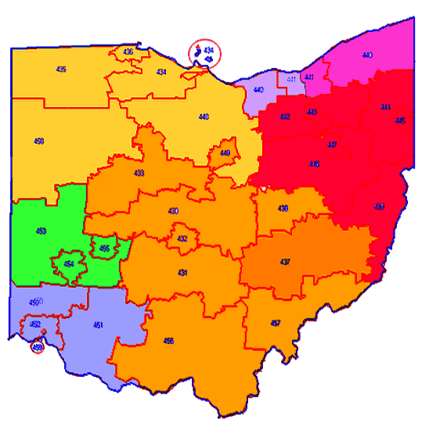
OAPA
President – Albert Etheart President Elect - Douglas Eulberg Vice President – James Fry Secretary – Leah Barmasse Treasurer – Andrea Boyd Past-President - Daniel Goodrich Student Representative – Lauren Wiley Region 1: JP Thompson Region 2: Justin Stafford Region 3: Natalie Talboo Region 4: Jeffrey Fisher Region 5: Sara Bassler Region 6: Karen Storer Region 7: Clare Logan Executive Director: Elizabeth Adamson
Region 1: Cleveland area east of the Cuyahoga River Region 2: Cleveland area west of the Cuyahoga River Region 3: Akron, Youngstown areas Region 4: Columbus and the southeastern part of Ohio Region 5: Toledo area Region 6: Dayton area Region 7: Cincinnati area

Slide 21
Thank you!
Special thanks to the OAPA board, Beth Adamson for all her hard work organizing the conference, each individual lecturer and guest speaker, the PA school directors, and the students for making this a wonderful
1st ANNUAL conference.

