Slide 1
Pediatric Cardiology for Physician Assistants
Kristen Breedlove, PA-C, MPAS

Slide 2
Inpatient Cardiology Service:
Infant in ER
Young athlete in ER
5yo with murmur – on hospitalist service
Newborn with Down Syndrome
Profoundly cyanotic newborn
5 day old male in shock

Slide 3
1 month old infant presents with tachypnea, pallor, mottling and diaphoresis. Had been fussy for one day.

Slide 4
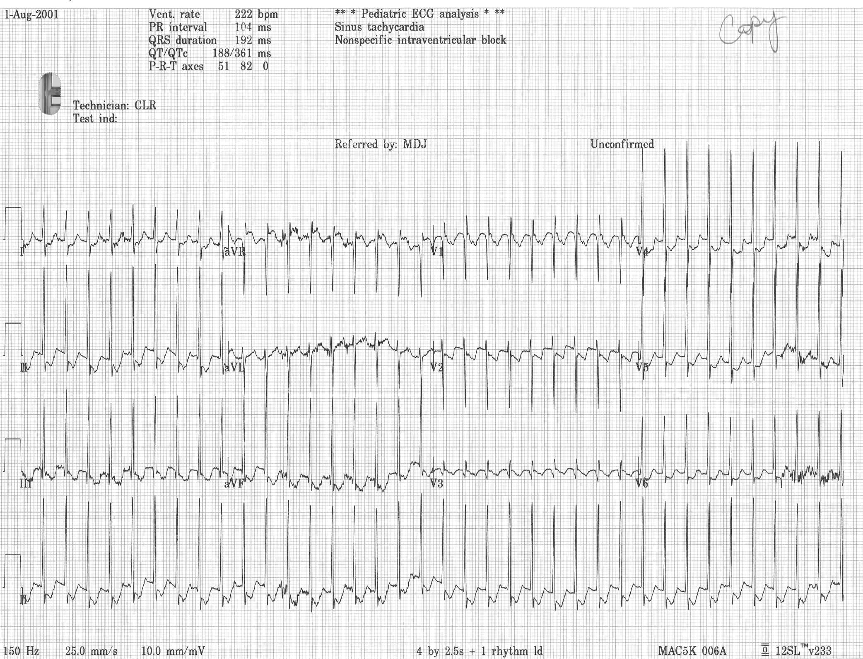

Slide 5
Pediatric Arrhythmias
Comparison
Sinus tachycardia Supraventricular Tachycardia
HR < 200 bpm HR > 230 bp
Variable rate No beat - beat variation
Slows gradually Stops abruptly

Slide 6
Pediatric Arrhythmias
SVT
Valsalva maneuvers (Ice to face)
Adenosine 100-300 mcg/kg
12 lead rhythm strip

Slide 7
SVT in Neonates
May require more than one medication
Often resolves within first year of life
Refractory to meds?

Slide 8
The Young Athlete
14 year old male presents to ER with CC of palpitations and “heart racing”
HR is 290 bpm
Converted with adenosine

Slide 9
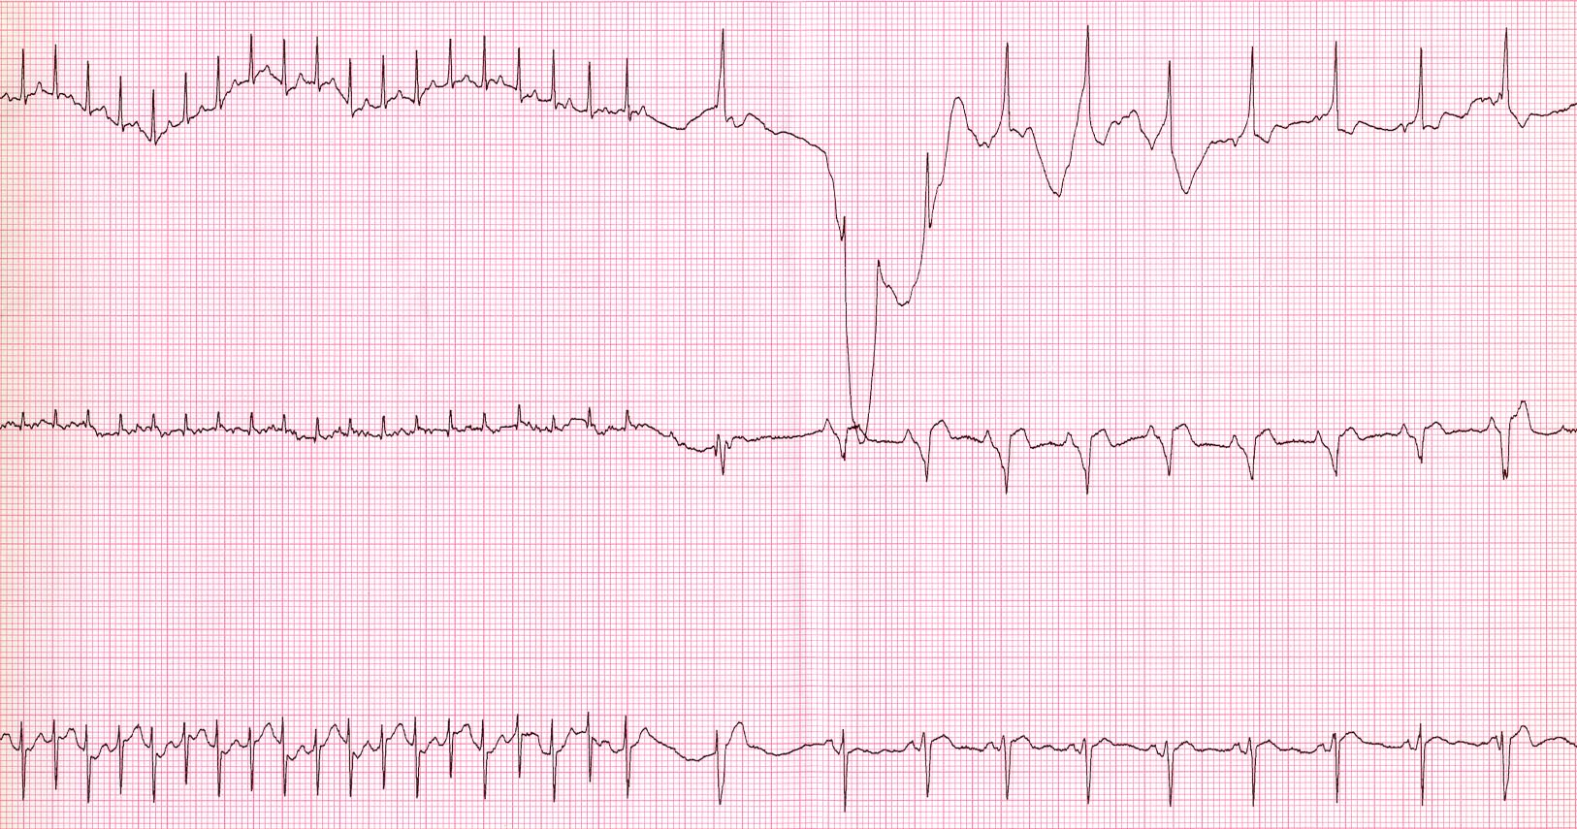
Adenosine
Notes:
2

Slide 10
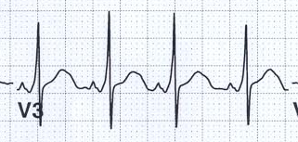
Wolff-Parkinson-White
Syndrome
Delta Wave
Wide QRS
Short PR
Notes:
2

Slide 11
The Young Athlete
Arrhythmias
WPW:
Incidence: 0.1% to 0.3% of population
Gender ratio: male to female 2:1
Pre-excitation
  Short PR interval, delta wave, and wide QRS
  Re-entry circuit and SVT
Risk of sudden death: Increases 1% for every decade of life
Treatment: Meds vs. Ablation

Slide 12
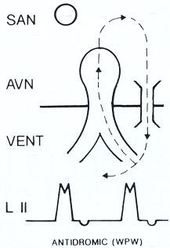
Wolff-Parkinson-White
Syndrome
Notes:
2

Slide 13
The 5 year old with a murmur
Susie’s History:
  Fever 5 days
  Cough, congestion, sore throat and other stuff
  Temp: 101⁰ Fahrenheit, HR 120, RR 40, BP 92/63
  II-III/VI SEM LUSB
  Fixed, split S2, no click or rub
  Rest normal: no rash, clear lung fields, no HSM, Rapid strep neg

Slide 14
Murmur
Definition: Sound created by turbulent blood flow in the heart
Frequency: 50%-75% children have normal murmur
Congenital Heart Disease: some have no murmur
Factors: fever, anemia, anxiety ↑ murmur
SEM: think outflow
HSM: VSD or AV Valve regurgitation
Notes:
2

Slide 15
Atrial Septal Defect
Definition: atrial septal wall deficiency
Types:
  Secundum
  Primum
  Sinus venosus
  Foramen ovale (PFO)
Incidence:
  6-10% of CHD
  Second most common heart defect
Gender Ratio:
  Males:Females = 1:2

Slide 16
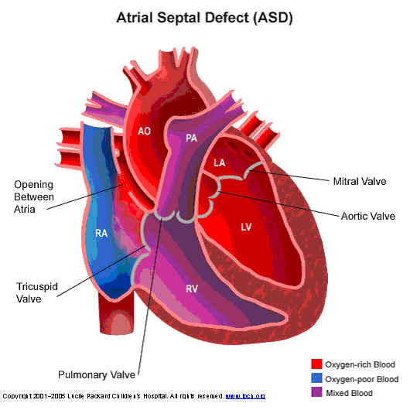
Atrial Septal Defect
Lungs
Lungs
Body

Slide 17
Atrial Septal Defect
Presentation
  Spontaneous closure
  Infants & children (asymptomatic)
    Murmur
    Normal growth, Normal Activity
    Frequent URI
  Adults
    Palpitations, arrhythmias- PACs, SVT
    Exertional dyspnea
    Paradoxical emboli
    Pulmonary vascular disease
Notes:
.fc,cds;lkfjes0f[rjesdbxciy osakfwr[bfp;l

Slide 18
Atrial Septal Defect
Physical Exam
  Murmur
    Grade: 2 to 3/6
    Type: Systolic ejection
    Location: Left upper sternal border
  Abnormality of S2
    Wide & fixed splitting

Slide 19
Atrial Septal Defect
Pulmonary Blood Flow
Increased
  WHY?
  Compliance of Right Ventricle
  Signs & Symptoms
    URIs
    Pulmonary HTN
      Rare - irreversible 5% patients
      3rd to 5th decade

Slide 20
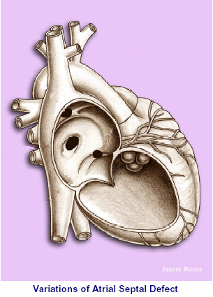
Atrial Septal Defect
Sinus Venosus ASD
Associated with partial anomalous pulm venous return
Secundum ASD
Fossa Ovalus Deficiency
Cath Intervention option for some
Primum ASD
Partial AV Canal defect
Always has mitral valve defect
Scientific Software Solutions, 2003
Scientific Software Solutions, 2003

Slide 21
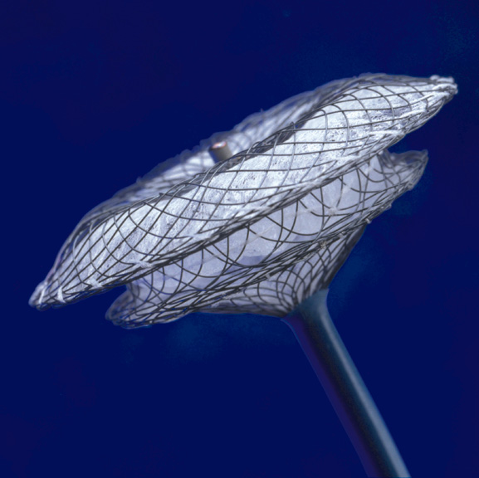
Atrial Septal Defect
Device Closure
Secundum ASDs
PFOs
  Indication: CVA or TIA on therapy
Surgery
  Large Secundum defects (without rims)
  Sinus venosus or primum defects

Slide 22


CHD- Down Syndrome

Slide 23
Down Syndrome
Trisomy 21 (extra copy/portion of chromosome 21)
Described 1894 by Langdon Down
Incidence: 1 in 660 newborns
X²¹ X²¹ X²¹
Associated with advanced maternal age
  Age < 20: 1/1700
  Age 30: 1/900
  Age 40: 1/100
  Age 45: 1/25

Slide 24
Down Syndrome
Multiple dysmorphic features
CNS: Hypotonia, MR
Pulmonary: Airway obstruction, Sleep apnea, PHTN
Hematologic: B-Cell, T-Cell, Leukemia
Congenital Heart Disease (40% - 50%)
  AV Canal: (endocardial cushion) 40%
  VSD: 30%
  Other: TOF, ASD, PDA

Slide 25
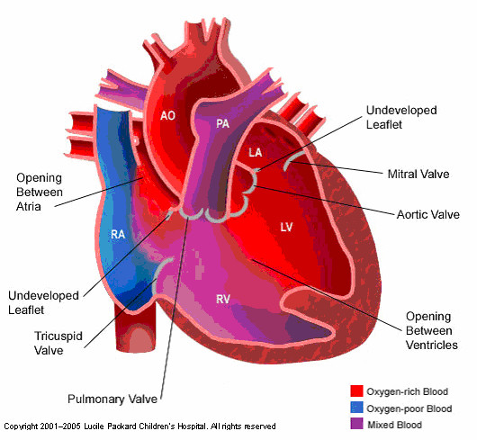
Atrioventricular Canal

Slide 26
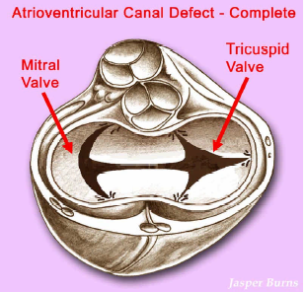
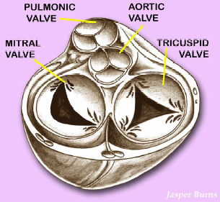
Atrioventricular Canal
Common AV Valve
Scientific Software Solutions, 2003
Notes:
Valves are separated by fribrous tissue
Common AV valve

Slide 27
Atrioventricular Canal
Physical Exam
  Cachectic (if not, think PHTN)
  Hyperdynamic precordium
  Murmur
    Grade: 1 to 3/6
    Type: Systolic ejection
    Location: Left lower sternal border
  Hepatomegaly

Slide 28
Atrioventricular Canal
Patient care
  Increase contractility (digoxin)
  Decrease preload = diuresis
  Decrease afterload (captopril)
  Maximize calories
  Oxygen sparingly

Slide 29
AV Canal Repair
Usually 3-6 months of age
  Repair cleft in MV
  Close ASD and VSD
Key to need for reintervention is the degree of MR long-term

Slide 30

Got it all together???

Slide 31
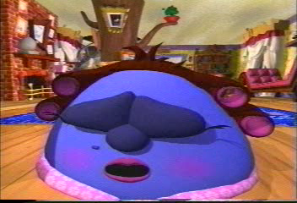
Profoundly Cyanotic Newborn

Slide 32
Oxygen Challenge Test
D-TGA
TAPVR-obstruct
PHTN
Truncus
TAPVR-no obstruct
HLHS
Pulmonary
Neurologic
Methemoglobinemia
PaO2 < 50
PaO2 < 150
Pao2 > 150
Tricuspid Atresia/PS
Pulmonary Atresia
Tetralogy of Fallot

Slide 33
Cyanotic Lesions
The 5 Ts
(It’s all at your fingertips!)
PEDS

Slide 34
Cyanotic Lesions
Truncus Arteriosus
Transposition of the Great Arteries
Tricuspid Atresia
Tetralogy of Fallot
Total Anomalous Pulmonary Venous Return
PEDS: Pulmonary Atresia, Ebstein’s, DORV, Single Ventricle (HLHS) & others

Slide 35
Truncus Arteriosus
Definition:
  Single trunk from heart
    Aorta
    Pulmonary arteries
    Coronary arteries
  VSD (99%)
Associated ♥ Defects:
  Right aortic arch (33%)
  Interrupted aortic arch (19%)
Classification: pulmonary artery location
Incidence: less than 0.5% CHD

Slide 36
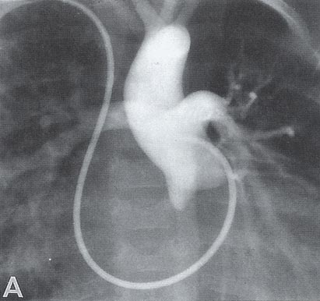
Truncus Arteriosus

Slide 37
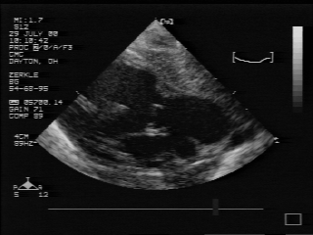
Truncus Arteriosus
Truncal
Valve
R.V.
AO
L.V.
PA

Slide 38
Transposition of the Great Arteries
Definition: Great arteries come from wrong
ventricle
  Right Ventricle → Aorta
  Left Ventricle → Pulmonary Artery
Parallel circulation
Mixing obligatory (ASD, VSD, PDA)
Forms of TGA:
  VSD (30%)
  VSD/Pulmonary Stenosis (15%)
Incidence: 5% CHD
Gender ratio: M:F = 3:1

Slide 39
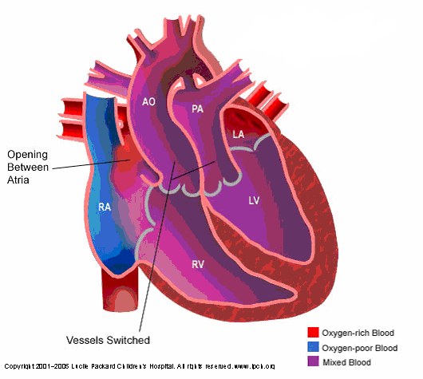
Transposition of the Great Arteries
Body
Lungs
Lungs
Lungs
Lungs
Body

Slide 40
Transposition of the Great Arteries
Patient Care
Exam: Very blue, no murmur, single S2
Room air POX: 60s-80s
Medical: Volume, bicarb, PGE1
Oxygen: Yes
Intervention: Balloon atrial septostomy
Surgery: Switch vessels

Slide 41
Tricuspid Atresia
Historical: Kreysig 1817
Definition:
  No tricuspid valve
  Rudimentary right ventricle
Associated ♥ Defects:
  VSD & Pulmonary Stenosis (50%)
  TGA (25%)
Extracardiac Anomalies: (20%) G.I., Musculoskeletal
Syndromes: Trisomy 21, Cat’s Eye, asplenia, Christmas Disease
Incidence: 1-3% CHD

Slide 42
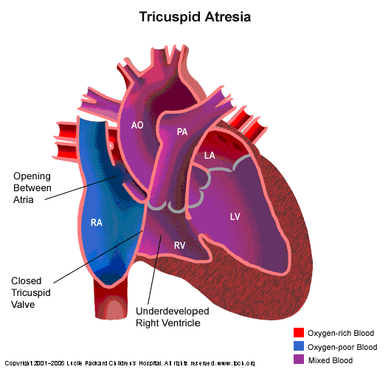
Tricuspid Atresia

Slide 43
Tricuspid Atresia
Patient Care
(Depends on pulmonary blood flow)
Exam: Blue, Murmur (VSD and Pulmonary Stenosis)
Room air Pox: 70s-80s
Medical: (depends) calories, PGE1-vs-diuretics
Oxygen: Yes
Surgery: Staged Fontan (stay tuned)

Slide 44

Wake UP!

Slide 45
Tetralogy of Fallot
Historical: Dr. Fallot in 1888
Incidence: 6% - 10% (most common cyanotic CHD)
Definition:
  VSD
  RV outflow tract obstruction (sub-PS/Pulmonary stenosis/atresia)
  Aortic override
  Right ventricular hypertrophy
Extracardiac anomalies: (16%) cleft lip/palate, skeletal
Syndromes: DiGeorge, VACTERAL, Goldenhar’s, CHARGE

Slide 46
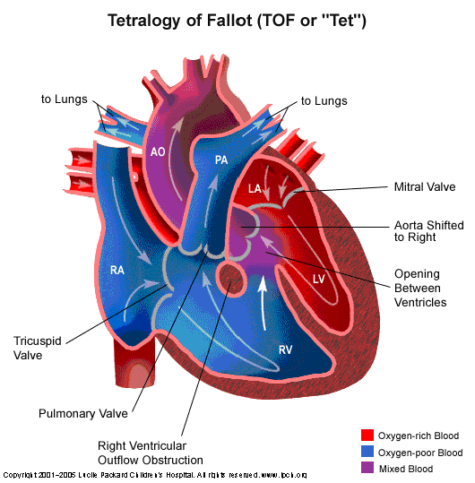
Tetralogy of Fallot

Slide 47
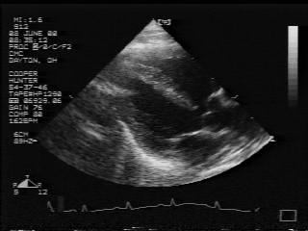
Tetralogy of Fallot
VSD
R.V.
L.V.
AO
L.A.

Slide 48
Tetralogy of Fallot
Patient Care
Exam: Blue-vs-pink, murmur
Room Air Pox: 70s-100
Medical:
  Chronic: Calories, rarely Propranolol
  Acute: Hypercyanotic Spell (blue and tachypneic)
Oxygen: Yes
Surgery:
  Palliation: Blalock-Taussig shunt (usually R thoracotomy)
  Complete repair: 3-6 months

Slide 49
Total Anomalous Pulmonary Venous Return
Definition: Pulmonary veins drain abnormally into the right atrium
Associated ♥ Defects: (33%)
  Single ventricle, HLHS
  Common AV canal
  Transposition of the great arteries
Classification: Determined by drainage pattern
Incidence: 1-5% CHD

Slide 50
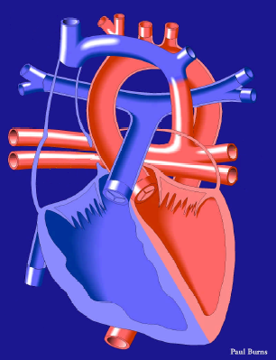
Total Anomalous Pulmonary Venous Return
LA
Venous confluence
RA
Scientific Software Solutions, 2001

Slide 51
Total Anomalous Pulmonary Venous Return
Patient Care
Exam: Not so blue, maybe a murmur, CHF
Room Air Pox: 90s
Medical: Calories
Oxygen: Not needed
Surgery: Connect pulmonary vein drainage to LA
Obstruction: Emergency
  Volume, bicarb, ECMO, surgery

Slide 52
5 day old male in shock
Mom didn’t have prenatal care
Normal delivery, no complications, went home w mom
Poor feeding x 1 day
Taken to local hospital once mom couldn’t wake him

Slide 53
Hypoplastic Left Heart Syndrome
Definition:
  Small (unusable) left ventricle
  Underdeveloped mitral valve, aortic valve/arch
Epidemiology:
  most common cause CHD death in first month of life
Incidence: 7-9% CHD
Gender ratio: M:F = 2.5:1

Slide 54
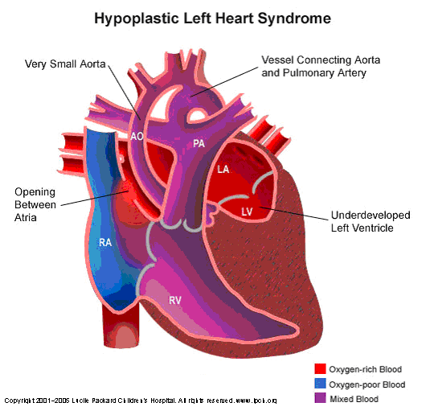
Hypoplastic Left Heart Syndrome

Slide 55
Hypoplastic Left Heart Syndrome
Patient Care
Exam: ↓ pulses/perfusion, shock, ± murmur
Room Air Pox: 80s
Medical: Volume, Bicarb, PGE1
Oxygen: NO!!!!!!!
Surgery: Staged Fontan Repair

Slide 56
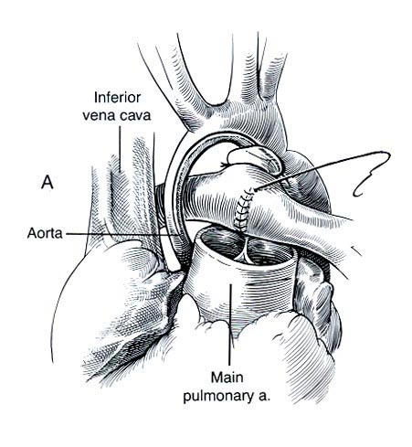
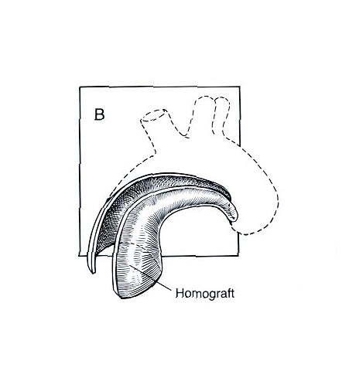
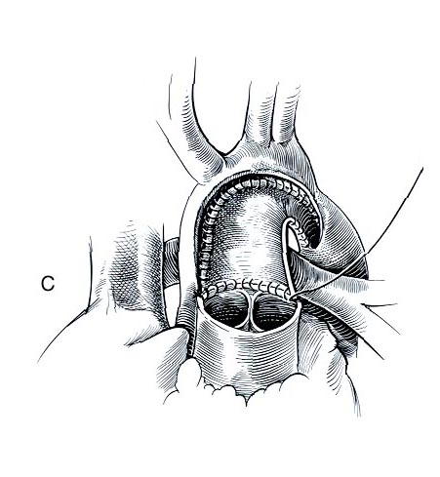
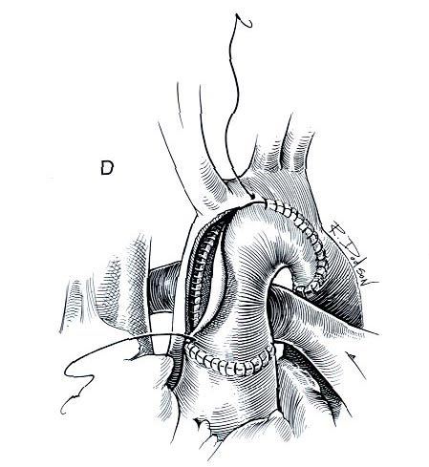
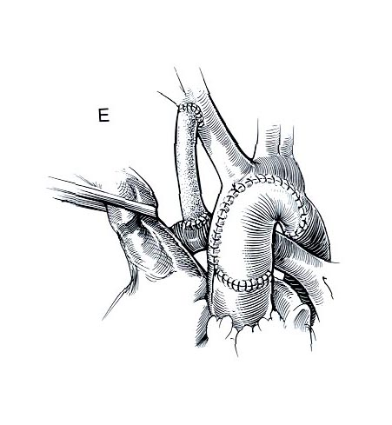
HLHS- Surgical Repair
Stage 1

Slide 57
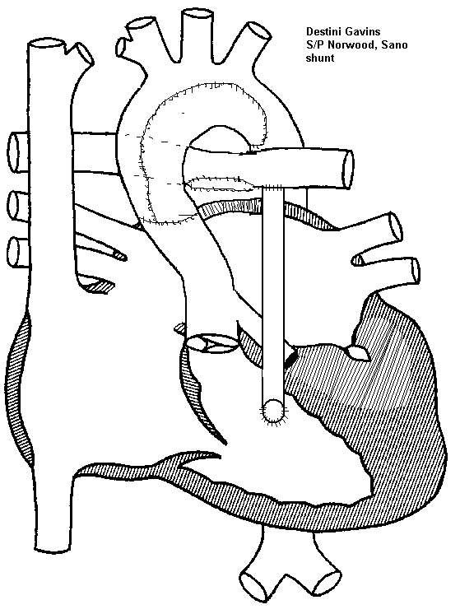
HLHS- Surgical Repair
Stage 1 Sano Shunt
No BT
Sano Shunt

Slide 58
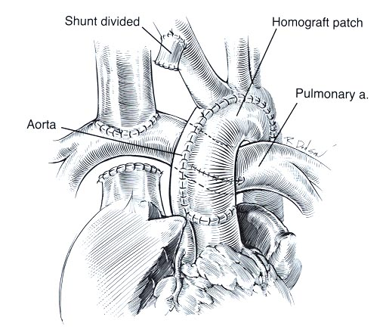
HLHS- Surgical Repair
Stage 2 (Bi-directional Glenn)
Stage 1 Norwood
SVC
RPA

Slide 59
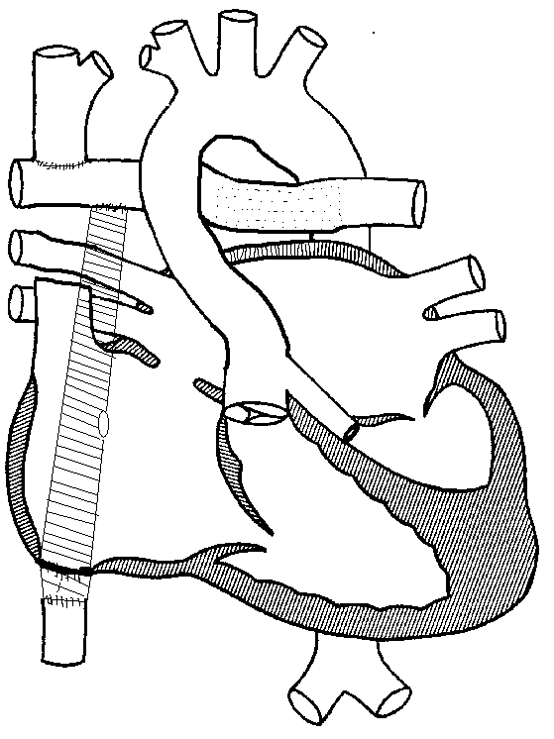
HLHS-Surgical Repair
Stage 3 (Fenestrated Extracardiac Conduit)
Glenn
Extracardiac Conduit
Fenestrated

Slide 60
The Office
Chest Pain
Dizziness and Syncope
HTN
Fetal echo referral

Slide 61
The 9 year old with Chest Pain
Kevin presents:
  Playing soccer
  20 minutes into game: chest pain-non radiating, SOB
  Other: no dizziness, palpitations
  Past history: No syncope
  Family History: No CHD, arrhythmia, SD/SIDS
  P.E.: NORMAL!!!

Slide 62
Pediatric Chest Pain
Musculoskeletal: (30-40%) costochondritis, trauma, overuse
Pulmonary: (15-20%) pneumonia, effusion, bronchitis
Psychogenic: (5-10%) panic attack, stress, somatoform
Gastrointestinal: (5-7%) esophagitis, ulcer, pancreatitis,
Other:
  Ingestion, Breast, endocrine (DM, Hypothyroid), SSD
  Idiopathic (12-85%)
Cardiac: (0-4%)
  Ischemia (spasm, LVOTO, HCM): EKG, echo, enzymes
  Inflammatory: (pericarditis, effusion): echo
  Arrhythmia: (SVT, PVCs, VT) EKG, Holter, EST

Slide 63
The 11 year old with Palpitations and syncope
Edward:
  Playing basketball
  Second half of game: drives to basket and has LOC 5 min
  No associated CP, Dizziness (does not remember event)
  P.E.: completely NORMAL
  Past HX: unremarkable
  Family HX: second cousin- ICD, Uncle MI at 19 years of age

Slide 64
Pediatric Syncope
Neurocardiogenic: common, at rest and upright
Vagal:
  Vasovagal: needle stick
  Micturition
  Cough
  Carotid Sinus
Hypoglycemia
Neuropsychiatric: hyperventilation, migraine, SZ, BHS
Cardiac:
  LVOTO, CA anomalies,
  Myocarditis, cardiomyopathy
  Arrhythmia

Slide 65
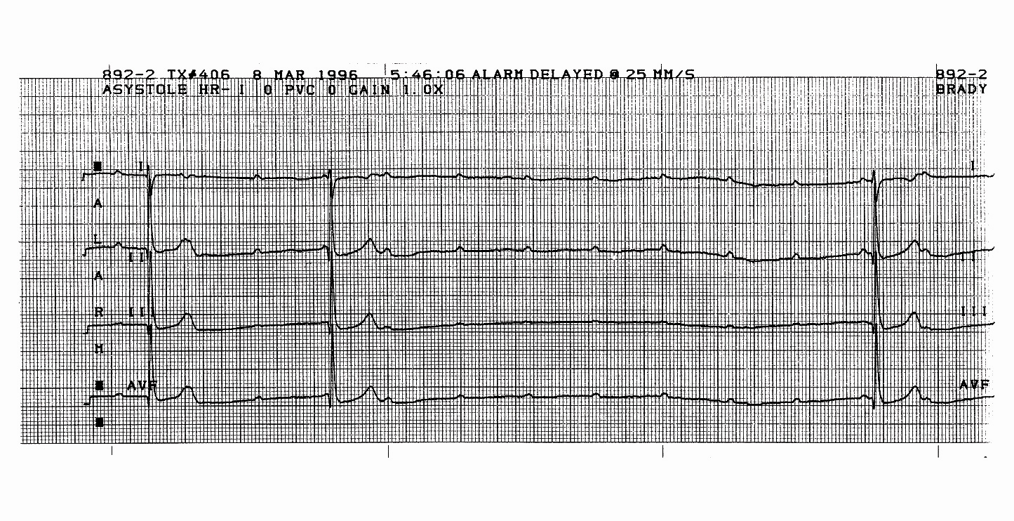
Pediatric Electrocardiogram
Figure 65: 15-year-old girl with syncope during phlebotomy

Slide 66
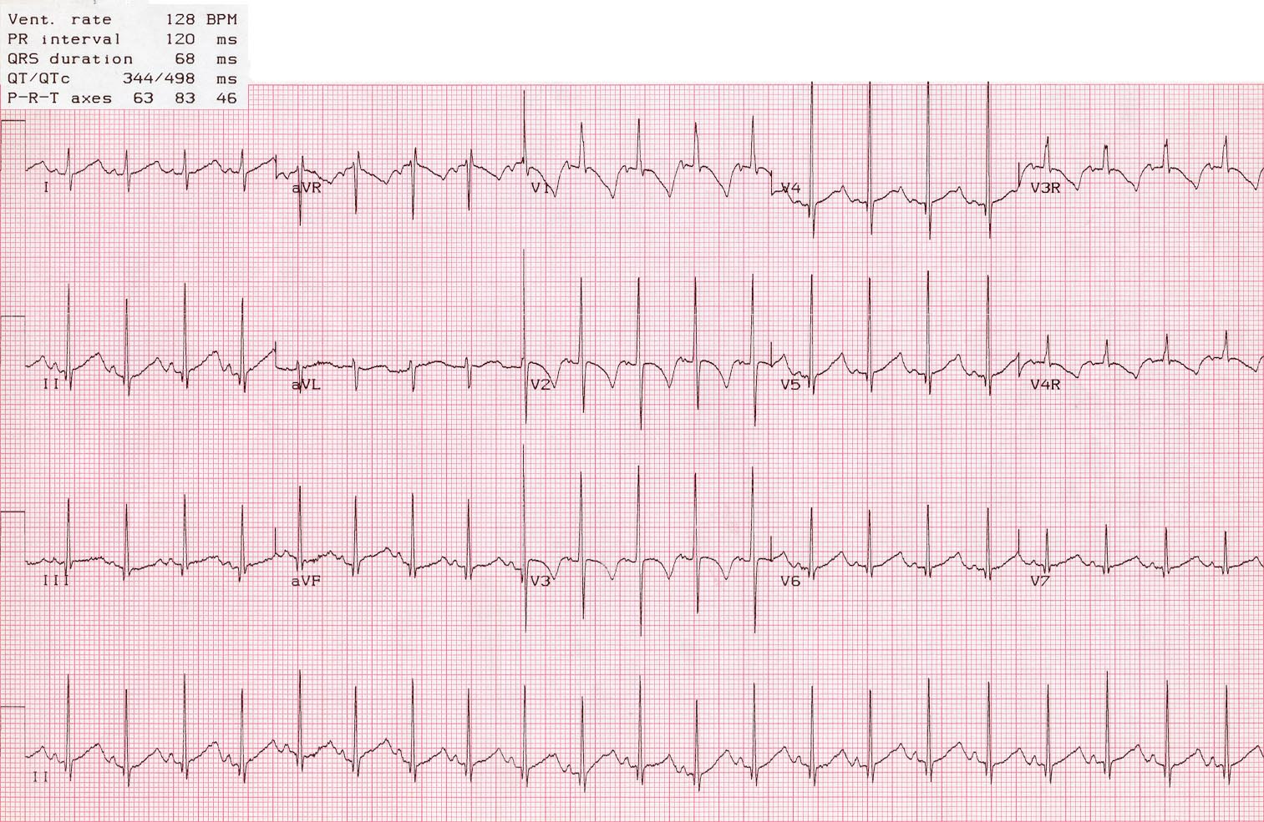
Edward
Notes:
2

Slide 67
Long QT Syndrome
Notes:
2

Slide 68
Long QT Syndrome
Definition: Prolongation of the QT interval
Significance: Predisposition to malignant arrhythmia
Forms:
  Romano Ward: (autosomal dominant)
  Jervell and Lange-Nielsen: congenital deafness (AR)
Other Causes: medications, metabolic, CNS
Presentation: syncope-26%, seizures-1%, arrest- 9%; SIDS
Treatment: Beta Blockers
Notes:
2

Slide 69
6yo male with HTN
HTN noted by PCP
No FH of HTN
Sent for renal US - NL

Slide 70
Coarctation of the Aorta
Definition: Narrowing @ proximal portion of the descending aorta
Presentation
  Infant: symptomatic
    Poor feeding/weight gain
    Dyspnea
    Shock (Critical CoA)
  Child: (usually asymptomatic)
    Hypertension
    Leg weakness/pain with exercise
Incidence: 5-8% of CHD
Gender ratio: M:F = 2:1

Slide 71
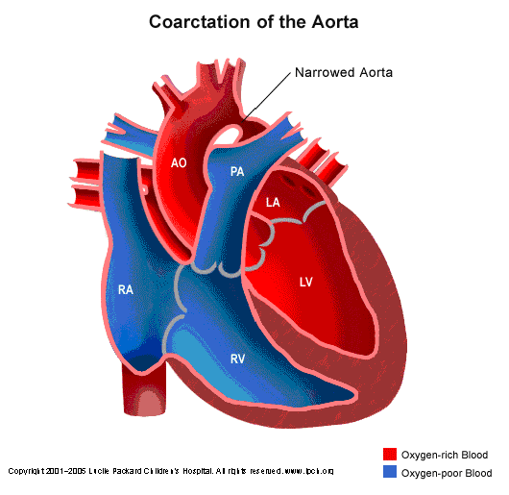
Coarctation of the Aorta

Slide 72
Coarctation of the Aorta
Physical Exam
  Infant:
    Weak/absent peripheral pulses
    Respiratory distress
    Acidosis
  Child:
    Weak/delayed/absent peripheral pulses
    Systolic blood pressure: arm > leg
    Continuous murmurs in back
    Ejection click, systolic ejection murmur @ right upper sternal border

Slide 73
Coarctation of the Aorta
Patient Care
  Infant: (Critical CoA)
    Maintain PDA patency
    Inotropic support
    Diuresis
    Oxygen
  Child:
    Monitor blood pressure: 4 Extremities!!!

Slide 74
Coarctation Repair
Surgery
  Left thoracotomy
  Less than 1 yo
  Coexisting arch hypoplasia
  Near interruption
Catheterization
  Balloon angioplasty

Slide 75
CHD- Etiology
Genetic:
  Missing Material: gene/part of gene (22q- microdeletion)
  Extra Material: Chromosomal Trisomies (13, 18, 21)
  Syndrome: single or multiple gene defects
  Familial: inherited genetic defect
Environmental (fetal)
  Maternal infection: Rubella, viruses
  Maternal Medications: hormones, alcohol, anti-seizure, etc.
  Maternal Illness: Lupus, Diabetes

Slide 76
CHD- Incidence
Extracardiac Anomalies
  CNS: 5% - 15%
  G.I.: 5% - 22% (T.E. Fistula, Anorectal)
  Ventral Wall: Gastroschisis- 3%, Omphalocele- 21%
  G.U./Renal: 5% - 43% (renal agenesis, Horseshoe Kidney)
Associated Chromosomal Abnormalities
  Deletions: 25% - 50% (5p-, 22q-, XO)
  Polysomies: 40% - 99% (13, 18, 21)

Slide 77
CHD- Syndromes
Aperts: VSD, TOF
Carpenter: PDA, VSD
CHARGE: Conotruncal
de Lange: VSD
DiGeorge: Conotruncal
Ellis-van Creveld: Single Atrium
Fetal Alcohol: VSD, PDA, TOF
Friedeich’s Ataxia: Cardiomyopathy
Pompe: Cardiomyopathy
Holt-Oram: ASD, VSD
Kartageners: Dextrocardia
Laurence-Moon-Biedl: VSD
Leopard: PS, Cardiomyopathy
Marfans: Aortic Aneurysms
Hurler: AR, MR
DMD: Cardiomyopathy
Neurofibromatosis: PS, CoA
Noonan: PS, HCM
Pierre Robin: VSD, PDA, TOF
Smith-Lemli-Opitz: VSD, PDA
TAR: ASD, TOF
Treacher Collins:VSD, ASD
VATER: VSD
Williams: Supra-AS, PS

Slide 78
Thanks for your time and attention!
Email: kbreedlove@chmca.org

