Slide 1
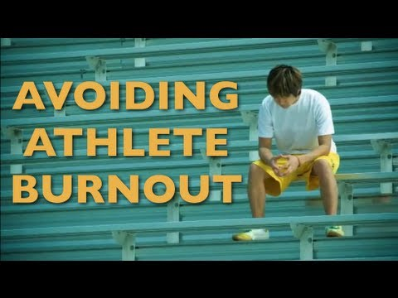
The Specialized Youth Athlete and Avoiding Burnout
George Friedhoff D.O.
St. Vincent Charity
Spine and Ortho Group

Slide 2
19 y/o lacrosse player p/w with 3 days of persistent axillary pain and swelling especially with weight-lifting. Pain remains despite reduction in overhead training but still practices lacrosse. PE-localized swelling with tenderness and firmness over left axilla. Supine there is prominent venous structures with left UE > right. Which of the following is the presumed diagnosis?
Superficial phlebitis
Pectoralis major tear
Labral tear
Effort induced thrombosis
Lymphangitis

Slide 3
Objectives
Define Sports Specialization
Recognize and Interpret Overuse Syndrome
Identify High Risk Injuries
Develop Prevention Plan

Slide 4
D.O.’s Do It Better
Osteopaths(D.O.s)
Allopaths(M.D.’s)
60% Primary Care
Back Pain
84% of providers
Foot Pain
41% of providers
35% Primary Care
Back Pain
31% of providers
Foot Pain
10% of providers
Notes:
According to a survey of the Steering Committee on Collaboration among physicians providers involved in MSK care the percentages of MDs who felt adequately prepared to assess problems of low back pain and foot pain were respectively as opposed to DO.s This should be a little confident boost on this Saturday afternoon. This illustrates the importance of osteopathic training and its presence at the forefront of addressing major healthcare issues and fulfilling public demands for patient-focused care. Also keeping in mind that MSK conditions are among the most common reasons for visits to physicians in the U.S. and costs over 200 billion dollars annually.

Slide 5
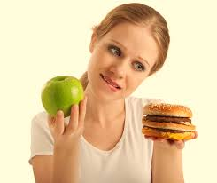
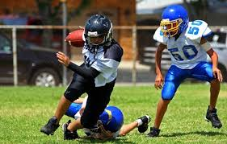
Youth Participation
27 million youth between 6 to 18 y/o in team sports
National Council of Youth Sports
60 million participate in some form of organized sports
Less than 6 y/o in organized sports
1997: 6%
2008: 12%
Notes:
Although inactivity and obesity are on the rise, the number of children and adolescents who participate in organized sports has grown considerably over the past 2 decades. It is estimated that 30-45 million youth participate in some form of organized athletics. Sports is more accessible to all youth from rec play, to highly organized and competitive traveling teams to pre-Olympic training opportunities.

Slide 6
Defining Sport Specialization
Intense year round training with exclusion of other sports?
Hours spent in Sport A > Sport B & Sport C
Not a “single focus” but also training time
Starting sooner & sooner(Age Limit)
Multiple teams during single season
Notes:
There is no single pathway to success in sport. If there were, we wouldn’t be able to compare the stories of Chrissie Wellington, who discovered her remarkable talent late in life but went on to dominate IronMan Triathlon within a few years, to that of another endurance athlete, say Floyd Landis, who began cycling at school, with a single minded focus that took him to the professional level many years later. Someone who only practices tennis for one hour a day is more specialized than someone who trains tennis for two hours, but also plays football for an hour a day.

Slide 7
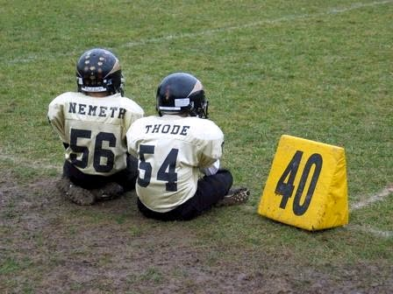
Introduction To Overuse
Centers For Disease Control and Prevention
> 5 million children suffer sport-related injury annually
Year-Round Specialized Training
Safe Kids Survey
9 out 10 parents underestimate length of recovery
25% of adult athletes
Notes:
According to CDC more than 5 million children under age of 18 suffer sport-related injury each year with approximately half of these due to overuse. More children are playing one sport year round with club teams, off-season training and private coaches.

Slide 8
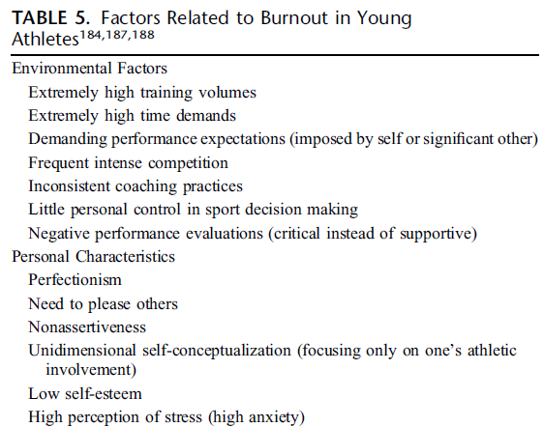
Burnout & Overtraining Syndrome
Open Access Journal of Sports
80% of youths quit by age 15
Non-functional overreaching
Overtraining Syndrome
Series of psychological, physiological and hormonal changes that result in decreased performance
Fatigue
Lack of Enthusiasm
Notes:
There is a misconception that youth athletes are miniature versions of grown-up competitors. ¾ American families have at least one child playing sport. Burnout is well described and documented in literature for adults but little is found regarding its applicability to youth. Burnout should be recognized as a sequela of overtraining syndrome. Prevention should be addressed by the physician and the opportunity can be made by PCP.

Slide 9
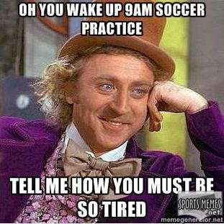
Preventing Overtraining/Burnout
1) Keep practice fun
2) Take 1-2 days off per week
3) Permit longer scheduled breaks from training & competition focusing on cross-training
4) Be in tune with their bodies
Organizations
National Youth Sports & Safety Institute( www.NYHSI.org)
Notes:
The physician or medical provider should encourage the athlete to be well rounded and well versed in a variety of activities just as in life rather than one sport. The ACSM and Sanford Institute have collaborated to form an organization whose mission is to advocate for advancing and disseminating the latest research and evidence based education including recommendations and policies to enhance the youth experience in sports while at the same time promoting health and development. These 4 prevention guidelines are a summary of the Amer. Academy of Pediatric association, ACSM and AMSSM as well as NATA.
1)Keep practice fun and workouts interesting with age-appropriate games and training to keep practice fun
2)Take time off per from organized or structured sports participation 1-2 days per week to allow body to rest or participate in other activities
3)Permit longer scheduled breaks from training and competition every 2-3 months while focusing on other activities and cross-training to prevent loss of skill or level of conditioning
4)Focus on wellness and teaching athletes to be in tune with their bodies for cues to slow down or alter their training methods.

Slide 10
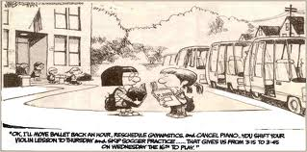
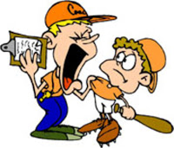
Who Is Responsible?
1-Coaches 10-Child
2-Parents

Slide 11
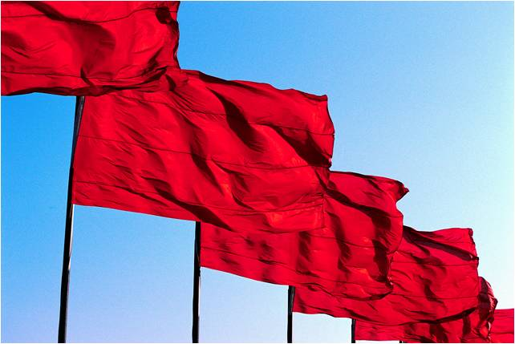
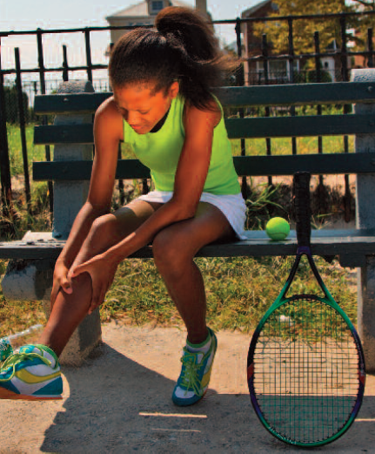
Clinical Presentation
VAGUE MSK COMPLAINTS
Pain
Decreased Performance
Limping
Swelling
Physical Exam
Stature
Strength
Flexibility
Notes:
The preparticipation exam are important for detecting life-threatening conditions as well as examining biomechanical assessments to detect risk of overuse injury.

Slide 12
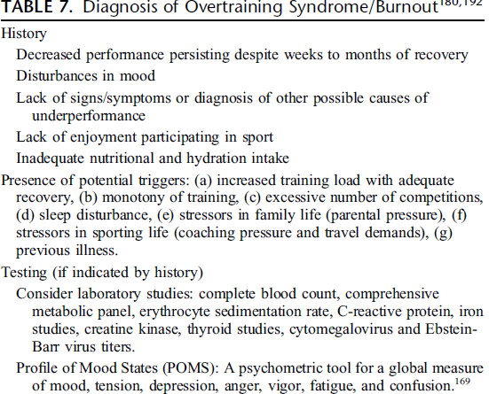
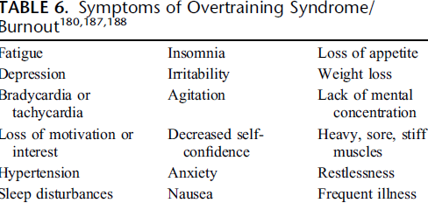

Slide 13
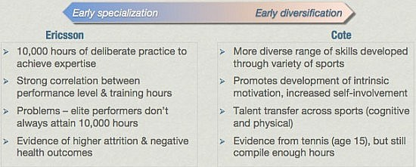
Notes:
So on your left is this model of “early specialization”, where an early focus on a sport is recommended. This is motivated largely by the framework that it takes so many practice hours to become proficient, and so you have to start young, and focus young, in order to accumulate them. This is the Ericsson argument, and if you’ve read Bounce or Outliers, you’ll know of Ericsson – he did a study on violinists in Berlin and found that the outstanding violinists had practiced for almost 10,000 hours, compared to only 8,000 hours for the “good” and 4,000 hours for the “normal” violinists (the ability of the violinists was assessed by the professors and teachers, in case you were wondering).
That study led to this 10,000 hours concept, which has since been applied to all kinds of skills, including sport. There is an inherent problem with this, because sport is not the same as playing a violin in that there are without doubt physical attributes that training cannot change but which determine one’s “ceiling of ability” in most sports

Slide 14
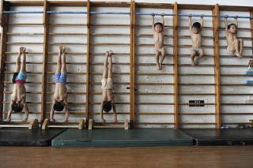
Trends In Sports Specialization
Children 6 Years Or Younger
9% in 1997
12% in 2008
77% of HS AD’s Notice Trend
↑ USTA (70% by 14 & 95% by 18)
Growing Number of Travel Leagues
Notes:
Eastern European influence with coaches with migration of eastern coaches to U.S. Hill and Simons from J.Social Sport Issues noted. Further evidence for early sports specialization is the growing number of travel leagues at 7 or 8 years of age37 and an increase in young Olympic athletes. A study of 519 US Tennis Association junior tennis players found that 70% began specializing at an average age of 10.4 years old.28 Specialization rate gradually increased after 14 years, with 95% of players by age 18 years. However, enjoyment and satisfaction ratings decreased in players older than 14 years old (P < 0.01).

Slide 15
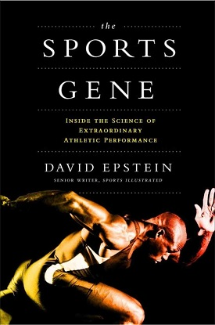
Notes:
David Epstein was the keynote speaker at the national AMSSM conference in New Orleans and I had the opportunity to hear him speak. He blows up the notion of the 10,000 rule developed by Ericcson. The more I practise, the luckier I get," said the golfer Gary Player, giving birth to one of sport's most famous aphorisms, one that is cherished by the world's most driven athletes, their coaches and, perhaps dangerously in some cases, their parents. There has been a "big bang of body types", says Epstein, which means there are genetic characteristics that, with the odd exception, all but rule some in and some out of reaching the very top in certain sports, never mind how many hours they've practised

Slide 16
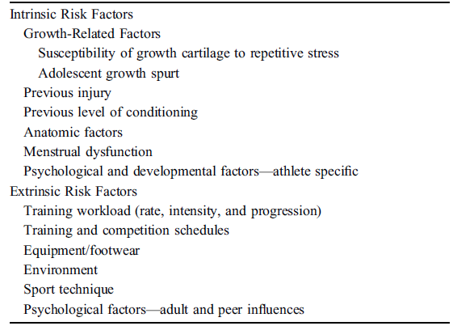
Risk Factors For Overuse Injury

Slide 17
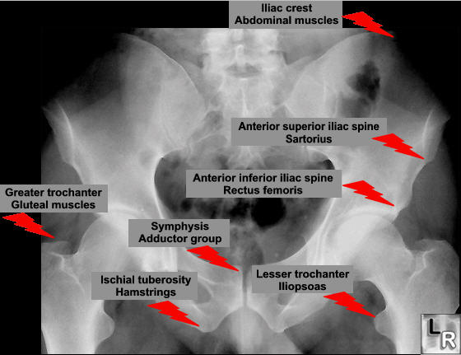
Physes Vs. Apophyses
Notes:
Physes are responsible for longitudinal bone growth. Apophyses are secondary centers of ossification, found where major tendons attach to bone

Slide 18
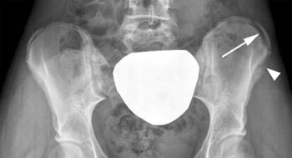
Notes:
In an apophysitis there is repetitive pulling of the muscle on the bone at its insertion site. This results in irritation and partial avulsion of the apophysis. In the past, it was felt that apophysitis was always due to inflammation of the area. Recent evidence suggests that apophysitis may be due to many small fractures similar to stress fractures.

Slide 19
Classification of Overuse Injuries
Pain In Affected Area After Physical Activity
Pain Without Restricting Performance
Pain With Restricting Performance
Chronic Pain Even At Rest

Slide 20
Overuse Injuries:Predisposing Factors
Extrinsic Factors
Intrinsic Factors
Training Errors
Excessive Volume
Excessive Intensity
Rapid Increase
Sudden Change in Type
Inadequate Recovery
Faulty Technique
Equipment
Psychological Factors
Environmental Conditions
Inadequate Nutrition
Malalignment
Muscle Weakness
Muscle Imbalance
Lack of Flexibility
Sex
Size
Body Composition
Other
Genetic Factors
Endocrine Factors
Metabolic Conditions
Notes:
Overuse syndrome is an umbrella term that encompasses many specific diagnoses. Usually result from repetitive motions,stresses, sustained exertion of particular body part. Overuse injuries can affect muscles, tendons, nerves and bone and most commonly affects musculotendinous unit

Slide 21
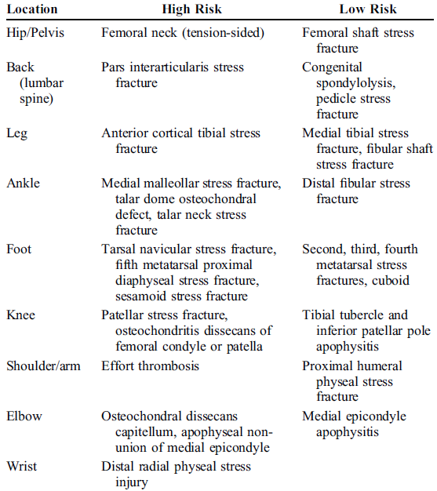
Notes:
Bone stress reactions and stress fractures can occur in
children as they do in adults, and risk factors are similar for
both age groups.62 Most heal uneventfully if treated appropriately
with rest, rehabilitation, and graded return to activity.
However, certain stress reactions or fractures do not heal readily, and are thus deemed high risk. If these high-risk injuries are not identified and treated properly, the injury may go on to nonunion, result in chronic pain, and/or lead to the development of degenerative joint disease.

Slide 22
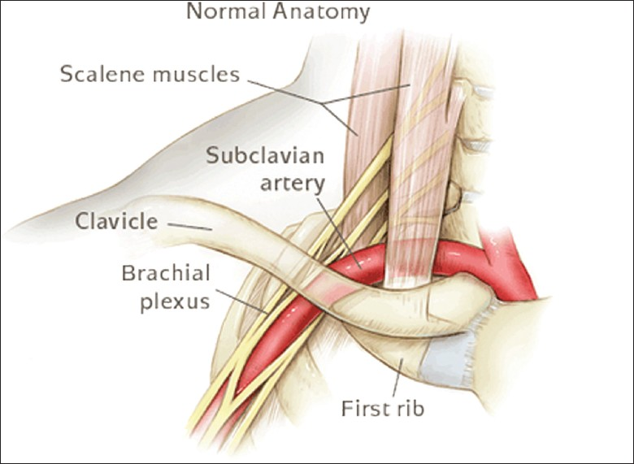
Thoracic Outlet Syndrome
Costoclavicular space-clavicle and 1st rib
Hyperabduction syndrome
Overhead sportspeople
Poor posture-scapular protraction
Scapular dyskinesis
Anterior tilt
Notes:
The most common area for compression is the costoclavicular space also known as costoclavicular syndrome.other sites of compression is the triangle of anterior scalene and middle with upper border of the 1st rib. The angle between the Coracoid process and pectoralis minor insertion. Droopy shoulder can decrease diameter of cervicoaxillary canal.Tight pectoralis minor,scalene and upper trapezius muscles with weak serratus anterior and lower traps leading excessive anterior tilt and protraction

Slide 23
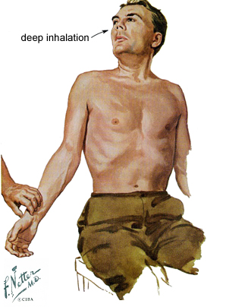
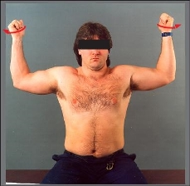
Thoracic Outlet Syndrome Presentation
Symptoms-pain, numbness & weakness
Venous engorgement
Clinical tests
Adson’s test-enhances sensitivity with doppler flow
Roos test-most sensitive
Notes:
Patient may complain of pain in neck and/or shoulder with numbness or tingling in the entire upper limb or forearm or hand. There may be complaints of arm feeling weak or fatigued with venous engorgement or coolness. Physical signs may be absent altogether.

Slide 24
Thoracic Outlet Syndrome Management
Physical Therapy
Pectoral and scalene stretching
Joint mobilization of 1st rib
Scapular and scapulothoracic mobilization
Thoracic extension and brachial plexus exercises
3 to 6 months
Anticoagulation & thrombolysis
Thoracic outlet decompression
Unresponsive neurogenic
Vascular compromise
Notes:
Treatment depends on type of TOS and only treat for symptomatic patients. However certain treatments apply to all forms of TOS including drooping shoulders,poor posture and poor body mechanics. The mere presence of 1st rib does not warrant surgery. Thoracic extension and brachial plexus neuromobility exercises as tolerated. Progressive neurologic TOS with associated progressive weakness before becomes chronic and severe.

Slide 25
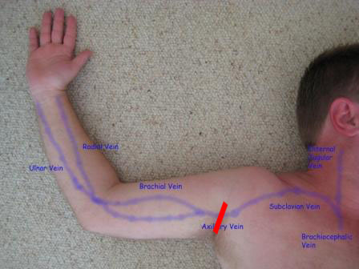
Axillary Vein Thrombosis “effort thrombosis”
Paget-von Schrotter Syndrome
Compression
Costoclavicular Space
Clavicle & 1st rib
Subclavian Muscle & 1st rib
Presentation-fatigue & heaviness
Physical Exam
Superficial veins prominent
Venography
Rest and Anticoagulation
Notes:
Paget-von schrotter out of favor. Repetitive activities particular overhead activites or trauma. The vein can be thrombosed at multiple sites along the pathway but most commonly at costoclavicular space. Compression most often occurs when athlete hyperextends the neck and hyperabducts the arm simultaneously. Patients complain of dull,achy feeling, numbness or tightness with heaviness and fatigue of upper arm with repeated activity involving upper extremity. Exam will show mottled skin and cold possibly with prominent veins as seen in question at beginning of lecture. Treatment is rest and anticoagulation with most athletes making full recovery and resuming activities.

Slide 26
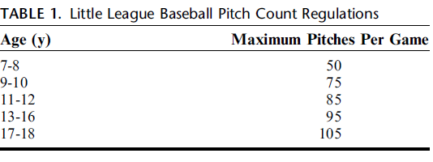
Little Leaguer’s Shoulder
Olsen et al.
6 innings with 7.9 months versus 4innings with 5.5 months
11-13 years of age
Proximal humeral physis
Repetitive rotational stress
Notes:
Little leaguers shoulder is caused by repetitive rotational stress across prox. Humeral physis during throwing activities. 11-13 is most common age as this is when physeal maximum growth occurs. Authors included intensity and duration of pitching rather than curveball mechanics has lead to increase rate of adolescent injury in pitchers. In an effort to decrease recommend limits.

Slide 27
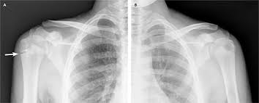
Notes:
Compare injured shoulder to uninjured shoulder. This is the approach we learn in medical school, always examine the contralateral side to compare. In this plain film please compare the right humeral physis to left humeral physis and appreciate the widening of the physis. Please note this is a clinical diagnosis and imaging is used to support the diagnosis.

Slide 28
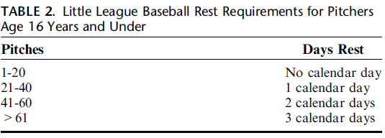
Little Leaguer’s Shoulder Management
Radiographs-Gasser & Carson
Widening
Sclerosis
Cystic changes
Treatment
Progressive throwing program
Proper mechanics
3 months
Notes:
Gasser reviewed 30 cases LLS and found evidence of persistent widened physis even after asymptomatic. Tx is rest until pain resolves. Average discontinuation of pitching was 3 months. Once initiate return to activity must start progressive throwing program emphasizing proper mechanics and control rather than speed. Rehab emphasizes rotator cuff, periscapular and core strengthening.

Slide 29
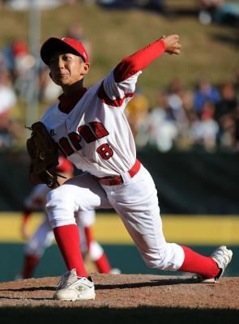
Little League Elbow
Humeral origin of UCL
8-15 years of age
Medial elbow pain with throwing
Widening of apophysis
Rest & biomechanical assessment
Notes:
Once youngsters have become interested and passionate about baseball, training can begin in earnest. This is particularly true of young pitchers, who will likely want to try to add pitches to their repertoire and attempt to throw with more velocity as they gain experience. However, pitching requires an unnatural arm motion. Young people are vulnerable to injury and that's why most youth baseball leagues employ strict pitch counts. Youngsters can do certain exercises to strengthen the pitching arm, help build velocity and avoid injury

Slide 30
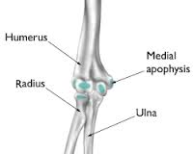
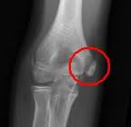

Slide 31
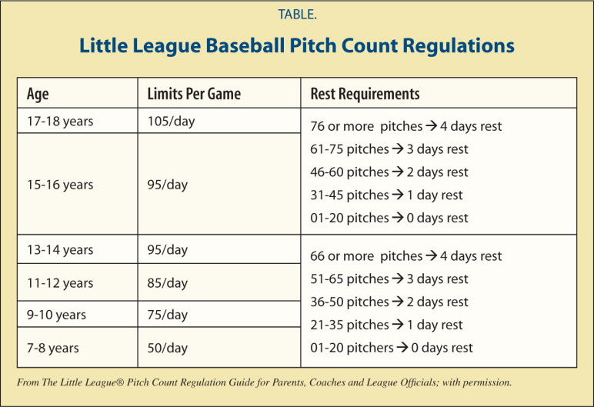
Notes:
Must adhere to age-based pitch counts once the athlete is pain-free and rehabilitation has occurred to correct biomechanical faults. In the throwing athlete, care should be taken to review the pitch count, types of pitches, and amount of rest between pitching (Table), as these have been shown to increase the risk of shoulder injury.^{1,5} A throwing program emphasizing proper mechanics over a period 1 to 3 months, depending on the severity of the injury, may be initiated once pain-free motion and strength have been achieved.

Slide 32
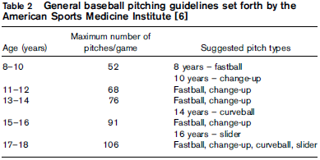
Shoulder Overuse Prevention
Notes:
Throwing fig. 2 with differences in pitches thrown at different ages can prevent shoulder injuries in baseball pitchers

Slide 33
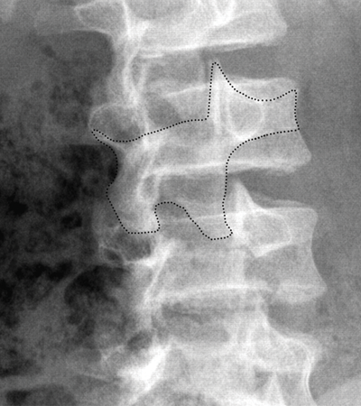
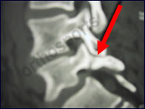
Pars Interarticularis
Insidious Onset
48.5% youth athletes with back pain
Progression to non-union-14-70%
Oblique plain films
Scotty Dog

Slide 34
Management
Imaging of Choice
Treatment Plan
MRI
No radiation
85% & 95%
SPECT scan
Radiation
85%
MRI vs. SPECT
Goal-Pain Free
Rest-3 months
57 youth soccer players(optimal results)
Physical Therapy
Bracing ?
Notes:
Rest is usually mainstay of treatment and typically 3 months for acute lesions. For the more chronic lesions causing pain then abstain from activity until pain resolves is the goal of treatment. The thoracolumbar orthosis is debatable. I have seen them more valuable when you sense the patient may not be compliant. PT emphasizes hamstring and quad flexibilty with core strengthening.

Slide 35
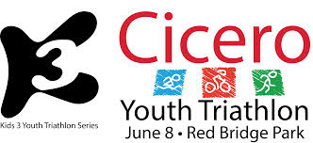
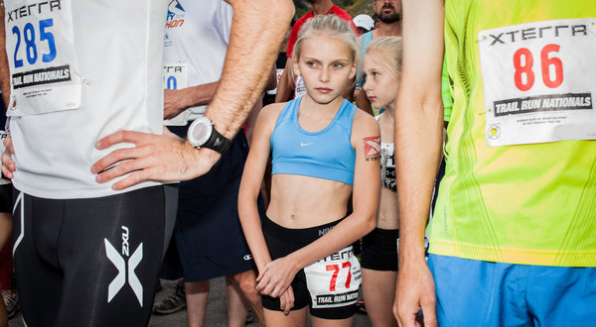
Endurance Athletes
American Academy of Pediatrics
Triathlons Are Safe
Marathons
10% Rule
Heat Stress
Nutrition
Total Caloric Intake
Iron
Calcium
Notes:
AAP does state triathlons and marathons are safe for adolescents with modifications made to be age appropriate. Which include shorter duration, length and careful attention to should be given to safety and environmental conditions.

Slide 36
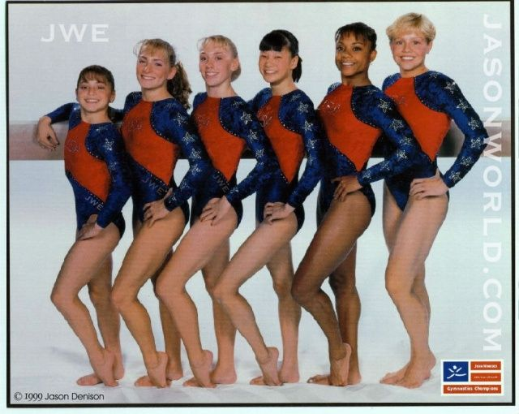
Growth And Development
Menarche
Amenorrhea
Pre-Selection
Female Triad
Boys vs. Girls
Notes:
Children undergo growth & development at an individual rate. Biologic growth and maturation are genetically regulated whereas development is culturally mediated. Girls tend to reach peak height and body mass around 15 where boys are later around 17. Wide maturation rates have been suggested to increase injury risk data is lacking. A decrease in age adjusted bone mineral density also plays a role in stress injuries. History of amennorhea in the setting of sports that promotes leanness increases risk of stress fractures, There are studies looking at athletes such as college cross-country runners and risk of number of menses per year and stress fractures. When female athletes with bone stress injuries are evaluated it is important as the clinician you screen for disordered eating, low BMD and menstrual irregularity

Slide 37
Will Early Specialization Get Me To the Pros?
With the exception of:
Swimming,diving, gymnastics and figure skating
Notes:
With the exception of a few sports,research in athletes has not consistently demonstrated that early intense training is essential for attaining an elite level in all sports.

Slide 38
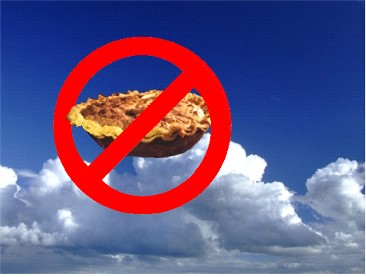
What is the Goal?
Pie In The Sky?
Professional Pie
Area of Specialization
0.2%-0.5% make it pro
Promote Lifelong Physical Activity
Unfulfilled Childhood Dreams
Notes:
The athlete with the guidance of their parents and coach are now playing sports to obtain the professional pie in the sky. As mentioned only 0.2% to 0.5% highschool athletes make it pro depending on sport. Yet youth continue to specialize in one sport. The true goal of youth sports is to promote lifelong physical activity that can be used or transfer to all facets and future endeavors. Too often parents are living vicariously through their children and looking to fullfill or change the course of time. One of my mentors when confronted with this type of parent or there was concern regarding overuse he would ask the parents what sport they played and level of competition they achieved.

Slide 39
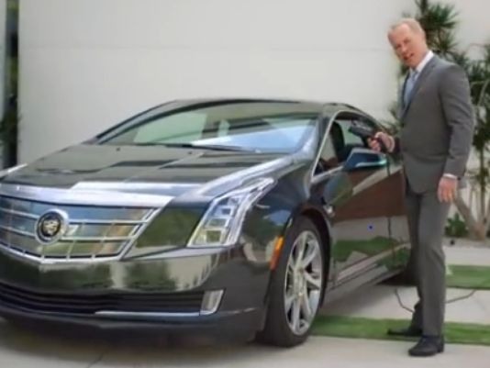
American Dream
Notes:
The opening shot shows a middle-aged man, played by the actor Neal McDonough, looking out over his backyard pool, asking the question: "Why do we work so hard? For this? For stuff?" Other countries, they work," he says. "They stroll home. They stop by the cafe. They take August off. Off." Why aren't you like that?" he says. "Why aren't we like that? Because we're crazy, driven, hard-working believers, that's why.“ I think that taking August would be great!!! The mentality in this Cadillac commericial can get us into trouble. So what is Burnout Syndrome? How do we know when we are personally burned out? As physicians or physicians in training this is an important question that often times gets overlooked. This is also a dilemma that has plagued youth sports.

Slide 40
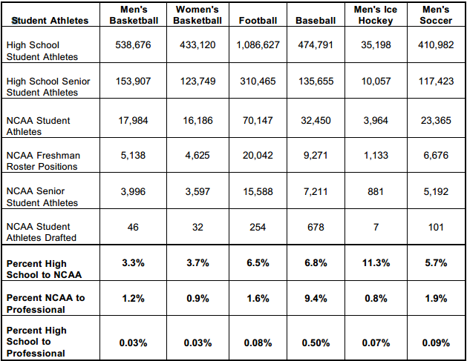
Notes:
98 out of 100 high school athletes never play collegiate sports of any kind at any level. There are more than 460,000 NCAA student-athletes, and fewer than two percent will go pro in their sports. One of my mentors when concerned about youth burnout while speaking to family and youth athlete he would ask the parents what sport they played & level of competition did they reach to almost plant the seed of realistic goals.

Slide 41
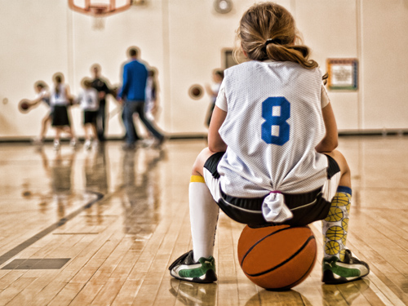
Social Risks- “I Just Want To Have Fun”
Overdependence
Social Isolation
Problem Solving Skills
Maladaptive Behaviors
Notes:
Limit exposure to other activities and endanger the development of the young athlete where down the line may not be able to cope in certain.

Slide 42
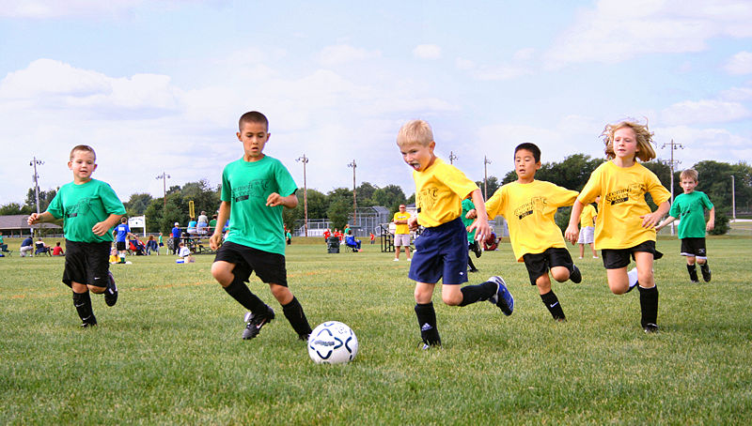
Money Is The Root Of All Evil
Youth Sports Movement
$7 Billion Industry
Youth Sports Tourism
Fastest Growing Segment in Travel
Columbus Dispatch
Non-profit Groups-$5 Billion/Year in 2010
Notes:
The Youth Sports Movement is one of the fastest growing industries in the United States and one particular segment of the economy that is benefiting is the travel industry with youth sports tourism being the fastest growing segment. Money like many aspects in life is driving force behind the Youth Sports Movement. The days of children playing and organinzing pick up games in the backyard are over. Now families can expect to spend upwards of 8,000 dollars per year on 1-2 children who are involved in the single sport specialization, privatization of youth leagues. Do not get me wrong medical field is benefiting as well. ER annual costs for 6 to 19 y/o is 935 million dollars. Pessly of me smiling. We have committees to regulate religion and stock brokers but no one is designated to regulate youth sports. Youth sports tourism wasn't even a category four years ago, and now it's the fastest-growing segment in travel," said Dave Hollander, professor at New York University's Tisch Center for Hospitality, Tourism and Sports.
"You've got millions of kids involved, parents spending thousands of dollars, and cities building facilities to host events and chase tourism dollars," he said. "It's just hugeThe problem is that while the FDA takes responsibility for knowing everything about our food (as the EPA does with the environment and a group called ARDA does with religious life), no one agency or organization monitors youth sports either as a central part of American childhood or as an industry. (And it is an industry.

Slide 43
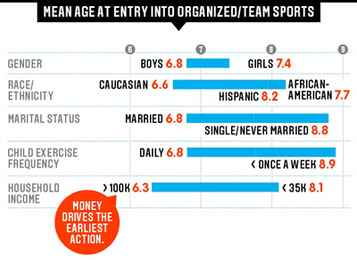
Odds of Going Pro | Odds
Odds of a high school football player making it to the NFL | 1 in 6,000
Odds of a hgh school baseball player making it to MLB | 1 in 4,000
Odds of a high school basketball player making it to the NBA | 1 in 10,000
Odds of a high school soccer player receiving a full ride to a Div I or II School | 1 in 90
The above is taken from a study on youth sports by Michigan State University. It surveyed 10,000 children ages 5-14 nationwide.
Notes:
This was a study from my alma mater MSU illustrating the odds of playing professionally in the 3 most popular sports in the U.S. as well as playing division 1 or 2 soccer. The odds are against youth athletes yet at a growing rate youth athletes continue specialize in a single sport and parents will spend upwards of thousands of dollars monthly as well as spend the time either driving across town and even fly across the country so their child has that opportunity to obtain the pie in the sky. The other graph tabulated by Sports and Fitness Industry Association and Don Sabo long-time youth researcher who does thousands of online interviews showed But we also see starkly what drives the very earliest action: money. The biggest indicator of whether kids start young, Sabo found, is whether their parents have a household income of $100,000 or mor

Slide 44
A Parent’s Influence
YOUTH FOOTBALL PARENT OUT OF CONTROL - YouTube

Slide 45
What To Tell Parents?
Well-Rounded Individual Leads To Success
Late Specialization Works
Enjoyment/Intrinsic Motivation
Supportive Not Authoritative
No Penalty For Starting Late
Notes:
Enjoyment is most sustaining. If a child enjoys the activity they are more likely to be motivated to see an activity to completion leading to life-long lessons. Be supportive during elementary years while focusing on basic skills and reinforcing importance of having fun and sampling sports. Opportunity is there to experience success if the necessary skills and desire are present.

Slide 46
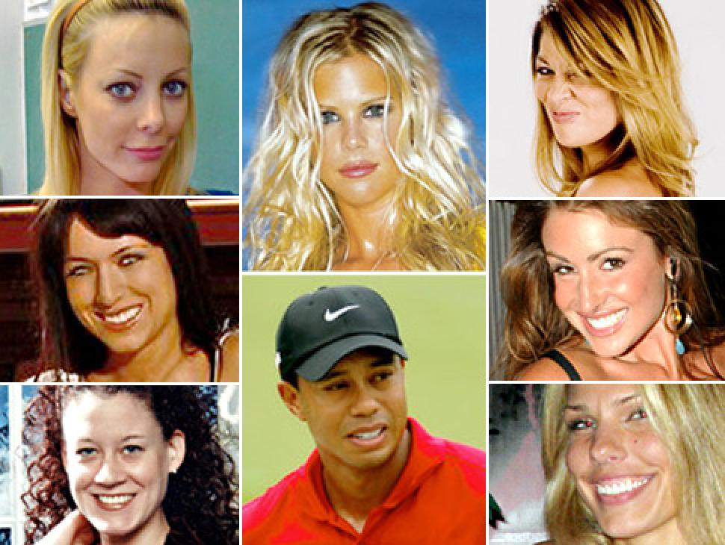
VS.

Slide 47
Summary
Specialization in a single sport before adolescence is discouraged
Clinicians should work with parents and coaches to strive for early recognition of overuse injuries
Be alert for signs and symptoms of overtraining including decline in performance, weight loss, apathy and fatigue
High risk injuries can lead to nonunion, result in chronic pain, and/or lead to the development of degenerative joint disease
Notes:
Clinicians should work with parents to ensure the athlete is being coached by persons who are knowledgeable about proper training techniques equipment and unique physiological and emotional characteristics of children. Early recognition is the first step to prevention. Child athletes should never be encouraged to fight through their pain or such injuries like tendinitis, apophysitis, stress fractures and shin splints

Slide 48
19 y/o lacrosse player p/w with 3 days of persistent axillary pain and swelling especially with weight-lifting. Pain remains despite reduction in overhead training but still practices lacrosse. PE-localized swelling with tenderness and firmness over left axilla. Supine there is prominent venous structures with left UE > right. Which of the following is the presumed diagnosis?
Superficial phlebitis
Pectoralis major tear
Labral tear
Effort induced thrombosis
Lymphangitis

Slide 49
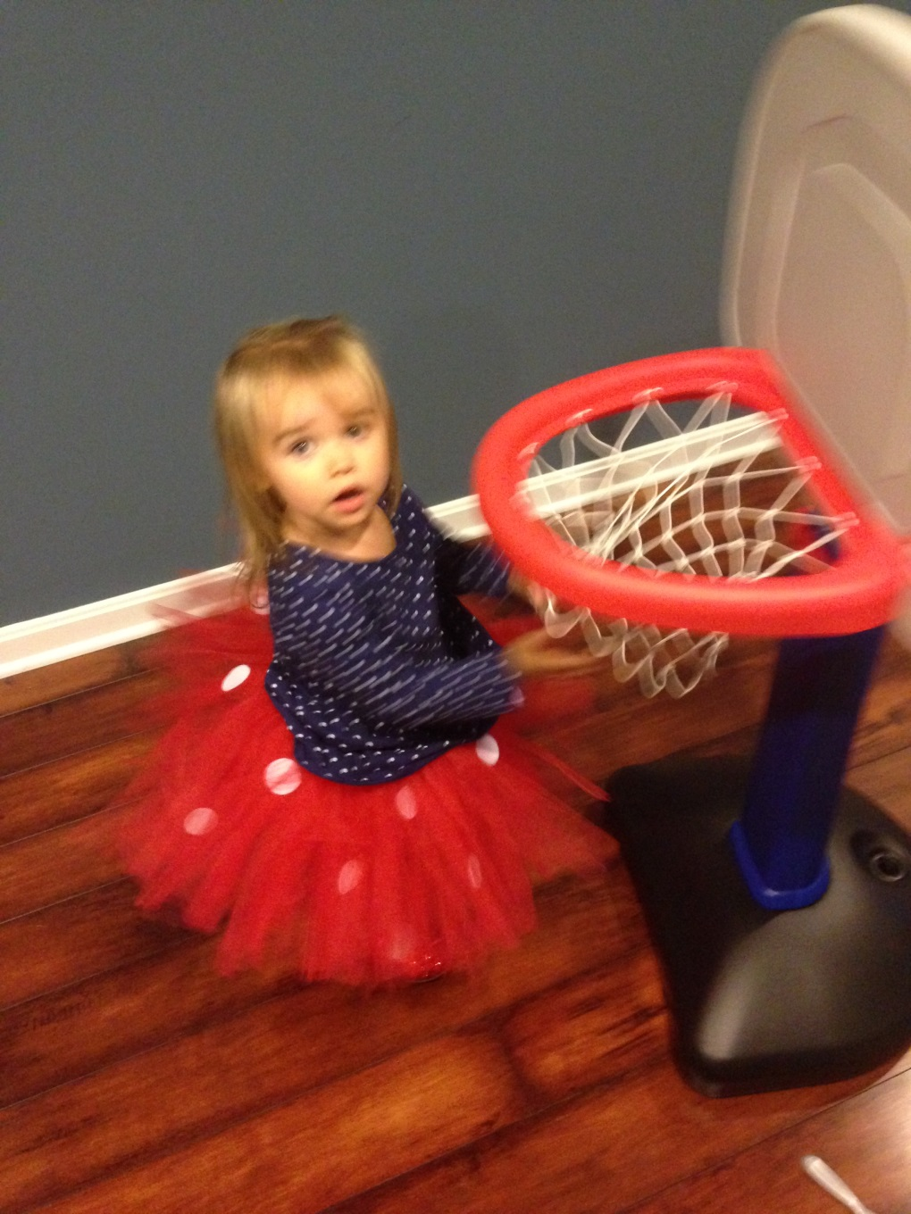
Questions
Notes:
PIC of V dunking a basketball. I do not believe I will have a problem with my daughter specializing in gymnastics!

Slide 50
References
1. Mostafavifar AM, Best TM, Myer GD. Early sports specialization,does it lead to long term problems? BJSM. 47:1060-1061, 2013.
2. Difiori JP, et al. Overuse injuries and burnout in Youth Sports: AMSSM. Clin J Sports Med. 24: 3-20, 2014.
3. Malina RM. Early Sports Specialization: roots effectiveness, risks. Curent Sports Med Rep. 9: 364-371,2010.
4. Jayanthi N. et al. Sports Specialization in young athletes: evidence based recommendations. Sports Health. 251-257. 2013
5. Hecimovich, M, et al. Sports Specialization in youth: a literature review. JACA. 41:32-41, 2004.
6. Kaleth AS, Mikesky AE. Impact of early sports specialization. J Phys ED Rec Dance 81:29-38,2013.
7. Brenner JS. Overuse injuries, overtraining and burnout in child and adolescent athletes. Pediatrics.119: 1242-1245, 2007
8. Baker J, Cobley S, Frasier-Thomas J. What we know about early sport specialization? Not Much! High Ability Studies. 20.77-89, 2009.
9. Thompson, Dixie. ACSM Society Fit Page. ACSM. 15:1-7.
10.Committe on Sports Medicine. Intensive Training and Sports Specialization in Young Athletes. Pediatrics 106: 154-159. 200
11.Tamara, C, et al. NATA Position Statement: Prevention of Pediatric Overuse Injuries. Journel of Athletic Training. 46(2):206-220. 2011.

