Slide 1
Breast Cancer Update 2014
Helen Mabry, MD F.A.C.S.
Breast Surgeon
Assistant Professor of Surgery
University of Toledo Medical Center

Slide 2
Objectives
Breast cancer treatment overview
Breast cancer risk factors
Possibilities for breast cancer prevention

Slide 3
Class of organisms named after breasts
Notes:
Three middle ear bones four chambered heart presence of hair and absence of feathers and scales

Slide 5
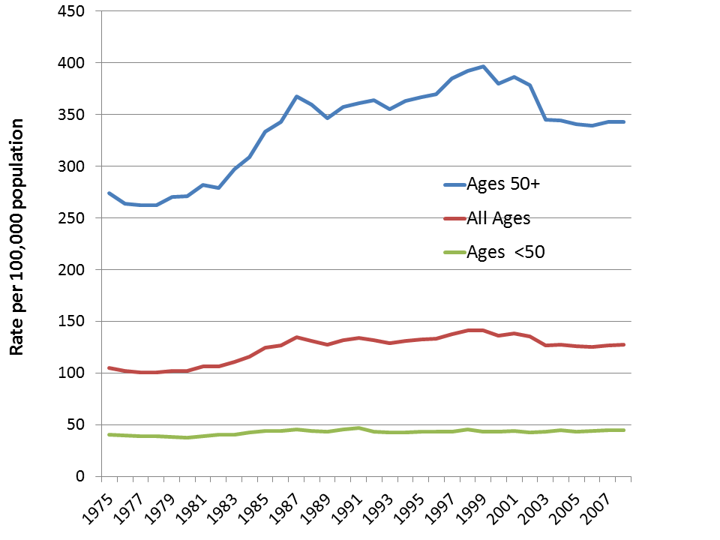

Slide 7
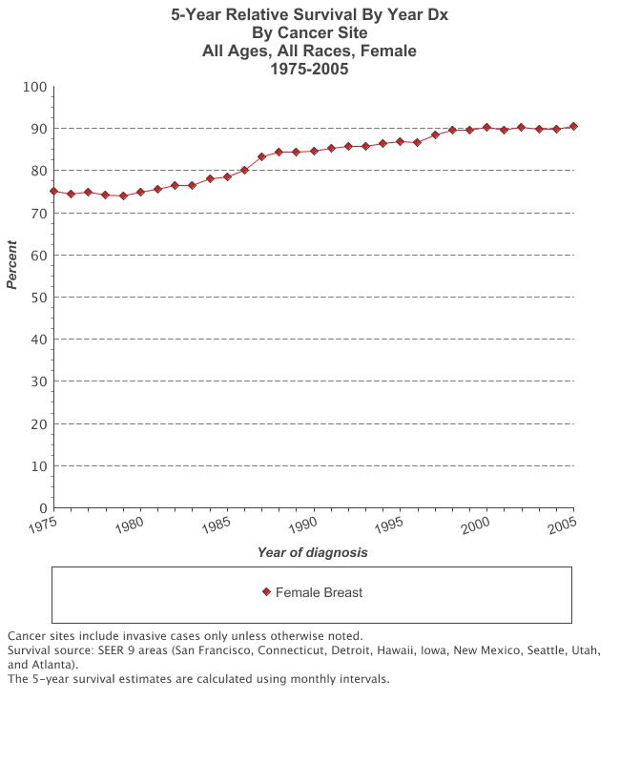

Slide 8
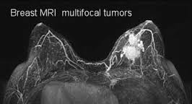
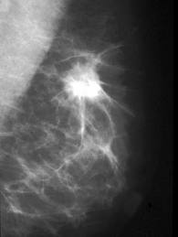
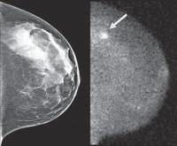
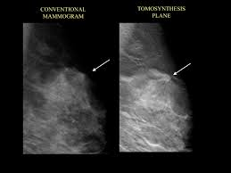
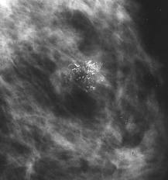
Presentation
Screening
Most common and effective method is mammography, however, it is imperfect
Additional imaging: Ultrasound, MRI, MBI, Tomosynthesis, other
Once detected it is palpable vs. non-palpable
BIRADS coding

Slide 9
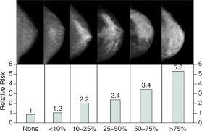
Screening Mammography— good or bad?
False positives, false negatives
Cost
Radiation exposure
No reduction in breast cancer mortality
Benefits of early detection Stage 1 vs. Stage 3
Genetics of tumors trumps everything?
Notes:
From age 40-59 over ten years 50-60% risk of false positive mammogram.
False negative range from 20-29%

Slide 10
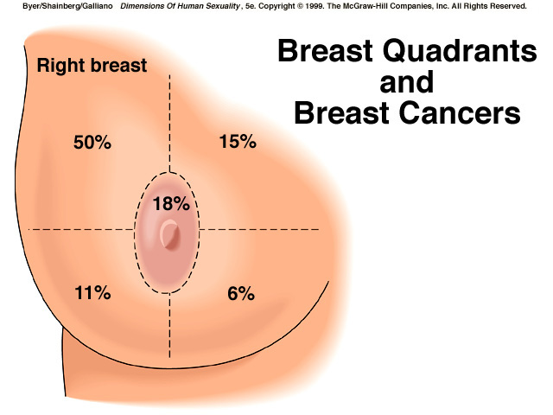
Presentation: palpable mass
Evaluation of palpable mass: history and physical, age, imaging workup
Less than 30 years old, start with ultrasound
Over 30 ultrasound and mammogram
The older the patient the more likely it is cancer
Even young women sometimes have breast cancer

Slide 11
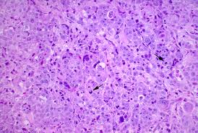
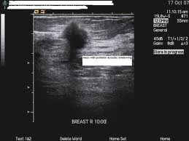
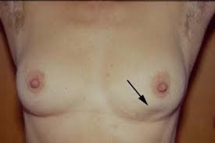
Palpable mass
Needle biopsy
Concordance of imaging, physical exam and pathology “Triple Test”

Slide 12
Breast pain
Only 9% of breast cancers presented with pain to Dr. Haagensen (1956)
Pain is not a common presentation for breast cancer, but it is a common complaint
Pain in a mass may be a favorable finding less associated with cancer than a painless mass¹
Khan 2002 Cancer Detect Prev

Slide 13
“Where’s The Outrage?” over not enough needle biopsies
In 2009 36% of all diagnostic biopsies were still open surgical biopsies instead of needle biopsies.
Clarke-Pearson et al. Quality Assurance Initiative at One Institution of Minimally Invasive Breast Biopsy as the Initial Diagnostic Technique J Am Coll Surg Vol 208, Issue 1, January 2009 Pages 75-78

Slide 14
After the needle biopsy has been done
Non-Invasive (Stage 0)
DCIS: Ductal Carcinoma In Situ
LCIS: Lobular Carcinoma In Situ
Invasive (Stage 1 and up)
Invasive Ductal Carcinoma
Invasive Lobular Carcinoma
Others (medullary, colloid, tubular)

Slide 15
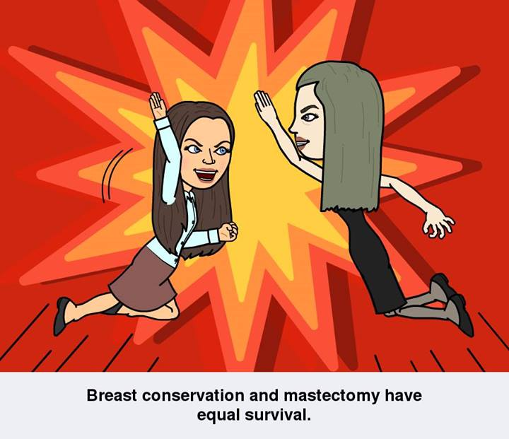
Surgical Management of Breast
Breast Conservation
Lumpectomy and radiation
Mastectomy
With or without reconstruction
Survival equal
Local recurrence may vary (14.3% lumpectomy plus radiation, 39.2% lumpectomy alone)
Twenty-Year Follow-up of a Randomized Trial Comparing Total Mastectomy, Lumpectomy, and Lumpectomy Plus Irradiation For the Treatment of Invasive Breast Cancer Fisher B, Anderson S, Bryant J, Margolese RG, Deutsch M, Fisher ER, Jeong JH, Wolmark N New England Journal of Medicine 347(16):1233-1241, October 17, 2002

Slide 16
Mastectomy
Radical
Modified radical
Skin sparing
Areola sparing
Nipple and areola sparing

Slide 17
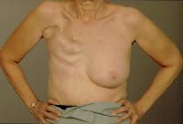
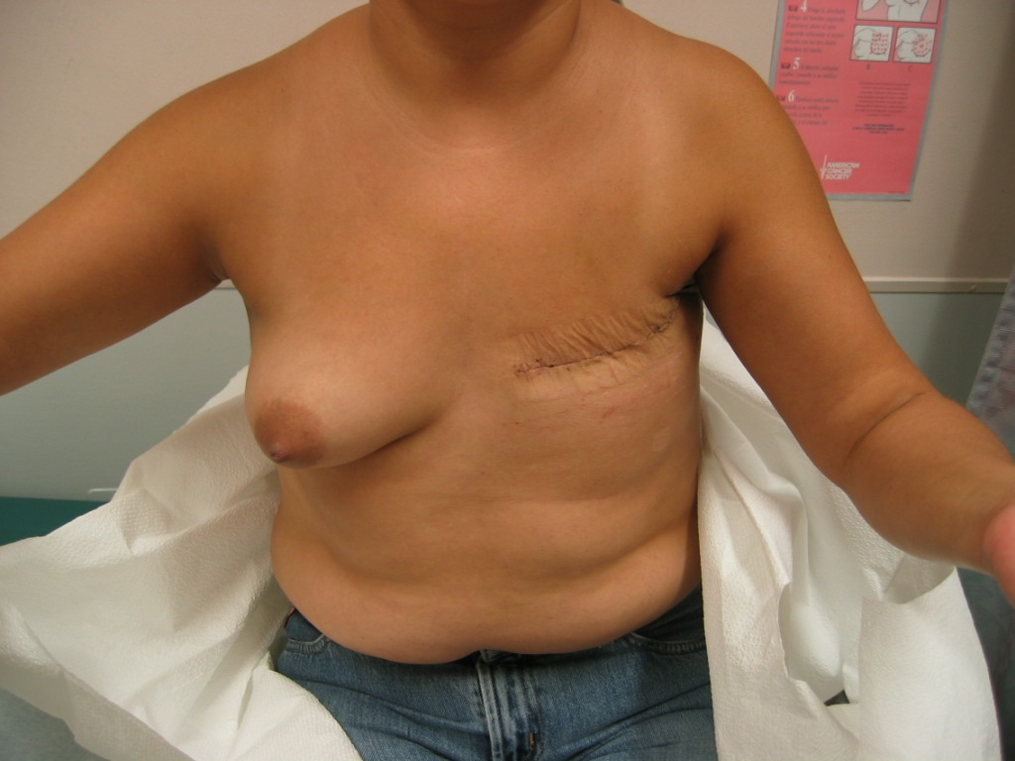
Evolution of Mastectomy

Slide 18
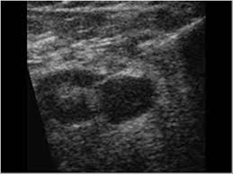
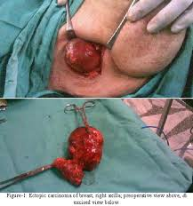
Surgical Management of Axilla
Physical exam
Imaging
Ultrasound of axilla
Characteristics of metastases to axillary nodes
No fatty hilum
Thickened cortex
Shape round instead of kidney bean

Slide 19
FNA of suspicious axillary node
Proceed straight to axillary dissection without sentinel node biopsy
Reduced cost of surgery and shorter OR time
Additional procedure to schedule and await results
Bleeding
False negative
Painful on awake patient
Can be technically difficult

Slide 20
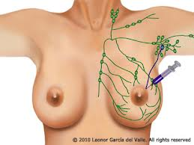
Sentinel node biopsy
Indicated for all invasive cancers and some DCIS
DCIS treated with mastectomy
DCIS located close to sentinel node (accessible through the same incision)
Large DCIS (>4 cm)
Not indicated for LCIS unless performing risk reduction mastectomy

Slide 21
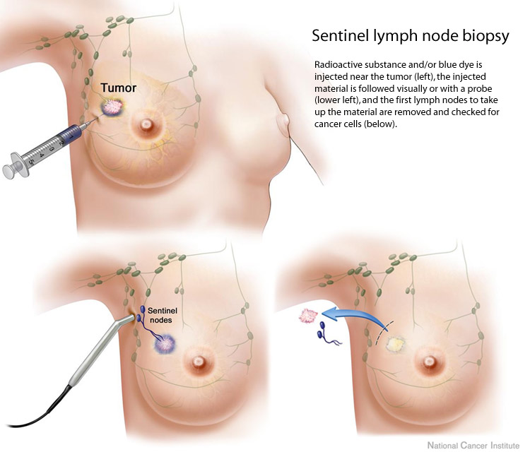

Slide 22
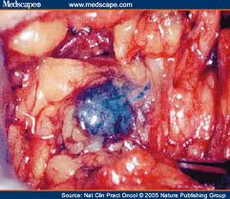
ACOSOG Z0011 findings
Sentinel node biopsy in women
with 1 or 2 positive sentinel nodes
if they were initially clinically
node negative, and if they planned
to be treated with lumpectomy
And whole breast radiotherapy

Slide 23
The results from ACOSOG Z0011 are not directly applicable to patients who
• Have T3 tumors
• Have more than 2 positive nodes
• Are undergoing mastectomy
• Are undergoing partial breast radiation 2
• Have been identified as having matted axillary nodes or preoperative palpable nodes
• Are receiving neoadjuvant chemotherapy
The results from ACOSOG Z0011 are potentially practice changing and ALND may no longer be routinely required for patients who meet all of the following criteria:
• T1-2 tumors
• One to two positive SLNs without extracapsular extension
• Patient acceptance and completion of whole-breast radiation therapy without extended fields of therapy
• Patient acceptance and completion of adjuvant therapy (hormonal, cytotoxic, or both)

Slide 24
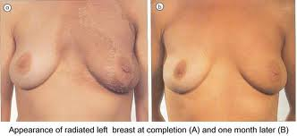
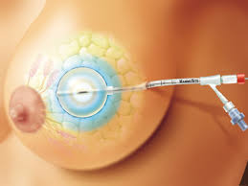
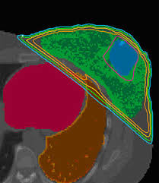
Radiation therapy
Whole breast
Catheter based partial breast
Mammosite
SAVI
Contura
IMRT
Intra-operative radiation therapy

Slide 25
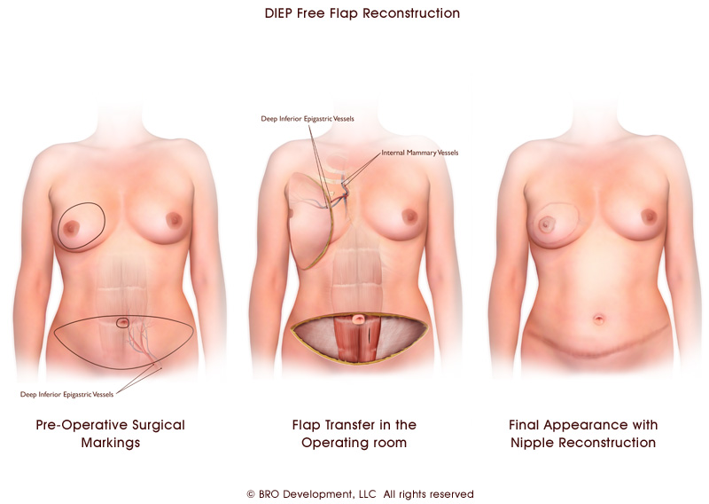
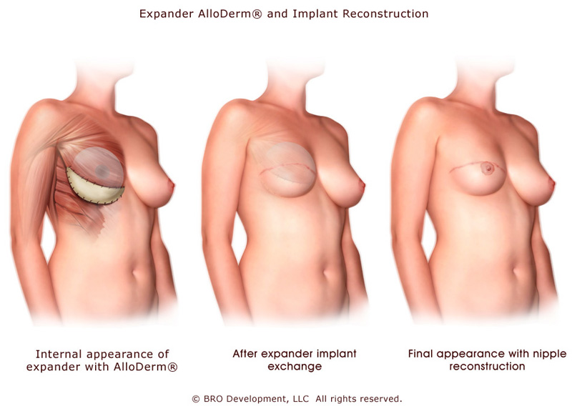
Reconstruction
Immediate
Delayed
Autologous tissue
Latissimus
TRAM
DIEP
Implant
Alloderm

Slide 26
Bilateral Mastectomies
DIEP reconstruction
Implant reconstruction

Slide 27
Chemotherapy
Cytotoxic—infusion based, hair loss, etc. usually 4 or 6 cycles
Decision used to be based on tumor size and node status
Now genetic profiles of tumors contribute to this decision much more than tumor size

Slide 28
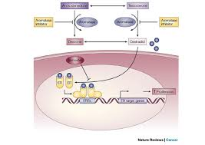
Hormonal Therapy
Tamoxifen
Aromatase Inhibitors
Arimidex
Femara
Aromasin

Slide 29
Survivorship
There are over 3 million breast cancer survivors.
Most breast cancer patients survive and live for many years with some sequelae of their breast cancer treatment
Neuropathy
Changed body image
Chemo brain
Pain or tenderness of treated area
Alterations of sexual function
Concerns over risk of recurrence

Slide 30
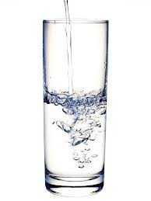
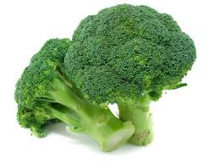
“The only way to keep your health is to eat what you don’t want, drink what you don’t like and do what you’d rather not”
Mark Twain

Slide 32
Risk factors for breast cancer
medical interventions,
dietary exposure to nutrients, energy and toxins,
ionizing radiation,
chemicals from industrial and agricultural processes,
consumer products,
reproductive choices,
energy balance,
adult weight gain,
body fatness,
voluntary and involuntary physical activity,
medical care,
exposure to alcohol and tobacco and
occupational exposure including shift work.^{1\}
Institute of Medicine, Breast Cancer and the Environment: A Life Course Approach Dec, 2011
Notes:
Specific work agriculture bars gambling 2.28 automotic plastics manufacturing 2.68 food canning and metalworking. Premenopausal BC highest for automotive plastics 4.76 and food canning 5.70

Slide 33
DES (diethylsilbestrol)
Used 1940’s-1971
1971, a report published in the New England Journal of Medicine showed a probable link between DES and vaginal clear cell adenocarcinoma in girls and young women who had been exposed to this drug in utero
3 million pregnant women exposed
First documented transplacental carcinogen
Daughters risk increased for fertility problems and reproductive anomalies
Male fetuses more likely to have cryptorchidism or hypospadias
Investigations ongoing for third generation effects

Slide 34
Environmental Contributions to Breast Cancer
Why are these difficult to determine?
Exposures difficult to measure—proxies (location, occupation)
Timing may be crucial (nuclear bomb data)
Laboratory animals may be different from humans
People change over time—habits, BMI, food, region
Memory is faulty—recall bias

Slide 35
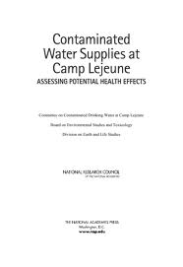
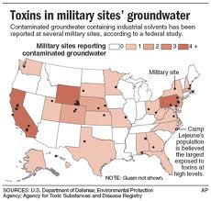
Camp Lejeune Environmental Contamination
Notes:
Most contaminated drinking water ever discovered in the United States TCE (tricholoroethylene) and PCE (perchloroethylene) leaky storage tanks from 1953 to 1987
5 pp billion is legal limit established in 1989. measurements were 1600 ppb of TCE and 1184 ppb elementary school. 750,000 people exposed. Largest cluster of male breast cancers ever identified. Pt one was diagnosed age 39 he was conceived and born on the base.

Slide 36
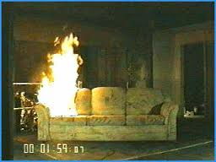
Flame retardants in breast milk
The EU has banned several polybrominated diphenyl ethers (PBDEs) as of 2008 10 years after they were found to be accumulating in breast milk in Sweden
PBDEs are found in higher concentrations in household dust especially near electronics

Slide 37
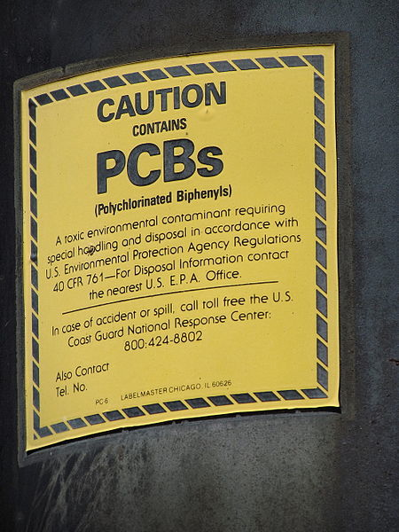
Xenoestrogens
Molecules that mimic estrogens and may be found in plants or chemicals
These can have effects on all animals
PCBs
BPA
Phthlatates
Herman-Giddens “Secondary Sexual Characteristics and Menses in Young Girls Seen in Office Practice: A Study from the Pediatric Research in Office Settings Network” Pediatics 1997
Notes:
Polychlorinated biphenyls used in industrial processes, phthaltes are used to soften plastics there is no covalent bond and as plastics age they are released. They are found in building materials, detergents, paints, floor tiles, shower curtains, vinyl ulholstry, food containers and wrappers, perfume, moisturizer, nail polish, liquid soap and hair spray

Slide 38
Earlier Puberty: A Pediatric Condition with Geriatric Implications.

Slide 40
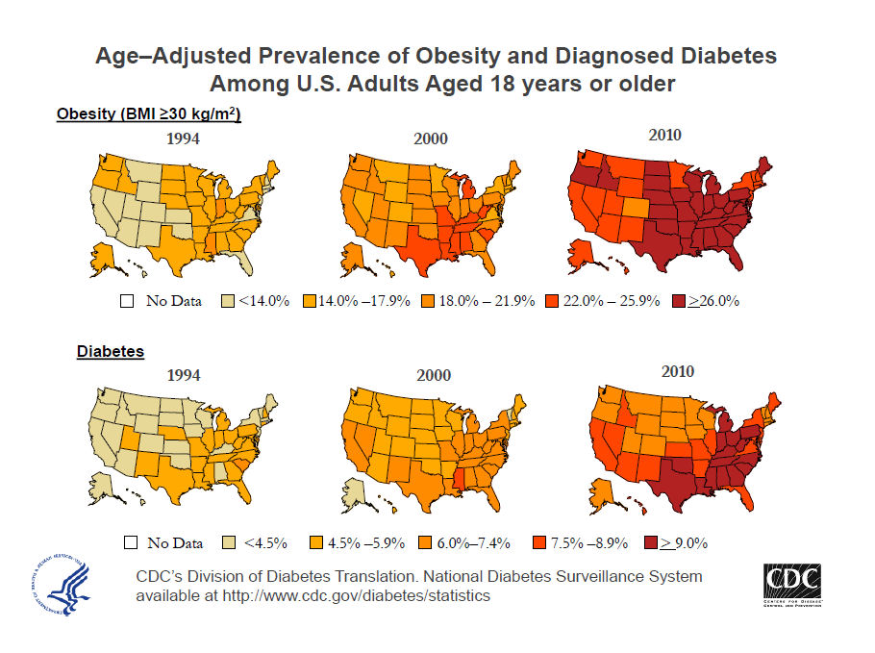

Slide 43
Diabetes and Breast Cancer
Meta-analysis showed a 20% increased risk of breast cancer.
Christos Mantzoros, Mlicja Wolk. Diabetes mellitus and risk of breast cancer: A meta-analysis Susanna C. Larsson, International Journal of Cancer Volume 121, Issue 4, pages 856-862 August 2007.

Slide 44
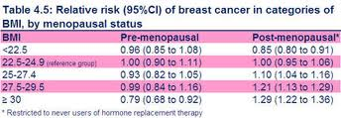
Obesity
Associated with decreased premenopausal breast cancer risk
Interferes with regular menstrual cycling
Less proliferation in breast
Associated with increased postmenopausal breast cancer risk
Increases estrogen exposure
Fat cells form estrogen from other hormones
http://www.cancerresearchuk.org/cancer-info/cancerstats/types/breast/riskfactors/

Slide 45
Obesity and Social Networks
Obesity spreads in social networks according to the Framingham Heart Study.
Individuals are influenced most powerfully by close friends of same gender whom he or she admires (57%). There is more influence from same gender siblings (40%) than spouses (37%) or neighbors (no effect).
Christakis NEJM 2007

Slide 46
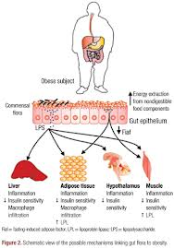
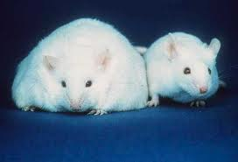
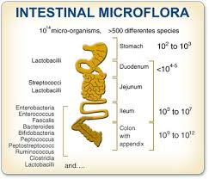

Slide 47
Humanfoodproject.com

Slide 49
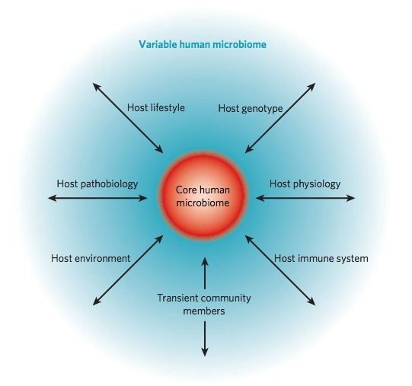
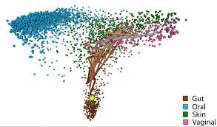
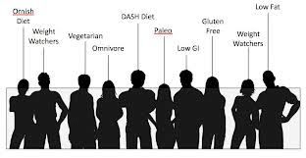
Living Environment

Slide 50
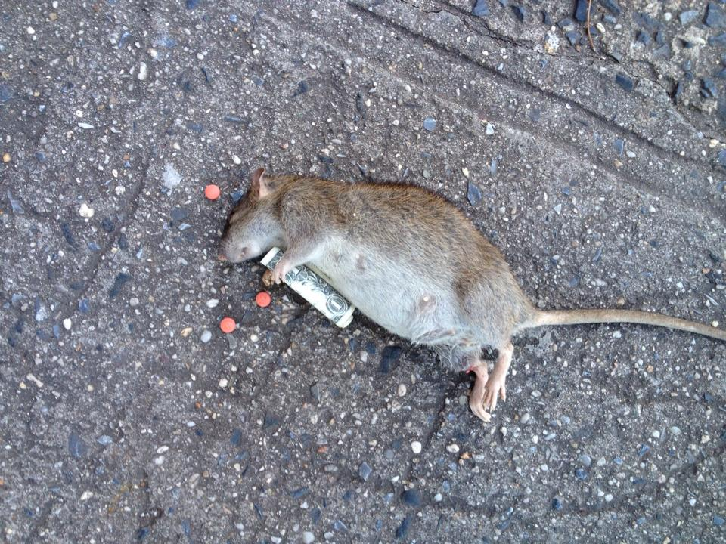
Certain foods affect rats like cocaine
Rat allowed unlimited access to sausage, cheesecake and chocolate quickly became overweight and neglected normal chow.
These rats ate 2x the calories of controls
Dopamine D2 receptors showed evidence of desensitization
When denied access to these foods they refused all food for 2 weeks before returning to normal chow
Johnson and Kenny, Nature Neuroscience, May 2010

Slide 51
Reduced risk of breast cancer with exercise
With very vigorous exercise breast cancer risk risk can be reduced by 50% in postmenopausal women
Risk reduction is dose dependent with the most vigorous and lengthy exercise yielding the most benefit
http://www.cancer.gov/cancertopics/factsheet/prevention/physicalactivity#r4

Slide 52
Conclusions
Breast cancer treatment is very effective.
New understanding of the causes of breast cancer may help improve prevention.
Prevention should be OUR GOAL!
Physicians need to act as a referral point for patients into survivorship programming.

Slide 53
There is hope…

Slide 54
Further Reading

Slide 55
Indications for Skin and Nipple Sparing Mastectomy
Tumor at least 2 cm from nipple
Tumor size small and not extensive
No skin or nipple involvement
No extensive axillary disease
Minimal ptosis of the breast
Small size of the breast
BRCA positive patients

Slide 56
Malignant NAC involvement in Prophylactic Mastectomy
Study | # prophylactic mastectomies | NAC malignant involvement
Rusby et at | 70 | 0%
Bractel et al | 84 | 0%
Reynolds et al | 33 (all BRCA+) | 0%
Kaplan et al | 117 | 0%
Rusby, et al Breast J, 2008
Bractel et al , JCO, 2009
Reynolds et al. Ann Surg Onc, 2011
Kaplan, et al (Weill Cornell – in publication)

Slide 57
Malignant Nipple Involvement
Study | Therapeutic Mastecomy | Malignant NAC Involvement
Simmons et al | 217 | 10.6%
Voltura et al | 34 | 5.9%
Bractel et al | 232 | 21%
Rusby et al | 130 | 25%
Reynolds et al** | 4421 | 18%
Simmons et al , Ann Surg Onc 2002
Voltura et al, Ann Surg Onc, 2008
Rusby, et al Breast J, 2008
Bractel et al , JCO, 2009
Reynolds et al. Ann Surg Onc, 2011** (16 study combined analysis)

Slide 58
Indications for BPM
Presence of BRCA mutation
Strong family history of breast cancer
Presence of pathologic risk factors
Difficult breast surveillance
2007 SSO guidelines report Giuliano, et al. Ann Surg Oncol 2007;14:2425-7

Slide 59
Effective?
BPM results in a cancer-risk reduction of about 90%¹
¹ Hartmann et al, NEJM 1999;340:77-84.

