Slide 1
The Dizzy Patient:
An Approach to the Work Up and Management of Vertigo
Ellen Baxter, DO, FAAOA
Promedica Physicians ENT
Otolaryngology and Facial Plastic Surgery

Slide 2
I have no financial disclosures

Slide 3
OBJECTIVES
Identify the differential diagnosis for the dizzy patient
Form a systematic approach to narrowing the differential diagnosis
Create a diagnostic and treatment approach for your patient

Slide 4
The Problem
Dizzy
Let’s consider the definition
1: Foolish, silly
2: a : having a whirling sensation in the head with a tendency to fall
b : mentally confused
3: a : causing giddiness or mental confusion <dizzy heights>
b : caused by or marked by giddiness
merriam-webster.com

Slide 5
Dizzy Definition Cont…
1: Having or involving a sensation of spinning around and losing one’s balance
2: silly but attractive
3: feel unsteady, confused, or amazed
oxforddictionaries.com
1: feeling faint or lightheaded to feeling weak or unsteady
Mayoclinic definition

Slide 6
The Problem
The problem is, there’s no precise meaning or consistency to the word DIZZY.
Yet, all your patients will use it.

Slide 7
THE PROBLEM
DIZZINESS
Why does this symptom cause us such anxiety?
Let’s consider the differential diagnosis.

Slide 8
DIFFERENTIAL DIAGNOSIS
Benign paroxysmal positional vertigo
Vestibular neuritis
Labyrinthitis
Meniere’s Disease
Migraine with vertigo
Vertebrobasilar insufficiency
CVA
Migraine
Hypertension
Hypotension
Cardiac arrhythmias
Carotid artery disease
Multiple sclerosis
Parkinson’s Disease
Diabetic neuropathy
Brain Tumor
Cervical spondylosis
Neuropathy
Poor eye sight
Prescription drug use
Illicit drug use
Myocardial infarction
Cardiomyopathy
Aortic stenosis
Hypoxia
Dehydration
Hypoglycemia
Dementia
Menopause
Arteriosclerosis

Slide 9
DIFFERENTIAL DIAGNOSIS
Perilymphatic fistula
Herpes Zoster Oticus
Ototoxicity
Otitis Media
Semicircular Canal Dehiscence
Chiari malformation
Encephalitis
Trauma
Herpes Simplex
Mastoiditis
Meningitis
Subarachnoid Hemorrhage
Subdural Hematoma
Toxicity (Carbon Monoxide)
Anxiety
Hyperventilation
Orthostatic hypotension
Anemia
Acoustic Neuroma
Concussion
Panic disorder
Endocrine disorders
Labyrinthine concussion
Cholesteatoma
Metastasis to brain
TIA
Otosyphillis
Wernicke Encephalopathy

Slide 10
Differential Diagnosis
You would have to entertain all of the previous diagnoses to work up a chief complaint of dizziness.
How can we effectively narrow the DD?

Slide 11
The approach
How to narrow this DD
  History is KEY!
  Feel free to steal this phrase…
    “Describe to me what happens to you and DON’T use the word DIZZY.”
  Don’t be afraid to be a stickler on this one. It will be your most valuable piece of information.

Slide 12
The approach
Additional history
  When did it start?
    Get the approximate onset but also any possible related factors such as trauma, new meds, surgeries, new environment, social stressors, etc.
  How long does it last? (sec, min, hours, days)
  How often does it happen?
  What are you doing when it happens?
  Is there anything you know you can do to make it better or worse?

Slide 13
The approach
Find out any associated symptoms such as…
  Ringing in the ears
  Decrease in hearing
  Headache
  Feeling cold or clammy
  Difficulty articulating
  Numbness or tingling of extremities

Slide 14
The approach
Dissect out their description of dizziness. It will most likely match one of the following.
  Vertigo (room spinning, feeling of movement of self or environment)
  Lightheadedness (presyncope, feeling that they could pass out)
  Disequilibrium or off-balance (sensation that they are being pushed in one direction or that they are generally unsteady on their feet)
  Foggy or confused ( sensation that things are not clear or may have trouble focusing their thoughts)

Slide 15
The approach
Physical exam: perform as usual but paying special attention to eyes, ears, neuro, and cardiovascular.
  Eyes: EOMI, pupils, nystagmus, (if so what type? Horizontal, vertical, tostional and to what side?) Is nystagmus decreased by fixation?
  Ears: fluid or infection, signs of trauma, cholesteatoma, vesicular lesions near/on ear?

Slide 16
The approach
  Neuro: Cranial nerves intact, loss of sensation or strength in extremities, rapid alternating movements intact, Romberg test, fakuda test?
  Cardiovascular: Blood pressure, orthostatics, pulse rate and rhythm, arrhythmia, carotid bruits, murmurs?

Slide 17
The approach
Let’s use an algorithm!

Slide 18
DIZZINESS
VERTIGO
CENTRAL N.S.
PERIPHERAL N.S.
FOGGYNESS
/CONFUSION
CENTRAL N.S.
ENDOCRINE
MEDS/DRUGS
LIGHTHEADEDNESS
DYSEQUILIBRIUM
OTOLOGIC
CARDIOVASCULAR
CENTRAL N.S.
PERIPHERAL (OTOLOGIC)

Slide 19
VERTIGO
Central signs
  Tend to be more constant
  May have accompanied Headache
  Purely vertical or torsional nystagmus that does not stop with fixation
  Nystagmus that changes directions with change in gaze

Slide 20
VERTIGO
Peripheral/Otologic signs
  Nystagmus tends to be horizontal or torsional and may decrease with fixation.
  May be more intermittent/episodic
  May be associated with ringing, change in position, hearing loss, nausea/vomitting

Slide 21
LIGHTHEADEDNESS/PRESYNCOPE
Cardiovascular
  Can be related to change in position, i.e. laying to sitting and sitting to standing
  Also seen with extreme head extension
  May appreciate arrhythmia, murmurs, or bruits on exam
  Look for other cardiovascular risk factors or signs or new meds that affect this system
  No nystagmus seem

Slide 22
DYSEQUILIBRIUM
Otologic
  May have hx of acute and severe vertigo attack preceding current symptoms
  Chronic meclizine (Antivert) use.
  History of ear surgery or trauma

Slide 23
DYSEQUILIBRIUM
Peripheral N.S.
  Issues with lower extremity neuropathy (diabetic or other)
  Lower extremity weakness
  No nystagmus

Slide 24
DYSEQUILIBRIUM
Central N.S.
  Usually associated with some other central defect, i.e. headache, weakness, numbness/tingling,
  Nystagmus possible but not always constisant or helpful with diagnosis
  Stroke or extrapyramidal symptoms commonly seen with this description, i.e. dysarthria, slow movements, rigidity

Slide 25
FOGGINESS/CONFUSION
Central N.S.
  Often associated with headache
  May have other signs suggestive of dementia
  May have signs of focal neurologic deficit

Slide 26
FOGGINESS/CONFUSION
Endocrine
  Low blood sugar
  Hx of thyroid or adrenal gland dysfunction
Medications
  Common with antidepressents, antiseizure, antipsychotics, benzodiazapenes, narcotics
  Look for prescription and illicit drug abuse

Slide 27
Diagnosis and Treatment
So now you have narrowed the patients “dizzy” issue down to likely 1-2 systems, i.e., brain and nervous system, inner ear, cardiovascular, or other.
Diagnosis approach is really system based.
If you are unsure which system is the most likely to be the culprit, start with the area that maybe most life threatening.

Slide 28
Diagnosis and Treatment
Otologic
  Diagnostic tests
    Hallpike maneuver
    Audiogram
    Vestibular testing (Electronystagmography, Rotary Chair, Posturography)
    Electrocochleography (ECOG)
    CT scan (SCCD or enlarged IAC)
    MRI if suspicious for acoustic neuroma

Slide 29
Diagnosis and Treatment
Otologic- Most common otologic diagnoses
  Benign Paroxysmal Positional Vertigo (BPPV)
  Vestibular Neuritis/Labyrinthitis
  Meniere’s Disease
  Migraine with vertigo (debatable if this is truly otologic, more likely central)
  Acoustic neuroma (incredibly rare)

Slide 30
BPPV
Most common otologic cause of vertigo (40%)
Usually seen in pts past 5th decade of life
50% of patients will have some history of trauma to the head or body
Frequently starts with rolling over in bed
May be diagnosed in office with Hallpike maneuver

Slide 31
Diagnosis and Treatment
Hallpike maneuver
  Can be easy to perform in office
  Diagnostic for Benign Paroxysmal Positional Vertigo (BPPV)

Slide 32
Hallpike maneuver
  May not be able to perform if pt has:
    Limited ROM of neck
    Cervical spine disease
    Down syndrome
    Severe vascular disease
    Severe kyphoscholiosis
    Severe RA
    Spinal cord injuries
    Morbidly obese

Slide 33
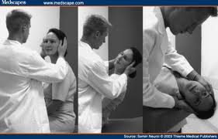
Hallpike maneuver

Slide 34
Hallpike maneuver
Have pt sit straight up with feet out in front
Make sure there is enough room behind them to lay flat, preferably allowing the head to hang off the table
Turn the head to the left or right at 45 degree angle (I usually start with the side I suspect)
Lay the patient back with head just slightly off the table (20 degrees), wait at least 30sec.

Slide 35
Hallpike maneuver
Looking for geotropic (towards the ear that’s down), rotary (torsional), nystagmus
Tends to stop within 10-15 seconds but may last longer
Allow pt to sit upright for at least 30 sec and repeat with the opposite ear down
Usually unilateral but it can be bilateral
Most commonly involves the posterior semicircular canal followed by the horizontal

Slide 36
Hallpike maneuver
Hallpike maybe negative if pt is at the end of an episode or if it’s involving the horizontal canal
If you have a positive result with one ear, treat that ear. If both ears then treat the one that makes pt most symptomatic.
80% of pts will respond to 1 treatment

Slide 37
BPPV
Treatment is by particle repositioning maneuvers (PRM)
  Epley maneuver (most commonly practiced)
  Semont maneuver
  Lempert maneuver
  Gufoni maneuver

Slide 38
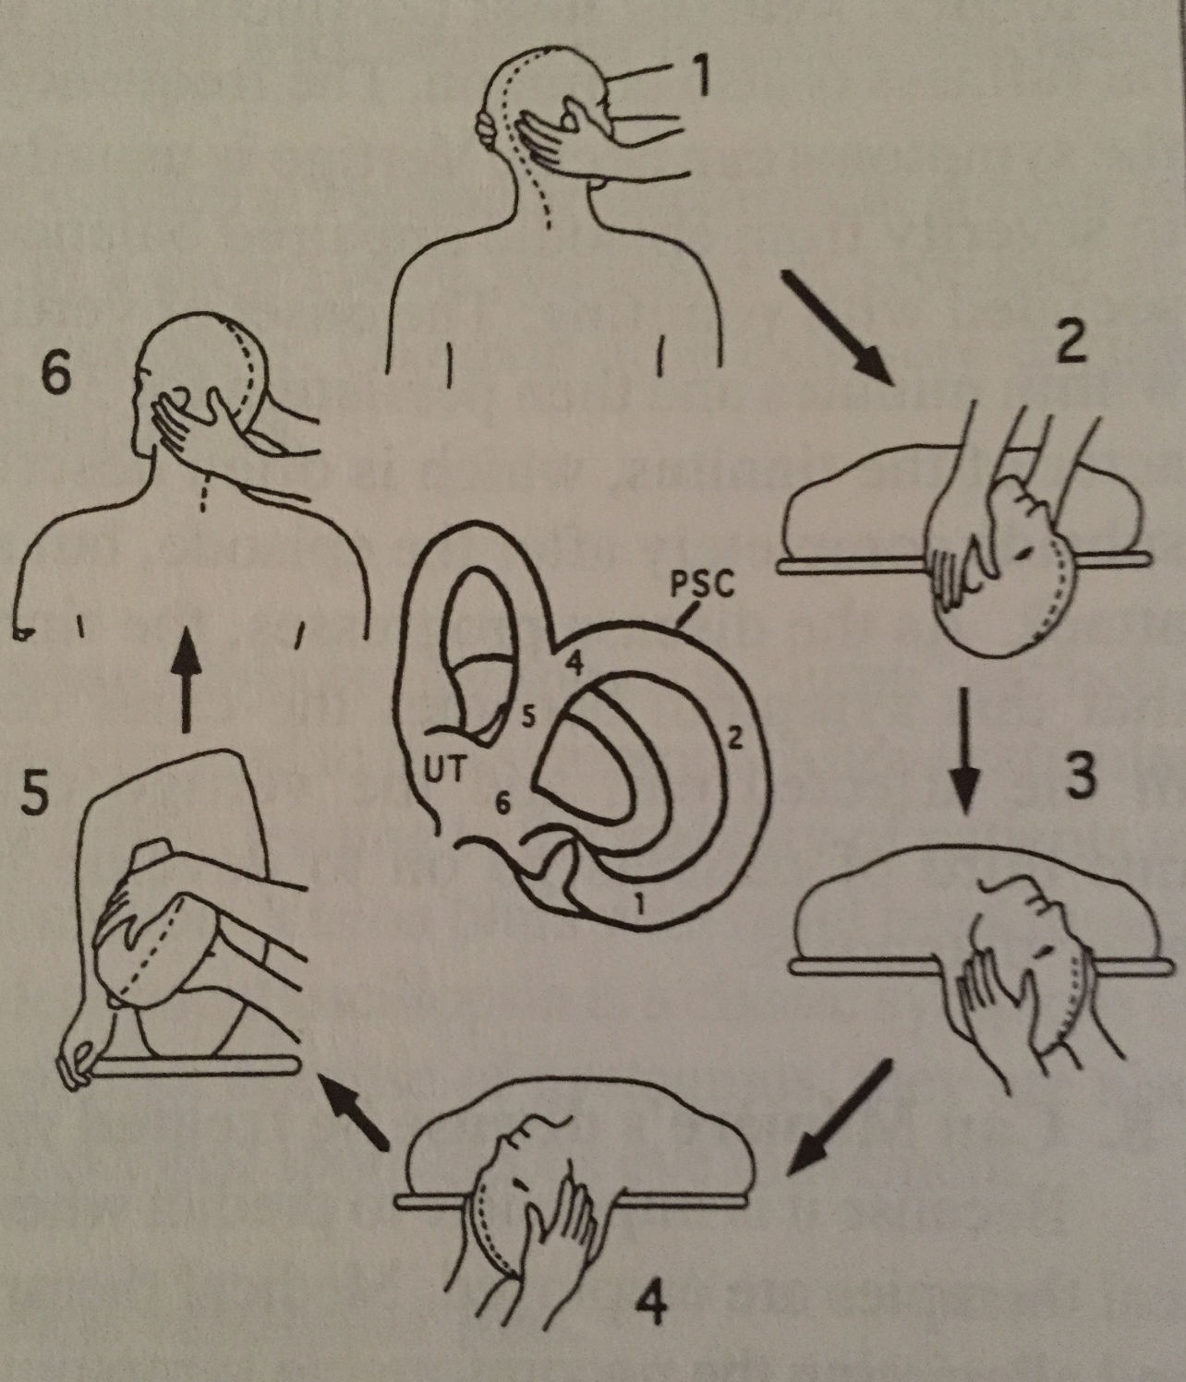
BPPV
Epley maneuver
1: Start similar to HP with affected ear down.
2: Wait 30sec or until asymptomatic for all stops
3: Turn head so nose to ceiling
4: Head opposite start position
5: Roll onto side of good ear and nose down
6: Slowly sit up

Slide 39
BPPV
Post maneuver instructions
  Stay upright (>45 degrees) for 48hours
  Keep head in neutral position for 1 week
    No quick head movements
    No looking to the extremes, up or down
  After one week patient may resume normal activities.
  If symptoms return, repeat and consider further workup or vestibular therapy

Slide 40
BPPV
This can be self limiting and may be recurrent
Meclizine does not work well for this disease
Can give patient at home exercises to help control symptoms (Brandt-Daroff)
  Doesn’t necessarily cure the disease but it does fatigue the vestibular system
  Use caution as patient may do incorrectly or if very symptomatic, may fall from surface

Slide 41
  Vestibular Neuritis/Labyrinthitis
Usually sudden onset, severe vertigo, lasting several hours to days
Second most common cause of otologic vertigo
Tends to be seen between 3 and 5th decades of life
Associated symptoms: nausea and vomiting

Slide 42
Vestibular Neuritis/Labyrinthitis
Nystagmus tends to be unilateral, continuous, and generally improves with fixation
These patients look sick, usually eyes closed, sitting still, and holding an emesis basin
No known predisposing factors
  Many patients have a history of a viral infection within 1 month of onset of symptoms

Slide 43
Vestibular Neuritis/Labyrinthitis
Diagnosis
  History
  Vestibular testing
  Imaging if Dx uncertain or symptoms persistent
Treatment-supportive
  Increase fluids
  Steroids
  CNS suppressants (Antivert, Ativan, Valium, Benadryl, Phenergan)

Slide 44
Vestibular Neuritis/Labyrinthitis
Treatment cont…
  Antivirals (literature doesn’t support their efficacy but frequently used)
  Antibiotics used if suspicious for bacterial labyrinthitis (may see pus in middle ear space)
  Vestibular rehab may be needed if patient fails to compensate/recover quickly

Slide 45
Meniere’s Disease
Presents with intermittent
  Aural fullness
  Tinnitus
  Fluctuating hearing loss (low frequency)
  Vertigo
Patients can have 1, some, or all these symptoms
Symptoms are acute onset and last 20min to several hours (usually less than 12)

Slide 46
Meniere’s Disease
Diagnosis
  History and physical (physical may be negative during latent phase of the disease)
  Audiogram (may see fluctuant nature of the hearing loss)
  Vestibular testing and Ecog (again may be neg if during latent phase)
  Imaging not typically helpful

Slide 47
Meniere’s Disease
Treatment
  Consider referral to ENT
  Will require serial audiograms
  Meds include diuretics, steroids (oral, transtympanic), cns suppressents
  Diet modification- avoid CATS (caffiene, alcohol, tobacco, and salt) and increase hydration
  Immunotherapy, Surgery, and external devices also used

Slide 48
Migraine with Vertigo
Patients present with episodic vertigo, imbalance, or foggy sensation
Often present with headache, but NOT ALWAYS
Symptoms often mimic Meniere’s disease
Diagnosis tends to be a diagnosis of exclusion

Slide 49
Migraine with Vertigo
Treatment
  Trigger avoidance
  Abortive therapy (Fioricet, triptans, Excedrin migraine)
  Preventative therapy (beta-blockers, calcium channel blockers, antidepressants, anti-seizure meds)

Slide 50
Central Etiology
If at any point you are concerned about a CVA, TIA, subdural/intracranial hemorrhage, seek emergency care and stoke work up
If non emergent, diagnostic studies after H&P Include:
  MRI
  Ct scan
  MR or CT angiogram
  Consider neurology referral
Treatment
  Diagnosis dependant

Slide 51
Peripheral N.S. Etiology
Work up for causes of peripheral neuropathy
Treatment for neuropathy or appropriate referral

Slide 52
Cardiovascular Etilogy
Diagnostic work up
  EKG
  Holter monitor
  Carotid ultrasound
  Orthostatics
  Arteriogram
  Echocardiogram
Treatment as appropriate or consider Cardiology referral

Slide 53
Endocrine/Meds and Drugs
Endocrine work up to look at thyroid, diabetes, pituitary, adrenal dysfunction.
Blood or urine drug screen
Exhaustive review of patients meds
Treat accordingly or consider Endocrinology referral

Slide 54
Summary
Have the DD in mind but don’t let it overwhelm you. You can come back to it once you have narrowed it down by system.
Narrow the DD by using the patients description of their symptoms and associated symptoms to choose a system to work up, i.e. cardio, neuro, otologic, endocrine, etc.
Thoroughly work up that system(s) and treat and or refer accordingly.

Slide 55
Questions?

Slide 56
THANK YOU!

