Slide 1
The Presentation of Maladaptive Postural Deviations in Young Children
Tara Fenamore, M.A.
Doctoral Candidate, 2021
Teachers College, Columbia University

Slide 2
BACKGROUND

Slide 3
RESEARCH PROPOSAL
Question
Do maturation and cognitive demand influence the presentation of forward head posture in children performing a graphomotor task?
Hypothesis
The occurrence of FHP will correlate positively with maturation and cognitive demand in typically developing subjects performing a graphomotor task.

Slide 4
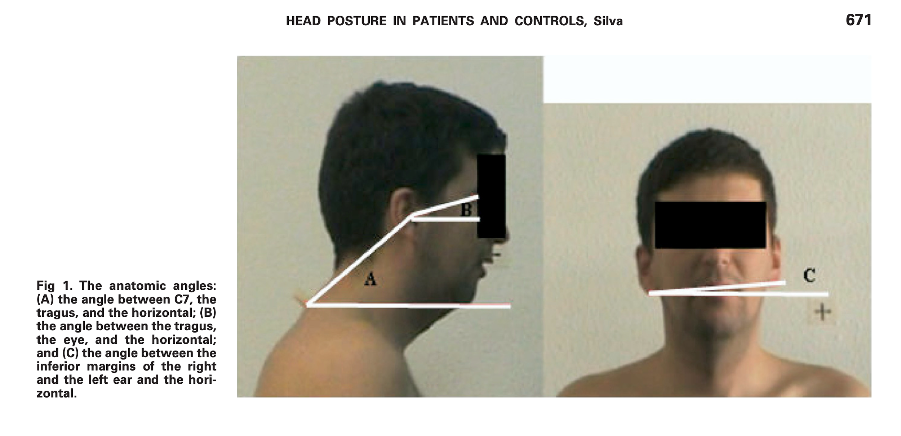
FORWARD HEAD POSTURE (FHP)
Anteriorization of the head and neck relative to the thoracic spine
Silva, A.G., Punt, T.D., Sharples, P., Vilas-Boas, J.P., & Johnson, M.I. (2009). Head posture and neck pain of chronic nontraumatic origin:
A comparison between patients and pain-free persons. Archives of Physical Medicine and Rehabilitation, 90(4), 669-674. https://doi.org/10.1016/j.apmr.2008.10.018.

Slide 5
STUDY AIMS
Evaluate the validity and reliability of a Postural Deviation Rating Scale
Track the occurrence of forward head posture in a child population to isolate a critical period of musculoskeletal vulnerability to postural deviation
Identify variables that shift the musculoskeletal system into a deviant and maladaptive attractor state in early childhood (Thelen & Smith, 1994)
Observe changes in postural alignment that occur as children transition from an unstable behavioral pattern to a stable behavioral pattern (Thelen, 2005)

Slide 6
QUALITATIVE MEASURE
Notes:
Interrater reliability will be measured to assess the validity of the rating scale as a measure of the dependent variable. Two secondary coders will be assigned 30% of the sampled participants. All coders will use the FHP rating scale that was developed for this study. The scale is based upon descriptions of FHP in studies that measured cervical-thoracic kinematics in adult populations (Baer, Vasavada, & Cohen, 2019; Silva et al., 2009). Photographs will also be provided to supplement the rating scale as a more concrete reference.

Slide 7
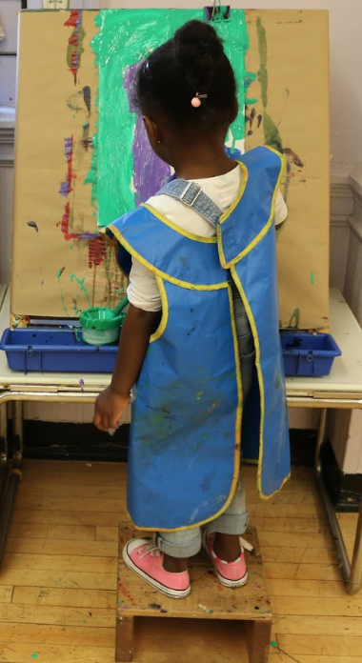
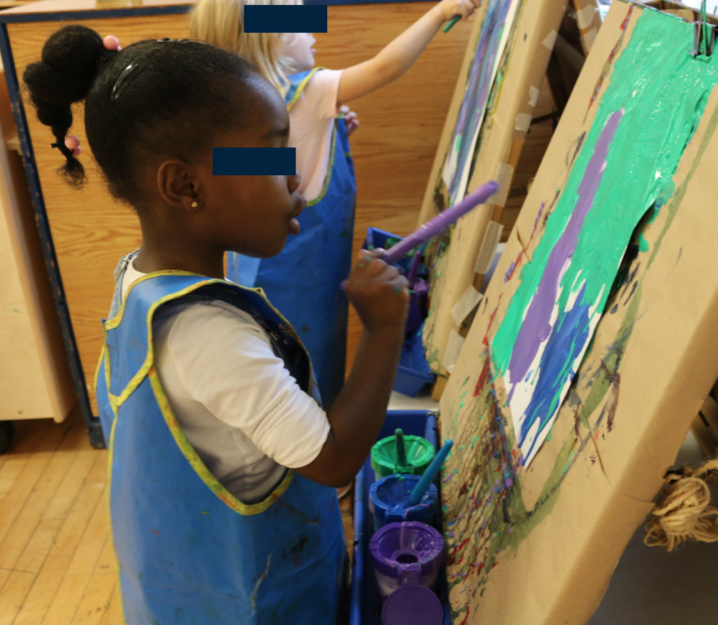
POSTURAL DEVIATION RATING SCALE
Rating | Sagittal Plane | Frontal Plane
0: None

Slide 8
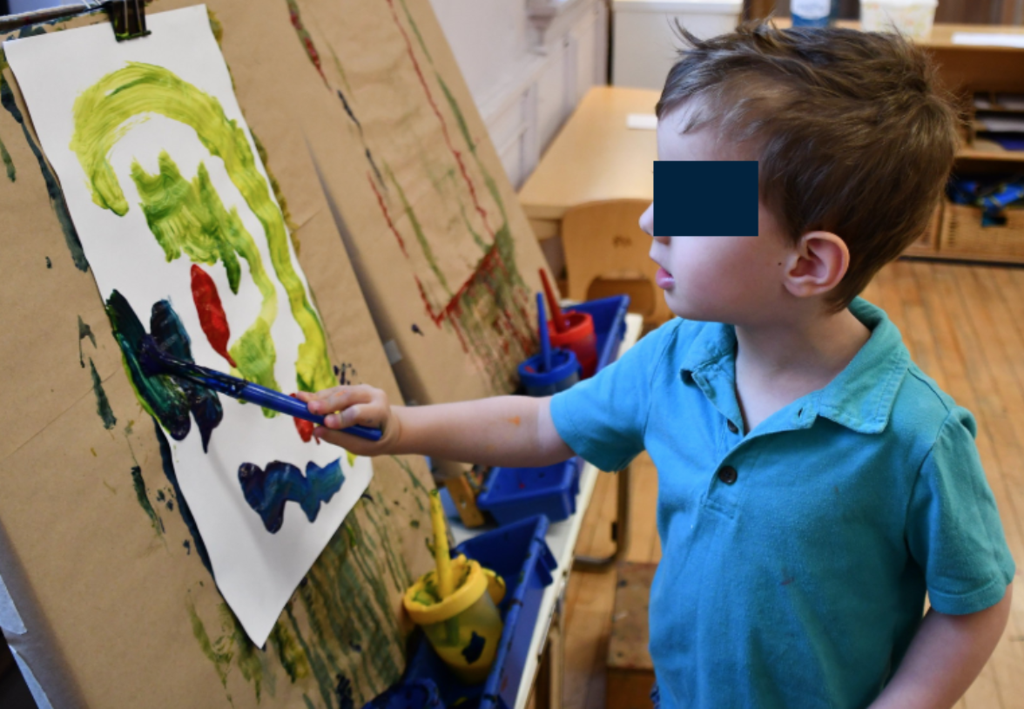
POSTURAL DEVIATION RATING SCALE
Rating | Sagittal Plane | Frontal Plane
1: Mild

Slide 9
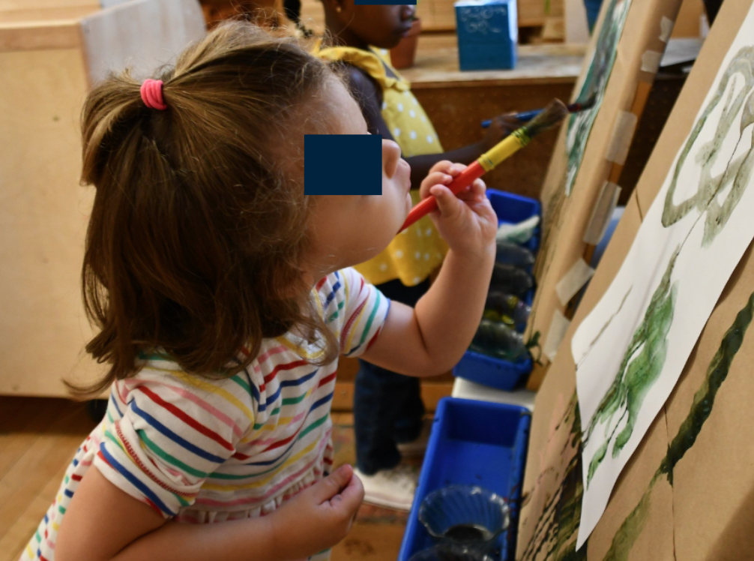
POSTURAL DEVIATION RATING SCALE
Rating | Sagittal Plane | Frontal Plane
2: Extreme

Slide 10
PARTICIPANTS
Group | Age | N = 14
Group 1 | 3-4 years | 7
Group 2 | 6-7 years | 7
Table 1. The proposed study will employ a cross-sectional, within-subjects design. Participants will be assigned to groups according to age.

Slide 11
EXPERIMENTAL CONDITIONS
Condition 1 | Low Cognitive Demand self-directed drawing task
Condition 2 | Medium Cognitive Demand NEPSY-II Visuomotor Precision Task
Condition 3 | High Cognitive Demand NEPSY-II Design Copying Task
Table 2. The proposed study will use a 2x3 within-subjects factorial design. The three conditions would be assigned to all participants in a blocked, counterbalanced order.

Slide 12
PSYCHOMETRIC MEASURE
NEPSY-II Selective Assessment Tool
Designed to assess neuropsychological development and cognitive ability of children aged 3-16
Evaluates child’s performance on tasks relative to age-mate peers
Notes:
6 Domains: memory and learning; executive functioning/attention; language; social perception; sensorimotor functioning; visuospatial processing
Selective assessment

Slide 13
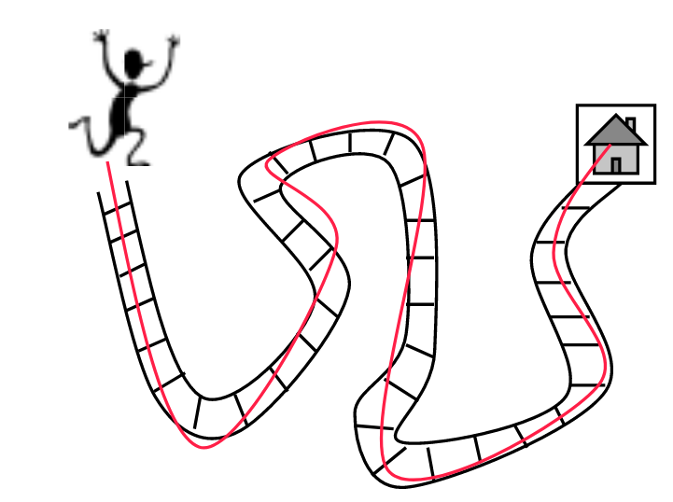
NEPSY-II SELECTIVE ASSESSMENT TOOL
Sensorimotor Functioning Domain
Test: Visuomotor Precision Test
assesses graphomotor speed & accuracy
https://www.txasp.org/assets/conference-materials/2015/miller_nepsyii_tasp.pdf

Slide 14
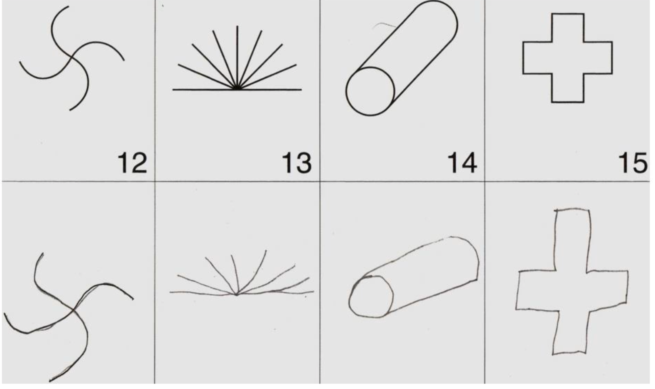
NEPSY-II SELECTIVE ASSESSMENT TOOL
Visuospatial Processing Domain
Test: Design Copying Task
Assesses motor and visual-perceptual
skills
https://www.txasp.org/assets/conference-materials/2015/miller_nepsyii_tasp.pdf

Slide 15
METHODOLOGY
Children will perform all tasks on a height-adjustable easel
Two digital video cameras will be used to collect data in the sagittal and frontal planes
Three trained research assistants will analyze the recordings and report the frequency, magnitude, and duration of forward head posture during the first 30 seconds of each task
Test inter-rater reliability of Postural Deviation Rating Scale scores
Statistical analysis to test for significant differences in group means with respect to maturation, cognitive demand, and forward head posture

Slide 16
FUTURE DIRECTIONS
Implementation of Postural Deviation Rating Scale in educational settings
Curriculum to guide the selection of adaptive psychomotor outcomes
Compare Postural Deviation Rating Scale scores with kinematic data using 3D Motion Capture technology

Slide 17
REFERENCES
Alexander, F.M. (1969). Evolution of a technique.​ ​In Edward Maisel (ed.) ​The resurrection of the body: The writings of F. Matthias
Alexander ​(pp. 139-160). New York, NY: Delta Publishing Co., Inc. (Original work published in 1932).
Alexander, F.M. (1910). ​Man’s supreme inheritance​. London, UK: MOURITZ.
Baer, J.L., Vasavada, A., & Cohen, R.G. (2019). Neck posture is influenced by anticipation of stepping. Human Movement Science, 64, 108-122. doi: https://doi.org/10.1016/j.humov.2019.01.010
Brattberg, G. (1994). The incidence of back pain and headache among swedish school children. Quality of Life Research, 3(1), 27-31. doi: 10.1007/BF00433372
Brooks, B., Sherman, E., & Strauss, E. (2010). NEPSY-II: A Developmental Neuropsychological Assessment, Second Edition. Child Neuropsychology, 16, 80–101. https://doi.org/10.1080/09297040903146966

Slide 18
REFERENCES
Dimon, T. (2015). ​Neurodynamics: The Art of Mindfulness in Action​. Berkeley, California: North Atlantic Books.
Dimon, T., & Brown, G.D. (2011). The body in motion: Its evolution and design. Berkeley, CA: North Atlantic Books.
Fiebert, I. M., Roach, K. E., Yang, S. S., Dierking, L. D., & Hart, F. E. (1999). Cervical range of motion and strength during resting and neutral head postures in healthy young adults. Journal of Back and Musculoskeletal Rehabilitation, 12(3), 165–178. https://doi.org/10.3233/BMR-1999-12304
Galbusera, F., & Wilke, H.J. (2018). Biomechanics of the spine: Basic concepts, spinal disorders and treatments. London, UK: Elsevier/Academic Press.
Haughie, L. J., Fiebert, I. M., & Roach, K. E. (1995). Relationship of Forward Head Posture and Cervical Backward Bending to Neck Pain. Journal of Manual & Manipulative Therapy, 3(3), 91–97. https://doi.org/10.1179/jmt.1995.3.3.91

Slide 19
REFERENCES
Huguet, A., Tougas, M.E., Hayden, J., McGrath, P.J., Stinson, J.N., & Chambers, C.T. (2016). Systematic review with meta-analysis of childhood and adolescent risk and prognostic factors for musculoskeletal pain. Pain, 157, 2640-2656. Doi: 10.1097/j.pain.0000000000000685
Korkman, M., Kirk, U., & Kemp, S. (2007). NEPSY-II: Clinical and interpretive manual. San Antonio, TX: The Psychological Corporation.
Magill, R., & Anderson, A. (2016). Motor Learning and Control: Concepts and Applications. Dubuque: McGraw-Hill Education.
Miller, D.C. (2015, Oct. 9). How to administer and interpret the NEPSY-II - Part I [Conference Session]. TAPS 2015 Convention, San Antonio, TX. https://www.txasp.org/assets/conference-materials/2015/miller_nepsyii_tasp.pdf
Silva, A.G., Punt, T.D., Sharples, P., Vilas-Boas, J.P., & Johnson, M.I. (2009). Head posture and neck pain of chronic nontraumatic origin: A comparison between patients and pain-free persons. Archives of Physical Medicine and Rehabilitation, 90(4), 669-674. https://doi.org/10.1016/j.apmr.2008.10.018.

Slide 20
REFERENCES
Thelen, E. (2005). Dynamical systems theory and the complexity of change. Psychoanalytic Dialogues, 15, 255-280.
doi: https://doi.org/10.1080/10481881509348831
Thelen, E., & Smith, L.B. (1994). ​A Dynamic Systems Approach to the Development of Cognition and Action. ​Cambridge, Massachusetts: MIT Press/Bradford Books.

