Slide 1
Academy of Medicine of Cincinnati
50 Year Physician Awards
Celebration
August 28, 2024
Special Thanks to Our Sponsor:
50 Year Physician Awards Presented on Behalf of the Ohio State Medical Association
Notes:
Good afternoon! I’d like to welcome all of you here on behalf of the Academy of Medicine Council and staff.
I am Jessica Sellar, the Academy’s Executive Director. It is such a pleasure to be with you all and share in the celebration of our honorees who have served the medical profession for 50 years.
This is one of my favorite events of the year. It brings us so much joy to witness colleagues and peers reconnect after many years “in the trenches” together. It is a constant source of inspiration to me to continue in our work at the academy in supporting the physician profession.

Slide 2
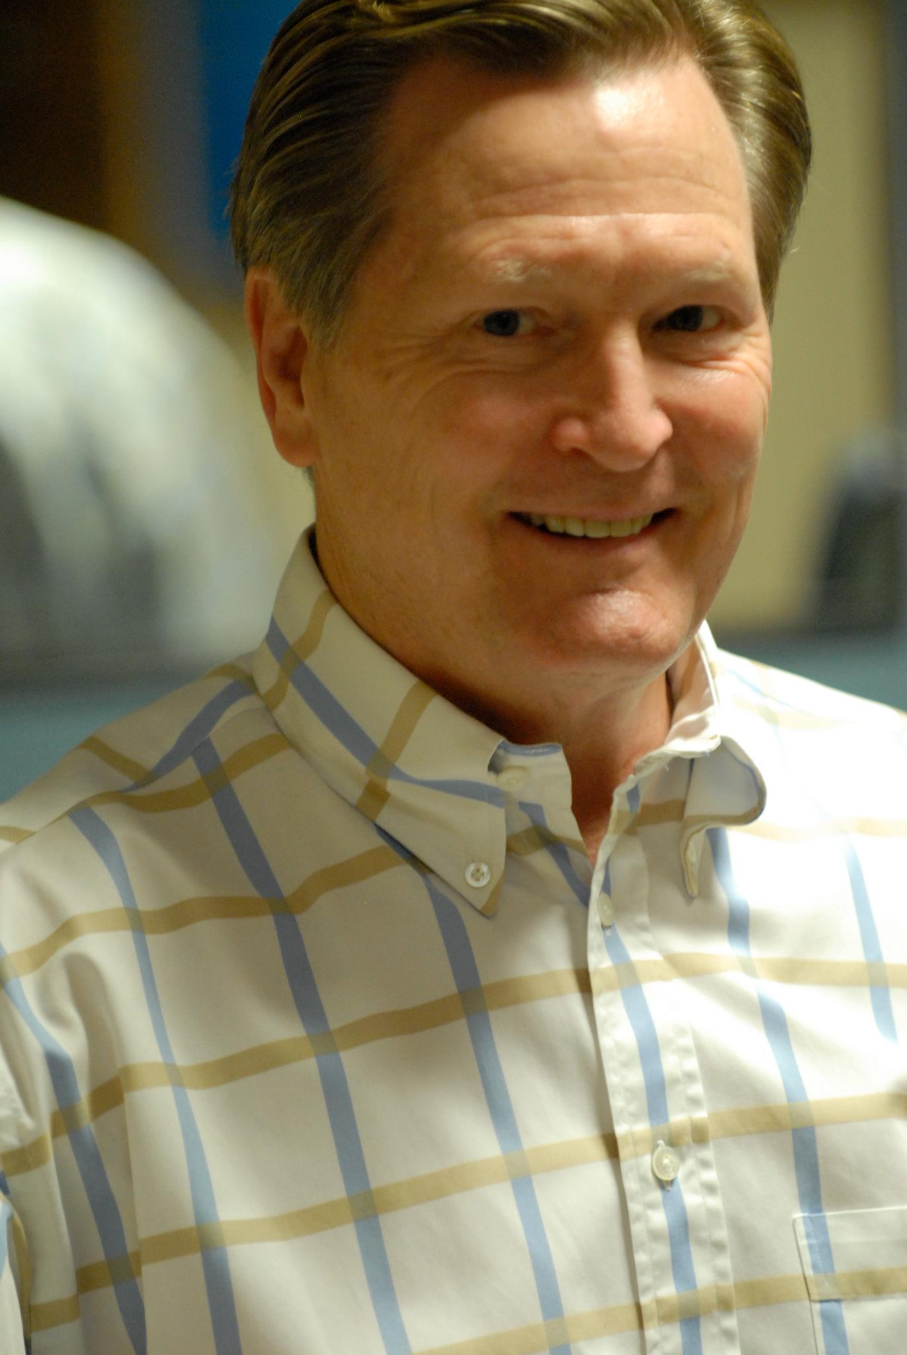
Miles J. Burke, MD
Pediatric Ophthalmology
Education & Training
MD – University of arizona College of Medicine, 1974
Residency – Department of Ophthalmology, University of Michigan Medical Center, Ann Arbor, MI 1975-78
Fellow – Pediatric Ophthalmology & Strabismus, Wills Eye Hospital, Philadelphia, PA 1978-79
Medical Practice Information
Director, Department of Pediatric Ophthalmology & Strabismus, Cincinnati Children’s Hospital Medical Center, 1979-98
Solo practice, 1998-present
Professional Associations
American Academy of Ophthalmology
American Association for Pediatric Ophthalmology & Strabismus
American Academy of Pediatrics
Notes:
Miles J. Burke, MD-Invite up Kathy Myers, Opthalmology Head Nurse at CCHMC
Miles J. Burke, MD, is a distinguished figure in the field of pediatric ophthalmology
-Dr. Burke earned his medical degree from the University of Arizona College of Medicine in 1974, and he went on to complete his residency in Ophthalmology at the University of Michigan Medical Center from 1975 to 1978.
-His pursuit of excellence continued with a fellowship in Pediatric Ophthalmology and Strabismus at Wills Eye Hospital in Philadelphia, where he honed his skills from 1978 to 1979.
-Dr. Burke's professional journey took him to Cincinnati Children’s Hospital Medical Center, where he served as the Director of the Department of Pediatric Ophthalmology & Strabismus from 1979 to 1998.
-at this time, Dr. Burke transitioned to solo practice, where he has continued to provide outstanding care to his patients to this day.
-Dr. Burke is an active member of several prestigious professional associations, including the American Academy of Ophthalmology, the American Association for Pediatric Ophthalmology & Strabismus, and the American Academy of Pediatrics. His involvement in these organizations reflects his dedication to advancing the field and improving patient outcomes.

Slide 3
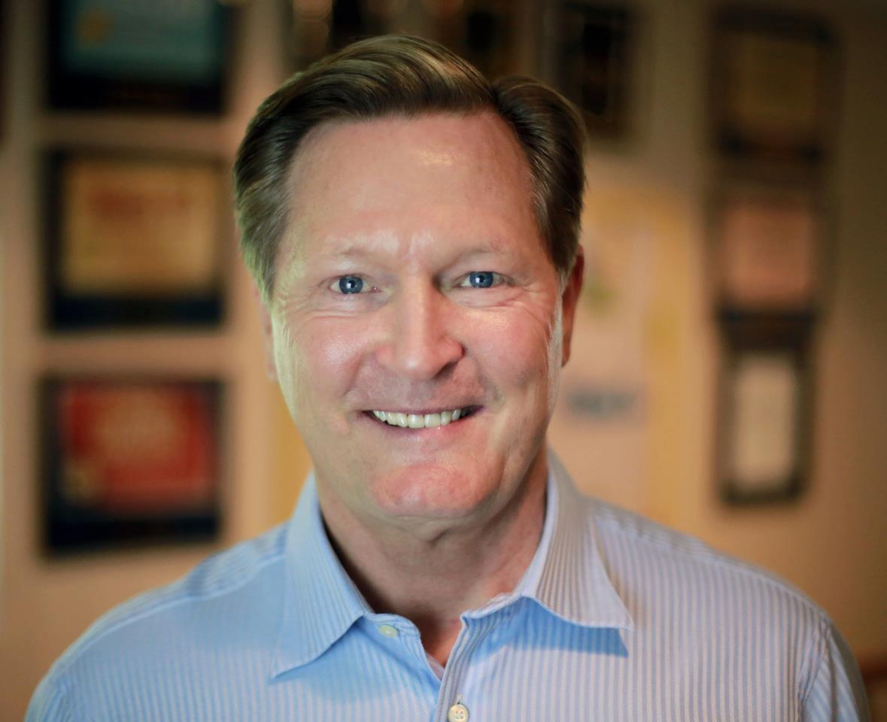
Miles J. Burke, MD
Pediatric Ophthalmology
Professional Awards:
America’s Top Doctors
Best Doctors in America
America’s Top Ophthalmologists
Patient’s Choice: Favorite Doctor
Patient’s Choice: Most Compassionate Doctor
Promptness “On time” Awards
Family
Married, 2 grown sons
Interests: family golf, physician fitness, photography, and wine
Notes:
-Throughout his career, Dr. Burke has been recognized with numerous accolades, including:
-being named as one of America’s Top Doctors, Best Doctors in America, and America’s Top Ophthalmologists.
-His commitment to compassionate care has also earned him the Patient’s Choice Favorite Doctor award, as well as recognition for promptness with “On Time” Awards
Outside of his professional life, Dr. Burke enjoys spending time with his family, including his wife and two grown sons. He is passionate about golf, maintains a commitment to fitness, and has a keen interest in photography and fine wine.
Dr. Miles J. Burke’s unwavering dedication to pediatric ophthalmology and his significant contributions to the field make him a truly deserving recipient of this distinguished award.
Here to share more on a personal level is his colleague, Kathy Myers, Opthalmology Head Nurse at CCHMC
(pleased to present with this 50 Year Award)
INVITE LIZ UP FOR NEXT QUESTION

Slide 4
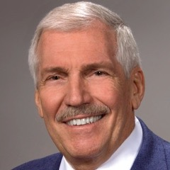
Lawrence E. Eynon, MD Diagnostic Radiology
Education & Training
BA – Ohio Wesleyan University, 1969
MD – University of Cincinnati College of Medicine, 1974
Internship – Dept. of Pediatrics, University of Cincinnati, 1974-75
Resident 1& 2 in Radiology – University of Cincinnati, Cincinnati General Hospital, 1975-77
Chief Resident 3 in Radiology, 1977-78
Staff Radiologist (Special Procedures) – University of Cincinnati Medical Center, 7-78 thru 10-78
Medical Practice Information
Private practice, Nuray Radiologists – Mercy Hospital Hamilton/Fairfield, 1978-2015
Columbus Radiology Corp. – Mercy Hospital Fairfield, 2015-16
Retired 5-2016
Notes:
Lawrence Enyon, MD
-The next of our honorees is Dr. Lawrence E. Eynon, a distinguished physician in the field of Diagnostic Radiology.
-Pursuant to undergraduate studies at Ohio Wesleyan University, Dr. Enyon earned his medical degree at the University of Cincinnati College of Medicine, graduating in 1974.
-This was followed by an internship in Pediatrics at the University of Cincinnati, and residency in Radiology at the University of Cincinnati and Cincinnati General Hospital
-I must assume Dr. Enyon gave up sleeping for the entire year of 1978, because it was at this time that he completed his Chief Residency served as Staff Radiologist for Special Procedures at UCMC, and transitioned to Private Practice at Nuray Radiologists.
-It was with NuRay that Dr. Enyon would continue to practice until 2015 when he transitioned for his last year of practice at Columbus Radiology Corp before retirement in May of 2016

Slide 5
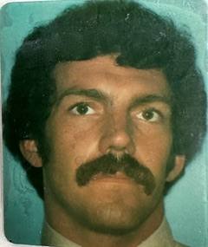
Lawrence E. Eynon, MD Diagnostic Radiology
Highlight of Medical Career:
Installing the first 1.5 Tesla MRI unit in the tri-state region (May 1985)
Advice to New Physicians
Keep an open mind and focus on your future goals, one day at a time.
Family
Married - 1 son 48 & 1 daughter 50.
Notes:
-Dr. Enyon recalls the highlight of his career taking place in 1985, when he installed the first 1.5 Tesla MRI Unit in the Tristate region. And no, I checked, no relation to the car (thank you Google). Tesla is the unit of measurement used to describe the strength of a scanner's magnetic field. For reference: While the very first commercially available MR systems operated at field strengths between 0.3 and 0.6 Tesla (T) using permanent magnets, cryogenically cooled, superconducting 1.5T systems were introduced in rapid succession in 1985 and subsequently dominated the market as the standard for clinical imaging. Dr. Enyon’s installation of this advanced technology was a landmark achievement that significantly advanced diagnostic imaging in the area.
-BUT, Dr. Eynon’s career is marked not only by his technical expertise but also by his wise advice for future generations of physicians. His counsel to “keep an open mind and focus on future goals, one day at a time,” reflects his thoughtful and patient-centered approach to medicine.
Beyond his professional achievements, Dr. Eynon values his family life deeply. He is married and is the proud father of a son and a daughter, aged 48 and 50, respectively.
Dr. Eynon, on behalf of everyone here, we extend our deepest gratitude and congratulations for your remarkable career. We are honored to present you with this award in recognition of your half-century of excellence in medicine.
[Presenter hands the award to Dr. Eynon.]
INVITE LIZ UP

Slide 6
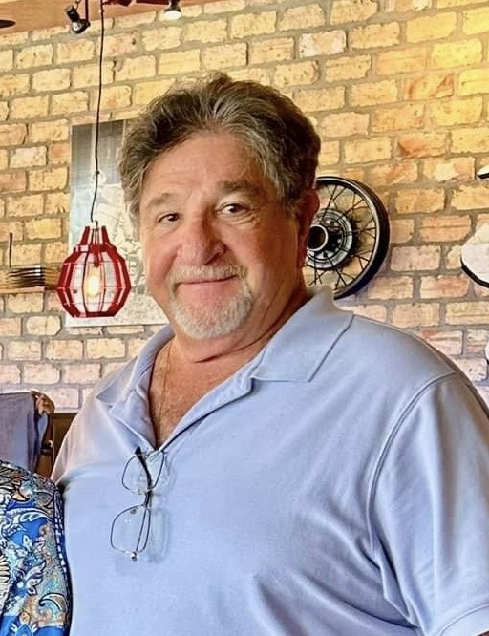
Oran Daniel Fox, MD
Orthopaedic Surgery
Education & Training:
BS (Cum Laude) – University of Cincinnati, 1971
MD – Ohio State University College of Medicine, 1974
Internship – Grady Memorial Hospital, 1974-75
Orthopaedic Residency – Ohio State University, 1975-79
Medical Practice Information:
Private practice of Orthopaedic Surgery in Cincinnati, 1979-2012
Northwest Orthopaedics, 1979-95
Orthopaedic Associates, 1995-97
Beacon Orthopaedics & Sports Medicine, 1997-2013
Retired in 2013 and moved to FL
Worked as an independent contractor for 21st Century Oncology in Estero, FL until full retirement in 2018
.
Notes:
Oran Daniel Fox, MD (invite Albert Weisbrot up)
Dr. Oran Daniel Fox is a highly accomplished orthopaedic surgeon whose distinguished career has spanned several decades and two states. He earned his Bachelor of Science degree, cum laude, from the University of Cincinnati in 1971 and his medical degree from Ohio State University College of Medicine in 1974. Following his graduation, he completed his internship at Grady Memorial Hospital and an orthopaedic residency at Ohio State University from 1975 to 1979.
In 1979, Dr. Fox began his private practice in Orthopaedic Surgery in Cincinnati. He served with distinction at Northwest Orthopaedics until 1995, followed by Orthopaedic Associates until 1997, and Beacon Orthopaedics & Sports Medicine until his retirement in 2013. After relocating to Florida, he continued his medical practice as an independent contractor for 21st Century Oncology in Estero, FL, until he fully retired in 2018.

Slide 7
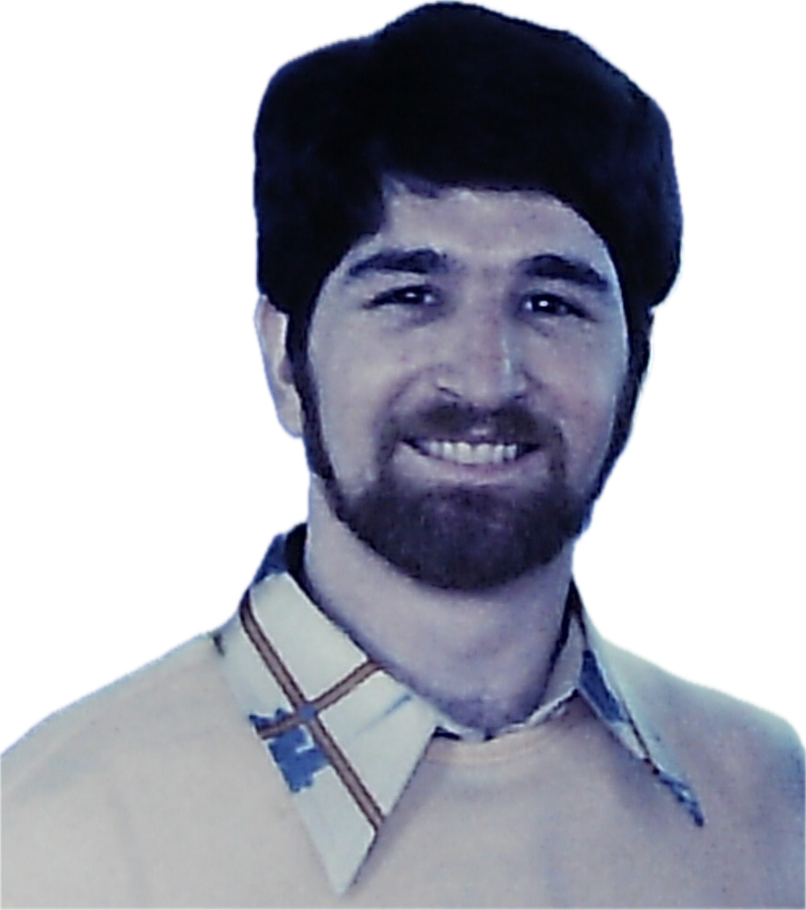
Oran Daniel Fox, MD
Orthopaedic Surgery
Highlight of Medical Career:
Member of American Academy of Orthopaedic Surgery, American Medical Association, and Florida Medical Society
Past president of Yavneh Day School Board, 1990-91, and Temple Judea of Ft. Myers, FL, 2023-2024
Board Certified in Orthopaedic Surgery, 1981
Advice for New Physicians:
Our role as I see it now is service in all aspects of our lives, not just the practice of medicine
Family:
Married Ellen Turner in 1973; 4 children, 5 grandchildren
Notes:
Throughout his career, Dr. Fox has been a dedicated member of several professional organizations, including the American Academy of Orthopaedic Surgery, the American Medical Association, and the Florida Medical Society. He achieved board certification in Orthopaedic Surgery in 1981. Beyond his professional life, he has contributed to his community as a past president of the Yavneh Day School Board and Temple Judea of Ft. Myers, FL.
The career highlights noted by Dr. Fox are reiterated in his advice for new physicians when he says “Our role as I see it now is service in all aspects of our lives, not just the practice of medicine.”
Married to Ellen Turner since 1973, Dr. Fox is the proud father of four children and the grandfather of five grandchildren.
Here to share more is Dr. Weisbrot
(PRESENT AWARD)
Invite LIZ

Slide 8
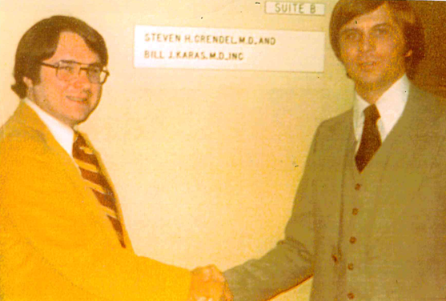
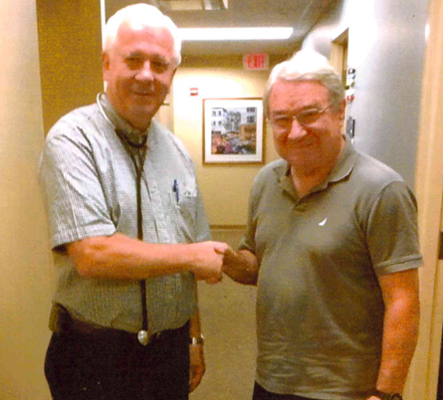
Steven Grendel, MD
Internal Medicine
Education & Training
BA – Hiram College, 1970
MD – University of Cincinnati College of Medicine, 1974
Medical Practice Information
Practice with Bill J. Karas, MD, 1977-2014
Highlight of Medical Career:
Medical residency at Good Samaritan Hospital (best time of my life)
Academy of Medicine, Medi-Club and CME trips
Best Advice Received/Advice to New Physicians
The practice of medicine is an honorable profession; keep it that way!
Family
Wife Sue; 5 children: Geoff, Jenny, Michael, Amy Soder, and Brian Soder (dec.); 7 grandchildren

Slide 9
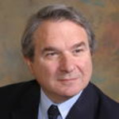
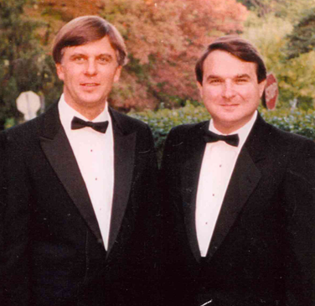
Bill Karas, MD
Internal Medicine
Education & Training
BA – Ohio Wesleyan University, 1969
MD – University of Cincinnati College of Medicine, 1974
Internship – Dept. of Pediatrics, University of Cincinnati, 1974-75
Resident 1& 2 in Radiology – University of Cincinnati, Cincinnati General Hospital, 1975-77
Chief Resident 3 in Radiology, 1977-78
Staff Radiologist (Special Procedures) – University of Cincinnati Medical Center, 7-78 thru 10-78
Medical Practice Information
Practiced with Steve Grendel, MD in Lebanon for many years
Family
Wife Lynn; 1 daughter, Lauren (42), Director of Education at the US Holocaust Memorial Museum; 2 grandchildren

Slide 10
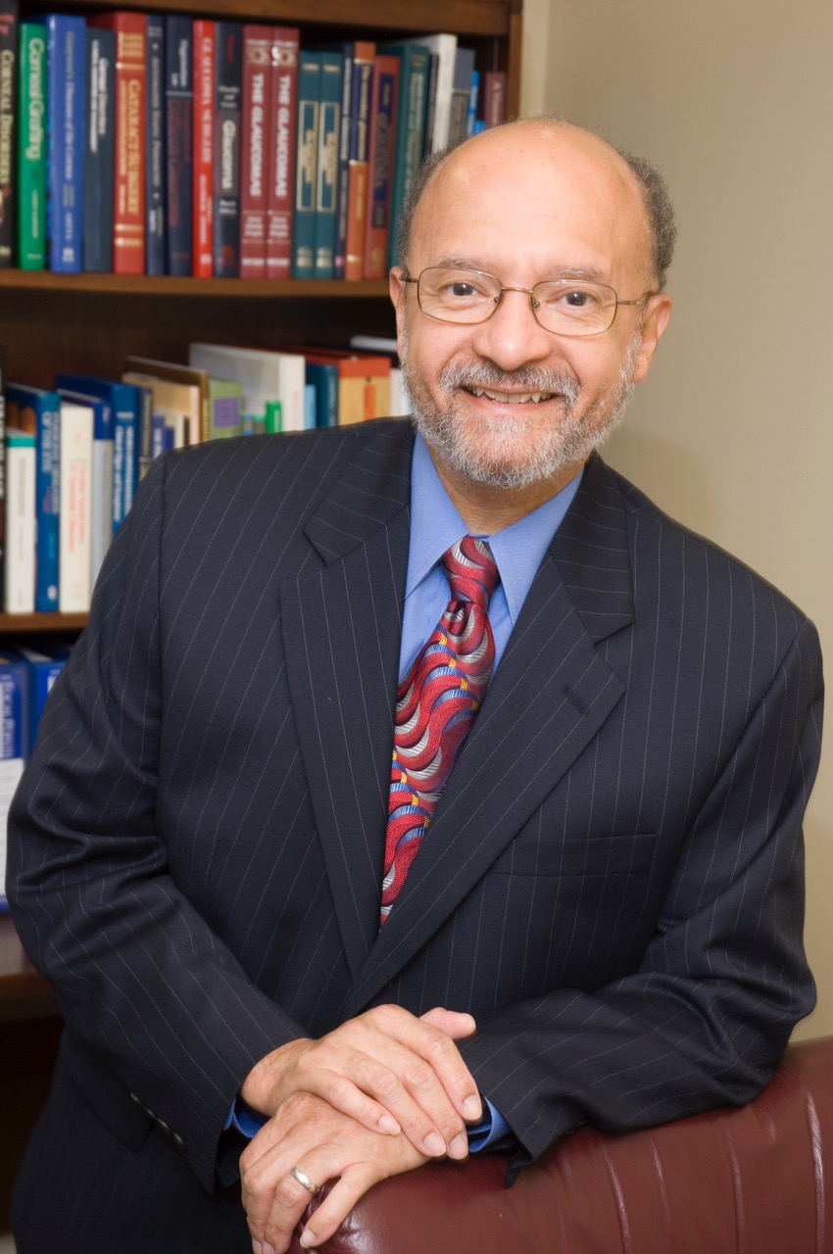
Leon A. Reid, III, MD
Ophthalmology
Education & Training
BS – Virginia Union University, 1970
MD – Meharry Medical College, 1974
Internal Medicine Residency – District of Columbia General Hospital, 1974-1975
Ophthalmology Residency – Howard University Hospital, 1975-1978
Medical Practice Information
Solo practice: Richmond, VA, 1978-80; Cincinnati, 1980-1997
Apex Eye, 1997-2019; Cincinnati Eye Institute, 2019-2023; UC Physicians, 2023-present
Notes:
Leon Reid-Ask Dr. Henderson to Join
-Dr. Leon A. Reid, III, is a distinguished ophthalmologist whose path to the profession began with a Bachelor of Science degree from Virginia Union University in 1970, followed by his medical degree from Meharry Medical College in 1974.
Dr. Reid's early training included an Internal Medicine Residency at District of Columbia General Hospital from 1974 to 1975, before he pursued his passion for ophthalmology through a Residency at Howard University Hospital, where he trained from 1975 to 1978.
In 1978, Dr. Reid began his solo practice in Richmond, Virginia, before relocating to Cincinnati in 1980. There, he continued his solo practice until 1997, when he joined Apex Eye. His career further evolved with his tenure at Cincinnati Eye Institute from 2019 to 2023, and he is currently serving with UC Physicians.

Slide 11
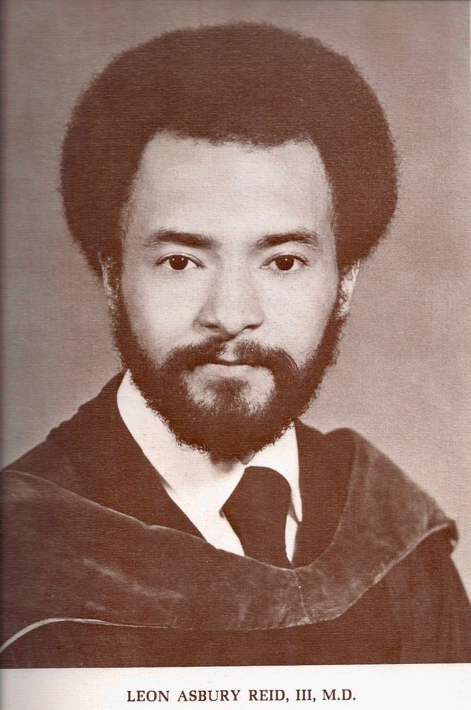
Leon A. Reid, III, MD
Ophthalmology
Highlight of Medical Career:
During my first year of medical school, I spent a month with the Department of Ophthalmology. The Chairman, Dr. Axel Hansen, was truly inspirational and the joy that he exhibited in his work was truly contagious.
Advice to New Physicians
In the current practice environment, which focuses on increasing productivity and efficiency, never lose your focus on your patient. Do not hesitate to call on your colleagues for advice in those difficult cases.
Family
Married to Alva Reid, RN, PhD; 3 grown children and 4 grandchildren
Notes:
A notable highlight of Dr. Reid's medical career was his first-year experience in medical school, where he spent a month with the Department of Ophthalmology. He described the inspiration and joy of the work that was exhibited by the Chairman, Dr. Axel Hansen, as truly contagious.
-Dr. Reid’s professional philosophy & advice to new physicians is one I wish I could be inscribed in page 1 of Medicine 101. He says “In the current practice environment, which focuses on increasing productivity and efficiency, never lose your focus on your patient. Do not hesitate to call on your colleagues for advice in those difficult cases.”
Outside of his professional life, Dr. Reid is married to Alva Reid, RN, PhD, and they have three grown children and four grandchildren. Here to share more on Dr. Reid is Dr. Clyde Henderson…
Dr. Henderson, a few words…
CONGRATULATE, PRESENT
LIZ INVITE UP

Slide 12
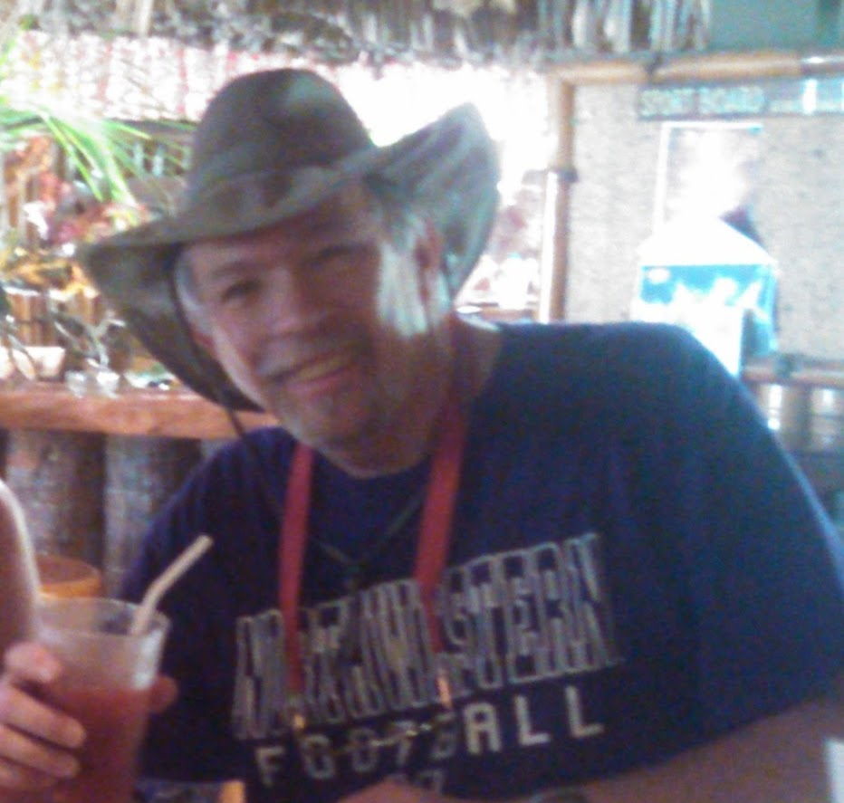
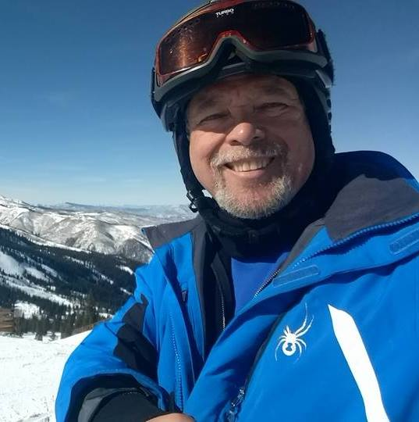
Andrew M. Roth, MD
Orthopaedic Surgery (Spine & Total Joint)
Education & Training
BA – Northwestern University, 1970
MD – University of Kentucky, 1974
General Surgery Internship – University of Pittsburgh Medical Center, 1974-75
Orthopaedic Research Fellowship – Rancho Amigos Hospital/USC Medical Center, Los Angeles, CA, 1975-76
Orthopaedic Surgery Residency – University of Cincinnati Medical Center, 1976-80
Medical Practice Information
Freiberg Orthopaedics & Sports Medicine, Cincinnati, 1980-2010
TCH Physicians, Orthopaedics & Sports Medicine, Cincinnati, 2010-13
Hospital appointments: Jewish, Bethesda Oak & North, Mercy Mt. Airy, The Christ Hospital, Cincinnati Childrens Hospital Medical Center, 1980-99
Highlight of Medical Career:
The best part of my medical career was the friendships made with my office staff, the hospital nursing and OR staffs, and fellow physicians I met along the way. I suppose the highlight in med school was when I was on call with the orthopaedic intern, at the very end of my third year. It completely changed my professional choice, deciding to pursue orthopaedics and not ob/gyn (…just imagine!)
Notes:
Andy Roth, MD (invite Lee Shaftel MD up)
-I am also honored to recognize Dr. Andrew M. Roth for his extraordinary achievement of 50 years in the field of medicine.
-I am also incredibly nervous to do because he flew all the way from California for this, so the pressure is on!
-Following his Bachelor’s at Northwestern University in 1970, Dr. Roth earned his medical degree from the University of Kentucky in 1974.
-From there, Dr. Roth held a General Surgery Internship at the University of Pittsburgh Medical Center, an Orthopaedic Research Fellowship at Rancho Amigos Hospital/USC Medical Center, and an Orthopaedic Surgery Residency at the University of Cincinnati Medical Center.
In 1980, Dr. Roth began his medical practice at Freiberg Orthopaedics & Sports Medicine in Cincinnati, where he served with dedication and skill for 30 years.
-He continued his career with TCH Physicians, focusing on orthopaedics and sports medicine until 2013.
-His contributions extended to several prominent hospitals, including Jewish, Bethesda Oak & North, Mercy Mt. Airy, The Christ Hospital, and Cincinnati Children’s Hospital Medical Center.

Slide 13
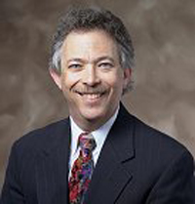
Andrew M. Roth, MD
Orthopaedic Surgery (Spine & Total Joint)
Advice to New Physicians
The best advice is to choose where you want to live and have your family. Do not just take the first offer that you may receive. There is always room for another doctor, in just about every city and town. (And, engage a professional financial advisor early in your career and let them make the investments. Doctors generally make horrible investment and business decisions!)
Family
We married in 1976 and have 4 adult children, all born in Cincinnati, and 5 grandchildren. We retired in late 2013 and moved back to Los Angeles in December 2016. Our oldest daughter is married with 3 daughters and lives in Atlanta. Our married youngest son has 2 kids and lives in Los Angeles. Our other son and daughter each live in/near Washington, DC.
Notes:
-In reflecting on career highlights, Dr. Roth recalled a profound experience at the very end of his 3rd year of med school when he was on call with the orthopaedic intern. The experience completely changed his professional choice, deciding to pursue orthopaedics and not ob/gyn (…just imagine!)
-Overall, however, Dr. Roth says the highlight throughout his career has been friendships made with office staff, hospital nursing and OR staff, and fellow physicians met along the way.
- Dr.Roth’s words of wisdom for aspiring physicians—is to choose a practice location that aligns with personal and family goals rather than simply accepting the first offer. As he puts it “There is always room for another doctor, in just about every city and town.” He also advises new doctors to seek the guidance of a professional financial advisor to navigate the complexities of investment and business decisions because quote “Doctors generally make horrible investment and business decisions!”
-Beyond his professional achievements, Dr. Roth’s personal life reflects the same commitment and dedication. Married in 1976, he and his wife have raised four wonderful children, all born in Cincinnati, and are blessed with five grandchildren. Since retiring in 2013, Dr. Roth and his family moved back to Los Angeles in 2016, where they continue to enjoy life together. His family includes their oldest daughter in Atlanta, their youngest son in Los Angeles, and two other children near Washington, DC.
I am pleased to now ask Dr. Roth’s friend, Dr. Lee Shaftel, to share a few words…
CONGRATS AND AWARD
Invite liz up

Slide 14
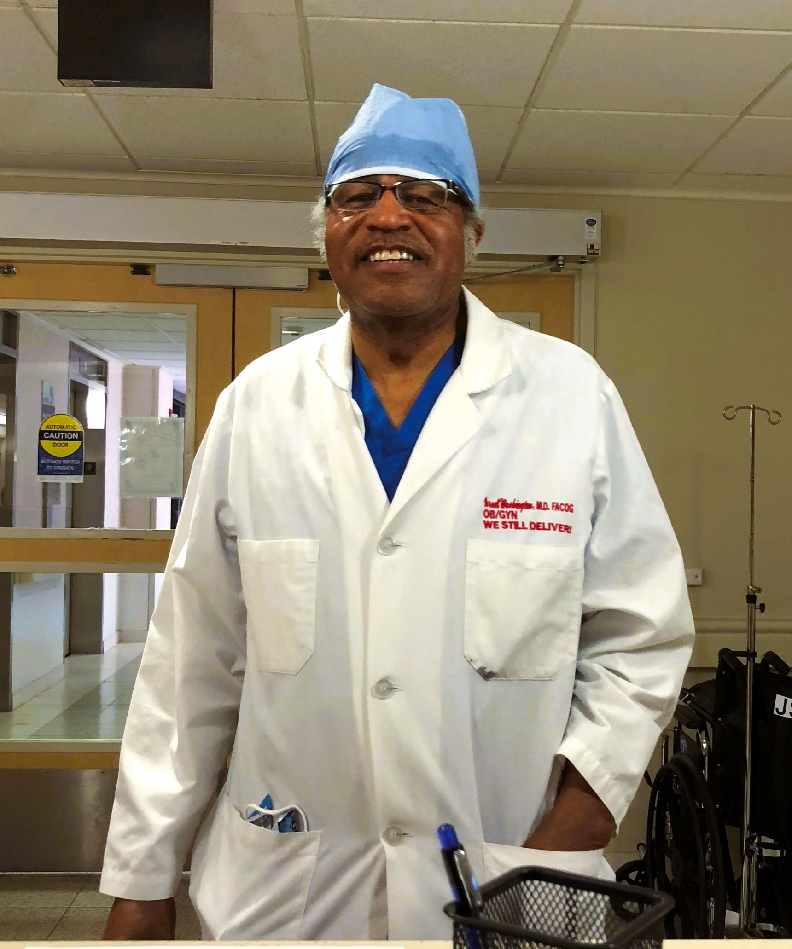
Israel Washington, MD
Obstetrics & Gynecology
Education & Training
Medical School at University of Alabama School of Medicine Class of 1974
Residency in Obstetrics & Gynecology at University Hospital
Fellow, American Congress of Obstetrics & Gynecology
Medical Practice Information
Sole Proprietor Practice
Affiliated with TCH
Notes:
Israel Washington-invite dr. Elbert Nelson
is board certified in obstetrics and gynecology.
Dr. Washington earned his medical degree from the University of Alabama at Birmingham (Shandong medical college? Dr. Israel Washington, MD | Obstetrician / Gynecologist (OBGYN) in Cincinnati, OH (everydayhealth.care)) and completed his residency at University Hospital in Cincinnati, OH.
From there, he established his practice which has served the community for decades.
I can’t say I know Dr. Washington well, though I’ve had the privilege of meeting him a few brief times. A google search will not turn up a whole lot either. But his lack of “digital presence” actually only confirms his pure focus on excellent patient care. A physician peer recently described him as treating generations of families-when a patient’s trust is so great she insists her sisters, aunts, daughters, seek his care. His legacy can be found in the community rather than a website.
In glowing reviews, his patients have shared:
“Dr. Washington delivered my Daughter 25 years ago. Now he is her doctor. I love how he educates as well as treat and care for you”
“Dr. Israel Washington is a super blessing to all. His bedside manner is personal and genuine. He makes you feel comfortable enough to talk to him. He cannot retire until I don't need him anymore. Thank you Dr. WASHINGTON.”
“I have been a pt. of Dr. Washington for 32 years, When I first came to this country. He delivered all of my Children, and my daughter now goes to him. I love you Dr. Washington, and thanks so much for your years of service to my family and I. God Bless you”
“I have known Dr Wasington for more than 35 years as a professional colleague. I have been his patient for more than 27 years. My daughter who is expecting my first granddaughter has chosen him as her OB, and I can not think of a better recommendation. “
And in the age of texting and Twitter where we now replace words with emojis, perhaps this patient summed it up best: 👑

Slide 15
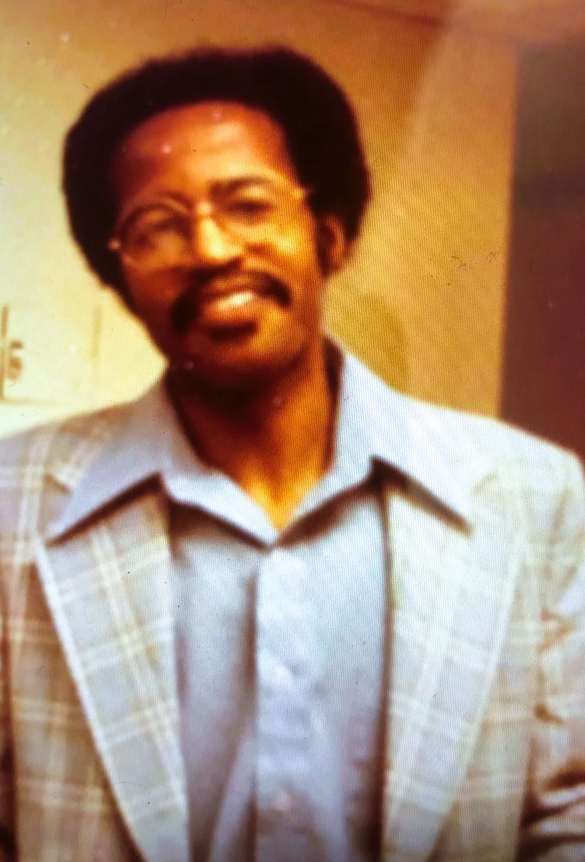
Israel Washington, MD Obstetrics & Gynecology
Patient Testimonials:
“Dr. Washington delivered my daughter 25 years ago. Now he is her doctor. I love how he educates as well as cares for you.”
“Dr. Washington is a super blessing to all. His bedside manner is personal and genuine. He makes you feel comfortable enough to talk to him. He cannot retire until I don’t need him anymore. Thank you Dr. Washington!”
“I have been a patient of Dr. Washington for 32 years. When I first came to this country. He delivered all of my children, and my daughter now goes to him. I love you Dr. Washington, and thanks so much for your years of service to my family and I. God Bless You.”
“I have known Dr. Washington for 32 years as a professional colleague. I have been his patient for more than 27 years. My daughter who is expecting my first granddaughter has chosen him as her OB, and I cannot think of a better recommendation.”
Notes:
Now that we know how his patients feel, I’m pleased his colleague and friend Dr. Nelson is here to share.
PRESENT AWARD
Invite LIZ UP

Slide 16
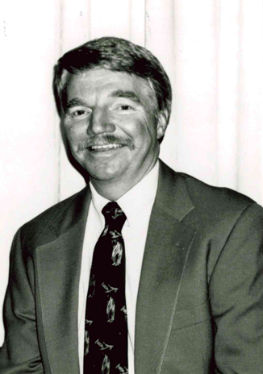
Barry Webb, MD
Family Practice
Education & Training
MD – University of Cincinnati College of Medicine, 1974
Family Practice Residency – University of Maryland, 1974-77
Medical Practice Information
Started practice 9-1-77 in Glendale with Tom Todd, MD
Incorporated to Springdale Family Medicine in 1978
Joined Mercy Health Partners in 2009
Highlight of Medical Career
My entire medical career has been a highlight. From medical school I have dear friends for life.
Notes:
-It is with great pleasure that I introduce Dr. Barry W. Webb, a dedicated family practice physician whose career spans over five decades of exemplary service and care.
-Dr. Webb earned his medical degree from the University of Cincinnati College of Medicine in 1974, followed by a Family Practice Residency at the University of Maryland, which he completed in 1977.
-He began his medical practice on September 1, 1977, in Glendale, partnering with Dr. Tom Todd. He incorporated his practice into Springdale Family Medicine in 1978, and later joined Mercy Health Partners in 2009. Throughout his career, Dr. Webb has demonstrated a deep commitment to his patients and has played a vital role in the community he serves.
-Reflecting on his medical career, Dr. Webb considers the entirety of his professional journey as a highlight. He cherishes the lifelong friendships he made during medical school, which continue to enrich his life.
-Dr. Webb offers 2 pieces of valuable advice to new physicians. First, He emphasizes that “to be a successful doctor you need to have 4 ‘A’s – affability, affordability, availability, and ability” Second, he shares a piece of advice that as a mom, stopped me in my tracks when I read it “to have successful children you need to give them roots and give them wings.” I’ll be saving that one.
-On a personal note, Dr. Webb and his wife, Karen, recently celebrated their 54th wedding anniversary, having started their marriage just two weeks before medical school began. Together, they have raised four children and are the proud grandparents of thirteen grandchildren. Dr. Webb describes them all as the apples of his eyes and the loves of his life.
What I do not want to overlook is the contributions Dr. Webb made to his peers through service to organized medicine. In fact, his leadership of the Academy of Medicine as president in 1999-2000 was so impactful, we begged him to serve again in 2010-2011. With that in mind, I’d now like to welcome up Academy President Joe Cheng to share some of Dr. Webb’s contributions.

Slide 17
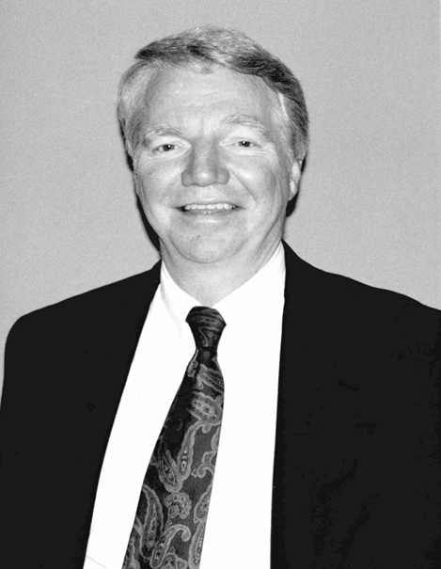
Barry Webb, MD
Family Practice
Advice to New Physicians
Two pieces of advice: 1) to be a successful doctor you need to have 4 ‘A’s – affability, affordability, availability, and ability; 2) to have successful children you need to give them roots and give them wings.
Family
Karen and I just celebrated our 54th wedding anniversary, starting marriage two weeks before medical school started. We have 4 children and 13 grandchildren, all of whom are the apples of my eyes and the loves of my life.
Physician Association Leadership
President, Academy of Medicine, 1999-2000
President, Academy of Medicine, 2010-2011
Notes:
-Dr. Webb offers 2 pieces of valuable advice to new physicians. First, He emphasizes that “to be a successful doctor you need to have 4 ‘A’s – affability, affordability, availability, and ability” Second, he shares a piece of advice that as a mom, stopped me in my tracks when I read it “to have successful children you need to give them roots and give them wings.” I’ll be saving that one.
-On a personal note, Dr. Webb and his wife, Karen, recently celebrated their 54th wedding anniversary, having started their marriage just two weeks before medical school began. Together, they have raised four children and are the proud grandparents of thirteen grandchildren. Dr. Webb describes them all as the apples of his eyes and the loves of his life.
What I do not want to overlook is the contributions Dr. Webb made to his peers through service to organized medicine. In fact, his leadership of the Academy of Medicine as president in 1999-2000 was so impactful, we begged him to serve again in 2010-2011. With that in mind, I’d now like to welcome up Academy President Joe Cheng to share some of Dr. Webb’s contributions.
Invite Cheng Up:
President, Academy of Medicine 1999
-Led development of “Discover Health!”, a program that traveled across eight counties visiting 2nd-4th graders to teach them about healthy life styles.
-Helped form a new set of “Unified Clinical Guidelines” from the ground up, showing how managed care and organized medicine can work together.
-Engaged the Academy in supporting efforts to recruit and retain underrepresented minority physicians to Cincinnati. This would evolve into the focus of The Doctor’s Foundation, which was funded via a class action lawsuit led by the Academy. The Doctors Foundation continues mission today.
President, Academy of Medicine 2010-2011
-Served during formation of Project Access (need a line on what this is), gaining support from hospital systems,
-helped the Academy pivot when OSMA ceased their dual membership structure with county societies
Understanding the challenges of this role and uphill battles within organized medicine, I have great admiration for Dr. Webb’s achievements during his terms and his impact in supporting his physician peers.
Please join me in honoring Dr. Barry W. Webb for 50 years of outstanding contributions in service to the physician profession, family practice and his unwavering commitment to his patients and family.
PRESENT AWARD INVITE LIZ UP FOR FINAL QUESTION

Slide 18
CLASS OF 1974

