Slide 1
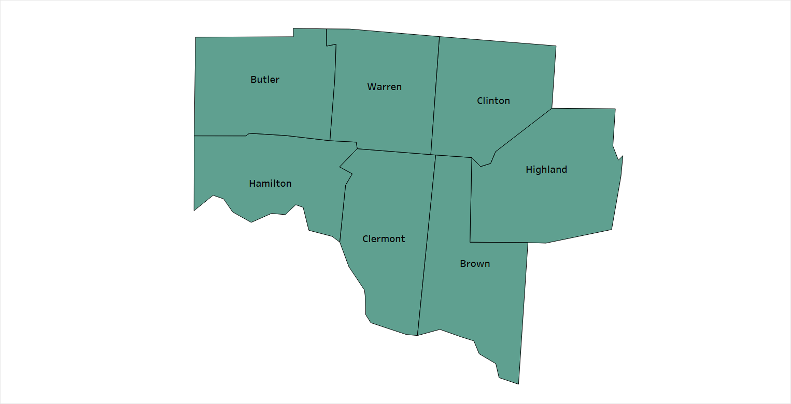
Syphilis Cases in Southwest Ohio (Region 8)

Slide 2
Region 8
Syphilis Overview
Region 8 Total Syphilis by Year
2020 | 2021 | 2022 | 2023 | Q1-Q3 2024
333 | 400 | 754 | 807 | 512
Region 8 1st - 3rd Quarter Comparisons
2023 | 2024 | % Change
624 | 512 | -17.9%↓
Hamilton County
Hamilton County Total Syphilis by Year
2020 | 2021 | 2022 | 2023 | Q1-Q3 2024
248 | 283 | 562 | 591 | 371
Hamilton County 1st - 3rd Quarter Comparisons
2023 | 2024 | % Change
455 | 371 | -18.5%↓
Hamilton County makes up the majority of Region 8 Cases
* Data downloaded from ODRS

Slide 3
Region 8 % of Early Syphilis Cases Treated
Early Syphilis Cases Treated
A 97% average of Early Syphilis (Early Latent, Primary, and Secondary) cases have been treated during this time frame
2020 | 2021 | 2022 | 2023 | Q1 - Q3 2024
98.98% | 96.59% | 97.14% | 95.93% | 96.64%
Hamilton County % of Early Syphilis Cases Treated
2020 | 2021 | 2022 | 2023 | Q1 –Q3 2024
98.66% | 96.28% | 96.71% | 96.77% | 96.94%
* Data downloaded from ODRS

Slide 4
Case Classification Probable A condition affecting an infant whose mother had untreated or inadequately* treated syphilis at delivery, regardless of signs in the infant, OR an infant or child who has a reactive non-treponemal test for syphilis (VDRL, RPR, or equivalent serologic methods) AND any one of the following: - Any evidence of congenital syphilis on physical examination (see Clinical Description). -Any evidence of congenital syphilis on radiographs of long bones. -A reactive CSF VDRL test. -In a nontraumatic lumbar puncture, an elevated CSF leukocyte (white blood cell, WBC) count or protein (without other cause). -Suggested parameters for abnormal CSF WBC and protein values: 1. During the first 30 days of life, a CSF WBC count of >15 WBC/mm³ or a CSF protein >120 mg/dL. 2. After the first 30 days of life, a CSF WBC count of >5 WBC/mm³ or a CSF protein >40 mg/dL, regardless of CSF serology. The treating clinician should be consulted to interpret the CSF values for the specific patient. * Adequate treatment is defined as completion of a penicillin-based regimen, in accordance with CDC treatment guidelines, appropriate for stage of infection, initiated 30 or more days before delivery. Confirmed A case that is laboratory confirmed. Comments Congenital and acquired syphilis may be difficult to distinguish when a child is seropositive after infancy. Signs of congenital syphilis may not be obvious and stigmata may not yet have developed. Abnormal values for CSF VDRL, WBC count, and protein may be found in either congenital or acquired syphilis. Findings on radiographs of long bones may help because radiographic changes in the metaphysis and epiphysis are considered classic signs of congenitally acquired syphilis. While maternal antibodies can complicate interpretation of serologic tests in an infant, reactive tests past 18 months of age are considered to reflect the status of the child. The decision may ultimately be based on maternal history and clinical judgment. In a young child, the possibility of sexual abuse should be considered as a cause of acquired rather than congenital syphilis, depending upon the clinical picture. For reporting purposes, congenital syphilis includes cases of congenitally acquired syphilis among infants and children as well as syphilitic stillbirths.
Congenital Syphilis Case Definition
Source: https://odh.ohio.gov/know-our-programs/infectious-disease-control-manual/section3/section-3-syphilis

Slide 5
2023 Rates per 100,000 Live Births
Congenital Syphilis Rates in Ohio
Ohio | Cuyahoga | Franklin | Hamilton
58.4 | 116.9 | 120.5 | 78.5
* ODH, STD Surveillance Program: https://odh.ohio.gov/wps/wcm/connect/gov/1bbb0641-5b2e-488f-8baa-144bbb63d60c/CongSyp1923.pdf?MOD=AJPERES&CONVERT_TO=url&CACHEID=ROOTWORKSPACE.Z18_79GCH8013HMOA06A2E16IV2082-1bbb0641-5b2e-488f-8baa-144bbb63d60c-p6z4lM2

Slide 6
Region 8 and Hamilton County Congenital Syphilis
2018-2023 data from ODRS
2024 data provided by HCPH Disease Prevention
Numbers may change as cases get added or removed.

Slide 7
https://hamiltoncountyhealth.org/reports/
Hamilton County Public Health Reports
Epidemiologist: Jacob. Henderson@hamilton-co.org
HIV/STI Coordinator: Todd. Rademaker@hamilton-co.org
HCPH Infectious Disease: HCPH.ID@hamilton-co.org
* ODH, STD Surveillance Program: https://odh.ohio.gov/wps/wcm/connect/gov/1bbb0641-5b2e-488f-8baa-144bbb63d60c/CongSyp1923.pdf?MOD=AJPERES&CONVERT_TO=url&CACHEID=ROOTWORKSPACE.Z18_79GCH8013HMOA06A2E16IV2082-1bbb0641-5b2e-488f-8baa-144bbb63d60c-p6z4lM2

