Slide 1
The Strategy to Achieve Long-Term Transportation Funding Reform
North Carolina Can't Afford to Wait
February 3, 2015 v2

Slide 2
Situation Analysis
Universal recognition of the problem and business support being a major priority
Major legislative agenda focus for NC Chamber and the allied business community
Priority for Governor, House and Senate
Long tradition of business community coming together to provide leadership on major issues impacting our state

Slide 3

Infrastructure & Growth Leadership
The North Carolina business community widely recognizes the inextricable link between infrastructure and North Carolina’s ability to compete for job growth and economic development.
Sufficient physical infrastructure, including transportation, water and sewer, energy and broadband, to meet future demand.

Slide 4
So What's the Problem?
U.S. Census Bureau projects NC to jump from 11th most populous state to 7th by 2030 - more than 12.2 million residents
We need to create 1 million jobs to keep up
Aging roads and bridges... Rank 2nd nationally for most non-interstate-rural road deaths, 30% of bridges are structurally deficient
Metro population will double (Charlotte and Raleigh)

Slide 5
So What’s the Problem?
Increased CAFE standards in 2018, cars become more efficient, use less gas, less gas tax revenue collected
July 1 marks the “fiscal cliff” for NC, gas tax revenue cut occurs – projected to be a $400-500 million cut in NCDOT budget annually
Uncertain federal highway funding commitment to NC
No long-term plan to fund the $65 billion in infrastructure needs in our state
Decaying infrastructure hurts our ability to compete

Slide 6
What Would Happen If . . .
NCDOT funding increased by $5-10 billion over the next 10 years?
The NC Chamber made this an economic/jobs issue?
North Carolina politicians believed that infrastructure investment is critical and action in 2015 is a better option than delay?
We created a pattern interrupt to generate a different outcome; new messenger/message?

Slide 7
Campaign Objectives
Mobilize the organized business community to action, build and sustain momentum for a defined period
Demonstrate business support to the NCGA and Gov. – this must remain a priority
Neutralize far right anti-government crowd and far left anti-growth groups
This is not a campaign to shape and change public opinion

Slide 8
So what have we done so far....
Hired Public Opinion Strategies, a national Republican polling firm to do a statewide voter poll (November 2014)
Hired the Institute for Transportation Research and Education (ITRE) out of NC State to do a comprehensive macro economic analysis on the fiscal impact of positive action in NC and the negative consequences of inaction.
Benchmark research on how other state chambers have dealt with this issue, learned the good and the bad - Michigan, Virginia, Iowa, Texas, Pennsylvania

Slide 9
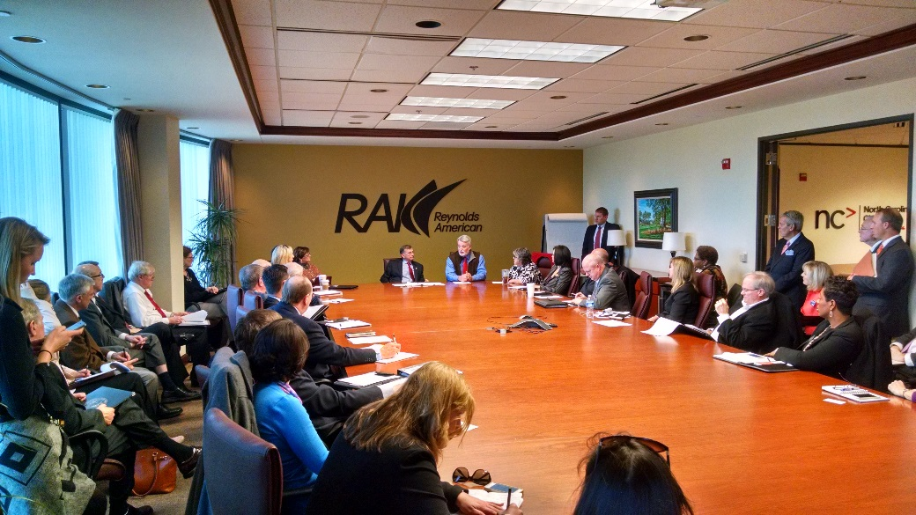
So what have we done so far....
Built a significant statewide coalition of local chambers, associations, business groups and companies willing to support change and invest in North Carolina’s future
Developed an advocacy plan that the NC Chamber and coalition are working in the 2015 long session.

Slide 10

So what have we done so far....
Coordinated a major press event, held January 28
Invested more than $230,000 in significant TV, digital, radio buys that direct to microsite

Slide 11
Public Opinion Poll Findings
58% of public say this is a problem in need of attention, not a crisis
Voters react 2:1 against increasing taxes and fees
Younger voters ok with increase, conservative voters are big time against it
When informed on the issue, 44% voters said increasing fees and taxes would make no difference on re-election

Slide 12
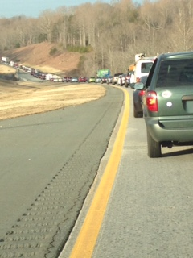
Key Messages
According to the Public Opinion Strategies poll in Nov. 2014, the following messages test best with the public:
  Safety – best in rural areas
  Congestion – best in urban regions

Slide 13
CEO Poll Results – 2014
The NC Chamber conducts an annual CEO Poll to gauge top business concerns and optimism levels among North Carolina’s job creators.
67% see North Carolina’s infrastructure as a priority; up from 41% in 2011.
Job creators cite it as a top issue affecting profitability alongside taxes, education, health cost, regulations and legal reform.

Slide 14
Study Results:
Diversifying Revenues to Improve Commerce and Economic Prosperity
Completed by the Institute for Transportation Research and Education (ITRE) out of NC State
Major economic benefit for every $1 billion in investment
  14,000 jobs, $10 billion increased wages, $10 billion in GSP
Cost of inaction also has a impact on North Carolina, makes certain economic decline to occur

Slide 15
Study Results: 16 Ideas to Increasing Infrastructure Funding
Vehicle Miles Traveled
State Motor Use Tax
Statewide Sales Tax
Heavy Vehicle Fees
Highway Use Tax
Title, Registration, Vanity Plate Fees
Severance Fees
Flat-Rate Tolling
Property Tax
Income Tax
Payroll Tax
High Occupancy Toll Lanes
Value Capture
Fine-Based Fees
Cordon Pricing
Advertising Revenue

Slide 16
The Opposition
Status Quo – the future is hard to see from here
Industry groups that are impacted by a particular funding source will have opposition to that funding option
Anti-tax groups like AFP, AARP, Tea Party, anti-growth groups like the Justice Center and extreme environmentalists
Lots of organizations are working this issue – this creates competition for limited resources – the resources are spread out, not aligned for action

Slide 17
Major Assumptions
This will be a heavy lift in long session
Campaign will require extraordinary resources beyond the NC Chamber operating budget
The companies that will see direct benefit will be major investors in the campaign, seeing it as a business development expense

Slide 18
Who is on Our Side: Broad-Based Coalition
Coalition for a Prosperous Future
Alamance County Area Chamber of Commerce American Airlines American Council of Engineering Companies American Planning Association of North Carolina American Society of Civil Engineers – North Carolina Section American Society of Highway Engineers Archdale-Trinity Chamber of Commerce Asheville Area Chamber of Commerce Cabarrus Regional Chamber of Commerce Carolinas AGC Carolinas Asphalt Pavement Association Carolinas Concrete Pipe & Products Association Cary Chamber of Commerce Chambers of Commerce of NC East Alliance Charlotte Chamber of Commerce Cook Medical Deere-Hitachi Construction Machinery Corp Fayetteville Regional Chamber of Commerce Gaston County Chamber of Commerce Greater Raleigh Chamber of Commerce Greensboro Partnership Greenville-Pitt Chamber of Commerce Hanesbrands Havelock Chamber of Commerce High Point Chamber of Commerce Highway 17 Association HNTB John Deere Kinston-Lenoir County Chamber of Commerce Mack Trucks | Moore County Chamber of Commerce NCGo! National Federation of Independent Business – North Carolina New Hanover County Airport Authority/Wilmington International North Carolina Aggregates Association North Carolina Association of County Commissioners North Carolina Economic Developers Association North Carolina Center for Global Logistics North Carolina Chamber North Carolina Farm Bureau North Carolina Forestry Association North Carolina League of Municipalities North Carolina Metropolitan Mayors Coalition North Carolina Poultry Federation North Carolina Society of Surveyors North Carolina League of Transportation and Logistics North Carolina Railroad Company North Carolina Section Institute of Transportation Engineers Professional Engineers of North Carolina Regional Transportation Alliance Rocky Mount Chamber of Commerce Rowan County Chamber of Commerce Sepi Engineering and Construction UPS Volvo Trucks Wayne County Chamber of Commerce Wilkes Chamber of Commerce Wilmington Chamber of Commerce Winston-Salem Chamber

Slide 19
Why It’s Now or Never
This opportunity will not present itself again in the near future.
Pro-business majorities in NCGA
Bipartisan support
Pro-business Governor
Non-election year
This has been a problem for decades, it may be the most studied issue in our state
Appears to be the one issue all can work to resolve
The right people are taking notice and speaking up…

Slide 20




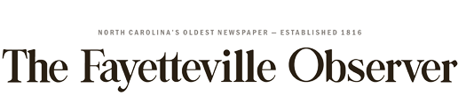

NC Chamber: State will fall behind if roads not improved
Business leaders push for
more transportation funding
I-TEAM: New Ad Aims to Scare Up Support foBridge Improvements in North Carolina
NC Chamber, others back more transportation funding
N.C. Chamber predicts transportation funding 'crisis,' calls for new ways to pay for roads, rail, etc.
Driving home the
coming transportation
funding crisis in NC

Slide 21
Where are we now?
Senate Bill 20
  Cuts gas tax and freezes the rate at 35 cents per gallon
  Sets this as a floor to stabilize transportation revenue
  Prevents a drop to as low as 29 cents which would have lost hundreds of millions of dollars
House Bill 927
  Cuts gas tax
  Increases highway use tax, as well as DMV, auto insurance, truck, car rental and vehicle registration fees
  Phases out highway trust fund transfers over four years

Slide 22
