Slide 1
2014 CAPA ANNUAL MEETING
Mike Holder, P.E.
NCDOT Chief Engineer

Slide 2
Governor and NCDOT Focus Areas
The Three Es
Economy
Efficiency
Education
Notes:
The Governor has asked all of state government to focus on three areas. Each of these items ties to NCDOT as well as the contracting industry.
Economy – We need to leverage our infrastructure dollars for overall economic development and job creation and this will also result in a strong contract construction program. Recent legislative changes in project selection supports this commitment. I will discuss STI in upcoming slides.
Efficiency – We need to continue to look for ways to reduce costs and speed up delivery both internally and externally. This requires us to jointly work to streamline project costs and schedules through good construction practices and implementation of smart innovations. Don’t be afraid to try new things but properly assess the risk through consultation with subject matter experts.
Education – While this emphasis area doesn’t pertain primarily to DOT, we are certainly using it to remind us that continual training of our employees and keeping them aware of new initiatives and overall goals is important for success. Also, DOT continues to be involved in outreach to schools through various programs in the areas of STEM (that’s Science, Technology, Engineering, Math). Our goal is to encourage strong STEM interest among students, and strong STEM curricula in the schools.

Slide 3
Other Important Initiatives
Customer Service
Strengthening Local Partnerships
Aesthetics on Projects
Communication
Notes:
Customer Service – In all areas of NCDOT we are working to improve customer service. Our employees have been directed to be the last wrong # the person calling for assistance makes to DOT. We need to have the same emphasis dealing with each other as well as contractors. We also expect contractors to work toward this same goal in dealing with DOT and stakeholders that travel through our projects.
Local Partnerships – The local Division personnel is critical in forming regional partnerships with municipalities, citizen groups, as well as contractors and material suppliers.
It is very important for contractors working in a geographical region to form a relationship with the local Division staff and solve as many issues as possible at the local level. The CAPA central working committees is a great way to resolve repeat issues or issues that have statewide significance but this should not be a forum to resolve specific project level issues.
Aesthetics – We have an increased focus on using our highway and bridge projects to assist with “branding” NC, especially in local historic areas or high visibility areas with potential economic benefits.
Communication – Communication is always a focal point to a successful project. Face to face efforts to solve problems can not be replaced by an email or a text message. Technology is a great tool to help us plan and share information but often becomes a barrier to truly understanding and resolving issues.

Slide 4
Partnerships for Success:
DOT Divisions
DOT Raleigh
Media
Highway Patrol
State Emergency Mgt
Schools
Contractors
Communications Office
Notes:
As I have already mentioned for NCDOT to be successful we must form partnerships with many stakeholders. Contractors represent a significant stakeholder. Without your support and input we can not achieve our goals.
We just completed regional asphalt summits in all 14 Divisions as one example of several things we are doing to help cultivate this partnership.

Slide 5
Partnerships for Success:
Upcoming US Open
Highway improvement projects
Landscape/beautification projects
Cleanup/equipment removal
Notes:
Since we are here in Pinehurst I would like to mention a regional event that will have a tremendous economic impact for North Carolina. Hosting the Men’s and Women’s US Open will put North Carolina in the National Spot Light for 2 weeks in June. We have multiple enhancement efforts underway and are partnering with contractors to complete 3 critical local construction projects prior to the Open.
Local transportation projects on NC 211, US 1, and US 15/501

Slide 6
Technology in our Partnership
iPads/Construction teamsites
Internal use successful
Ultimate goal: open up to contractors
Notes:
We are successfully using ipads to access documentation and electronic files in 30% of our construction offices. To faciliate the us of the field ipads, we have developed team sites for construction projects, which enables field personnel to access and share important project information. Our ultimate goal is to open up the team sites to contractors as well, which means the entire team will be able to share critical information more efficiently.

Slide 7
2013 Accomplishments
Central
Division
Let 236 projects with total bid value of $1,577,598,868
Let 450 projects with total bid value of $238,311,392
Notes:
Hopefully everyone agrees that 2013 was a very good letting year for NCDOT. We had a good mix of small and large projects and TIP, resurfacing, and bridge preservation and replacement projects. Almost 15% of the program was from Division let projects which continues to provide a great opportunity for smaller businesses.
We are proud of our program considering the economy has still not fully recovered and many other states are still struggling to fund critical projects.

Slide 8
Historical Funding for C/R Program
SFY $(M)
2008 277
2009 277
2010 300
2011 267
2012 406
2013 427
2014 433
2015 402
Notes:
From a resurfacing perspective our State Funded Contract Resurfacing Program has steadily continued to grow and it is critical that we continue this pattern to make sure our vast pavement system is properly maintained.

Slide 9
2014 and Beyond Letting Projects
From April 2014 to March 2016
$2.3 Billion
34 projects in that period greater than $20 Million

Slide 10
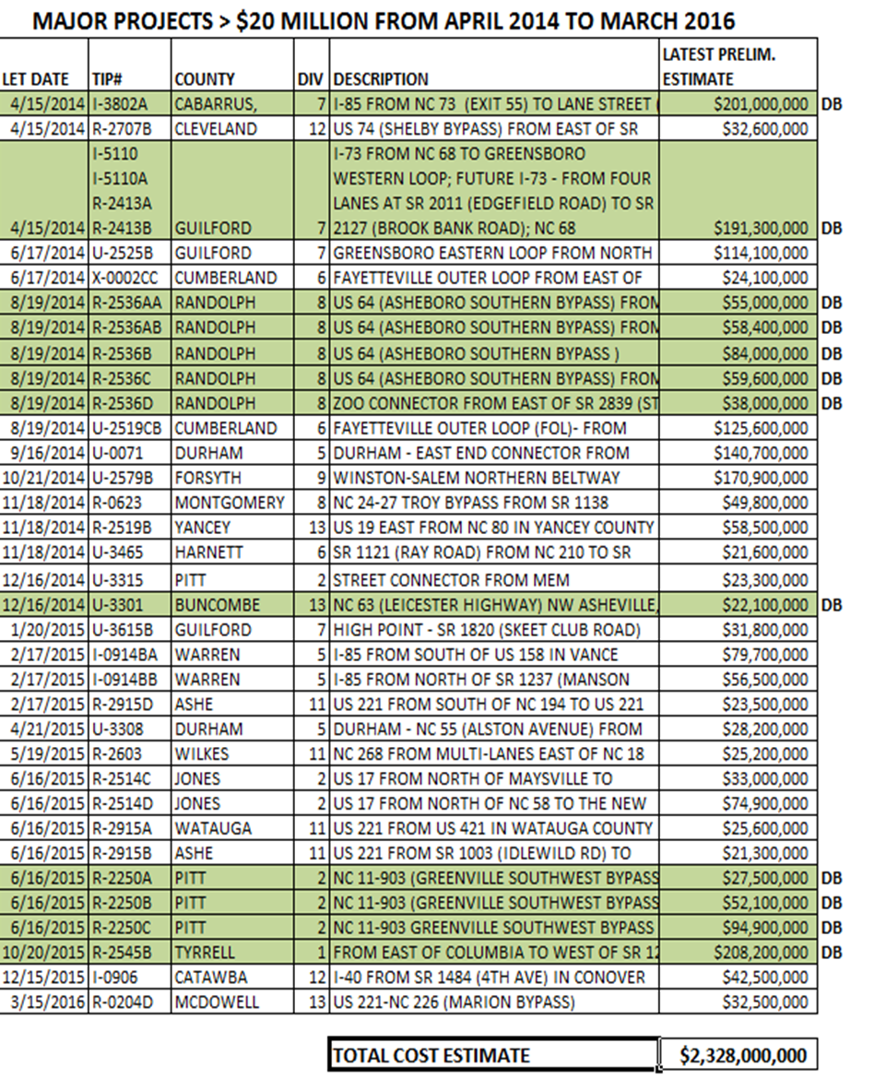
Major Project List
Notes:
This list of future projects greater that $20 Million is difficult for you to read, but this powerpoint will be available on the CAPA website after the conference.
I would like to highlight a few notable projects:
Greensboro Eastern Loop June 2014 letting, $114 Million
Asheboro Bypass August 2014 letting, 5 sections totaling $295 Million
Greenville Bypass June 2015 letting, 4 sections totaling $380 Million

Slide 11
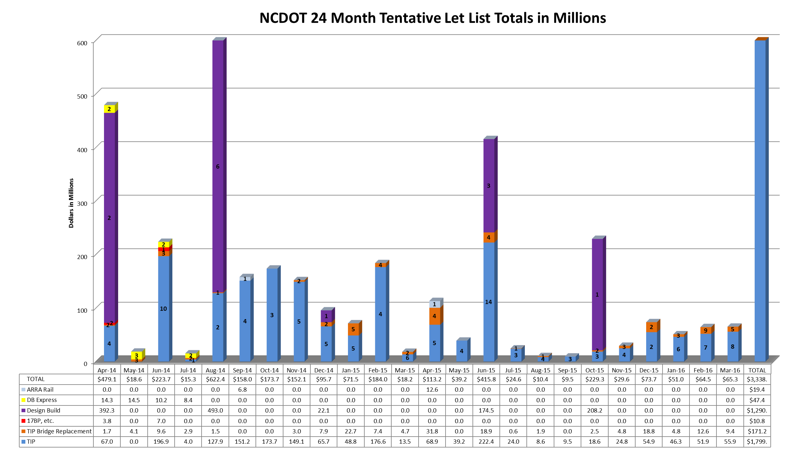
Notes:
This Bar Chart shows monthly letting totals and tracks different project types by color code. We monitor this and look for ways to reduce peaks and valleys to better balance project lettings. We know from the industry perspective that a more balanced letting schedule is desired. Obviously major projects will effect the peaks and valleys.
Purple – Design-Build projects
Blue – traditional bid-build TIP projects
Green/Red - bridges
Gray – ARRA rail
Large spikes are:
April 2014 spike is 2 projects: I-85 Cabarrus/Rowan and I-73, Guilford County
Aug 2014 spike is NC 12 long-term improvements at Rodanthe
June 2015 spike: Greenville Southwest Bypass
Oct 2015 spike: US 64, Tyrrell Co

Slide 12
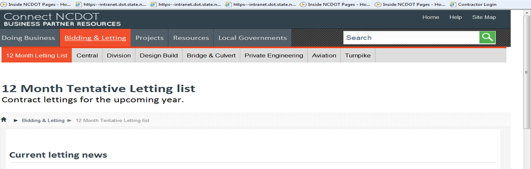
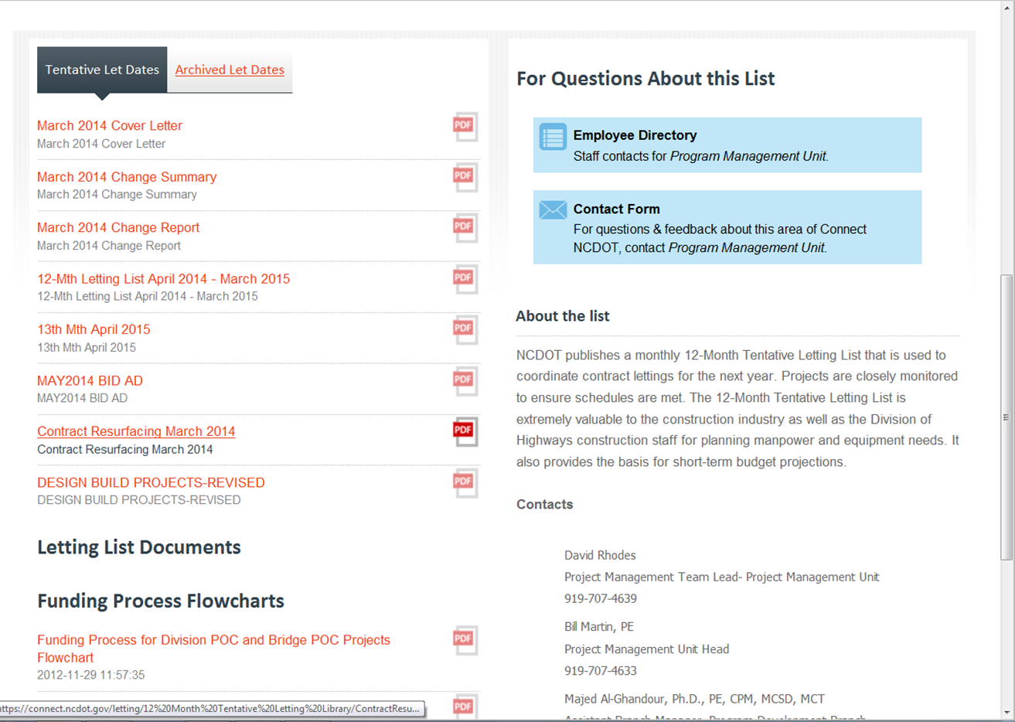
Notes:
As requested by CAPA in 2013 we started posting a 12 month tentative letting schedule for resurfacing projects. This is a screen shot of the link to this information, located on the central letting web page, at connect.ncdot.gov.

Slide 13
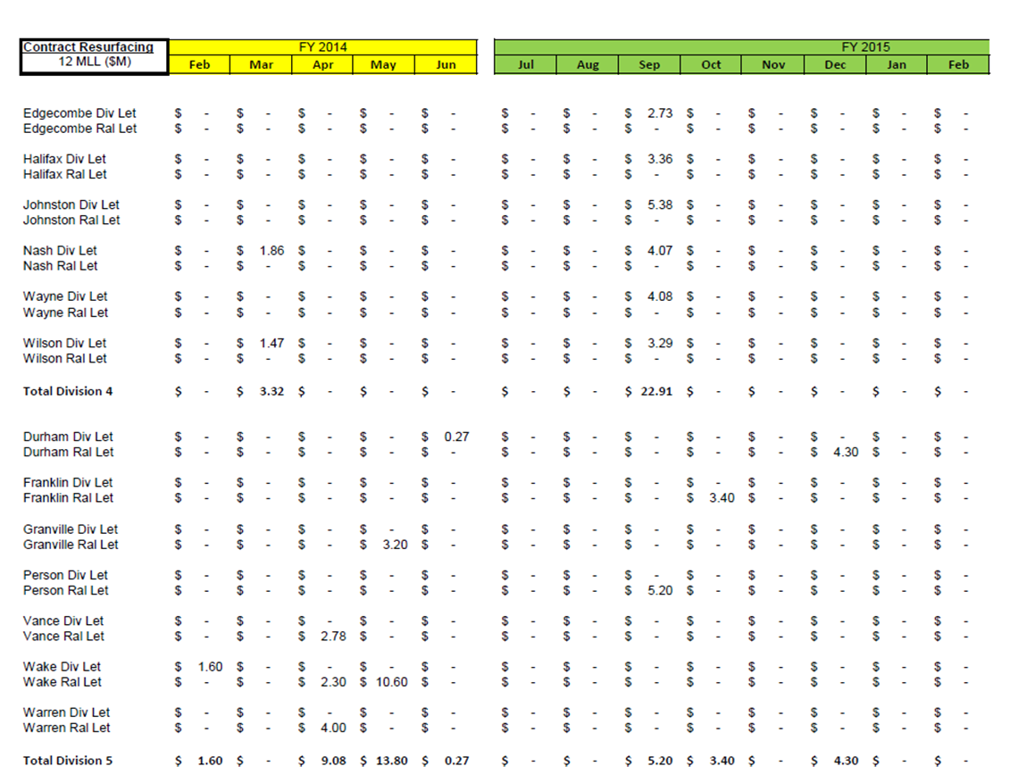
Contract Resurfacing Let List
https://connect.ncdot.gov/letting/12%20Month%20Tentative%20Letting%20Library/ContractResurfacing-12MLL-Feb27-2014.pdf
Notes:
This slide shows a screen shot of the projected resurfacing letting. We show a list by Division and County with the anticipated letting date and rough dollar amounts. I hope that you find this helpful; please let us know if you have ideas to improve this process or make the information more useful. The link to the information is provided at the bottom, so you can review this information.

Slide 14
Life Cycle Cost Analysis - Pavement Type Selection
April 4, 2014 NCDOT scheduled to report to the Joint Legislative Transportation Oversight Committee on this issue.
This is not a new issue but has been recently elevated based on a FHWA Technical Advisory.
We plan to closely engage both the asphalt and concrete industries to develop a fair process that promotes competition.
Notes:
I would like to mention an issue that I know is very important to your industry. Life Cycle Cost Analysis for Pavement Selection is a process the Department has been using for a number of years. It is not a process that we have included in conjunction with alternate bidding. For the last couple of years we have been working to update our current Life Cycle Cost Analysis procedures and define an alternate bidding process related to pavements. We are scheduled to report on this issue to the Joint Legislative Oversight Committee tomorrow. You can be assured we will not make any final decisions regarding this issue without getting your input. We do need to establish clear guidelines that everyone understands. Our ultimate goal is to develop a fair process that promotes competition.

Slide 15
2014 Focus Areas
STI Implementation in preparation for new formula to take effect July 1, 2015.
Develop 25-year vision – “Moving People and Moving Products”
Identify new transportation revenue sources.
Notes:
Review top 3 focus areas in 2014 for NCDOT Div of Highways

Slide 16
Strategic Transportation Investments
Notes:
Next 6 slides details about STI

Slide 17

problem
+ 1.3m
Increased population
= Infrastructure need
Infrastructure gap.
Decline in businesses and jobs.
Decreased
Revenue projections
MFT, DMV, Highway
- $1.7b
2013-2023

Slide 18
state
40%
region
30%
division
30%
strategically invest resources to ensure
state, regional, and local priorities are met

Slide 19
Address statewide and regionally significant congestion/bottlenecks
  Statewide and regional tier ONLY
  All modes compete
  (hwy and non-hwy projects)
100% data driven
  Benefit-cost
  (reduced travel time /project costs)
  Existing congestion
  Economic competitiveness
  Freight
  Multi-modal
state
40% of revenue or
$6 billion statewide (over 10 years)

Slide 20
Address projects with regionally significant impact
  Statewide and regional tiers
  Paired divisions: (1&4), (2&3), (5&6), (7&9), (8&10), (11&12), (13&14)
  All modes compete
70% data; 30% local ranking
  Benefit-cost
  Connectivity (jobs, healthcare, education, recreation ctrs.)
  Congestion
  Safety
region
30% of revenue or
$4.5 billion over all regions
(over 10 years)

Slide 21
Address localized congestion & safety concerns
  All tiers
  All modes compete
50% data; 50% local ranking
  Benefit-cost
  Connectivity
  Shoulder width
  Safety
division
Equal share over 14 divisions.

Slide 22
Tools to Help Continue a Strong Letting Program
Alternate financing to include tolls, GARVEE bonds, and private-public partnerships
Design build for better innovation and expedited delivery time.
Strategic state funded programs similar to the ongoing Bridge Improvement Program.

Slide 23
Challenges
1.3 million population growth in NC over next 10 years.
Over the same period current revenue sources will generate $1.7 billion less.
Current transportation funding is not sufficient to support the need.

Slide 24
Challenges
Federal Authorization, MAP 21 is scheduled to expire September 30, 2014.
28% of our planned program is represented by Federal Dollars.

Slide 25
FUNDING TRIVIA
$7.50 / Year
Each 1 cent of motor fuel tax represents what cost per year to a driver?
$50 M / Year
Each 1 cent of motor fuel tax represents what funding per year for NCDOT projects?
$20 M / Year
1% change in overall consumption of fuel represents what funding change to NCDOT projects?
Notes:
Since 70% of our funding is currently dependent on the gas tax, we need to take the opportunity to educate everyone we can the impacts reducing the gas tax would have on Transportation. As shown in this slide to individual cost related to a 1 cent adjustment is very small compared to what it represents to our funding.
At the same time we need to realize that the gas tax model will not sustain our needs going forward and alternate revenue sources are needed that are more predictable and not subject to fluctuation from fuel consumption.

Slide 26
Alternate Revenue Considerations
Size of the Revenue Gap
General Tax vs User Fee
Effects of Population Change
Administrative / Collection Issues
Public Perception / Political Will
Notes:
There are many things to consider in developing a new revenue model that is predictable. With the creation of STI we have a dependable project selection process and the next step is to establish alternate revenues.

Slide 27
How Can CAPA Help?
Help explain the challenges we face and what is at risk.
Lobby to avoid Federal transportation funding shutdown.
Advocate for State and Federal transportation revenue reform.
Notes:
How can CAPA help with funding related issues?
It is important that we all explain the challenges we are facing to build and maintain a reliable transportation system that will support and promote a stronger economy. Please share your concerns with elected officials and stress the importance of State and Federal transportation revenue reform.

