Slide 1


Thin Lift Asphalt Overlays
Christie Bishop Barbee
Joint Asphalt Training
March 24, 2010

Slide 2

Maintenance Using HMA
2nd Largest State Maintained System
79,000 miles
Total Resurfacing Needs
$300 million
$450 MILLION
Contract Resurfacing

Slide 3
Preventive Maintenance
Approved Uses of Funds
Micro-surfacing
Chip Seals
HIP Recycling
Novachip
Asphalt Overlays
$100 million
System Preservation

Slide 4

Looking for Solutions
Preservation funds are being used to address resurfacing needs
  Micro-surfacing
  HIP Recycling
  Thin Asphalt Overlays
  Novachip

Slide 5


Micro-surfacing
Polymer modified slurry seal
Placed at rate of 24 lbs. per square yard
Homeowners and motorists don’t like it
Life Expectancy of 5-7 years

Slide 6
Looking for Solutions
Preservation funds are being used to address resurfacing needs
  Micro-surfacing
  HIP Recycling
  Thin Asphalt Overlays
  Novachip

Slide 7
HIP Recycling
Has a place in our arsenal
Pavements with limited deterioration
Pavements with uniform mix
Does not add structure
Problems with certain mixes
Environmental concerns

Slide 8
HMA Alternative
Must be competitive in cost
Must perform as well or better
Must use readily available materials
Other States
Ohio – Smoothseal
Michigan – Preventive Maintenance HMA

Slide 9
S 4.75A Mix
“Sand Asphalt”
Predominately a resurfacing mix
Uses aggregate screenings
Public loves it – Smooth ride, looks good
10-12 yr life expectancy
NC has some 18+ yr. 4.75 pavements

Slide 10
Advantages of S 4.75A Mix
Smoothness
Longer Life
Increased Strength
Better for the Environment
Cost Effective
Ease of Use

Slide 11
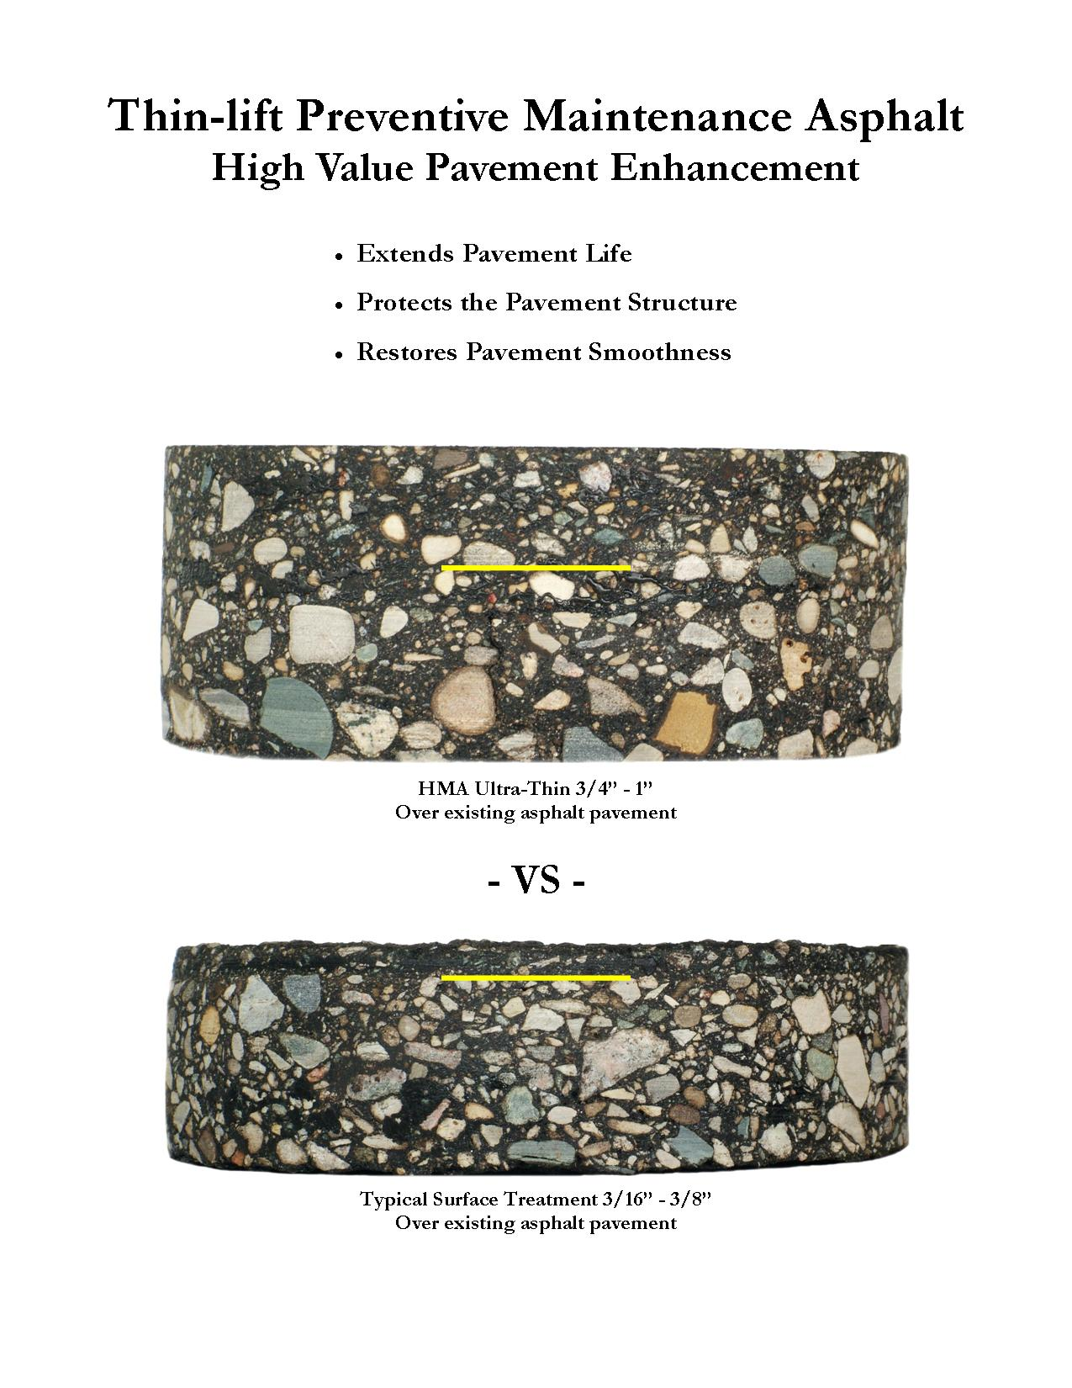

Slide 12
Preventive Maintenance Treatment Cost Comparison
Description | $/sy | Cost/Mile (24’ wide) | Life Extension (Years) | Cost/Mile/Year | Application Rate
Micro-surfacing
June 2008 | $2.50 | $35,200 | 5 | $7,040 | 24#/sy
June 2008 | $2.76 | $38,861 | 5 | $7,772 | 24#/sy
Thin-Lift Asphalt | AC adjusted for June 2008
April 2008 | $2.72 | $38,298 | 10 | $3,829 | 70#/sy
December 2007 | $2.66 | $37,453 | 10 | $3,745 | 70#/sy
July 2008 | $2.79 | $39,283 | 10 | $3,928 | 70#/sy
July 2008 | $2.75 | $38,720 | 10 | $3,872 | 70#/sy

Slide 13
Looking for Solutions
Preservation funds are being used to address resurfacing needs
  Micro-surfacing
  HIP Recycling
  Thin Asphalt Overlays
  Novachip

Slide 14
Novachip
Concrete
has performed well
HMA
no good reason
Expensive
Patent on process
Availability
materials
paver

Slide 15
HMA Alternative
Must be competitive in cost
Must perform as well or better
Must use readily available materials
Solution
OGFC
Quieter
Safer
Cooler

Slide 16
Why Asphalt?
Funding Crisis Places Emphasis on Preservation and Maintenance
Cost Effective
Black is Green
Provides Good Jobs for NC Workers

Slide 17

Thank you!

