Slide 1
Proposed Revisions to Ohio’s Drainage Laws
Ohio Drainage Law Revision Task Force
Presented by:
Doug Reinhart, P.E., P.S.
Auglaize County Engineer

Slide 2
History of Ohio Drainage Laws
1ST Public Ditch Laws 1850’s-1860’s (Mirrored Road Petition Law)
August 23, 1957 - Permanent Maintenance Amendment Became Effective
Late 1960’s - Senate Bill 160; ORC Section 1515; Petitions Through SWCD
1981 - Multiple Changes Eliminating some of the Antiquated Language
1986 - Amendment to Reduce Easement on Open Ditches to 25’ and Mandate 4’ Permanent Sod Strip (up to 15’ reduced from taxes)
2013 - Amendment to 940 mandating certified mail to owner adjacent to property
2020 HB 340 Sponsored by Representative Cupp

Slide 3
Auglaize County Petition Ditches
71.05 miles of log jam removal
170.47 miles of open ditches
124.01 miles of tile ditches
8.17 miles of grass waterways
373.7 miles of ditch maintenance

Slide 4
Ohio Drainage Revision Task Force
Task Force was first established October 11, 2013
Chairman:
Steve Stolte, Union County Commissioner
Members:
County Engineer’s Association
Soil and Water Conservation Board and Staff
Ohio Farm Bureau Federation
Ohio State University Extension
County Auditors
Ohio Department of Agriculture

Slide 5
OHIO REVISED CODE SECTIONS
ORC 940: Soil and Water Petitions
(formerly ORC 1515)
ORC 6131: Single County Ditch Petitions
ORC 6133: Joint County Ditch Petitions
ORC 6137: Permanent Maintenance of Ditches
HB 340: 156 PAGES AND 4,585 LINES

Slide 7
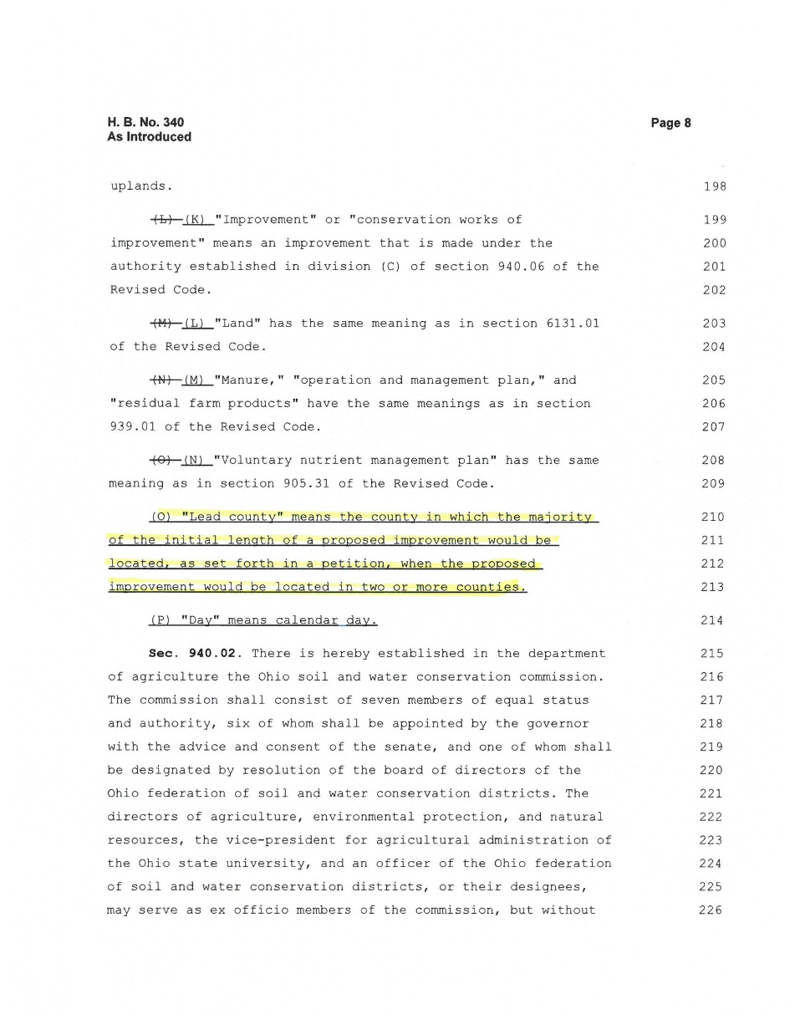
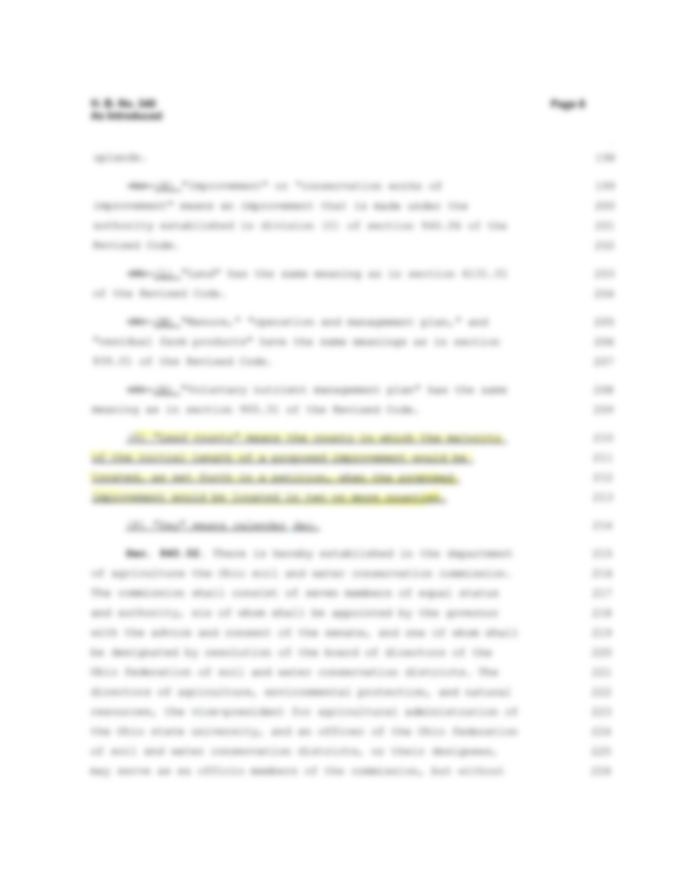

Slide 8
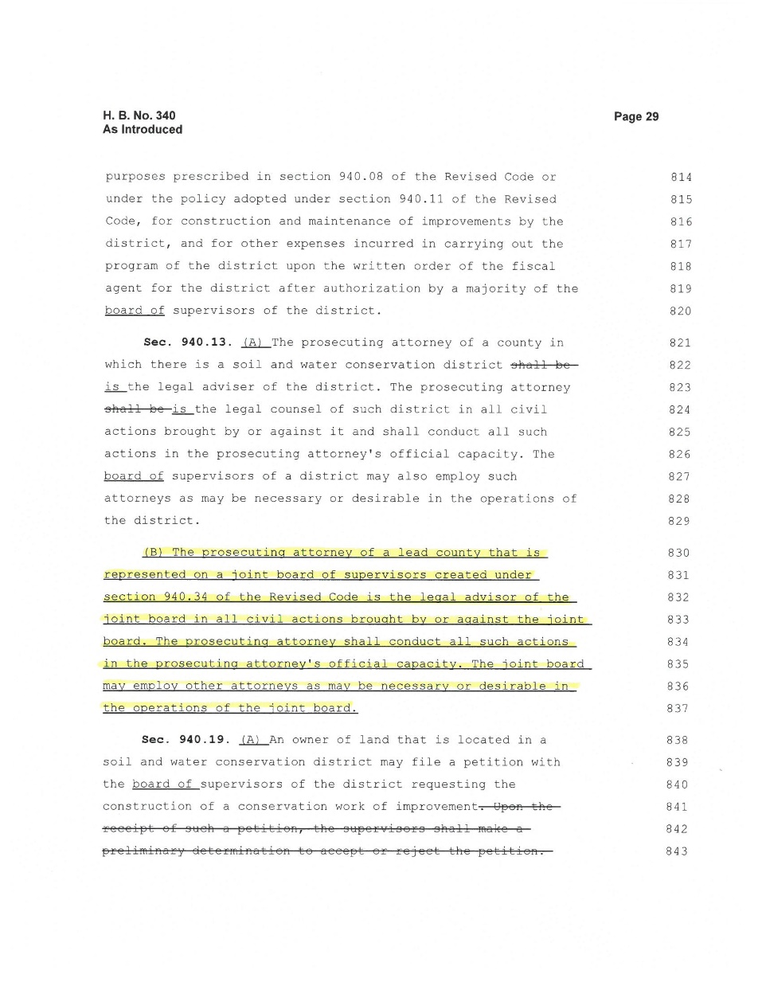
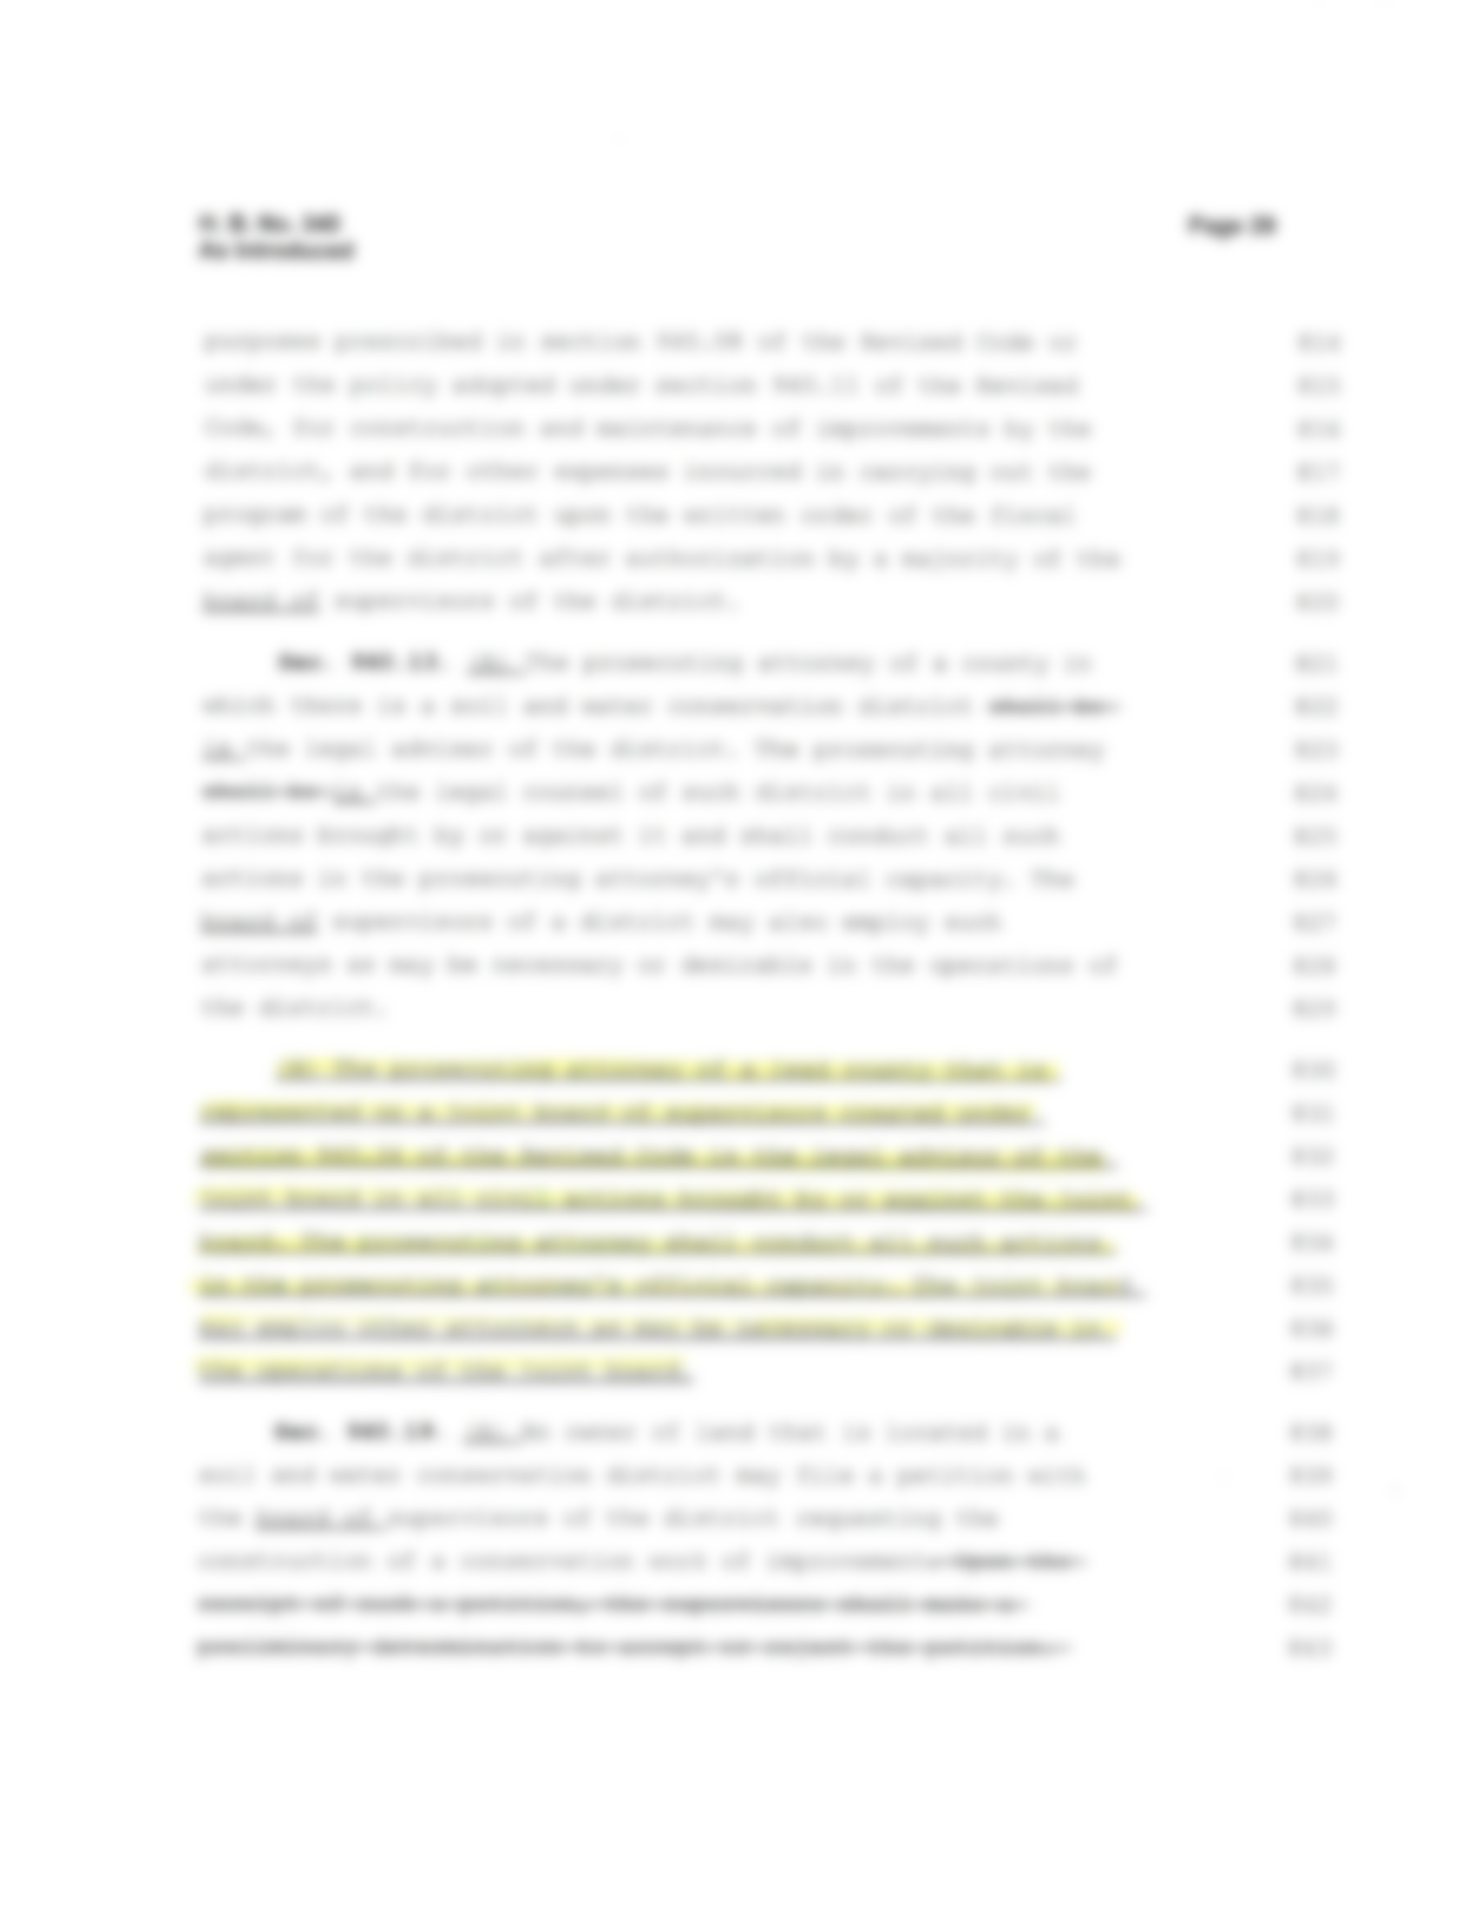

Slide 9
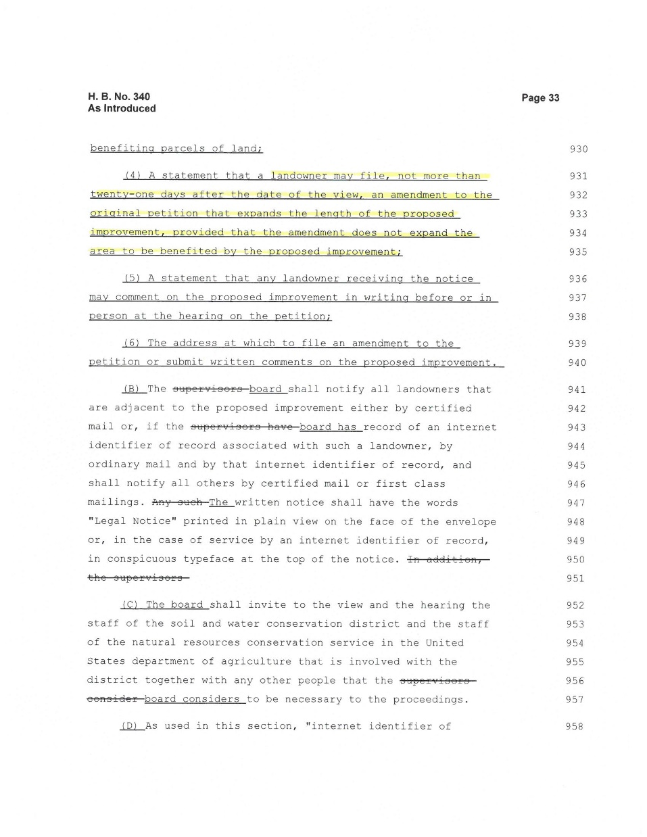
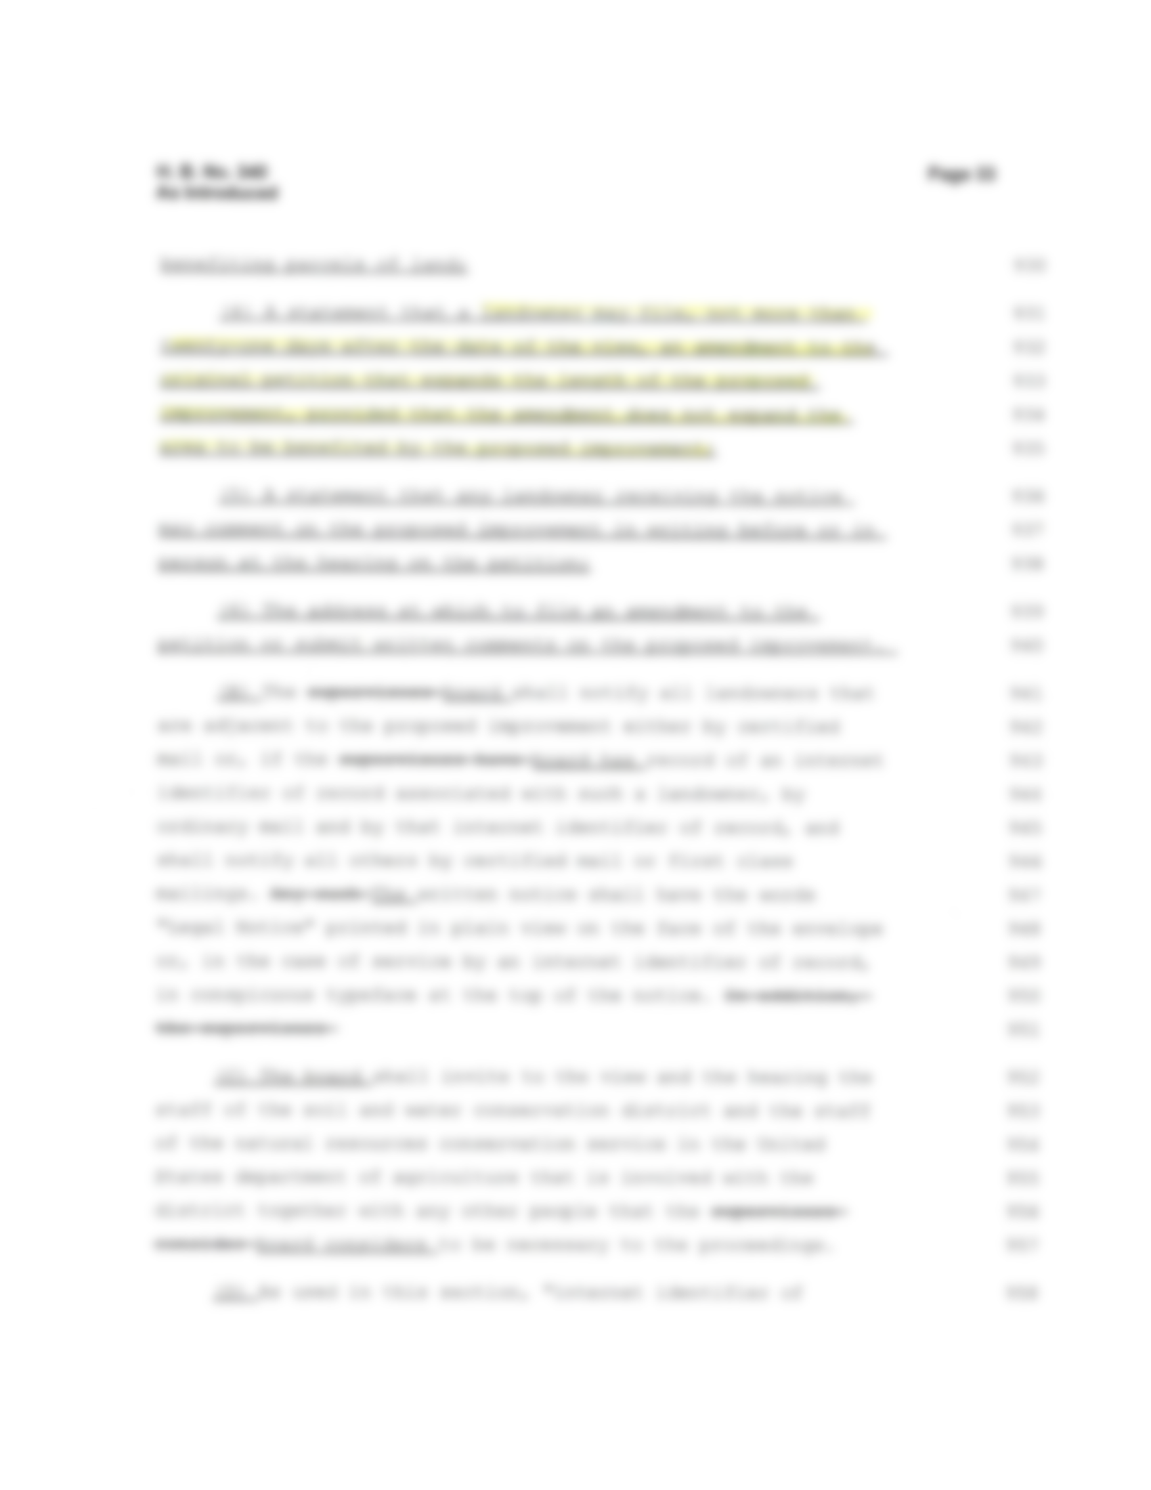

Slide 10
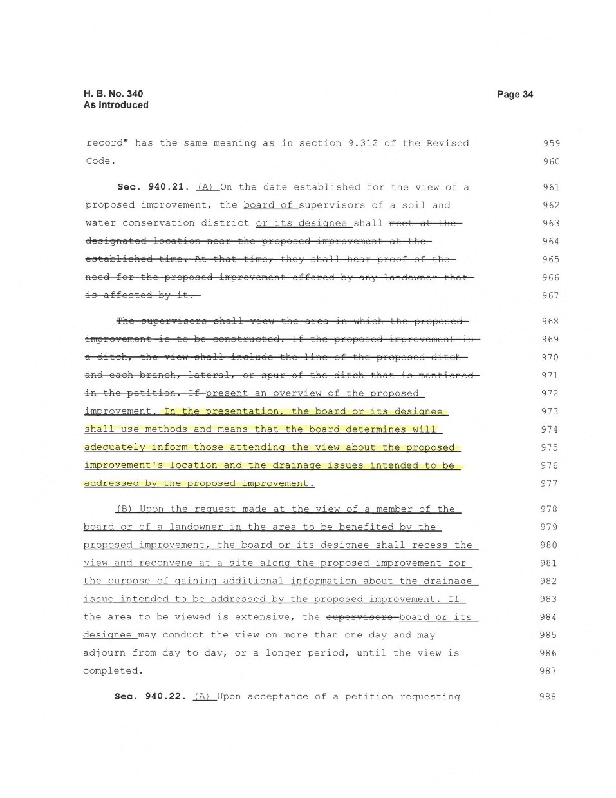
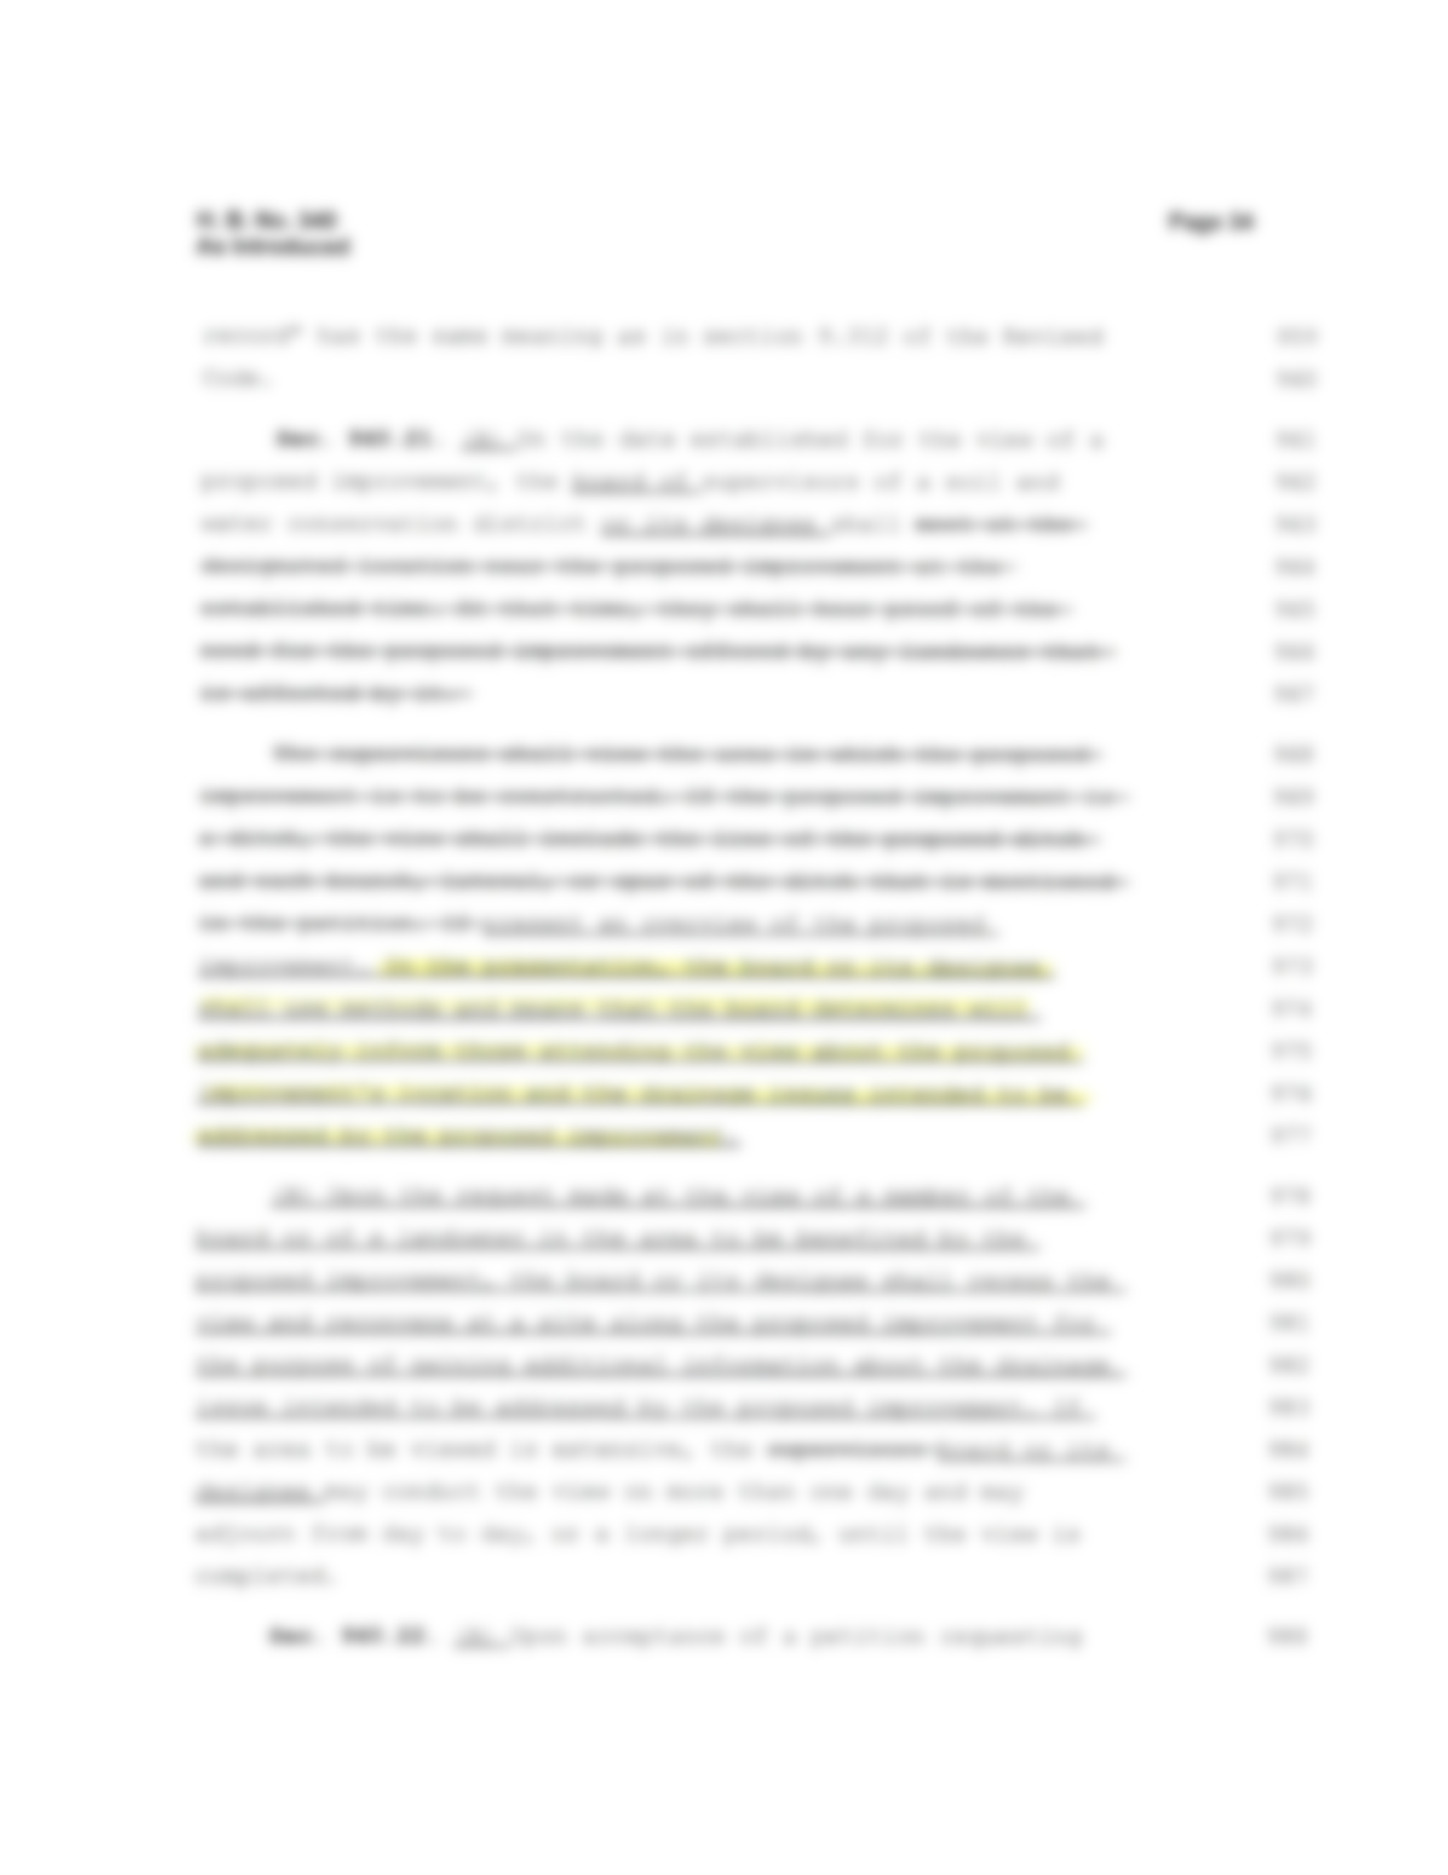

Slide 11
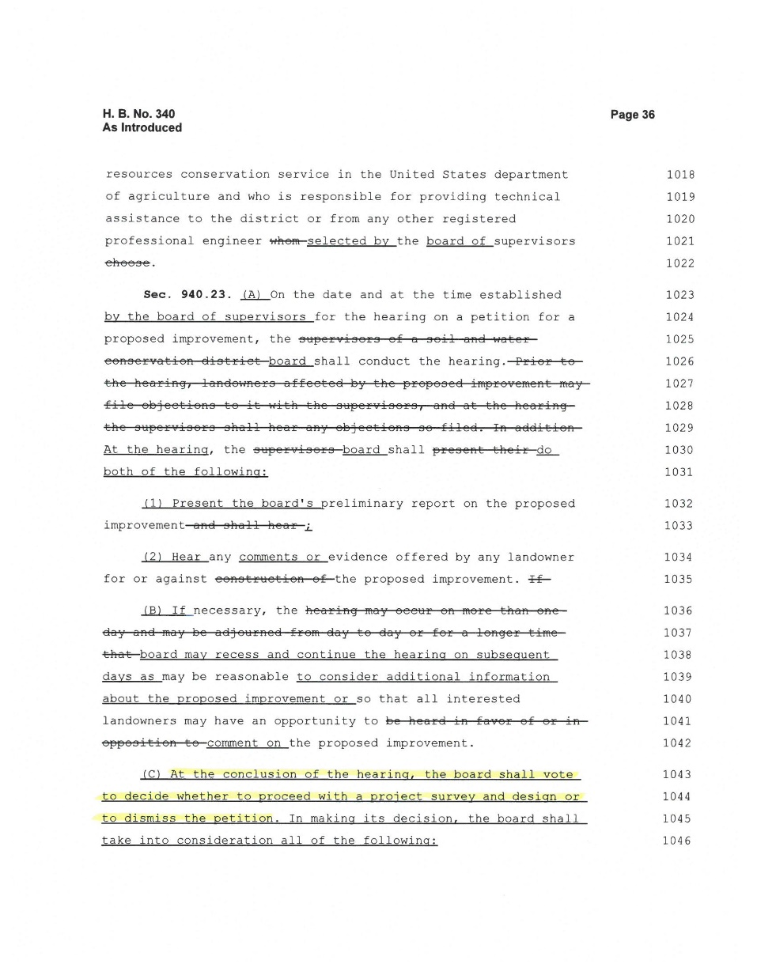
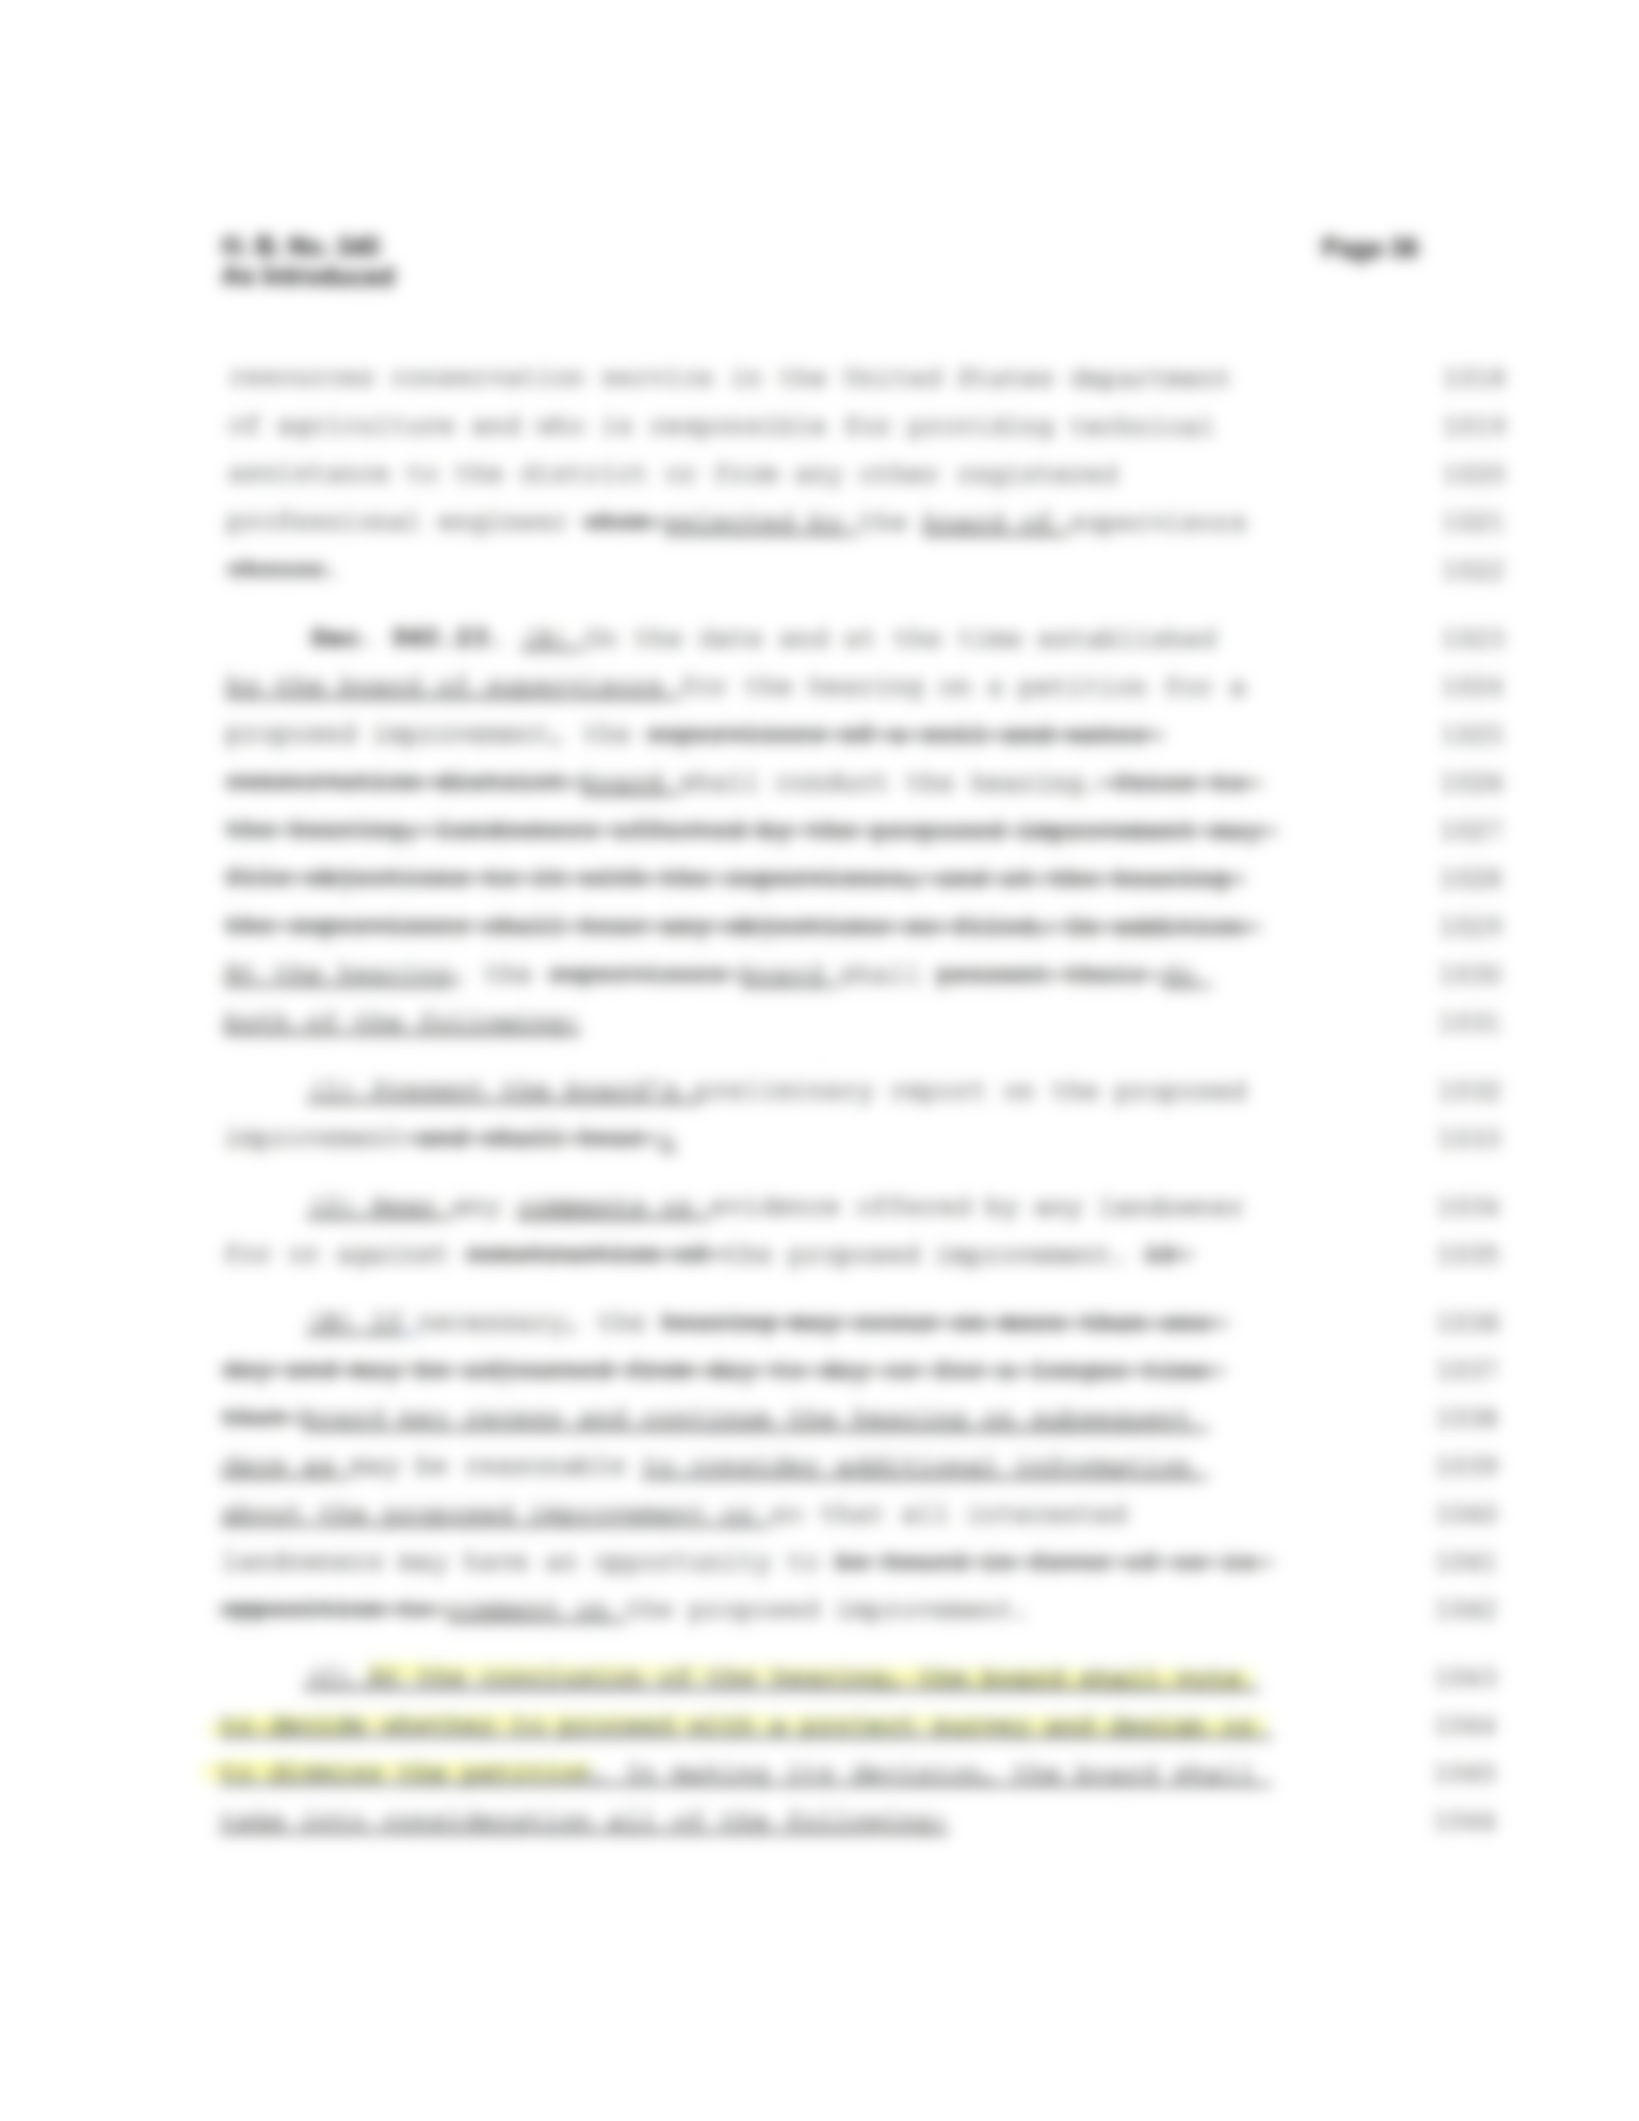

Slide 12
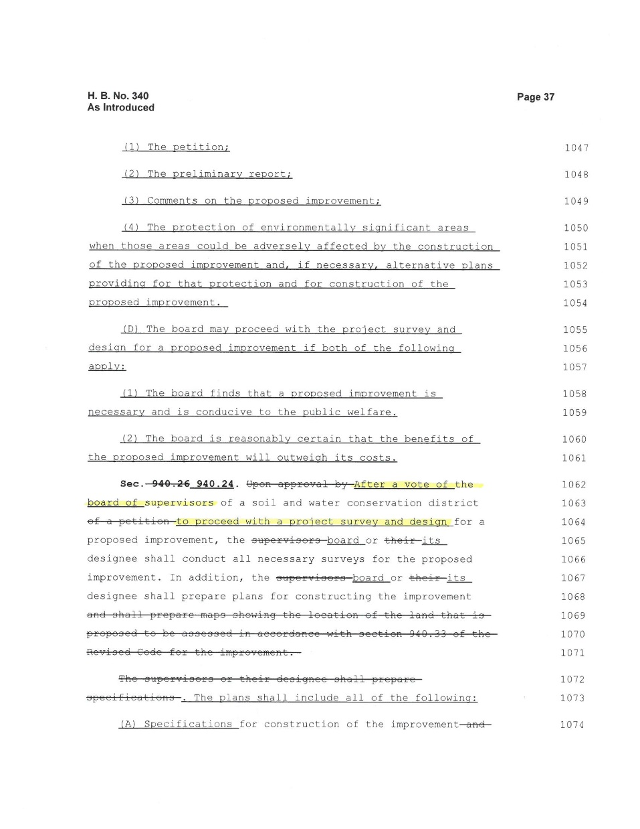
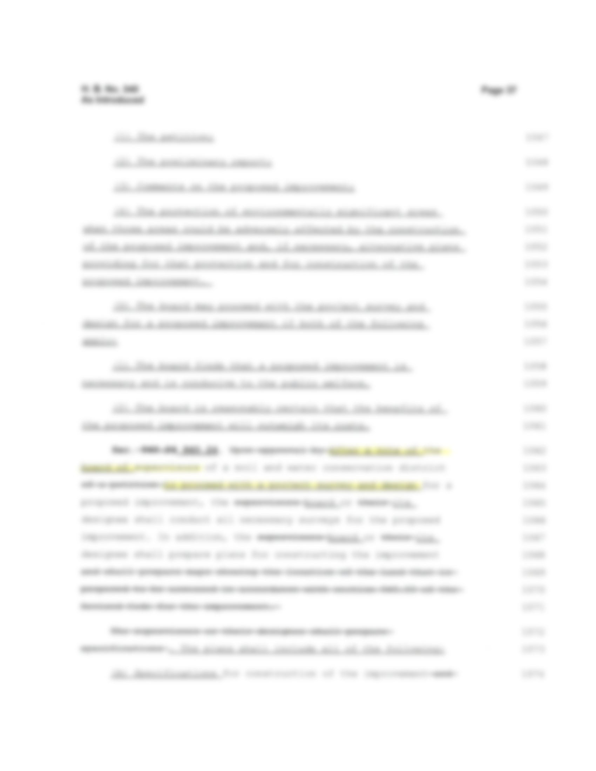

Slide 13
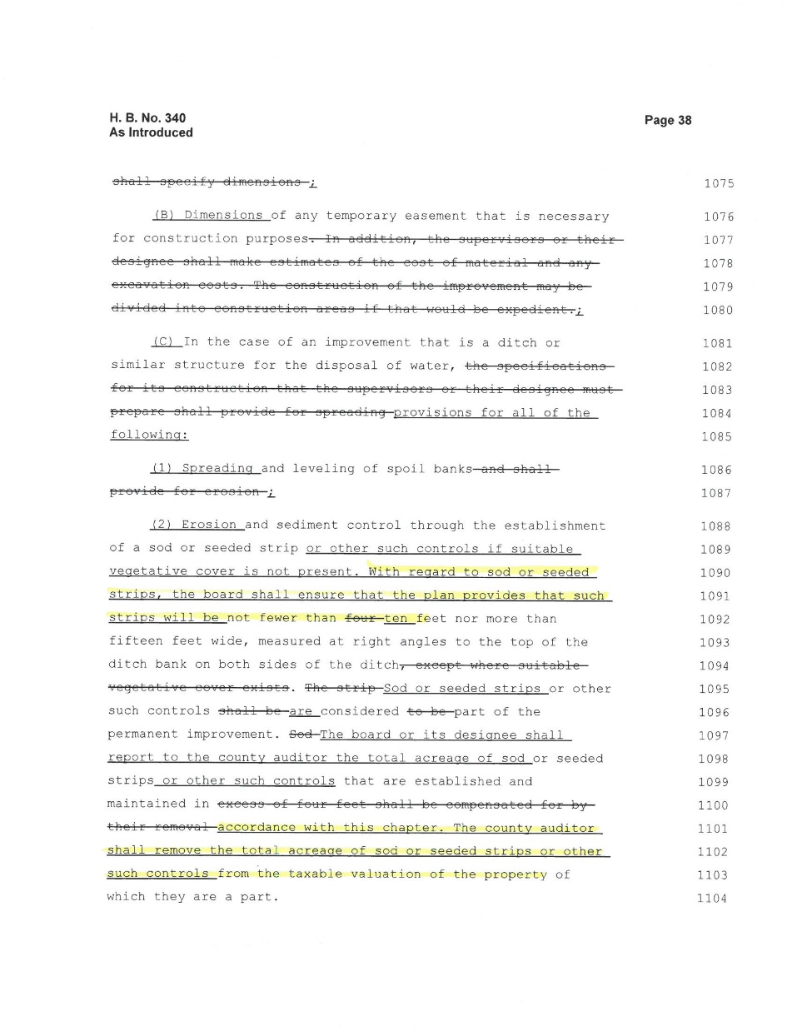
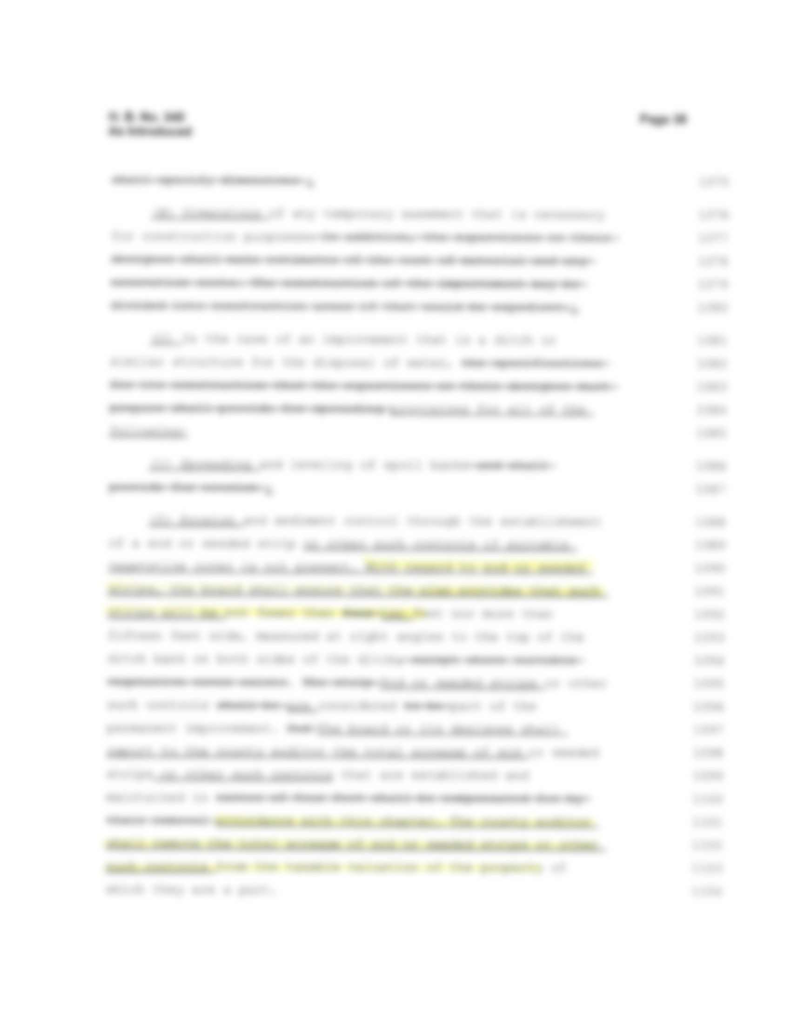

Slide 14
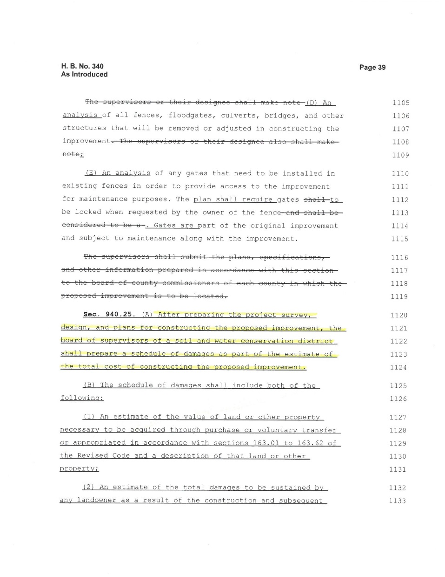
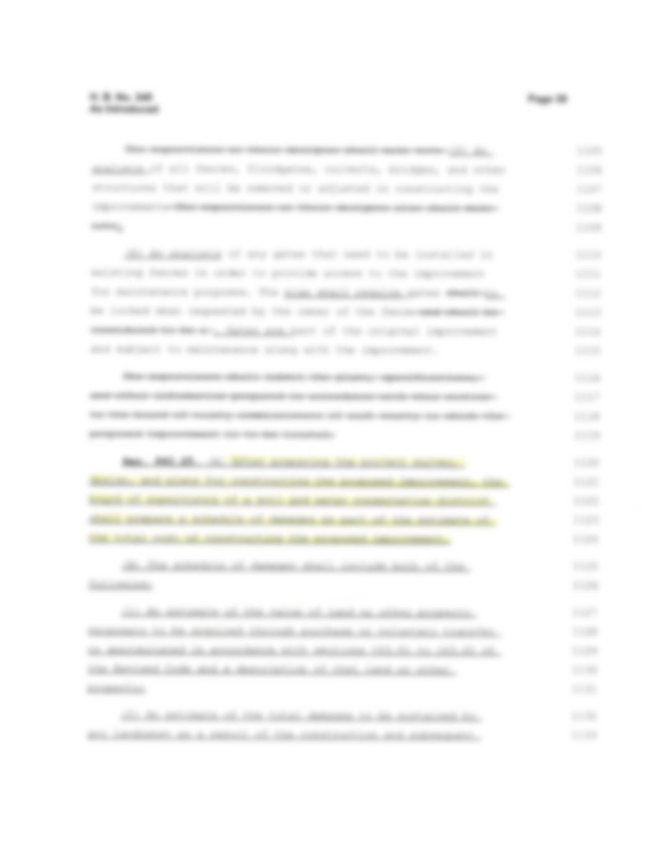

Slide 15
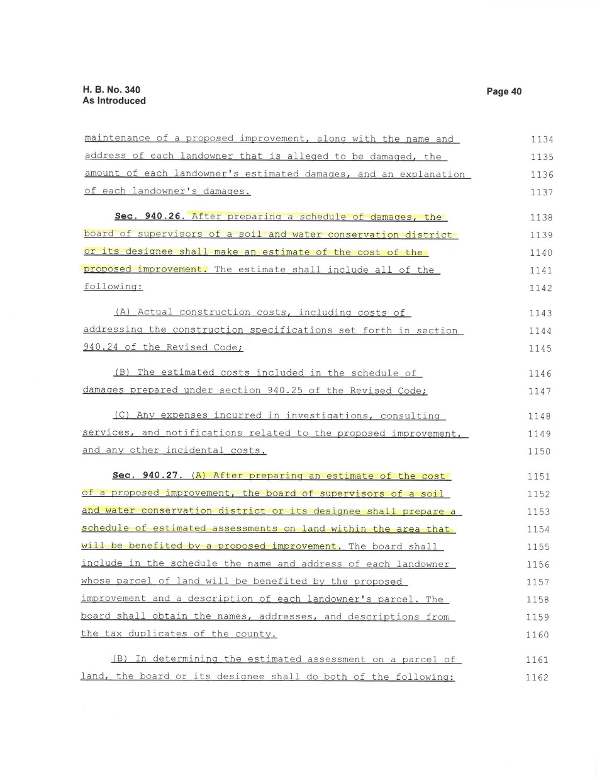
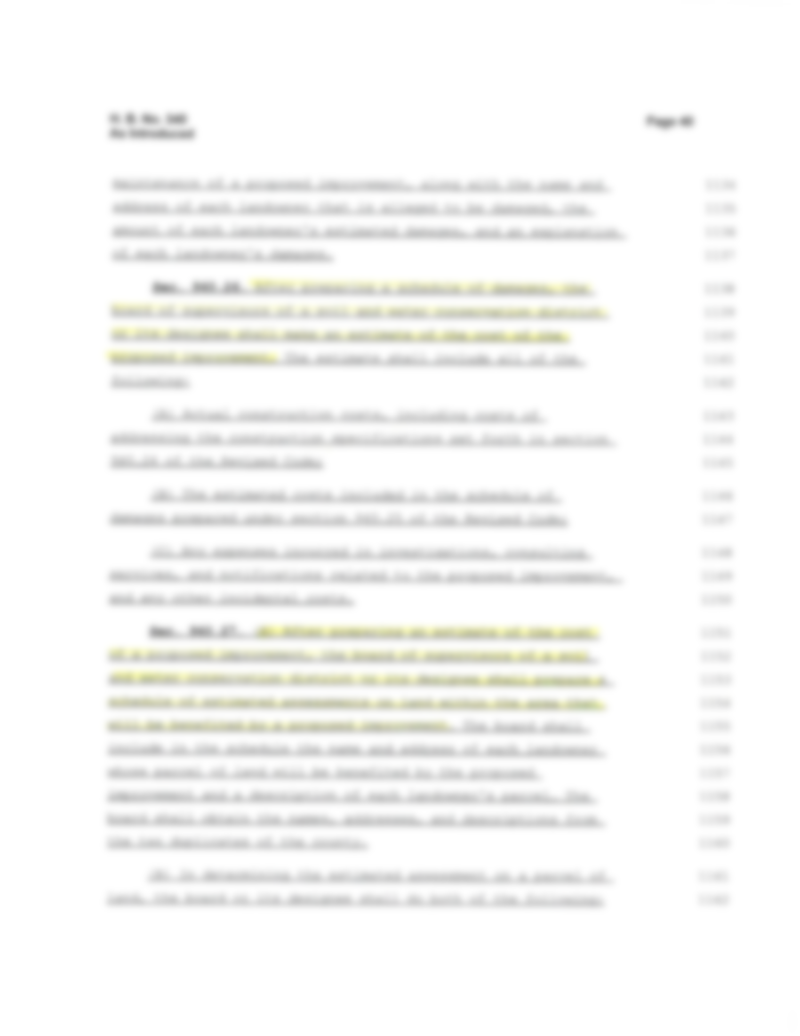

Slide 16
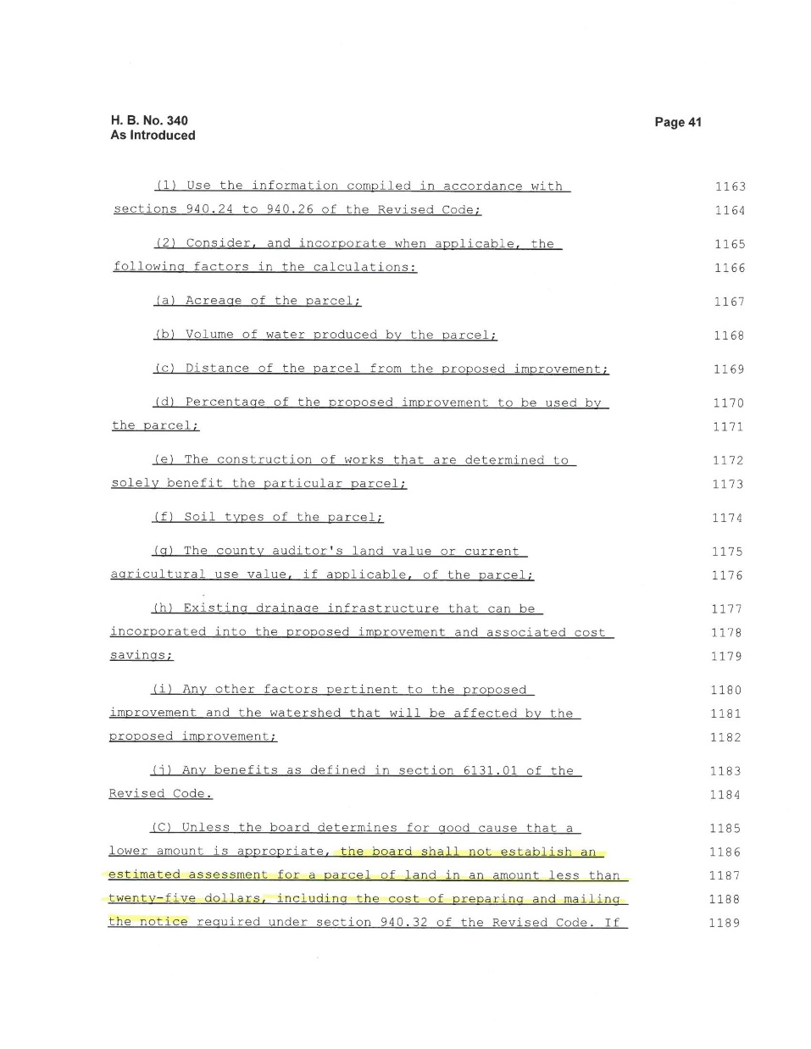

Slide 17
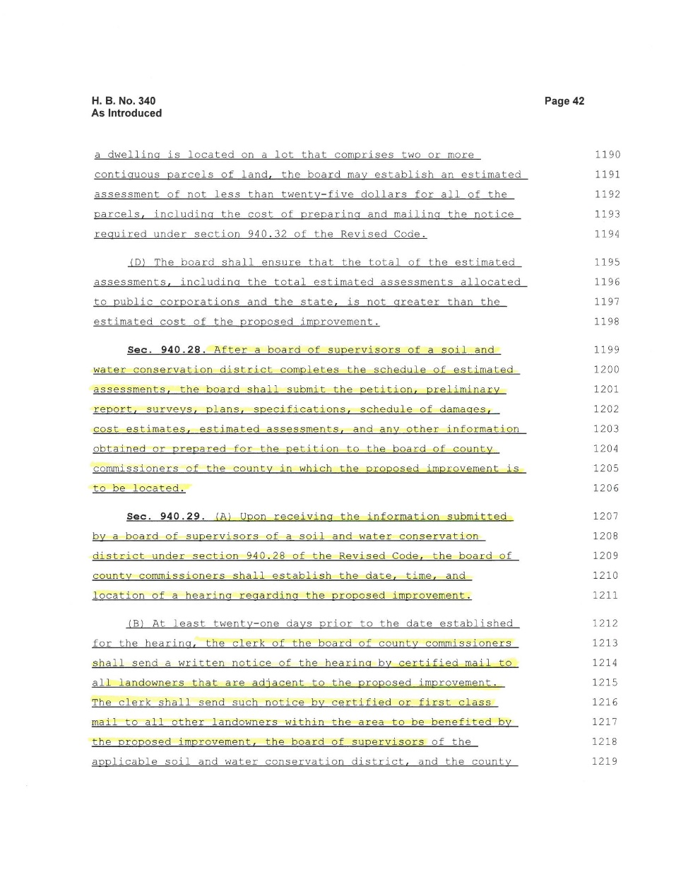

Slide 18
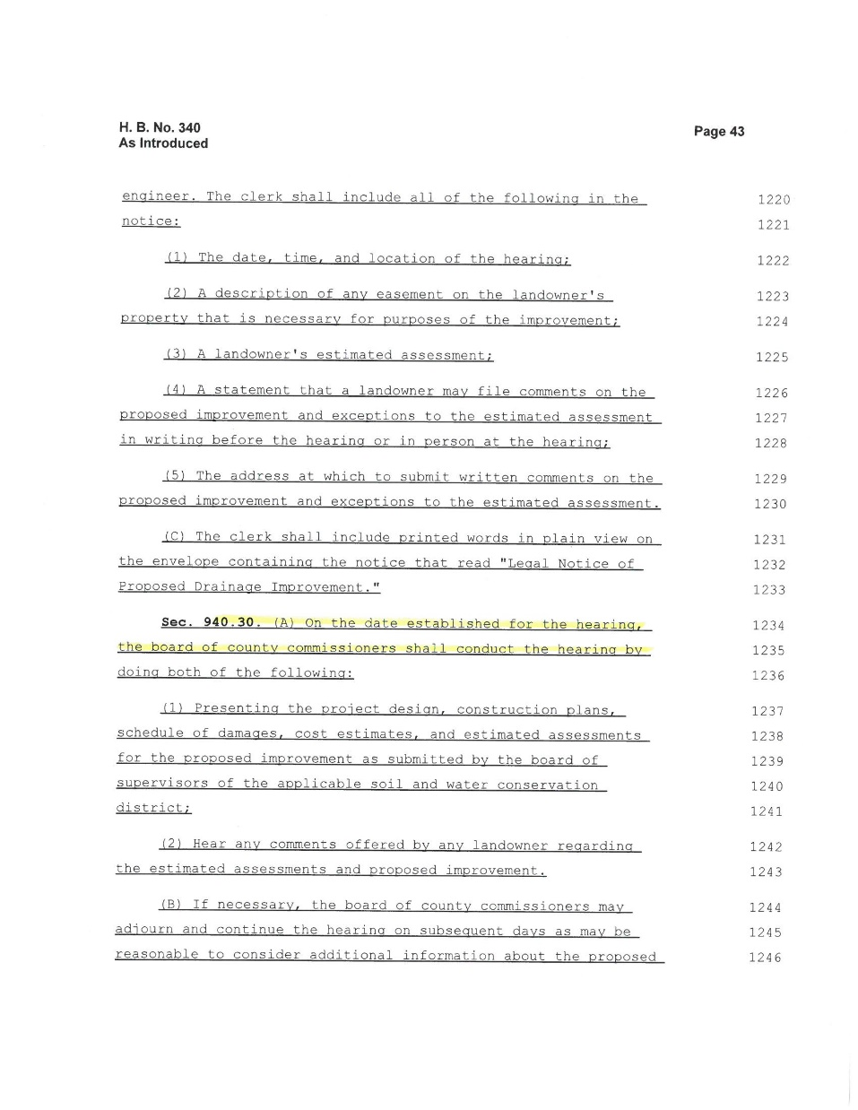

Slide 19
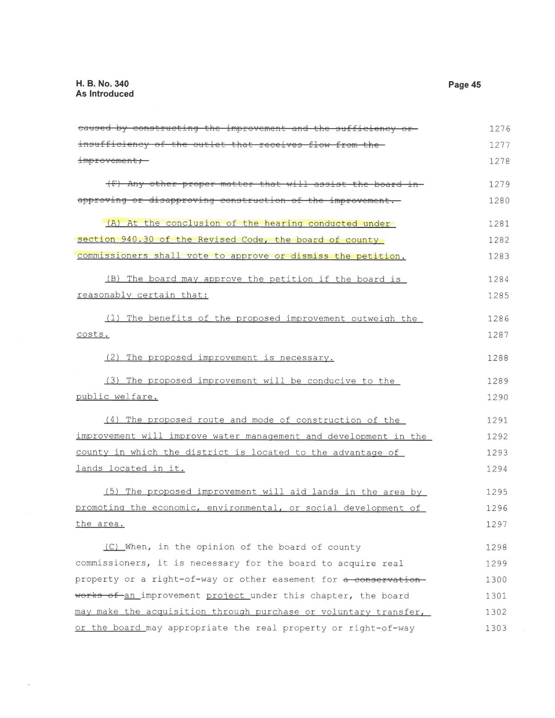
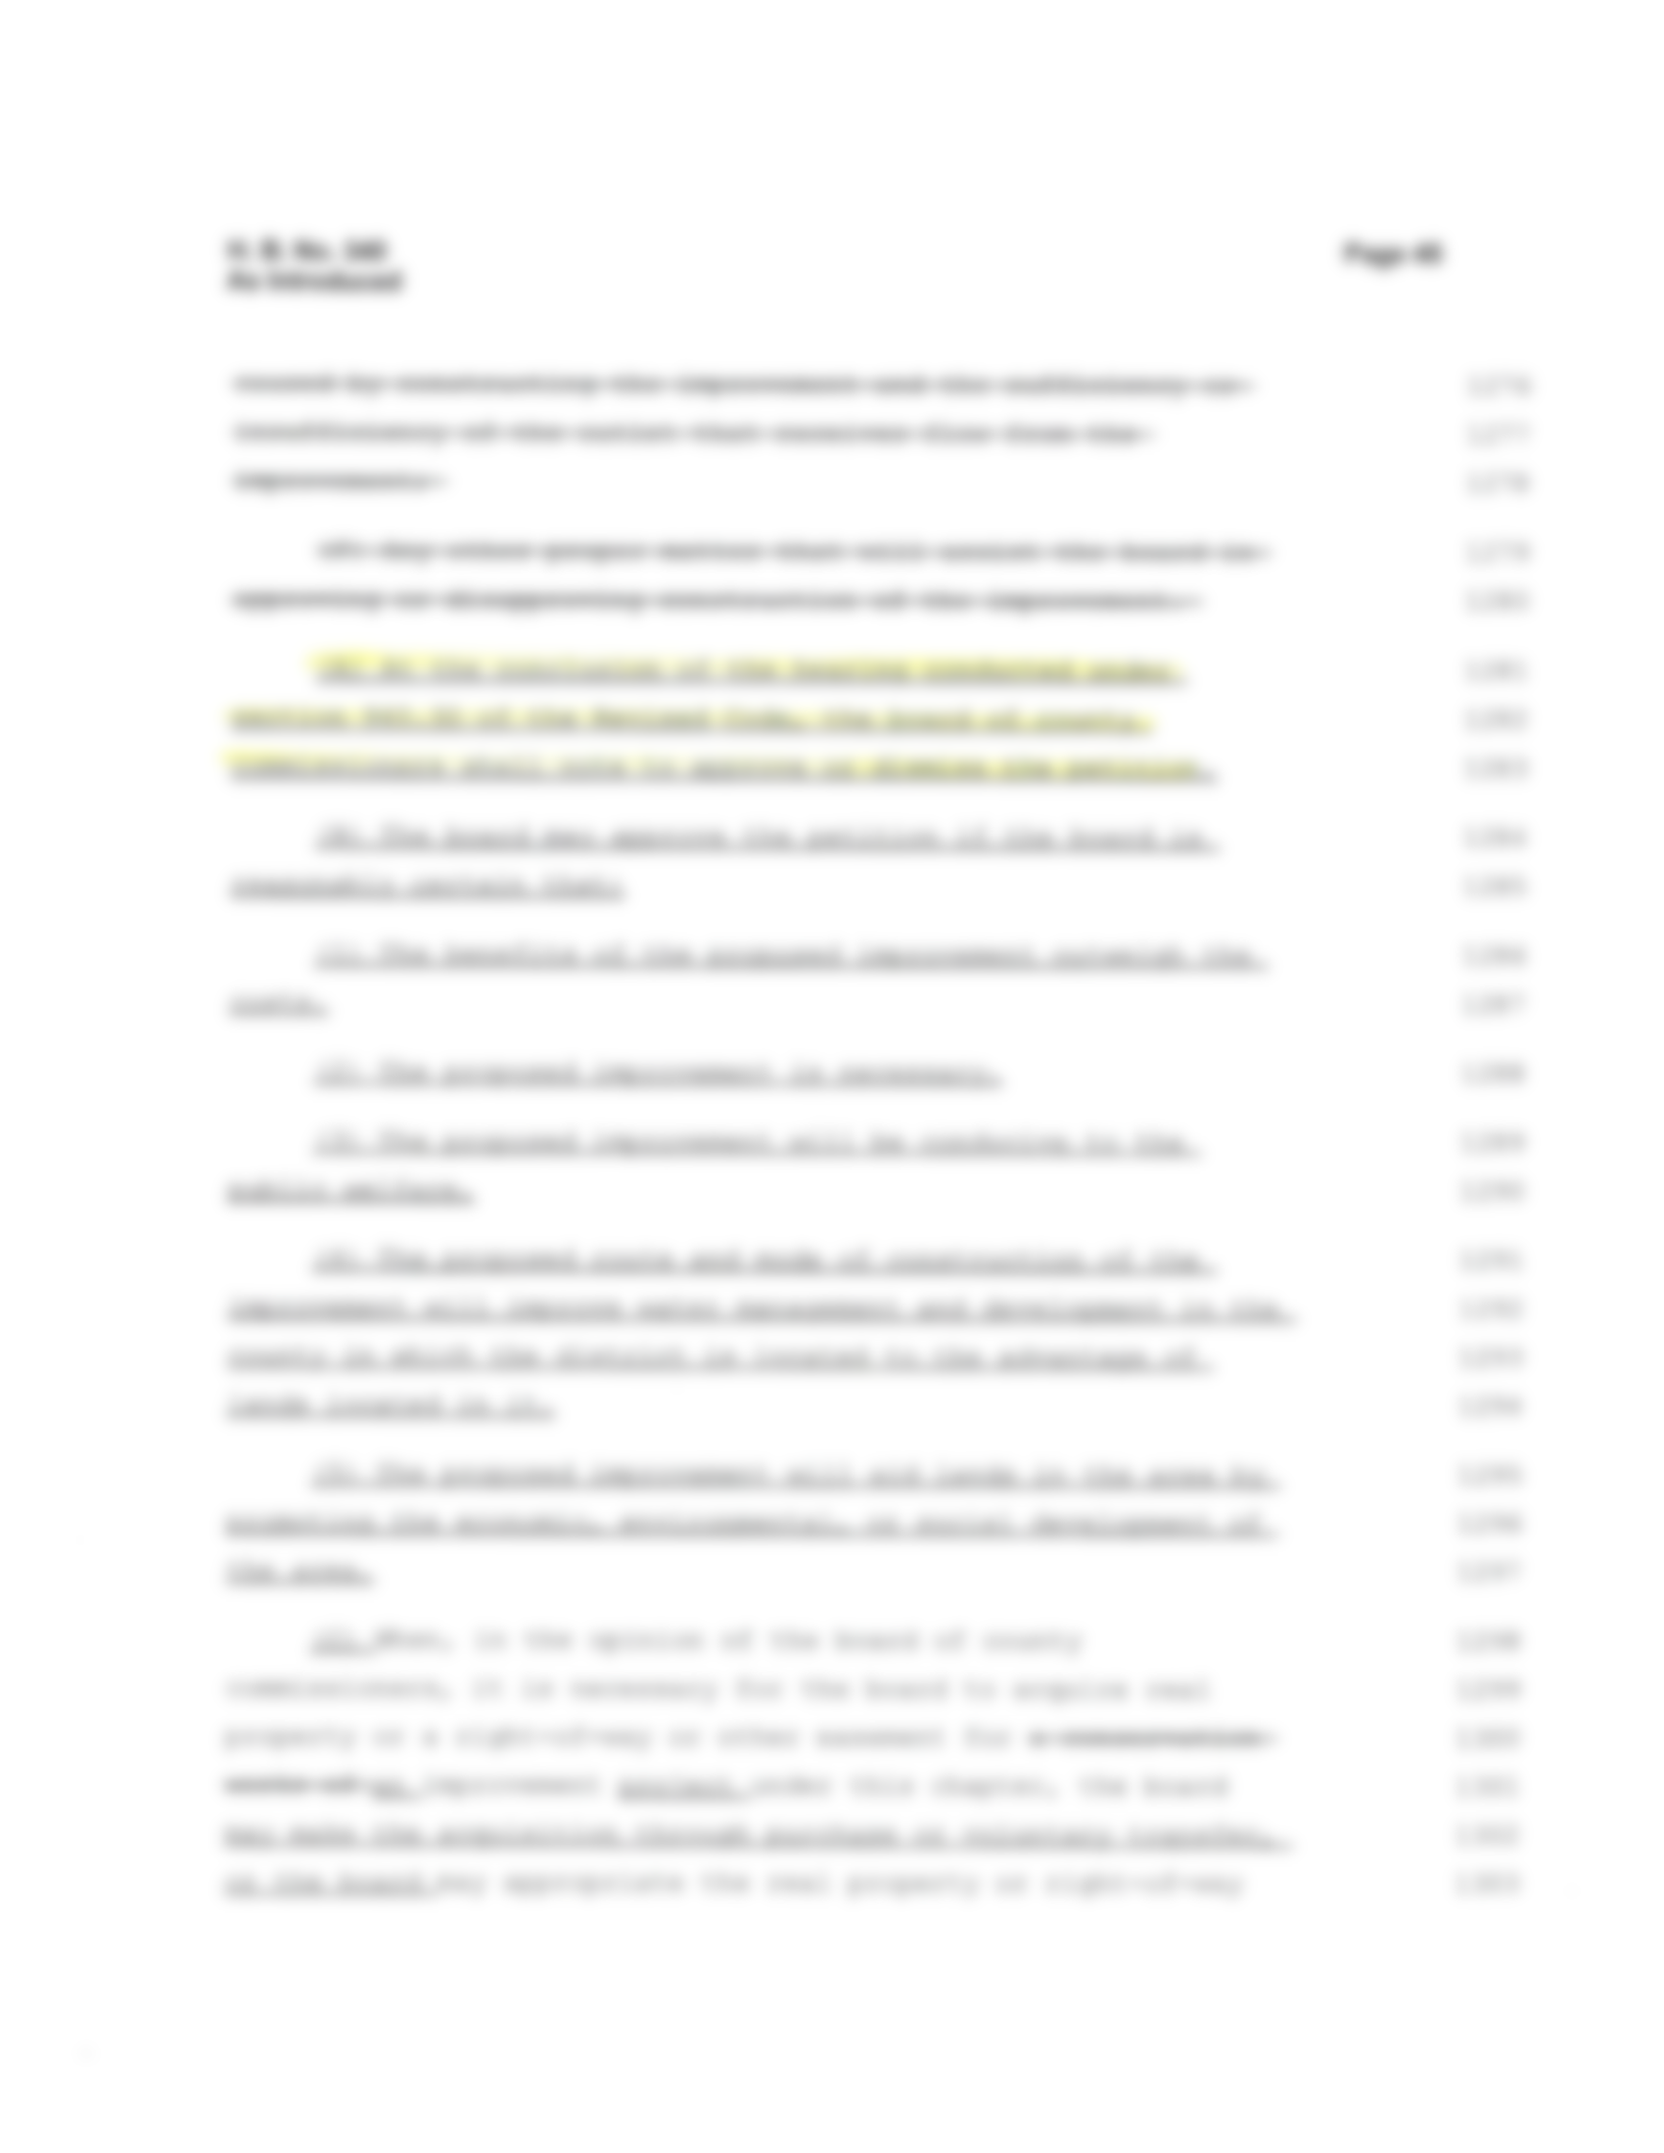

Slide 20
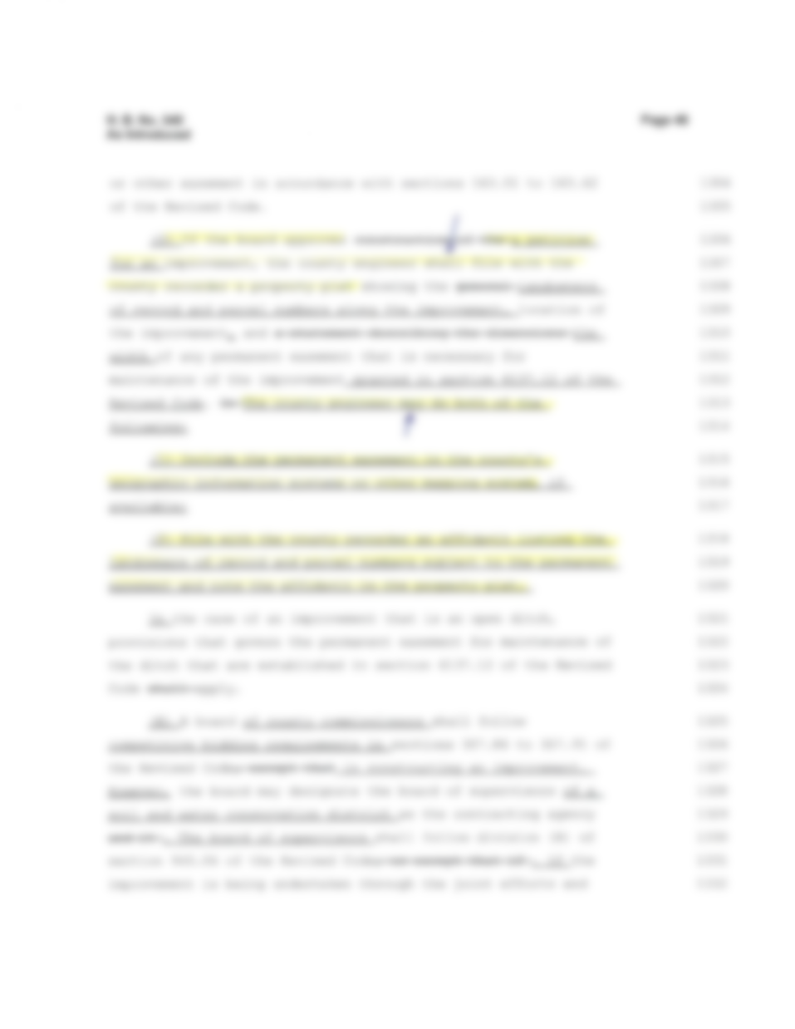
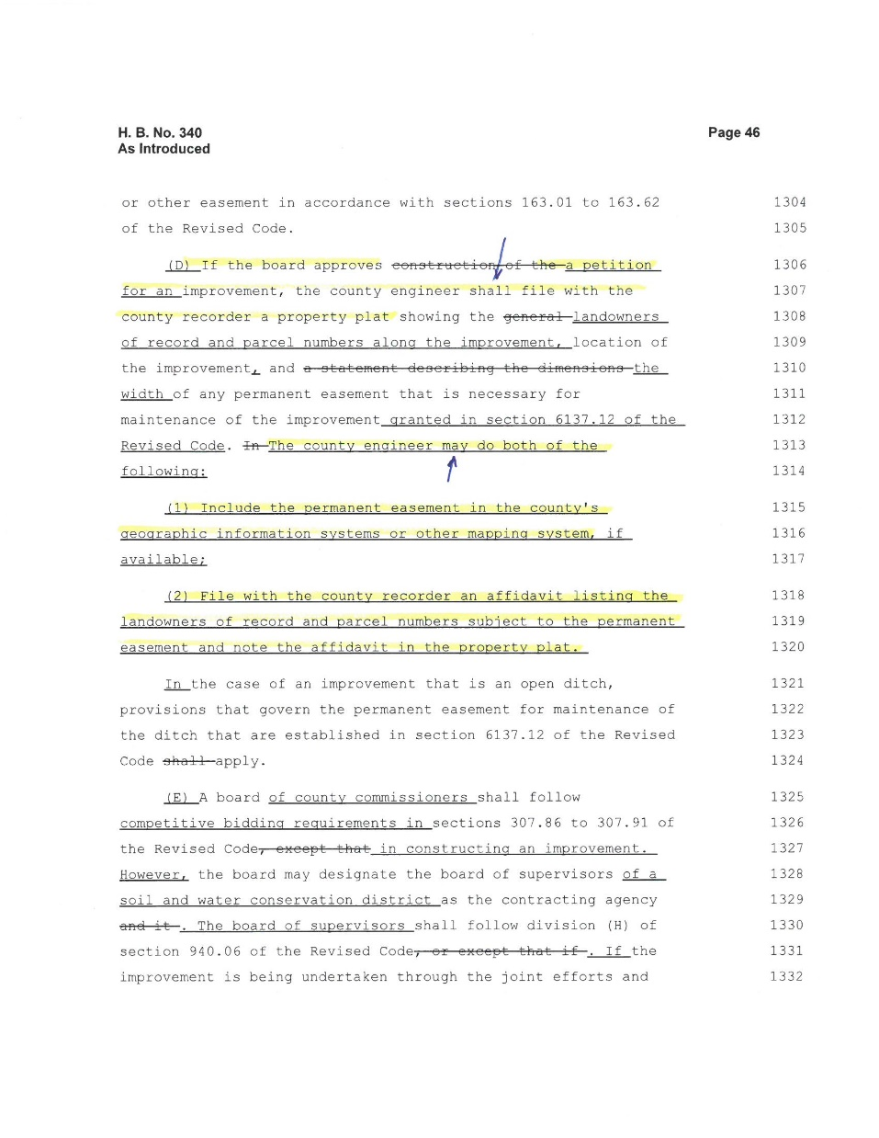

Slide 21
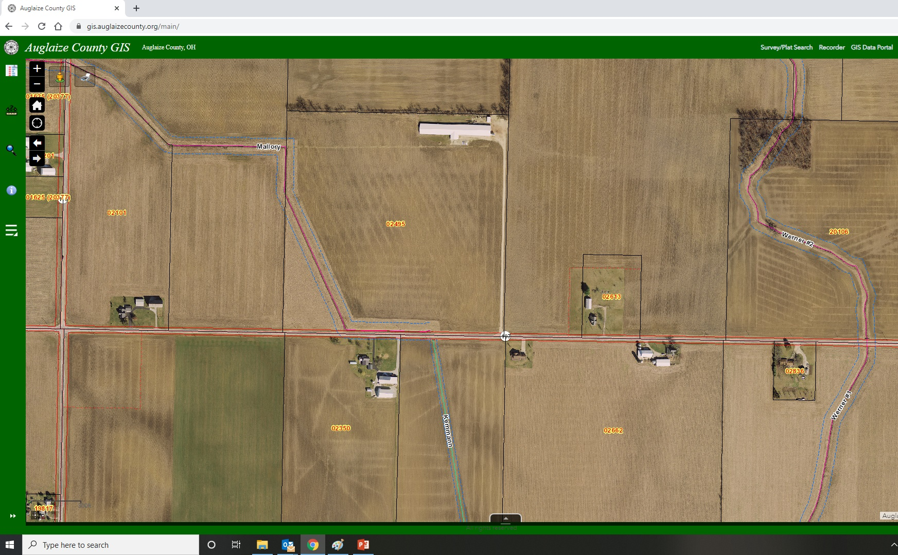

Slide 22
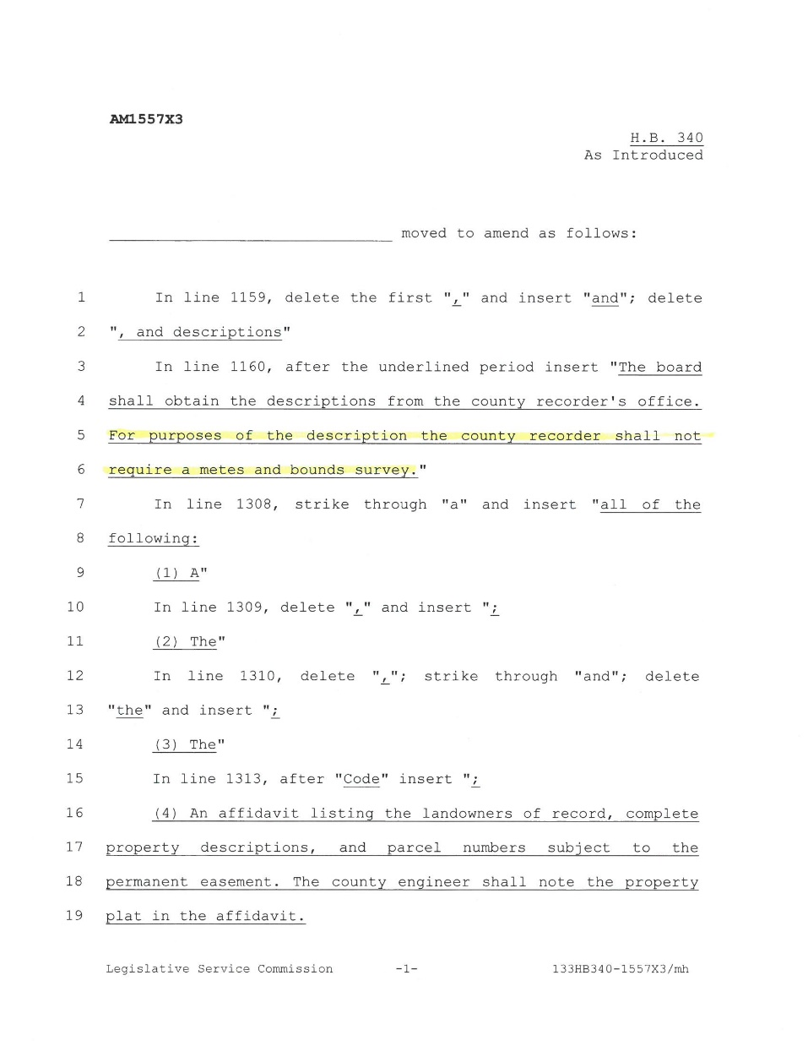
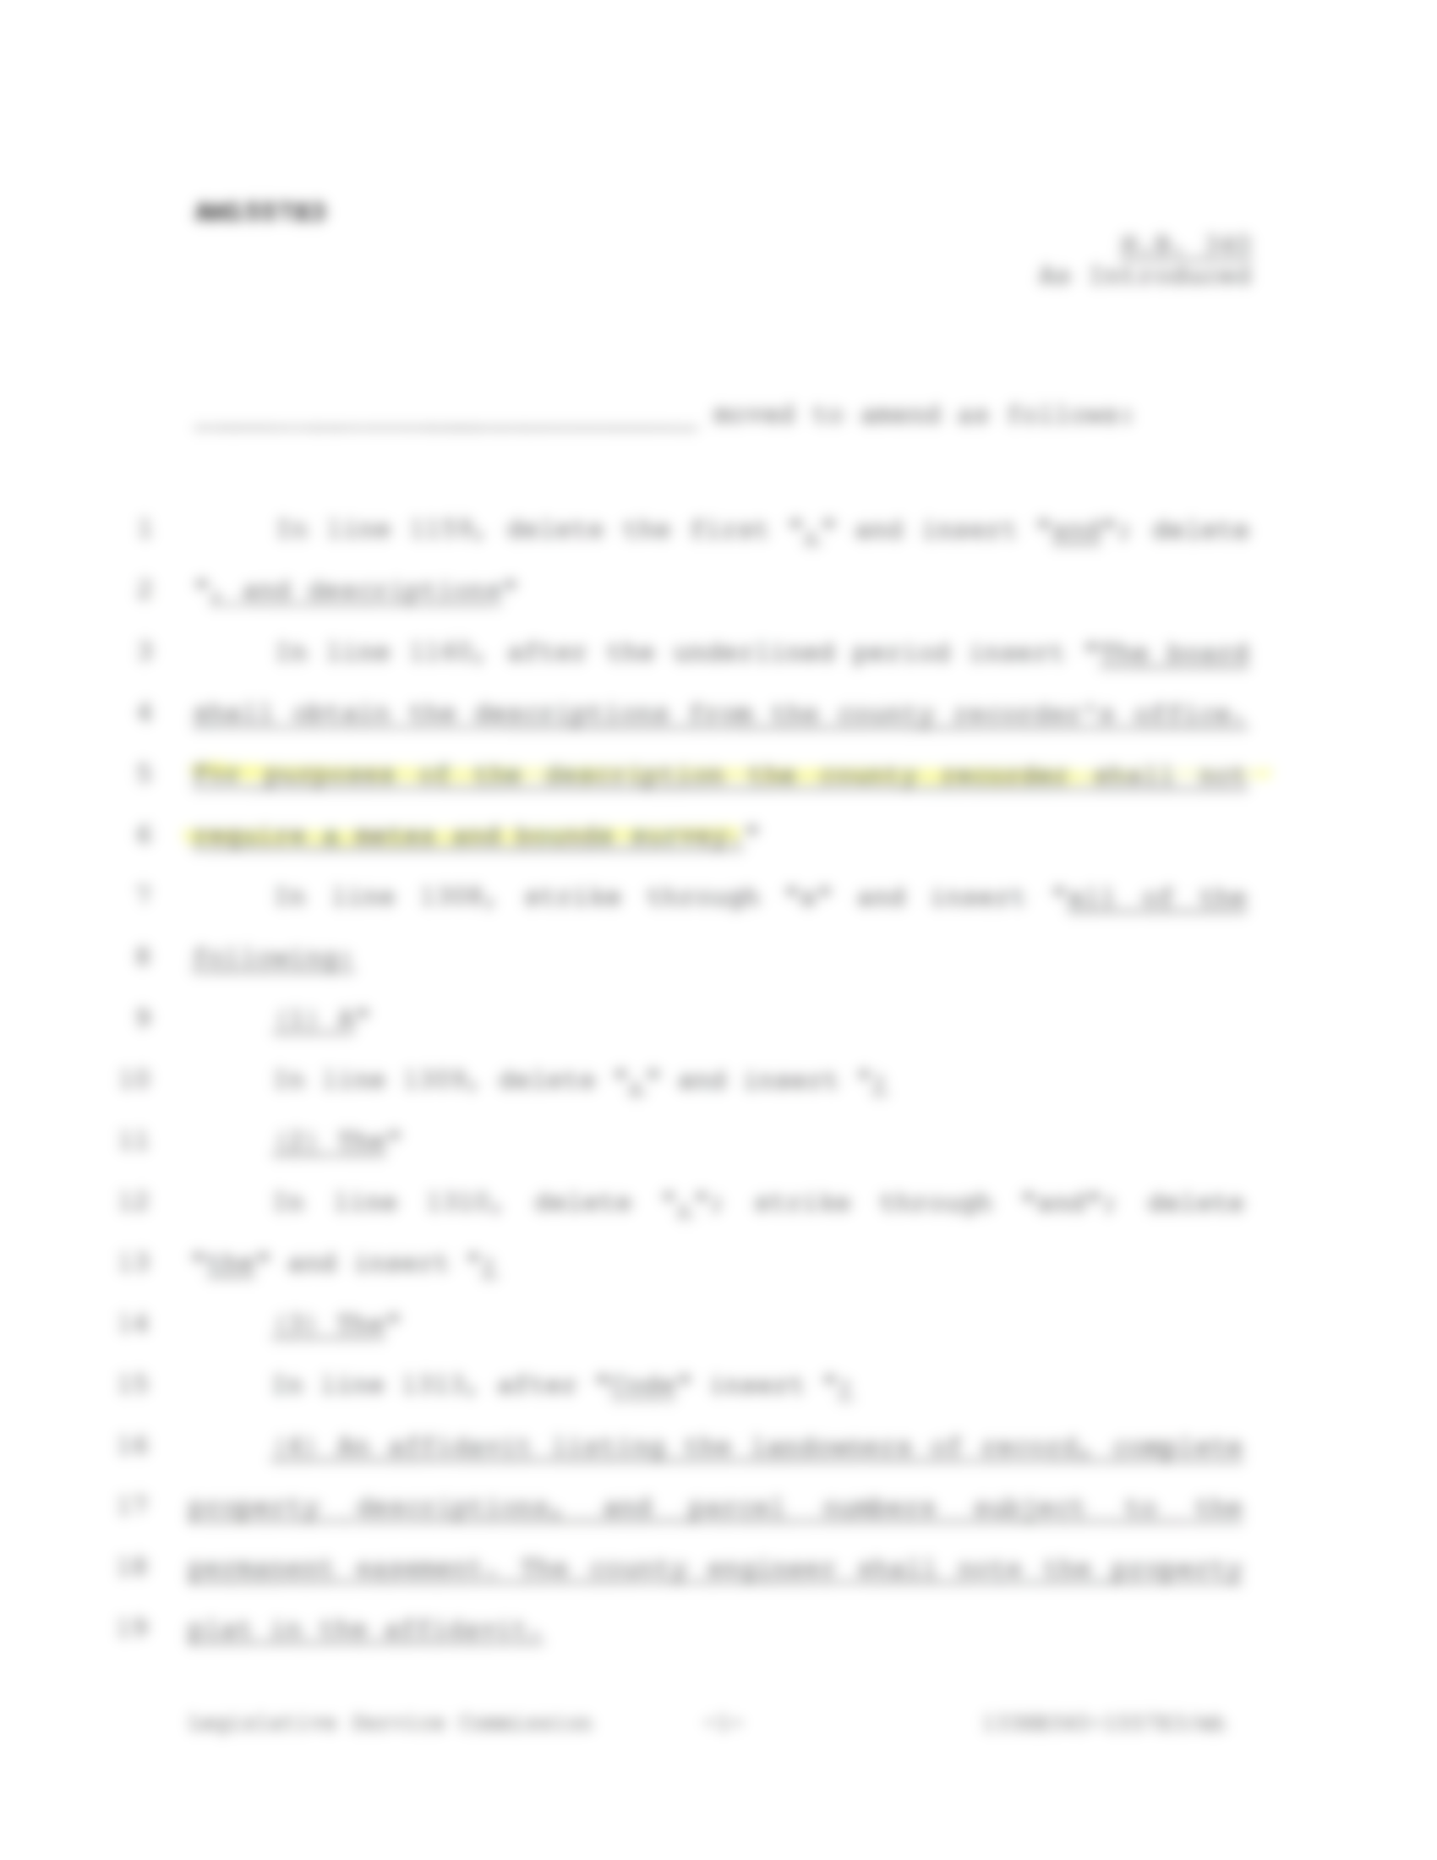

Slide 23
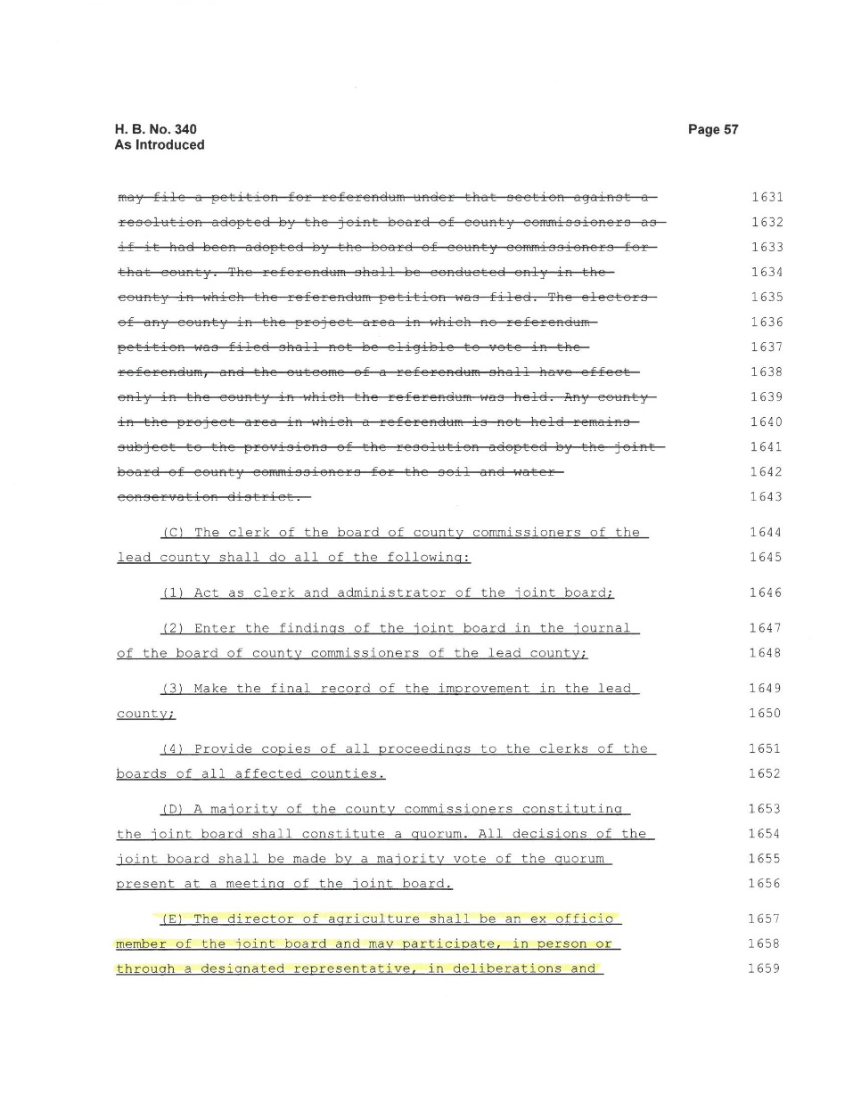
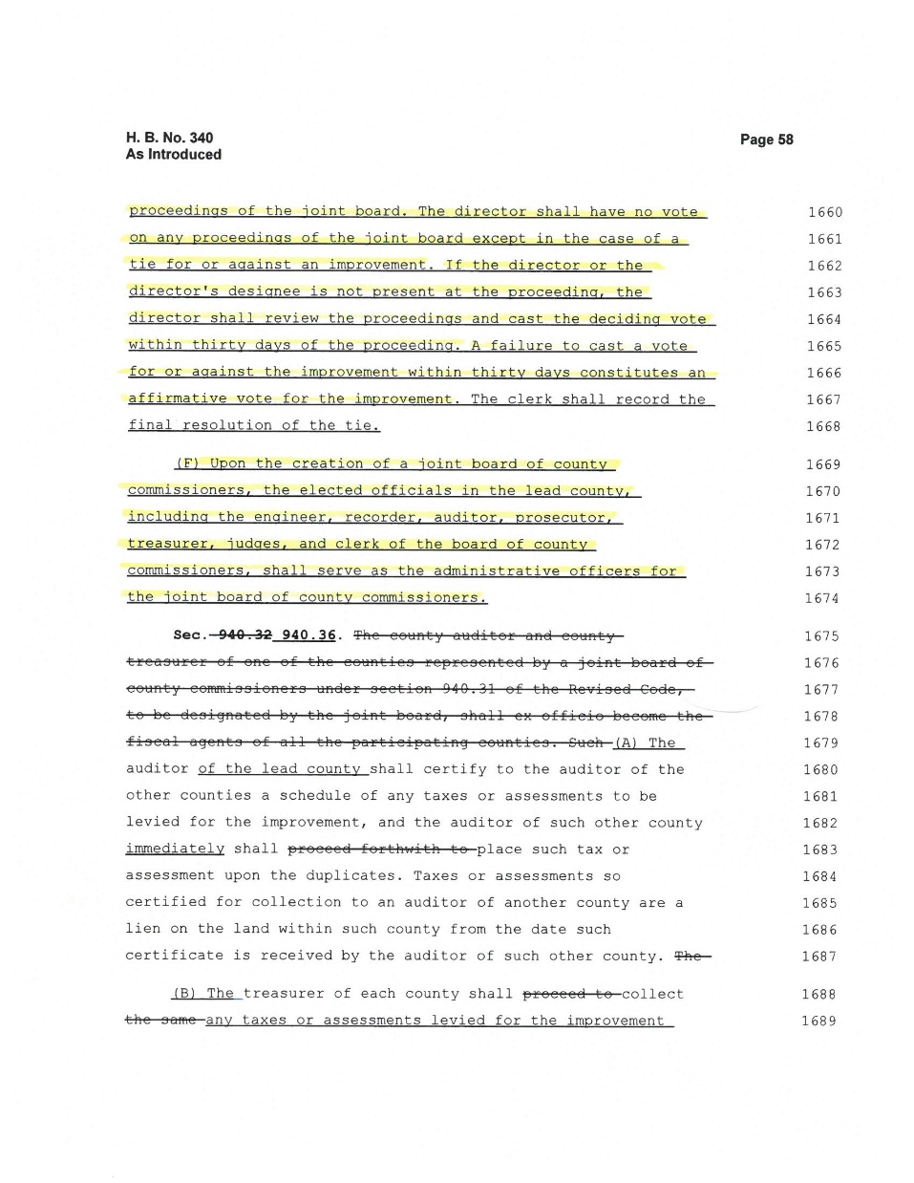

Slide 25
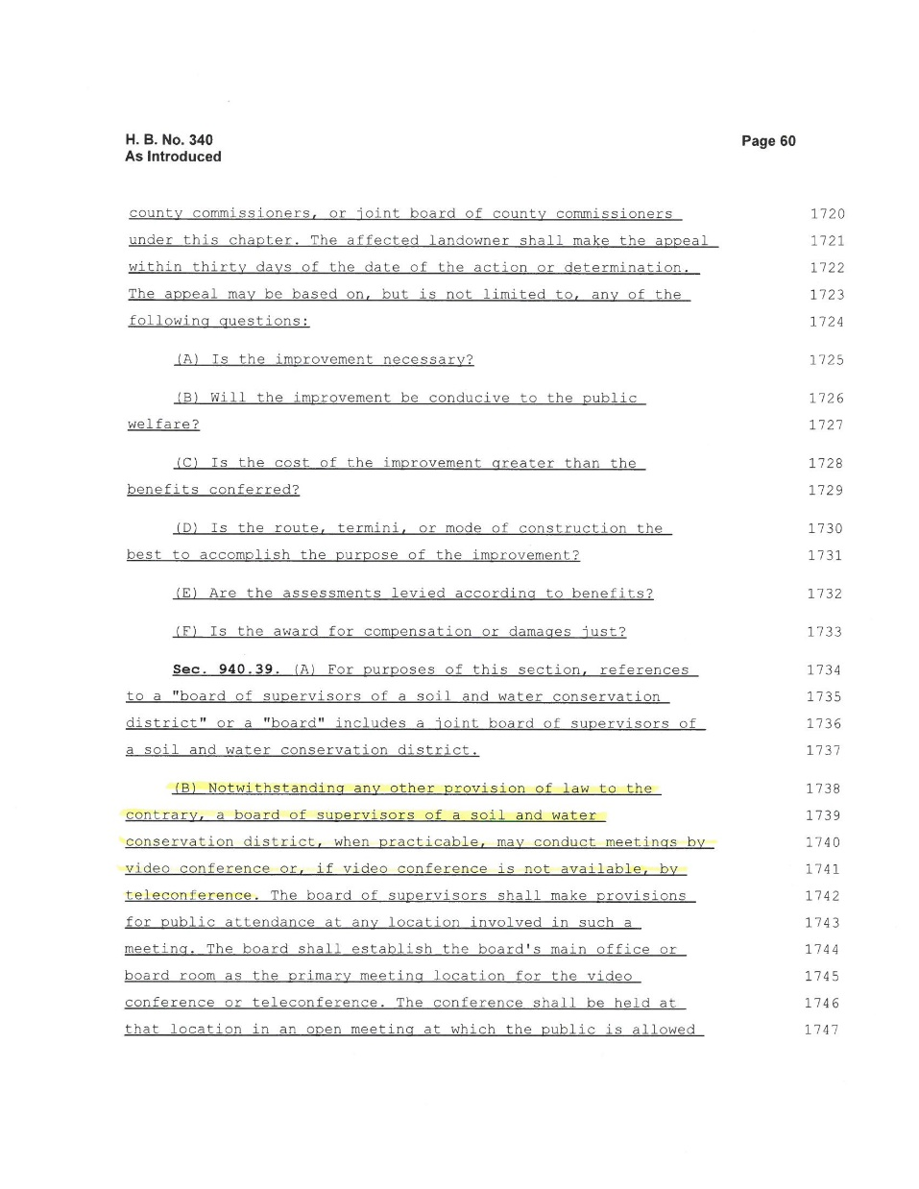
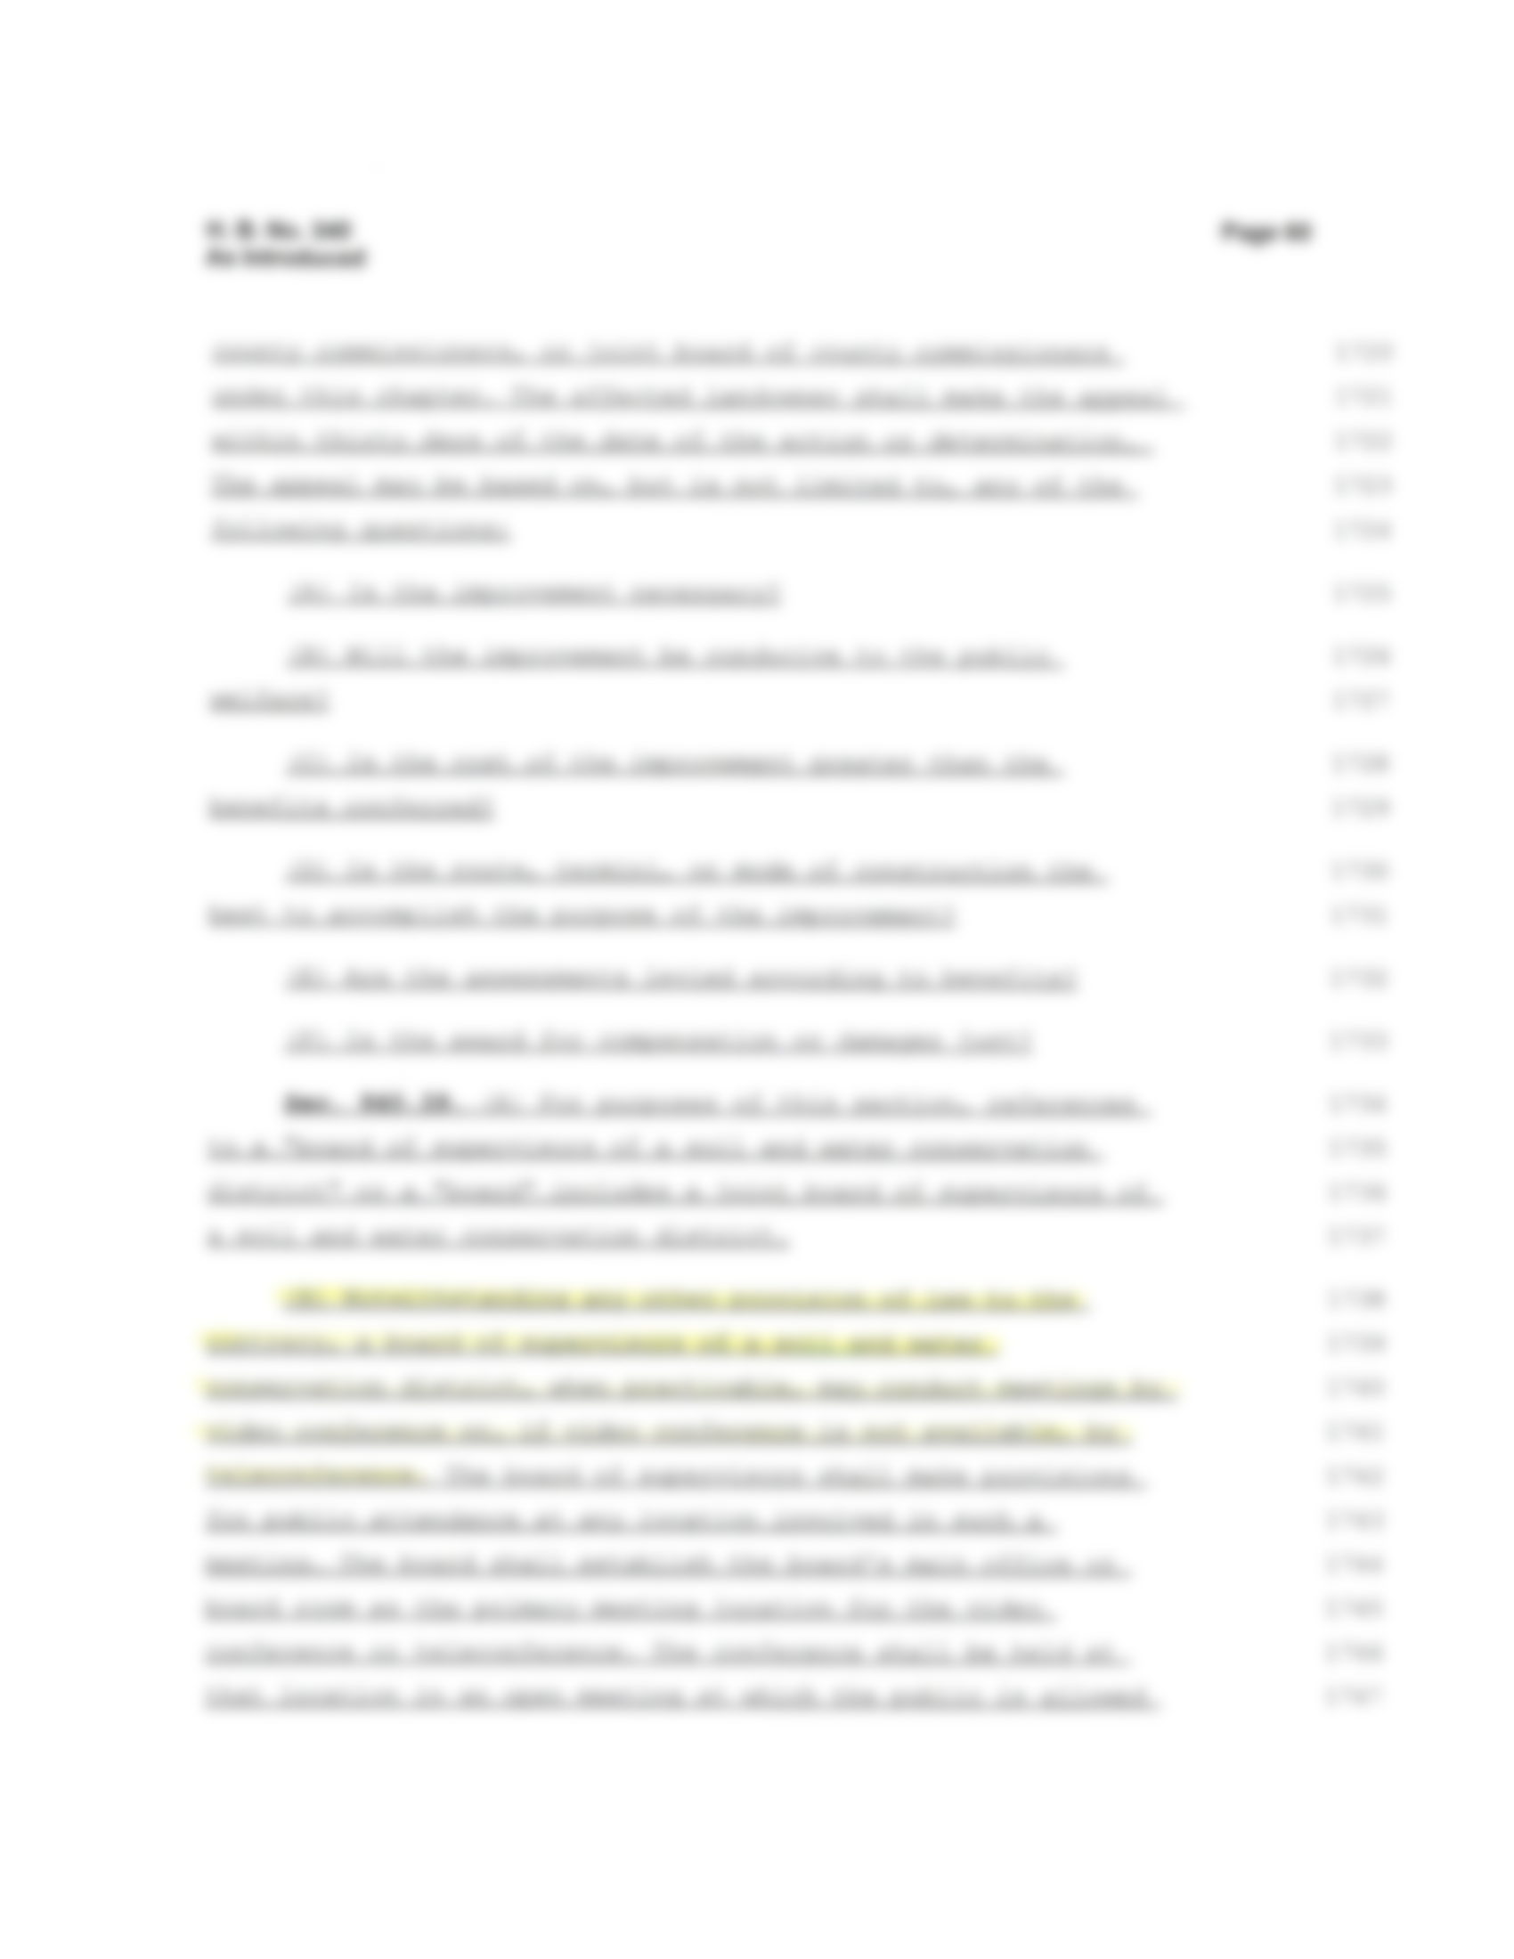

Slide 26
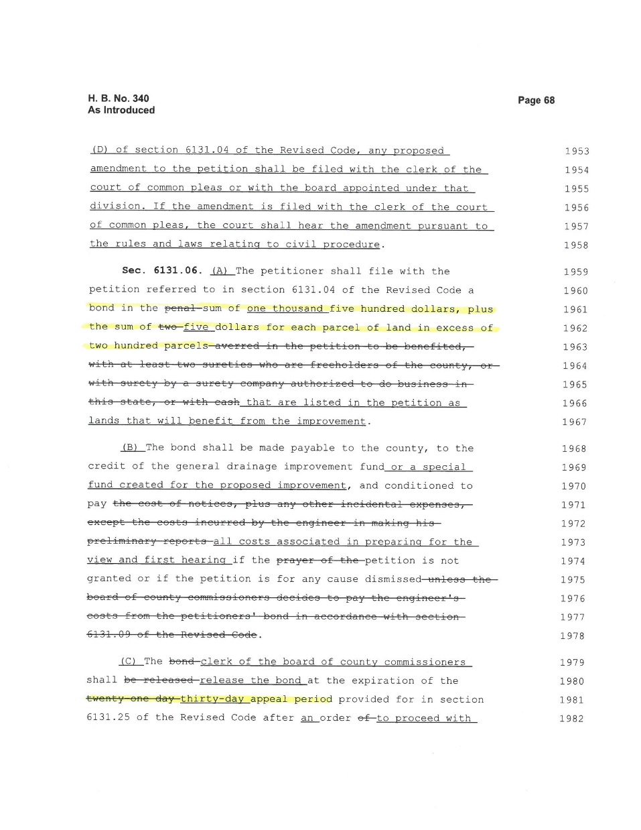
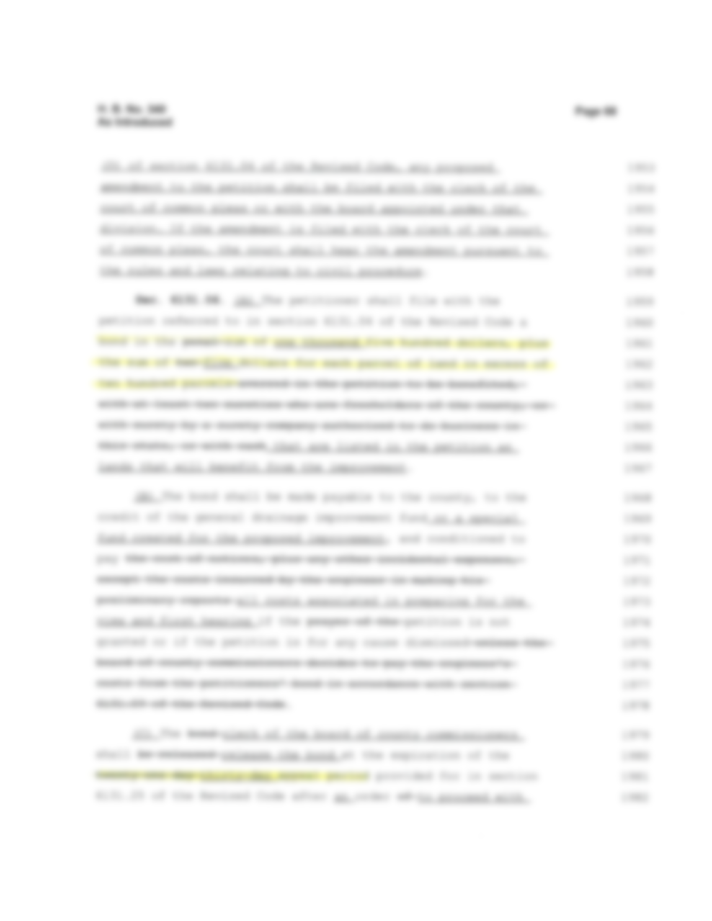

Slide 27
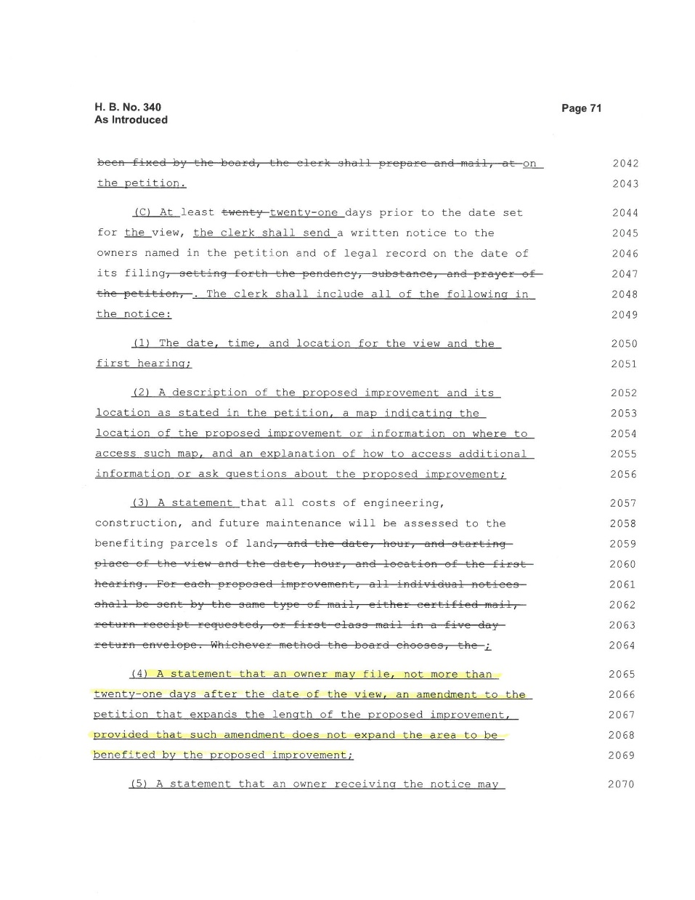
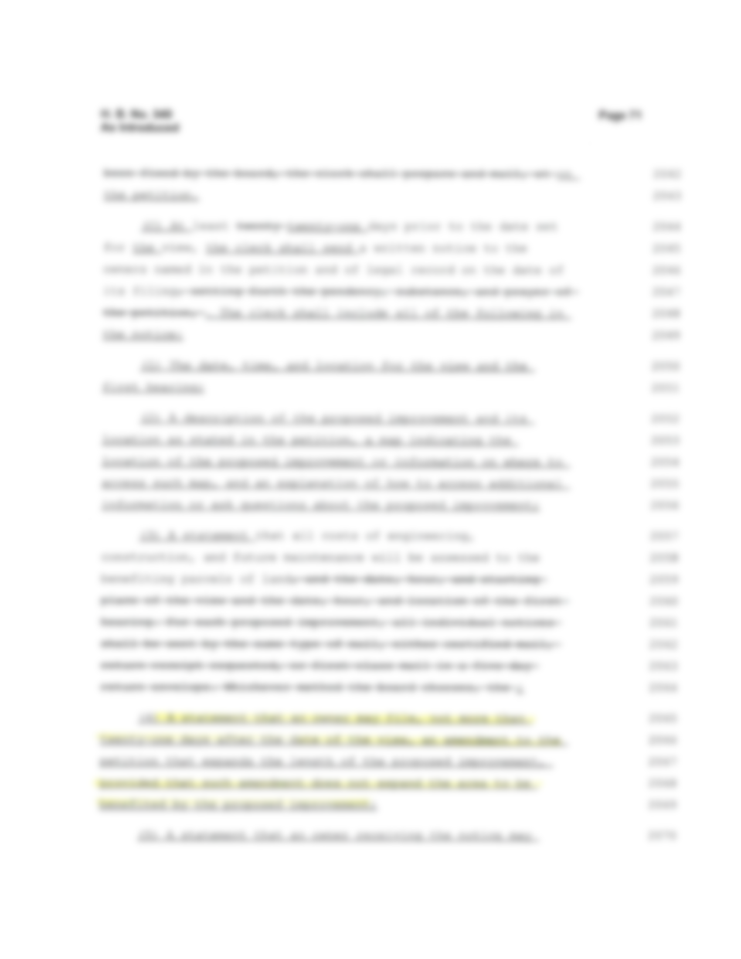

Slide 28
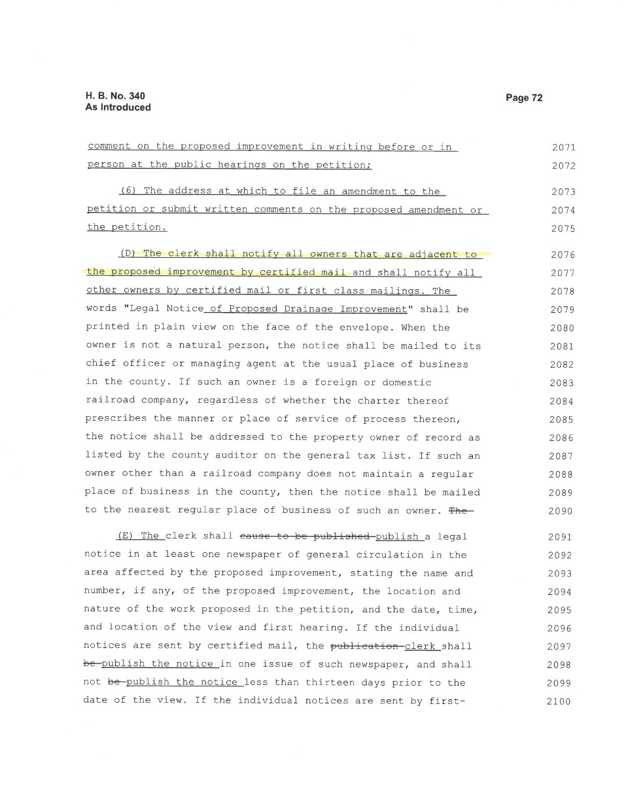
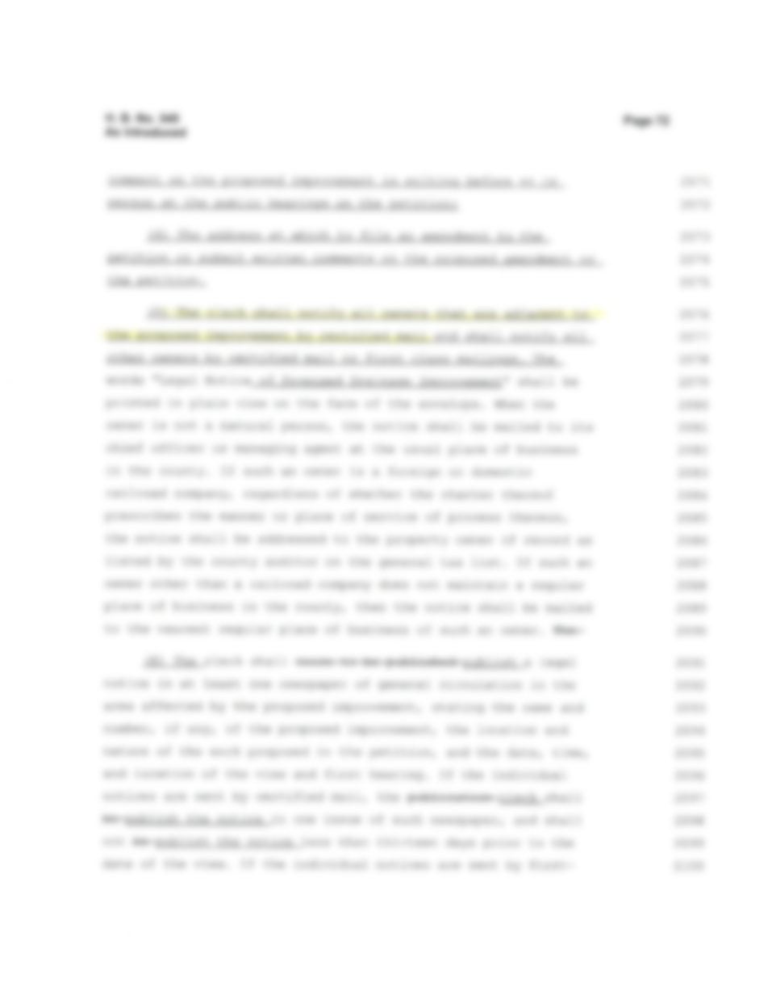

Slide 29
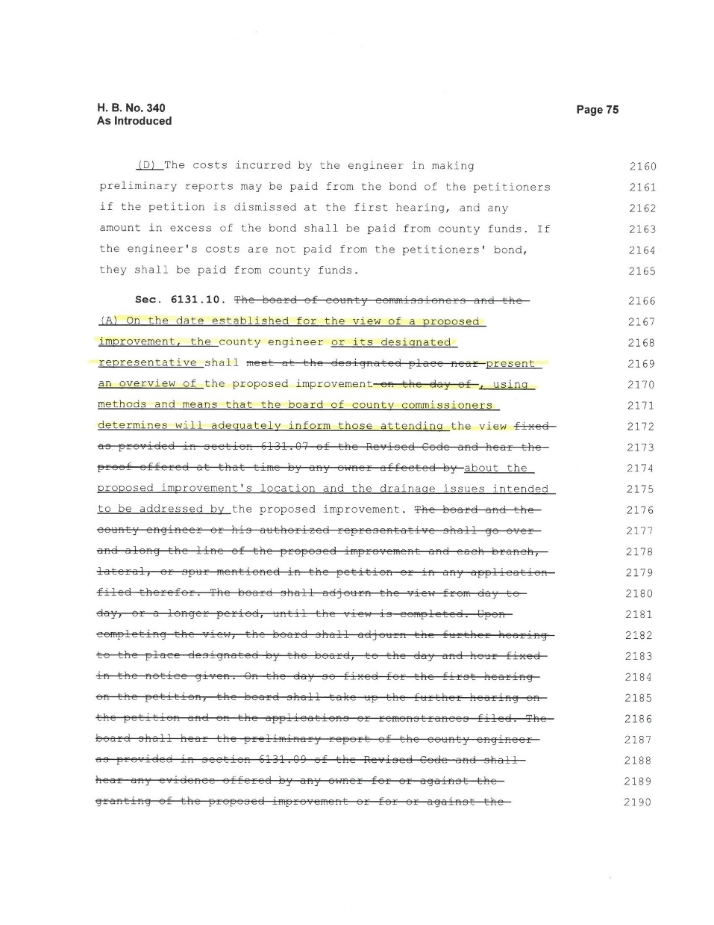
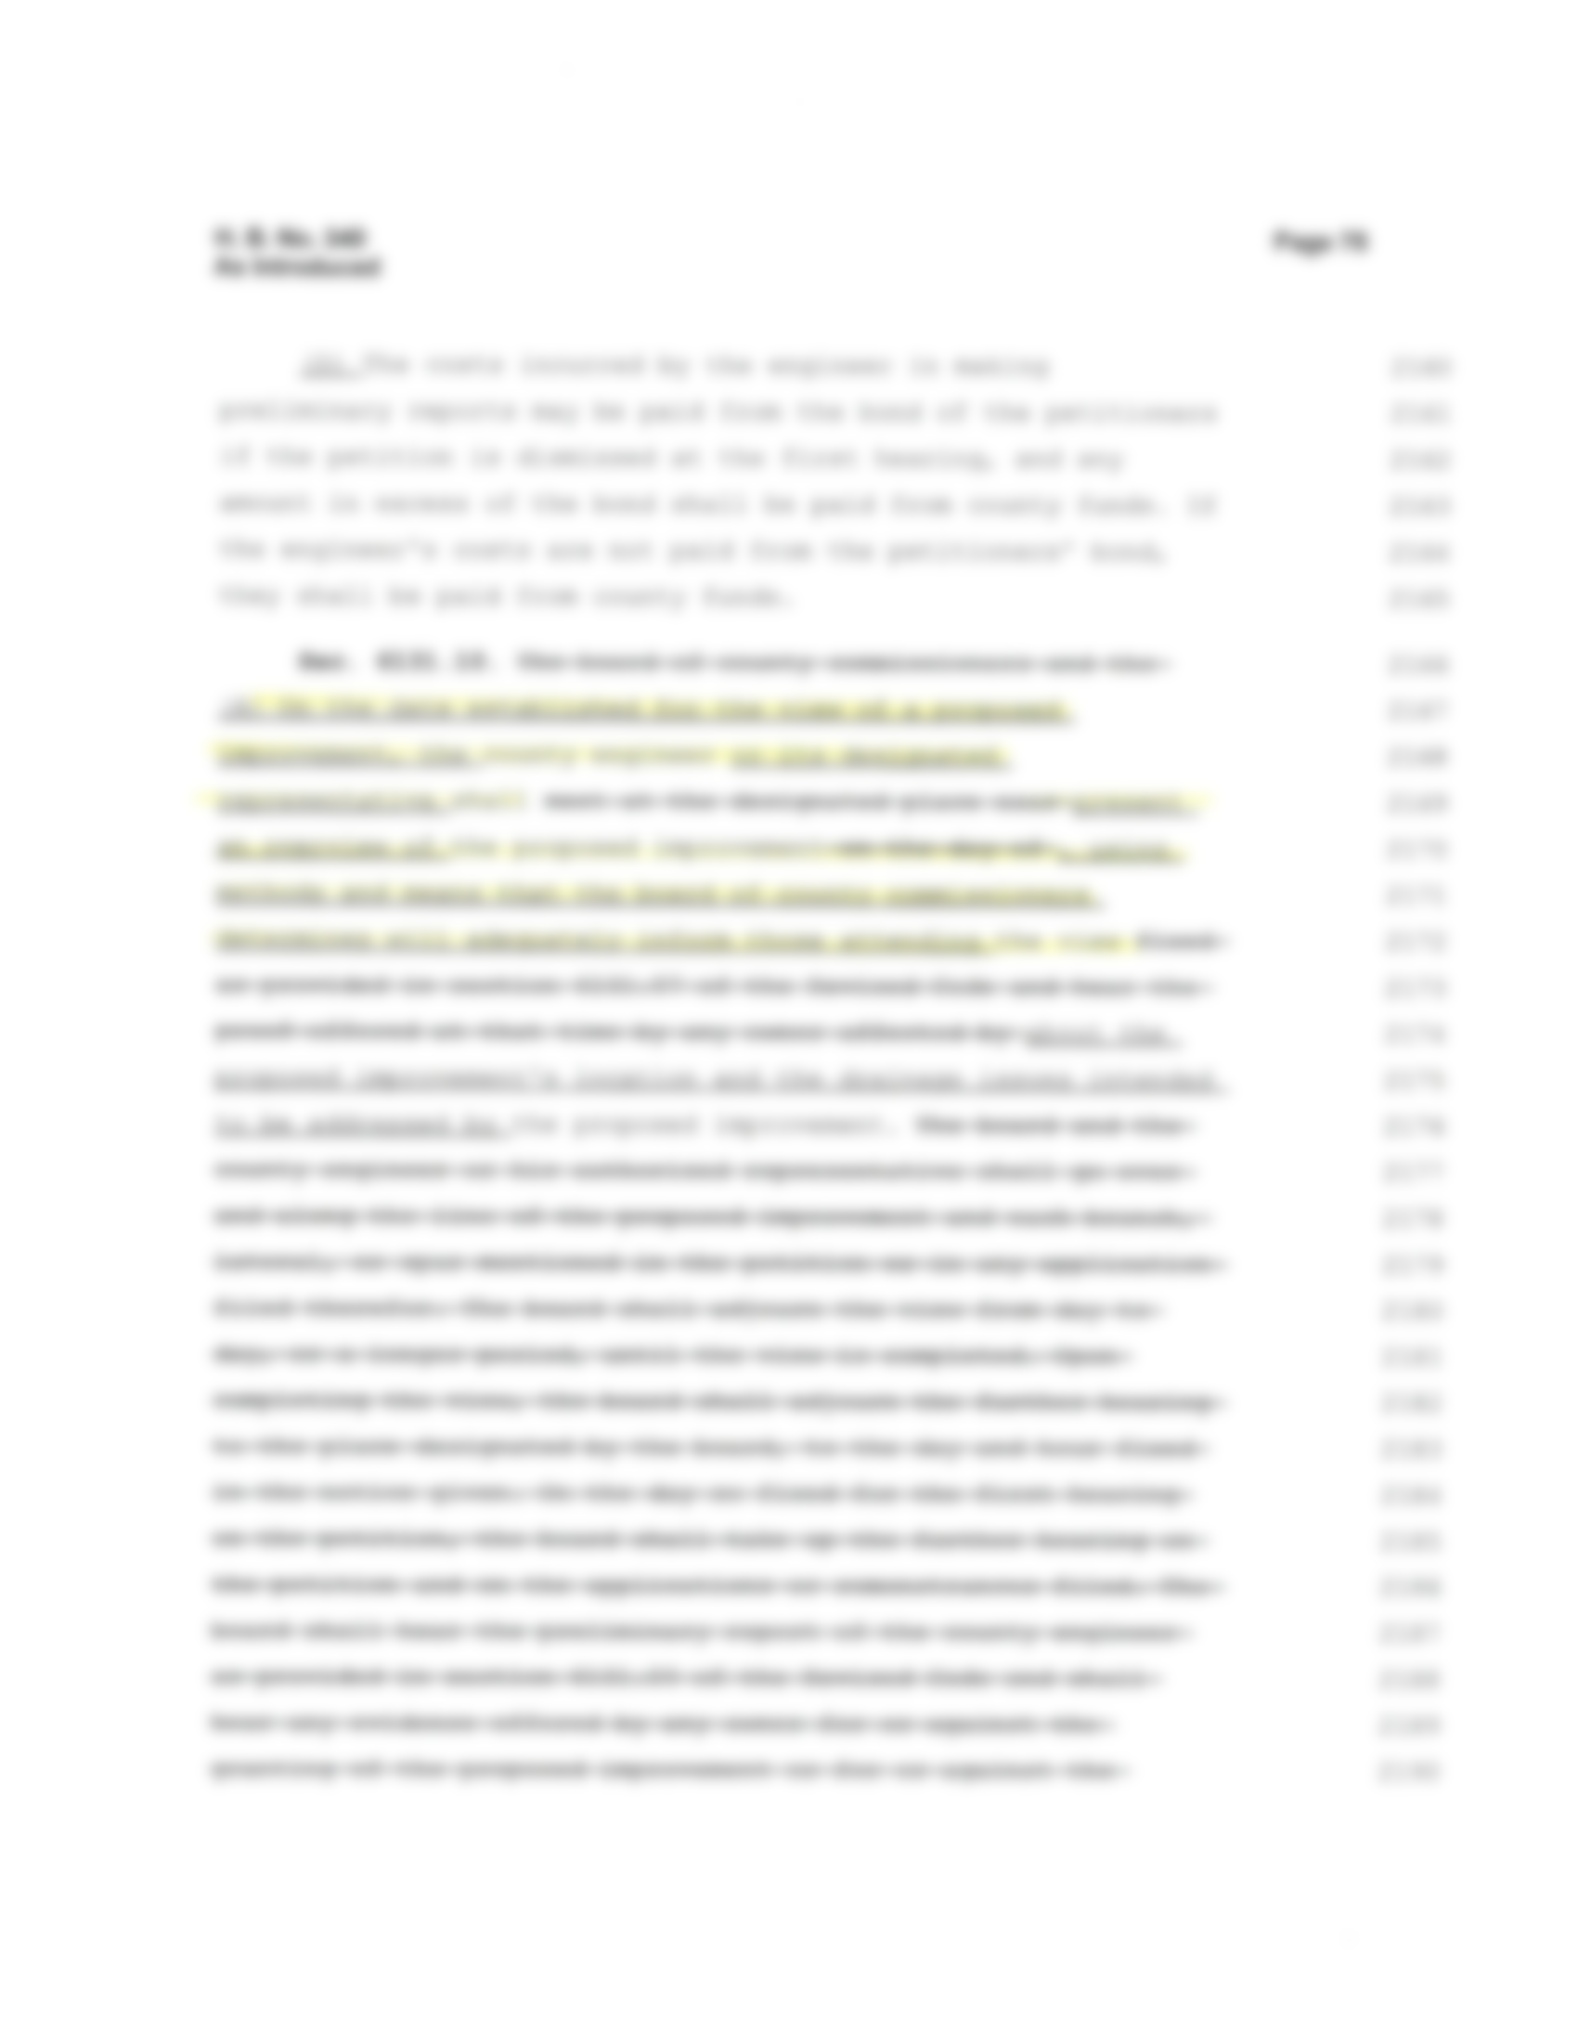

Slide 30
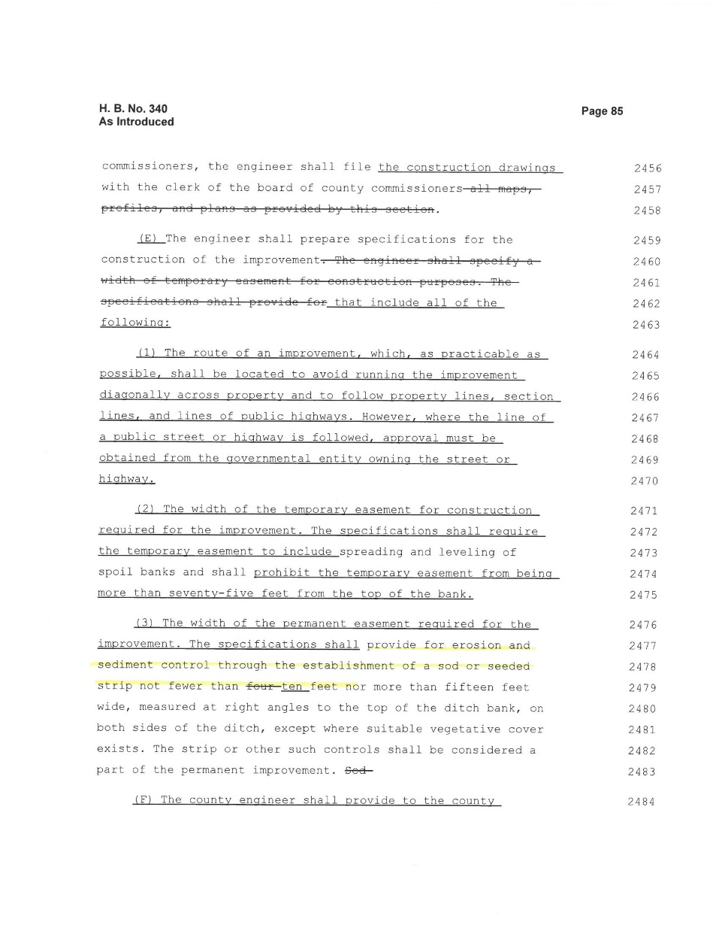
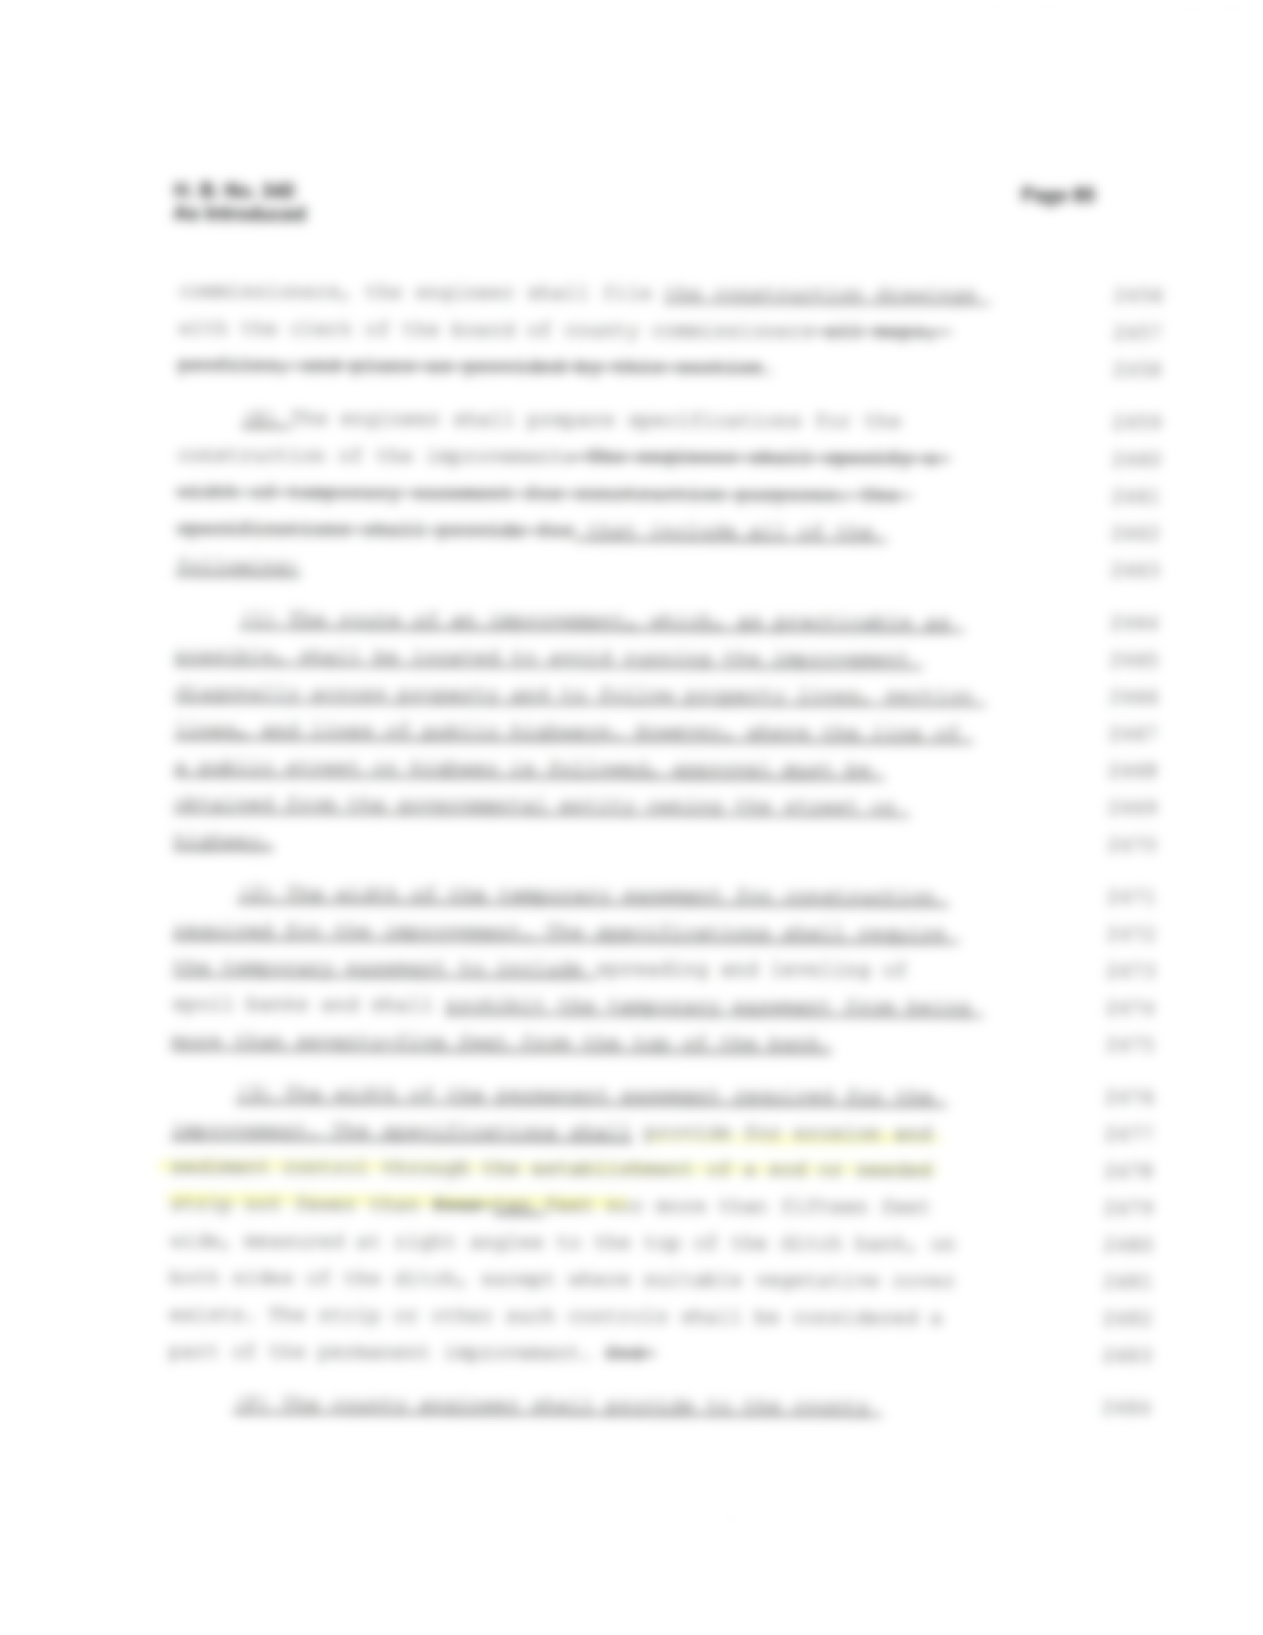

Slide 31
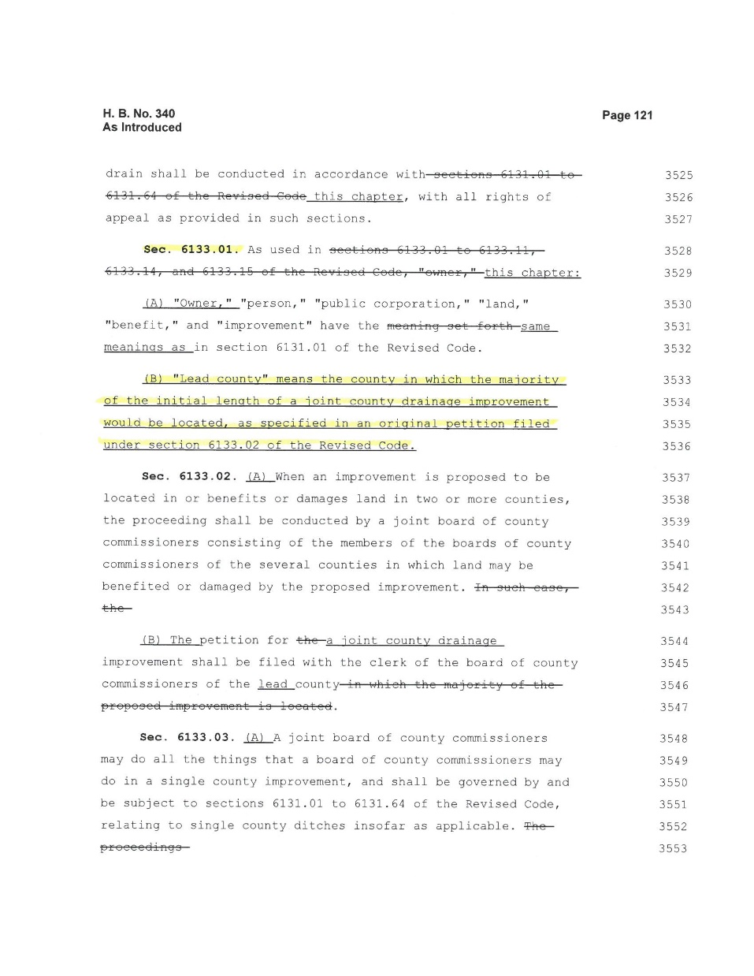

Slide 32
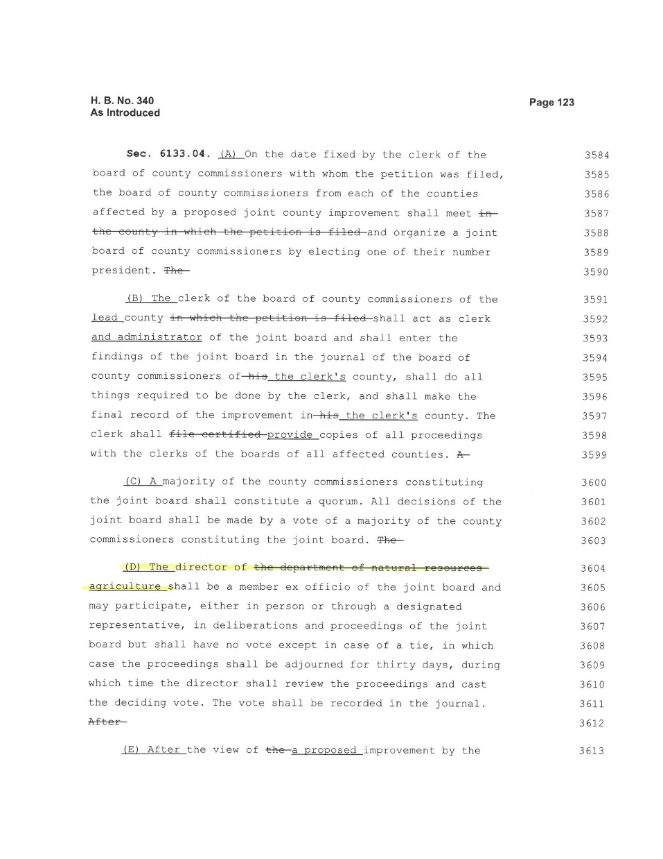

Slide 33
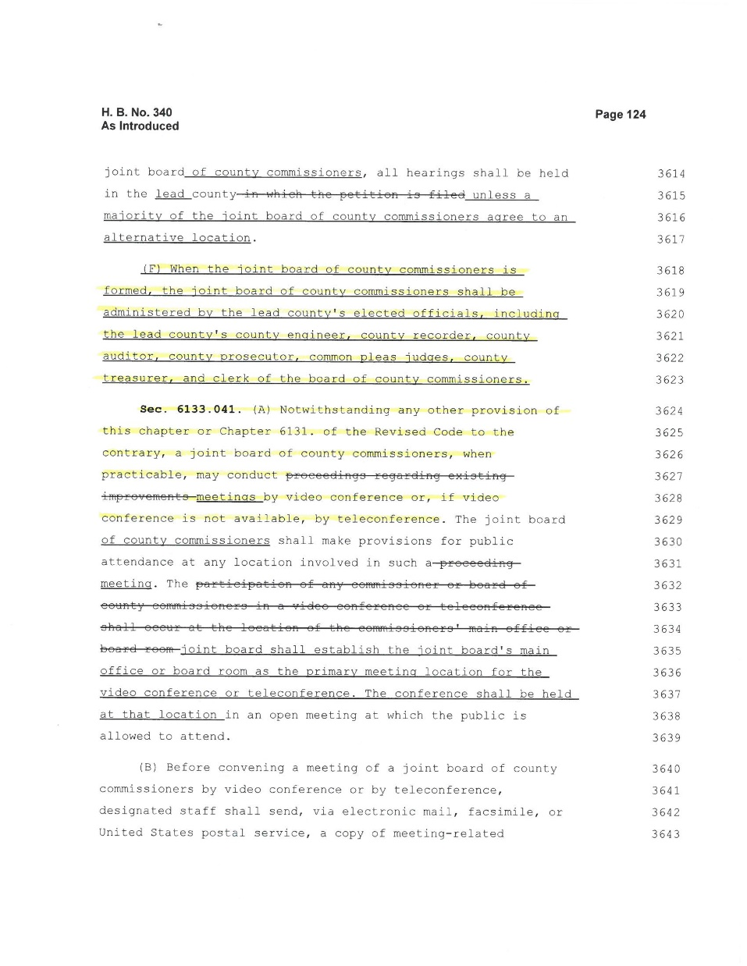

Slide 34
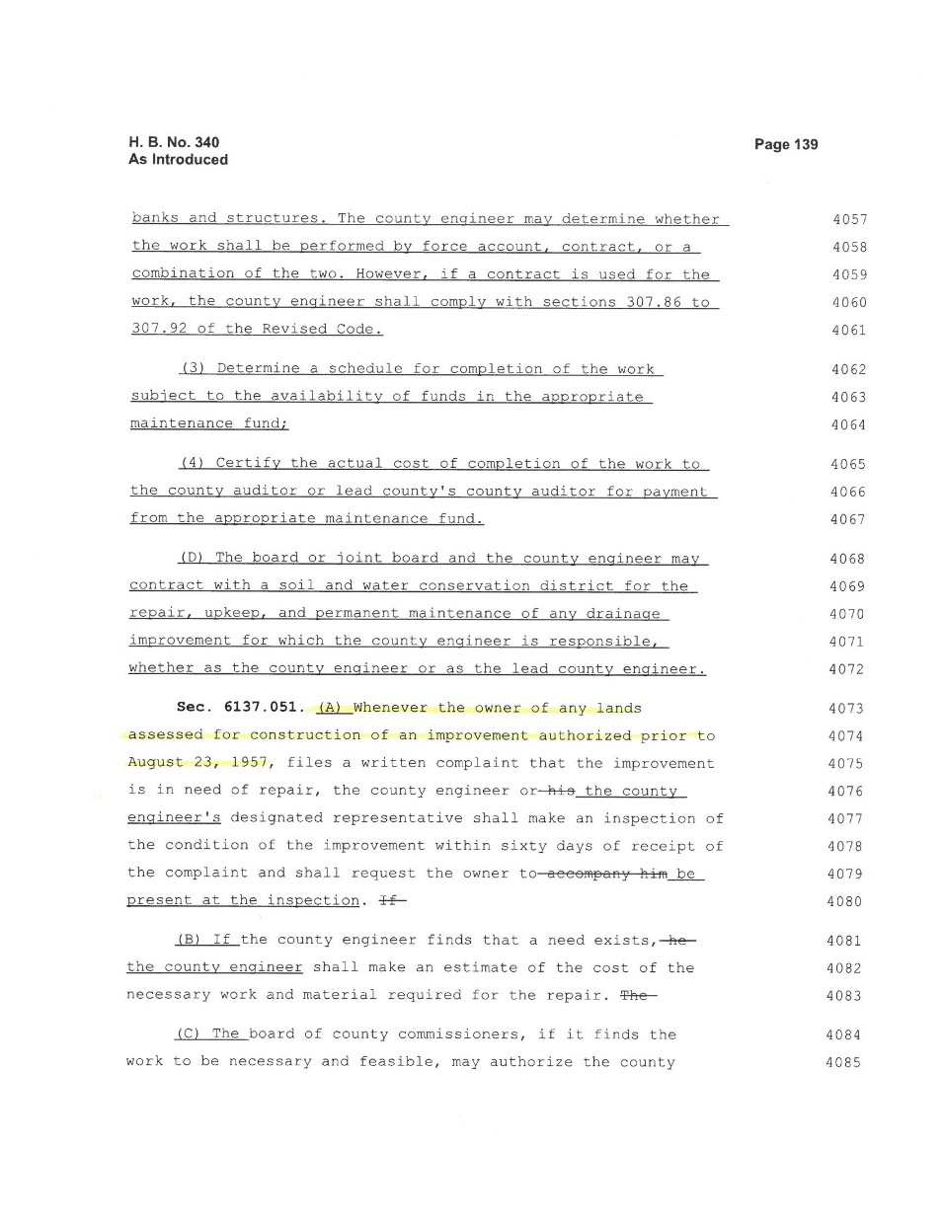

Slide 35
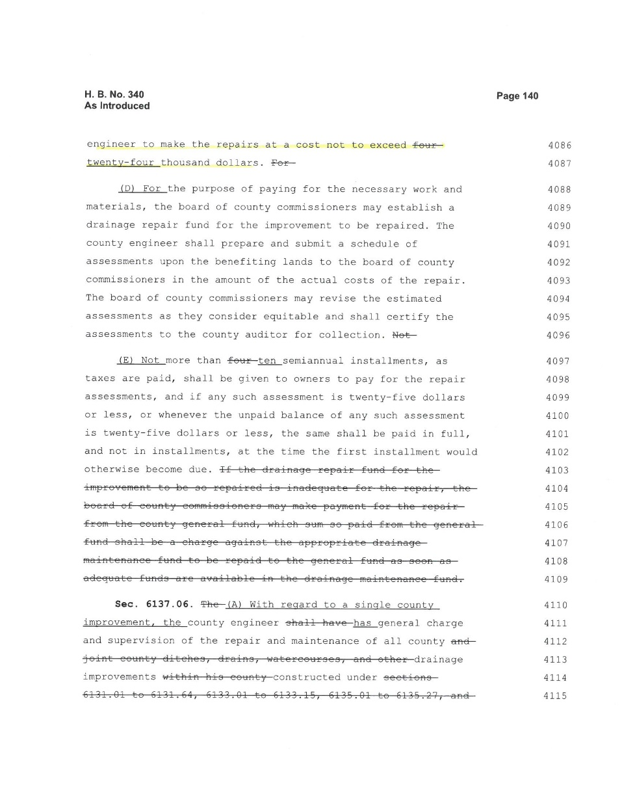

Slide 36
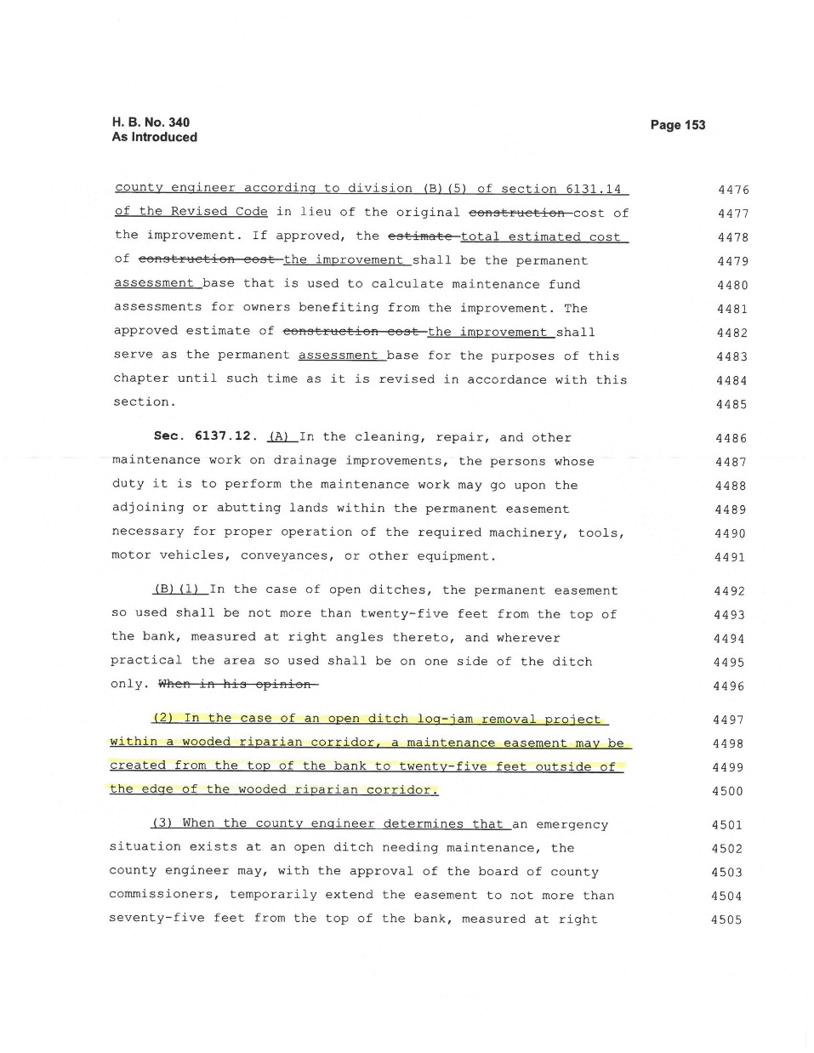

Slide 37
Questions??
Doug Reinhart, P.E., P.S.
Auglaize County Engineer
419-739-6520
dreinhart@auglaizecounty.org

