Slide 2
CyberOhio
Vital Cybersecurity Practices for County Treasurers
County Treasurers Association of Ohio
2023 Fall Conference
November 15th, 2023

Slide 3
CyberOhio Background
CyberOhio was initially created by Attorney General Mike DeWine as a Small Business Cybersecurity Advisory Board in 2017
CyberOhio became an initiative of InnovateOhio at the beginning of the DeWine-Husted Administration and continued its work as an advisory board.
In 2022, Executive Order 2022-07D created the Cybersecurity Strategic Advisor (CSA) and tasked them with four core missions: protecting the base, assisting locals, bolstering the workforce, and securing critical infrastructure.
CyberOhio evolved into a broader initiative of the Governor's Office to aid the CSA in the execution of the duties laid out in the EO.
CyberOhio and the CSA coordinate all cybersecurity activities within the State of Ohio.
CyberOhio and the CSA were created because the DeWine-Husted administration prioritizes cybersecurity.

Slide 4

Why Cybersecurity Matters
Cybersecurity is an issue of public trust, national security, and fiscal responsibility. It is imperative that we protect citizens and prevent critical service disruption.
The average time to recover from ransomware attacks rose in nearly every sector last year. In 2021, the average recovery time for all sectors was just over a week. Last year saw an increase in the average recovery time from 7.8 days in 2021 to 14.9 days in 2022 or a 91% increase. The energy and technology sectors saw a 54% uptick.
Ransomware is one of the biggest threats today. Black Kite’s 2023 Ransomware Landscape Report reports that ransomware victims nearly doubled between April 2022 and 1.6 times higher than the peak month in 2022.
Cyber-attacks are frequent. Global cyber-attacks rose by 7% in Q1 2023. Weekly cyber-attacks have increased worldwide by 7% in Q1 2023 compared to the same period last year. Overall, global cyberattacks increased by 38% in 2022 compared to 2021.
Attacks are becoming more complex. 59% of the public sector saw increased volume and complexity of attacks, with 21% of public sector organizations taking an average of a month to recover. Source: Microsoft Digital Crimes Report.
In 2023, the global annual cost of cybercrime is predicted to top $8 trillion. In 2021, U.S. financial institutions lost nearly $1.2 billion in costs due to ransomware attacks alone, representing an about 200% increase over the previous year.

Slide 5
Four Missions Mapped to EO 2022-07D
Coordinate a “…unified approach among state agencies to guide the state’s cyber initiatives…”
Protect State systems and information
Support Ohio’s local government cybersecurity efforts
Address cybersecurity workforce challenges
Engage the private sector in statewide efforts of cyber protection activities
Protect the Base
Assist the Locals
Cyber
Workforce
Critical Infrastructure Cyber
Whole-of-State Approach

Slide 6
Whole-of-State Approach
CyberOhio aims to provide a “whole-of-state” approach by leveraging existing and new committees, partnerships, and working groups focused on maturing cybersecurity practices and incident response across the State of Ohio.
When such groups – public, private, military, and educational experts – combine their experience and dedication, all Ohioans benefit from the resulting state-wide advances in cybersecurity practices, education, and workforce development.

Slide 7
Current Ohio Comprehensive Cybersecurity Plan Goals
Improve cyber intelligence sharing across local, state and federal organizations
Expand Ohio Persistent Cyber Improvement (OPCI) – 3 levels of training, cyber assessments and table-top exercises for local governments
Whole-of-State cyber capabilities and resiliency
Improve cybersecurity across state agencies
Update and test the Ohio Cyber Incident Response Emergency Operations Plan with state and local governments

Slide 8
Local Government Cyber Grants
The Infrastructure Investment and Jobs Act (IIJA) included provisions for SLCGP (State and Local Cybersecurity Grant Program) to address cyber risks and threats to the information systems of state, local, or tribal governments. State of Ohio is matching with over $10 million in-kind contributions.
Phase 1
Local Government IT professionals will receive a cybersecurity assessment with assistance from the Cyber Reserve.
Phase 2
Local government staff will receive training from the Ohio Cyber Range Institute aimed at filling gaps observed in the assessment.
Phase 3
The local government entity will participate in a tabletop exercise.
Round 1: $5 million
Creates the Ohio Persistent Cyber Improvement Program. This program routes local governments through 3 phases of cybersecurity uplift.
Round 2: $10 million
Creates a cybersecurity grant program, helping local governments purchase cybersecurity software, transition to a Dot Gov, and receive intelligence and response from a Cyber Fusion Center. Round 2 builds on round 1 by giving locals the tools they need to continue the improvement gained through the Persistent Cyber Improvement Program.
Local government cybersecurity grants (Helps Defend and Recover)
Local government Dot Gov Domain Transition (Protects Websites and Prevents Fraud)
Cyber Fusion Center (Cyber Intelligence and Incident Response for Local Governments)
Notes:
Talk about a case study.

Slide 9
Best Practices & Action Plan
Complete a Cybersecurity Assessment
Close gaps with training and resources
Create a response plan for a cyber-attack
What processes do you need to have in place to function?
Test your plan with a tabletop exercise
Identify further areas for improvement
Coordinate with your county to get an assessment done through the O-PCI program.
Apply for grant dollars through the Local Government Cybersecurity Grant program to fill any gaps found.
Reference the State Cyber Emergency Response plan.
Coordinate with your county EMA to create a plan specific to you
Participate in a tabletop exercise with your county through O-PCI or CISA.
Repeat!
Understanding what your vulnerabilities are is crucial to charting a way forward.
Use the O-PCI program to learn and train for preventing cyber-attacks.

Slide 10
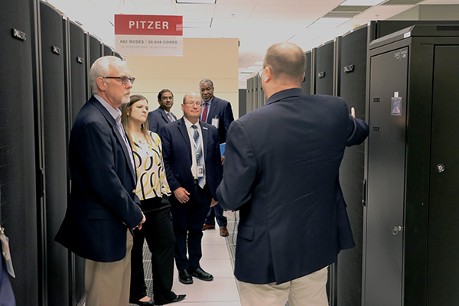
CyberOho: Resources Are Available
CyberOhio exists to connect you to resources and help you navigate the cybersecurity world.
Several State of Ohio Agencies have resources and support available:
Ohio Department of Public Safety, Department of Homeland Security
Ohio Adjutant General’s Office, Cyber Reserve and Ohio Cyber Range Institute
Connect with us at: CyberOhio@Governor.ohio.gov or at Cyber.Ohio.gov

Slide 11
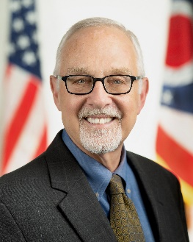
CyberOhio
Kirk Herath
Cybersecurity Strategic Advisor to Governor Mike DeWine
Chair, CyberOhio
Kirk Herath is Governor Mike DeWine and Lt. Governor Jon Husted’s Cybersecurity Strategic Advisor and Chairman of CyberOhio, the State of Ohio’s Cybersecurity Advisory Board.
His role spans coordinating and enhancing the State of Ohio’s cybersecurity capabilities, working with local governments to prepare and remediate cyber attacks, and helping to build a modern cyber workforce.
He retired as Vice President, Associate General Counsel, and Chief Privacy Officer for Nationwide after 32 years.
Kirk is Past President and past board member of the International Association of Privacy Professionals, and he served on the U.S. Department of Homeland Security’s Data Privacy and Integrity Advisory Committee from 2005 to 2011. Kirk is admitted to the Ohio Bar.

