Slide 1
Getting Clients to Prepare for Life After Business
Isaiah Stidham, CPA, CFP®, CEPA
Partner, Wealth Advisor, Business Succession Lead
August 8, 2023

Slide 2
Today’s Discussion
The need for Exit Planning
How to start the conversation
Case study
Encouraging action

Slide 3
Business owners are not alone in waiting to talk about exit planning

Slide 4
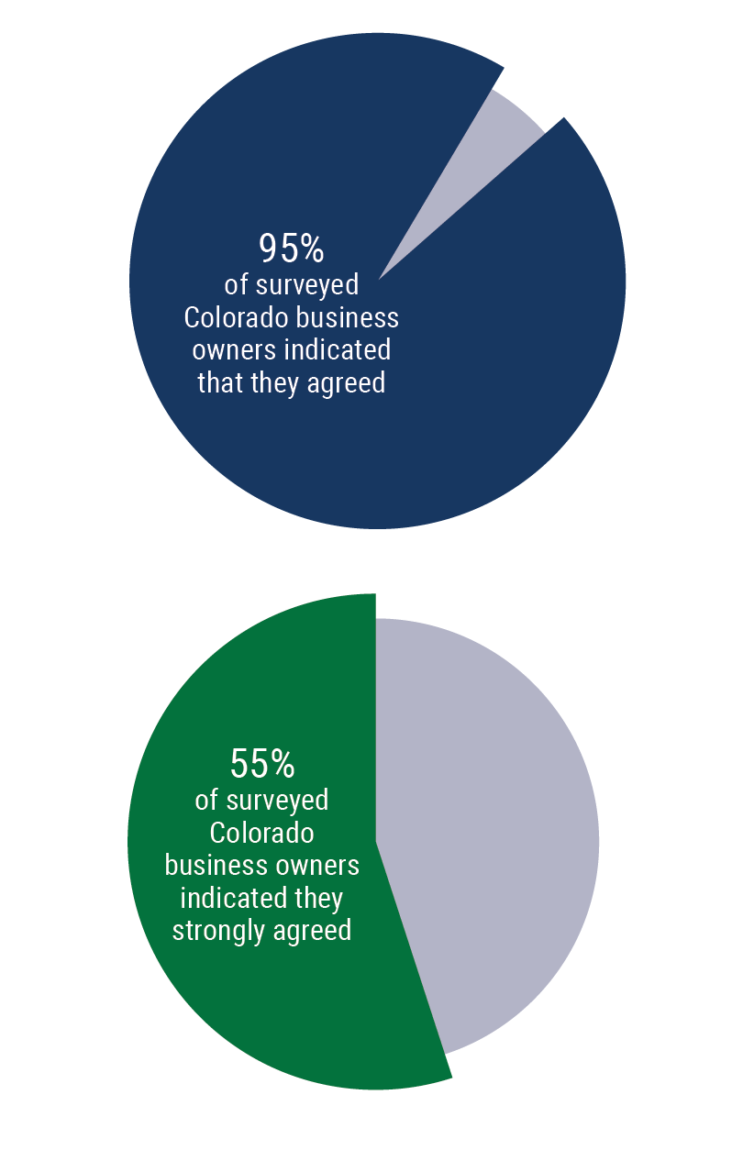

The Need for Exit Planning
HAVING A TRANSITION STRATEGY IS IMPORTANT FOR MY FUTURE AS WELL AS THE FUTURE OF MY BUSINESS.
© Exit Planning Institute: September 2022, State of Owner Readiness Report - Colorado

Slide 5
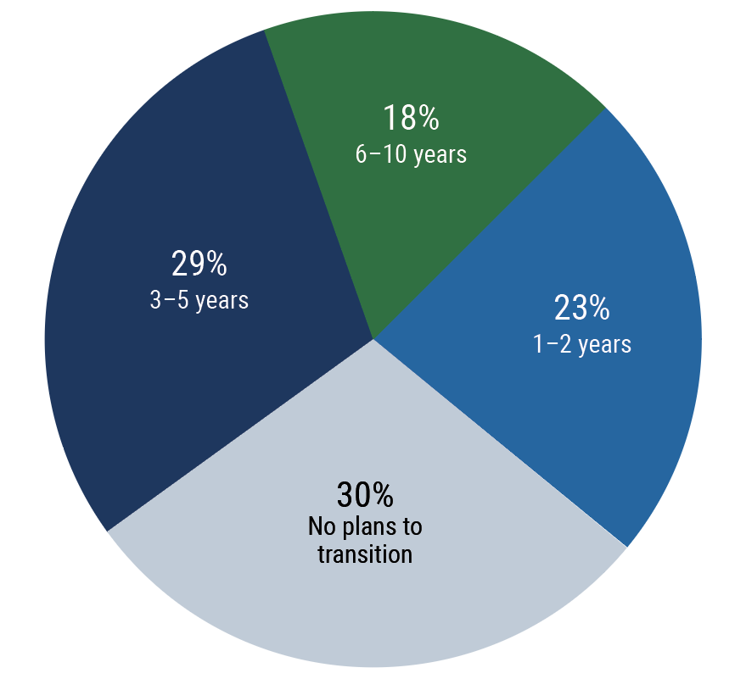
The Need is Now
WHEN ARE YOU PLANNING TO TRANSITION THE COMPANY?
© Exit Planning Institute: September 2022, State of Owner Readiness Report - Colorado

Slide 6
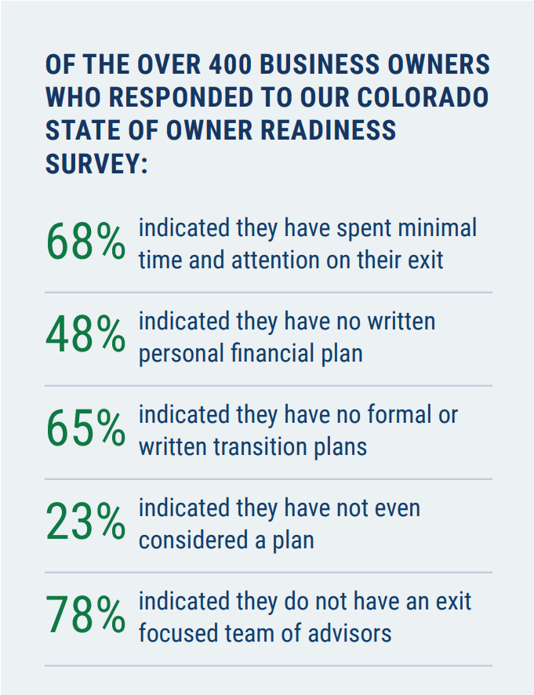
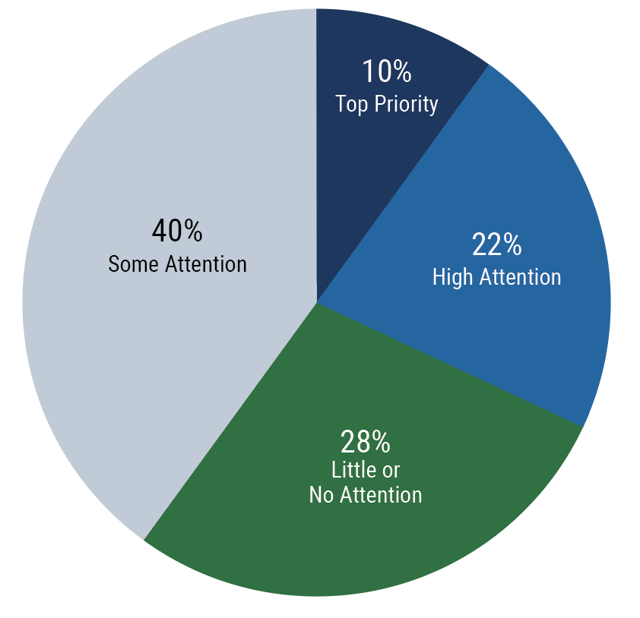
Most Owners Aren’t Ready
© Exit Planning Institute: September 2022, State of Owner Readiness Report - Colorado

Slide 7
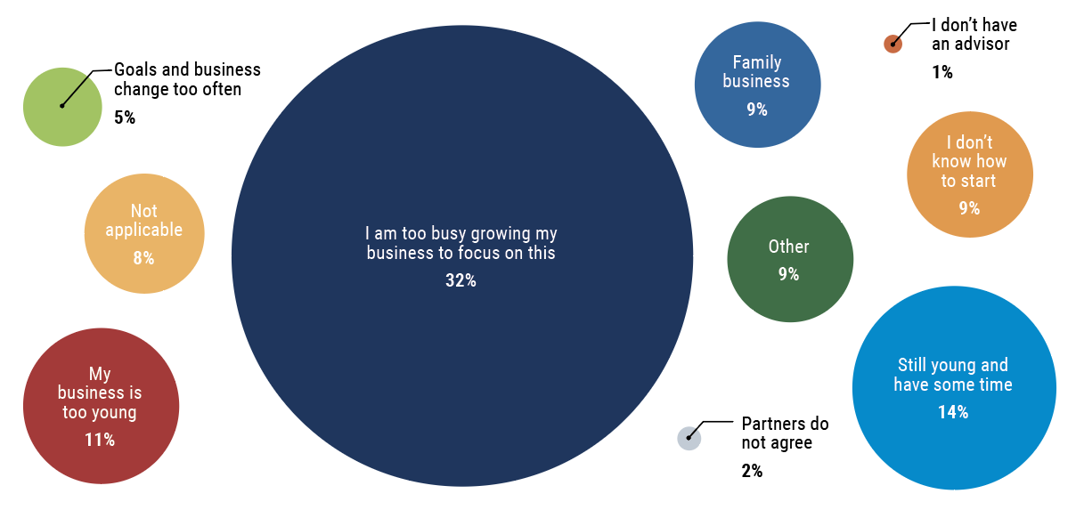
Most Owners Aren’t Ready
© Exit Planning Institute: September 2022, State of Owner Readiness Report - Colorado

Slide 8
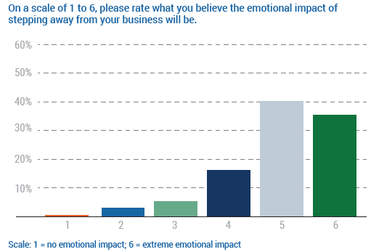
Post-Transaction Emotion
© Exit Planning Institute: October 2021, State of Owner Readiness Report – New York

Slide 9
Expect the Unexpected
Over 50% of business owner exits are not voluntary!
Death
Disability
Divorce
Distress/Departure
Disagreement
© 2017 Exit Planning Institute Change the Outcome Presentation

Slide 10
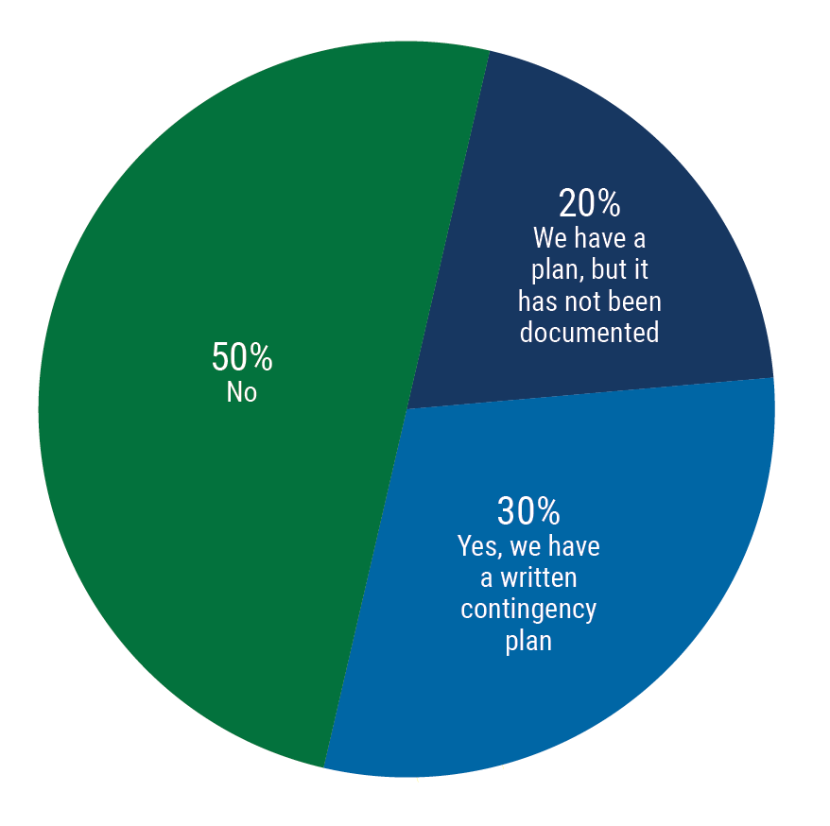
Expect the Unexpected
DO YOU HAVE A DOCUMENTED CONTINGENCY PLAN IN PLACE?
© Exit Planning Institute: September 2022, State of Owner Readiness Report - Colorado

Slide 11
How to Start the Conversation

Slide 12
Alignment of Goals
Business
Personal
Financial

Slide 13
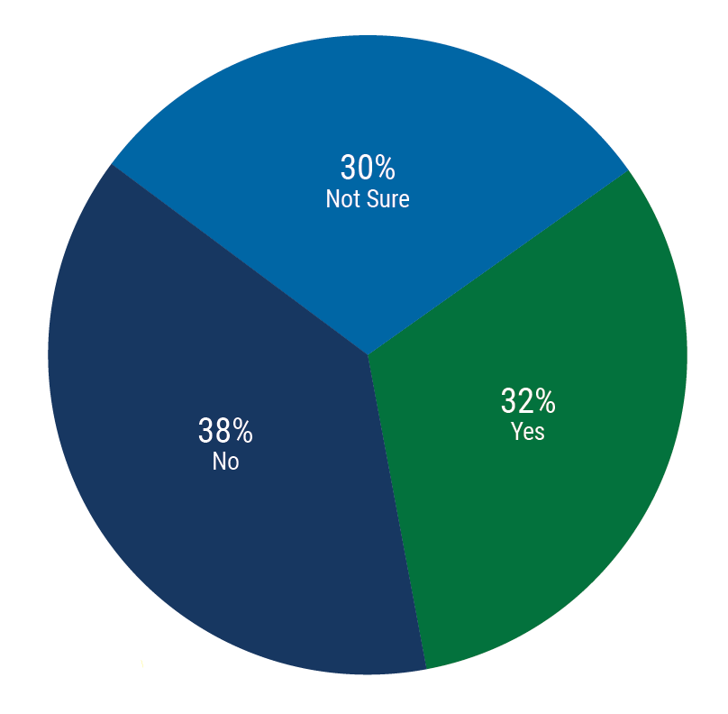
Business: What is the Plan for the Future?
ARE YOU FAMILIAR WITH ALL OF YOUR TRANSITION OPTIONS?
© Exit Planning Institute: September 2022, State of Owner Readiness Report - Colorado

Slide 14
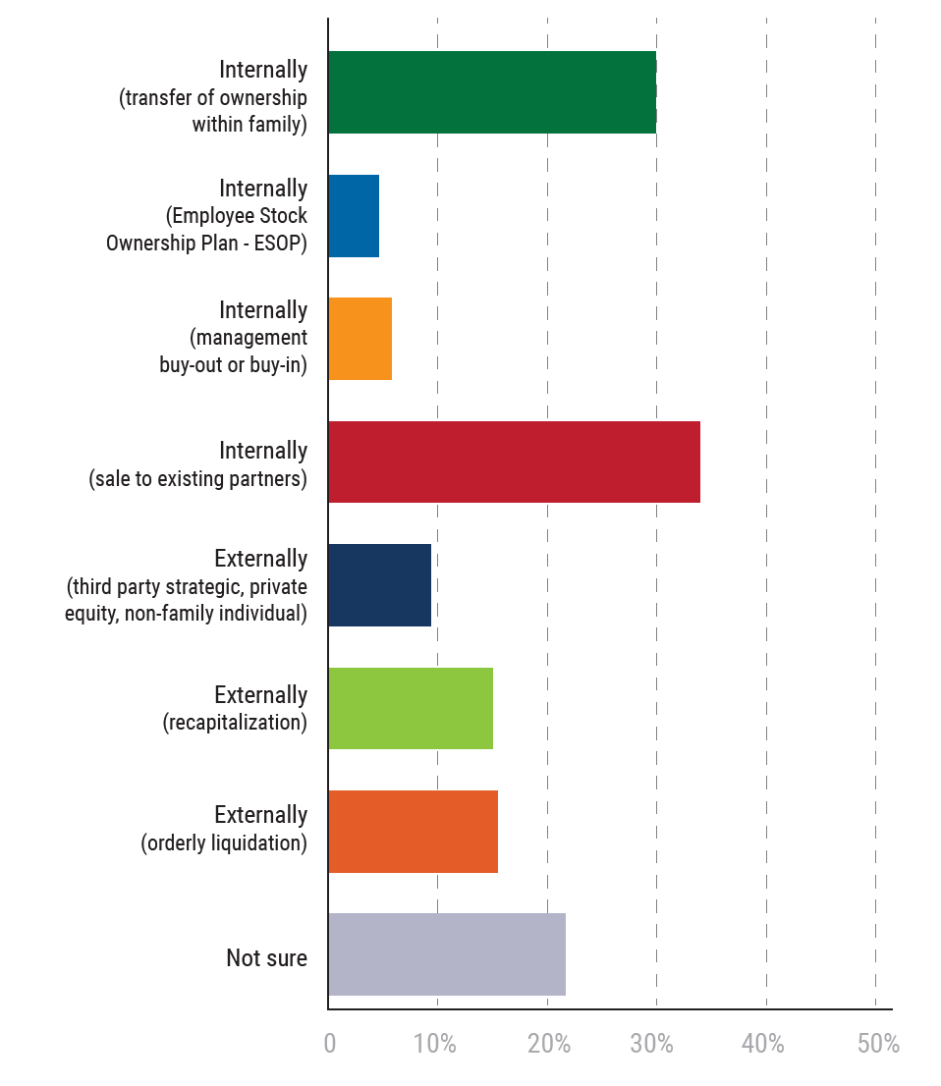
Business: What is the Plan for the Future?
© Exit Planning Institute: September 2022, State of Owner Readiness Report - Colorado

Slide 15
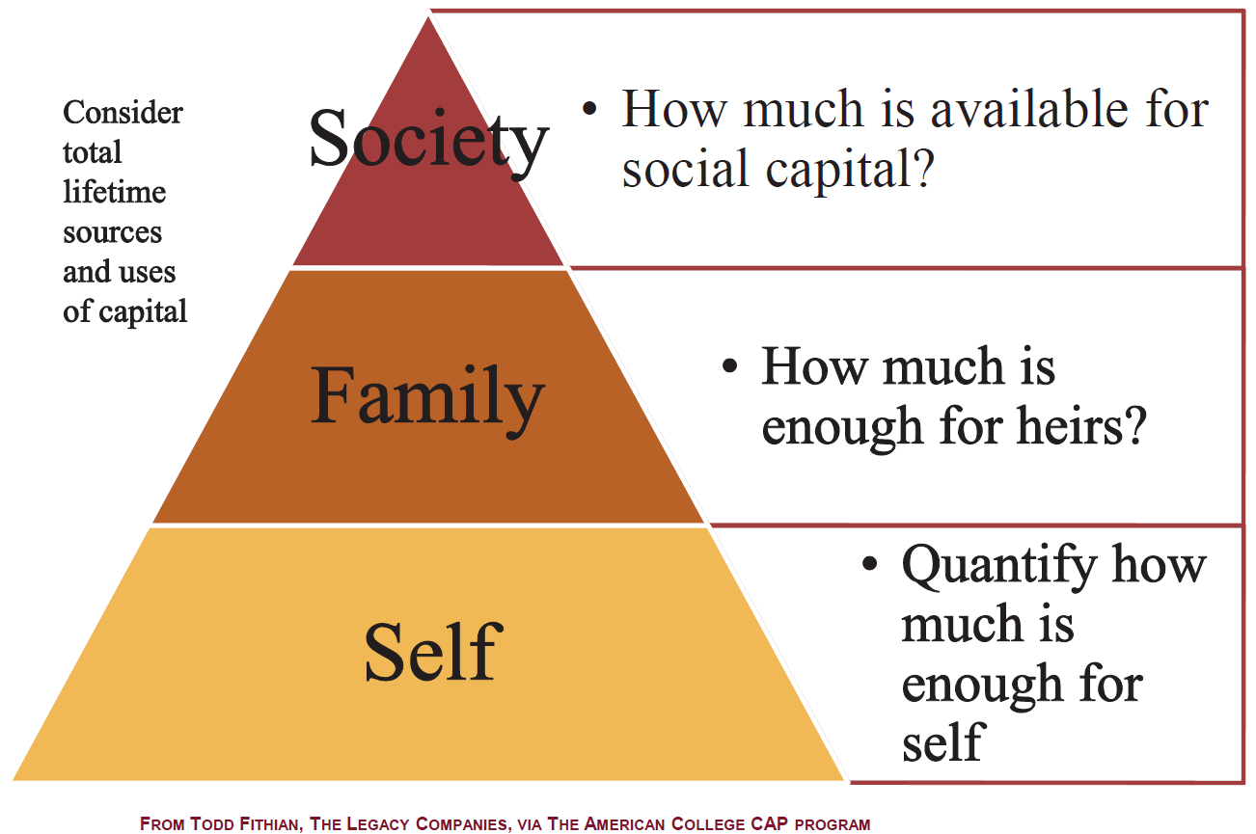
Financial: Do We Have Enough?

Slide 16
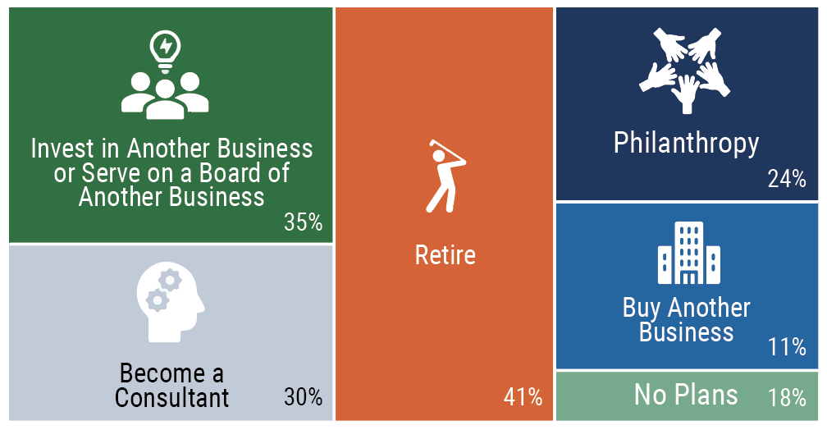
Personal: Life After Business?
© Exit Planning Institute: September 2022, State of Owner Readiness Report - Colorado

Slide 17
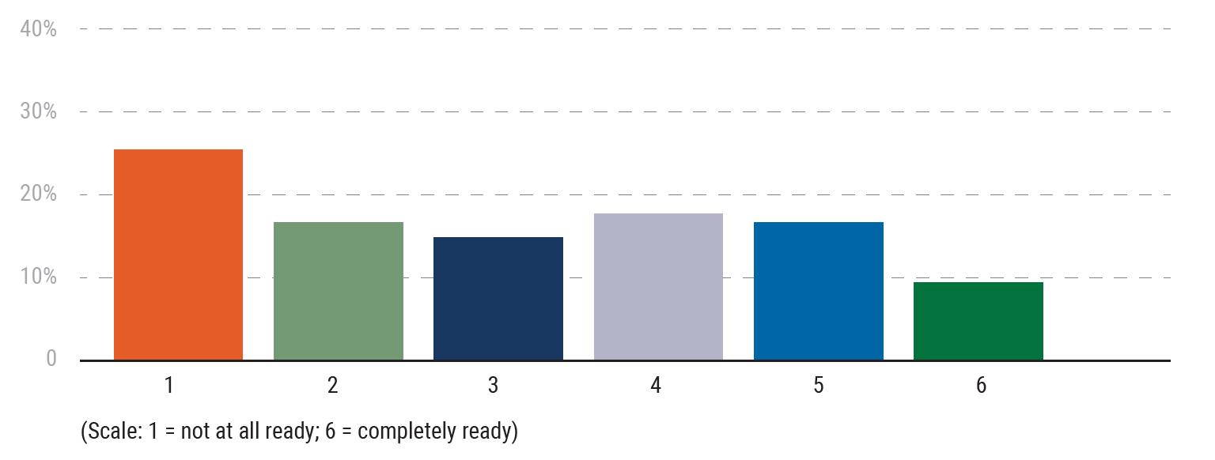
Personal: Life After Business?
HOW “READY” DO YOU CONSIDER YOURSELF PERSONALLY, TO TRANSITION AWAY FROM YOUR BUSINESS AND DO SOMETHING ELSE?
© Exit Planning Institute: September 2022, State of Owner Readiness Report - Colorado

Slide 18
Case Study:
Widget Solutions, Inc.
Hypothetical example and not actual client situation

Slide 19
Case Study: Widget Solutions
Established: 1976
Pioneer in manufacturing of various widgets
Employees: 120
2022 Revenue: $30 million
2022 EBITDA: $2.4 million
Loyal employee base
Concentration of responsibilities remain with founder
Hypothetical example and not actual client situation

Slide 20
Case Study: Rich & Beverly
Bradley (41)
Rich and Beverly (68/63)
Sam (15)
Melissa (15)
Alyssa (45)
Beth (17)
Jason (14)
John (12)
Hypothetical example and not actual client situation

Slide 21
Case Study: Rich & Beverly
Financial
Salary: $625,000
Add’l company distributions: $875,000
Personal expenses “deducted”: $600,000
Rich assumes $1.2 million annual “income” needs
  Rich’s “napkin math” needs: $42 million
Non-business assets: $4.8 million
10% of company has already been gifted to Trust
Hypothetical example and not actual client situation

Slide 22
Case Study: Rich & Beverly
Personal Goals/Interests
Retire at 72
Avid car collector/racer
Very active in local communities
Residences in Ohio, Tennessee and North Carolina
Hypothetical example and not actual client situation

Slide 23

Do You Really Want to Rely on a Napkin?
I think we can do better! Let’s prove it out…

Slide 24
More to Explore
Work to gain a better understanding of actual spending:
  Expenses per property and plans for each
  Confirm exact expenses paid by company
  Discuss potential changes to spending in “retirement”
Gain a better understanding of business income/cashflow/tax situation
Discuss goals around race team going forward
Explore potential goals around family/charity/community

Slide 25
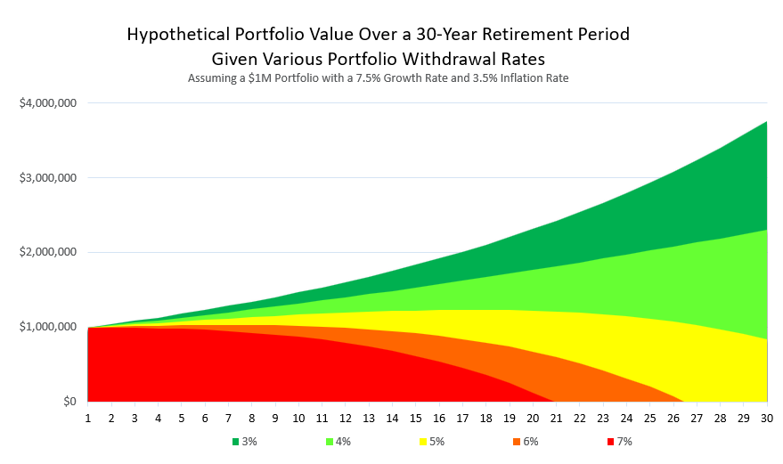
Portfolio Withdrawal Rates
Corient calculations

Slide 26
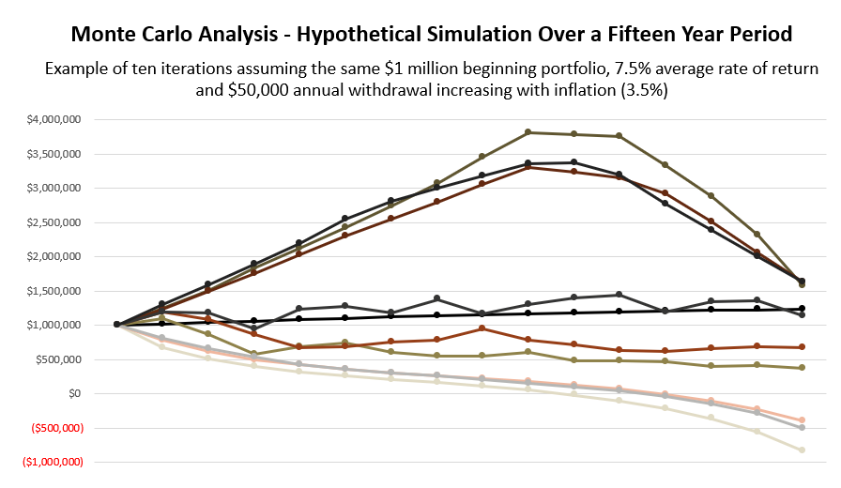
Monte Carlo Analysis
Corient calculations

Slide 27
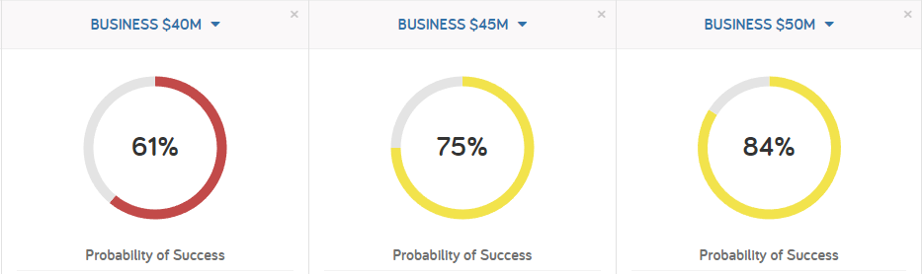
Sensitivity Around Business Value
Corient calculations through eMoney

Slide 28
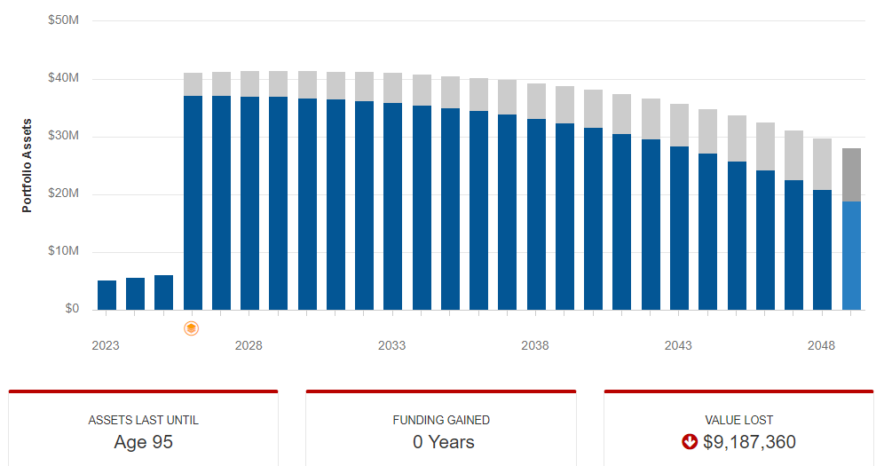
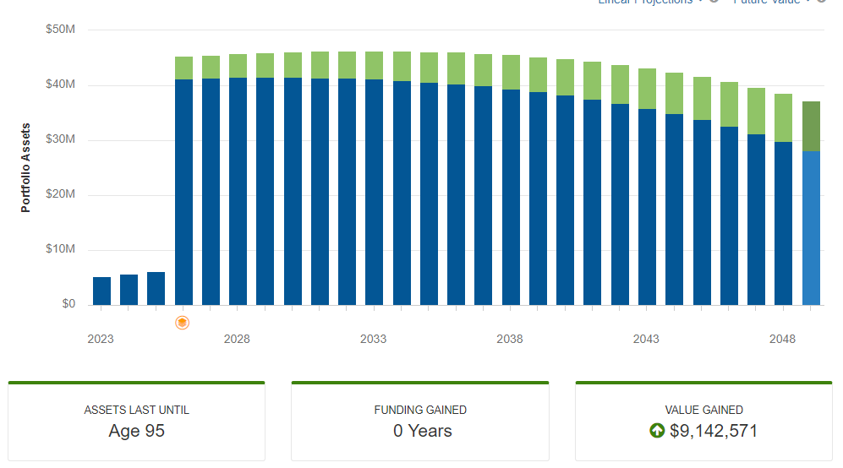
Sensitivity Around Business Value
Impact of $40M Sale
Impact of $50M Sale
Corient calculations through eMoney

Slide 29
Closing the Wealth Gap
PROFIT X MULTIPLE = VALUE
Common Value Formula

Slide 30

Closing the Wealth Gap
DISCOUNT
INDUSTRY AVERAGE
BEST IN CLASS

Slide 31
Encouraging Action

Slide 32
Reviewing the Facts
95% of business owners agree having a transition strategy is important to their future
Over 50% of business owners anticipate transitioning in the next five years
However, 68% have spent minimal time on planning their exit and life after
Even for those with a plan, most exits are not voluntary
© Exit Planning Institute: September 2022, State of Owner Readiness Report - Colorado

Slide 33
Deep Dive Into Planning
Business
Readiness and attractiveness are a state of fact, not of mind
How do your clients look to push their company from “average” to best-in-class attractiveness?
Financial
How much do they need?
Are they taking the appropriate steps now for their financial future?
Personal
Retirement is just the state of a whole new phase of life and not the finish line. What does life after business look like for them?
What is you’re their significance?

Slide 34
Encouraging Action
You are a trusted influencer in their preparedness
Collaborate with experts in the space to develop a strategy
You become a hero in helping them out of paralysis and into planning

Slide 35

Questions?
Thank you!
Isaiah Stidham, CPA, CFP®, CEPA
Partner, Wealth Advisor, Business Succession Lead
Isaiah.Stidham@corient.com
614-481-6900

Slide 36
Disclosures
This information is for educational purposes and is not intended to provide, and should not be relied upon for, accounting, legal, tax, insurance, or investment advice. This does not constitute an offer to provide any services, nor a solicitation to purchase securities. The contents are not intended to be advice tailored to any particular person or situation. We believe the information provided is accurate and reliable, but do not warrant it as to completeness or accuracy. This information may include opinions or forecasts, including investment strategies and economic and market conditions; however, there is no guarantee that such opinions or forecasts will prove to be correct, and they also may change without notice. We encourage you to speak with a qualified professional regarding your scenario and the then-current applicable laws and rules.
Different types of investments involve degrees of risk. The future performance of any investment or wealth management strategy, including those recommended by us, may not be profitable or suitable or prove successful. Past performance is not indicative of future results. One cannot invest directly in an index or benchmark, and those do not reflect the deduction of various fees that would diminish results. Any index or benchmark performance figures are for comparison purposes only, and client account holdings will not directly correspond to any such data.
Advisory services are offered through CI Private Wealth and its affiliates, each being a registered investment adviser (“RIA”) regulated by the U.S. Securities and Exchange Commission (“SEC”). The advisory services are only offered in jurisdictions where the RIA is appropriately registered. The use of the term “registered” does not imply any particular level of skill or training and does not imply any approval by the SEC. For a complete discussion of the scope of advisory services offered, fees, and other disclosures, please review the RIA’s Disclosure Brochure (Form ADV Part 2A) and Form CRS, available upon request from the RIA and online at https://adviserinfo.sec.gov/. We also encourage you to review the RIA’s Privacy Policy and Code of Ethics, which are available upon request.
Family office services, such as tax preparation and bill pay services, are exclusively provided by CIPW Family Office Services, LLC (Family Office Services), an affiliate of CI Financial Corp. and the RIAs. Family Office Services is not a registered investment adviser or accounting firm and does not offer or provide investment or accounting advice or services.

