Slide 1
2023 Tax Update
November 14th, 2023

Slide 2
Disclaimer
This document and information is provided by Ary Roepcke Mulchaey, P.C. and the presenter for general guidance only, and does not constitute the provision of legal advice, accounting services, investment advice, written tax advice, or professional advice of any kind.
The information provided herein should not be used as a substitute for consultation with professional tax, accounting, legal, or other competent advisors.
Before making any decision or taking any action, you should consult with a professional adviser who has been provided with all pertinent facts relevant to your particular situation.
The information is provided “as is” with no assurance or guarantee of completeness, accuracy, or timeliness of the information, and without warranty of any kind, express or implied, including but not limited to warranties of performance, merchantability, and fitness for a particular purpose.

Slide 3
Ohio SALT Workaround
Federal state and local tax (SALT) cap is $10,000
Many states now have a workaround for individual business owners to workaround the cap deduction of $10,000.

Slide 4
Ohio SALT Workaround
Example
Assume $1,000,000 of business income in 2023.
$30,000 tax would be paid by entity, which would reduce Federal adjusted gross income since the tax would be a business deduction that reduces K-1 income.
The $30,000 of income would be added back when calculating Ohio business income.

Slide 5
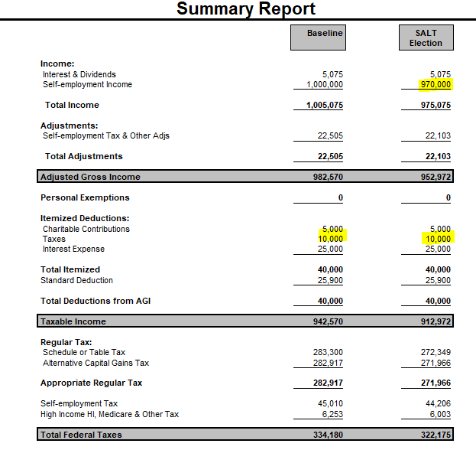
Ohio SALT Workaround

Slide 6
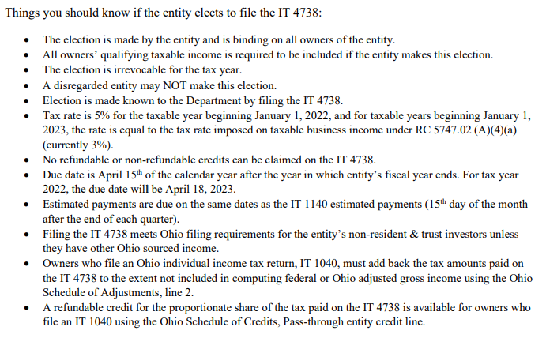
Ohio SALT Workaround

Slide 7
Ohio Credits
Until House Bill 33 that was passed back in July 2023, taxpayers could not take a credit for SALT workaround taxes paid to other states (since it was not technically a personal income tax).
For the purposes of the resident income tax credit for taxes paid to other states, the bill now allows taxpayers to take into account pass-through entity taxes paid to other states.
These changes apply to taxable years ending on or after January 1, 2023, but taxpayers may apply them to taxable years ending on or after January 1, 2022, by filing an amended or original return for that year.

Slide 8
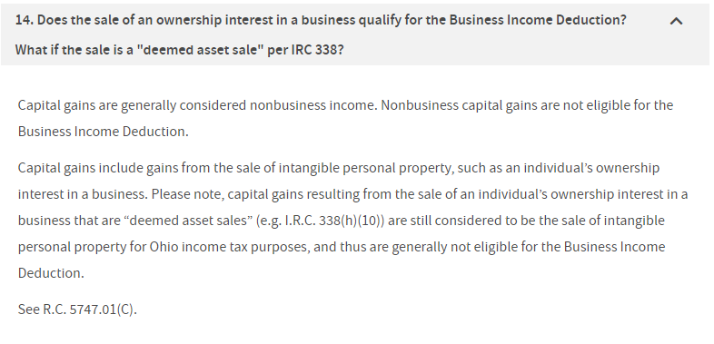
Ohio Business Income

Slide 9
Ohio Business Income
On June 24th, 2022, Governor DeWine signed House Bill 515 into law. The law became effective September 21, 2022
Clarifies that the sale of an equity or ownership interest in a business qualifies for the Ohio Business Income Deduction
The bill’s changes apply to any transactions, refund applications, audits, petitions for reassessments and appeals pending on or after the bill’s 90-day effective date
To qualify as business income, certain requirements must be met including either
a) the sale must be treated for federal tax purposes as the sale of assets or
b) the seller materially participated in the activities of the business during the taxable year in which the sale occurs or during any of the five preceding taxable years

Slide 10
Ohio Business Income
Materially Participation test
The tax law references the description in the U.S. Code of Federal Regulations 26 C.F.R. 1.469-5T to define material participation in the activities of the business

Slide 11
Ohio Business Income
Refund Claim
Taxpayers who engaged in the sale of a business in the past several years where the transaction was not eligible for Ohio BID…file refund claim!
Deadline to file an amended return and refund claim in Ohio is four years from the date the return was filed or required to be filed, whichever is later.
Make sure future sales are properly treated as business income.

Slide 12
Sale of Business
3.8% Net Investment Income Tax

Slide 13
Sale of Business
Be sure to review Form 8960!
Ohio BID income as well

Slide 14
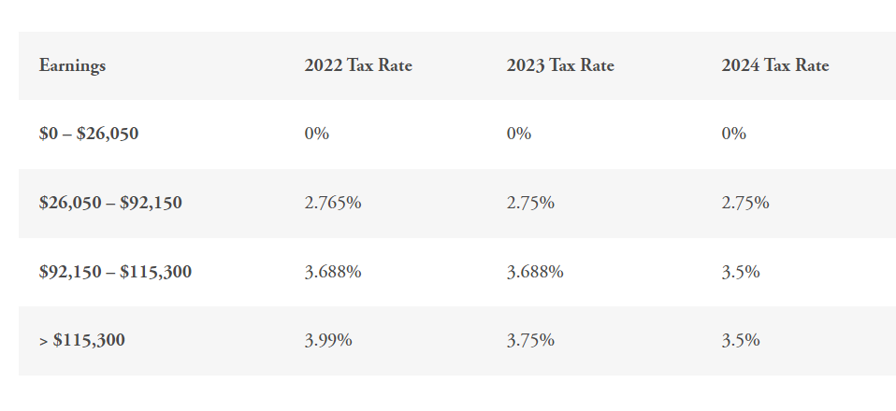
Ohio Tax Rates

Slide 15
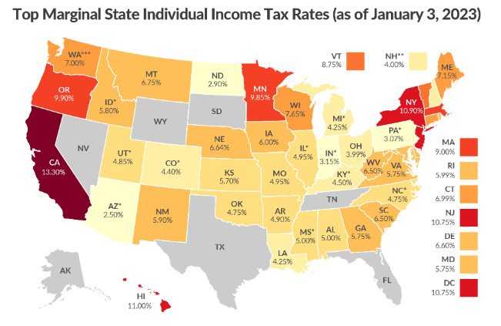
Ohio Tax Rates

Slide 16
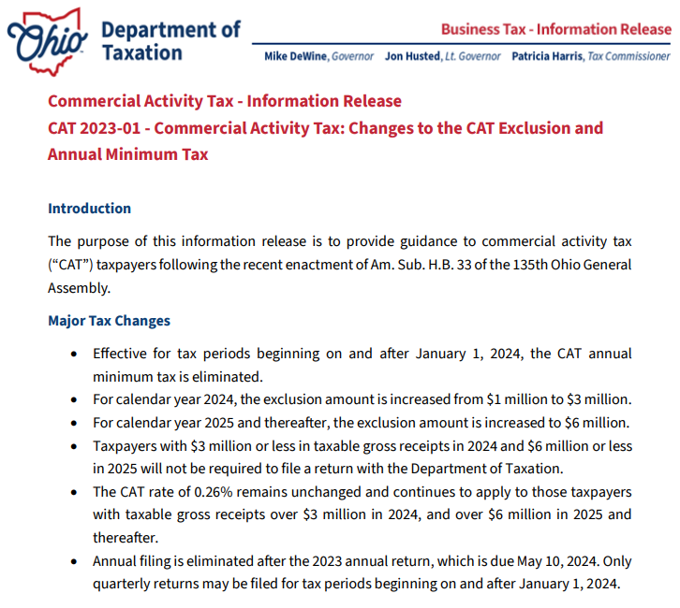
Ohio CAT Tax

Slide 17
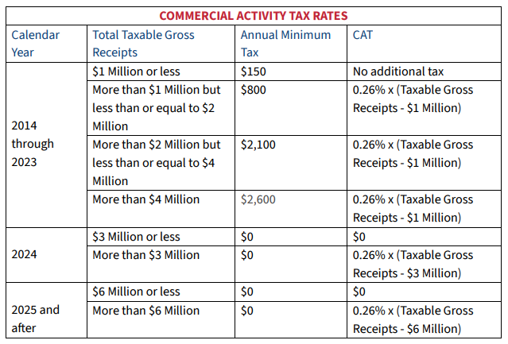
Ohio CAT Tax

Slide 18
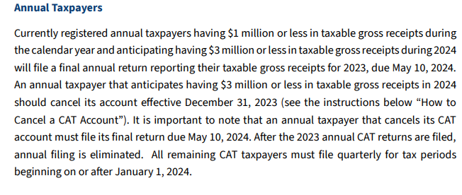
Ohio CAT Tax

Slide 19
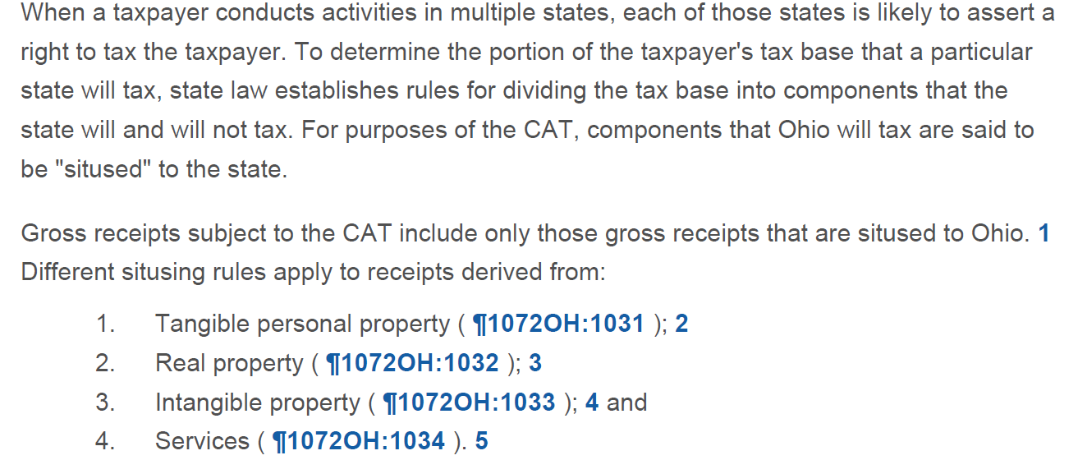
Ohio CAT Tax
Refund Opportunity??

Slide 20
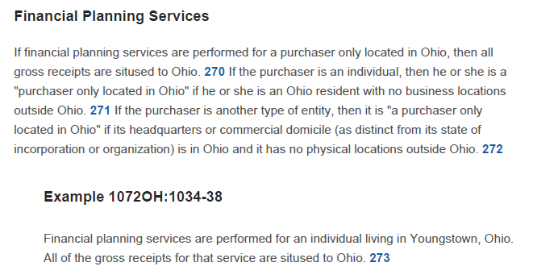
Ohio CAT Tax

Slide 21
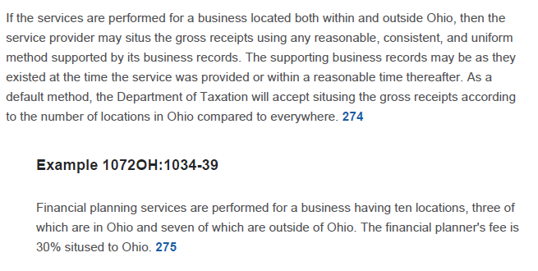
Ohio CAT Tax

Slide 22
Homeownership
House Bill 33 authorizes an income tax deduction for individuals who contribute to homeownership savings accounts, which can be used towards the down payment and closing costs associated with the purchase of a home

Slide 23
Homeownership
The deduction has two components:
A deduction for contributions to an account. This deduction is limited to $10,000 per year, per account for joint filers and $5,000 per year, per account for all other filers, with a lifetime maximum per contributor, per account of $25,000. Only the account holder, or the account holder’s parent, spouse, sibling, stepparent, or grandparent are eligible to take this deduction.
A deduction for the interest earned on deposits in, and employer contributions to, an account. This deduction is only available to the account holder.

Slide 24
Homeownership
Under the bill, if an account holder withdraws money from a homeownership savings account, but does not use the money to pay the closing costs on a home that will be the account holder’s primary residence, that individual is required to pay income tax on the amount withdrawn. The amount is added back to the account holder’s taxable income, even if the amount was originally contributed by someone else.
The tax deduction is available for taxable year 2024 and thereafter.

Slide 25
Scholarship Credit
House Bill 33 allows donations to scholarship granting organizations (SGOs) made before the federal income tax return filing deadline (generally April 15) to be the basis of a tax credit claim against the income tax for the preceding taxable year.
Under prior law, such donations may be the basis for an income tax credit claim, but only for the taxable year in which the donations are made. The bill does not change other aspects of the credit, such as a $1,500 cap for spouses filing jointly, and a $750 cap for single filers.

Slide 26
Apportionment
House Bill 33 allows businesses with employees who work remotely to use a modified version of this apportionment formula. Instead of apportioning the payroll earned, sales made, or property used by a remote employee to that employee’s remote work location, the employer may instead apportion those amounts to a designated “reporting location.”
This alternative is available both to businesses that file returns with municipal tax administrators and businesses that elect to file a single return covering all municipal corporations with the Tax Commissioner.

Slide 27
Apportionment
To use the bill’s modified apportionment formula, the business must assign a remote employee to a designated reporting location, which is any location owned or controlled by the employer or, in some circumstances, by a customer of the employer.
An employee’s designated reporting location will be (a) the location at which the employee works on a regular or periodic basis, (b) if no such location exists, the location at which the employee’s supervisor works on a regular or periodic basis, or (c) if neither such locations exist, any reporting location designated by the employer, provided that the designation is made in good faith and is reflected in the employer’s business records.

Slide 28
Apportionment
A business can change a remote employee’s designated reporting location at any time. If the business is a pass-through entity, e.g., a partnership or LLC, it can also designate a reporting location for any of its equity owners who work remotely.

Slide 29
Stock Options
House Bill 33 exempts stock option and nonqualified deferred compensation income from any municipality’s income tax. Under previous law, those types of income are exempt only if a municipality exempted such income in an ordinance adopted before 2016.
The bill’s changes apply to taxable years beginning on or after January 1, 2024

Slide 30
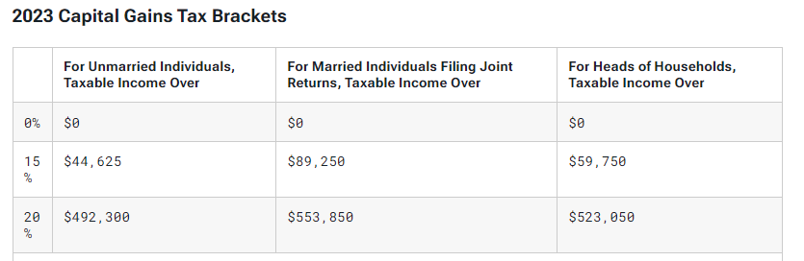
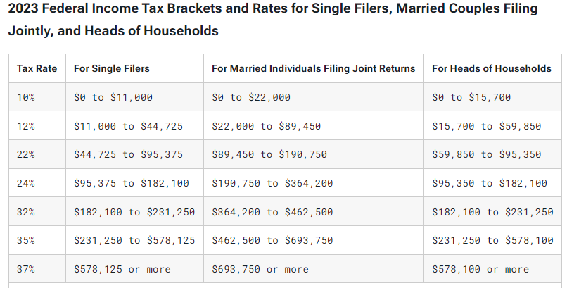
Marginal rate

Slide 31
Marginal rate

Slide 32
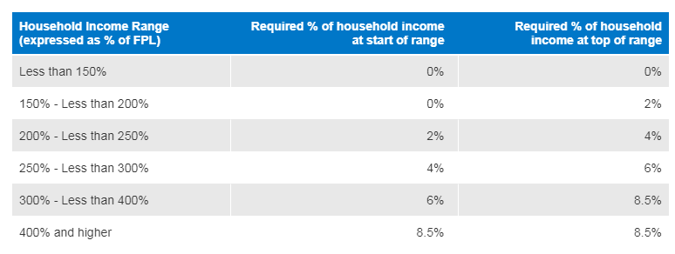
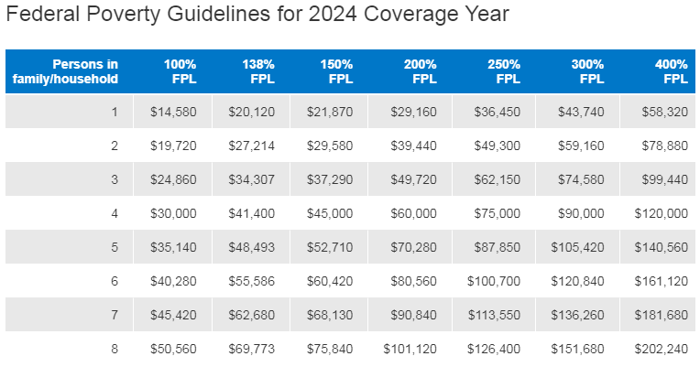
Marginal rate

Slide 33
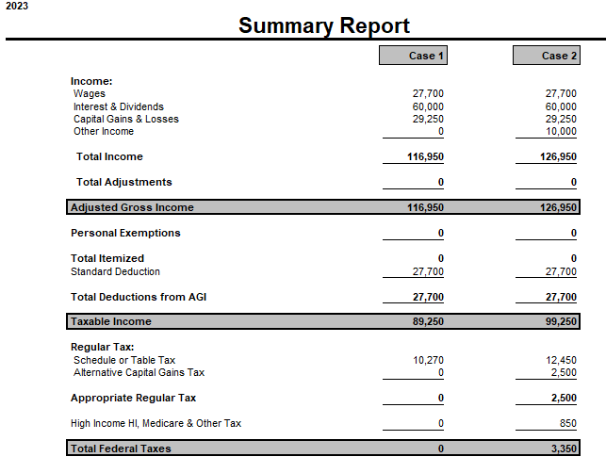
Marginal rate

Slide 34
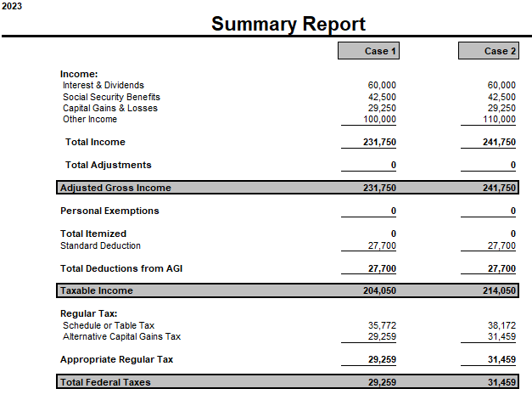
Marginal rate

Slide 35
Backdoor Roth
Reminder to check tax return to make sure it is reported properly!

Slide 36
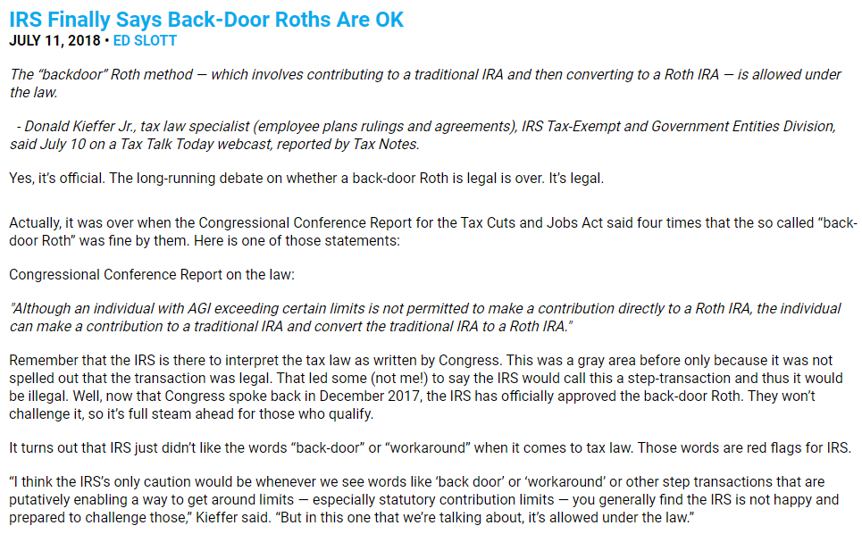
Back-Door Roth

Slide 37
Backdoor Roth

Slide 38
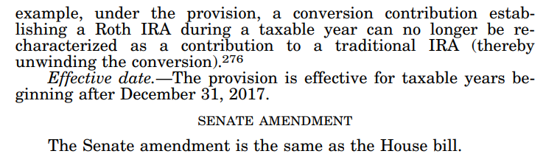
Back-Door Roth

Slide 39
Back-Door Roth

Slide 40
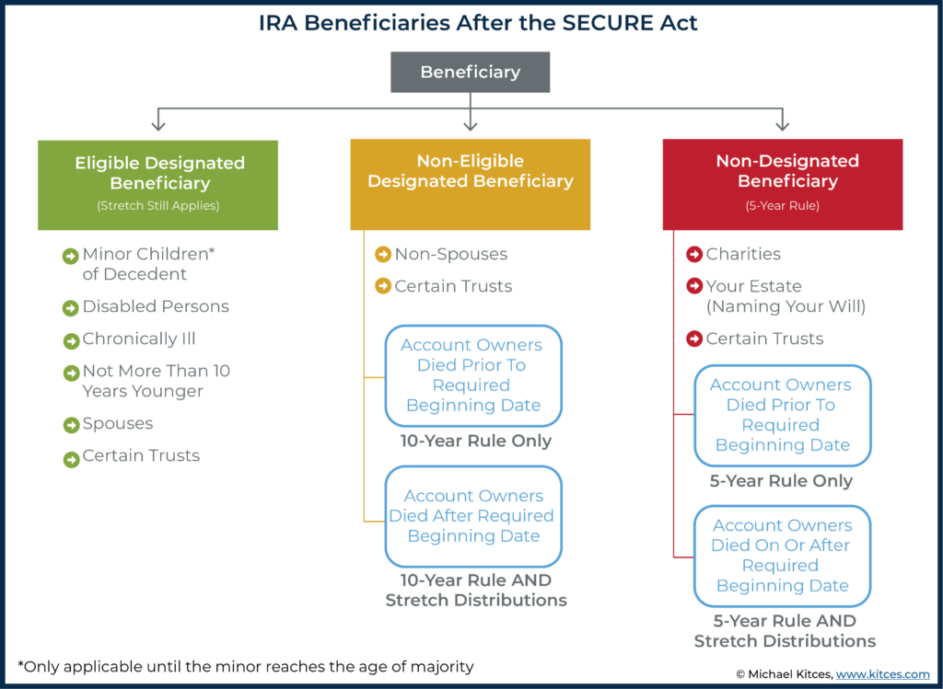
10 Year Rule

Slide 41
10 Year Rule - Update
Notice 2023-54 extended relief even further
The new Notice added another year of relief by waiving 2023 RMDs for NEDBs of IRA owners who died in 2020 or 2021 after the required beginning date.
It also excused 2023 RMDs for NEDBs of owners who died in 2022 after the required beginning date.

Slide 42
Secure Act 2.0
Secure Act Changes | Secure Act 2.0 Changes
Delayed Required Beginning Date Part-Time Worker Participation Opportunities Small Business Retirement Plan Credits Repeal of IRA Contribution Age Limit IRA Beneficiary Withdrawal Period Changes | Delayed (again) Required Beginning Date Increased Part-Time Worker Participation Opportunities Expanded Catch Up Contributions Mandatory Automatic Enrollment & Escalation Terms Roth Matching Opportunities Student Loan Matching Lost & Found Retirement Account Database

Slide 43
RMD
SECURE Act 2.0 Replaces Age 72 with Ages 73-75 Based on Timeline:
Age 73 starting in 2023
Age 74 starting in 2030
Age 75 starting in 2033

Slide 44
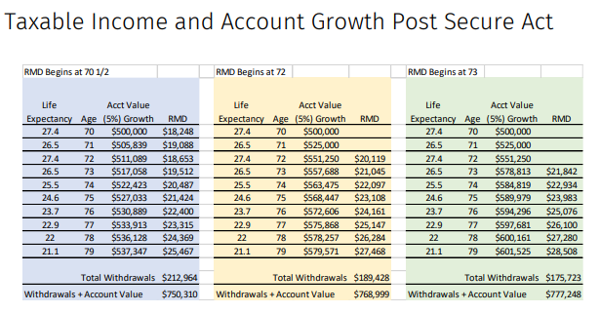
RMD

Slide 45
RMD Penalty
IRC 4974(a) imposes a penalty if employee (or any beneficiary) withdraws less than the RMD
Penalty = 50% of amount that was not withdraw but should have been withdrawn.
Secure Act 2.0 reduces the penalty under 4974(a) to 25%.

Slide 46
RMD Penalty
New IRC 4974(e) added to allow further penalty reduction to 10% if taxpayer withdraws the previously un-withdrawn amounts during a “correction window” and pays tax on those amounts.
Correction Window ends on the earlier of:
Date a notice of deficiency is mailed relating to the 4974(a) penalty
Date Taxpayer addresses the 4974(a) penalty, or
The last day of the 2nd year after the penalty is imposed
If not corrected within the Correction Window, then 10% reduced penalty is no longer available. Intended to incentivize taxpayers to address unwithdrawn RMDs instead of ignoring or waiting out the statute of limitations.

Slide 47
RMD Penalty
Currently, IRS permits taxpayers to request waiver of penalty for reasonable cause.
Taxpayer attaches statement explaining the circumstances surrounding the missed withdrawal and explains how they are correcting it.
Will Secure Act 2.0 reduced penalty impact IRS’ voluntary penalty waiver process?

Slide 48
Roth Catch-up
Originally effective January 1, 2024, catch-up contributions to employer sponsored plans (i.e. 401k, 403b, 457b plans) must be made to a ROTH account if taxpayer earns more than $145,000 Delayed to 2026
401(k) Limits Example:
Under Age 50 = $22,500 (all pre-tax)
Over Age 50
$22,500 (pre-tax)
$7,500 (post-tax ROTH)
Ages 62-64
$22,500 (pre-tax)
$10,000 (post-tax ROTH)

Slide 49
Early Withdrawal
IRC 72(t) allows taxpayers to withdraw retirement funds before age 59 ½ without paying the 10% penalty for a multitude of reasons (medical expenses, college, first-time homebuyer, disability etc).
Secure Act 2.0 adds to this list of exceptions by allowing taxpayer to make a one-time withdrawal of up to $1,000 per year for an unforeseeable or immediate financial need related to personal or family emergency expenses.
Taxpayer can repay the withdrawal within 3 years. If not repaid, taxpayer cannot make further withdrawal during 3-year period.
Effective starting January 1, 2024

Slide 50
Retirement Savings
Effective January 1, 2024, retirement plans can offer linked Emergency Savings Accounts to non-highly compensated employees.
Employee can contribute 3% of salary up to total account balance of $2,500 on a post-tax (ROTH) basis.
Participant can withdraw up to $1,000 once per year for an emergency. No 10% Early Withdrawal Penalty.
Withdrawal can be repaid within 3 years of the withdrawal, but if not repaid, no further withdrawals during 3-year term.
Intended to address lower income earner’s worries that saving for retirement leaves them without an emergency fund.

Slide 51
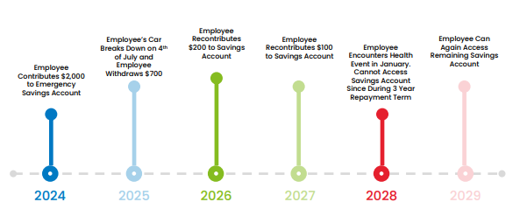
Retirement Savings

Slide 52
Automatic Terms
SECURE ACT 2.0 adds new IRC Section 414A which requires NEW defined contribution plans to include provisions that would automatically enroll employees once eligible.
Initial automatic savings rate must be at least 3% but no more than 10%.
Savings rate must automatically increase by 1% annually up to at least 10% but no more than 15%.
Employee may elect out of saving at anytime.
Effective for plans beginning after December 31, 2024.

Slide 53
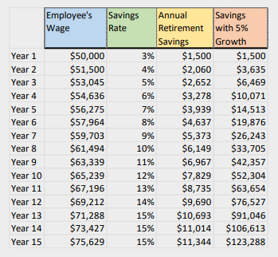
Automatic Terms

Slide 54
Roth Employer Contr.
Current law requires employer contributions or matches to be made on a pre-tax basis.
Secure Act 2.0 allows employees to elect to recognize some or all of the employer’s contribution as income.
Contributions recognized as income could then be contributed to a ROTH account.
Normal contribution income limits still apply limiting total contributions by both Employee and Employer.

Slide 55
Roth Employer Contr.
Employee earns $100,000 per year and contributes 10% of their earnings to a pre-tax 401(k) and 10% of their earnings to a post-tax Roth 401(k)
Employee has contributed $10,000 to the 401(k) and $10,000 to the Roth 401(k).
Employer offers a 6% match of employee’s contributions.
Employee is eligible for $6,000 contribution from Employer.
If Employer’s plan allows, Employee may choose to have all of the contribution added to either the 401(k) or Roth 401(k) or part to each account.

Slide 56
Student Loan Matching
IRS Private Letter Ruling 201833012 permitted employers to provide a retirement plan matching contribution based on employee’s student loan payments (instead of actual retirement contributions).
Secure Act 2.0 makes this ruling a permanent statutory fixture.
All other tests for the retirement plan must still be met including anti-discrimination calculations.

Slide 57
Student Loan Matching
Employee earns $50,000 annually. Pays $500 per month ($6,000 annually / 12% of salary) toward student loans. Cannot afford to save for retirement on top of student loan payments.
Employer who has adopted this plan provision who normally contributes a 4% of employee’s retirement savings can now deposit $2,000 in employee’s retirement account even if employee contributes nothing.
Employee’s payments toward their student loans count as retirement contributions for purposes of the employer’s matching calculations.

Slide 58
529 Plan Rollovers
Secure Act amends IRC 408A and 529 to permit unused 529 savings to be rolled into Roth IRA accounts.
Beneficial for students who did not fully deplete their educational savings accounts and would have been subject to nonqualifying use penalties + tax on any earnings.
Effective for tax years after December 31, 2023.

Slide 59
529 Plan Rollovers
Transfers must be done on a trustee-to-trustee rollover.
Beneficiary of 529 and Owner of Roth must be the same person.
529 must be open for 15 years prior to rollover.
Total rollovers cannot exceed $35,000 during beneficiary’s lifetime.
Roth IRA contribution limits apply (without considering taxpayer’s income).

Slide 60
529 Plan Rollovers
Parents and grandparents contribute $200,000 to 529 savings account to grandchild.
Grandchild gets scholarships and has $30,000 remaining in their 529 account upon graduation.
Grandchild can roll-over $6,500 in 2024 to ROTH IRA account.
The next year, they can roll-over another $6,500 and so on until the account is empty.
Grandchild now has a solid start to retirement savings during years when income levels may have been too low to contribute.

Slide 61
QCDs
After age 70 1/2, taxpayers can make charitable contributions of up to $100,000 per year directly from an IRA (not a 401k)
Under the SECURE ACT 2.0, the $100,000 limit is now indexed for inflation.
Inflation index will start for tax years starting after 2023. $105,000 for 2024

Slide 62
Questions?

