Slide 1
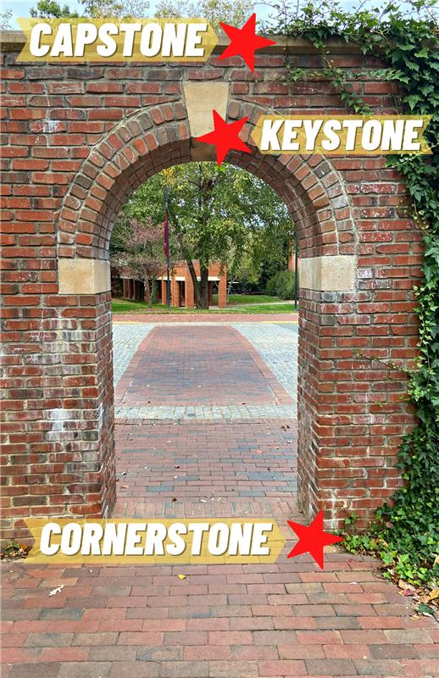

FLM Capstone Project
A capstone project is
the culminating assignment of
an academic program,
serving as a bridge between
classroom theory and real-world practice.
FLM

Slide 2
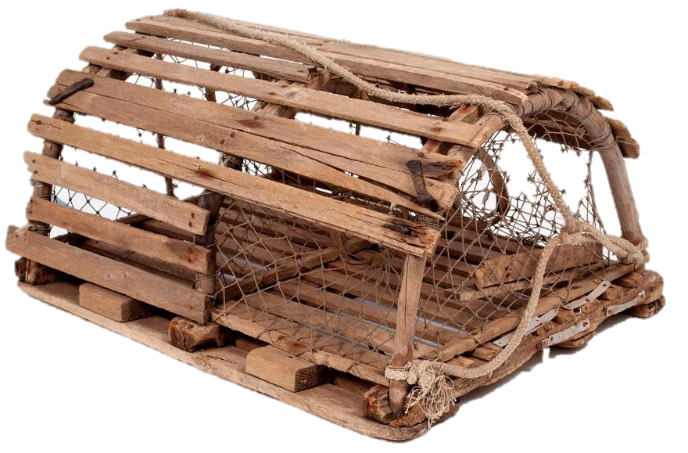
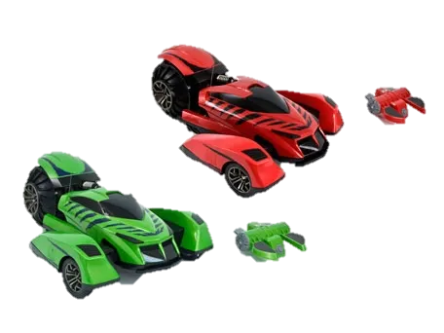
Theme: Harbor Hustle Lobster Trap Challenge!
Overview of event
Schedule
Resources
  Budget
  Hotel Room and Local Area
Event Details
Marketing Plan
FLM Team Roles
FLM

Slide 3
Overview
Networking Event sponsored by FLM
On-site at Westin hotel
Incorporate leadership, team building and executive skills
Opportunity to demonstrate your abilities
Create engagement between attendees
Fun!
FLM

Slide 4
Schedule for Monday, Oct. 5th
8:00 am - 11:00 am Private Fishing Excursion
9:00 am - 3:00 pm Golf Outing – Scramble Shotgun Start at 9:00 am
9:00 am - 5:00 pm Registration Desk Open
10:00 am - 12:30 pm City & Lighthouse Tour
10:00 am - 5:00 pm 2026 FLM Workshop & Lunch
1:00 pm - 5:00 pm Vendor Showcase Set-Up
4:30 pm - 5:30 pm FPDA/ISD BOD Meeting
5:30 pm - 7:00 pm Welcome Reception
7:00 pm - 9:00 pm Harbor Hustle Lobster Trap Challenge
FLM
Notes:
The Opening Reception is on 15th floor and will be closed for our private event/ Once we’re done the bar stays open. So challenge will be to MOVE THE CROWD downstairs. Elevator capacity… slow move downstairs…
The Longfellow space is ours whenever we want it for however long we want it. We do need to tell the hotel.

Slide 5
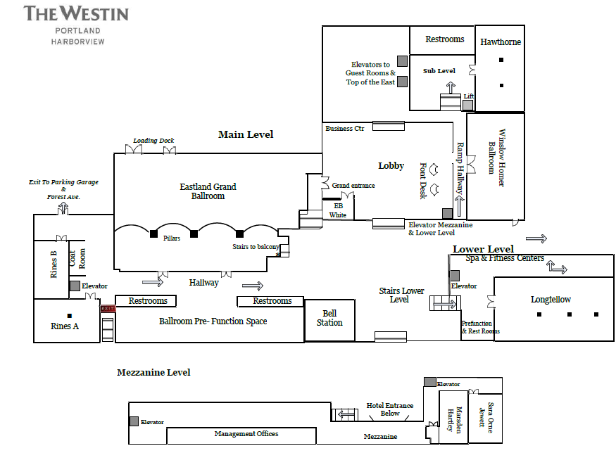
Resources Available to You
Budget - $1000
Westin Property – Longfellow Ballroom (Video?)
1500sf
Consider how to best use the space!
Video
FLM

Slide 6
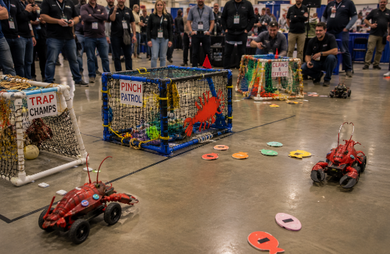
Event Idea Harbor Hustle: Lobster Trap Heist
The Idea
Maine-themed event where teams compete in a build-and-steal challenge using remote-control lobsters.
Each Team Receives
🛠️ Supplies to build a lobster trap
🐟 Lobster bait to protect
🎮 A remote-control lobster/car
🎨 Materials to outfit or decorate their lobster
The Challenge
Build a lobster trap that protects your bait and makes it difficult for competitors to steal it.
Objective
Steal the most bait while protecting your own. Winner = Team with the most bait at the end of the competition.
Build. Defend. Steal. Escape. Win.
FLM

Slide 7
Your Assignment: Design the Event
Supplies
What materials are you providing to the teams? Lobster cars, trap materials, bait, etc.
Rules
Trap size limits?
Minimum trap entrance size?
How is bait captured?
How do you keep the competition fair?
Schedule
Build time?
Practice time?
Competition format (heats or all at once)? How do teams rank and win? What prizes?
Create an event that is: Fun, Fair, Easy to understand, and Exciting to watch
FLM

Slide 8
Your Mission: Engage and Entertain
50-100 Participants of varying age and physique
  FPDA and ISD member companies
Teams of 6-8 people? Need to set a MAX number of teams to ensure correct # of cars.
Self-run event. FPDA and ISD member volunteers and staff.
Food – People will be hungry following reception.
  Work with FPDA staff and Hotel
GOAL – Fun memories and new connections
FLM

Slide 9
Deliverables
Competition format and points system
Staffing plan
Resource/Materials list (RC Car decorations, lobster traps, event props, puzzles, prizes)
Event Budget
Marketing Plan – social media posts, videos, mailers?
Presentation to Bill, Luke and Chris – August TBD @ 3PM EDT – 1 week before BOD presentation
Presentation to FPDA BOD – August 27th @ 3PM EDT
FLM

Slide 10
Team Roles
Up to YOU to decide which roles are required, and who should do what
Self-organize and report team roster back to Bill Haley by July 3rd.
FLM

Slide 11

Questions?
FLM

