Slide 1
Learning from Near-Misses and Mistakes
Laurie Heels, MSN, RN
Director, Perioperative Services
Dartmouth-Hitchcock Medical Center

Slide 2
Learning Objectives Slide
Identify the types of unplanned events that can occur in an ASC setting
Identify what can be learned from early catches, near-misses and actual sentinel events.
Understand and apply rule-, knowledge- and skill-based errors
Understand the differences between apparent cause analysis and root cause analysis
Understand these concepts and apply leadership behaviors in the workplace

Slide 3


Harm in Healthcare – an Overview
“A 747 a Day”
2016 (BMJ) Johns Hopkins University School of Medicine:
  Medical error may be the third most common cause of death
Notes:
Speaker’s Notes:
We’re here today to talk about Harm in Healthcare –. Healthcare is an industry where people work hard, but they do very complex activities, with great possibility for harm – and in fact great harm occurs. You may not realize it, but according to the 1999 Institute of Medicine report, between 44,000 to 98,000 deaths occur each year as the result of medical errors.
A retrospective study conducted by HealthGrades and released in 2005 supported the projections of the IOM report, revealing that almost 300,000 people had died as a result of preventable patient safety incidents during the 3-year period 2001 to 2003.
This is an incredible number, and it got a lot of attention because they compared the number of people dying as if a 747 jumbo jet were crashing every day in the United States and killing everyone on board. That’s what 98,000 deaths from medical errors is like.
This is why we’re here today – to talk about how we can reduce these events and create a culture of safety

Slide 4

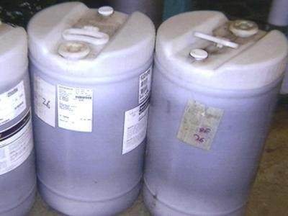

Safety is Everybody’s Business
Contract elevator maintenance employees drained fluid from elevators into containers used for surgical detergent. The containers were not properly re-labeled or securely stored. They were restocked and shipped as detergent back to Durham Regional Hospital and Duke Health Raleigh Hospital.
In November and December of 2004, the elevator hydraulic fluid was used as detergent in one step of a multi-step cleaning and sterilization process of surgical tools.
Photo Credit: Duke University Medical Center
Notes:
Speaker’s Notes:
Here is another story from Duke Health that shows how patient safety is not limited to the clinical environment – its really everybody’s business – and its why we’re all going through this training.
“In November and December of 2004, hydraulic fluid was accidentally substituted for detergent in one step of a multi-step cleaning and sterilization process of surgical tools at Durham Regional Hospital (DRH) and Duke Health Raleigh Hospital (DHRH), both of which are part of the Duke University Health System (DUHS).
Employees of Automatic Elevator, a firm that serviced the hospitals’ elevators, drained the fluid from elevators into containers that had held surgical detergent. The containers were not properly re-labeled or securely stored by Automatic Elevator.
Cardinal Health, the firm that provides surgical detergent to DUHS, picked the containers up, restocked and stored them, and then shipped them as detergent back to several hospitals. The fluid was then used in the cleaning process for surgical instruments at DRH and DHRH. The mix-up was not immediately noticed, in part because the detergent our hospitals use and the hydraulic fluid have a similar color and consistency.”
During this time the surgeons were saying: “the instruments seem to be a little more slick” and the staff in sterile processing were saying: The soap looks a little darker and smells a little different. Yet no one took the next step and asked why. NOBODY HAD A GOOD QUESTIONING ATTITUDE OR FELT EMPOWERED TO “STOP THE LINE” WHEN SOMETHING DIDN”T SEEM RIGHT.
Points to emphasize:
3,800 patients were involved in this error.
This event demonstrates that we all play a role in keeping our patients safe. There is no professional group in healthcare that has not, through an error of omission or commission, caused harm to a patient. A hospital is first and foremost a patient care enterprise. Every job is important to patient safety.

Slide 5
2013 CMS report
Luer Misconnections continue to result in adverse events and deaths – Luer connectors easily link many medical components, accessories, and delivery systems. Clinicians, in any type of provider or supplier setting, can mistakenly connect the wrong devices and deliver substances through the wrong route. Despite numerous alerts and warnings, a patient’s blood pressure tubing was recently misconnected to an intravenous (IV) line in an ambulatory surgery center (ASC) resulting in a patient death.
Facility Reporting to Food & Drug Administration (FDA): Surveyors should encourage health care facilities to report problems with Luer misconnections to the FDA, even if no adverse event occurred.
https://www.cms.gov/Medicare/Provider-Enrollment-and-Certification/SurveyCertificationGenInfo/Downloads/Survey-and-Cert-Letter-13-14.pdf
March 8, 2013 report

Slide 6
Over 23 million procedures performed in ASCs/year
Where is the risk?
  Falls
  Wrong sided surgery/site
  Patient burn
  Patient transfer/admission
  Device malfunction or misuse
  Pressure injuries/gaps in skin assessment
TJC: https://www.jointcommission.org/ambulatory_buzz/making_ambulatory_surgery_safer/

Slide 7
Safety Events Across the Continuum
Transitions of Care
  Handoffs
Medication Safety
  Adverse Drug Events
  Medication reconciliation
Missed and delayed diagnoses
  Test result follow-up
  Referral management
National Patient Safety Foundation (NPSF) Patient Safety Curriculum 2nd edition, 2015
Notes:
Transitions of Care
Handoffs and transitions are particularly high-risk for adverse events (e.g. how do we hand off information from ambulatory care? Inpatient units? Radiology? Nursing homes? Upon discharge?, etc.)
20% of patients experience adverse events after discharge;
ADE is most common (66%)
Procedure related: 17%
Medication Safety
ADE
Inpatient errors (prescribing, administration)
ADE’s after discharge
Outpatient prescription errors
Med reconciliation:
Half of all medication errors occurred at interfaces of care
Over half of patients have a medication discrepancy at the time of hospital admission
One study, using phone follow-up 3-5 days after discharge found that 29% of patients:
Not taking a medication on their discharge list
Taking a different dose or frequency
Taking an additional medication
Missed and delayed diagnoses
Test result follow-up:
Multiple contributing factors re: failure to follow up:
41% of patients discharged had test results return after discharge; providers unaware of 2/3 of these results
Absence of guidelines re: who has responsibility and how and when to notify patients
Lack of integrated information systems
Multidisciplinary nature of the test management process
Lengthy turn-around time for test results
Lack of standard communication strategies
Diffused responsibilities (whose responsibility is it to follow up? (E.g. Polyp biopsied: GI, Pathologist, or PCP to follow up?)
Typical PCP reviews 800 chem-hem, 40 rad, and 12 path reports/week
Referral Management:
Poor referral communication issues are often cited as a factor in outpatient missed/delayed diagnosis claims

Slide 8

Anatomy of a Safety Event
Multiple Barriers (technology, processes, and people) designed to stop active errors
Poorly designed processes or active errors within a well designed process
Harm Events
Active errors by individuals result in initiating action(s)
Weaknesses in barriers
(Latent errors)
“Safety is a Dynamic Non-Event”
Slide concept adapted from
James Reason, Managing the Risks of Organizational Accidents, 1997
Notes:
Time: <2 min
Key Point: Swiss Cheese Model- there are processes and systems in place to detect human error or prevent it from reaching the patient, but no safe guard is perfect. It is not just one person making a mistake, we are one team and at any point care, someone has the option to Question the process and/or system. If harm reaches a patient, we’ve all made a mistake!
Why Significant Events Happen
The Swiss Cheese Effect, a model that explains how human error results in events of harm, was developed by James Reason, a psychologist studying events in aviation. In most everything we do, there are checks and barriers built designed to help catch errors and prevent them from resulting in events. This is called defense-in-depth. The slices of Swiss cheese represent that defense-in-depth.
Latent errors/weaknesses: Inherent weaknesses in the system. Most days these weaknesses do not result in errors (e.g. failing to double check 2 forms of ID). However, on a particular day, due to the circumstances surrounding the event, these latent weaknesses can allow an active error to reach the patient. (e.g. failing to double check 2 forms of ID when there are 2 patients with the same name on a unit or in clinic)
The healthcare system is designed wherever possible with defense-in-depth such that single human errors do not result in harm. Good defenses can include technology (a pharmacy order entry system that warns the Pharmacist of potential drug interactions); processes (operative site verification procedure that requires the OR team to pause before making the incision to confirm the correct site); or other people (a coworker who sees us prepare to care for a patient without washing our hands and stops to remind us).
Sometimes, however, those good checks and barriers fail. Those failures are seen as the holes in the Swiss cheese. When all our best defenses fail us, an error that otherwise would have been caught carries through the holes unstopped and results in an event. On average, a Serious Safety Event is the result of 8.3 human errors.
Safety doesn’t just happen. We have to work to make it happen. There are two basic approaches to reducing event rate. First, reduce the human error rate. The event rate is proportional to the human error rate, so any decrease in human error rate will reduce the number of events. Safety Behaviors using error prevention tools are designed to reduce the human error rate, and thereby event rate, by 80% in two years. Second, find and fix the holes in the Swiss cheese. Continuous improvement approaches to system reliability are designed to reduce event rate by 50% in two years.
Our hospital plans to continue finding and fixing the system problems, implement Behavioral Expectations for human error prevention, and measure the results through a reduction in Serious Safety Event Rate and an increase in the number of event-free days.

Slide 9
Medication Error
Barriers fail
Pt. developed infection and required an additional surgery to remove sponge
Patient seized;
transferred to
higher
level of care
Pharmacist asked provider to change
5 mg/kg (193 mg)
to 160 mg
so it could be given as a tablet.
RN relied on barcode scanner (e.g. confirmation that 38. 5 tablets was correct)
Dose Alerts overridden
Robot packages 38.5 tablets
Pharmacist sees
the “160” and
verifies the order
MD entered
“160 mg/kg” instead “160 mg”
Wachter, Robert (2015). The Digital Doctor: Hype, Hope, and Harm
Notes:
Time:
Key Point:
This event happened at the Univ of California San Francisco Children’s Hospital. Robert Wachter, a national expert in Patient Safety who works at UCSF, reported this error. Make the point that 38.5 tabs of Bactrim were given to an adolescent because of a simple typographical error in an electronic record. Technology not only failed to stop the error, it actually made it easier for the error to reach the patient (personnel were falsely reassured by the automation).
Original dose ordered was 5 mg/kg (193 mg.) for a 38.6 kg child)
The dose was rounded to 160 mg. When a dose is greater than 5% of the original dose, pharmacy is required to call the provider for approval.
Pharmacy called provider and she agreed to the new dose, but typed “160 mg/kg” (system defaulted to mg/kg based on the last order) instead of the correct 160 mg (total) dose
Several alerts popped up, but were ignored/overridden
Robot in pharmacy pulled 38.5 tablets to equal 160 mg/kg ( 6,176 mg)
RN caring for patient was floating to this unit; she felt that something wasn’t quite right, but because the unit was so busy, she didn’t want to bother anyone. However, she was reassured that the dose must be ok because she thought the electronic health system would have caught the error and the dose matched the order.
When she scanned the medication, the barcode scanner further confirmed that the dose was correct.
Technology in this case actually facilitated the error because the RN was falsely reassured.

Slide 10


What are Serious Safety Events?
Deviations
From Standard
Care
Significant
Patient
Harm
Serious
Safety
Event
Resulting in
Significant patient harm is death, permanent or temporary loss of function or injury. Examples of SSEs may include:
    Transfusion reaction (wrong blood)
    Medication event
    Misdiagnosis
    Hospital-Acquired Infection
    Treatment error
    Delay in treatment
    Wrong site/side surgery or procedure
    Fall with serious injury
1
Notes:
Time: <1 min
Key Point: Serious Safety Events= Variation from best practice-followed by- Significant Patient Harm
Serious Safety Events occur when we vary from generally accepted performance standards and cause significant patient harm.
Serious Safety Events are deviations in standard care that result in:
Death or
Moderate to severe temporary or permanent harm to the patient
In other words, a patient is seriously harmed or dies due to preventable harm….
There are 33 different event categories. Some of the top ones are listed here.
Do you think all of the examples of SSE’s identified in this slide have happened here at our hospital? Which do you think causes more errors here?
In HPI’s analysis of our SSEs they found that the causes across the various event types were “common.” For example, non-compliance, critical thinking failures, communication failures. These conditions cause events of different type. If miscommunication is an underlying common cause it will result in a medication event on one day and a delay in treatment event on another. Therefore, our plan is to not take tactical solutions but rather to focus on our behaviors and culture that addresses the observed common causes.

Slide 11


A deviation from generally accepted performance standards (GAPS) that…
Serious Safety Event
Reaches the patient and
Results in moderate harm to severe harm
or death
1
Serious
Safety
Events
100
1000
Precursor Safety Event
Reaches the patient and
Results in minimal harm or no
detectable harm
Precursor
Safety
Events
Near Miss Safety Event
Does not reach the patient
Error is caught by a
detection barrier or by chance
Near Miss Safety Event
1
Notes:
Time: 1 min
Key Point:
For every Serious Safety Event, there are most likely hundreds of Precursor Safety Events, and thousands of Near Miss Safety Events…..and the causes are the same. Everyone has been distracted and has inadvertently run a stop sign or stop light in their years of driving. However most of us have not experienced an accident, a few might have had a fender bender and once in a while a serious accident occurs. As we eliminate the SSEs we will need to shift our learning to the PSEs and NMEs. They are our “early warning system” and are just as valuable to evaluate as a SSE.
How effective are we at identifying Serious Safety Events?
What about Precursor and Near Miss Events?
We want everyone to report events or near events even when there was no harm to anyone. Why? Because by evaluating these events, we can understand what to do to prevent this same potential event from happening in the future. The same action that initiates a Near Miss or Precursor Safety Event could end up as a Serious Safety Event the next time!

Slide 12
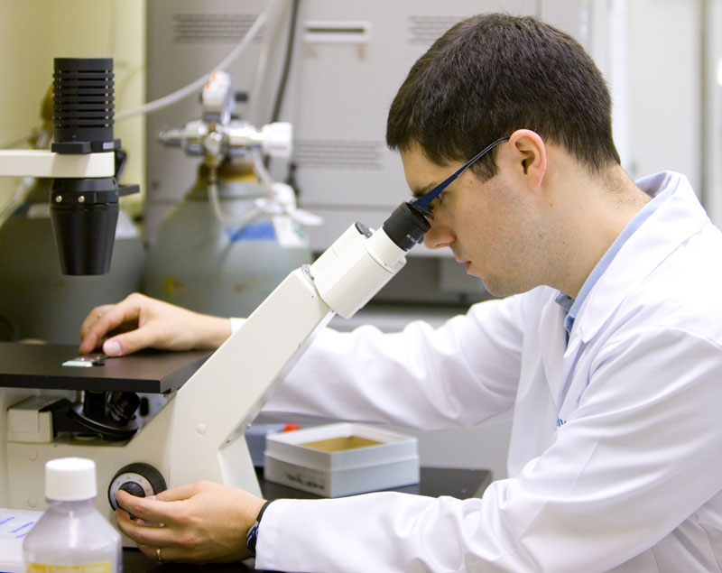
Why Do You Think Serious Safety Events Occur at your institution?
If someone you cared about was receiving care at your site, what would concern you the most about keeping them safe – free from preventable harm?
1

Slide 13
What is the Most Common Reason People are Hesitant to Report Safety Events?
Fear of disciplinary action for self or others
Perception of “tattling” on others
Form too long; lack of time
Unsure that event is “worth reporting” (e.g. event seemed “trivial”)
Unsure how and/or where to report event
Assume someone else will report event
Think that event is the “norm” and no need to report
Lack of feedback on incident follow-up
“Why bother”
Notes:
These are some common reasons that people fail to report safety events. Based on the results of the audience response system, engage in a discussion about these issues and that they should not be reasons that people fail to report (e.g. Just Culture philosophy, importance of learning from near miss and precursor events so that they don’t become serious safety events, etc.)

Slide 14
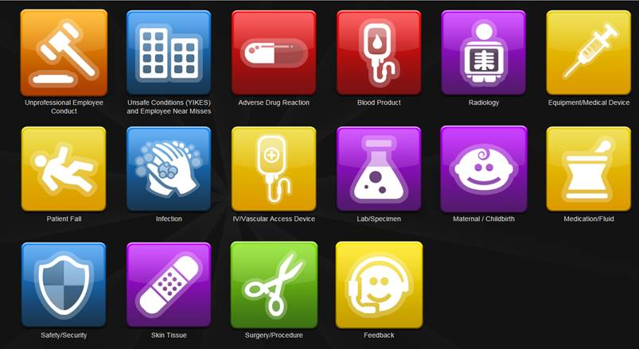

Adverse Events
What types of events do you report?
  Safety events (actual or near miss) that impact patient and/or employee safety.
  Disruptive Behavior which is behavior that includes words or actions that can create an unsafe or hostile environment.
  Good catches
2
Notes:
We’ve spent quite a bit of time talking about patient and employee safety events, so what types of events should be reported?
This is a screenshot of the OWLS (Occurrence with Learning System) reporting system. Encourage people to report actual and near miss errors as well as disruptive behavior events.
We want everyone to report events or near events even when there was no harm to anyone. Why? Because by evaluating these events, we can understand what to do to prevent this same potential event from happening in the future. The same action that initiates a Near Miss or Precursor Safety Event could end up as a Serious Safety Event the next time!

Slide 15
Human behavior can generally be broken down into three distinct categories: skill-based, rule-based and knowledge-based behavior
Notes:
Skill based- putting on a seatbelt
Cognitive psychologists distinguish between “skill-based” performance, “rule-based” performance, and “knowledge-based” performance. Skills are highly practiced behaviors that we perform routinely, with little conscious effort. They’re literally automatic. Rule and knowledge-based performance require more mental involvement or conscious deliberation. We rely on them when skill-based performance won’t work, typically in exceptional or novel situations.
Slips and lapses are errors in the performance of skill-based behaviors, typically when our attention is diverted. A common mechanism for a slip is “capture”, in which a more frequently performed behavior “takes-over” a similar, but less familiar one. For example, a capture error is made when a nurse misprograms a new infusion pump because the sequence of steps is similar, but not identical to the pump he is most familiar with. Description errors are slips that occur when the objects of different actions are close together or visually similar, as when the wrong control on an EKG is adjusted because it’s close to other controls that look the same. Loss of activation errors are lapses where the goal is forgotten in the middle of a sequence of actions (e.g., a radiologists forgetting what he is looking for after retrieving and displaying a comparison study), or we omit a step in a routine sequence (e.g., the failure to complete a “double-check” for blood-type in an organ transfer protocol).
Slips and lapses occur while our attention is diverted and we fail to monitor the actions we’re performing.
Mistakes are errors in rule or knowledge-based performance. They arise when we misinterpret a situation or misapply a rule (usually, a rule that is frequently used and seems to fit the situation well enough). Mistakes include errors in perception, judgment, inference, and interpretation. Mode errors are common mistakes. A mode error arises when we perform an action appropriate for one mode, but we are mistakenly in another (e.g., when a nurse assumes the default analgesic concentration of 1.0 mg applies, but the pump was set to 10 mg by previous user). Misdiagnoses, misinterpretation of test results, failing to provide indicated prophylactics, and failing to respond to a device alarm are all examples of mistakes.
The Role of Attention
As with slips and lapses, attention plays a key role in mistakes. Whereas attention’s job is to monitor skill-based performance, our attention is actively engaged in the analytical reasoning and problems solving of rule and knowledge-based performance. As a result, slips, lapses, and mistakes are all more common when situational factors divert our attention. Situational factors include physiological factors like fatigue, sleep loss, alcohol, drugs and illness and psychological factors such as having to juggle multiple activities, stress, boredom, frustration, fear, anxiety, and anger

Slide 16

Generalized Error Modes
Notes:
Note: There is a 5-7 second delay before the video starts.

Slide 17
Human Error
“Human error is not the cause of failure, but a symptom of failure. Human error…should be the start of our investigations, not the conclusion.”
(PM Fitts & RE Jones, 1947)

Slide 18
Root Cause vs Apparent Cause Analysis
What’s the difference?
RCA | ACA
More formal | Less structured
Review commitee | Able to be done at the local level
Often 1 root cause | Multiple apparent causes

Slide 19
Apparent Cause Analysis Process
  Investigate the event
  Identify the detectable causes
    Inappropriate acts or human error
    Equipment failure or misuse
    Develop the Apparent Cause statement
    Define actions to address any gaps in the system

Slide 20
What are the Most Common “Systems” Issues that Contribute to Safety Events?
Culture 55%
Processes 18%
Structure 12%
Policy & Protocol 10%
Technology & Equipment 5%
*Data from 168 HPI hospitals
Notes:
Data from 168 HPI hospitals indicated that these are the top 5 most common systems issues that contribute to safety events.
Structure: organizational structure, resource allocation, collaboration mechanisms
Culture: vision/mission, collaboration, operational leadership, high reliability environment, competency, communication, critical thinking, compliance
Process: omitted or excessive actions, information handoffs,
Policy & protocol: usability, understandability, knowledge in environment
Technology & Environment: visual display, alarms, lighting, noise,
NOTE: “Culture” is ranked first; that is one of the reasons we are focusing our efforts on building and sustaining a culture of safety.

Slide 21
Expected Safety Behaviors for All:
Just Culture
HUMAN ERROR Inadvertent action: slip, lapse, mistake | AT-RISK BEHAVIOR A choice: risk not recognized or believed justified | RECKLESS BEHAVIOR Conscious disregard of unreasonable risk
Manage through changes in: Processes Procedures Training Design Environment | Manage through: Removing incentives for at-risk behaviors Creating incentives for healthy behaviors Increasing situational awareness | Manage through: Remedial action Punitive action
CONSOLE | COACH | PUNISH
Notes:
When errors occur, patient outcome is not the only thing that needs to be considered. It is also important to understand the behavior that contributed to the error in order to respond appropriately.

Slide 22
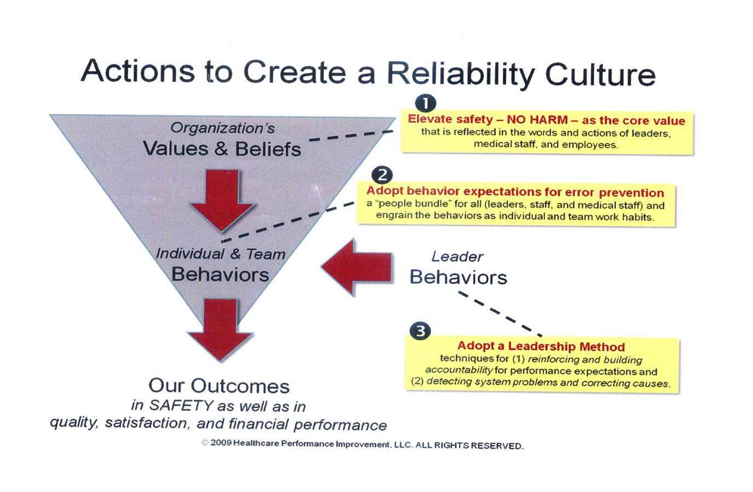

Slide 23
What would you do?
One facility lead shared the story of a nurse who faced two challenging situations that required her to speak up to a senior surgeon. On the first occasion, the nurse observed a surgeon as he was about to begin a case, and she suspected that the wrong limb had been prepared for the procedure. Just prior to skin incision she spoke up using the structured language tools taught in the program. Her suspicion turned out to be wrong and the surgeon ridiculed her for interrupting the case and questioning his judgment.
https://www.ahrq.gov/sites/default/files/wysiwyg/professionals/quality-patient-safety/hais/tools/ambulatory-surgery/sections/ambulatory-surgery-report.pdf

Slide 24
On the second occasion this same nurse found herself working with this surgeon and, once again, just prior to skin incision, she had a similar suspicion that the wrong limb had been prepared. While it clearly would have been easier for her to say nothing, especially given the reception she received the last time she spoke up, she used the training once again to voice her concerns.
On this occasion, however, the nurse was correct and the team was about to operate on the wrong limb. This time the surgeon reacted very differently. He was extremely appreciative and thanked the nurse for preventing a wrong-site surgery. He also apologized for his earlier negative reaction to her speaking up and has since become a champion for better communication in the OR.

Slide 25
Performance Management Decision Guide
Answers the question “why did the individual act this way?”
Deliberate Harm Test
  Did the individual intend the harm?
Incapacity Test
  Is there a suspicion of ill health, medical condition, or substance abuse?
Compliance Test
  Did the individual depart from policies, procedures, accepted standards of practice?

Slide 26
Performance Management Decision Guide
Other Considerations
Substitution Test
  Would individuals in the same profession and with comparable knowledge and skill act the same under similar circumstances?
Leader actions based on algorithm
  May include Disciplinary action, Coaching and Consoling
  Find and Fix problems

Slide 27
How Change is Typically Experienced
Enhanced Steady State
Competence & Confidence
Steady State
Stimulus for
Change
Acknowledgement & Reinforcement
Experimenting with New Ways of Working
MORALE & PRODUCTIVITY
Uncertainty &
Disorientation
New Tools & Training
Acceptance of Change
Trust Established
TIME
Notes:
Spend a good amount of time on this chart.
Set up the graph first
When change is implemented the typical effect on morale and productivity can be shown on this “bathtub” chart
As we can see there is a significant impact on performance before achieving the future state
Ask for input on things such as where do we have stimulus for change? Where have we experienced it before? How has this been handled? Communicated? Etc.?
Focus on the role of a project leader and how they can manage the team and area through required change.

Slide 28
Overall Goal: Establish Safety as a Core Value
Create a highly reliable environment for safe practices with global safety metrics and control loops to ensure continuous improvement.
Leadership Method
Learn, adopt, and practice leader skills for building and sustaining a culture of safety and performance excellence.
Recommended Interventions
Error Prevention
Implement behavior expectations for error prevention, targeted at common causes of past events.
Cause Analysis
Implement an philosophy and tools of a “state-of-the-art” cause analysis program to accelerate learning from events.
Lessons Learned
Implement robust lessons learned program for safety metrics, great catches, and successful tactical strategies aimed at eliminating events.
Notes:
28
Leadership is solving problems. The day your staff stops bringing you their problems is the day you have stopped leading them. They have either lost confidence that you can help or concluded you do not care. Either case is a failure of leadership.” – Colin Powell
1. Leadership Method
Leaders build and sustain a culture of safety and performance excellence by facilitating open communication, promoting teamwork to eliminate error-likely situations and by reinforcing and building accountability as clear expectation. Accountability is not about punishing people; it is about everyone being responsible for their actions and conduct. Leaders will learn new skills and reinforce behaviors that support and accelerate prevention, detection, and correction of human errors.
2. Make Error Prevention Effective and Reliable
This intervention is what we’re here to learn about today. NCH has defined specific safety behaviors and proven error prevention techniques for all NCH staff, physicians and leaders to use. This will be followed by a fair and just monitoring and accountability system to ensure the desired behaviors and techniques are practiced.
3. Cause Analysis Processes and Capabilities
It is imperative to establish robust root cause and common cause analysis capabilities from problem initiation, screening, analysis, implementation, and monitoring. The response to events and preventing their recurrence must be “owned” by front line management with appropriate support from risk management and quality departments. Lessons learned and generic implications must be shared and effectively resolved. We modify our RCA process routinely to assure that the process and follow up get to the true ‘root cause’ of an event, and that appropriate action plans were developed, implemented and sustained.
4. Create and implement a robust Lessons-Learned program
Highly reliable organizations have “institutionalized” their “lessons learned” approaches to ensure that knowledge gained from both good and bad experience is shared and utilized to continually improve performance. NCH will be looking at unique ways to ‘share our lessons learned’.
Highly reliable organizations establish Safety as a Core Value, something that can not be compromised for any reason, and never a priority. Why not a priority? – Because priorities change….Safety can never take a back seat.
Time: <10 sec
Key Point: We are in the Error Prevention Stage and that is what everyone is doing here today!

Slide 29
Senior Leader Walking Rounds
Senior Leaders set the tone
  Support safety as core value by how you spend your time
  Ask subordinates and staff about safety concerns and great catches
  Maintain a relentless drumbeat regarding safety
  Hold operational leaders accountable for practicing leadership methods
  Be personally involved in patient safety – put a “face” on safety issues – “let me tell you a story” – now, tell me a story…
  Transparency and learning when events occur

Slide 30
Senior Leader Walking Rounds
3 key messages
  You’re the expert about your job (deference to expertise)
  We really care about your opinions
  Part of your job is to improve your job – making it safer for our patients and our employees

Slide 31
Ways to ID & Prioritize
Jodi
Prioritize Problems
High Urgency
to Solve
Low Urgency
to Solve
Identify Problems
  Daily Check-In
  Walking Rounds
  Direct observation
  Safety events and near misses
  Things that keep you up at night…
Safety Critical
Primary Focus “A”
For Top 10 List
Secondary Focus For Top 10 List
Not
Safety Critical
Primary Focus “B” For Top 10 List
Add to Top 10 When All Other Problems Solved

Slide 32
It’s All Hawthorne Until Habit*
Mike
Awareness
100%
Skill Acquisition
Safety Behavior Education
Event Rate
Habit Formation
20%
Leadership Influence
Performance
~2 Years
Time
*Glen Bingle, CMO Community Health
Notes:
One of the most important things for you to take away from this presentation is that our safety initiative does not end with this training session! Remember that our initiative is all about practicing new behaviors that will help prevent us from making errors – AND making those behaviors become our habits. Errors and harmful events will continue to happen if we do not make this initiative stick.
This graph shows the stages of an effective error prevention program:
Awareness – That’s what our training session is all about; we’re educating you on our behavior expectations and tools for error prevention. But as you can see on the graph, awareness will drop our event rate only a small amount.
Skill Acquisition – When we leave this training session, we’ll begin to practice our behaviors and use our error prevention tools. We won’t have it down perfectly – sometimes we’ll forget, and we may apply a technique incorrectly every once in a while. During this phase we’ll be counting on leaders and team members to reinforce our behavior expectations and help build our accountability for practicing them.
Habit Formation – “Practice makes…habits!” At first, we’ll have to consciously remember to practice our expected safety behaviors and error prevention techniques. But over time, they will indeed become our work habits. Most likely, you’ll find yourself practicing them at home, too, and you’ll see a reduction in the errors that you make outside of work. Our goal is to make these best practices become our common practices.
Performance – As our expected safety behaviors become our common practice, we will begin to see a reduction in the number of errors we make as individuals and in the number of events that occur at our hospital.

Slide 33
Questions?
Feel free to contact me:
laurie.b.heels@Hitchcock.org

Slide 34
References
HPI White paper SEC & SSER Patient Safety Measurement System for Healthcare
    http://hpiresults.com/publications/HPI%20White%20Paper%20-%20SEC%20SSER%20Measurement%20System%20REV%202%20MAY%202010.pdf
Childrens’ Hospitals Solutions for Patient Safety
    https://www.patientsafety.va.gov/professionals/onthejob/rca.asp
    A Frontline Management System To Sustain Improvement in Safety Practices. Content last reviewed June 2017. Agency for Healthcare Research and Quality, Rockville, MD.
    http://www.ahrq.gov/professionals/quality-patient-safety/hais/tools/ambulatory-surgery/sections/sustainability/management/kit.html

Slide 35
AHRQ Safety Program for Ambulatory Surgery, AHRQ Publication No. 16(17)-0019-1-EF, May 2017
    https://www.ahrq.gov/sites/default/files/wysiwyg/professionals/quality-patient-safety/hais/tools/ambulatory-surgery/sections/ambulatory-surgery-report.pdf
HPI (Healthcare Performance Improvement)/ Press Ganey consulting
  http://www.pressganey.com/consulting/safety-high-reliability

