Slide 1



Communicate to Care: Strengthening Connections
Emily D. Tisdale, M.Ed. & Katie Greenan, Ph.D.
WAVES
Fall Conference
September 9-10, 2025
Embassy Suites Noblesville | Indianapolis, IN

Slide 2
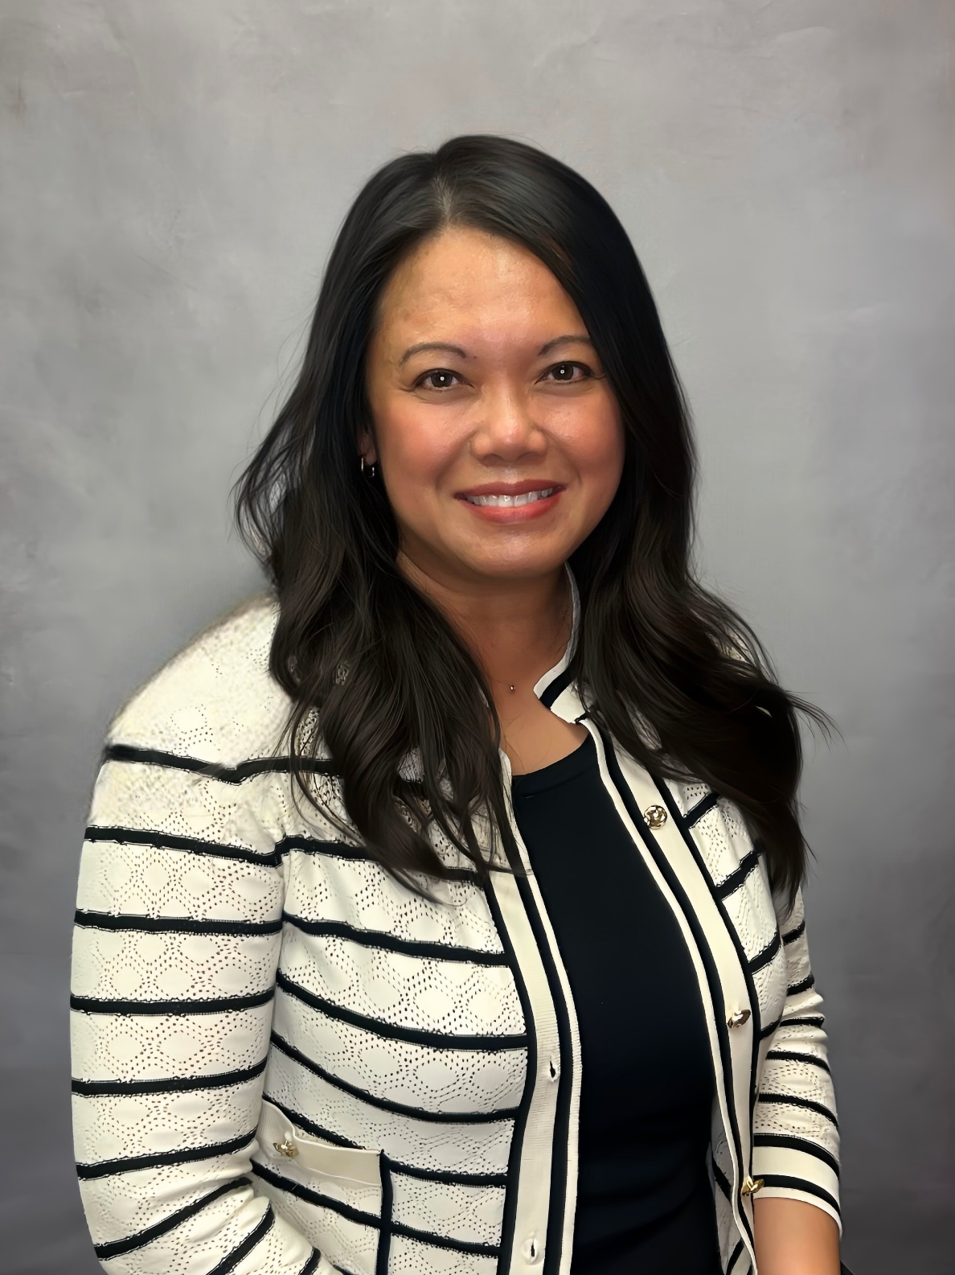
Emily D. Tisdale, M.Ed. University of Indianapolis Executive Director | Center for Aging & Community Adjunct Faculty | College of Health Sciences
WAVES
Fall Conference

Slide 3
Katie Greenan, Ph.D. University of Indianapolis Associate Professor of Communication Department of Communication Shaheen College of Arts & Sciences
WAVES
Fall Conference

Slide 4
Session Overview
This program shares key insights from a donor-funded pilot with an Indianapolis aging services partner focused on improving communication among healthcare professionals.
The session highlights how effective communication enhances patient relationships, supports decision-making, and addresses sensitive issues such as end-of-life care, family dynamics, loneliness, and health concerns.
Participants will leave with practical, evidence-based strategies to strengthen engagement, navigate tough conversations, and improve quality of care.
WAVES
Fall Conference
Fall Conference

Slide 5
Learning Objectives
Apply motivational interviewing (MI) strategies in diverse care and support contexts.
Demonstrate effective listening, responding, and self-reflection skills.
Analyze communication strengths, challenges, and relational dynamics.
Utilize evidence-informed resources to strengthen communication practices.
Engage with peers to exchange experiences and build meaningful connections.
WAVES
Fall Conference
Fall Conference

Slide 6
UIndy Center for Aging & Community
The University of Indianapolis Center for Aging & Community (CAC) is a trusted partner in aging-focused research, training, and collaboration.
We turn ideas into action. From training and program development to strengthening systems of care, CAC designs and delivers solutions that improve aging services and support those who deliver them.
We work with service providers, policymakers, and community leaders to ensure that care is effective, equitable, and sustainable for older adults of today and the generations to come.
WAVES
Fall Conference
Fall Conference

Slide 7

CAC Fellows Program
The UIndy Center for Aging & Community (CAC) Fellowship is an ongoing, two-year, collaborative fellowship program that supports faculty from across the university in leveraging expertise through innovative approaches to meeting the needs of older adults. The goal of the fellowship is two-fold:
To provide fellows an opportunity for applied research that will extend their academic expertise into the area of aging
To enhance or create services, programs, education/training, or business processes that support healthy aging
WAVES
Fall Conference

Slide 8
Fellowship Components
Fellows develop a project in conjunction with a service provider to enhance or create services, programs, education/training, or business processes
CAC provides a stipend, and Fellows are encouraged to apply for additional funding to support their research project
Current Fellows participate in the selection of the next cohort of Fellows.
WAVES
Fall Conference
Fall Conference

Slide 9
Fellowship Components
Year 1
Work with service provider to identify existing and emerging areas of practice that would benefit from university-led research and expertise
Develop project idea and design implementation plan
Apply for external funding for Year 2 (encouraged)
Participate in the selection of the next cohort of CAC Fellows
WAVES
Fall Conference
Fall Conference

Slide 10
Fellowship Components
Year 2
Conduct applied and community-based research as determined in Year 1
Continue to work with service provider during project implementation
Discuss research and fellowship at a CAC Affiliated Faculty meeting
Determine project future through continued research, publication, or project wrap-up
WAVES
Fall Conference
Fall Conference

Slide 11
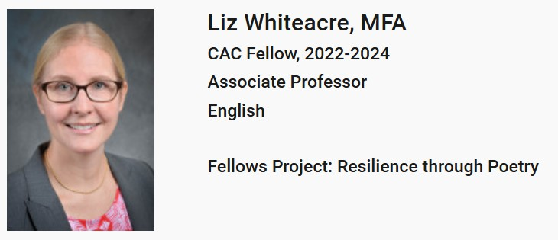
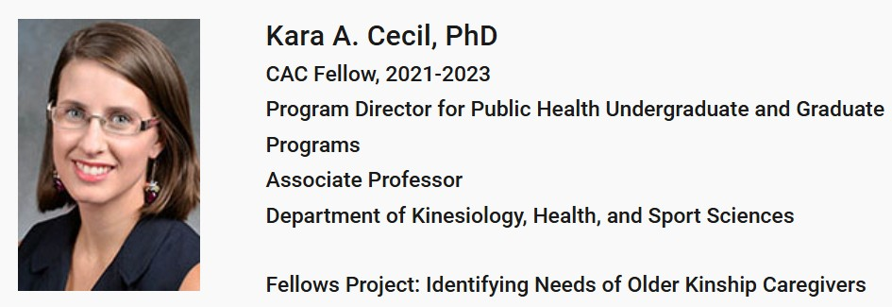
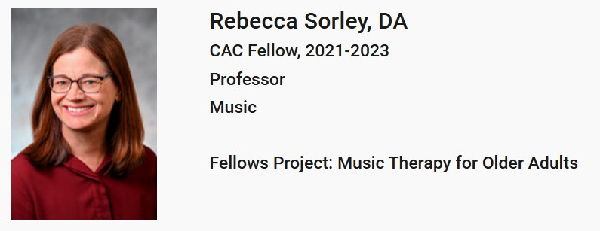
Fellows Profiles
WAVES
Fall Conference

Slide 12
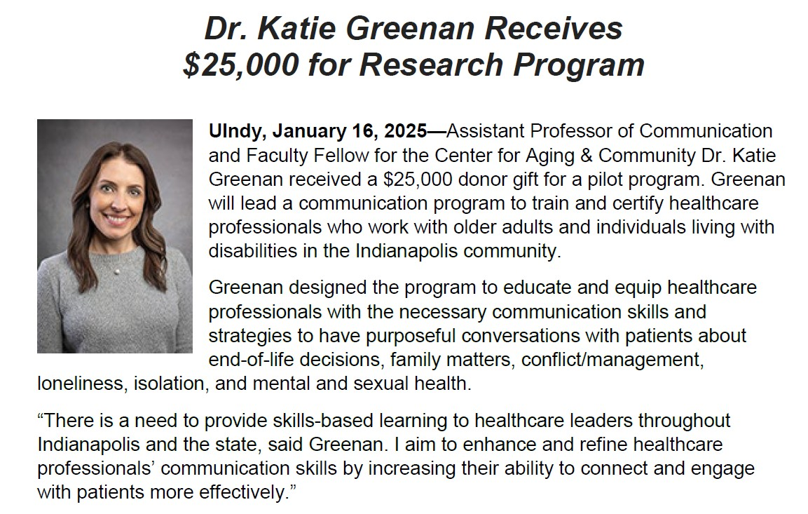
Fellows Profile
WAVES
Fall Conference

Slide 13
Food for thought…
Patient-centered communication is associated with positive health outcomes, increased patient satisfaction, reduced medical expenditures, and prevention of malpractice litigation.
Social connections improve odds of survival by 50%.
Communication skills training improved patient-centered care without increasing visit length and showed measurable improvements in professional performance and self-efficacy.
83% of studies showed social support benefited depression symptoms and lonely adults are more than twice as likely to develop depression.
WAVES
Fall Conference
Fall Conference

Slide 14
Group Discussion
WAVES
Fall Conference

Slide 15
Pilot Program
Collaboration:
UIndy CAC
CICOA
25 participants
15 contact hours over five weeks
15 CECs
Certificate of Completion
WAVES
Fall Conference

Slide 16
To strengthen engagement with patients
To navigate sensitive conversations with greater confidence
Purpose
To have more purposeful conversations with patients
To improve the overall quality of care

Slide 17
To create social connections
To share stories and exchange information
To learn and practice techniques of Motivational Interviewing
Learning Objectives
To assess the value and health of one’s relationships
To practice listening and responding skills in different
communication contexts
To evaluate one’s communication strengths and weaknesses

Slide 18
Program Content
Self-assessments
PRCA-24
SPCC
Conflict Style Scale
Communication Theory
Social Penetration Theory
Systems Theory
Uncertainty Reduction Theory
WAVES
Fall Conference
Fall Conference
Notes:
I will provide hard copies of all assessments and explain each.

Slide 19
Program Content
Academic readings & discussions
Refrigerator Rights: Creating Connection and Restoring Relationships (Miller & Sparks, 2015)
Communicating in Small Groups: Principles and Practices (Beebe & Masterson, 2015)
Understanding Interpersonal Communication
Communication and The Self
Listening and Responding
Conflict Management Skills
Motivational Interviewing for Mental Health Clinicians (Frey & Hall, 2021)
Motivational interviews:
Interview (ER)
Interview (EE)
WAVES
Fall Conference
Fall Conference
Notes:
I will bring books to show attendees.

Slide 20
Data & Findings
WAVES
Fall Conference

Slide 21
Data & Findings
WAVES
Fall Conference

Slide 22
Data & Findings
Post-Training Survey:
19 of 25 participants (76%)
Quantitative data
Qualitative data
WAVES
Fall Conference

Slide 23
Quantitative Data
Q1: Would you recommend this training to others? | Q2: How relevant was the training material to your job/role? | Q3: Do you feel more confident addressing sensitive topics? | Q4: How likely are you to apply the knowledge and skills learned in your daily work? | Q5: Have you noticed improvement in your communication skills as a result of participating in the program? | Q6: Do you feel more confident communicating as a result of taking the training?
100% recommend (n=19) | 84% "very relevant” (n=16) | 100% more confident (n=19) | 100% likely (n=19) | 74% "great improvement“ (n=14) | 89.5% "more confident“ (n=17)
 | 16% "relevant“ (n=3) |  |  | 26% "improvement“ (n=5) | 10.5% "somewhat more confident” (n=2)
WAVES
Fall Conference
Fall Conference

Slide 24
Qualitative Data
 | Q7: What aspects of the training were particularly valuable? | Q8: How could the training improve? | Q9. Which sensitive topics are you more confident addressing? | Q10: Provide any additional information here.
Respondent 1 | “…the interview techniques were extremely helpful, but the book really made me think about my current relationships." | "More time" | "Personal questions" | "I really enjoyed learning more about myself. I really related to the book and decided to reconnect with family friends."
Respondent 2 | "Your class has helped me in more ways than MI, I am getting better with communicating with confidence. I am a big time introvert that would rather send an email than talk. I've been talking, even making phone calls instead of emails." | N/A | "I've been a more attentive listener when I have had to hear my employees’ personal struggles." | "I really enjoyed this class - thank you for capitalizing on the relationship CICOA has with UIndy to make it happen. My work here can be SO busy - it is so nice to have time for personal and professional enrichment during my day."
Respondent 3 | "The book was such a good tool for discussion and really brought the topic of communication into a whole new light. Having insight from the instructor expanded on the basic topics and how to use communication in real-world situations." | "More time in breakout sessions" | "End of life issues" | "[I learned] Asking open-ended questions to gain more knowledge about sensitive subjects. Learning to listen rather than speak"
WAVES
Fall Conference
Fall Conference
Notes:
Will talk about goals, expanding program

Slide 25
Group Discussion
WAVES
Fall Conference

Slide 26
Future Implementation
Option 1 Asynchronous Online Learning | Option 2 Hybrid Learning | Option 3 Consulting Support
Self-paced modules | Self-paced modules | Self-paced modules
 | Live session(s) with Dr. Greenan | Live session(s) with Dr. Greenan
 |  | Customized organizational assessment
WAVES
Fall Conference
Fall Conference

Slide 27
Questions?
WAVES
Fall Conference

Slide 28
References
Iversen, E. D., Wolderslund, M., Kofoed, P. E., Gulbrandsen, P., Poulsen, H., Cold, S., & Ammentorp, J. (2021). Communication Skills Training: A Means to Promote Time-Efficient Patient-Centered Communication in Clinical Practice. Journal of patient-centered research and reviews, 8(4), 307–314. https://doi.org/10.17294/2330-0698.1782
Martino, J., Pegg, J., & Frates, E. P. (2015). The Connection Prescription: Using the Power of Social Interactions and the Deep Desire for Connectedness to Empower Health and Wellness. American journal of lifestyle medicine, 11(6), 466–475. https://doi.org/10.1177/1559827615608788
Mata, Á. N. S., de Azevedo, K. P. M., Braga, L. P., de Medeiros, G. C. B. S., de Oliveira Segundo, V. H., Bezerra, I. N. M., Pimenta, I. D. S. F., Nicolás, I. M., & Piuvezam, G. (2021). Training in communication skills for self-efficacy of health professionals: a systematic review. Human resources for health, 19(1), 30. https://doi.org/10.1186/s12960-021-00574-3
Wickramaratne, P. J., Yangchen, T., Lepow, L., Patra, B. G., Glicksburg, B., Talati, A., Adekkanattu, P., Ryu, E., Biernacka, J. M., Charney, A., Mann, J. J., Pathak, J., Olfson, M., & Weissman, M. M. (2022). Social connectedness as a determinant of mental health: A scoping review. PloS one, 17(10), e0275004. https://doi.org/10.1371/journal.pone.0275004
WAVES
Fall Conference
Fall Conference

Slide 29
Thank you!
Emily D. Tisdale, M.Ed. tisdalee@uindy.edu
Katie Greenan, Ph.D.
greenank@uindy.edu
WAVES
Fall Conference
September 9-10, 2025
Embassy Suites Noblesville | Indianapolis, IN

