Slide 1
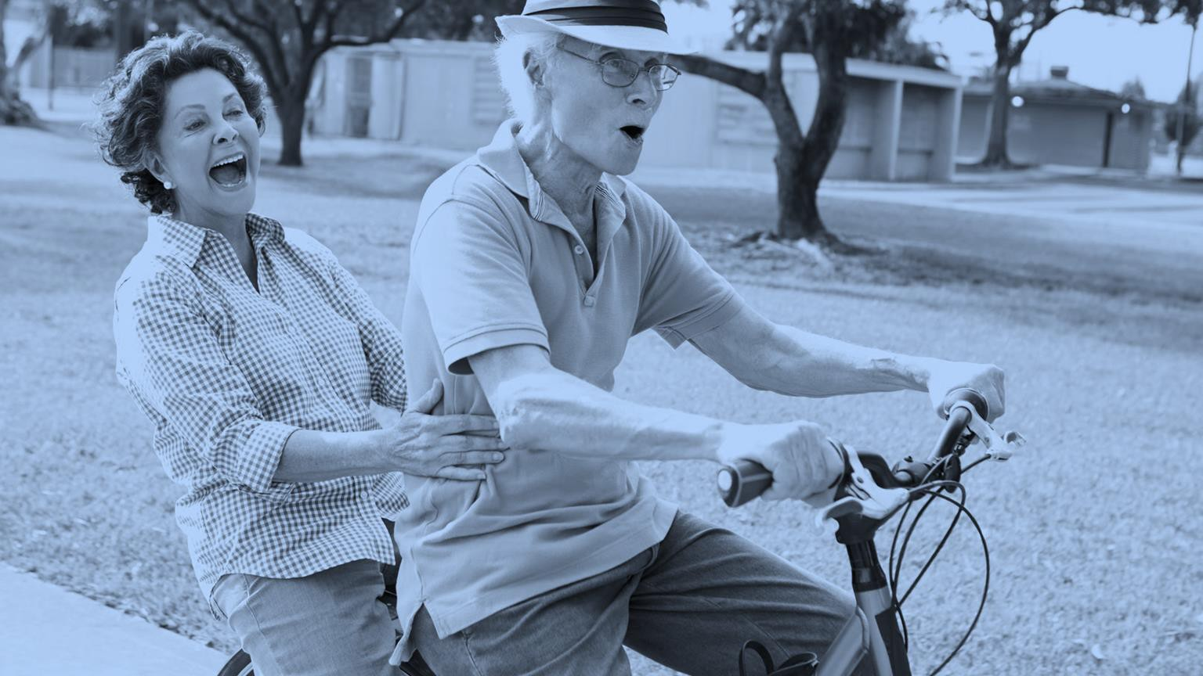

PURPOSEFUL
PLACEMAKING
PLANNING EFFECTIVE LIFE PLAN COMMUNITIES
Zachary Benedict, AIA, President
MKM architecture + design
LeadingAge Indiana Fall Conference
September 9, 2025 | Indianapolis, IN

Slide 2
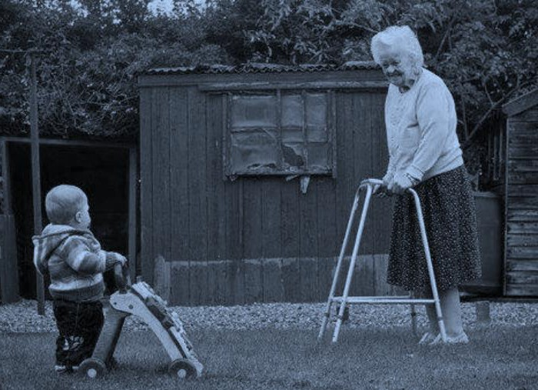
COMMUNITY DEVELOPMENT
“I believe that the community - in the fullest sense: a place and all its creatures - is the smallest unit of health and that to speak of the health of an isolated individual is a contradiction in terms.”
― Wendell Berry, Health is Membership

Slide 3

COMMUNITY DEVELOPMENT
Our instinctive desire to belong requires a common platform to develop reciprocal relationships.
“The problem holding everything up thus far is that Homo sapiens are an innately dysfunctional species. We are hampered by the Paleolithic Curse: genetic adaptations that worked very well for millions of years of hunter-gatherer existence but are increasingly a hindrance in a globally urban and technoscientific society. We seem unable to stabilize either economic policies or the means of governance higher than the level of a village.”
NESTS ARE LOCALIZED ECOSYSTEMS OF COOPERATION
― Edward O. Wilson, The Meaning of
Human Existence, 2014 (p141)

Slide 4
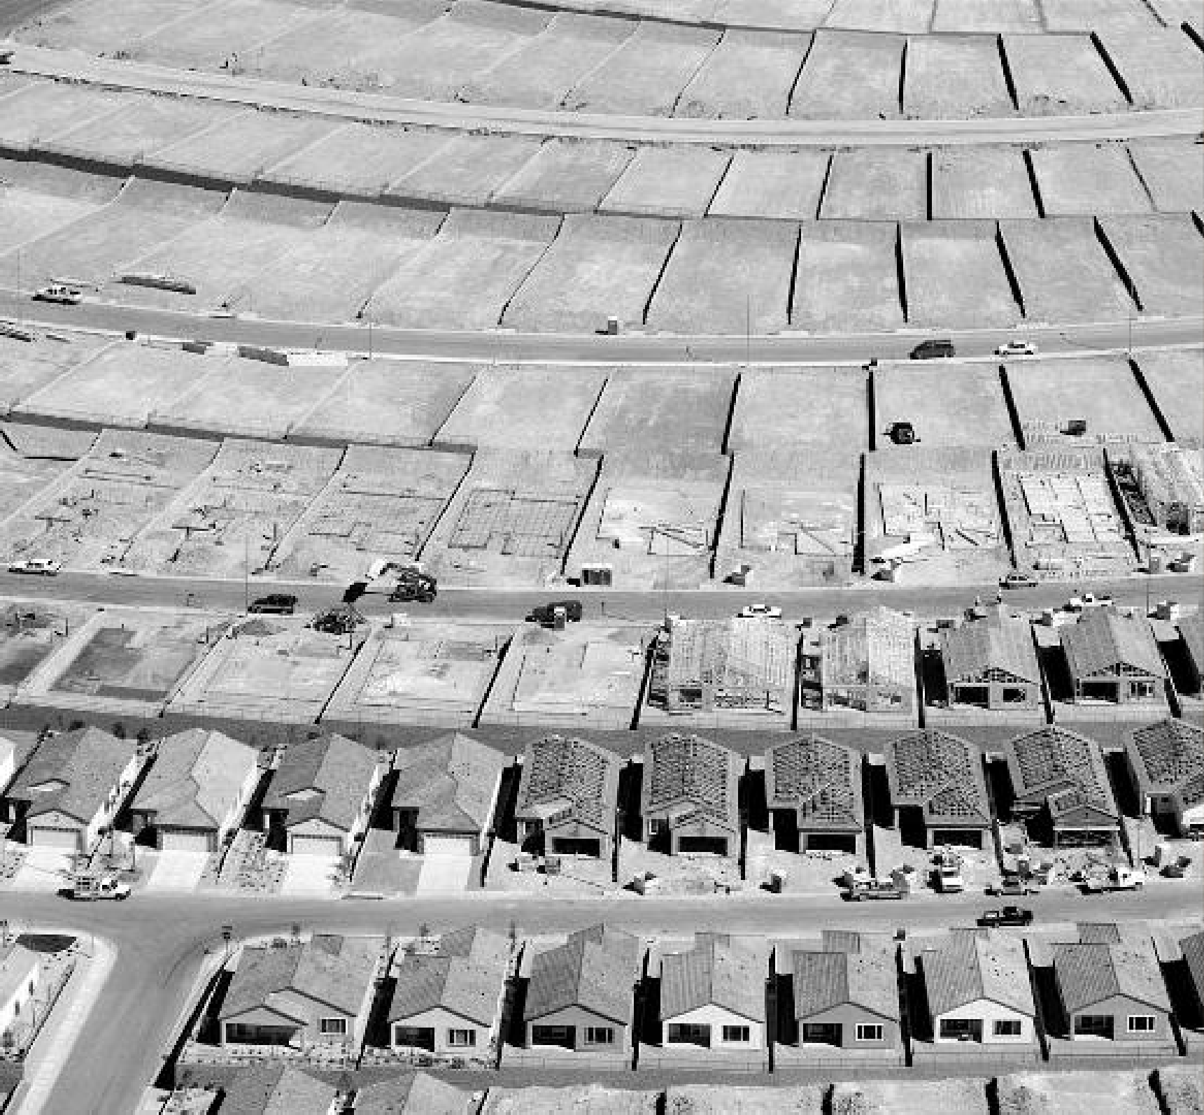
COMMUNITY DEVELOPMENT
The American Dream has been an idea that has consistently glorified the idea of independence.
And it’s this obsession with privacy and security that has disconnected us from the larger group. The positioning of homes, schools, businesses, parks, and sidewalks within a neighborhood can dramatically influence physical activity and, in turn, community well-being. Increased urban sprawl, by which farther distance between destinations decreases walkability, has been associated with less physical activity and directly correlated to deceased well-being.
― Duany Plater Zyberk as shown in Spielberg F. The traditional neighborhood development: how will traffic engineers respond? ITE J. 1989;59:17.

Slide 5
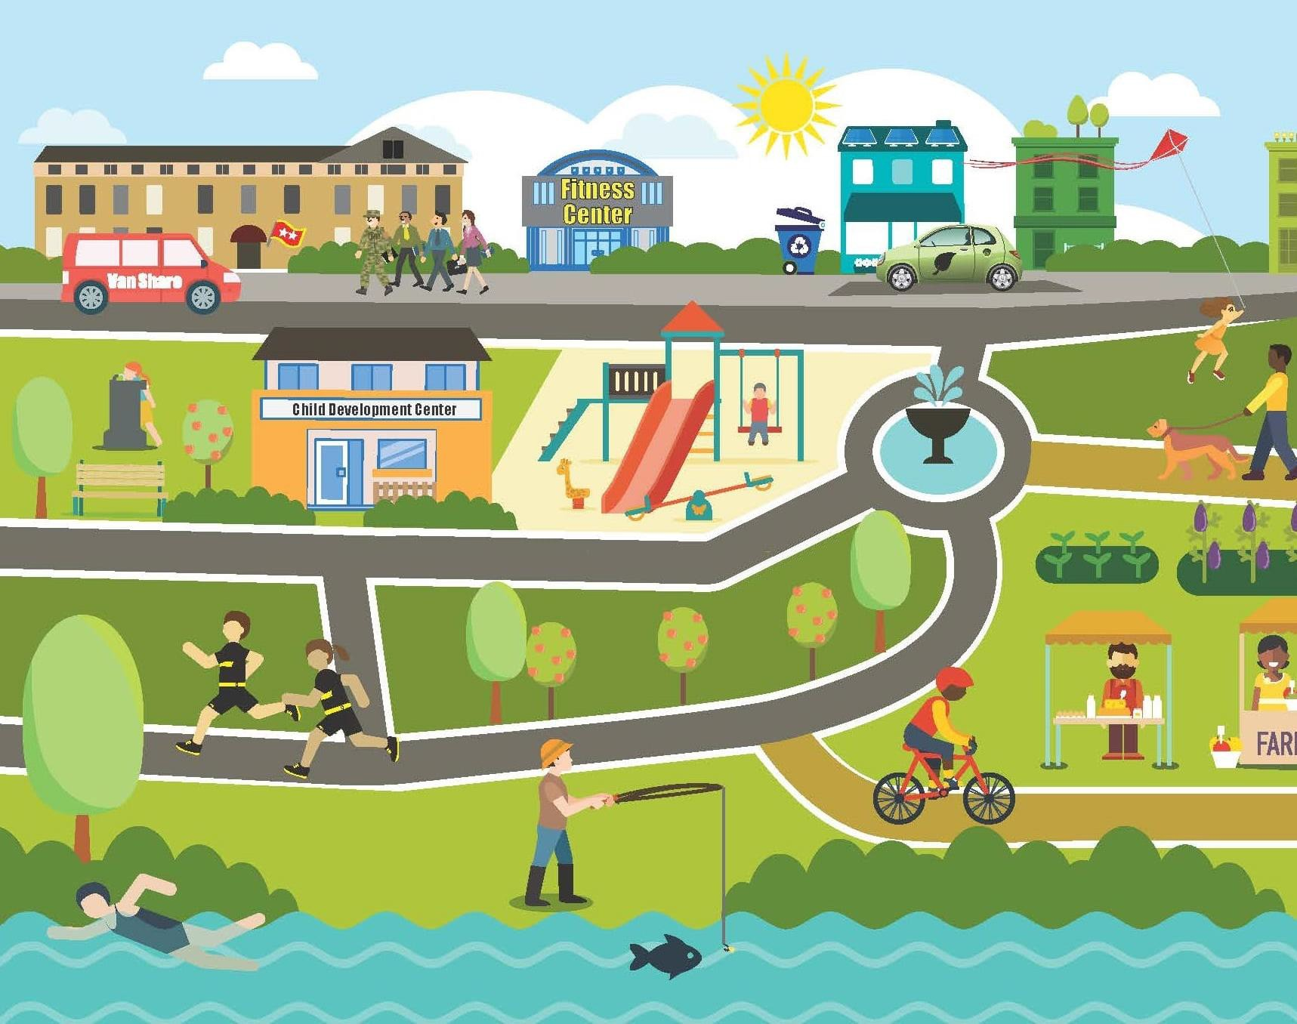
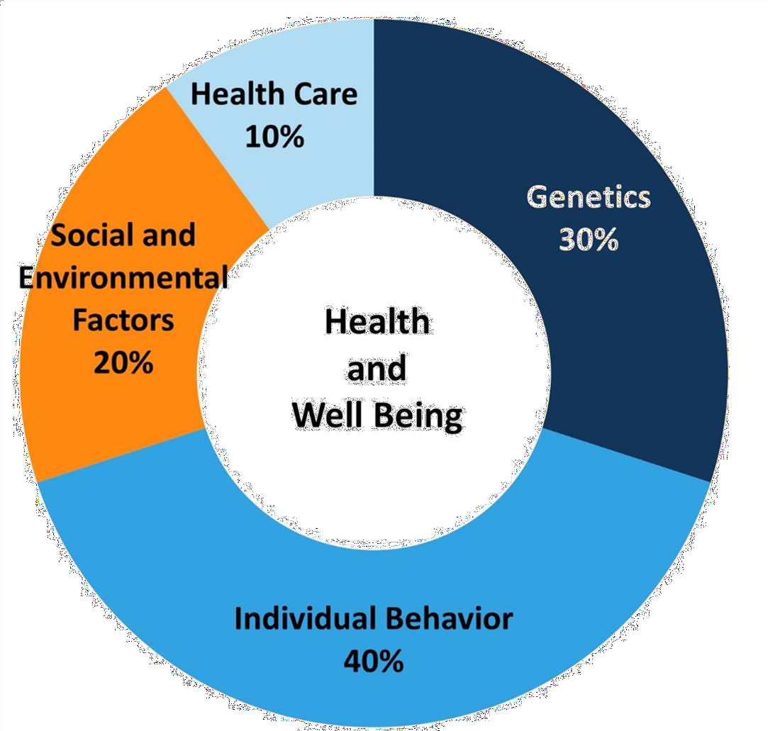
PRIORITIZING WELL-BEING
*
SOCIAL DETERMINANTS OF HEALTH
The quality of healthcare has a limited impact on our well-being. The guiding factors regarding the social determinants of health rest in the socio-economic factors that define our everyday routine.
COMMUNITIES DEVELOPMENT IS A HEALTHCARE PRACTICE
*SOURCE: The Kaiser Commission on Medicaid and the Uninsured, Beyond Health Care: The Role of Social Determinants in Promoting Health and Health Equity (2015)

Slide 6

It can often be difficult to measure the effectiveness of the built environment – especially in highly regulate care settings.
PRIORITIZING WELL-BEING
Qualifying “good” spaces can be a tricky exercise, but it can often be measured by an environment’s ability to balance the choice and health of the user. While healthier outcomes may be possible, they will be unsustainable if they limit the control and agency of the community it looks to support – making this balance a critical discussion when determining effective solutions for complicated problems.
DESIGN

Slide 7
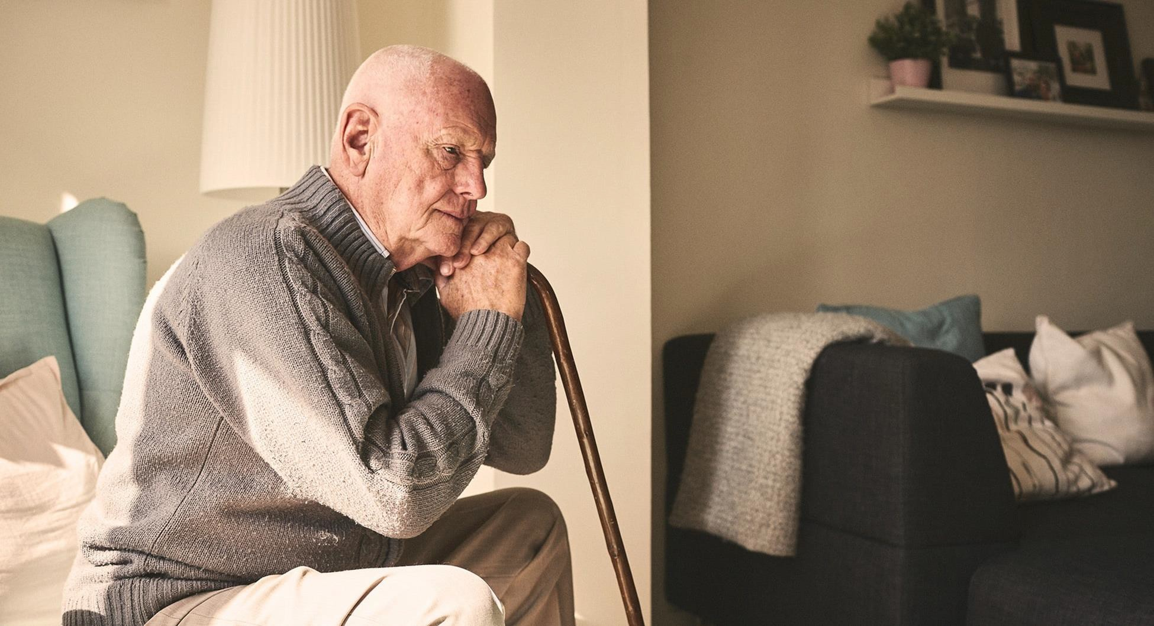
PRIORITIZING WELL-BEING
The burden of responsible for those in charge of planning, constructing, and operating residential care campuses rests solely on a fundamental understanding around how best to
CULTIVATE A SENSE OF DIGNITY AND BELONGING FOR ALL RESIDENTS.

Slide 8
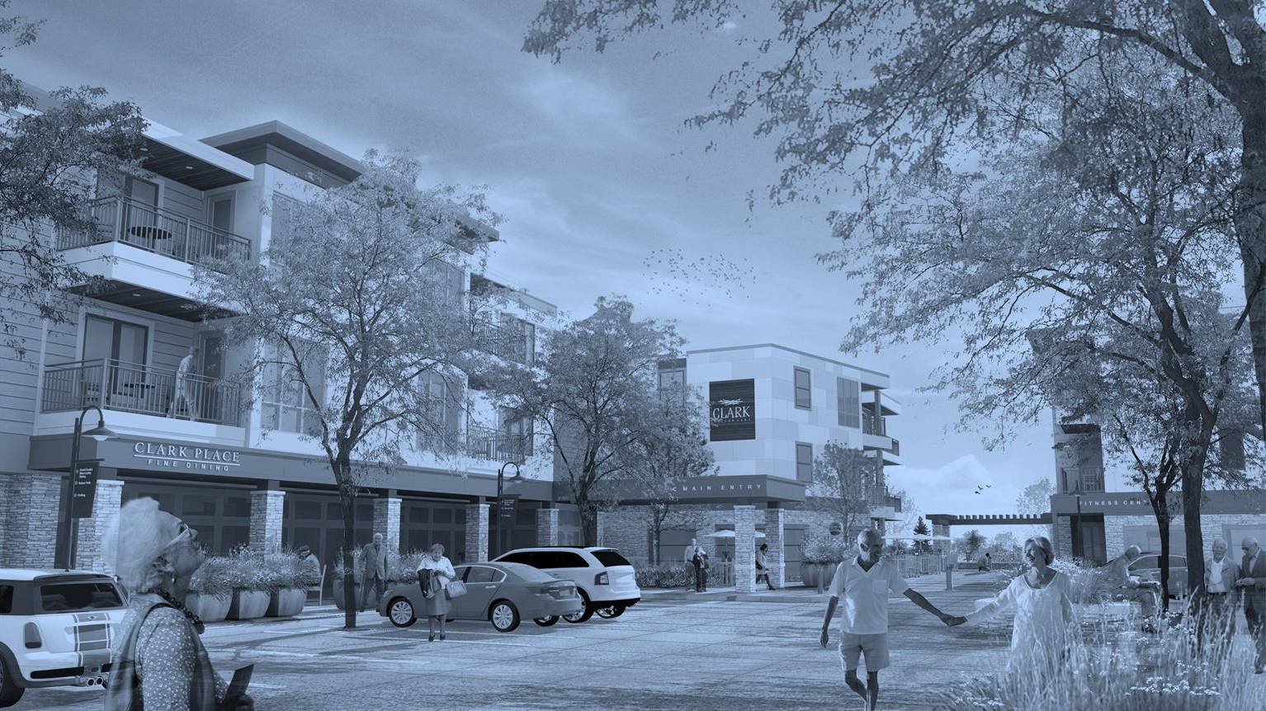
FOURTH PLACES

Slide 9

THE POWER OF CONNECTION
“There is mounting evidence that a rich network of face-to-face relationships creates a biological force field against disease.”
― Susan Pinker The Village Effect: How Face-to-Face Contact Can Make Us Healthier, Happier, and Smarter.
HOW SHOULD WE MEASURE HEALTH?
©MKM | 9

Slide 10

THE POWER OF CONNECTION
WHAT REDUCES YOUR CHANCES OF DYING THE MOST?
1
2
Close relationships.
These are the people that you can call on for a loan if you need money suddenly, who will call the doctor if you are not feeling well or take you to the hospital.
Social integration.
This measures how much you interact with people as you move through your day and how many people you talk to, with both your weak and strong bonds, not just the people you’re close to.
THIS IS SCALABLE ACROSS THE LIFESPAN

Slide 11
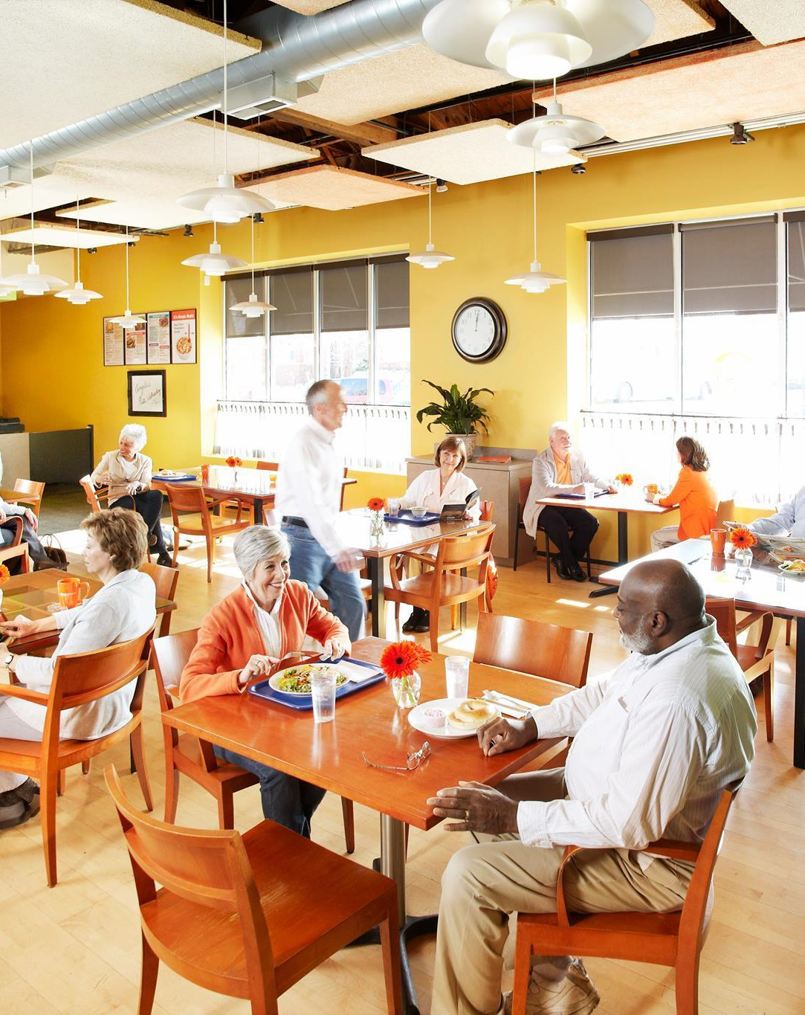

THE POWER OF CONNECTION
1. HOME
The home provides us our sense of control by offering a shelter for our sense of belonging and memory. It’s the realm of privacy.
2. WORK
Our chosen task (whether work or volunteerism) strengthens our identity and validates our talents. It’s the realm of purpose.
3. HUB
Social hubs provide us our ability to network with family, friends, and peers while exposing us to repetitive experiences that generate trust in others. It’s the realm of fellowship.
SOURCE: For more see https://www.mather.com/

Slide 12
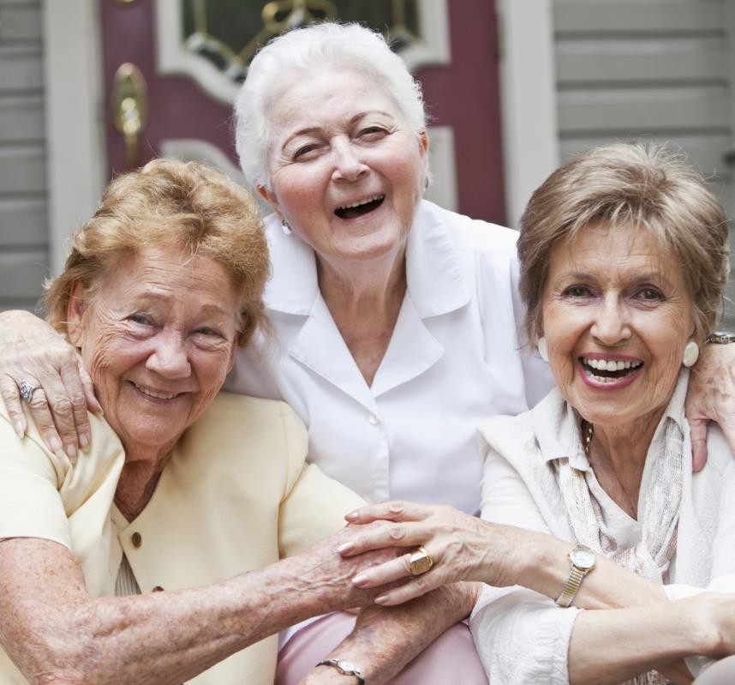
THE POWER OF CONNECTION
Sociologists dub our connections to friends, neighbors, and co-workers social capital, which is the knowledge and mutual trust captured in our relationships.
In 2003, when several Harvard epidemiologists put nearly 350 Chicago neighborhoods under the microscope, they discovered that social capital – as measured by reciprocity, trust, and civic participation – was linked to a community’s death rates. The higher the levels of social capital, the lower its mortality rates, and not just from violent crimes but from heart disease too.
― K. Lochner, “Social Capital and Neighborhood Morality Rates in Chicago,”
Social Science and Medicine 56, no. 8 (2003).

Slide 13

THE POWER OF CONNECTION
Women with a large network of friends are four times more likely to survive breast cancer than those with sparser connections.
In 2007 the first study was published that revealed one of the hidden mechanisms linking social interaction to the recovery of humans: Steve Cole and his team at UCLA discovered that social contact switched on and off the genes that regulate our immune response to cancer and the rate of tumor growth.
― Cole et al, “Transcript Origin Analysis Identifies Antigen Presenting Cells as Primary Targets pf Socially Regulated Gene Expression in Leukocytes,” Proceedings of the National Academy of Sciences of the united States of
America 108 (2011).

Slide 14

THE POWER OF CONNECTION
HAPPINESS FORMULA
H = S + C + V
H: EXPERIENCED HAPPINESS S: BIOLOGICAL SET POINT C: LIFE CONDITIONS
V: VOLUNTARY ACTIVITIES
The equation for community attachment is complicated, but the result is simple. Our happiness is directly connected to our perceptions of how well we belong within the world around us – a perception that is a complicated journey.
REDUCING MISERY > INCREASING HAPPINESS
SOURCE: Johnathan Haidt, The Happiness
Hypothesis, p91 (2006).

Slide 15
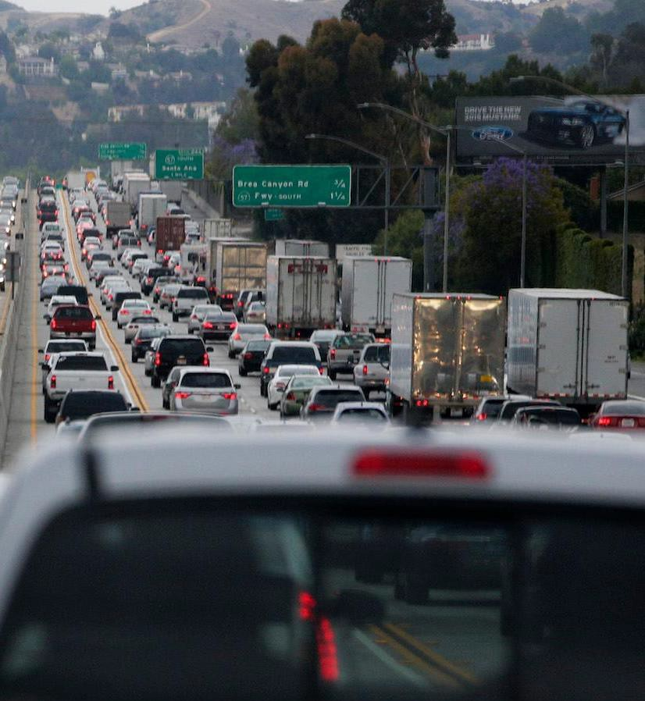
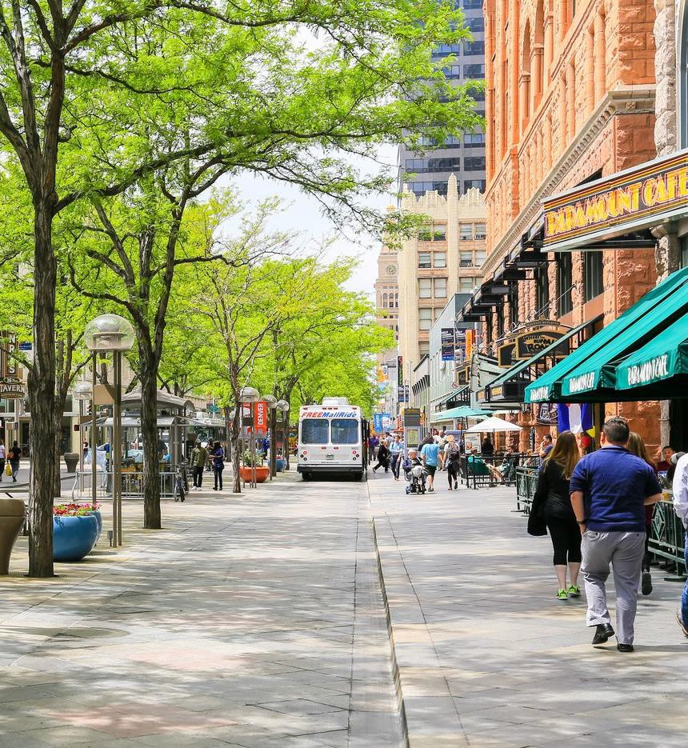
THE POWER OF CONNECTION
When comparing two experiences like these,
it’s easy to talk about the car or the walkability. But we might take these conversations more seriously if we start claiming that the image on the left portrays an environment that limits our capacity to cooperate, reduces our ability to develop reciprocal relationships, and diminishes our sense of purpose.

Slide 16
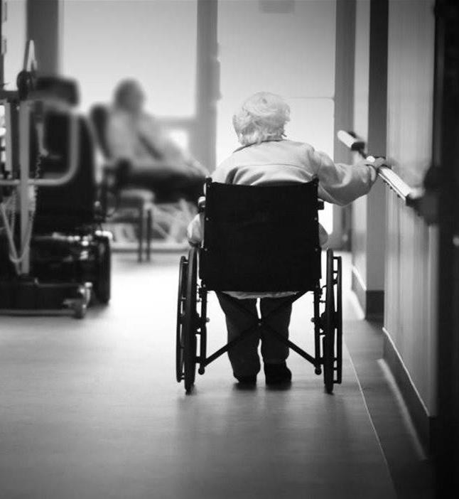
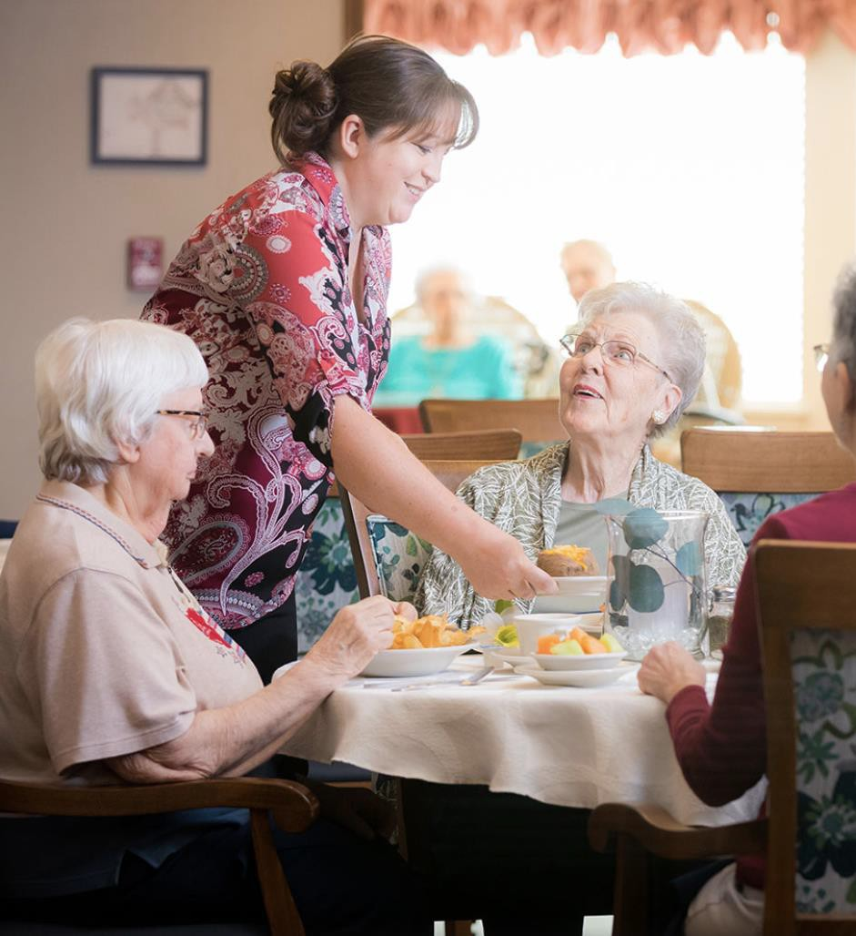
THE POWER OF CONNECTION
VS.
IT’S A SIMILAR DISCUSSION WHEN CONSIDERING THE DESIGN AND OPERATION OF CARE ENVIRONMENTS –
ESPECIALLY ONES THAT AIM TO PROVIDE A SUPPORTIVE COMMUNITY FOR OLDER ADULTS.

Slide 17
2. LEARNING
PRIORITIZING FOURTH PLACES
Our chosen task (whether work or volunteerism) strengthens our identity and validates our talents. It’s the realm of purpose.
1. LIVING
The home provides us our sense of control by offering a shelter for our sense of belonging and memory. It’s the realm of privacy.
3. COMMONS
Social hubs provide us our ability to network with family, friends, and peers while exposing us to repetitive experiences that generate trust in others. It’s the realm of fellowship.
Beyond the traditional trinity of places, a fourth typology is emerging that is reshaping how we define effective community development.
4. CARING
A healthcare infrastructure that supports the inability of the first three places to provide a sustainable and healthy existence. It’s the realm of healing.

Slide 18

PRIORITIZING FOURTH PLACES
Fourth places are cooperative platforms with limited tools – places that must understand communal instincts to be successful.
As fourth places continue to redefine their physical presence within care settings, they will benefit from a more dedicated focus towards exploring strategies they can borrow from legacy places to better cultivate a sense of belonging and connection with those they aim to serve.
EFFECTIVE PLACEMAKING PRIORITIZES AGENCY

Slide 19
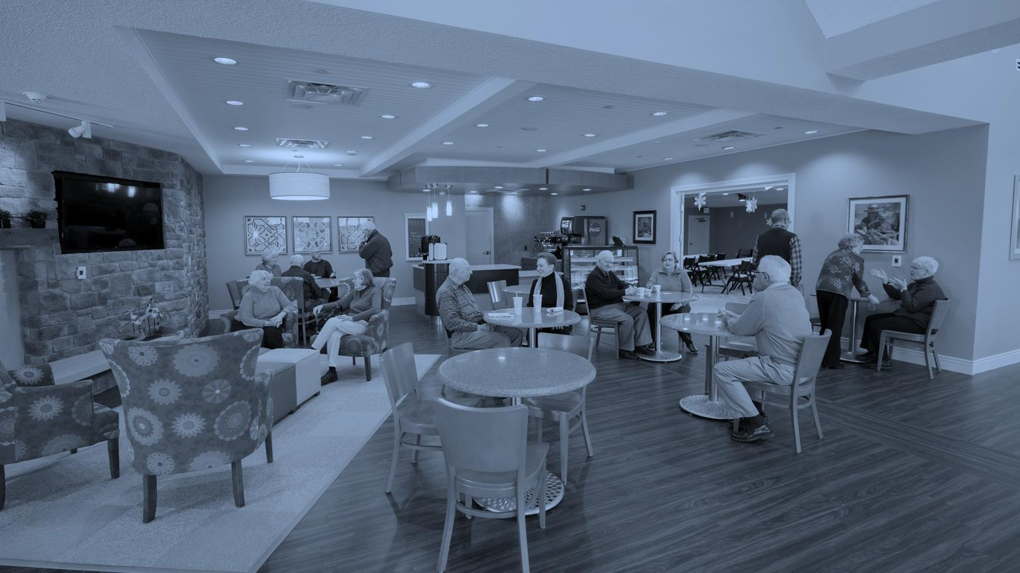
DEFININGA KITOFPARTS

Slide 20
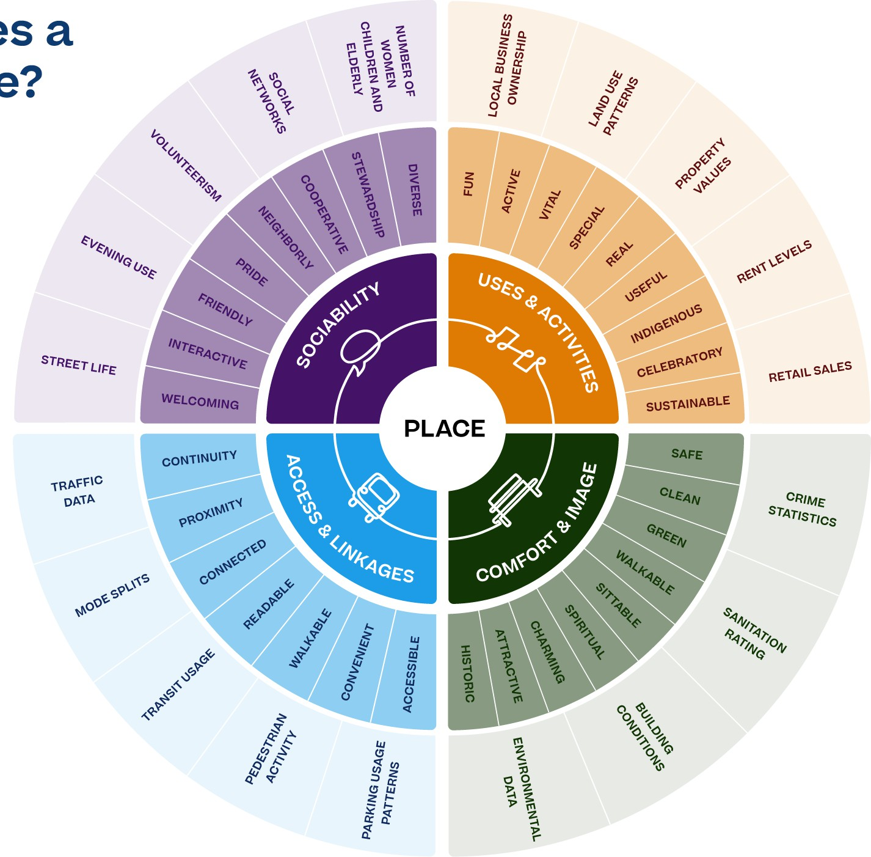
PURPOSEFUL PLACEMAKING
Placemaking is a people- focused process that aims to improve not only the physical elements of a space, but also the way people think and feel about the world around them.
Placemaking is not a new idea
– being formally
popularized in the 1960s by innovators like Jane Jacobs and William H. Whyte who introduced groundbreaking ideas about how cities should be designed for people, not just cars and suburban shopping centers. However, as the demand for more effective care settings continues to grow – so does the need for a more nuanced approach to placemaking.
For more see https://www.pps.org/article/what-is-placemaking
©MKM | 20

Slide 21

PURPOSEFUL PLACEMAKING
THE BUILT ENVIRONMENT IS A BEHAVIORAL SYSTEM

Slide 22
PLACES IMPACT OUR SENSE OF AGENCY
CORRELATING ENGAGEMENT PERCEPTIONS AND LEVELS OF SUCCESSFUL AGING
PURPOSEFUL PLACEMAKING
100%
90%
80%
31%
24%
39%
70%
60%
50%
40%
30%
20%
10%
0%
I am satisfied with my life the majority of the time
I am able to make choices about things that affect how I age
High Low
I have a high quality of life
SOURCE: AARP/Roper Public Affairs & Media Group of NOP World, Beyond 50.05 Survey, 2004.

Slide 23


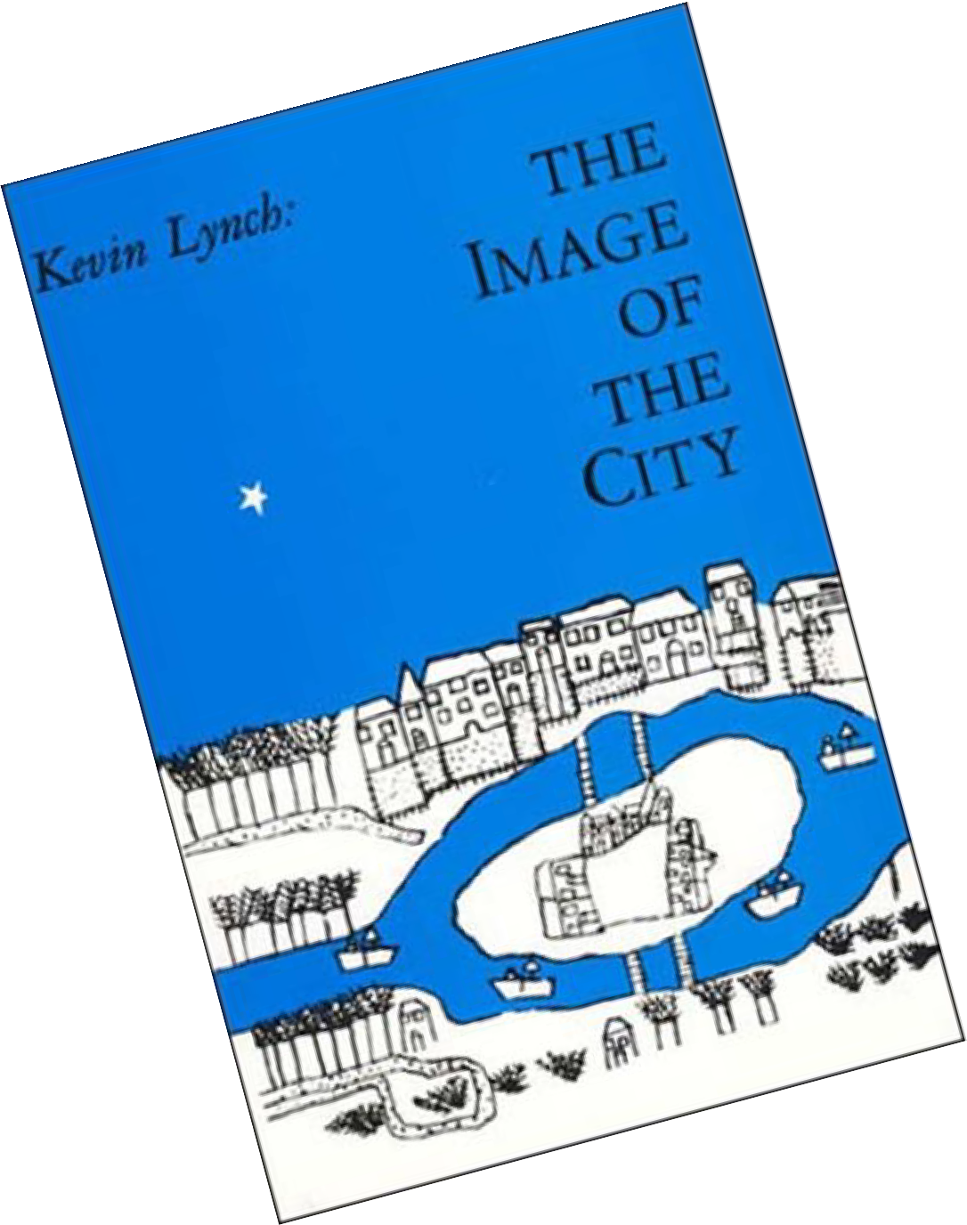
PURPOSEFUL PLACEMAKING
In 1960, Kevin Lynch published The Image of the City, one of the most influential theories in spatial cognition and behavioral geography ever written.
Lynch dedicates his work to understanding how people perceive and represent a city, and from what external urban artefacts the mental image of the city arises. Specifically, Lynch analyses two qualities of the built environment: legibility, ‘the ease with which its parts can be recognized and can be organized into a coherent pattern’ and imageability, ‘that quality in an object which gives it a high probability of evoking a strong image in’ the observer.’
― Kevin Lynch, The Image of the City (1960), p60.

Slide 24
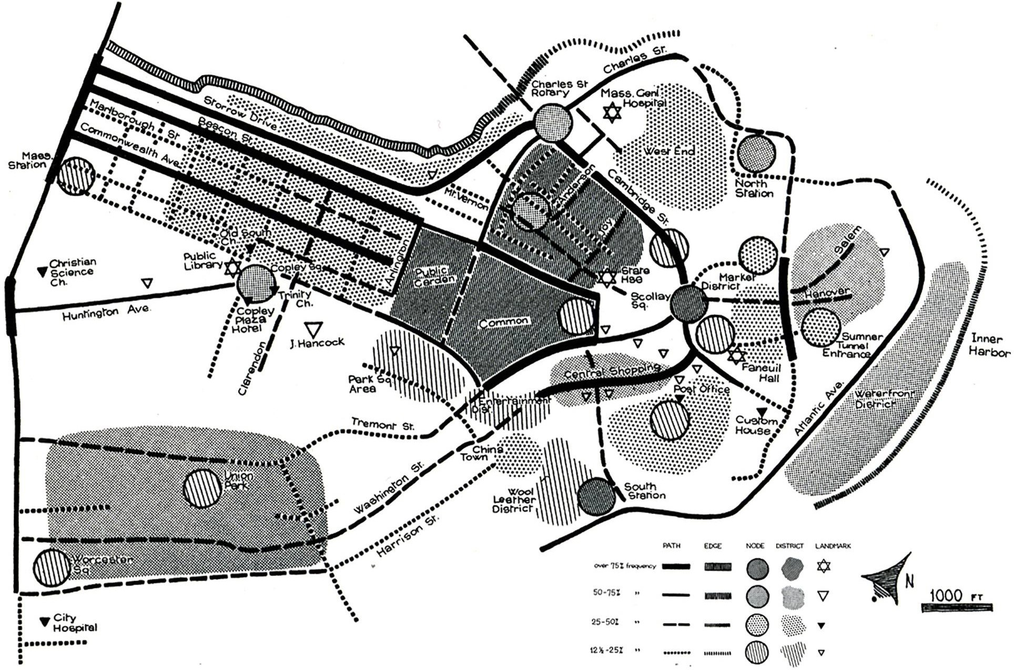
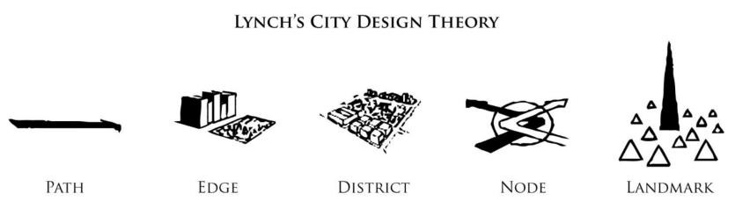
PURPOSEFUL PLACEMAKING
Studying the city form of Boston, Los Angeles and Jersey City, Lynch claimed that individuals’ mental
images could be overlapped to form a cognitive map of the community.
The resulting approach was informed by five types
of elements: paths, edges, nodes, districts and
landmarks.
These frame the most basic elements
in qualifying the experience and image of a neighborhood and present designers a unique and efficient set of basic tools that can be utilized to explore the effectiveness of modern care settings.
― Kevin Lynch, The Image of the City (1960), p6.

Slide 25


LYNCHIAN ELEMENTS
Disguisable elements are ideally are experienced collectively during a singular event or experience.
PURPOSEFUL PLACEMAKING
Path
Paths are “the channels along which the observer customarily, occasionally, or potentially moves.
Edge
Edges are the linear elements not used or considered as paths by the observer. They are the boundaries between two phases, linear breaks in continuity.
District
Districts are the medium- to-large sections of the city, conceived of as having two-dimensional extent, which they observer mentally enters ‘inside of,’ and which are recognizable as having some common , identifying character.
Node
Nodes are points, the strategic spots in a city into which an observer can enter, and which are the intensive foci from which people travel.
Landmark
Landmarks are another type of point reference, but in this case the observer does not enter within them, they are external – usually a rather simple defined physical object (building, sign, etc.).

Slide 26


PURPOSEFUL PLACEMAKING
VS.
EFFECTIVENESS IS MEASURED BY THE ABILITY TO EXPERIENCE THESE
DISTINGUISHABLE PARTS COLLECTIVELY DURING A SINGULAR EVENT

Slide 27
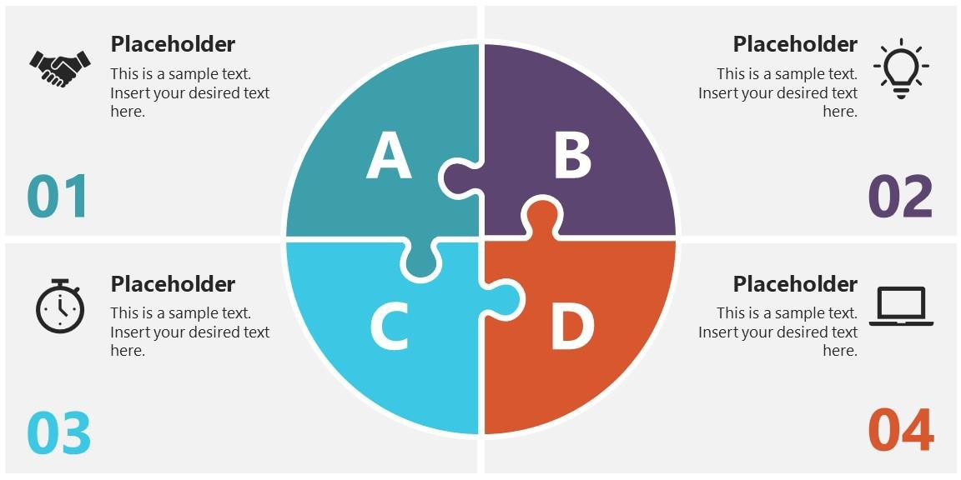


PURPOSEFUL PLACEMAKING
DEFINING THE HUMAN EXPERIENCE
Physical
Sensory
Stamina
Flexibility
Strength
Mobility
Agility
Sight
Hearing
Smell
Touch
Taste
Cognitive
Spatial
Memory
Learning
Communication
Perception
Attention
Air & Light
Color
Pattern
Form
Materiality

Slide 28
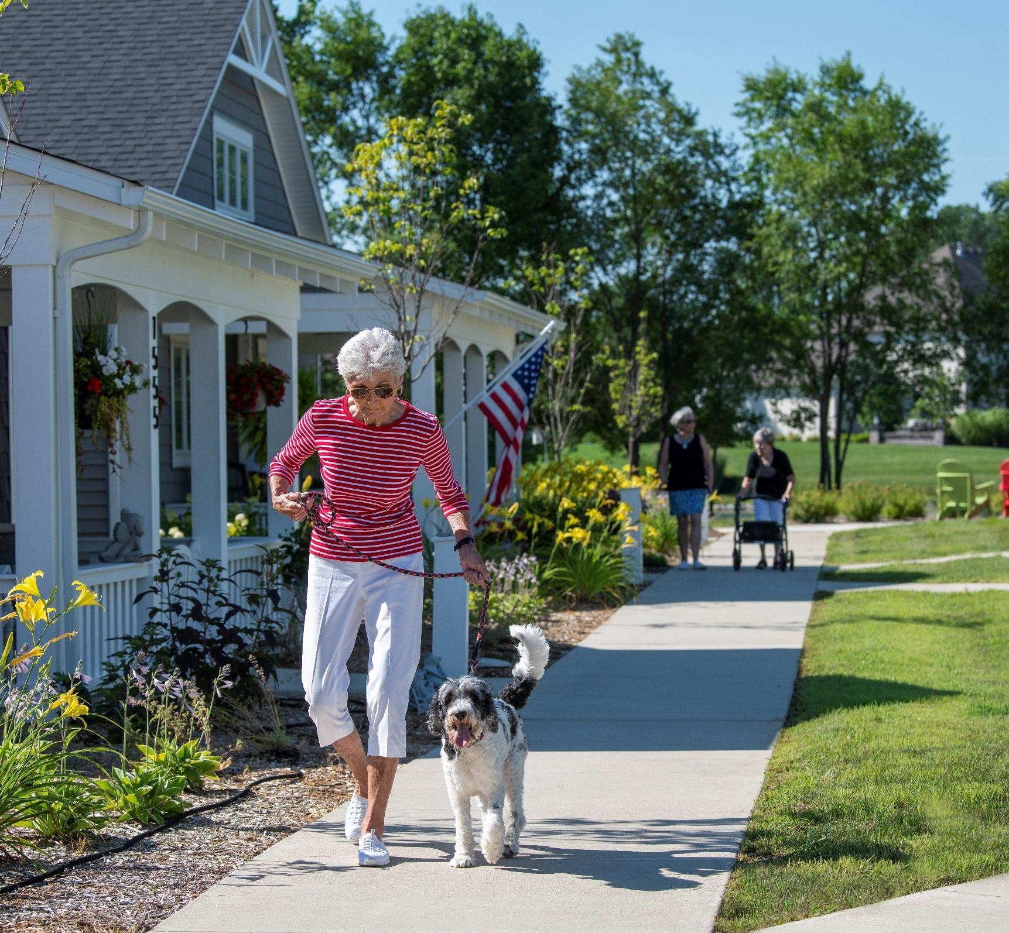
REDEFINING THE KIT OF PARTS
Paths serve as the predominate elements in which people move through and experience the built environment.
PATH
The success of an effective path is largely reliant
on its ability to support the cognitive endurance
of its user.
To maximize agency within a wider
variety of individuals, paths must balance the physical and mental stamina of users. For older adults, paths should embrace:
Concentrated walksheds (5–10-minute increments) that modulate capacity and allow access in stages;
Supportive amenities along the way (shade, benches, etc.); and
Incentivized social interaction
PATHS are “the channels along which the observer customarily,
occasionally, or potentially moves.”

Slide 29
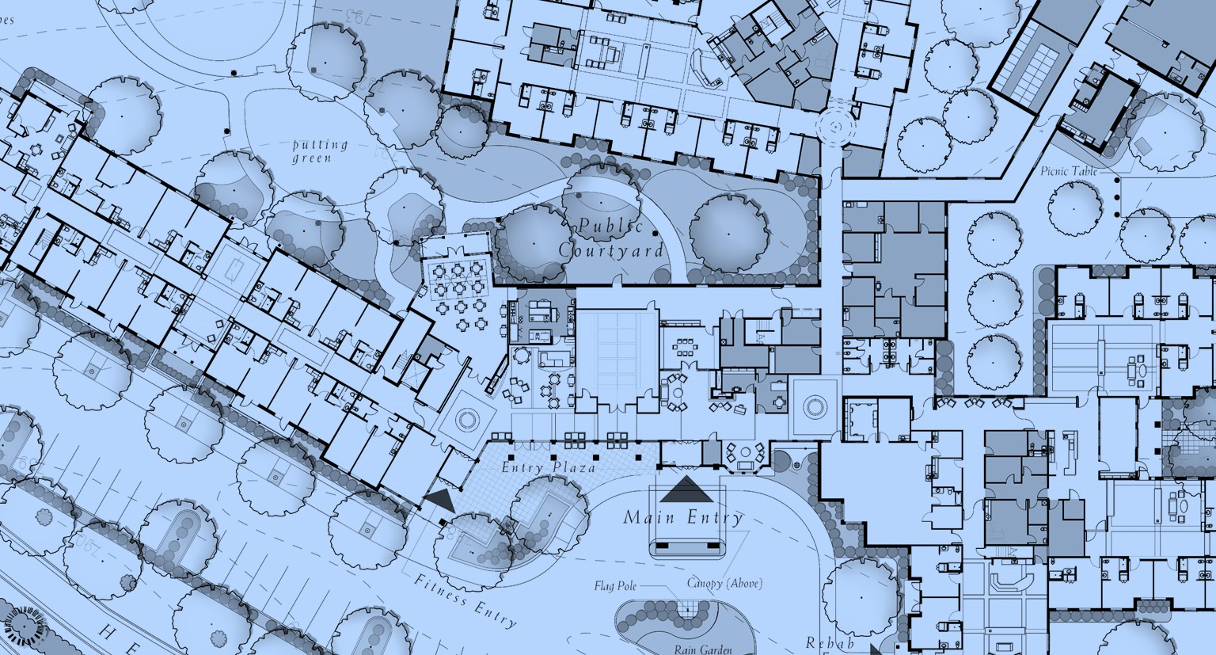
REDEFINING THE KIT OF PARTS
Defining Walksheds
The limits an individual is willing to comfortable walk depends on an array if variables, including physical ability and cognitive endurance. It’s critical that designers understand these limitations before identifying the limits of specific spaces and their ability to provide engaging and “walkable” environments.
PATH
PATHS are “the channels along which the observer customarily,
occasionally, or potentially moves.”

Slide 30
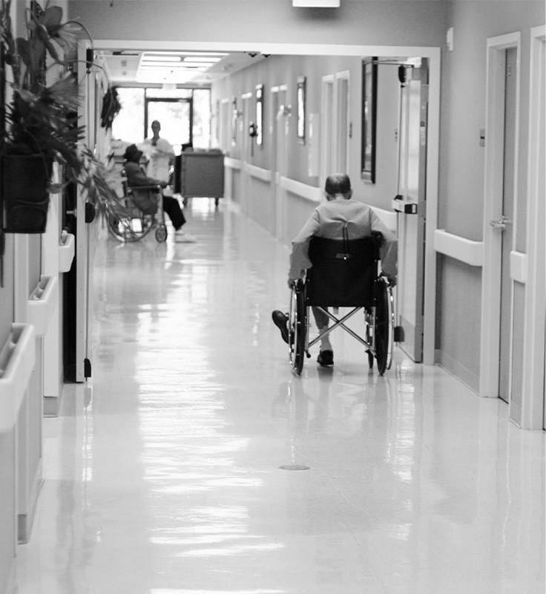
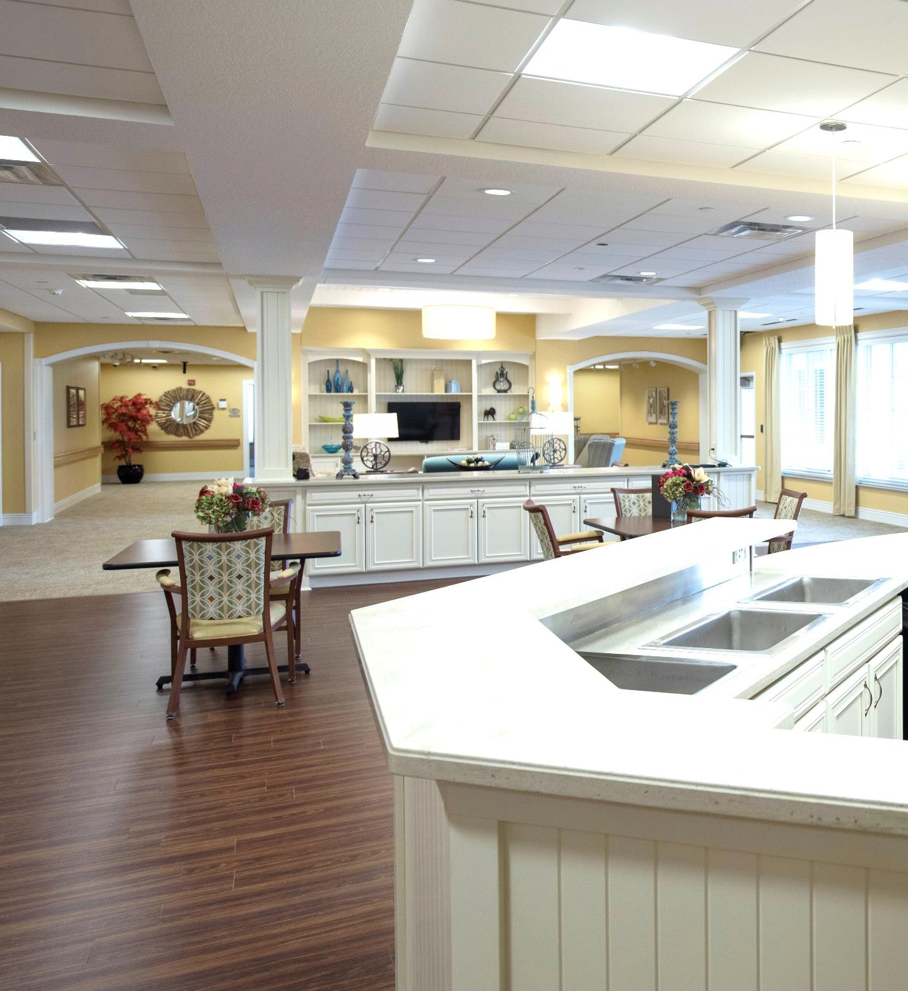
REDEFINING THE KIT OF PARTS
PATH
VS.
Paths benefit from their adjacency to other elements (districts, nodes, etc.) to incentivize social interaction and maximize resident choice. Even in a household setting, these paths can open view sheds for both residents and staff, creating environments that aim to leverage wayfinding as a mechanism for creating a sense of belonging.
PATHS are “the channels along which the observer customarily,
occasionally, or potentially moves.”

Slide 31
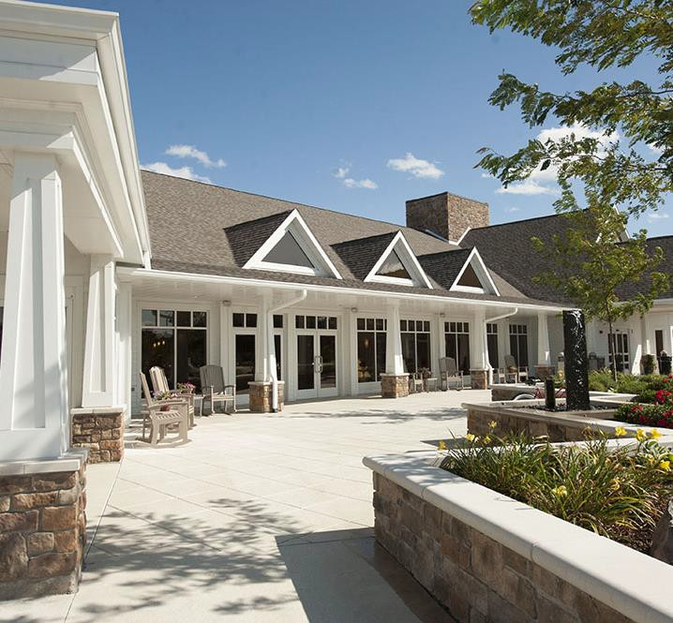
REDEFINING THE KIT OF PARTS
Edges often serve as penetrable barriers which close one region off from another.
EDGE
Edges work to help define distinct elements
within the built environment and can assist in
identifying transitions that may assist in
understanding the functional organization of a
space.
To maximize agency within a wider variety
of individuals, edges should be leveraged to increase safety and security within care environments. For older adults, edges should :
Provide unmistakable limits to secured
environments (i.e., memory care);
Establish formal transitions into public zones and functions (i.e., dining);
Highlight permeable locations for interior/exterior transitions; and
Define intuitive wayfinding by limiting key primary paths throughout a space.
EDGES are “the linear elements not used or considered as paths by the observer. They are the boundaries between two phases, linear breaks in continuity.”

Slide 32
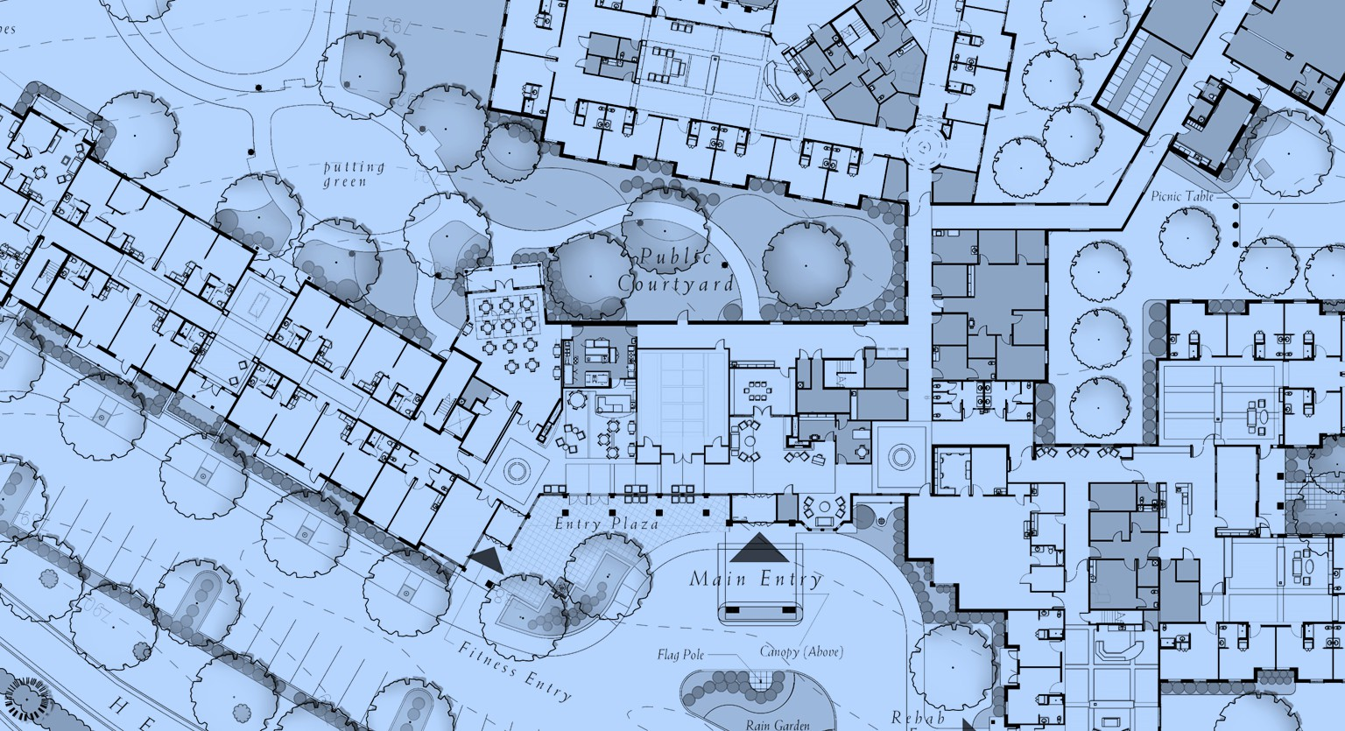
REDEFINING THE KIT OF PARTS
EDGE
Identifying Edges
Edges often contain primary paths and access points to districts, serving as a permeable barrier that indefinites circulation and thresholds that transition into other spaces. Where these edges erode, portals into adjacent spaces often emerge. When edges are unclear, wayfinding can become confusing.
EDGES are “the linear elements not used or considered as paths by the
observer. They are the boundaries between two phases, linear breaks in
continuity.”

Slide 33
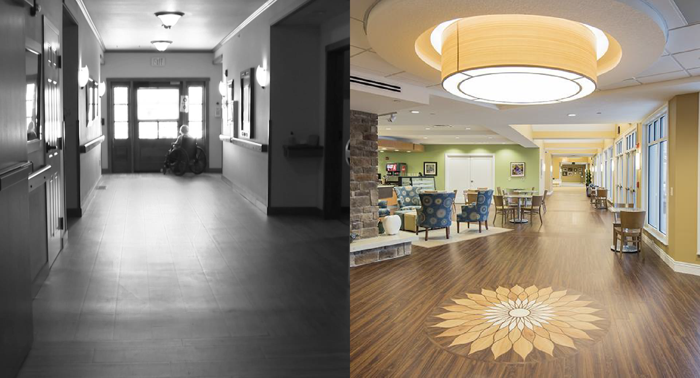
REDEFINING THE KIT OF PARTS
EDGE
VS.
Edges provide a spatial delineation that contains specific activities. Where they become permeable often indicates additional wayfinding opportunities for residents and guests. For example, the edge of this veranda contains the interior lobby; however, its permeable nature retains some connection to the adjacent plaza outside.
EDGES are “the linear elements not used or considered as paths by the
observer. They are the boundaries between two phases, linear breaks in
continuity.”

Slide 34
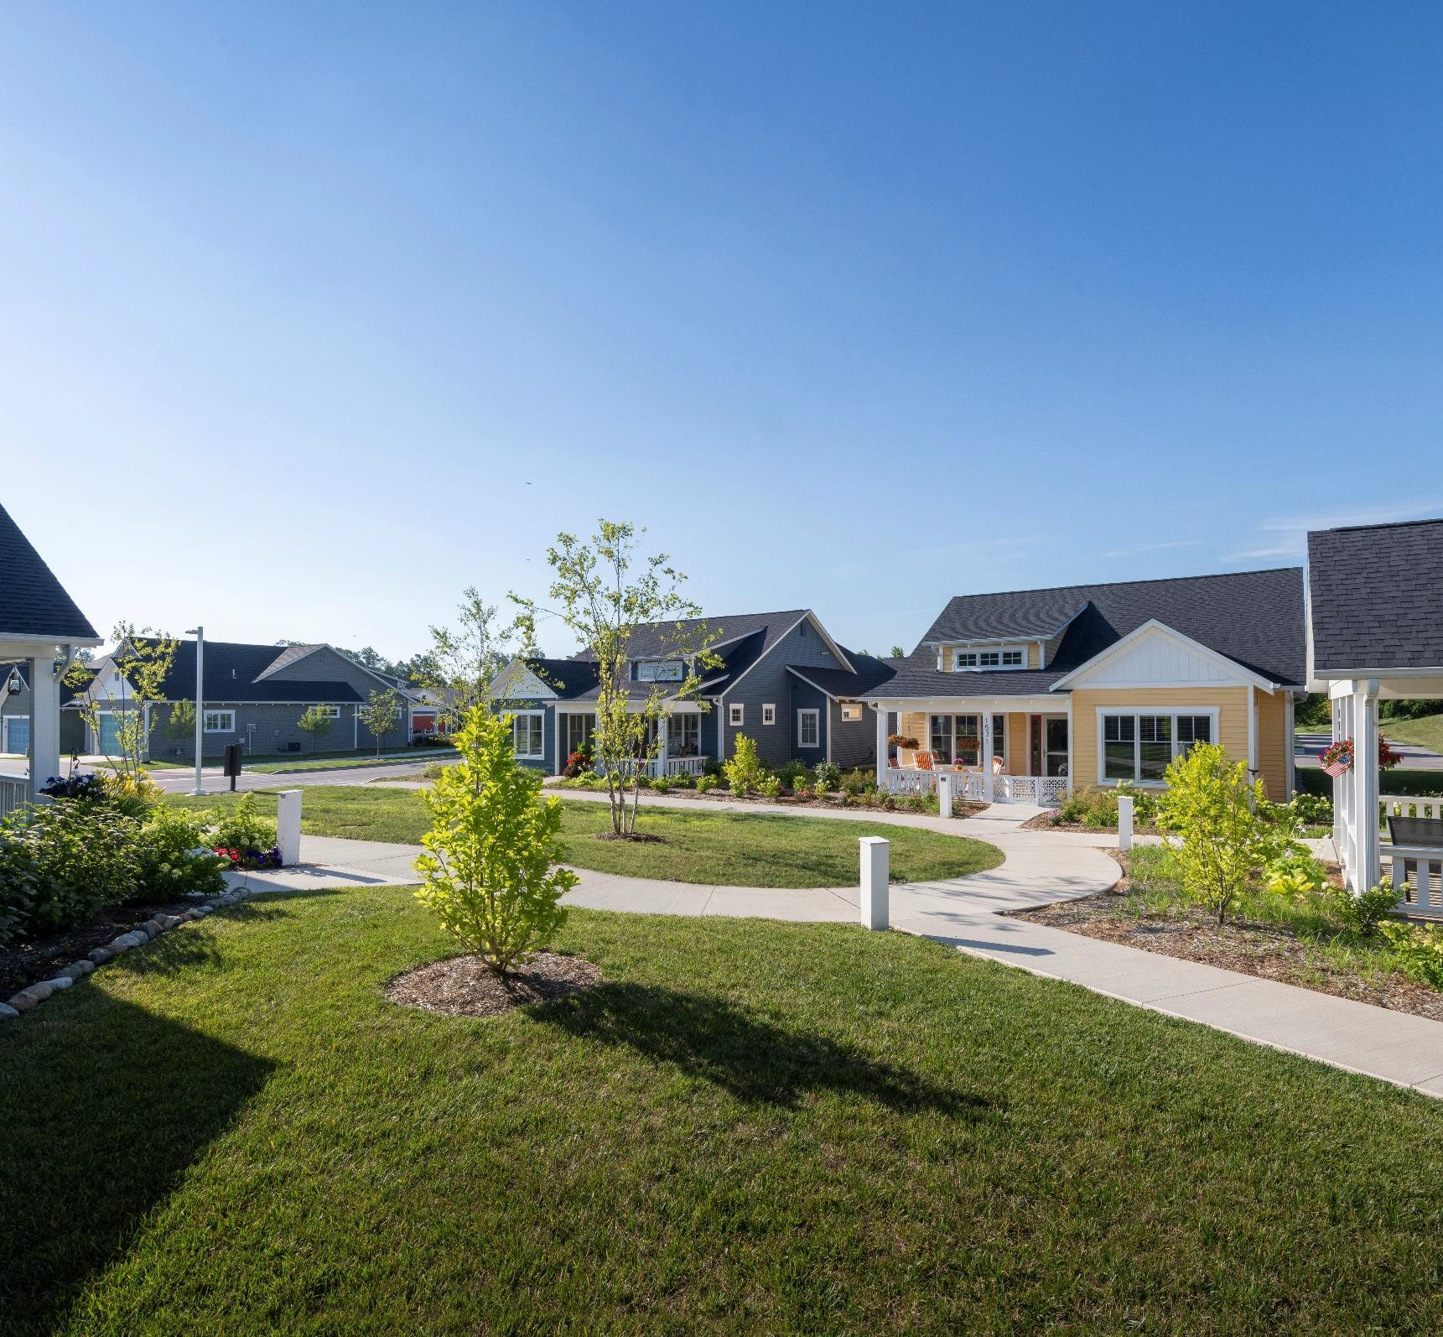

REDEFINING THE KIT OF PARTS
Districts are areas characterized by common characteristics, which observers mentally enter ‘inside of’ to experience.
DISTRICT
Districts serve as segmented spatial arrangements
that offer unique and often thematic experiences.
Often districts have discernable edges and obvious points of entry and exit. However, when these boundaries are vague, the identity of the district can be diminished. To maximize agency within a wider variety of individuals, districts should be leveraged to differentiate public and private space. For older adults, districts should :
Provide clearly defined and thematic spaces;
Establish clear distinction between public and private functions; and
Provide mechanisms to identify trespassers
and in-group members.
DISTRICTS are “the medium-to-large sections of the city, conceived of as
having two-dimensional extent, which the observer mentally enters
‘inside of,’ and which are recognizable as having some common, identifying character.”

Slide 35
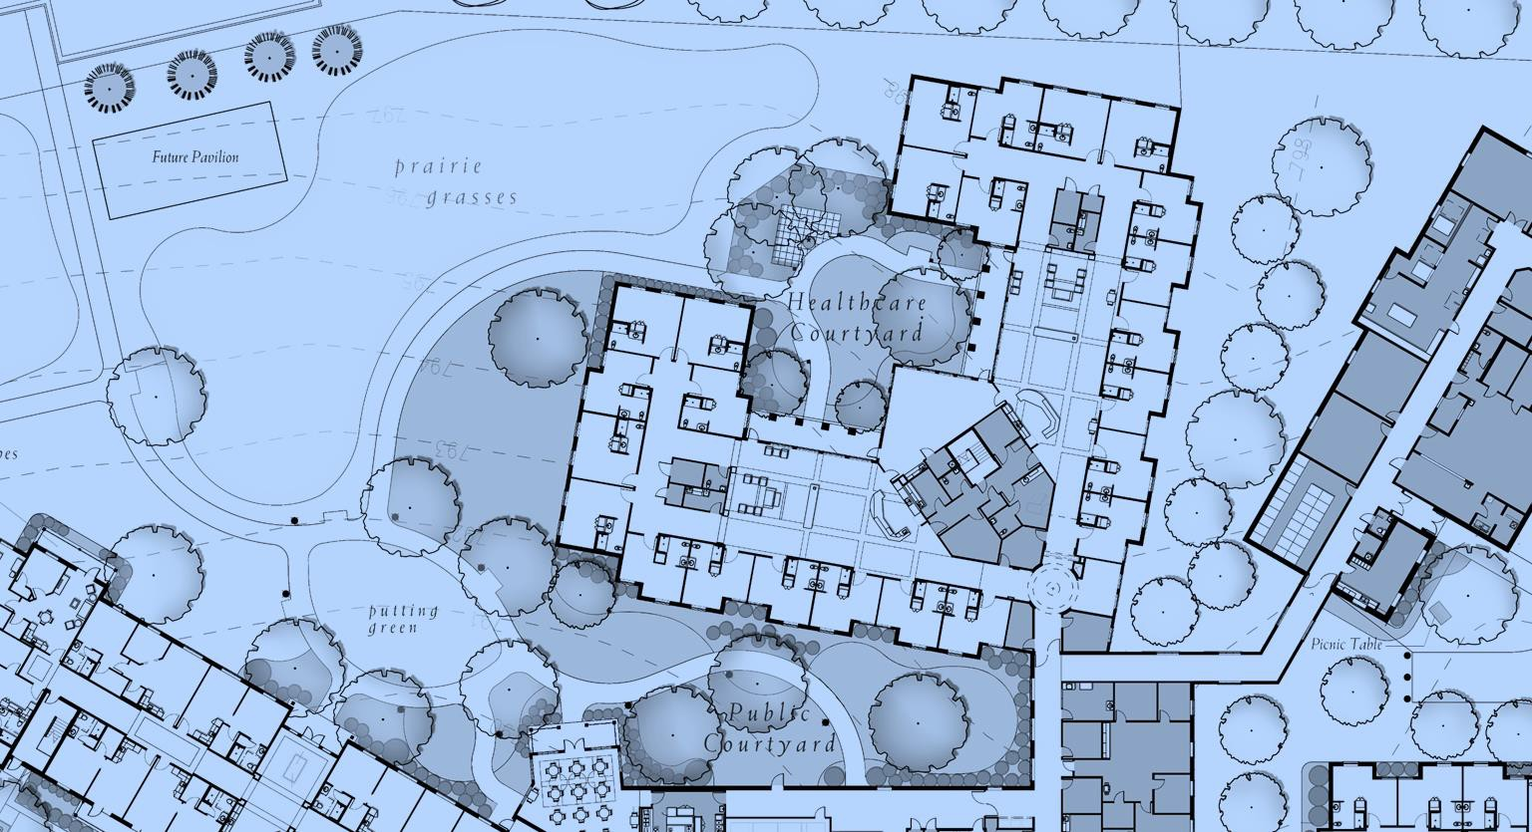
REDEFINING THE KIT OF PARTS
DISTRICT
Identifying Districts
The idea of districts is scalable, ranging from neighborhoods to interior building lobbies. In nursing care environments, its critical to understand how to clearly define district at the scale of the household to compartmentalize use and differentiate gathering spaces from circulation paths.
DISTRICTS are “the medium-to-large sections of the city, conceived of as
having two-dimensional extent, which the observer mentally enters
‘inside of,’ and which are recognizable as having some common, identifying character.”

Slide 36
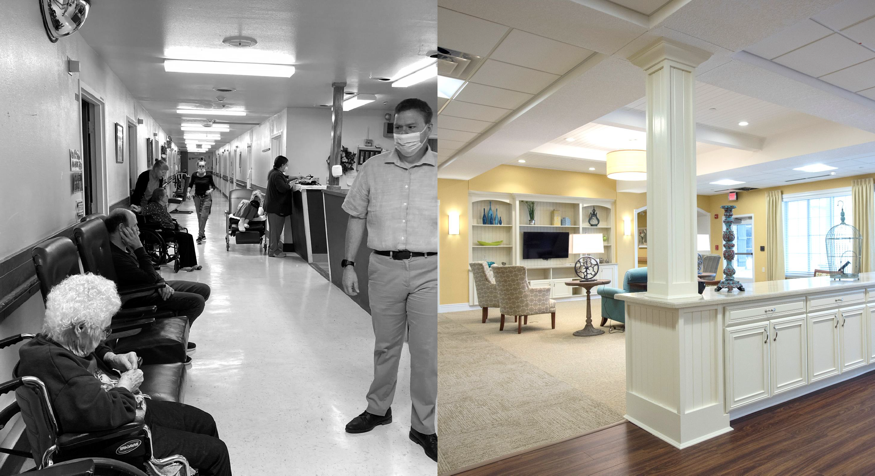
REDEFINING THE KIT OF PARTS
DISTRICT
VS.
Districts come in all shapes and sizes, depending on the audience and can be define with an array of architectural features. Within a typical household, this could be something as simple as delineating a shared lounge area from the adjacent paths with changes within the flooring and strategically places casework.
DISTRICTS are “the medium-to-large sections of the city, conceived of as
having two-dimensional extent, which the observer mentally enters
‘inside of,’ and which are recognizable as having some common, identifying character.”

Slide 37
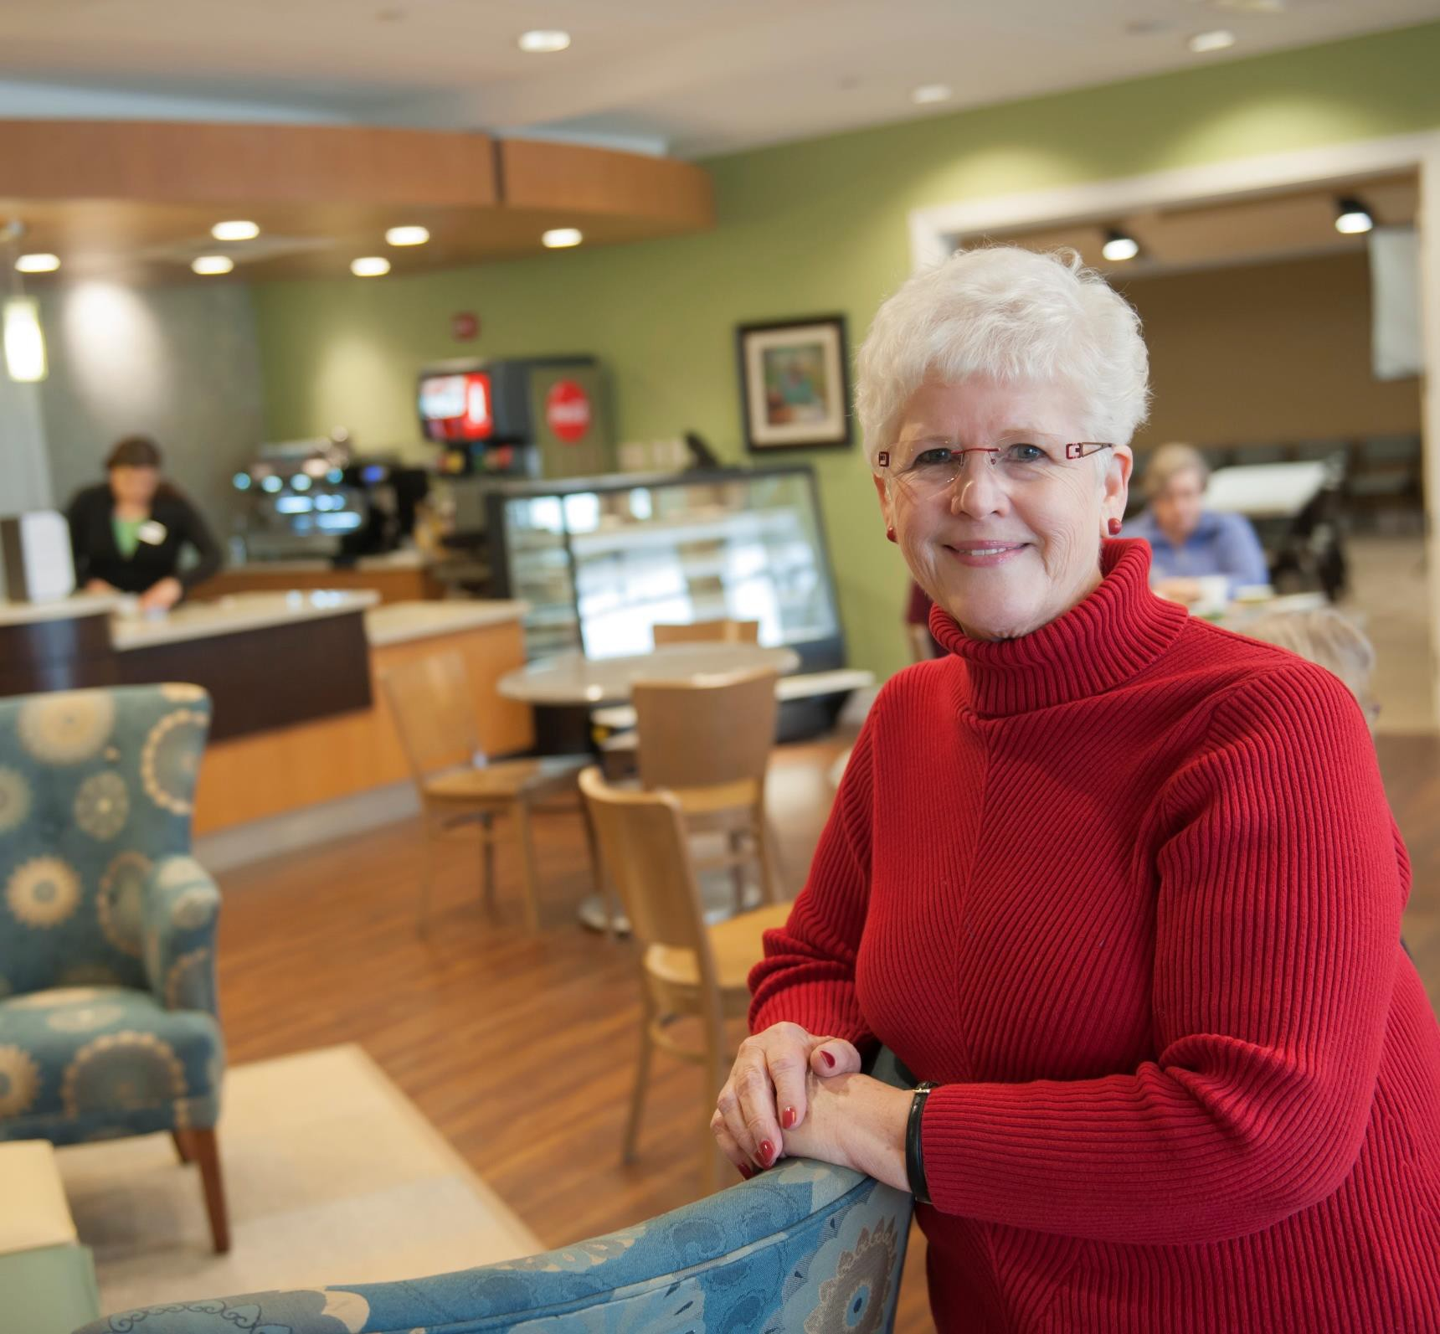
REDEFINING THE KIT OF PARTS
Nodes are primary junctions where a break in transportation or a convergence in paths consolidates activity.
NODE
Nodes provide the primary mechanism for
informal social interaction.
While individuals can
experience planned interactions elsewhere, the nodal relationships between active paths present a unique opportunity to cultivate a sense of belonging within an environment. For older adults, nodes should :
Embrace their role as a key platform for cultivating bridged relationships;
Define predetermined locations to engage in social interaction (especially for those experiencing chronic loneliness); and
Provide additional capacity for unplanned
meetings and informal gatherings.
NODES are “points, the strategic spots in a city into which an observer
can enter, and which are the intensive foci from which people travel.”

Slide 38
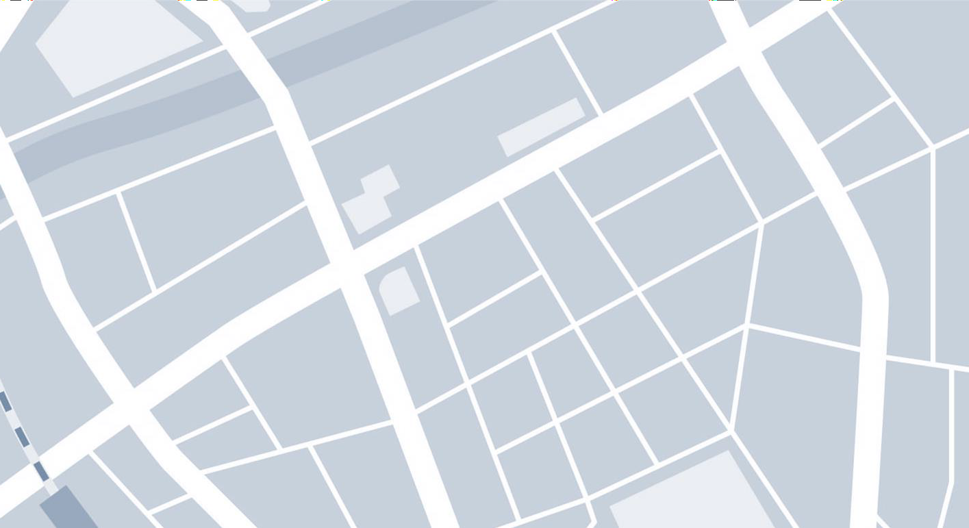

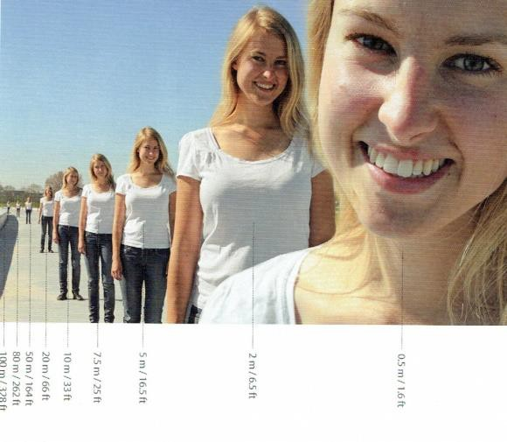




REDEFINING THE KIT OF PARTS
Social Field (100 meters)
At 100 meters we can recognize gender and age, being able to identify movement and body language in a broad outline
NODE
Emotional Field (35 meters)
At 35 meters we can recognize facial expressions.
Conversational Field (3 meters)
At 3 meters and less we can engage in conversation and the visual processing is most rich.
Auditory Field (7 meters)
At 7 meters we can more easily hear someone and use all of our senses.
Our brains have limits.
The human brain’s ability to recognize other humans and engage in social situations is limited by geographic proximity. These distances need to be appreciated when providing livable neighborhoods for people of all ages and abilities.
NODES are “points, the strategic spots in a city into which an observer
can enter, and which are the intensive foci from which people travel.”
Source: Jan Gehl, Cities for People.

Slide 39
REDEFINING THE KIT OF PARTS
NODE
Defining Walksheds
The limits an individual is willing to comfortable walk depends on an array if variables, including physical ability and cognitive endurance. It’s critical that designers understand these limitations before identifying the limits of specific spaces and their ability to provide engaging and “walkable” environments.
NODES are “points, the strategic spots in a city into which an observer
can enter, and which are the intensive foci from which people travel.”

Slide 40
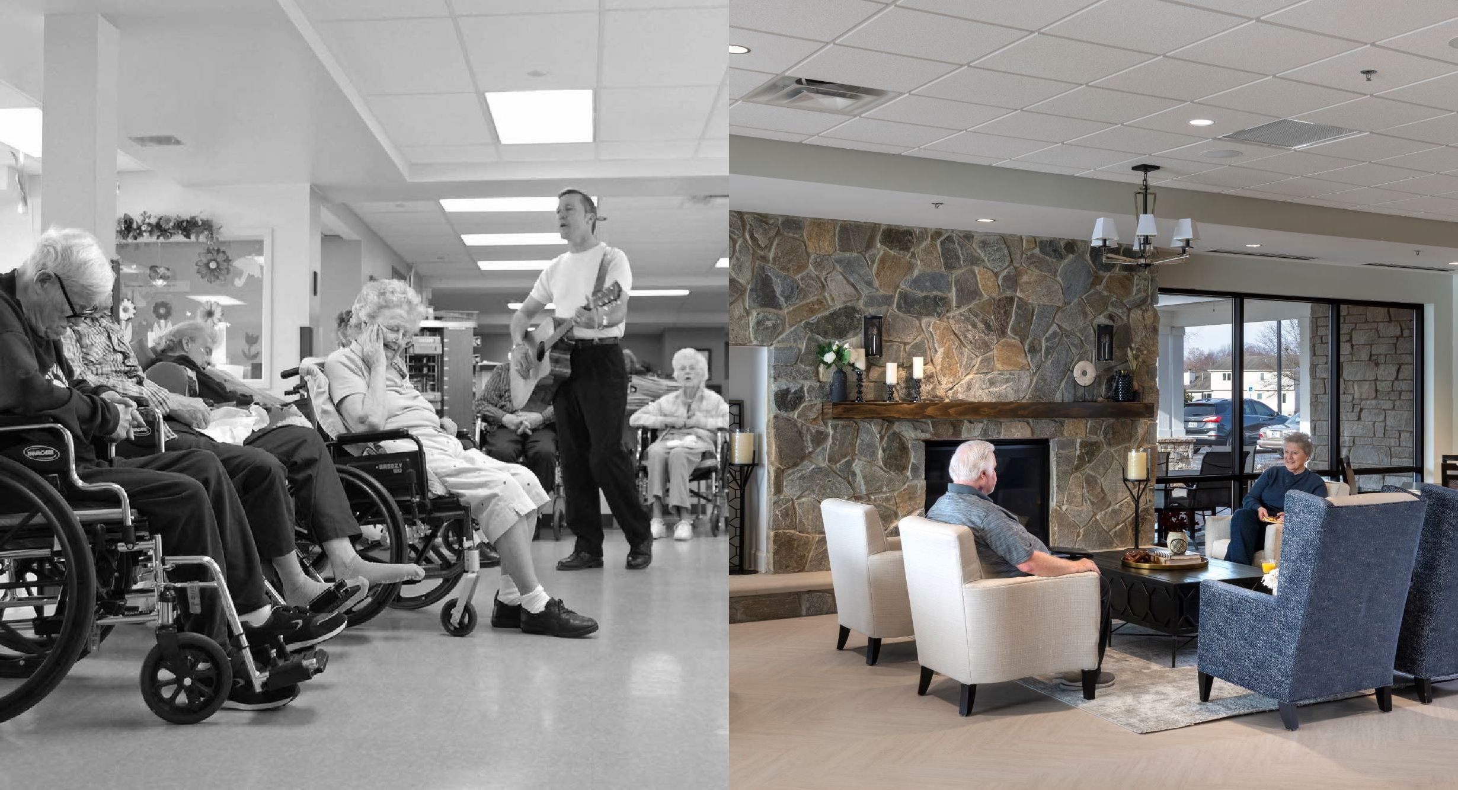
REDEFINING THE KIT OF PARTS
Nodes are busy points of convergence – and they need the space to allow for both planned and unplanned events. Additionally, they often serve as effective locations for “people-watching”, which can be an undervalued function of space planning. This could be something as simple as a small collection of chairs near the nurse station or a comfortable lounge directly off a central lobby.
NODE
VS.
NODES are “points, the strategic spots in a city into which an observer
can enter, and which are the intensive foci from which people travel.”

Slide 41
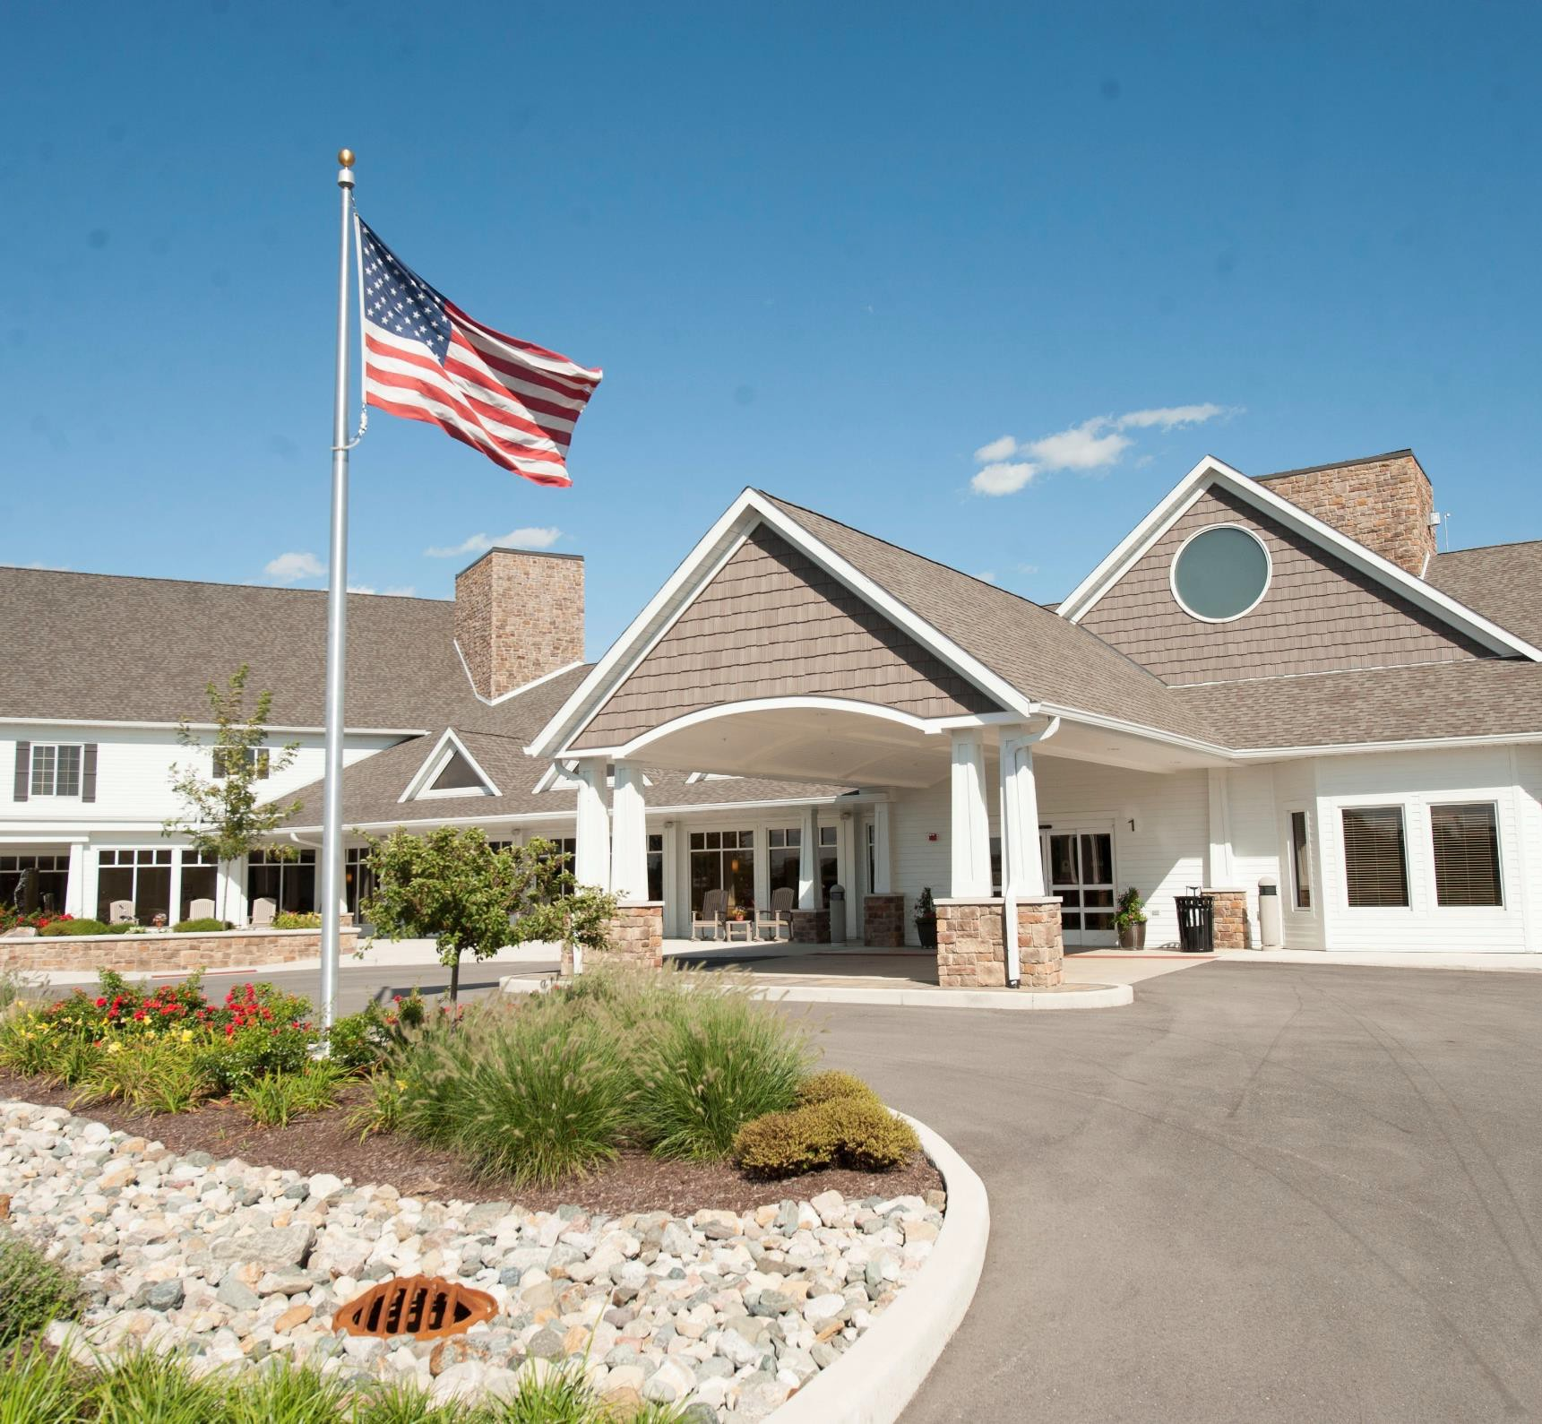

REDEFINING THE KIT OF PARTS
Landmark’s key physical characteristics rely on a singular aspect that is unique or memorable within a specific context.
LANDMARK
Landmarks are traditionally used sparingly to
identify important elements within the built
environment.
These focal point provide a
hierarchal order to spatial arrangements. To maximize agency within a wider variety of individuals, landmarks should be leveraged to increase legibility and wayfinding within care environments. For older adults, landmarks should:
Highlight key wayfinding features (main entry, dining hall, etc.);
Identify key amenities aimed at increasing resident quality of life (TV, café, spa, etc.);
Provide periodic markers along longer paths to
define distance and strengthen wayfinding.
LANDMARKS are “another type of point reference, but in this case the observer does not enter within them, they are external” – usually a rather simple defined physical object (building, sign, etc.).

Slide 42
REDEFINING THE KIT OF PARTS
LANDMARK
Utilizing landmarks.
Landmarks have a unique ability to provide quick and effective hierarchy within spatial arrangements. Whether at the scale of a neighborhood or within a building lobby, landmarks offer a clear and memorable way to catalog the experience of a specific place.
LANDMARKS are “another type of point reference, but in this case the
observer does not enter within them, they are external” – usually a rather simple defined physical object (building, sign, etc.).

Slide 43
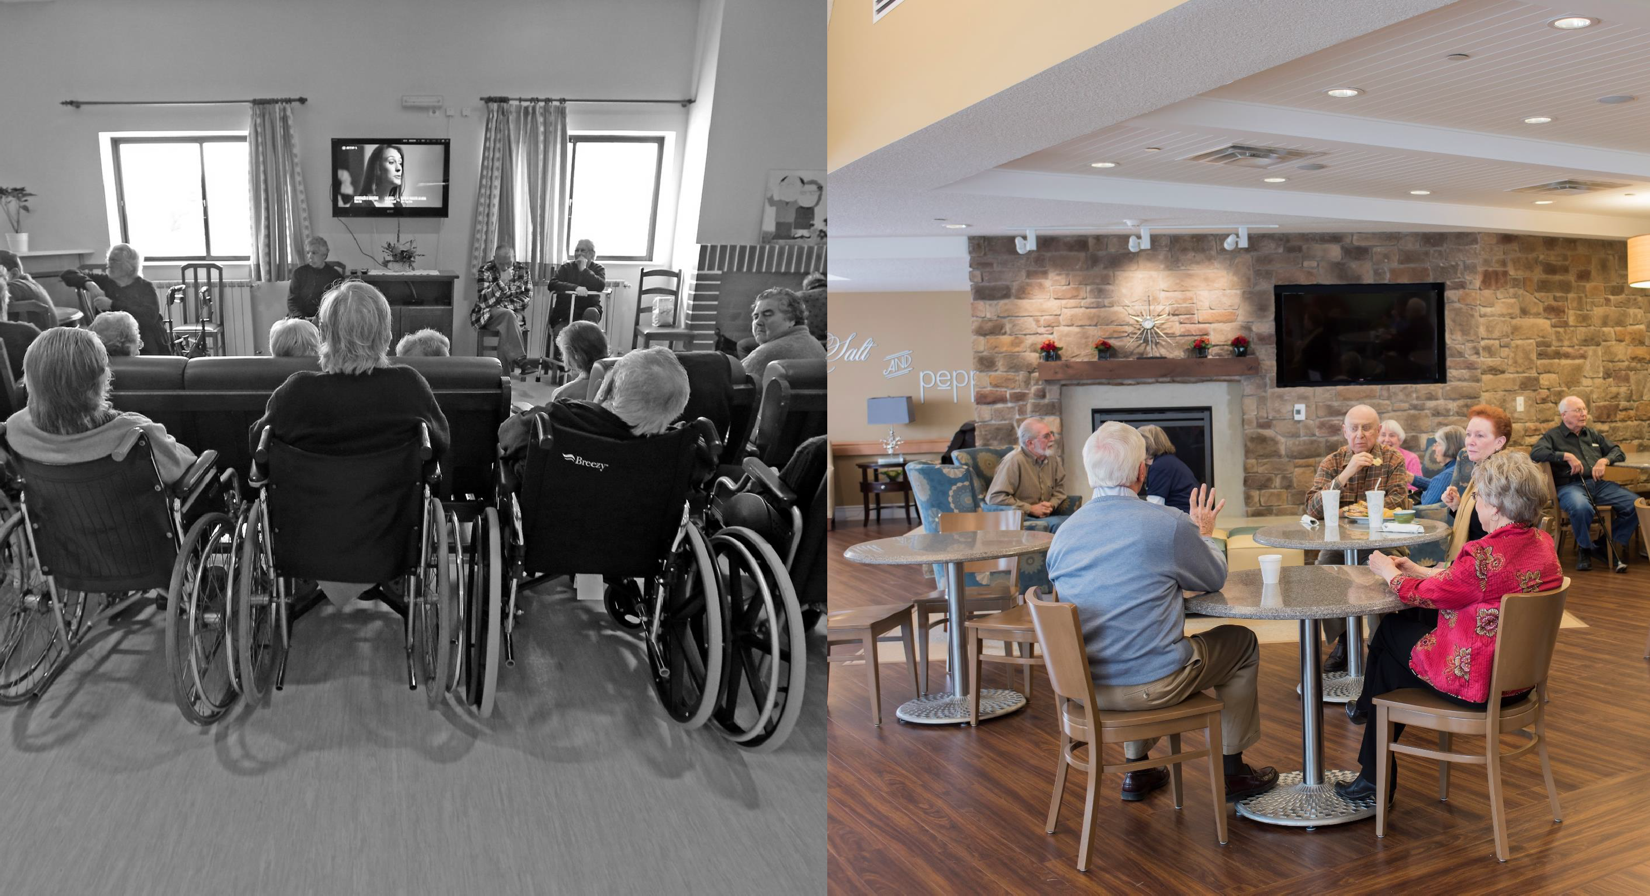
REDEFINING THE KIT OF PARTS
LANDMARK
VS.
While landmarks can often be large sculptural gestures (i.e., clock tower), at the household scale that can be something as simple as a shared
television. As a central amenity within a resident’s everyday routine, it also marks a shared feature for a larger group – one that can be used to center the focus of a space and define the identity of a district.
LANDMARKS are “another type of point reference, but in this case the
observer does not enter within them, they are external” – usually a rather simple defined physical object (building, sign, etc.).

Slide 44
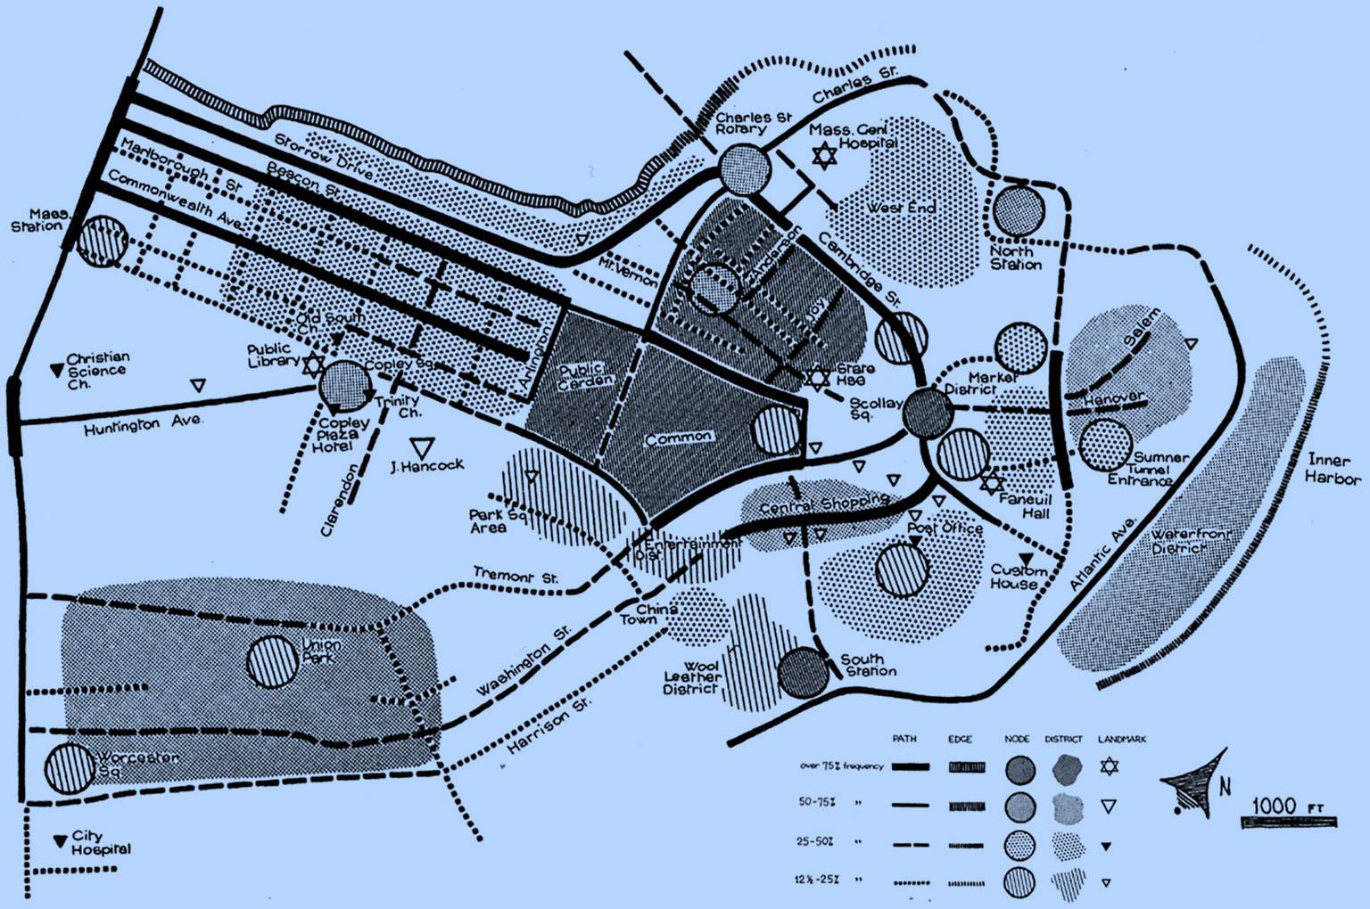
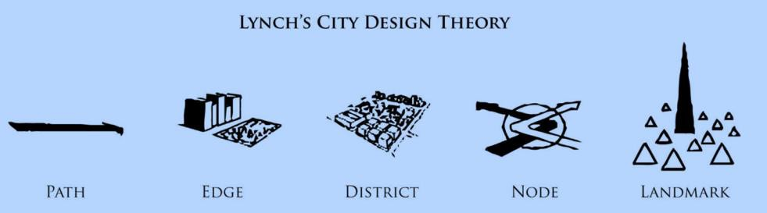
PURPOSEFUL PLACEMAKING
These elements provide a simple and effective way to understand the built environment and qualify its ability to function as a meaningful fourth place.
By using these five basic components, new and existing environments can be assessed for their ability to support older adults – evaluating how the design and operation of future Life Plan Communities can prioritize a sense of continued agency within its residents.

Slide 45
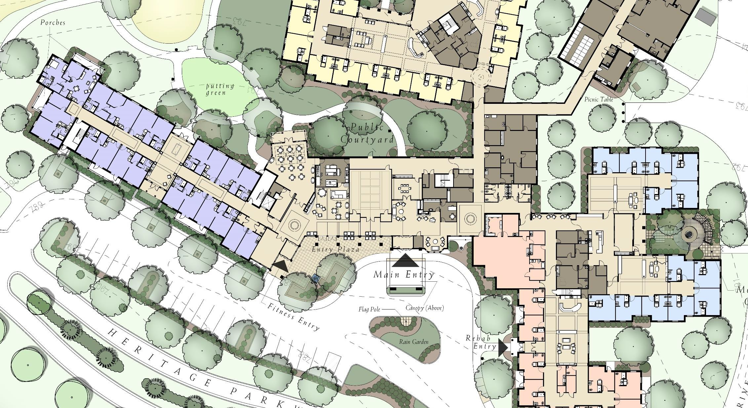
PURPOSEFUL PLACEMAKING
THE CHALLENGE LIES IN EXPLORING HOW THE IDEA OF 4th PLACES CAN SHAPE THE PROFESSION’S UNDERSTANDING
OF EFFECTIVE CARE SETTINGS AND REFINE OUR APPROACH FOR QUALIFYING THESE ENVIRONMENTS.

Slide 46
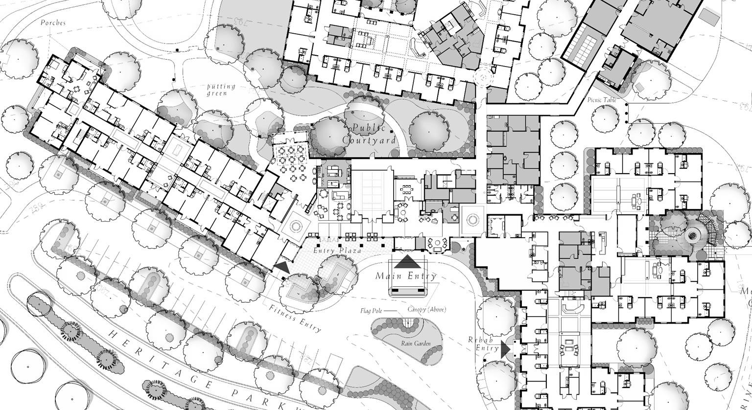
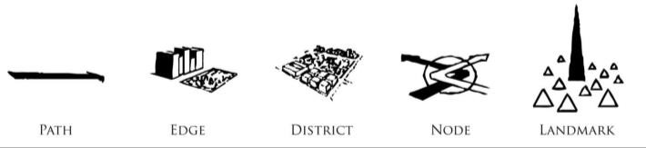
PURPOSEFUL PLACEMAKING
THE CHALLENGE LIES IN EXPLORING HOW THE IDEA OF 4th PLACES CAN SHAPE THE PROFESSION’S UNDERSTANDING
OF EFFECTIVE CARE SETTINGS AND REFINE OUR APPROACH FOR QUALIFYING THESE ENVIRONMENTS.

Slide 47

PURPOSEFUL PLACEMAKING
1 2 3 4
THE BUILT ENVIRONMENT IS A BEHAVIORAL SYSTEM – ONE THAT HAS AN ENORMOUS IMPACT ON OUR QUALITY OF LIFE AND THE WELL-BEING OF THOSE IT HOPES TO SUPPORT ACROSS THE LIFESPAN.
THE DEMAND ON FUTURE CARE ENVIRONMENTS IS LARGELY DETERMINED BY THE INEFFECTIVENESS OF THE PRIMARY THREE TYPES OF PLACES – A REALITY THAT WILL VARY WIDELY ACROSS DIFFERENT COMMUNITIES.
THE EMERGENCE OF A 4th PLACE WILL SHAPE THE DESIGN AND OPERATION OF FUTURE CARE SETTINGS AND REQUIRE A MORE SOPHISTICATED UNDERSTANDING OF EFFECTIVE COMMUNITY DEVELOPMENT.
TO QUALIFY THE EFFECTIVENESS OF MODERN CARE SETTINGS, CARE PROVIDERS WILL NEED TO EMBRACE A MORE NUANCED UNDERSTANDING OF HOW PLACEMAKING STRATEGIES CAN BETTER SUPPORT VULNERABLE POPULATIONS.

Slide 48
PURPOSEFUL PLACEMAKING
ASSESSMENT MATRIX
ELEMENT | DEFINITION | QUALIFIER | ASSESSMENT
PATH | Paths are the channels along which the observer customarily, occasionally, or potentially moves. | Paths should strive to offer clear and logical route that supports the physical limitations of desired users. | Is the path clear and logical (without relying on signage)? How are the acoustics and lighting along the path? Are there opportunities to rest along the path? Does the path intersect with key nodes or districts?
EDGE | Edges are the linear elements (not used or considered as paths by the observer that serve as the boundaries between two phases. | Edges work to create clear and logical boundaries for defined uses and activities. | Are the edges defined and located in appropriate locations (through application of walls, flooring patterns, etc.)? Are there any edges that cause unnecessary barriers?
DISTRICT | Districts are the medium-to-large sections of the neighborhood which the observer mentally enters ‘inside of’ a specific area with a recognizable character. | Districts attempt to offer recognizable area that clearly delineate areas of use (i.e., fellowship). | Are key areas functioning as defined districts that residents can “enter” into and be a part of? Is there an appropriate hierarchy of districts? Is the district welcoming? If so, how?
NODE | Nodes are the strategic spots in a neighborhood into which an observer can enter, and which have an intensive foci from which people travel. | Nodes work best when they offer a strategic intersection between a variety of paths to create vibrant concentration of potential social interaction. | Do the nodes provide ample opportunities to encourage unplanned social interaction? Are the nodes sensitive to the dimensional limitations of emotional fields?
LANDMARK | Landmarks are a key type of point reference offering a defined physical object (building, fireplace, etc.). | Landmarks offer clear wayfinding clues through the provision of iconic spatial elements within the neighborhood. | Does every sequence leverage a landmark for wayfinding? Is the iconography noticeable from an appropriate distance? Are there experiences that lack landmarks that can be addressed?
NOTE: To assess an existing building, select a key group of residents (i.e., resident council) to evaluate the most common single event and have them review the imageability of the experience through the lens of these five elements – being sure to evaluate the success of the place and its ability to provide a sense of agency and engagement. Suggested questions are listed to spark feedback and comments for improvements.

Slide 49

PURPOSEFUL PLACEMAKING
The future of effective Life Plan Communities rests in their willingness to embrace their role as a sophisticated platform for cooperative healing.
As placemaking strategies continue to evolve their understanding of more supportive environments for aging populations, the evolution of LPC’s as modern 4th places will rely heavily on the delicate balance between community health and personal choice.

Slide 50


