Slide 1
Management of Osteoporosis in Older Adults
Michael Eldridge and Joseph Schreiner
Consultant Pharmacists
September 2025
©2023 CVS Health and/or one of its affiliates. Confidential and proprietary.
Notes:
Hello! Today we will be discussing management of osteoporosis in older adults.
Presenter: For comments or questions related to this program, please contact the Clinical Geriatrics Department at ClinicalGeriatrics@CVSHealth.com

Slide 2
Agenda
Risk factors associated with osteoporosis
Medications used in the prevention and treatment of osteoporosis
How supplied
Administration considerations
Potential side effects for medications
Monitoring parameters
Notes:
Before we begin let’s go over what we will be talking about. We will discuss risk factors associated with osteoporosis and review medications commonly used in its prevention and treatment. We’ll look at how they are supplied, administration considerations and what you should look for while residents are on them.
If at any time you have a question, feel free to stop me and ask. We will have time for questions at the end also.

Slide 3
Overview of Osteoporosis
Notes:
Let’s begin with an overview of osteoporosis.

Slide 4
What is Osteoporosis?
Osteoporosis is a progressive bone disease that weakens the bones and increases the risk of fractures.
Bones lose minerals like calcium
“Silent” disease
Bone with Osteoporosis
Normal Bone
NIH ORBD NRC Osteoporosis Overview October 2019.
HHS Surgeon General’s Report on Bone Health and Osteoporosis December 2019.
Notes:
Think of our bones as the framework of our bodies, similar to the wooden framing in a house. Now when an individual has osteoporosis, the framework of their body becomes like a house with termites. The way termites weaken the house, osteoporosis weakens the bones through the loss of minerals like calcium. Osteoporosis occurs when the body loses too much bone, makes too little bone, or both. As a result, bones become weak and may break from a fall or, in serious cases, from simply sneezing or minor bumps. Osteoporosis does not cause any outward symptoms until a break actually occurs and is therefore known as a “silent disease”.

Slide 5
Prevalence of Osteoporosis
54M
Americans have osteoporosis and low bone mass
1 in 2
women
aged 50 and older will break a bone due to osteoporosis
1 in 4
men
aged 50 and older will break a bone due to osteoporosis
Bone Health and Osteoporosis Foundation. What is osteoporosis and what causes it. 2023
Notes:
So why does this matter to us? Well about 54 million Americans have osteoporosis and low bone mass, placing them at increased risk for osteoporosis. Studies suggest about half of women and one in four men will break a bone due to osteoporosis. Most of the individuals in our care have multiple risk factors, which we will cover shortly, which increase their risk of developing osteoporosis. This is why we are taking the time to talk about this today.

Slide 6
Risk Factors of Osteoporosis
Notes:
Now, let’s talk about risk factors of osteoporosis.

Slide 7
Risk Factors*
Osteoporosis
Women > Men
Increasing Age
Slender, thin-boned body type
White or Asian women
Family History
Low estrogen/ testosterone
Low calcium + vit D intake
Excessive dieting
Lifestyle factors
*Not all-inclusive
NIH ORBD NRC Osteoporosis Overview October 2019
Notes:
As we saw earlier, women are at greater risk than men in developing osteoporosis. Another risk factor, that we will review again later, is an inadequate dietary intake of calcium and vitamin D. Most individuals in our care are impacted by low hormone levels which can increase their risk for bone loss. While there are factors that cannot be changed such as age, race, body type or family history. It is important to note that some may be modifiable by addressing lifestyle choices such as maintaining a healthy weight and avoiding tobacco or alcohol abuse.
Take a moment to read over the risk factors on the screen.

Slide 8
Risk Factors*
Medical Conditions
Medications
Diabetes
Hyperthyroidism
Calcium deficiency
Chronic liver disease
COPD
Kidney disease
Immobilization
Major depression
Anticonvulsants (e.g., phenytoin, valproate)
Glucocorticoids (e.g., prednisone)
Heparin
Lithium
PPI (e.g., omeprazole, pantoprazole)
SSRI (e.g., escitalopram, sertraline)
Thiazolidinediones (e.g., pioglitazone)
*Not all-inclusive
Camacho PM et al. American Association of Clinical Endocrinologists/American College of Endocrinology clinical practice guidelines for the diagnosis and treatment of postmenopausal osteoporosis- 2020 update executive summary. Endocr Pract. 2020; 26(5):564-570.
Notes:
Many individuals in our care have comorbid conditions, such as diabetes and kidney disease, which can increase the risk of developing osteoporosis. Some conditions are related directly, such as calcium deficiency, and others not so much. For example, immobilization increases risk because to develop strong bones physical activity is required. Preventing and managing comorbidities is key to either avoiding or delaying the progression of osteoporosis. Medications can play a major role in developing osteoporosis as well. Take a look at the list on the right and you may see many familiar drugs such as anticonvulsants, PPIs, and some antidepressants. Some of the ways drugs can cause or worsen osteoporosis is by preventing bone formation. While not always possible, we may be able to reduce risk by changing to a potentially safer alternative. When they cannot be changed, at least being aware may allow us to better address their increased risk and improve the care we provide.

Slide 9
Medications to Prevent or Treat Osteoporosis
Notes:
We now turn our attention to medications used to prevent and treat osteoporosis.

Slide 10
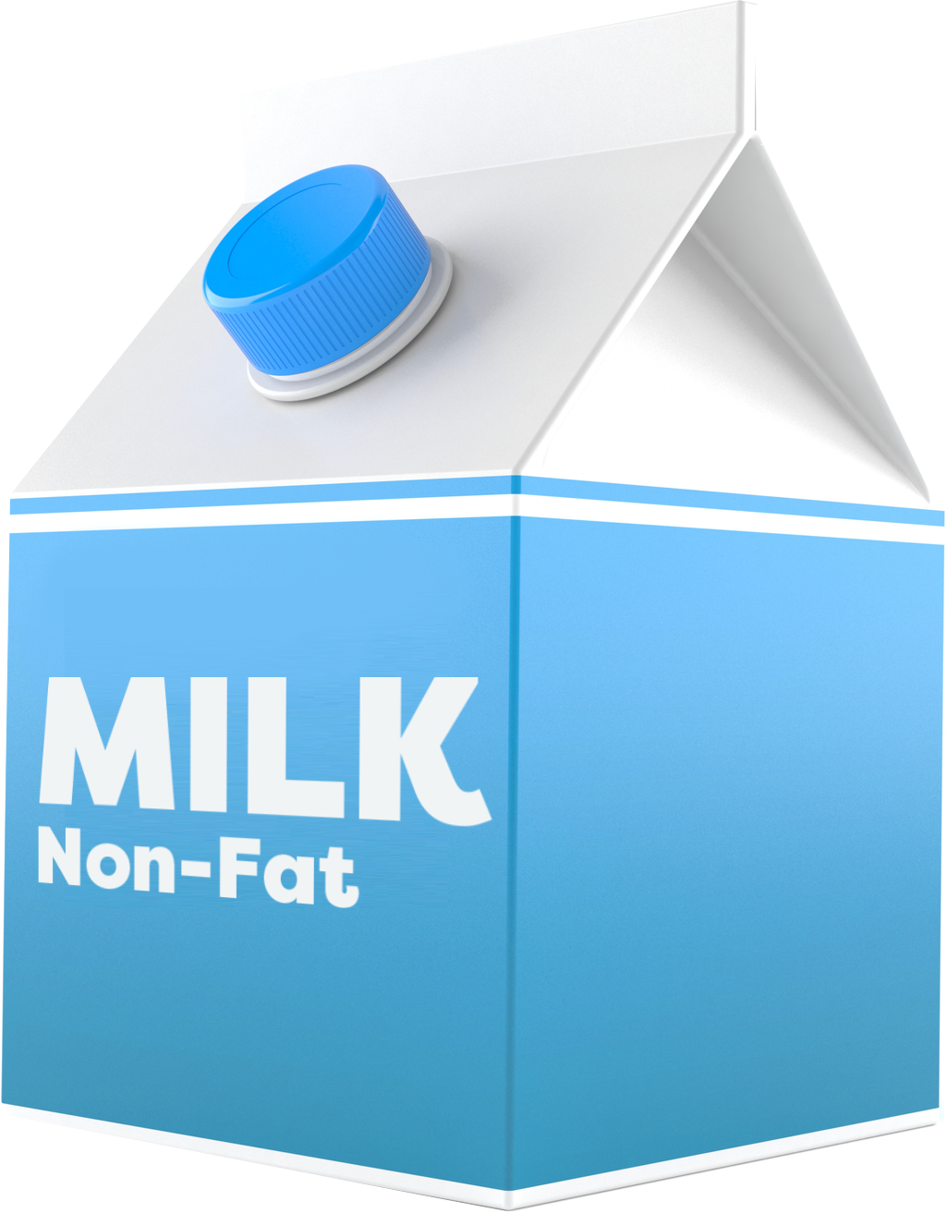



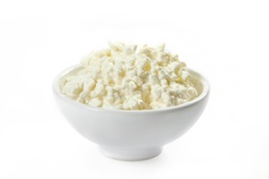
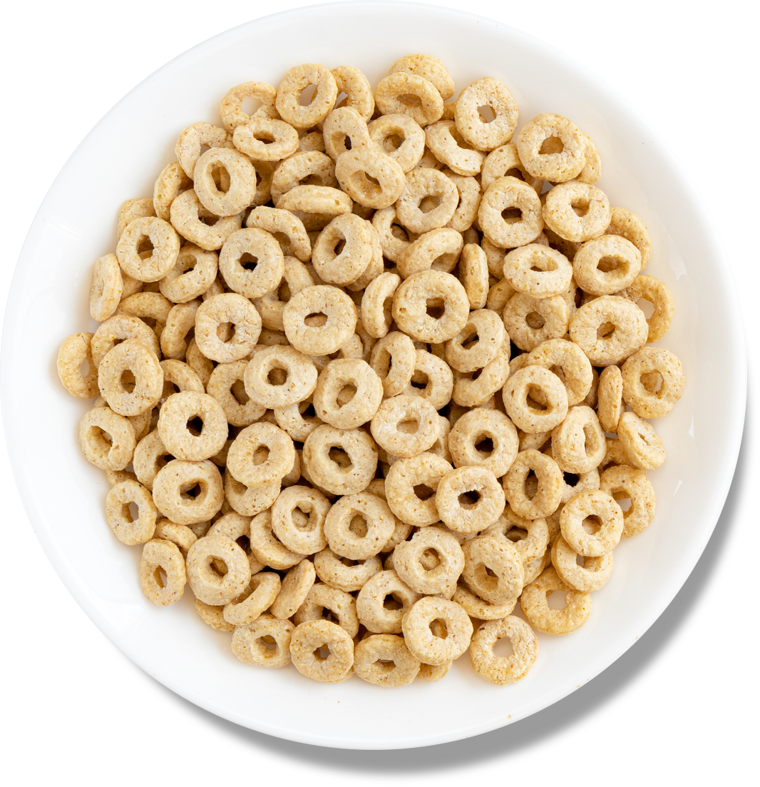

Role of Calcium + Vitamin D
To keep your bones strong, eat foods rich in calcium. Vitamin D helps your body absorb calcium.
Adults need 1,000 to 1,200 mg of calcium every day
Milk, nonfat
1 cup, 302 mg
OJ fortified with calcium
6 oz, 200 to 260 mg
Cheddar cheese shredded
1 ½ oz, 306 mg
Yogurt, plain low-fat
1 cup, 300 mg
Cereal fortified with calcium
1 cup, 100 to 1,000 mg
Broccoli, raw
1 cup, 90 mg
Cottage cheese, 1% milk fat
1 cup, 138 mg
HHS Surgeon General’s Report on Bone Health and Osteoporosis December 2019.
Bone Health and Osteoporosis Foundation. Calcium and Vitamin D. 2023.
Notes:
Before we get into medications, let’s discuss calcium requirements. Calcium and vitamin D are vital in developing and keeping bones strong. The medications we will discuss come with recommendations to ensure adequate intake of calcium and vitamin D through diet or if necessary, supplementation. On the screen, you can see the calcium content of common foods seen in facility menus. This list is not all-inclusive and only serves as a reminder that calcium is found in many foods. Per the 2019 Surgeon General’s report, typical adults need up to 1,200 mg of calcium every day, individuals with osteoporosis may require even more. When a resident’s dietary intake may be inadequate, a referral to a dietitian may aid in developing a meal plan to help increase intake. Vitamin D plays a supportive role to calcium, increasing calcium absorption in the body. Older adults, age 50 and older should consume at least 20 mcg (800) IU of vitamin D each day. If using supplements, make sure the product selected matches with the dose ordered. They come in a wide variety of products. Multiple products may be stocked in the house supply, so it is important to match the order to the label. When it comes to administration of calcium supplements, it is important to remember they may interact with iron supplements and multivitamins, so administration should be separated. Calcium supplements can be given 2 hours before or 1 hour after iron or a multivitamin. It is also vital to mention that along with appropriate intake of calcium and vitamin D, the surgeon general recommends 2 hours and 30 minutes per week of moderate-intensity physical activity as tolerated which puts some stress on the bones. Of course, any activity should be approved by the individual’s prescriber.

Slide 11
Medication Overview
RANK Ligand Inhibitor
Denosumab (Prolia)
Parathyroid Hormone Analogs
Abaloparatide (Tymlos)
Alendronate (Binosto, Fosamax, Fosamax/D)
Risedronate (Actonel, Atelvia)
Ibandronate (Boniva)
Zoledronate (Reclast)
Sclerostin Inhibitor
Romosozumab (Evenity)
Other Agents
Calcitonin (Fortical, Miacalcin)
Conjugated estrogens/ bazedoxifene (Duavee)
Bisphosphonates
Teriparatide (Forteo)
Raloxifene (Evista)
Eastell R. et al. Pharmacological Management of Osteoporosis in Postmenopausal Women: An Endocrine Society Clinical Practice Guideline. JCEM. 2019; 5(104):1595-1622.
LeBoff MS et al. The clinician’s guide to prevention and treatment of osteoporosis. Osteoporos Int. 2022.
Shoback D. et al. Pharmacologic Management of Osteoporosis in Postmenopausal Women: An Endocrine Society Guideline Update. JCEM. 2020; 3(105):587-594.
Notes:
Let’s dig into the medications. On the screen we have multiple classes of medications used to manage osteoporosis. Take a moment to look it over. Bisphosphonates, like alendronate and risedronate, are considered initial treatment options and Prolia, a RANK ligand inhibitor, is an alternative initial therapy. Parathyroid hormone analogs, Forteo and Tymlos, along with sclerostin inhibitor, Evenity, are recommended for those with severe or multiple vertebral fractures and for whom initial therapies are not appropriate. Other agents, such as selective estrogen receptor modulators and hormone therapy can be used in postmenopausal women with low risk of DVT and for whom initial therapies are not appropriate. Calcitonin is the unique formulation in the group as a nasal spray; however, it is considered a last line option for those in which all other medications are deemed inappropriate. Let’s get into some of the specifics.

Slide 12
Bisphosphonates
 | Route of Administration |  |  |  | Labeled Dosing Intervals
 | Tablet | Solution | Effervescent | Parenteral | Daily | Weekly | Monthly | Every 3 months | Every 1 to 2 years
Alendronate | ✔ | ✔ | ✔ |  | ✔ | ✔
Ibandronate | ✔ |  |  | ✔ |  |  | ✔ | ✔
Risedronate | ✔ |  |  |  | ✔ | ✔ | ✔
Zoledronic Acid |  |  |  | ✔ |  |  |  |  | ✔
Individual prescribing information from https://dailymed.nlm.nih.gov/
Notes:
Bisphosphonates are the initial therapy of choice, and there are multiple options: alendronate, risedronate, zoledronic acid and ibandronate. Alendronate and risedronate are administered orally and are available as tablets; whereas zoledronic acid is available as a solution for injection. Ibandronate has an oral tablet formulation and solution for injection. Of the medications listed, alendronate is the most commonly used. It also has the widest range of indications as compared to the other bisphosphonates. An important note to remember about this class, the frequency of administration (e.g., once daily vs once weekly) varies based on the dosage as well as the indication it is being used for. For example, for treatment of osteoporosis in women, Alendronate can be ordered as 70 mg tablet orally once weekly or 10 mg tablet orally once daily. However, if alendronate were being used for prevention of osteoporosis in women, the dosing can be 35 mg tablet orally once weekly or 5 mg orally once daily. While as nurses you are not expected to know the dosing, it is important to familiarize yourself with typical doses, so when you see the incorrect 70 mg once daily regimen, you can ask for a clarification from the physician before any delays or potential harm to the resident occur.

Slide 13
Oral Bisphosphonates Administration considerations
Administer 30 minutes* before first food, beverage or medication of the day with 6 to 8 oz of plain water
Resident should not lie down for at least 30 minutes* and until after first food of the day
Oral tablets should NOT be crushed
* 60 minutes for ibandronate
Individual prescribing information from https://dailymed.nlm.nih.gov/
Notes:
It is also important to be familiar with the administration recommendations for oral bisphosphonates. It is recommended that they be administered at least 30 minutes before the first food, beverage or medication of the day and that the individual remain in an upright position for at least 30 minutes and until they have had their first food of the day. This time increases to 60 minutes if the individual is on ibandronate. Avoiding administration with food, beverages (including mineral water) or other medications helps ensure optimal absorption of the medication and thus effectiveness. By staying upright, the risk for any esophageal irritation is reduced. Oral tablets should not be crushed for individuals who need their medications crushed. Instead, an alternative product or route of administration should be considered.

Slide 14
Bisphosphonates
Side Effects
Upper GI complications
Musculoskeletal pain
Atypical femur fracture
Jaw osteonecrosis
Monitoring parameters
Basic metabolic panel (BMP)
Serum calcium
Serum phosphate
Serum magnesium
Individual prescribing information from https://dailymed.nlm.nih.gov/
©2024 CVS Health and/or one of its affiliates. Confidential and proprietary. This is provided for informational and reference purposes only and is based on cited sources as existing at the time of review. It does not constitute medical, legal, or regulatory advice and is not a substitute for individualized assessment and treatment by an appropriate medical provider.
Notes:
The common side effects with bisphosphonates are upper GI complications, which is why we have the administration requirements we just talked about. More serious complications include atypical femur fracture and osteonecrosis of the jaw. Atypical femur fractures are prevented through fall precautions and standard safety measures. Osteonecrosis of the jaw can appear spontaneously but is generally associated with tooth extraction or delayed healing of an oral infection. It can present as pain, swelling, and/or numbness of the jaw and may require discontinuation of the bisphosphonate. If an individual is scheduled for any type of dental procedure, it is important to send a medication list to the dentist to ensure they are aware that they are on this drug. For alendronate, risedronate, and ibandronate, a BMP should be done at baseline and then annually. For zoledronic acid, monitoring includes a BMP at baseline, every 6 months and prior to each dose, along with a serum calcium, phosphate and magnesium at baseline and prior to each dose.

Slide 15
Denosumab (Prolia) Administration Considerations
Subcutaneous injection given in upper arm, upper thigh or abdomen once every 6 months
Prefilled syringe includes safety guard
Individual prescribing information from https://dailymed.nlm.nih.gov/
Notes:
Denosumab is administered as a subcutaneous injection every 6 months. The long duration between doses can make it difficult for staff at a nursing home to know when a dose is due if they have a new admission with denosumab on their medication profile. It is important, especially if the resident is a short stay, that staff attempt to determine when the next dose is due prior to ordering the medication. Once you receive the medication it must be kept in refrigeration and can be brought to room temperature, by letting it sit out for 15 to 30 minutes prior to administration. The syringe must be protected from direct heat and vigorous shaking. The injection can be given in the upper arm, upper thigh or abdominal area.

Slide 16
Denosumab (Prolia)
Side Effects
Musculoskeletal pain
Atypical femur fracture
Jaw osteonecrosis
Orthostatic hypotension possible following injection
Contraindications
Hypocalcemia
Monitoring parameters
Kidney function
Serum calcium
Serum phosphorus
Serum magnesium
Individual prescribing information from https://dailymed.nlm.nih.gov/
©2024 CVS Health and/or one of its affiliates. Confidential and proprietary. This is provided for informational and reference purposes only and is based on cited sources as existing at the time of review. It does not constitute medical, legal, or regulatory advice and is not a substitute for individualized assessment and treatment by an appropriate medical provider.
Notes:
Common side effects include injection site reactions and musculoskeletal pain. More serious side effects include atypical femur fracture and osteonecrosis of the jaw. We would take the same precautions with Prolia as we did with bisphosphonates, ensuring that all practitioners are aware that the individual is on a medication that can cause these issues. Orthostatic hypotension can occur after the injection; thus, it is recommended that the initial injection be given while the individual is seated or lying down. Serum creatinine should be checked at baseline and serum calcium, phosphorus and magnesium should be monitored at baseline and within 14-days of each injection. Since Prolia can worsen hypocalcemia, it is very important that prior to starting therapy or before any dose that any pre-existing hypocalcemia be corrected.

Slide 17
Teriparatide (Forteo) and Abaloparatide (Tymlos) Administration considerations and side effects
Daily, subcutaneous injection
Sites of injection
Teriparatide: thigh or abdomen
Abaloparatide: lower abdomen (avoid the 2-inch area around the navel)
Storage
Teriparatide: Store in the refrigerator except when administering; discard 28 days after opening
Abaloparatide: Before use, store in refrigerator, then can keep at room temperature for 30 days
Side Effects
Joint pain
Dizziness
Orthostatic hypotension possible following injection
Osteosarcoma
Hypercalcemia
Individual prescribing information from https://dailymed.nlm.nih.gov/
Notes:
Parathyroid hormone analogs stimulate the formation of bone, through increased absorption of calcium. This mechanism of action requires that individuals receive calcium and vitamin D supplements, while on these medications, if daily dietary intake is inadequate. Both medications are available as prefilled pens, administered as subcutaneous injections daily. Teriparatide can be injected into the thigh or abdominal region; whereas abaloparatide should be administered into the lower abdomen, but not within 2 inches of the belly button. The teriparatide pen must be kept in refrigeration when not being administered, even after you have started using the pen. The pen must be discarded 28 days after opening. The abaloparatide pen can be kept at room temperature for up to 30 days once in use. The common side effect profile consists of dizziness and joint pain. It is important to administer the first few doses of these medications while the individual is sitting or lying down due to an increased risk of orthostatic hypotension with use. This class of medications has warnings for hypercalcemia and an increased risk of osteosarcoma (a type of bone cancer), which is the reason use is generally limited to 2 years as we will talk about in a little bit.

Slide 18
Romosozumab (Evenity) Administration considerations
Dose: 210 mg subcutaneously once monthly into abdomen, thigh or upper arm
Two separate syringes are needed to administer the total dose
Storage: In refrigerator; may be stored at room temperature for 30 days
Individual prescribing information from https://dailymed.nlm.nih.gov/
Notes:
Romosozumab is the newest agent on the market in the treatment of osteoporosis. Romosozumab requires correction of pre-existing hypocalcemia prior to starting the medication and is available as a solution for injection. Romosozumab must be administered subcutaneously into the abdomen, thigh or upper arm once a month and is not recommended for use beyond 12 months. In order to administer the recommended dose of 210 mg, you must inject the individual twice, as each single use prefilled syringe only contains 105 mg (or half the dose required). Romosozumab must be kept in the refrigerator and can last up to 30 days at room temperature. Remember, a complete dose requires TWO injections. It is recommended that different injection sites be used for each injection, e.g., the upper arm and the abdomen. If a separate site cannot be used, do not inject into the same place as the previous injection, meaning if the first shot is administered into the top of the upper arm, the second shot should be administered lower.

Slide 19
Romosozumab (Evenity)
Boxed Warning
Increases risk of myocardial infarction, stroke and cardiovascular death
Side Effects
Jaw osteonecrosis
Joint pain
Muscle spasms
Headache
Contraindication
Hypocalcemia
Monitoring parameters
Kidney function
Serum calcium
Individual prescribing information from https://dailymed.nlm.nih.gov/
©2023 CVS Health and/or one of its affiliates. Confidential and proprietary. This is provided for informational and reference purposes only and is based on cited sources as existing at the time of review. It does not constitute medical, legal, or regulatory advice and is not a substitute for individualized assessment and treatment by an appropriate medical provider.
Notes:
This newer agent does come with a boxed warning of increased risk of myocardial infarction, stroke and cardiovascular death and therefore should not be used in individual’s who have had an MI or stroke in the preceding year. Romosozumab can cause osteonecrosis of the jaw as seen with bisphosphonates and denosumab. It is also important to monitor kidney function and serum calcium at baseline and as necessary while on therapy. There is also a warning for hypocalcemia, which is why it is recommended that any pre-existing hypocalcemia be corrected prior to initiating treatment.

Slide 20
Drug Holidays and Duration of Treatment
Drug | General Considerations
Bisphosphonates | Consider a holiday after 5 years of oral or 3 years of IV bisphosphonate therapy
Denosumab (Prolia) | If therapy is stopped, individuals are advised to transition to an oral bisphosphonate to avoid bone loss after stopping denosumab
Teriparatide (Forteo) and Abaloparatide (Tymlos) | Generally, limit treatment to 2 years and transition to either a bisphosphonate or denosumab
Romosozumab (Evenity) | Limit treatment to 1 year and follow with a drug intended for long-term use, such as a bisphosphonate or denosumab
Individual prescribing information from https://dailymed.nlm.nih.gov/
Notes:
While medications are useful in the management of osteoporosis, sometimes it is necessary to perform a drug holiday to help lower some of the risks associated with the medications. For bisphosphonates, it is recommended to consider a drug holiday once they are stable, which is often after 5 years of oral therapy or 3 years of IV therapy. And while drug holidays are important, if the prescriber deems it appropriate (such as if they develop another fracture), drug therapy may be restarted. The benefits on bone formation of Prolia quickly reverse when it’s discontinued which is why an individual should be transitioned to a bisphosphonate when stopping Prolia. The risks associated with Forteo, Tymlos and Evenity call for a limited duration of therapy and then switching to preferred treatment options. However, use of teriparatide may be considered beyond 2 years if the resident remains at or has returned to having a high risk of fracture.

Slide 21
Other Agents Administration Considerations
Calcitonin (Fortical, Miacalcin)
Dosing: 1 spray per day administered to one nostril, alternating nostrils daily
Prime the pump before its first use – hold the bottle upright and depress pump until a full spray is released
When administering, place the pump into the nostril with patient’s head in upright position and depress the pump
Storage: Unopened bottle in refrigerator; while in use can be kept at room temperature in an upright position
Raloxifene (Evista) and
Conjugated estrogens/bazedoxifene (Duavee)
Once daily dosing without regard to meals
Should NOT be crushed
Individual prescribing information from https://dailymed.nlm.nih.gov/
Notes:
The agents shown here are alternative options, not commonly used as first line treatments, in the management of osteoporosis. Calcitonin is indicated for treatment of postmenopausal osteoporosis in women greater than 5 years post menopause for whom all other treatments are contraindicated, not tolerated or not preferred. It is a unique nasal spray formulation. Unopened bottles must remain in the refrigerator, whereas bottles in use can be stored in an upright manner at room temperature. Calcitonin should be administered to one nostril daily with administration alternating between each nostril, e.g., give in left nostril on Tuesday, then right nostril on Wednesday. Therefore, it is important that site of administration (meaning left or right) be documented daily. The nasal spray must be primed prior to its first use, not daily. Evista and Duavee should be taken once daily without crushing. All of these options, like the previous ones we talked about, require adequate calcium and vitamin D intake.

Slide 22
Other Agents Side Effects
Calcitonin
Nose bleeds
Back pain
Joint pain
Headache
Raloxifene
Stroke
Leg cramps
Hot flashes
Arthralgia
Boxed Warning
Increased risk of VTE and death from stroke
Contraindication
History of VTE
Conjugated estrogens/ bazedoxifene
Nausea
Diarrhea
Muscle spasms
Boxed Warning
Increased risk of endometrial cancer, cardiovascular disorders, and dementia
Contraindications
History of VTE
Known or suspected breast cancer or estrogen-dependent neoplasia
Undiagnosed abnormal uterine bleeding
Known hepatic or thrombophilic disorders
VTE = venous thromboembolism
Individual prescribing information from https://dailymed.nlm.nih.gov/
©2024 CVS Health and/or one of its affiliates. Confidential and proprietary. This is provided for informational and reference purposes only and is based on cited sources as existing at the time of review. It does not constitute medical, legal, or regulatory advice and is not a substitute for individualized assessment and treatment by an appropriate medical provider.
22
Notes:
Common adverse reactions for calcitonin include administration site reactions such as rhinitis, nasal dryness and redness, and systemic effects include back pain, joint pain and headache. More common adverse effects of hormone therapy include flu like symptoms, leg cramps, hot flashes, nausea and diarrhea. Hormone therapies come with boxed warnings for increased risk of venous thromboembolism and death from stroke. Estrogen products come with an added warning for increased risk of dementia. Thus, these medications are contraindicated for any individual with an active or past history of venous thromboembolism. Duavee has many other contraindications including those with known or suspected breast cancer, estrogen-dependent neoplasia, undiagnosed abnormal uterine bleeding, and known hepatic or thrombophilic disorders.

Slide 23
Take Aways
Osteoporosis is a “silent” disease; many more can be affected than what is known.
Achieve good bone health through adequate Calcium+ Vitamin D intake and appropriate use of medication
Vigilant monitoring and management of osteoporosis can improve quality of life
Notes:
Osteoporosis impacts many individuals under our care. By modifying lifestyles and ensuring adequate intake of calcium and vitamin D we can maintain good bone health and delay bone loss. Using medications appropriately to prevent and treat osteoporosis can increase their effectiveness and prevent medication errors. Overall, vigilant monitoring and management can help improve an individual’s quality of life and potentially prevent a fracture.
What questions can I answer?

