Slide 2



Making a Difference as a Hospice Volunteer
Robert Hagopian
Volunteer Coordinator
CorsoCare Hospice of Indiana
WAVES
Fall Conference
September 9-10, 2025
Embassy Suites Noblesville | Indianapolis, IN

Slide 3
A Brief History of Hospice…
The word “hospice” comes from a Latin word that means “guesthouse”.
“Hospitality” is from the same Latin word - the idea of helping someone feel welcome, cared for, comfortable and at ease.
Hospice originally referred to a place of rest and shelter for weary or sick travelers on long journeys. This originated hundreds of years ago in Europe.
Today, hospice is a way of caring for people with a life-limiting illness, where the focus is on comfort care for the patient and family, rather than curing the illness.
WAVES
Fall Conference

Slide 4
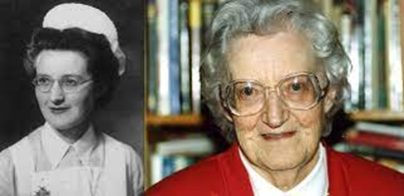
A Brief History of Hospice…
Dame Cicely Saunders (1918-2005) worked as a social worker and a nurse. At age 33, she returned to medical school to specialize in pain control for the terminally ill. As a physician, she influenced our attitudes toward medical care for patients who are dying.
She is quoted as saying, “There is never ‘nothing more’ than can be done.”
She helped develop the first modern-day hospice in London in 1967: St. Christopher’s Hospice. She is considered the founder of the modern-day hospice movement.
WAVES
Fall Conference

Slide 5

A Brief History of Hospice…
The first hospice in the U.S. opened in 1974 in Connecticut.
The hospice movement quickly spread throughout the U.S. and subsequently to many other countries.
Today, the number of hospice organizations continues to grow. In the U.S., there are more than 4,000 hospices.
As a field of medicine, hospice is a very young discipline…a relative newcomer to the medical scene.
Hospice became a Medicare benefit in 1982, and Medicare continues to regulate all hospices under the Conditions of Participation (CoPs).
WAVES
Fall Conference

Slide 6

Hospice Philosophy…
Hospice recognizes death as a natural part of the life cycle. We provide care for the whole person; physically, emotionally and spiritually.
Hospice offers support to the family, as well as the patient. Our goal is to enhance the patient’s quality of life during the time they have left.
Dignity is emphasized, and personal choices are honored as much as possible.
Hospice focuses on pain control and symptom management.
Hospice neither hastens nor postpones death.
WAVES
Fall Conference

Slide 7
In The Beginning…
ALL Hospice Services were provided by trained, certified, qualified and experienced
Volunteers!
WAVES
Fall Conference

Slide 8
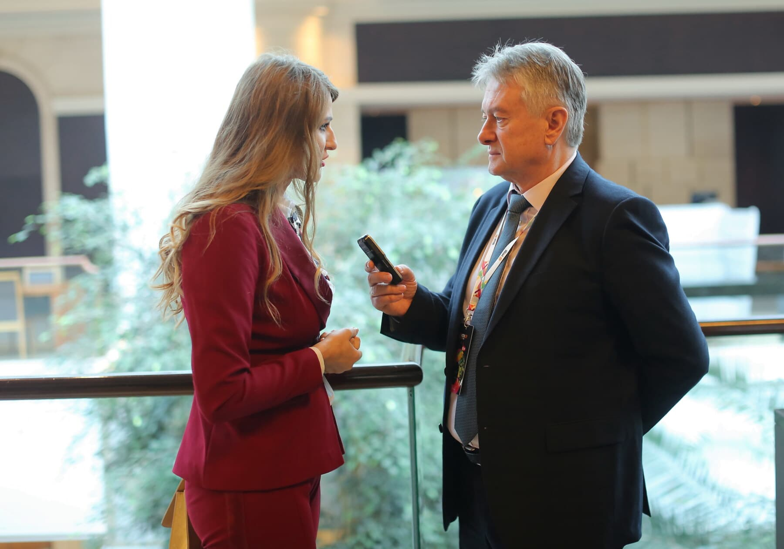
Hospice Volunteer Onboarding
Application
Interview
Personal References
Background Check
Fingerprint Check
OIG (Office of the Inspector General) Check
TB Test
Volunteer Orientation Class
1:1 Instruction and Counseling
Introductory Visit
Ongoing Support and Supervision
WAVES
Fall Conference

Slide 9
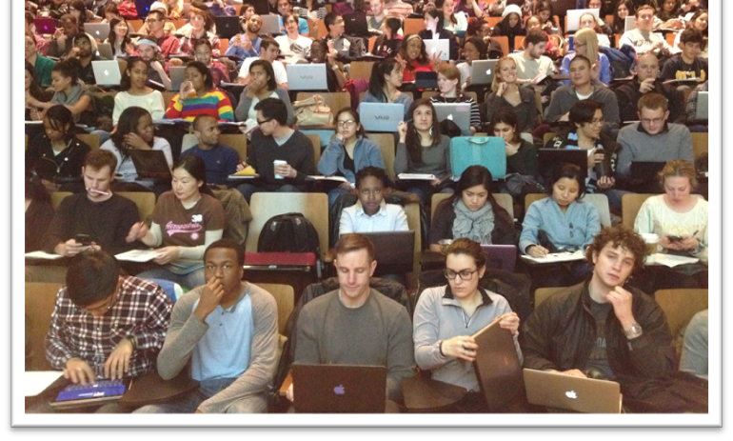
Hospice Volunteer Training
History of Hospice Care
Medical Aspects of Hospice Care
Dementia
Spiritual Care and Life Review
Death & Dying, Grief & Bereavement
Communication Skills for the Hospice Volunteer
The Volunteer’s Role on the Interdisciplinary Patient Care Team
Confidentiality & HIPPA
Professional Boundaries
Code of Ethics
Personal Protective Equipment & Safety
WAVES
Fall Conference

Slide 10
Why Volunteer?
Why Hospice?
WAVES
Fall Conference

Slide 11
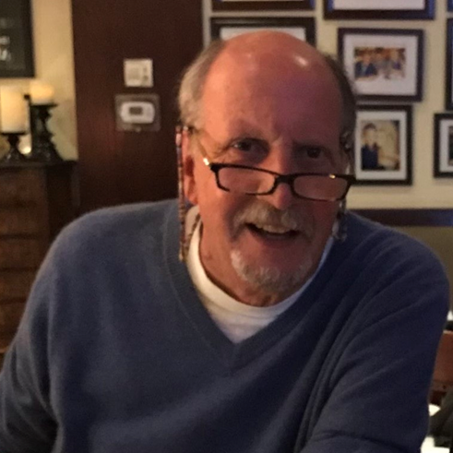
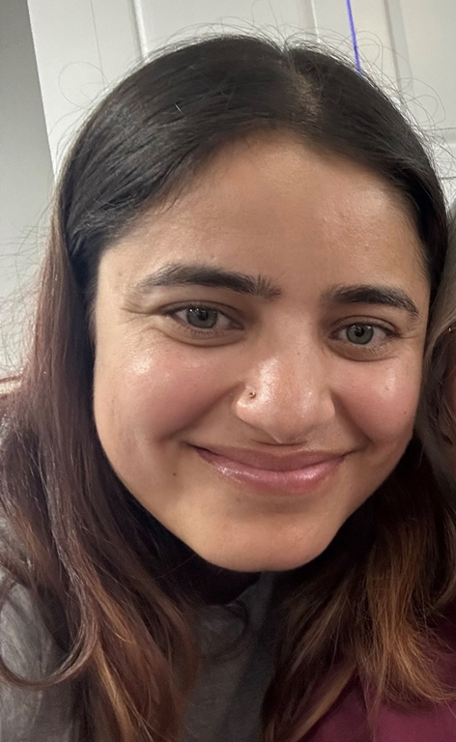
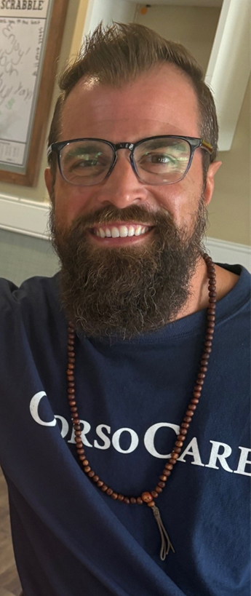
Russ Lilly
Many of our Volunteers have had personal experience with end-of-life through losses of family and friends. They want to give back or pay it forward to help others who are facing the greatest fear in life: Death.
Usha Ghimire
Joey Hunt
WAVES
Fall Conference

Slide 12
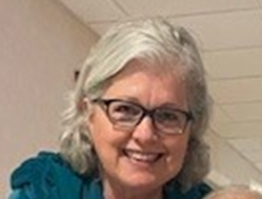
“When you help someone and they realize how sincere that help and compassion is, that is the best feeling for me. To see the looks on their faces when they know that they are not alone.” – Diane Sweeney
WAVES
Fall Conference

Slide 13
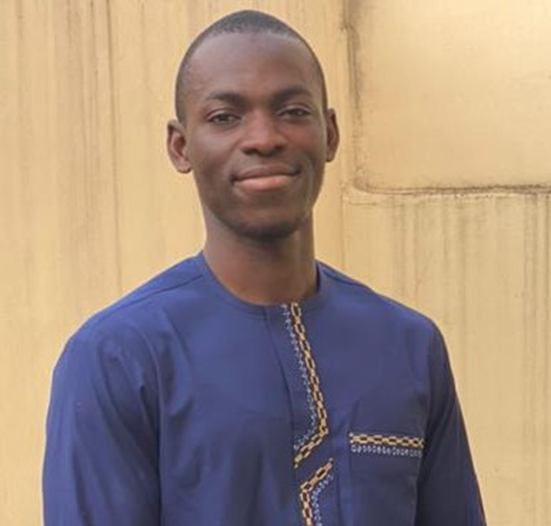
“In this world we can learn from others, something valuable, lessons from the other person, we provide lessons from our own lives shared with others, especially those we serve. Talking about their lives and our lives help us to connect. Similarities and differences can bring us together.”
– Hamedane Moustapha
WAVES
Fall Conference

Slide 14
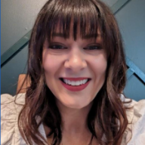
“I am an artist who works across a vast number of mediums - from painting, to sculpture, to crafting (crochet). I am an herbalist. I've also studied end of life doula services.
“I believe that everyone deserves to cross over with someone witnessing and supporting their journey to the other side. I believe that death in America has become something that is hidden away, and thus has become something people are frightened of. I think it's important to sit with patients and help them understand what's happening to their bodies and help them process it.” – Reagan Stafford-Tarin
WAVES
Fall Conference

Slide 15
“I’m about quality time with others, I’m a people person having worked in the service industry for many years. I enjoy getting to know people from all different cultures, I love to travel, learning about what others do, their lives, their culture, histories and backgrounds.” – Jessica Turner
“I want to give back whenever I can. Hospice helped my parents. I want to help the elderly and dying… Great to be there, helping out. I’m not a big talker, but I like to work hard in the background….Put a smile on someone’s face.” – Jim Woehler
WAVES
Fall Conference

Slide 16
“I love to ask people questions about their life and to find out who they are, what is their life like and what things do we have in common… I think my past experiences and my desire to have a future in healthcare makes me a good fit. I’ve been around Hospice staff. I care about my patients and want to be there to support others. I love to serve others and to give back to my community.” – Morgan Barrette
“I’m very intrigued with people’s stories, love learning about people by asking them questions about themselves, I run off their vibe …smiles open hearts, …take pride in getting to know people.” – Sarah Buschmann
WAVES
Fall Conference

Slide 17
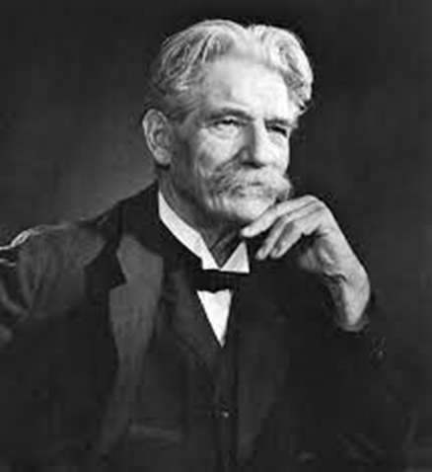
“I don't know what your destiny will be, but one thing I do know: the only ones among you who will be really happy are those who have sought and found how to serve.”
-- Albert Schweitzer (1875-1965)
WAVES
Fall Conference

Slide 18
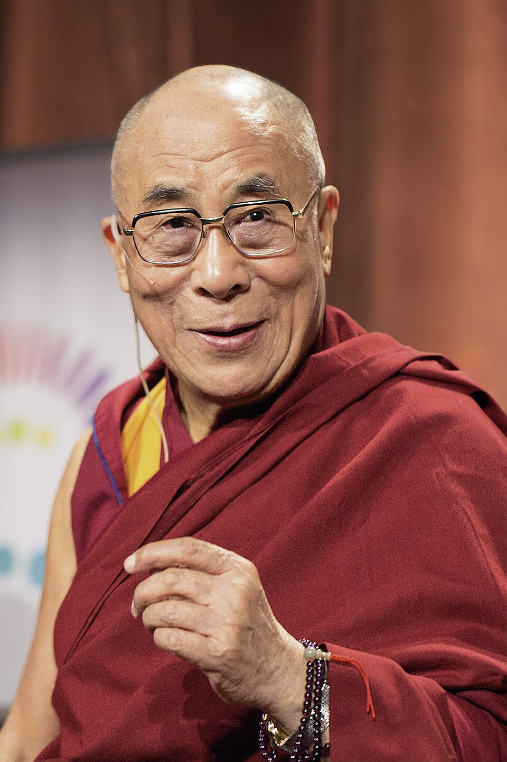
“If you think you are too small to make a difference, try sleeping with a mosquito.” - Dalai Lama
WAVES
Fall Conference

Slide 19

WAVES
Fall Conference

Slide 20
Thank you!
WAVES
Fall Conference

