Slide 1


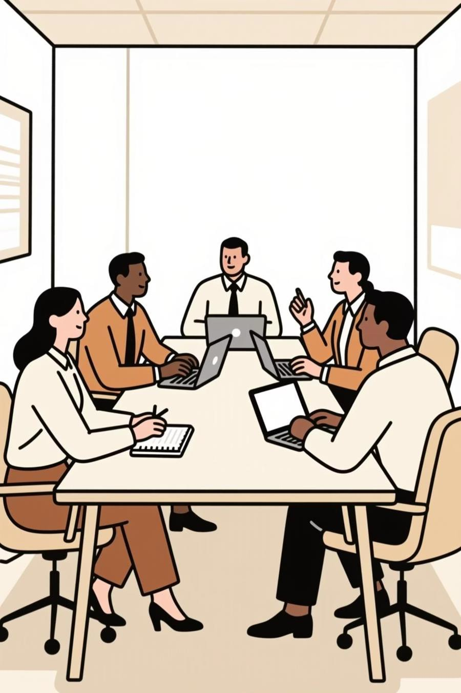




Making Meetings Count: Up-Level Your Facilitation Strategy
An interactive workshop for leaders who drive decisions, not just discussions.
Fall Conference
September 9-10, 2025
Embassy Suites Noblesville | Indianapolis, IN

Slide 2

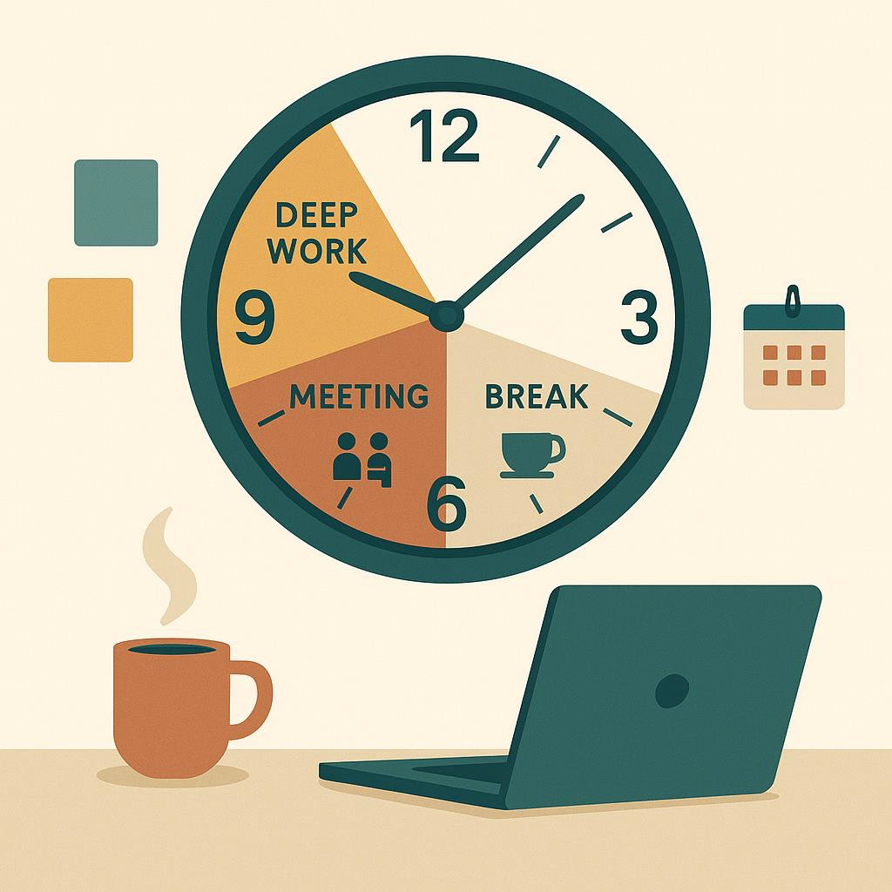

By the end, you'll be able to...
Design outcome-driven agendas
Facilitate with structure
Know when not to meet
Close the loop with crisp action items
If this meeting ended 10 minutes early, what would still make it a win?

Slide 3
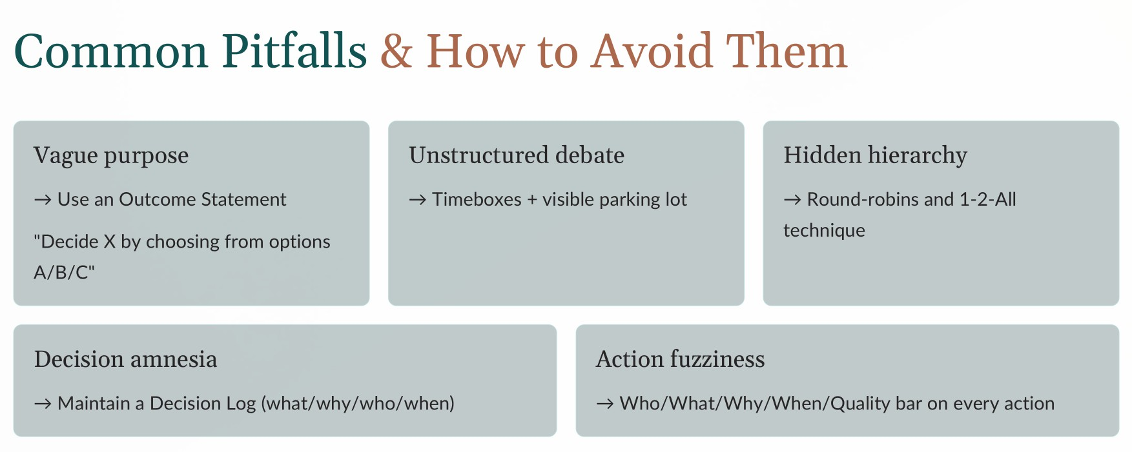

Slide 4
Activity 1 – Meeting Autopsy
In trios (15 minutes):
Pick a recent meeting
Diagnose pitfalls (8 min)
Redesign meeting (5 min)
Share insights (2 min)
Ask yourself:
"Where did purpose drift occur?"
"What single change would double ROI?"
Deliverable: Re-engineered agenda + success metric

Slide 5

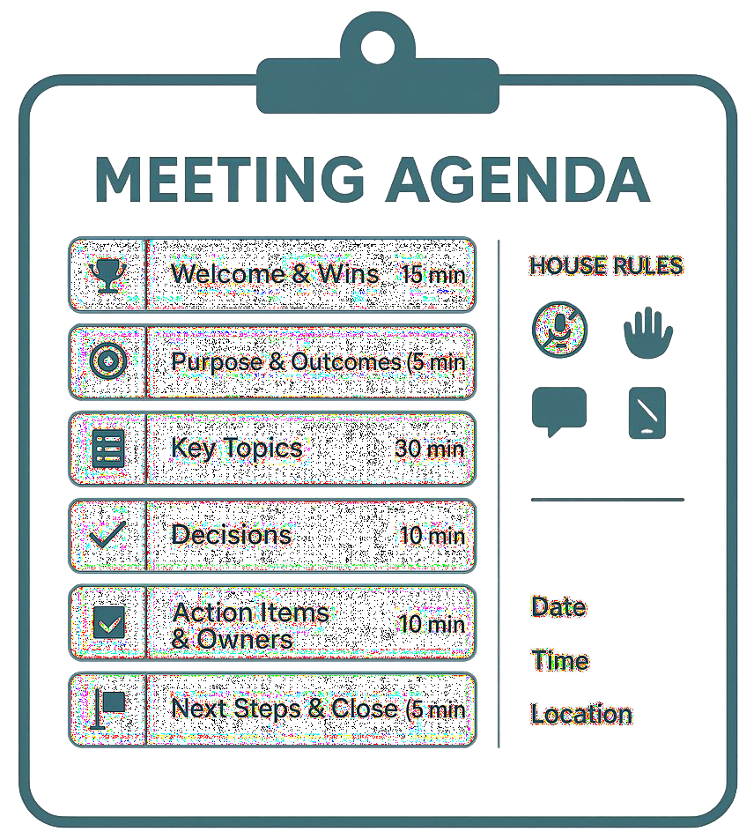

Designing Outcome-Driven Agendas
Open
Purpose, outcomes, norms, roles (2 min)
Context
Data, pre-reads distilled (timeboxed)
Diverge
Idea generation (round robin/1-2-All)
Converge
Decision framework (DACI/RAPID)
Close
Decisions, actions, owners, next checkpoints

Slide 6
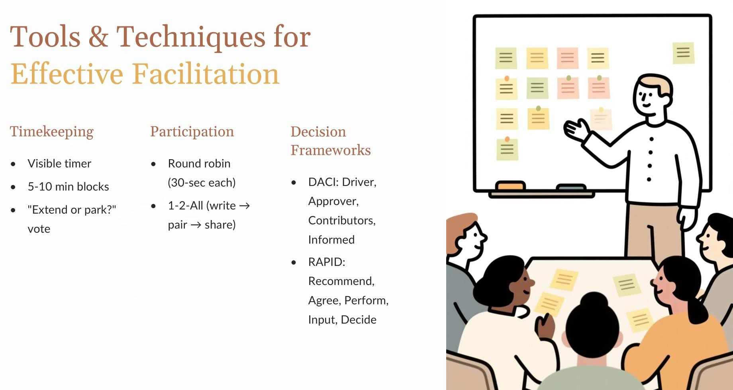

Slide 7
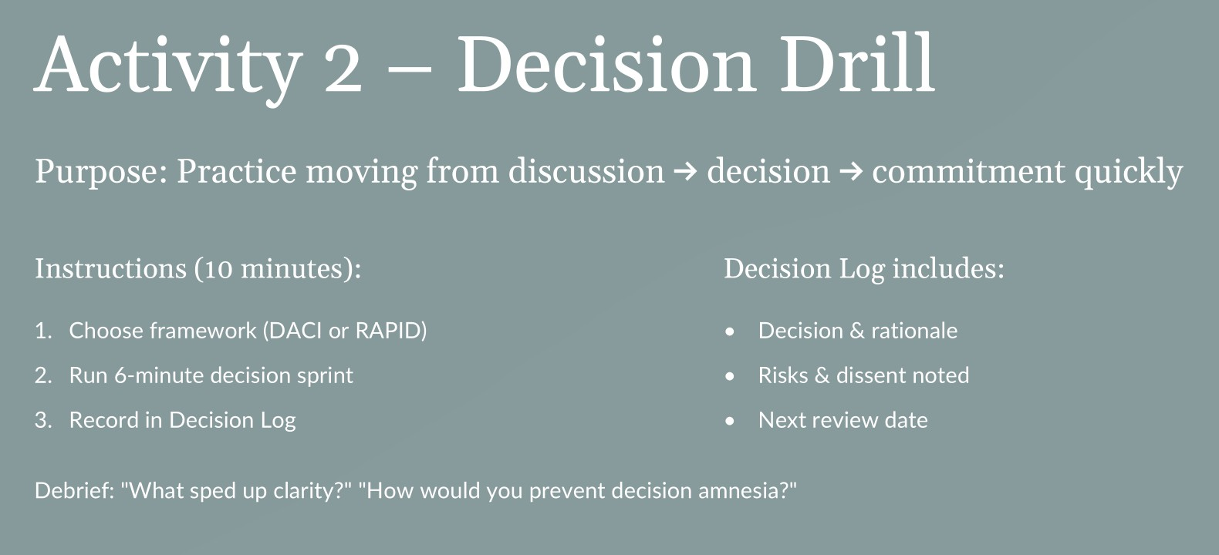

Slide 8

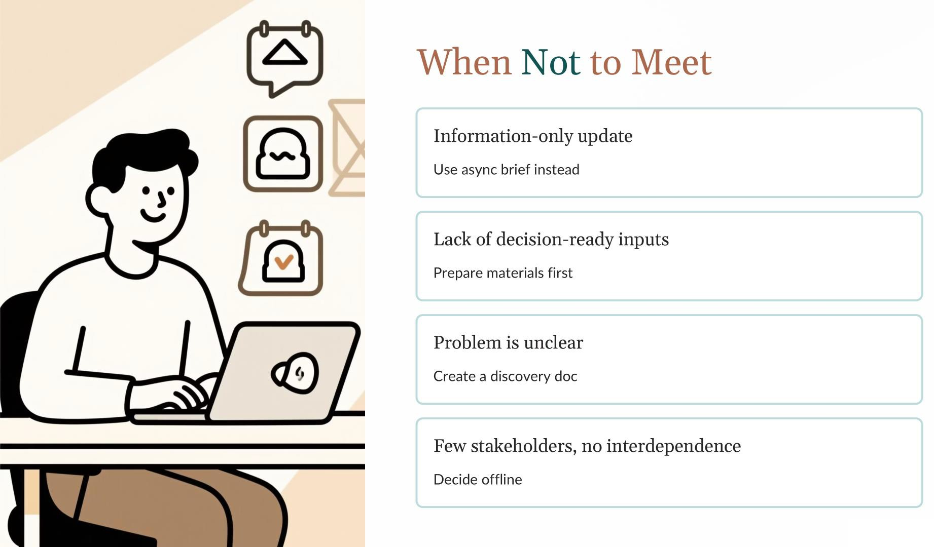

Slide 9
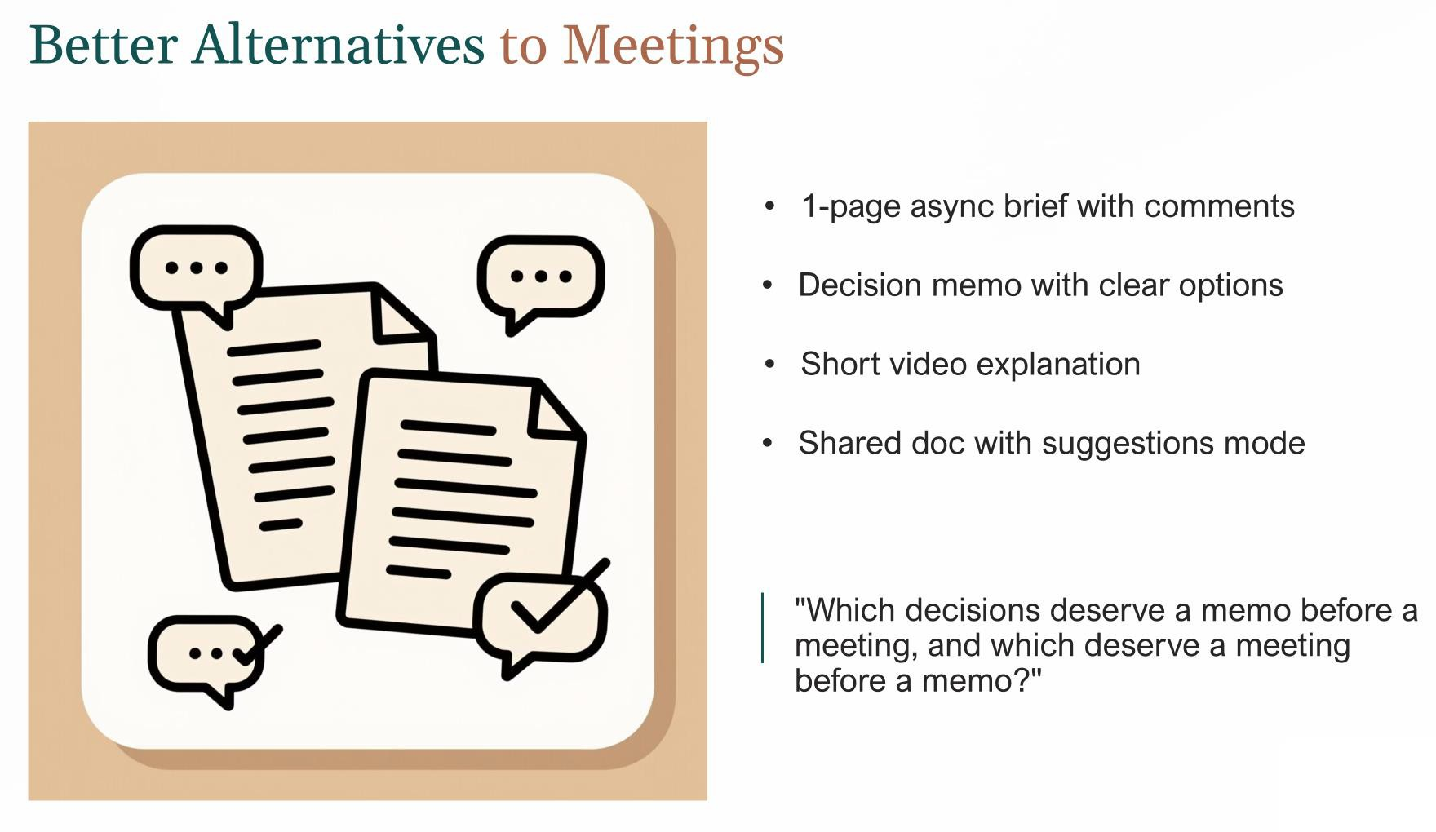

Slide 10
