Slide 1



In aging services,
progress
is never
made
2026 Fall Conference
August 25-26, 2026
alone.

Slide 2

Hostility, Heart, and Harmony
BENEATH THE SURFACE…
By, Debbie Carriveau, RN,C., QMCP, CDP
Hubbard Hill Living Wisdom Community

Slide 3
The Paradigm Shift…
  Reframing our thinking and how we see BEHAVIORS…
  Moving away from “difficult and disruptive
  symptoms” to “wordless communication”

Slide 4

The Iceberg Analogy
Surface: aggression, agitation, hoarding, resistance
Subsurface: Fear, loneliness, pain, loss of control

Slide 5
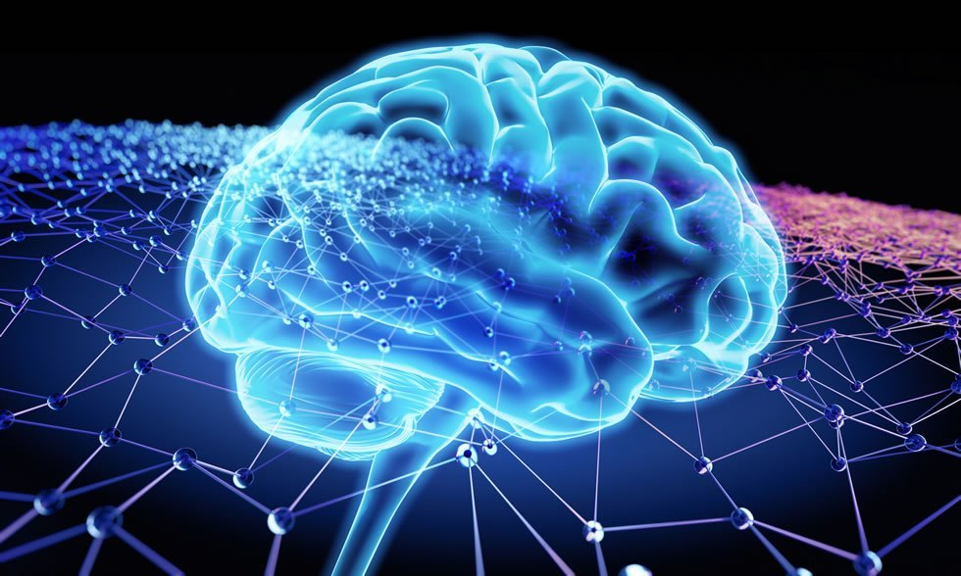
Understanding the
Dementia BRAIN in CRISIS
  Amygdala (The Emotional Center)
  Vs. Prefrontal Cortex (The Thinking Center

Slide 6
What’s happening?
  Amygdala:
  Controls primitive emotions Handles logic, planning, self control.
  Fear, anger, survival instincts.
  Fires up immediately during danger.
  Reacts to ANY perceived threat.
  Overreacts when damaged by trauma or disease.
  Prefrontal Cortex
  Handles logic, planning, self control.
  Calms down the emotional center.
  Weakens under high stress or brain damage.

Slide 7
Connection to how I respond…..
  Severe STRESS or any perceived THREAT….(real or not) locks the dementia brain into SURVIVAL MODE (“Fight or Flight”)
  Their emotional center stays in a perpetual state of HIGH ALERT
  Their logical thinking center SHUTS DOWN, making it extremely hard to calm fears or rely on memory or any kind of recall.
  Without their thinking center working well, they experience loss of control and the emotional center is dominant and takes over.
  That shift leads to sudden anger, fear, confusion, distress, and the need to protect and defend myself.

Slide 8
How to recognize an approaching crisis BEFORE it
happens…Stop, look, listen.
  Signs of an escalating individual or situation:
  Increasing restlessness
  Increasing speed of pacing or rocking
  Jumpiness or hyper alertness
  Aggressive wandering
  Irritability and intolerance
  Shakiness
  Flushing/sweating
  Complaining and criticizing
  Swearing or inappropriate language, name calling
  Emotional outbursts or strange noises

Slide 9
Additional signs of escalation:
  Harming myself somehow (scratching, digging, pinching myself, biting myself, ripping or shredding my clothing).
  Kicking things or throwing food, liquids, items in environment.
  Resisting help or care
  Destroying things in the environment.
  Slamming doors or physical things in the environment.
  Being physically disruptive in order to illicit constant attention.
  Pushing or shoving physical items.
  Repetitive questions or statements.

Slide 10
How to respond to escalation before it’s a crisis…
  Stay calm and use a soft slow voice.
  Very gentle touch to help the person feel safe.
  Validate whatever they are feeling and let them talk about it.
  Avoid arguing and try and simplify surroundings as much as possible.
  Offer simple choices and try and redirect their attention onto something different that you know typically brings comfort.
  Simplify the words you use.
  Slow down your movements.
  Keep your hands visible and open.

Slide 11
Crisis is here…Now what?
15 Steps to deescalate
Remove the threat, whomever or whatever that is perceived to be.
Portray, “I am on your side”. Use a calm, clear, neutral voice.
Give/create space. Step back. Remove too many people. Don’t corner or box them in.
Act in the person’s defense with others involved. Trust in you is critical.
Lower your stance, get at or below this person’s eye level, off to the side, not directly in front. Eye to eye is interpreted as confrontational.
Keep your body posture open and hands visible, offer an open flat hand for the person to take, if they take it, maintain a hand under hand position to give you control.

Slide 12
In the moment continued….
  7.Give the person in crisis a visually perceived “way out”. Acknowledge their feelings. Be respectful and non-judgmental.
  8.Begin taking deep audible breaths aloud, you’re trying to sync their breathing to yours in response. Physically move your body in rhythm with your breathing. Lowers heartbeat, B/P..
  9. The HUH positions automatically applies gentle pressure to the person’s palm, which has a calming effect on the person’s whole sensory system.
  10. Move slowly and deliberately. Continue to lower the volume and slow the cadence of your voice, this helps the other person slowly calm down as well.

Slide 13
In the moment continued….
  11. Gradually relax your body and posture from being in a defender position to a relaxed friend stance now.
  12. Once the person is calmed you can now assist them to do what you need them to or take them where you need them to go because you’ve established yourself as someone safe.
  13. Explain anything you’re going to do or how you’re going to move so there is no surprise for that person.
  14. Try to identify “in this moment” what needs does this person have and meet those immediately.
  15. Stop trying to explain, use logic, or reason.

Slide 14
Truths to REMEMBER…
  Responding early reduces the likelihood of physical violence or injury.
  DON”T WAIT! Act when you first start to see signs of escalation in individuals.
  If you cannot emotionally self-regulate in a crisis then stay away.
  Practice “pro-active awareness” DAILY. Pay attention. Know your people.
  They will always be your emotional weather vane.
  Acknowledge the feelings behind what I’m saying or doing.
  MATCH my emotion not my volume. Use low stimulus communication. Lower the emotional temperature.
  Non-verbal communication in de-escalation speaks way louder than words.
  You set the tone- you can either calm or inflame.

Slide 15
Resident to resident altercations….
  Utilize all the same de-escalation techniques as soon as you detect signs of escalation. ACT EARLY…RESPOND DON”T IGNORE.
  If crisis occurs and altercation happens :
  Separate the two residents from each other immediately. Use the crisis interventions we learned but utilizing two staff with each person individually.
  If a second staff person is unavailable in the moment, then distract whichever person you can with crisis interventions and calmly walk one away using HUH technique and try and further calm. Primary focus is separating the two so it does not further escalate into physical assault or injury.

Slide 16
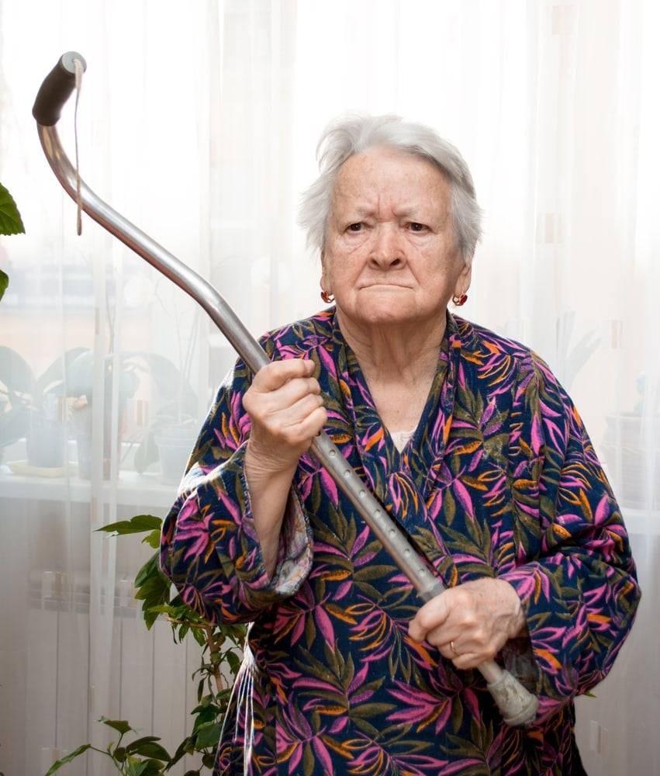
Role Plays…Let’s practice
  Scenarios:
  The Dining Room clash! (Martha and Arthur)
  The Hallway Blockade! (James and CNA)
  3. The Morning Shower Stand-off! (Helen and CNA)
This Photo by Unknown Author is licensed under CC BY-NC-ND

Slide 17
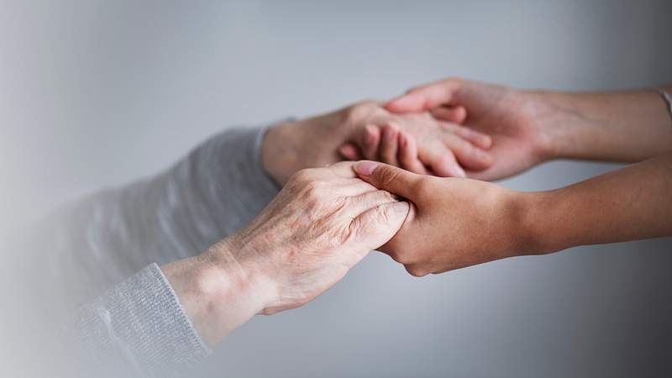
CONCLUSION
De-escalating a crisis situation is not easy. It can be heart wrenching and scary to watch. It can leave you feeling helpless.
But by paying attention to those you care for, by recognizing their signs of distress, by being responsive and acting early there are things you can do to help avert a crisis situation.
It requires those of us called to serve those with dementia, to look below the surface and identify the feelings underneath.
Hostility, Heart, and Harmony all lie there, our calling is to guide those we care for through them safely and with love.

Slide 18
Dementia is a complex disease, that has a major impact on all those affected by it, as patients, families and carers. People with dementia deserve to be treated with respect and love, remembering that they are made in God’s image and remain part of God’s family no matter how cognitively impaired they may become. Their core personhood, which God created in them, continues to exist. We are called to be the bridge between that core and the reality in which they now exist. Whenever we meet someone who is vulnerable, such as someone with dementia, we are meeting someone precious to God; let’s be sure not to turn them away!
Look. Listen. Respond.

Slide 19
THANK YOU

