Slide 1



Turning BenchMarks into Action
Leading from an Entrepreneurial Mindset
Leading Age Indiana Fall Conference
August 25, 2026

Slide 2








The
EOS
Model

Slide 3
The
EOS
Model
100%
Goal
80%
0%

Slide 4
The
EOS
Model
100%
Most
20%
0%

Slide 5


The
EOS
Model
8 Questions
Shared by All
100% Strong

Slide 6
Vision
Corporate Vision
KPI
Site Vision
Is the KPI just a number?
Is there a roadmap to achieving The Kpi?
Department Vision
Does it even reach ouR line staff?

Slide 7
The
EOS
Model
Right People
Right Seats
100% Strong

Slide 8
People
Corporate
Culture
Hiring guidelines
Site
Site culture may not match corporate
How do we measure success?
Department
culture may not match site or corporate
Are we hiring to fill a spot

Slide 9
The
EOS
Model
Scorecard
Measurables
100% Strong

Slide 10
Data
Corporate
Reports and Dashboards
Site
IS the report a task?
Do we look at the dashboard?
How does the data impact the site?
Department Vision
Is there discussion of how the day to day impacts the data?

Slide 11
The
EOS
Model
100% Strong
Issues List
IDS™

Slide 12
Issues
Corporate
Often Little to no feedback unless there are legal or regulatory implications
Site
Are we routinely engaging for feedback?
Incident reports
Quarterly mandatory meetings
  In
Department
Are we listening to those who are living in the framework we are constructing?

Slide 13
The
EOS
Model
100% Strong
Documented
20/80
Followed
by All

Slide 14
Process
Corporate
Policies and procedures
Regulations
Site
Processes around policies and procedures
Regulations and surveys
Department
How we actually do it
Does it actually work for those performing the task and for those being served?

Slide 15
The
EOS
Model
100% Strong
Rocks
Meeting Pulse

Slide 16
The
EOS
Model
8 Questions
Shared by All
Right People
Scorecard
Right Seats
Measurables
Issues List
Documented
IDS™
Followed
by All
Rocks
Meeting Pulse

Slide 17
EOS Foundational Tools
V/TO™ of Vision/Traction Organizer
Accountability Chart™
Rocks
Meeting Pulse™
Scorecard

Slide 18
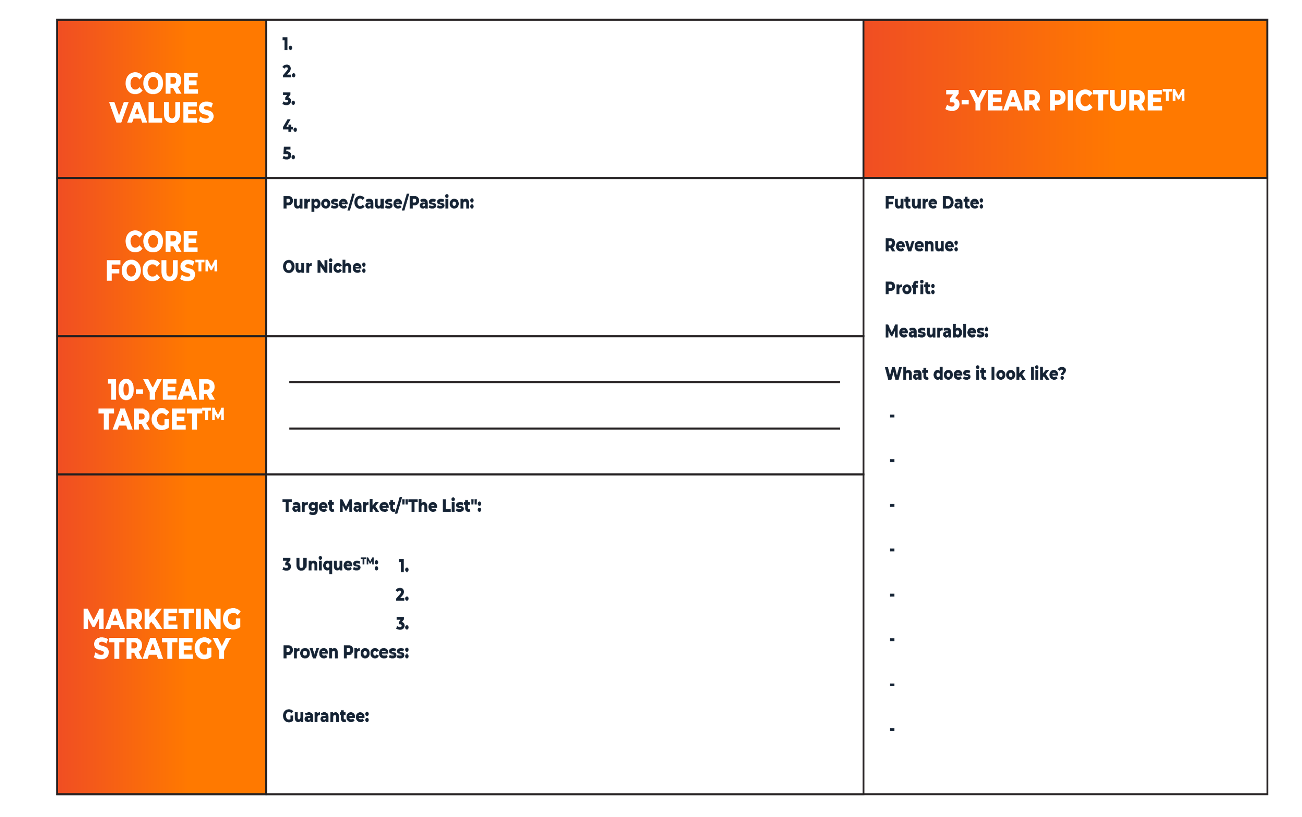
The Vision/Traction Organizer™

Slide 19
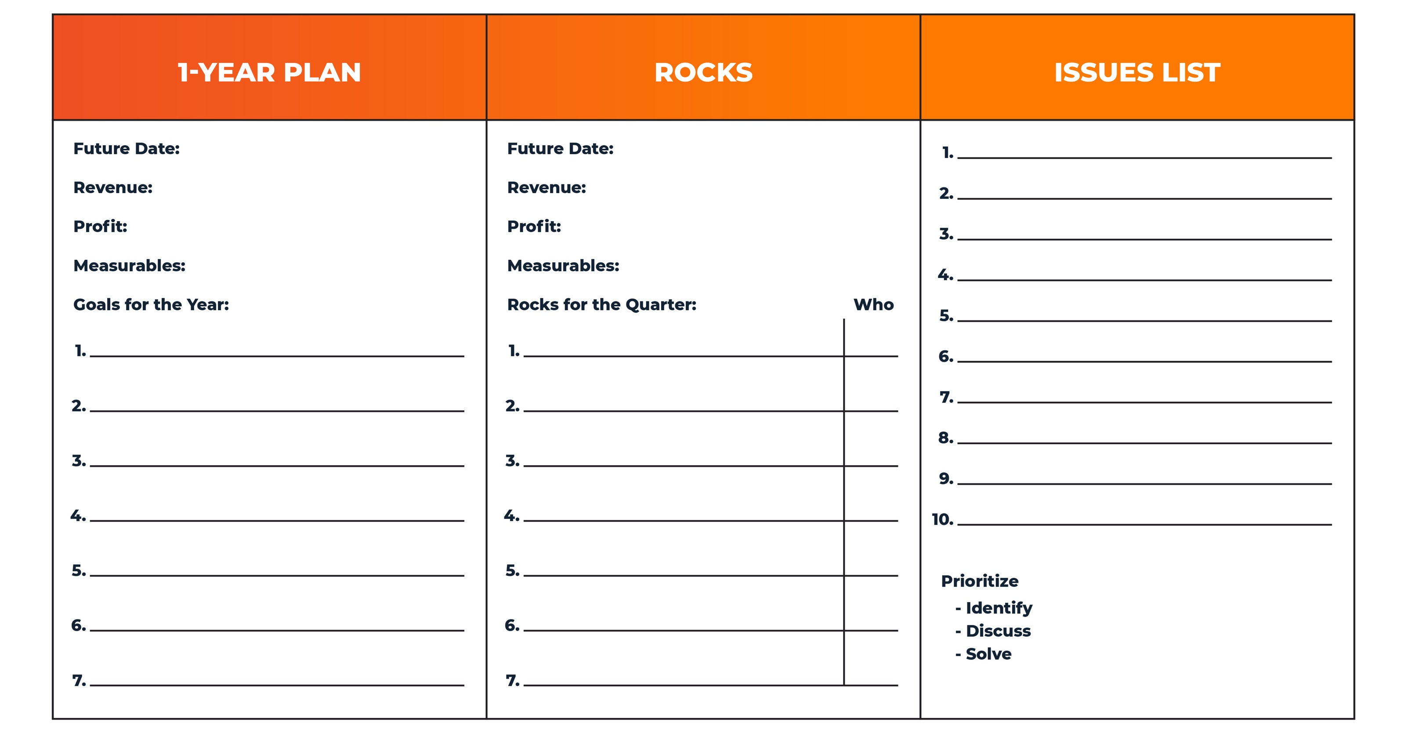
V/TO™

Slide 20
Intentional application
Core mission, vision and Values
  Development in strategic or annual planning
  Quarterly Assessment in QA Meetings
One year picture may be more appropriate for some organizations
Core focus should be a bridge between corporate kpi and site operations

Slide 21
Intentional application
One year picture may be more appropriate for some organizations
Ten Year Target may need to be scaled to 5 year depending on the tenure of your leadership and use of strategic planning
Marketing Strategy – This can reflect internal and external marketing

Slide 22
The Accountability Chart™
VISIONARY
20 Ideas
Creativity/Problem Solving
Big Relationships
Culture
R&D
INTEGRATOR™
Lead, Manage, Accountability (LMA)
Profit & Loss / Business Plan
Remove Obstacles & Barriers
Special Projects
MARKETING/SALES
OPERATIONS
FINANCE
LMA
Sales/Revenue Goal
Selling
Marketing
Sales & Marketing Process
LMA
Customer Service
Process Management
Making the Product
Providing the Service
LMA
Accounting
Reporting
IT
HR/Admin

Slide 23
The accountability Chart
Visionary
This may be corporate or the site Executive Director
Integrator
May be the Executive Director or the Department director
Departments
May be departments or employee groups within a department

Slide 24
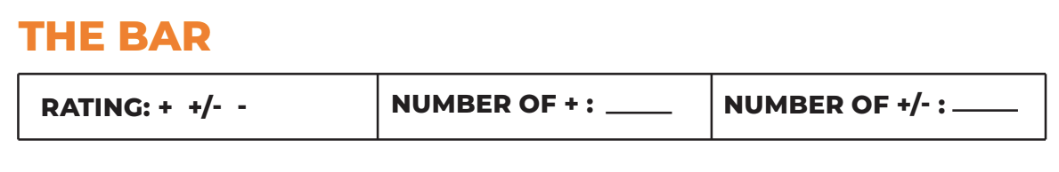
The People Analyzer™
GETS IT
WANTS IT
VALUE
CAPACTIY
VALUE
VALUE
VALUE
VALUE
VALUE
VALUE
Maria Rodriguez
John Smith
George Wilson
THE BAR

Slide 25

Rocks
“Focus”—Al Reis
Rocks, pebbles, sand, water,
and glass jar
3–7 (less is more)
The Harris Poll®
90-Day World™
Discuss and debate

Slide 26

Level 10 Meeting™
Good News 5 Minutes
Scorecard 5 Minutes
Rock Review 5 Minutes
Customer & Employee Headlines 5 Minutes
To Do List 5 Minutes
Issues List/IDS 60 Minutes
Conclude 5 Minutes
Reporting Only

Slide 27
Level 10 Meeting
Should follow all required report submissions or data base updates
  Department meetings should precede reports and database updates
  Inclusion at the end of daily or weekly standup meetings
Come Prepared
  Department specifics for Rocks, To Dos and Issues
Do not cover up what you have not completed or achieved

Slide 28
Company ScoreCard
WHO
MEASURABLES
GOAL
30
-
Sep
7
-
Oct
14
-
Oct
21
-
Oct
28
-
Oct
4
-
Nov
11
-
Nov
18
-
Nov
25
-
Nov
2
-
Dec
9
-
Dec
16
-
Dec
23
-
Dec
Anne
Weekly Revenue
>=$84,500
$92,000
$85,238
$81,200
$80,934
$88,678
$88,200
$85,321
$80,282
$95,291
$100,281
$86,200
$78,290
$83,498
Anne
Cash Balance
>=$14,245
$16,230
$15,200
$12,289
$11,989
$14,980
$15,123
$14,989
$11,291
$17,281
$18,359
$15,289
$10,221
$11,189
Robert
Sales Calls
50
54
55
61
59
32
48
51
72
61
54
50
52
54
Robert
Sales Meetings
10
10
10
10
8
10
10
12
11
15
10
9
8
8
Robert
Proposal
5
5
5
6
5
6
5
6
4
5
8
6
5
5
Robert
Closed Business
2
2
3
6
3
2
3
5
3
2
1
2
8
4
David
Customer Satisfaction
>=80%
80%
80%
80%
80%
80%
80%
80%
80%
80%
80%
80%
80%
80%
Claire
Accounts Payable
<$8,000
$8,450
$9,234
$3,450
$5,500
$4,300
$8,900
$2,300
$5,409
$4,390
$9,032
$3,445
$2,300
$5,009
David
Errors
<=4
3
2
2
2
2
1
2
3
0
0
0
2
1
John
Utilization/Capacity
>75%
75%
76%
75%
75%
75%
75%
75%
82%
75%
75%
78%
75%
75%

Slide 29
The scorecard
At the site level
  Measurable department benchmarks that work to achieve site and corporate goals
  Accountability at the department level
  Celebrate success and support misses
At the department level
  Measurable and achievable benchmarks for each employee
  Reward those achievements publicly

Slide 30
EOS Foundational Tools
V/TO™
Accountability Chart™
Rocks
Meeting Pulse™
Scorecard

Slide 31
For More Information
Bob Fasick,
EOS Implementer
Bob.Fasick@EOSworldwide.com
LaChele Henkle Weaver, HFA, MBA
CEO, Luminary Senior Living,
INALA Board Chair
LaChele.Weaver@LuminarySeniorLiving.com

