Slide 1


Unintentional Weight Loss in Older Adults
Lorinda Babb, PharmD, BCGP
  Clinical Manager
    April 2026

Slide 2
CVS Health Policy Statement
All CVS Health presentation materials are confidential and proprietary and
may not be copied, distributed, captured, printed or transmitted (in any
form) without the written consent/authorization of Omnicare.

Slide 3
Agenda
Understand
how unintentional weight loss (UWL) is defined and monitored
Identify
potential causes of UWL
Recognize
potential nonpharmacological and medication treatment options for UWL

Slide 4
Defining Unintentional Weight Loss (UWL)
Usually defined as losing greater than or equal to 5% of body weight in a 6-to-12-month period without meaning to
Body Mass Index (BMI) of less than 18.5 kg/m² is considered “underweight”
Gaddey H et al. Unintentional weight loss in older adults. Am Fam Physician. 2021; 104(1):34-40.

Slide 5



Evaluation of UWL in Older Adults
Could a medication
(newly started or
long-term) be
the cause?
Checking weights consistently is the
best way to identify and monitor UWL
Assess for changes
in eating and
dietary habits
Wasserman MR. Involuntary weight loss. Merck Manual Professional Version. 2023 Feb.

Slide 6
Causes of Unintentional Weight Loss (not all-inclusive)
Medications
Mental health/ Emotions
(e.g., depression)
Swallowing Problems
Dental Problems
(e.g., broken teeth)
Difficulty Eating
(e.g., tremor)
Constipation
May Cause UWL
Other Conditions
(e.g., Cancer)
Infections
Gaddey H et al. Unintentional weight loss in older adults. Am Fam Physician. 2021; 104(1):34-40..

Slide 7
Medications that may cause UWL (not all-inclusive):
Adverse Effect | Medication Class and Examples
Anorexia or Changes in appetite | Glucagon-like peptide 1 (GLP-1) agonists: Trulicity (dulaglutide), Ozempic (semaglutide) Opioid analgesics: codeine, hydrocodone, oxycodone, tramadol Selective serotonin reuptake inhibitors (SSRI): escitalopram, fluoxetine, sertraline
Changes in sense of taste | Antibiotics: amoxicillin, azithromycin, ciprofloxacin Statin drugs: atorvastatin, pravastatin, rosuvastatin Angiotensin-converting enzyme (ACE) inhibitors: benazepril, enalapril, lisinopril
Gaddey H et al. Unintentional weight loss in older adults. Am Fam Physician. 2021; 104(1):34-40.

Slide 8
Medications that may cause UWL (not all-inclusive):
Adverse Effect | Medication Class and Examples
Dry mouth | Anticholinergics: darifenacin, oxybutynin, solifenacin, tolterodine, trospium Antihistamines: cetirizine, desloratadine, diphenhydramine, fexofenadine, hydroxyzine, levocetirizine, loratadine
Nausea and vomiting | Antibiotics: azithromycin, cephalexin, clindamycin, levofloxacin Medications for Parkinson’s disease: levodopa, pramipexole, ropinirole
Gaddey H et al. Unintentional weight loss in older adults. Am Fam Physician. 2021; 104(1):34-40.

Slide 9
Treatment Options

Slide 10
Nonpharmacological Treatments for UWL: The First-Line Option
Treatment Approach | Potential Actions to Take
Consider Resident’s Individual Needs | Determine their likes and dislikes Consider cultural and religious expectations Care for the resident’s oral hygiene Provide feeding assistance, if appropriate Consider consultation with dietician
Offer Appealing Foods | Pay attention to color, texture, consistency and temperature Use herbs and spices to provide extra flavor Nutritional supplements may be required
Create a Positive Dining Atmosphere | Promote a social environment by sitting people together Furnish eating area with comfortable seating Give residents enough time to finish their meal
Nutrition and Weight. American Geriatrics Society. Retrieved from https://geriatricscareonline.org/application/content/products/B007/pdf/Nutrition_and_Weight.pdf

Slide 11
Medication Management in UWL
No medication has been approved by the FDA for general UWL
There is a lack of evidence demonstrated with medication treatments; serious adverse reactions are also possible.
Medication therapy may be considered an option if:
  Appropriate non-medication treatment measures were attempted
  The resident is comprehensively assessed
  The prescriber weighs that the potential benefits of the new medication outweigh the risks
FDA: Food and Drug Administration

Slide 12
Medication Options for UWL
          Mirtazapine (Remeron®)
          Dronabinol (Marinol®)
  Drug class: Antidepressant
  Evidence does not support use if depression is not also present
  May cause sedation, dry mouth
  Use with caution in those with liver or kidney disease
  Drug class: Cannabinoid
  Approved for anorexia in individuals with AIDS, but safety and efficacy for general older adult population not established
  May cause nausea, dizziness, somnolence, and headache
Please refer to the individual prescribing information at https://dailymed.nlm.nih.gov/dailymed/

Slide 13
Medication options for UWL (continued)
          Megestrol acetate (Megace®)
  Drug class: Progestin
  No demonstrated improvement in survival or quality of life for residents with UWL
  The AGS Beers Criteria strongly warns against use of megestrol in this setting due to risk of death from developing dangerous blood clots
AGS: American Geriatrics Society
American Geriatrics Society 2023 updated AGS Beers Criteria. JAGS. 2023.
Please refer to the individual prescribing information at https://dailymed.nlm.nih.gov/dailymed/
13
©2025 CVS Health and/or one of its affiliates: Confidential & Proprietary. This is provided for informational and reference purposes only and is based on cited sources as existing at the time of review. It does not constitute medical, legal, or regulatory advice and is not a substitute for individualized assessment and treatment by an appropriate medical provider.

Slide 14

Everyone Can Help Prevent Unintentional Weight Loss
Admissions
  Obtain accurate history of previous weights and chronic conditions
Administrator and
Director of Nursing
  Policies and procedures, reporting, quality assurance
Nursing and Other
Front-Line Staff (e.g., CNA)
  Communicate changes in eating habits or health conditions
Pharmacists
  Identifying medications that may potentially cause unintentional weight loss
Dieticians
  Assist with personalized plans to prevent weight loss based on individual factors
Providers (e.g., Physicians, NPs)
  Diagnosis of conditions that may potentially cause unintentional weight loss
CNA: Certified Nursing Assistant; NP = Nurse Practitioner

Slide 15

Addressing Depression in Long-Term Care

Slide 16
Agenda
Recognize the negative impact, risk factors, and symptoms of depression in older adults
Identify non-pharmacological options to potentially reduce symptoms of depression in older adults
Understand pharmacological treatment options to reduce symptoms of depression in older adults

Slide 17
Negative Outcomes of Depression
Poorer Quality of Life
  Loss of pleasure in activities
  Sad, irritable, or anxious
  Cognitive impairment
Higher Mortality-Rate
  Cardiovascular death
  Suicide
  All-cause mortality
Older adults may falsely
believe that it is normal for people to get depressed as they get older
CDC Healthy Aging. Depression and aging. https://www.cdc.gov/healthy-aging/about/depression-aging.html#:~:text=Older%20adults%20often%20face%20health,from%20the%20symptoms%20of%20depression
Jha MK et al. Screening and management of depression in patients with cardiovascular disease: JACC state-of-the-art review. J Am Coll Cardiol. 2019; 73(14):1827-1845.
Mental Health America. Depression. https://mhanational.org/conditions/depression/
Clinical Geriatrics | ©2025 CVS Health and/or one of its affiliates. Confidential and proprietary. This is provided for informational and reference purposes only and is based on cited sources as existing at the time of review. It does not constitute medical, legal, or regulatory advice and is not a substitute for individualized assessment and treatment by an appropriate medical provider.

Slide 18
Risk Factors for Depression
Female
Personal or family history of depression
Socioeconomically disadvantaged
Mental and physical impairments
Major life changes, trauma, or stress
Chronic illness and certain medications
Social isolation, loneliness, and abuse are leading risk factors for poor mental health in adults aged 60 and older.
CDC Healthy Aging. Depression and aging. https://www.cdc.gov/healthy-aging/about/depression-aging.html#:~:text=Older%20adults%20often%20face%20health,from%20the%20symptoms%20of%20depression
Mental Health America. Depression. https://mhanational.org/conditions/depression/
National Institute of Health topics: Depressionhttps://www.nimh.nih.gov/health/topics/depression
World Health Organization. Mental health of older adults. 2023.

Slide 19
Medications That Cause Or Worsen Depression*
    ACEI/ARB
    (e.g., lisinopril, valsartan)
    Benzodiazepines
    (e.g., alprazolam, lorazepam)
    Beta blockers
    (e.g., propranolol)
    Corticosteroids
    (e.g., prednisone)
    Opioids
    (e.g., hydrocodone, tramadol)
Anticonvulsants
(e.g., topiramate, gabapentin)
    PPI
    (e.g., omeprazole, esomeprazole)
Varenicline
* Not all-inclusive
ACEI = angiotensin converting enzyme inhibitor; ARB = angiotensin receptor blocker; PPI = proton pump inhibitor
Prescribing information obtained from DailyMed.
Qato DM et al. Prevalence of prescription medications with depression as a potential adverse effect among adults in the United States. JAMA. 2018; 319(22):2289-2298.

Slide 20
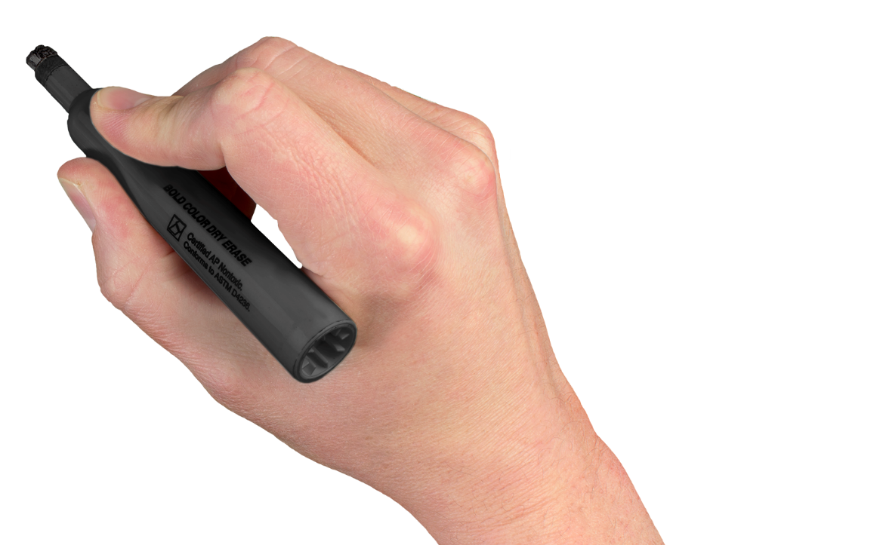
THOUGHTS OF SUICIDE
WORTHLESSNESS
FATIGUE
SLEEP CHANGES
LOSS OF PLEASURE IN ACTIVITIES
POOR SELF-CARE
APPETITE CHANGES
SYMPTOMS
WEIGHT CHANGES
WORRYING
CRYING
SLOW MOVEMENTS
IRRITABILITY
SELF-ISOLATION
SADNESS
PROBLEMS CONCENTRATING / PSEUDO-DEMENTIA
SLOW THINKING
Mental Health America Depression in Older Adults: More Facts https://www.mhanational.org/depression-older-adults-more-facts#2

Slide 21
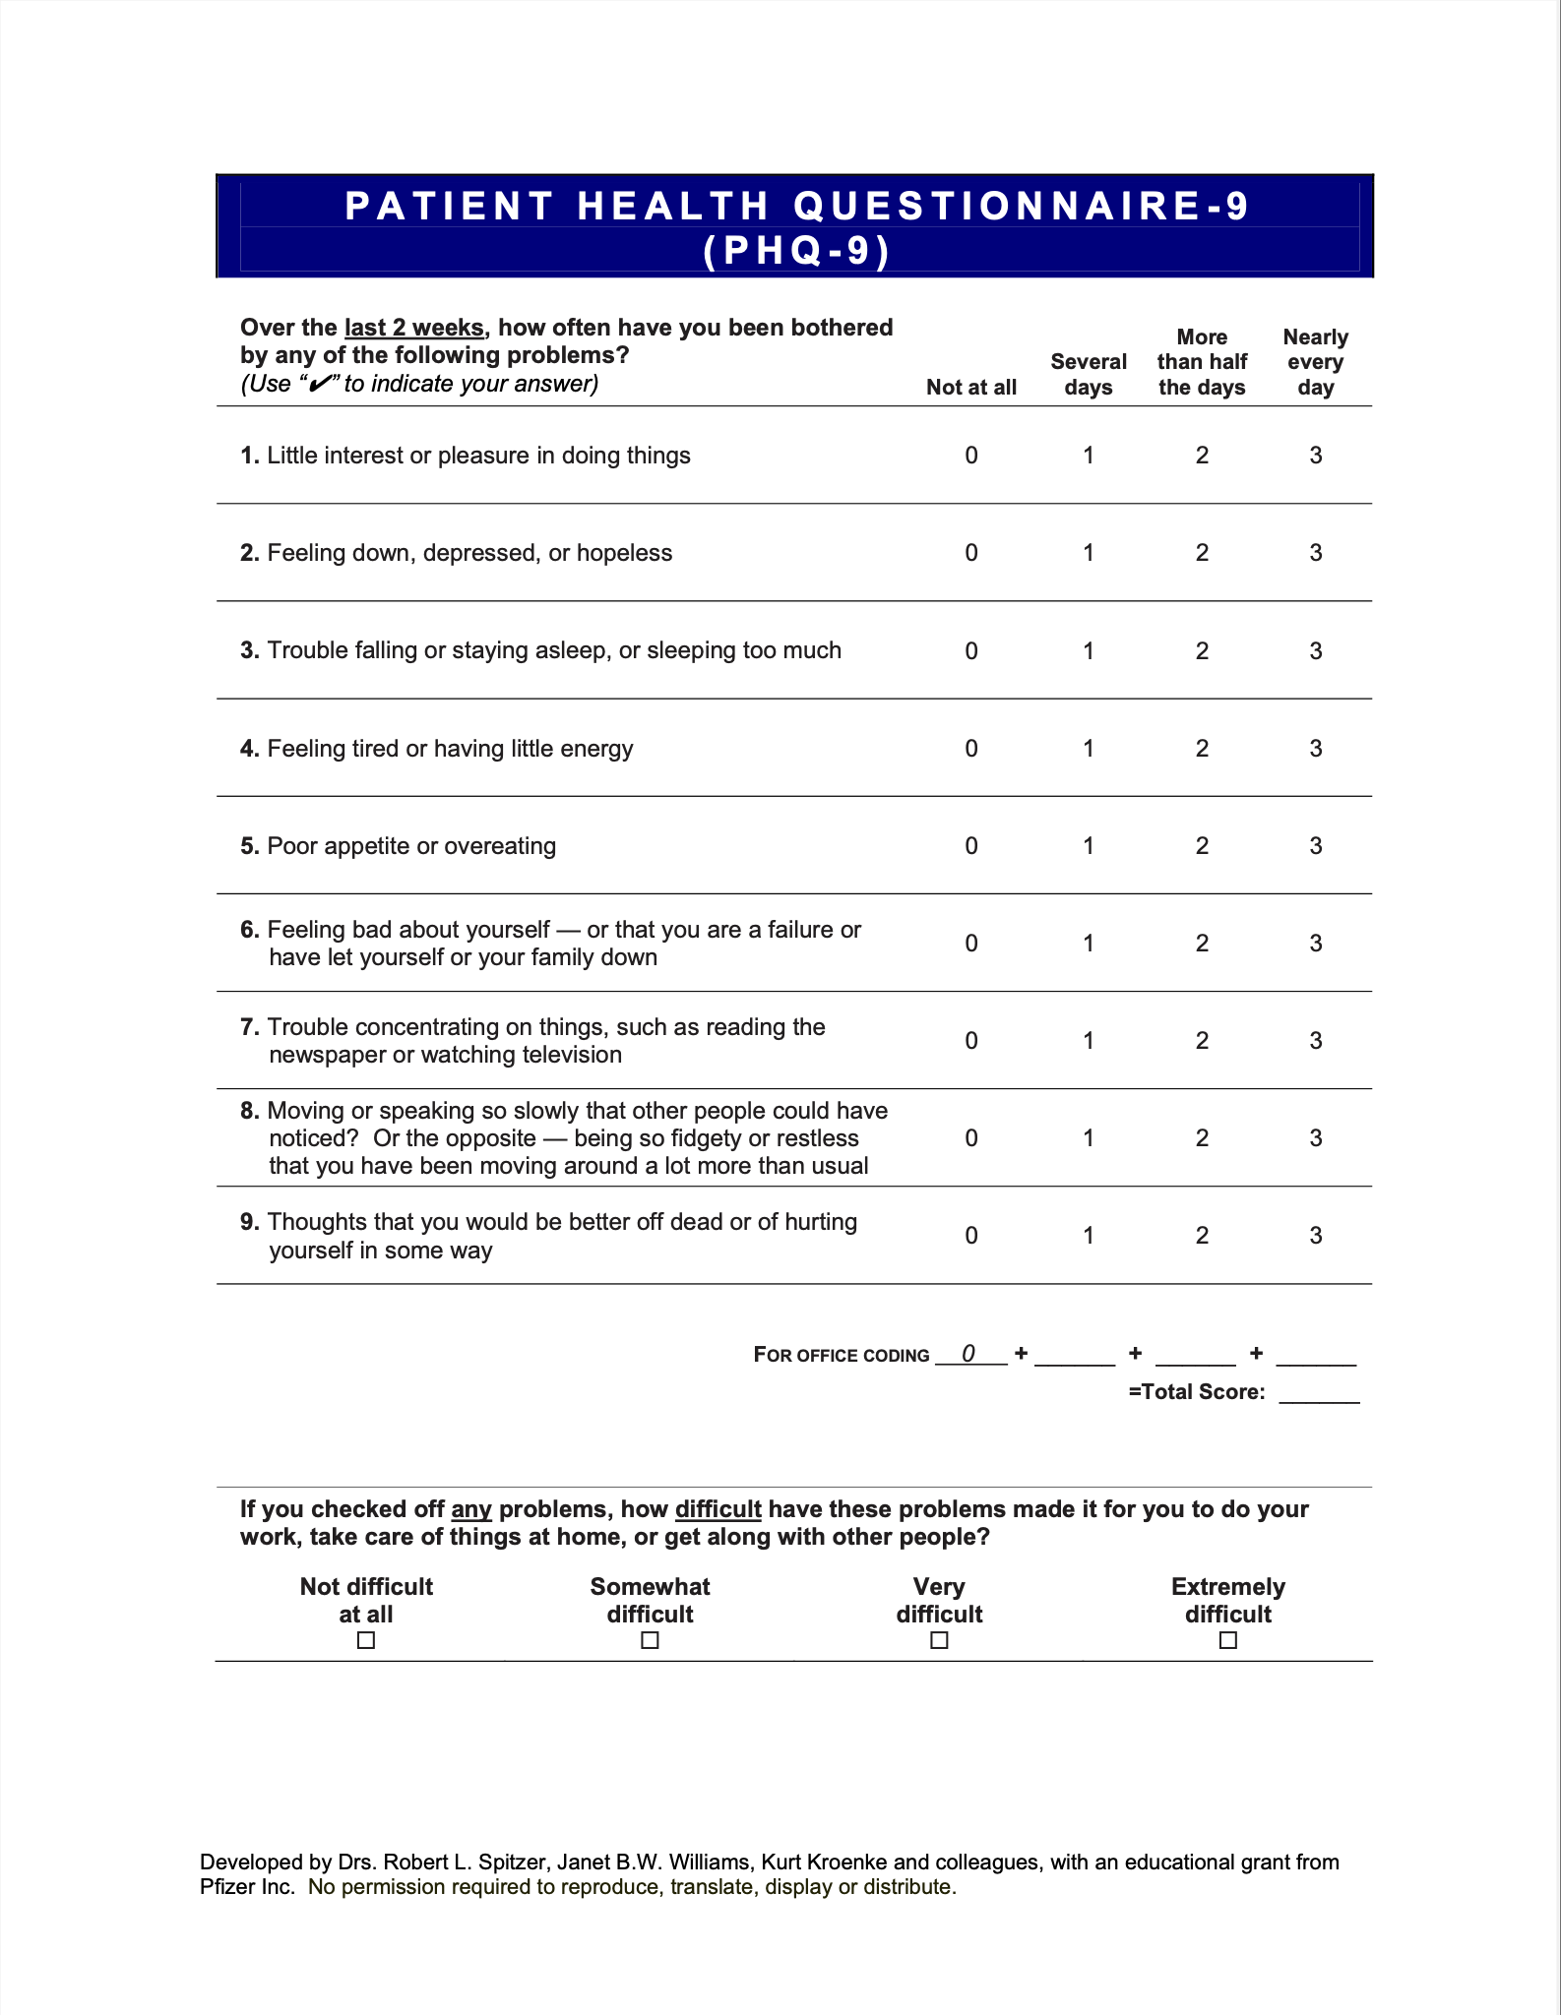

Tools That Screen for Depression Symptoms
PHQ-9 Questionnaire
A series of questions covering the individual’s mood over the last two weeks.
  Symptom presence and frequency
  Measure's severity of depression
Patient Health Questionnaire 9 https://www.apa.org/depression-guideline/patient-health-questionnaire.pdf

Slide 22
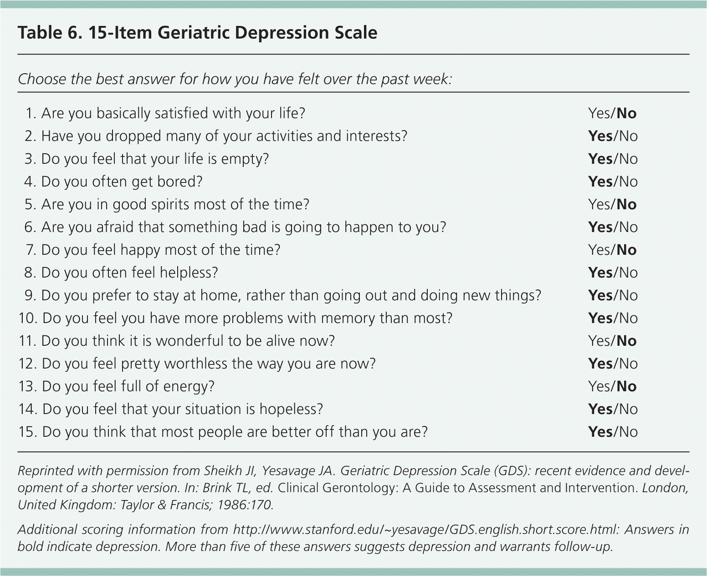
Tools That Screen for Depression Symptoms
Geriatric Depression Scale
  A series of yes and no questions about an individual’s mood over the last week.
  Long and short version
https://integrationacademy.ahrq.gov/sites/default/files/2020-07/Update_Geriatric_Depression_Scale-15.pdf
Clinical Geriatrics | ©2025 CVS Health and/or one of its affiliates. Confidential and proprietary. This is provided for informational and reference purposes only and is based on cited sources as existing at the time of review. It does not constitute medical, legal, or regulatory advice and is not a substitute for individualized assessment and treatment by an appropriate medical provider.

Slide 23
Non-Pharmacological Treatment

Slide 24
Non-Pharmacological Therapies
Psychotherapy
Cognitive-behavioral therapy, support groups
Activities
Games, gardening, art, baking, exercise, animal therapy
Personalize living spaces and surroundings
Pictures, music, colors and
textures, plants
Promote socialization
Family & friends, spiritual groups, book clubs,
card games
Electrical or magnetic stimulation
Reserved for
more severe cases of depression
Mental Health America https://www.mhanational.org/depression-older-adults-more-facts#2
National Institute of Mental Health https://www.nimh.nih.gov/health/topics/depression
Marvanova M, McGrane IR. Treatment Approach and Modalities for Management of Depression in Older People. Sr Care Pharm. 2021 Jan 1;36(1):11-21. doi: 10.4140/TCP.n.2021.11.. PMID: 33384030.

Slide 25
Pharmacological Treatment

Slide 26

Pharmacological Treatment
  Selective serotonin reuptake inhibitors (SSRI)
  Serotonin-norepinephrine reuptake inhibitors (SNRI)
  Miscellaneous

Slide 27
Time to Effect
  Antidepressants can take weeks to months before benefits are seen
  Side effects can be seen a few days after initiation of therapy
  This may affect adherence since side effects present before any potential benefits

Slide 28
Antidepressant Adverse Effects
    Falls
    Change in appetite
    Change in energy/sleep
    Low serum sodium
    Bleeding risk
    Lower seizure threshold
    Serotonin Syndrome – dangerously high serotonin levels
      Usually associated with combining two or more medications or supplements that increase serotonin (e.g., tramadol, linezolid)
      Symptoms: tremor, restlessness, confusion, hyperactivity, fever, excessive sweating, shivering, incoordination
    QT Prolongation – ventricular arrhythmias that result in fainting or even sudden death
    Thoughts of suicide

Slide 29
Utilizing Side Effects of Antidepressants
Trouble sleeping or lacking energy?
Bedtime vs morning administration
Gaining or
losing weight?
Antidepressants may decrease or increase appetite

Slide 30
Selective Serotonin Reuptake Inhibitors
Medication | Common Adverse Effects
Citalopram (Celexa) | GI symptoms, headache, sexual dysfunction, bleeding Citalopram and escitalopram have a risk of QT prolongation. Symptoms include irregular heartbeat, shortness of breath, dizziness/falls, fainting Fluoxetine is associated with weight loss and insomnia Paroxetine is associated with confusion, dry eyes, gait changes, sedation, and withdrawal symptoms if therapy is interrupted
Escitalopram (Lexapro) | 000
Fluoxetine (Prozac) | 000
Paroxetine (Paxil) | 000
Sertraline (Zoloft) | 000
Prescribing information obtained from DailyMed. https://dailymed.nlm.nih.gov/

Slide 31
Serotonin-Norepinephrine Reuptake Inhibitors
Medication | Adverse Drug Effects
Desvenlafaxine (Pristiq) | Dry mouth, headache, elevated blood pressure, falls, bleeding Desvenlafaxine and venlafaxine are associated with withdrawal symptoms if therapy is interrupted
Venlafaxine (Effexor) | 000
Duloxetine (Cymbalta) | 000
Levomilnacipran (Fetzima) | 000
Prescribing information obtained from DailyMed. https://dailymed.nlm.nih.gov/

Slide 32
Miscellaneous Antidepressants
Medication | Adverse Drug Effects
Bupropion (Wellbutrin) | Sedation, headache, dizziness/falls, tremor
Mirtazapine (Remeron) | Sedation, increased appetite, weight gain, dizziness/falls
Trazodone (Desyrel) | Sedation, dizziness/falls, postural hypotension
Vilazodone (Viibryd) | GI symptoms, insomnia
Vortioxetine (Trintellix) | Loss of appetite, abnormal dreams
Prescribing information obtained from DailyMed. https://dailymed.nlm.nih.gov/

Slide 33
Antidepressants Generally Avoided in Older Adults
Tricyclic Antidepressants (TCA)
Monoamine Oxidase Inhibitors (MAOI)
  Anticholinergic, cardiovascular, and central nervous system side effects
    Amitriptyline (Elavil)
    Doxepin (Sinequan)
    Nortriptyline (Pamelor)
  Several food and drug-drug interactions
    Phenelzine (Nardil)
    Selegiline (Emsam)
    Tranylcypromine (Parnate)
American Geriatrics Society 2023 updated AGS Beers Criteria. JAGS. 2023.
Prescribing information obtained from DailyMed. https://dailymed.nlm.nih.gov/

Slide 34
Summary
  Identify Depression Symptoms
  Pay attention to mood changes
  Routine screening
  Nonpharmacological Therapy
  Personalized Activities
  Psychotherapy
  Socialization
  Pharmacological Therapy
  SSRI
  SNRI
  Miscellaneous
  Medications to Avoid
  Adverse Effects of Medications
  Be aware
  Monitor
  Report
SNRI = serotonin-norepinephrine reuptake inhibitor; SSRI = selective serotonin reuptake inhibitor

