Slide 1

LeadingAge Indiana Fall Conference
Reimbursement Update | August 25, 2026
S
Alex Craig, CPA
Senior Manager
Deborah Lake, RN, RAC-CTA
Senior Managing Consultant

Slide 2

Objectives
Be aware of updates to Indiana’s UPL/ Indiana’s Quality Program
Understand where Indiana is with transition to PDPM
Be aware of updates/changes in the SNF PPS FY2027 Final Rule
Be aware of changes in 5-Star calculation
Identify areas affected in your facility and how to move forward

Slide 3
Our Agenda for Today
Indiana Reimbursement Update
Indiana’s Quality Program Update
Indiana PDPM Implementation Update
SNF PPS FY2027 Final Rule
PDPM Implementation – MDS Side
QM Update
  Hybrid Antipsychotic Medication Use
5-Star Update
SNF QRP and VBP Reports
SNF Validation Program

Slide 4

Indiana Reimbursement Update

Slide 5
Base Rate Changes
  Medicaid Rate Component Comparison
 | Legacy | Prospective
Indirect | Cost Based | Price Based
 | Median | Budget Neutral
Administrative | Price Based | Price Based
Capital | Fair Rental Value | Fair Rental Value
 |  | New Methodology in Development
Therapy | Based on Utilization | Based on Utilization
Quality | Base Rate Add-On | Portion of UPL

Slide 6
Base Rate Changes
  Direct Care Component Comparison
Legacy | Prospective
Cost Based | Price Based
Median | Price at 85th Percentile
Component Limit | Limit (Floor) on Profit
Profit Add-On | Allowable 5% Profit
CMI Adjusted Costs | CMI Adjusted Costs
(Social Services in Indirect Care Component) | Non-CMI Adjusted Costs
90% Minimum Occupancy (on ~25% of Direct Care Costs) | 70% Minimum Occupancy (on 100% of Direct Care Costs)

Slide 7
Indiana Reimbursement Update
Key Upcoming Dates
September 30, 2026
Due date for Schedule of Special Facility Qualification (Schedule Z) to determine eligibility effective January 1, 2027
This Fall (~September/October)
Release of PDPM CMI reports that will be used for July 1, 2027 rate-setting
~ November 15, 2026
Release of January 1, 2027 Medicaid reimbursement rates to Providers

Slide 8
Indiana Reimbursement Update
Phase-In of the Base Rate Changes:
 |  | Base Rate
 |  | Legacy | Prospective
July 1, 2024 |  | 100%
January 1, 2025 |  | 83% | 17%
July 1, 2025 |  | 67% | 33%
January 1, 2026 |  | 50% | 50%
July 1, 2026 |  | 33% | 67%
January 1, 2027 |  | 17% | 83%
July 1, 2027 |  |  | 100%

Slide 9
Indiana Reimbursement Update
Phase-In of UPL & Quality Changes:
 |  | Supplemental Payments |  |  | Quality Allocation
 |  | Legacy | Prospective |  | Prospective
July 1, 2024 FFS |  | 90% | 10%
July 1, 2024 Managed Care |  | 79.3% | 20.7%
January 1, 2025 FFS |  | 90% | 10% |  | 10%
January 1, 2025 Managed Care |  | 79.3% | 20.7% |  | 10%
July 1, 2025 |  | 60% | 40% |  | 12%
July 1, 2026 |  | 30% | 70% |  | 14%
July 1, 2027 |  |  | 100% |  | 16%
July 1, 2028 |  |  | 100% |  | 18%
July 1, 2029 |  |  | 100% |  | 20%

Slide 10
Indiana Reimbursement Update
Statewide Medians - Legacy
Component | July 1, 2026 | July 1, 2025 | July 1, 2024
Direct Care | $114.12 | $114.61 | $118.13
Indirect Care | $66.74 | $64.36 | $60.19
Administrative | $34.00 | $32.40 | $32.27
Capital | $36.30 | $35.42 | $34.51

Slide 11
Indiana Reimbursement Update
Statewide Prices – Prospective
Component | July 1, 2026 | July 1, 2025 | July 1, 2024
CMI Adjusted Direct Care | $140.19 | $136.86 | $143.80
Non-CMI Adjusted Direct Care | $19.57 | $18.24 | $15.69
Indirect Care | $59.80 | $60.40 | $59.31
Administrative | $33.74 | $32.02 | $31.39

Slide 12

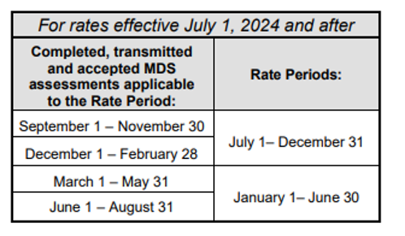
Indiana Medicaid Rate-Setting Process and Timeline
Reminders
CMI’s still very important. 2 quarters of CMI data aggregated for bi-annual rate-setting.
Occupancy under 70% negatively impacts the Medicaid rate under the Prospective system

Slide 13

Indiana NF Rate-Setting and UPL Payments
Reminders
If you do wish to delicense beds:
  Bed change requests should be submitted to the IDOH by:
      May 15th in order to impact the January 1 rate
      November 15th in order to impact the July 1 rate
  Make sure you also notify Myers & Stauffer timely about any change in beds
      By July 31st for the January 1 rebase
      By January 31st for the July 1 rebase

Slide 14
Indiana Medicaid Rate-Setting & UPL Update
Capital Reimbursement Changes Coming
Fair Rental Value Update
Considerations for new FRV include:
      Square footage
      Age of Facility
      Asset Additions
      Private Rooms

Slide 15
Indiana’s Quality Program

Slide 16
Indiana Medicaid Quality Reimbursement
Reimbursed through the per diem rate under the Legacy system
Reimbursed through the UPL payments under the Prospective system

Slide 17
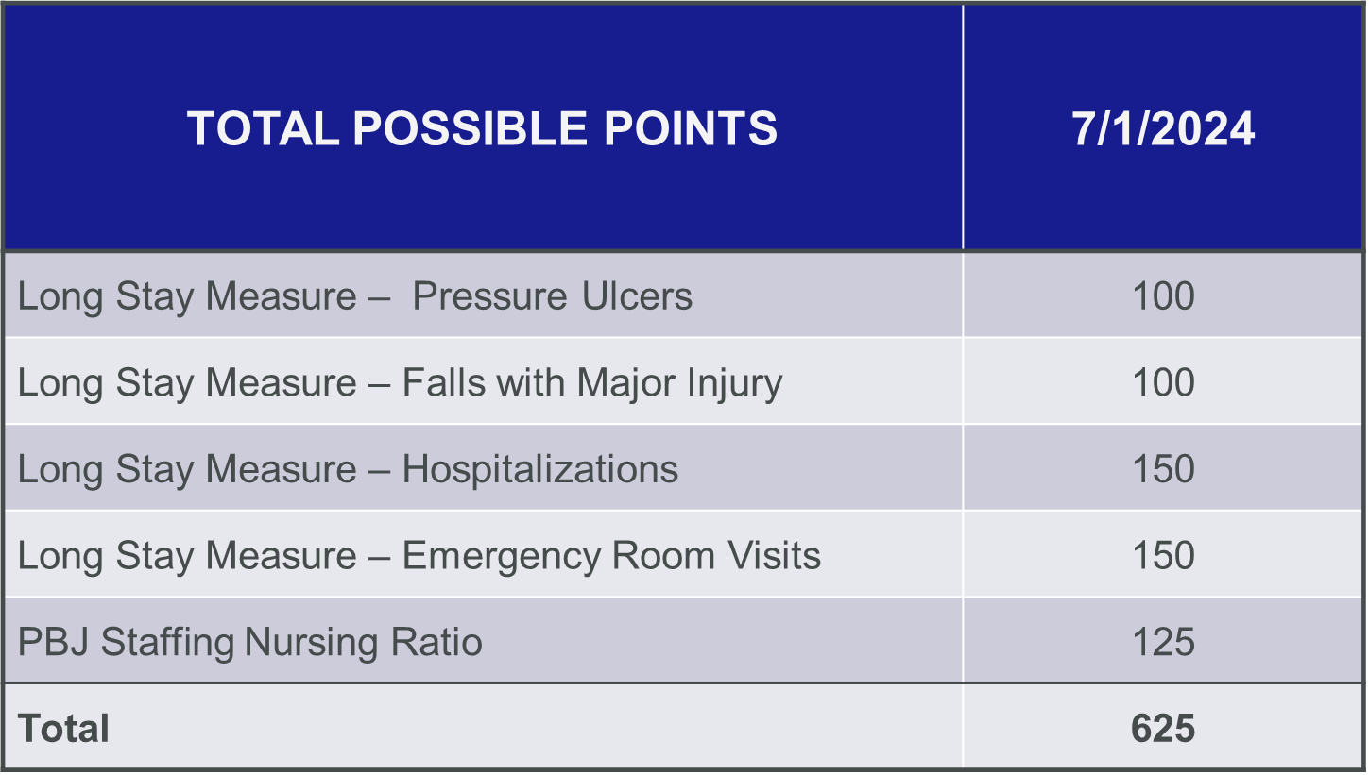
Indiana Total Quality Score

Slide 18
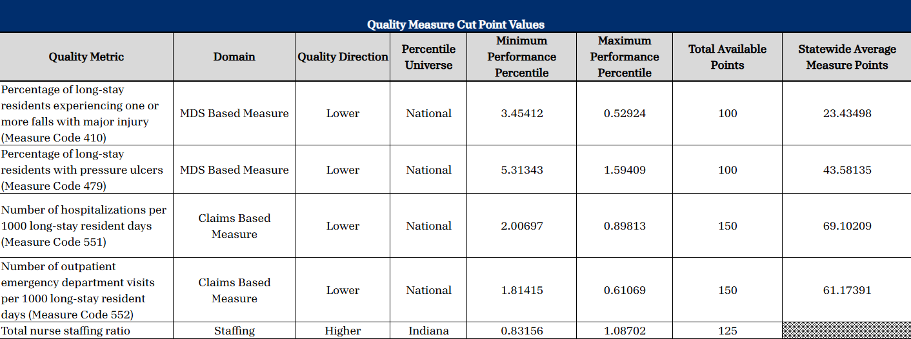
Total Quality Score 7/1/2026 Cut Points

Slide 19
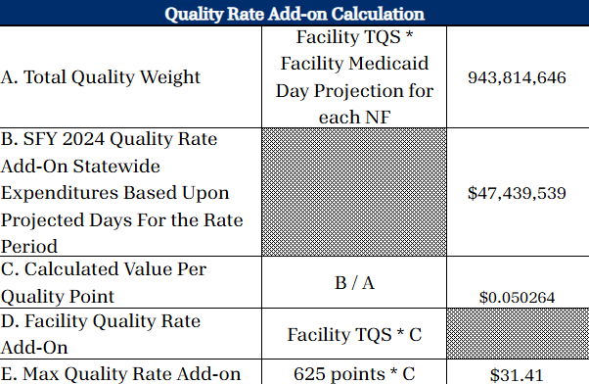
Total Quality Score 7/1/2026 Maximum Points

Slide 20
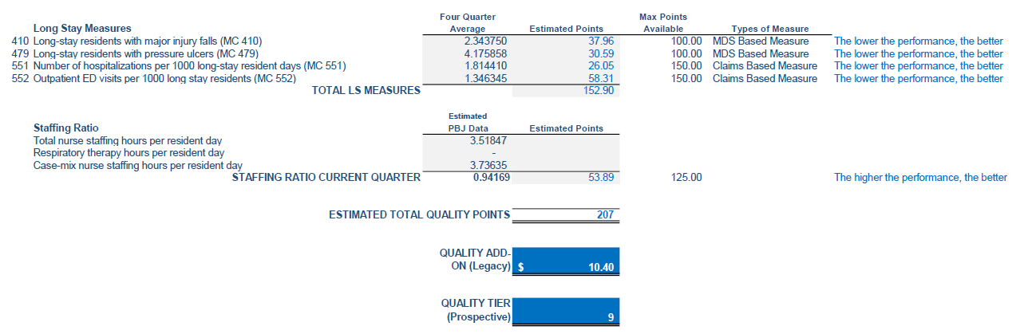
Quality Calculation
EXAMPLE FACILITY (Total Quality Score = 207 points)

Slide 21
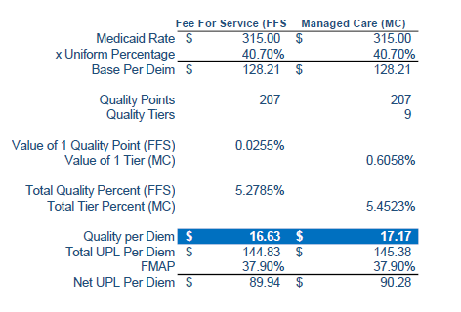
Indiana Medicaid UPL Payments
EXAMPLE FACILITY (Total Quality Score = 207 points)
Change in Method
The Uniform Percentage model multiplies the Medicaid Base Rate times a Uniform Percentage for all Providers
Will be fully phased in by July 1, 2027

Slide 22
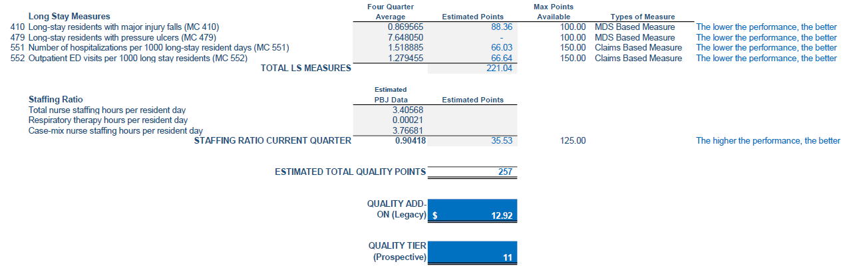
Quality Calculation
EXAMPLE FACILITY (Total Quality Score = 257 points)

Slide 23

Indiana Medicaid UPL Payments
EXAMPLE FACILITY (Total Quality Score = 257 points)
Change in Method
The Uniform Percentage model multiplies the Medicaid Base Rate times a Uniform Percentage for all Providers
Will be fully phased in by July 1, 2027

Slide 24
PDPM Implementation

Slide 25
PDPM Implementation
PDPM is targeted for implementation in SFY 2028 (July 1, 2027)
The last RUGs-based CMI report issued was for the quarter ended August 31, 2025
All subsequent CMI reports issued after August 31, 2025 are based on PDPM
  **M&S to release PDPM CMI reports for the quarters ended 5/31/25 & 8/31/25 this Fall
Rate Period | Medicaid CMI Period | All Resident CMI Period
January 1, 2027 | 9/1/24 – 8/31/25 | 3/1/24 – 2/28/25
July 1, 2027 | 9/1/26 – 2/28/27 | 3/1/25 – 2/28/26**

Slide 26
Medicaid CMI Period
July 1, 2025 Medicaid Rate – 9/1/24 thru 2/28/25
January 1, 2026 Medicaid Rate – 3/1/25 thru 8/31/25
July 1, 2026 Medicaid Rate – Frozen 9/1/24 thru 8/31/25
January 1, 2027 Medicaid Rate – Frozen 9/1/24 thru 8/31/25
July 1, 2027 Medicaid Rate – 9/1/26 thru 2/28/27
January 1, 2028 Medicaid Rate – 3/1/27 thru 8/31/27
July 1, 2028 Medicaid Rate – 9/1/27 thru 2/29/28
January 1, 2029 Medicaid Rate – 3/1/28 thru 8/31/28
July 1, 2029 Medicaid Rate – 9/1/28 thru 2/28/29

Slide 27
Total CMI Period
July 1, 2025 Medicaid Rate – 1/1/23 thru 12/31/23
January 1, 2026 Medicaid Rate – 1/1/23 thru 12/31/23
July 1, 2026 Medicaid Rate – 3/1/24 thru 2/28/25
January 1, 2027 Medicaid Rate – 3/1/24 thru 2/28/25
July 1, 2027 Medicaid Rate – 3/1/25 thru 2/28/26
January 1, 2028 Medicaid Rate – 3/1/25 thru 2/28/26
July 1, 2028 Medicaid Rate – 3/1/26 thru 2/28/27
January 1, 2029 Medicaid Rate – 3/1/26 thru 2/28/27
July 1, 2029 Medicaid Rate – 3/1/27 thru 2/29/28

Slide 28
FY2027 SNF PPS Final Rule

Slide 29
FY2027 Final Rule
Market Basket increase
  2.4% or $888.74 million estimated increase in aggregate payments to SNFs
    Market Basket of 3.3%
    Negative Productivity Adjustment of 0.9%
Does not include the impact of VBP reductions which is estimated to be $203.4 million
SNF-Specific Wage Index
  Did not establish a new wage index
  Thanked commenters and will use comments for future rule make
  Will continue to use hospital wage data for now

Slide 30
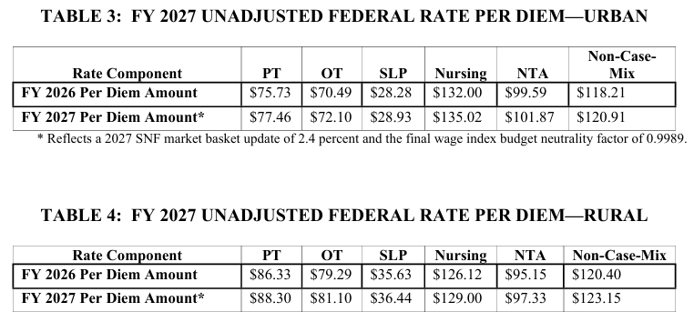
FY2027 Final Rule
FY 2027 PDPM Rate Components

Slide 31
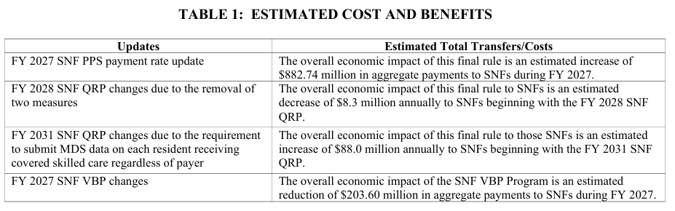
FY2027 Final Rule
Estimated Impact of Final Rule Changes

Slide 32
FY2027 Final Rule
PDPM ICD-10 Updates
  No ICD-10 Code Mapping changes
AAPACN Advocating for:
  Z51.A (Encounter for Sepsis Aftercare)
  F01.50 (Vascular Dementia)
  R62.7 (Adult Failure to Thrive)
  M62.81 (Muscle Weakness)

Slide 33
FY2027 Final Rule
SNF Quality Reporting Program (SNF QRP)
  No changes to current measures
  Removal of 2 COVID-19 Measures beginning FY2028
    COVID-19 Vaccination Coverage among Healthcare Personnel Measure
    COVID-19 Vaccine: Percent of Residents Who are Up to Date Measure
      Residents discharged on or after October 1, 2026
      Removal of O0350 from MDS on October 1, 2027
      Voluntary completion starting October 1, 2026
  COVID-19 Vaccination QRP Measures will not be reported on Care Compare after October 2026 update

Slide 34
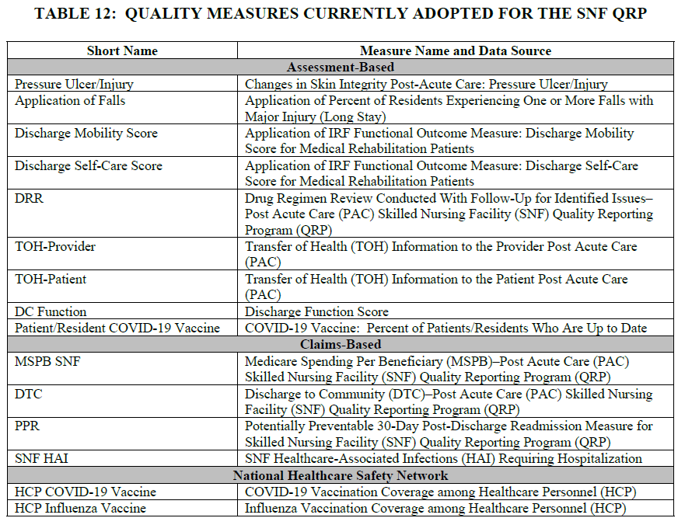
FY2027 Final Rule
SNF QRP Updates
  No new measures were adopted in the FY2027 Final Rule

Slide 35
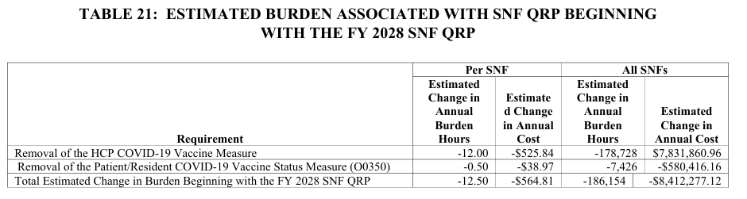
FY2027 Final Rule
Estimated savings from removal of COVID-19 vaccination reporting:

Slide 36
FY2027 Final Rule
SNF Quality Reporting Program (SNF QRP)
  Revised data submission deadline for MDS and NHSN reporting from 4.5 months to no later than the 15th day of the second month (45 days) after the calendar quarter
      Beginning with 2029 SNF QRP
      Effective January 1, 2027
      Will allow for more timely reporting of QRP measures for facility and consumer use

Slide 37
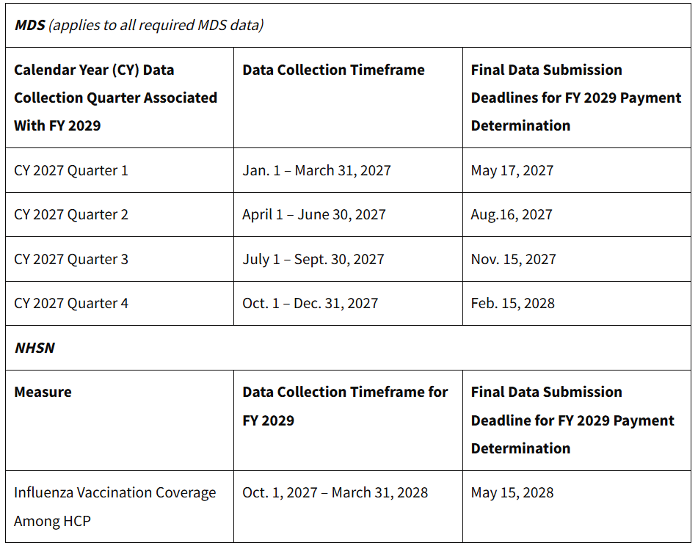
FY2027 Final Rule
Submission Deadlines for CY2027

Slide 38
FY2027 Final Rule
SNF Quality Reporting Program (cont.)
  Submission of MDS data on all residents admitted or re-admitted for covered skilled services, regardless of payer
    4 criteria
      Admitted to SNF for covered skilled nursing or skilled rehab services
      Services required on a daily basis
      Services delivered are reasonable and necessary for the treatment of the resident’s illness or injury
      As a practical matter, the daily skilled services can be provide only on an inpatient basis in a SNF
    Submit MDS assessments admitted on or after October 1, 2029.
    Included in SNF QRP for FY2031
    Include completion of PPS Discharge assessments (Skilled Care Discharge Assessment)
    Will require modification of one MDS item and addition of 3 new items as of October 1, 2029

Slide 39
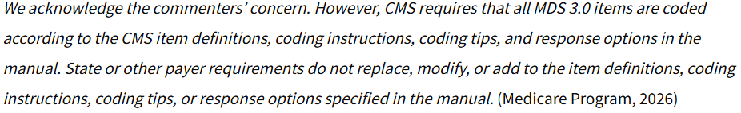
FY2027 Final Rule
SNF Quality Reporting Program (cont.)
  Submission of MDS data on all residents admitted or re-admitted for covered skilled services, regardless of payer (cont.)
    Education from CMS will be forthcoming
    Assessments will be used to calculate QRP compliance and measures
    Concerns regarding Medicare Advantage plans providing instructions that do no align with RAI instructions

Slide 40
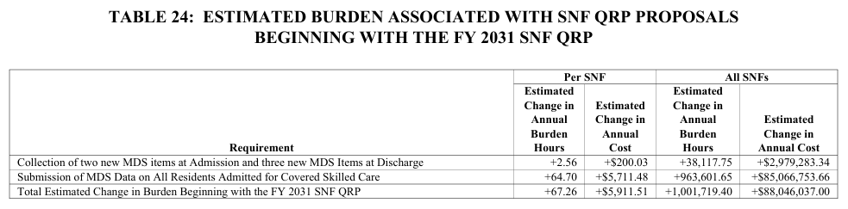
FY2027 Final Rule
SNF Quality Reporting Program (cont.)
  Submission of MDS data on all residents admitted or re-admitted for covered skilled services, regardless of payer (cont.)
    Estimated cost for requirement

Slide 41
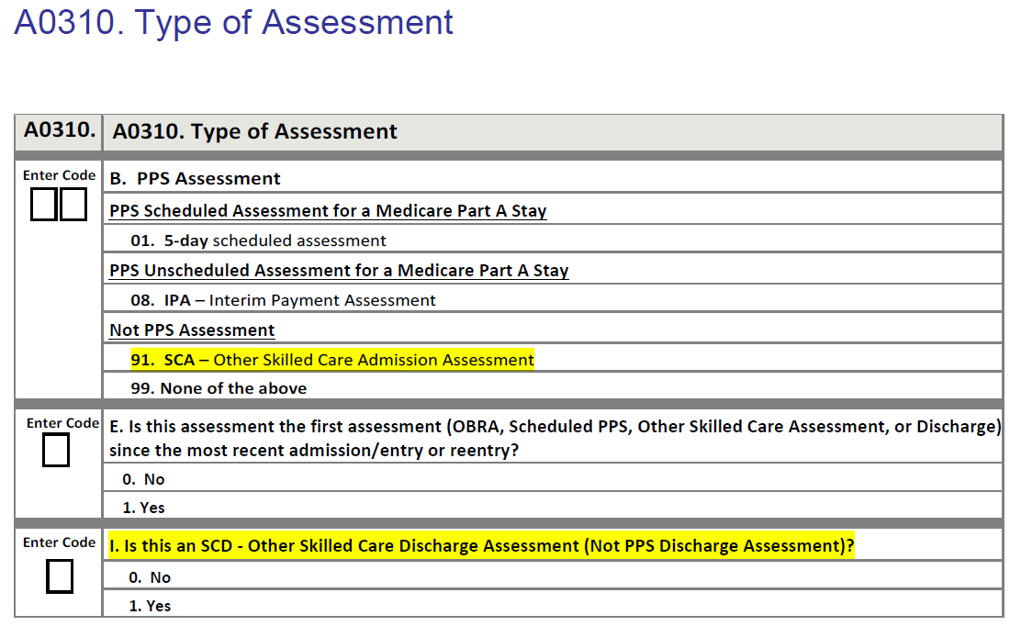
FY2027 Final Rule

Slide 42
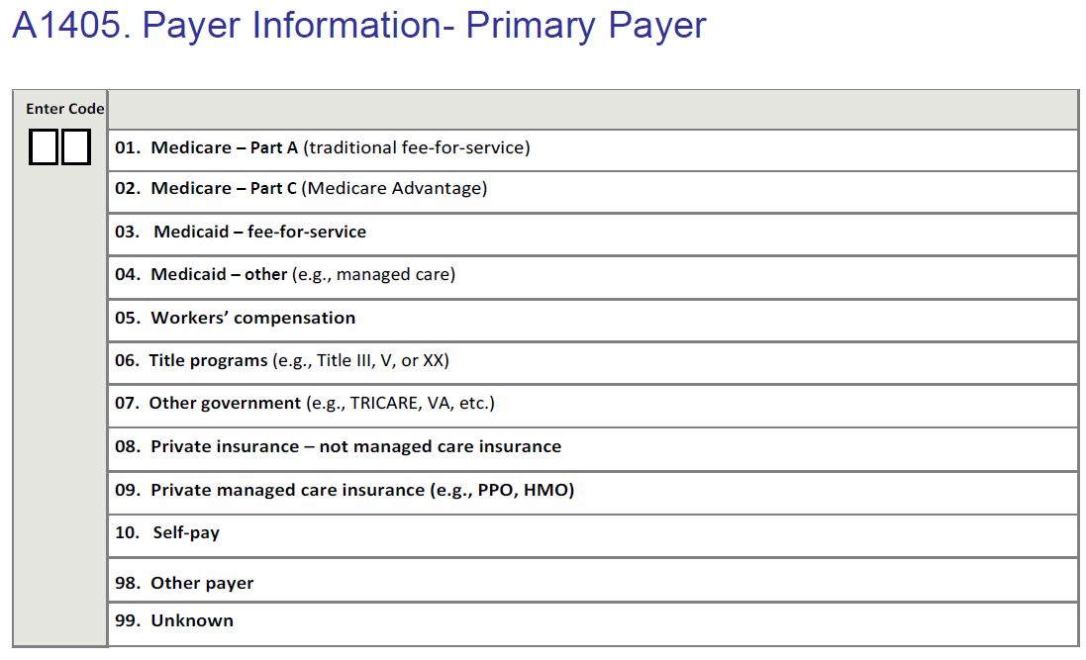
FY 2027 Proposed Rule

Slide 43
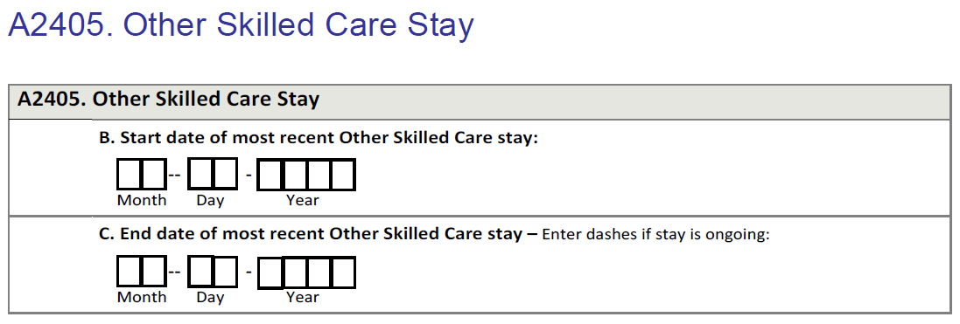
FY 2027 Proposed Rule

Slide 44
FY2027 Final Rule
SNF Quality Reporting Program Request for Information (RFI)
  Consideration of adopting future measure for Advance Care Planning (ACP)
PDPM Request for Information (RFI)
    How CMS could address observed case-mix upcoding (case-mix creep)
    Ensure coding aligns with actual patient acuity rather than changes in coding practices
      Malnutrition --- 5 – 47%
      Swallowing symptoms --- 4 – 21%
      Depression --- 4 – 19%
      Impaired Cognition --- 14 – 28%

Slide 45
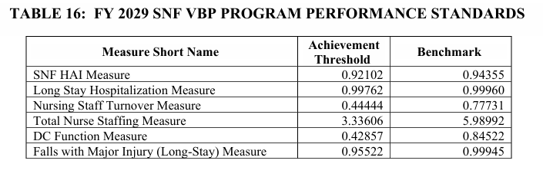
FY2027 Final Rule
SNF Value Based Purchasing (VBP)
  Provided estimated performance standards for FY 2029 program year

Slide 46
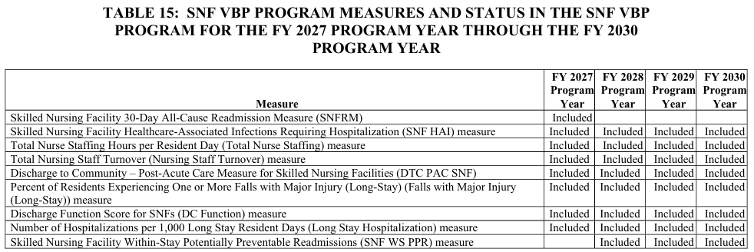
SNF Value Based Purchasing (VBP)
SNF Value Based Purchasing (VBP)
  For FY2027, VBP payment adjustments will be based on eight measures
  Table for inclusion of programs

Slide 47
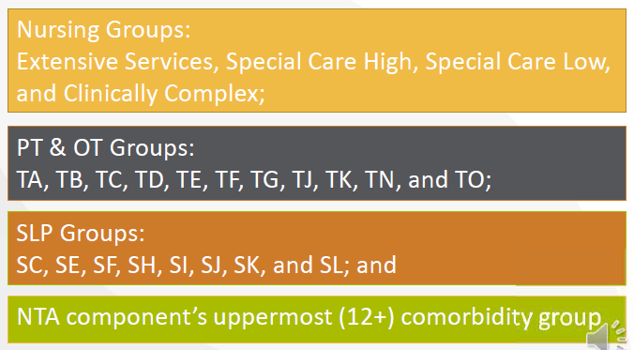
FY2027 Final Rule
Administrative Presumption of Coverage
  Reflect an administrative presumption that those beneficiaries who are correctly assigned one of the designated case-mix classifier in their initial Medicare assessment (5-day) are automatically classified as meeting the SNF level of care definition up to and including the assessment date (ARD) of that assessment.
  Must be admitted directly from hospital to quality

Slide 48
PDPM Implementation

Slide 49
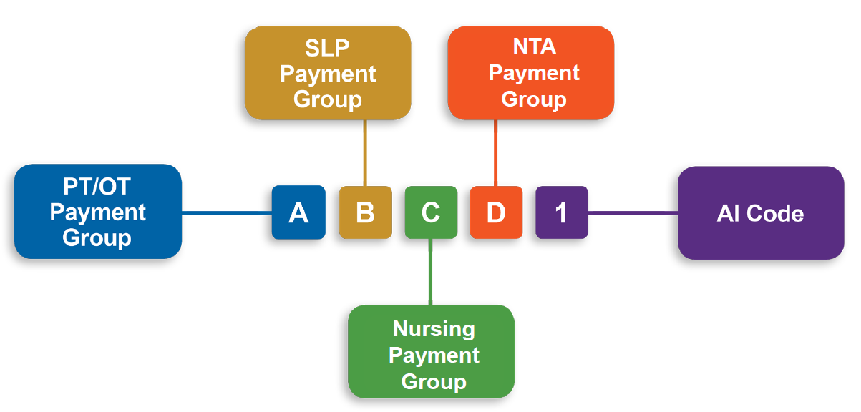
PDPM Implementation
PDPM is targeted for implementation in SFY 2028 (July 1 ,2027)
  FSSA memo of January 26, 2026
Indiana will use the Nursing Component of PDPM only
  Reflected a 3rd digit in HIPPS code

Slide 50
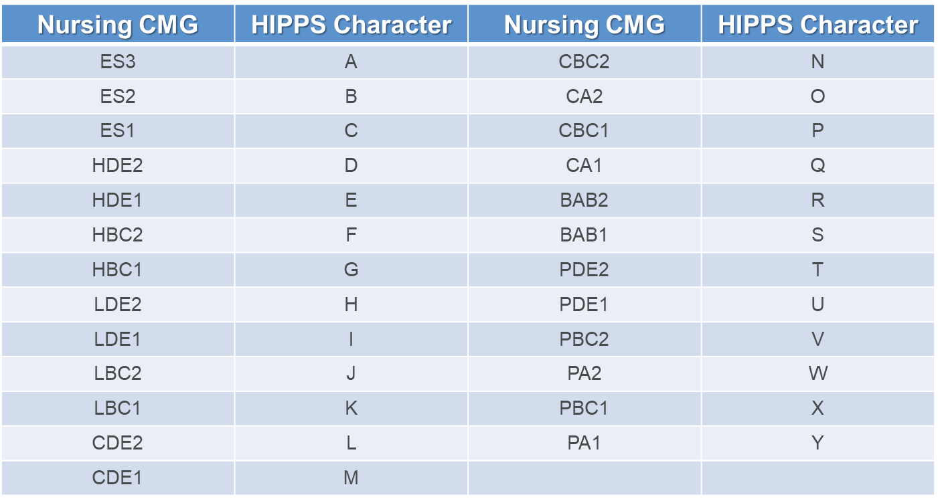
PDPM Implementation
Nursing Component HIPPS Translation

Slide 51
PDPM Update
PDPM Transition
  100% implementation of PDPM on July 1, 2027 for case-mix
    No phase in using “frozen” RUGS CMI values
    January 1, 2027 – last use of frozen CMI values for rates
    July 1, 2027 rates will use CMI reports of dates September 1, 2026 thru February 28, 2027 for rate calculation
  Normalization for 2025 cost report
    CMI reports for March 1, 2025 thru February 28, 2026
    Rosters to be posted in fall for review

Slide 52
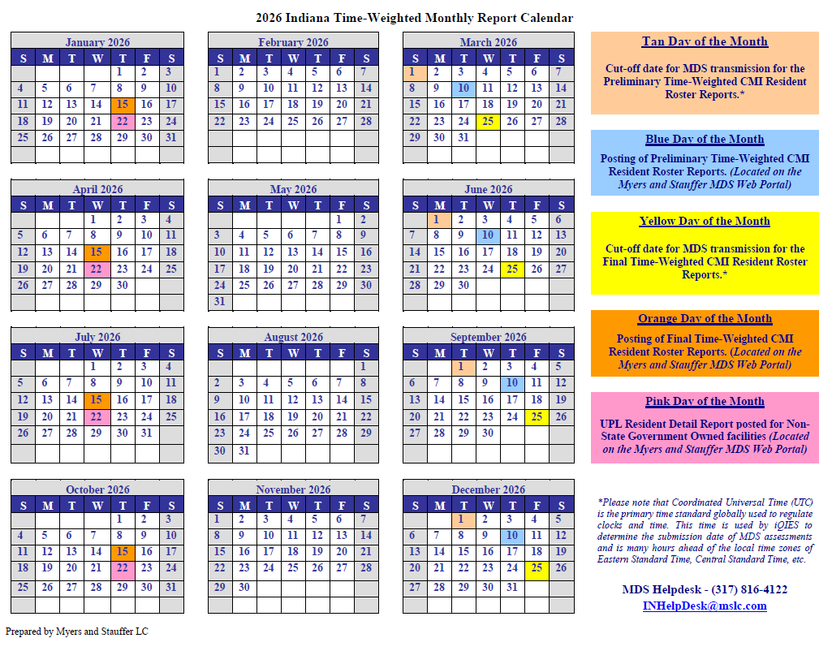

Slide 53
PDPM Implementation
Resident Rosters
  Time-Weighted CMI Rosters using PDPM classification
    Preliminary for November 2025 posted on December 10, 2025
    Final for November 2025 posted on January 15, 2025
  Will be posted as per the Myers and Stauffer calendar
  Said to be “informational only” at this time
  Recommend facilities review for accuracy and resolve any identified issues related to:
    Payer status
    Delinquent days
    Assessment sequencing
    Assessment classification

Slide 54
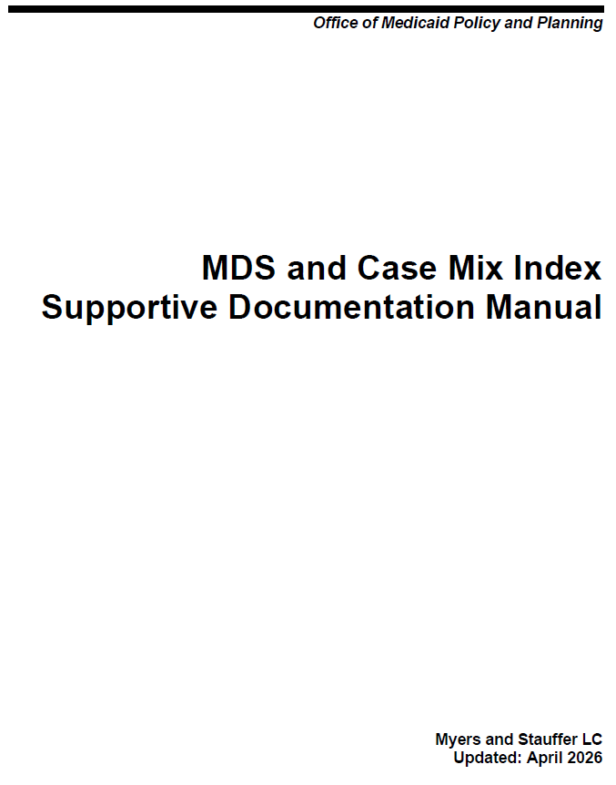
PDPM Update
New Supportive Documentation Guidelines
  Released during training in April 2026
  Effective June 1, 2026
  Myers and Stauffer PDPM Review
    Start 7-1-26
    Informational/educational thru 6-30-27
    Will attempt to do at least one facility per chain

Slide 55
PDPM Update
GG Documentation and Validation
  Definitions of GG items within the tool being used to collect data must be consistent with RAI language
  GG documentation must be for the appropriate 3-day window and be present in the medical record
  IDT collaboration to make GG coding decision between the 3-day window and before the Z0500 RN sign off date of the MDS
Documentation in 3-day Window
IDT Meeting to Determine Usual Performance
Monitoring for revision/changes
Documentation/Coding of IDT Decision
Care Planning

Slide 56
PDPM Overview
Physical Therapy (PT)
Occupational Therapy (OT)
Speech-Language Pathology (SLP)
Non-Therapy Ancillary (NTA)
Nursing
Notes:
Each resident is classified into a PT group, an OT group, an SLP group, an NTA group, and a nursing group. For each of the case-mix adjusted components, there are a number of groups to which a resident may be assigned, based on the relevant MDS 3.0 data for that component.
Additionally, there is a non-case-mix adjusted component to cover utilization of SNF resources that do not vary according to patient characteristics.

Slide 57
Nursing Component of PDPM
PDPM utilizes the same basic nursing classification structure as RUG-IV, with certain modifications:
  Function score based on Section GG of the MDS 3.0
  Collapsed functional groups, reducing the number of nursing groups from 43 to 25
    Extensive Services
    Special Care High
    Special Care Low
    Clinically Complex
    Behavior Symptoms/Cognitive Performance
    Reduced Physical Function

Slide 58
Nursing Component of PDPM
Extensive Services (3)
Uses hierarchical method instead of index maximizing for placement in category:
  Start at top of nursing category
  Stop at first case-mix category resident qualifies for
Special Care High (4)
Special Care Low (4)
Clinically Complex (6)
Behavior Symptoms/Cognitive Performance (2)
Reduced Physical Function (6)

Slide 59
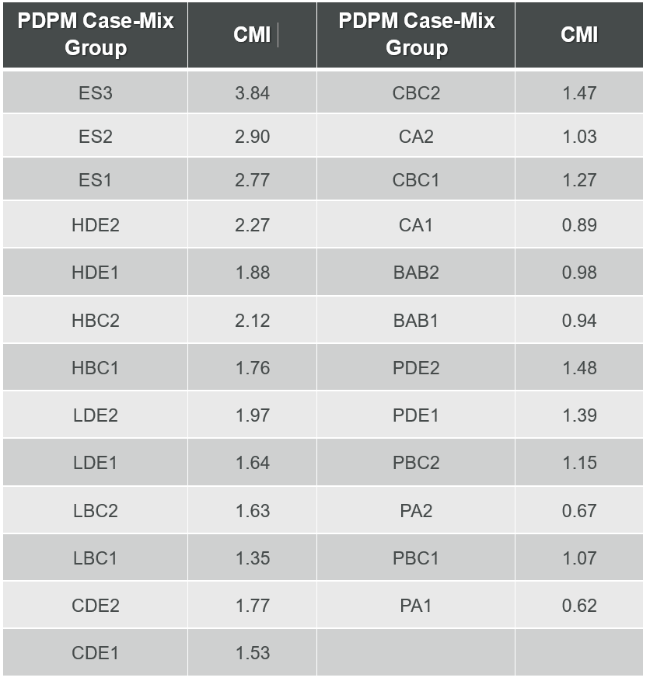
PDPM Implementation
Indiana will use the Medicare PDPM Nursing component CMI weights that were put in effect on October 1, 2023

Slide 60
PDPM Implementation
Additional Score Assignments
  Delinquent Days
    BC1 = 0.59
  Entry Record Followed by Discharge or Death in Facility
    LBC2 (1.63) – Death in Facility or discharge to hospital or inpatient rehab
    CBC2 (1.47) – Any discharge other than death or hospital/inpatient rehab

Slide 61
PDPM Implementation
Other Specifics
  No Other State Assessments (OSAs)
    Providers are required to complete all MDS items associated with the PDPM model including the following 3 items:
      I0020: Indicate the resident’s primary medical condition category
      J2100: Recent Surgery Requiring Active SNF Care
      O0400D: Respiratory Therapy
  No End of Therapy (EOT) portal
  IPA assessments will be considered valid assessments for classification and assignment of days
  Elimination of “Low Need” classification

Slide 62
PDPM Implementation
It is recommended that facilities focus on appropriate PDPM coding
  Section GG ADL Function Coding
  “Money” Diagnoses
    MS, CP, hemiplegia, Parkinson’s disease, Quadriplegia, pneumonia etc.
  Clinical services and conditions
    IV fluids, IV meds, oxygen use, dialysis, isolation, respiratory therapy etc.
  PHQ2-9 Interviews
    Depressive end-splits for Clinically Complex and Special Care High/Low
  Restorative Nursing
    Reduced Physical Functioning and Impaired Cognition/Behaviors

Slide 63
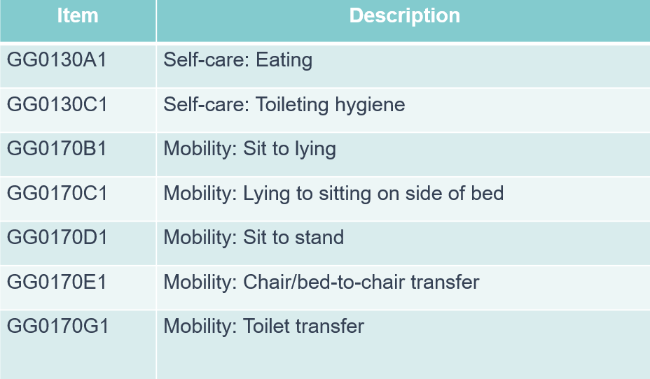
PDPM Implementation
Nursing Function Score:

Slide 64
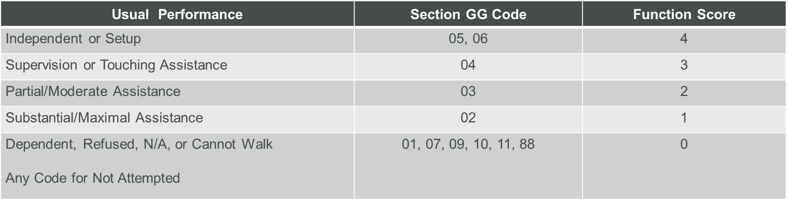
PDPM Implementation
Nursing Function Score

Slide 65
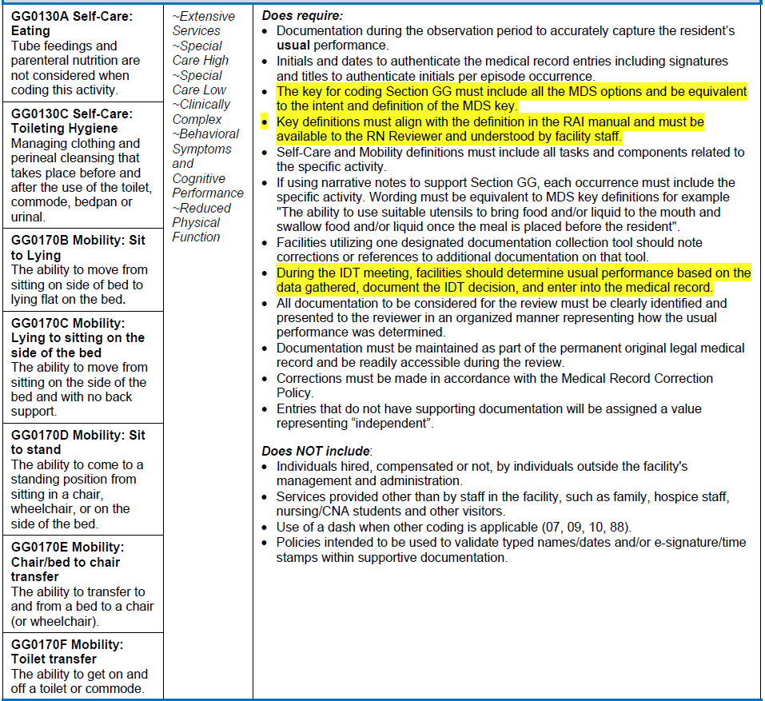
PDPM Update

Slide 66
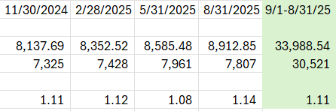
PDPM Implementation
CMI Freeze
  July 1, 2026 and January 1, 2027 rates
  From MDS reports September 1, 2024 thru August 31, 2025
    Total Medicaid points divided by total Medicaid days
    Will incorporate any changes d/t MDS audit reviews during period

Slide 67
QM Update

Slide 68
Long-Stay Antipsychotic Medication Use
New Quality Manual Released on December 1, 2026 (v18.0)
Long-Stay Antipsychotic Medication Use
  Improve accuracy of reporting antipsychotic medication use in nursing homes
    14.64% vs 16.98%
  Perceived discord between MDS record and claims
  Updating measure to include the following to supplement MDS data
    Medicare Part D prescribing data
    Medicaid state level claims
    Medicare Advantage (Part C) encounter data
  Resident will trigger if they received or had a claim for an antipsychotic medication

Slide 69
Long-Stay Antipsychotic Medication Use
Considerations:
  Will trigger on QM:
    Resident receives order, med if filled but never received medication
      Based on fill date even if filled one time in quarter
    Medication received at physician office
    Received in emergency room and returned to facility without being admitted
  Will not trigger on QM:
    Admitted to hospital and received medication as an inpatient

Slide 70
Long-Stay Antipsychotic Medication Use
  Exclusion Criteria
    Not continuously enrolled in Medicare A/B/D or C/D or Medicaid only during each month of the target period
      Private Pay if not enrolled in the above
      VA if not enrolled in the above
      Switch from traditional to managed care or vis versa
    Not continuously enrolled in Medicare A/B or C or Medicaid only during each month of measure exclusion look back window (1 year prior to target date until the target date?

Slide 71
Long-Stay Antipsychotic Medication Use
  Exclusion Criteria
    Resident is 65 or older at admission and is admitted 1 year prior to end of target period but not continuously enrolled in Med A/B or C or Medicaid only in each month of pre-admission look back window (1 year prior to day before admission date)
    Hospice
      Not based on MDS coding
      Part A and Medicaid hospice
      Based on hospice claims only – ensure provider is submitting timely
      Even if on for one day in the target period

Slide 72
Long-Stay Antipsychotic Medication Use
  Exclusion Validation
    Schizophrenia, Huntington’s disease, Tourette’s syndrome
    1/3 of long-stay resident with schizophrenia had no corresponding service claims (physician visit, hospital stay, etc.)
    Diagnosis must be on MDS
    MDS-coded diagnosis must be cross-validated against Medicare Part A/B, Part C or Medicaid claims or encounter data

Slide 73
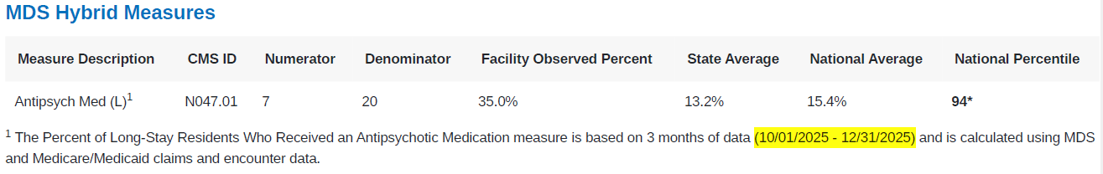
Long-Stay Antipsychotic Medication Use
Percent of Long-Stay Residents Receiving an Antipsychotic Medication (Hybrid Methodology):
  Updated QM manual for new measure effective January 1, 2026
  5-star manual for updated cut points for January 2026
  Care Compare updated in January 2026 using initial period of Q3 2025 (7-1-25 thru 9-30-25)

Slide 74
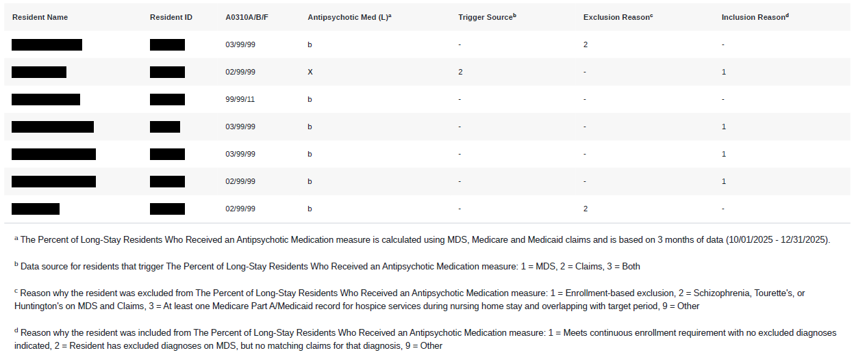
Long-Stay Antipsychotic Medication Use
Exclusions

Slide 75
5-STAR Update

Slide 76
5-Star Update
5-Star Update
  Effective with July 2026 refresh
  Increase to the Quality Measure (QM) threshold
  QSO 19-08-NH from March 5, 2019
  Each rating increased by one-half of the average improvement in QM scores
    Average improvement determined from January 2025 – April 2026

Slide 77
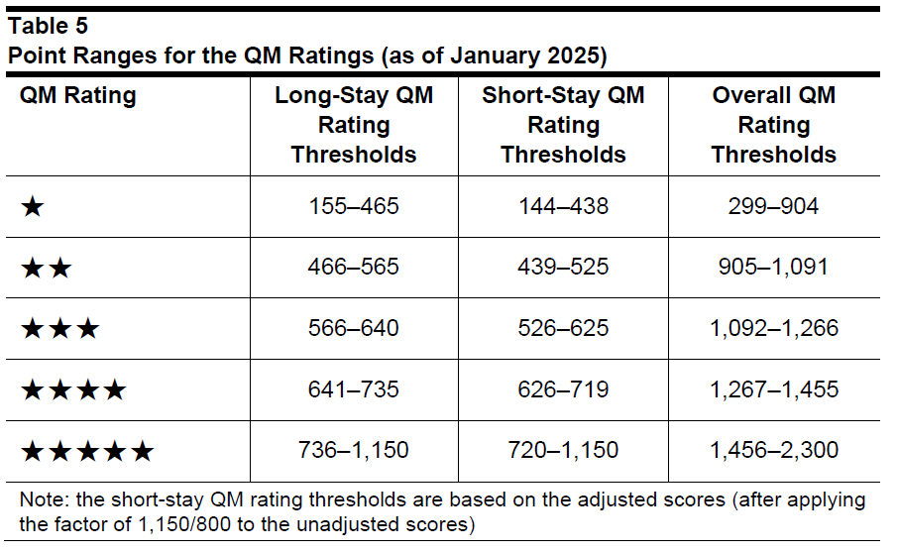

Slide 78
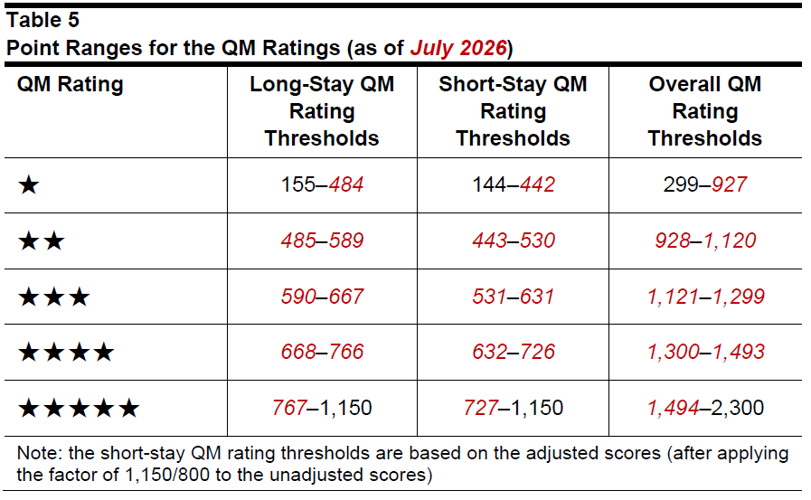

Slide 79
SNF QRP and VBP Reports

Slide 80
SNF QRP Non-ComplianceReports
SNF QRP Reports
  Posted in iQIES on August 4, 2026
  SNF Quality Reporting (SNF QRP)
    Non-compliance reports
      MDS < 90%
      Non-compliance with NHSN reporting
        HCP COVID-19 vaccination at least 1 week every month
        HCP Influenza vaccination at least yearly (May 15)
    30-days to file reconsideration or request for extension for reconsideration
      September 4, 2026 at 12:59 pm

Slide 81
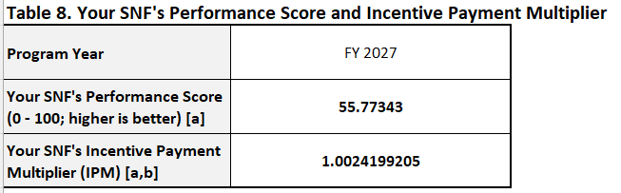
SNF VBP Reports
VBP Reports
  SNF Value Based Purchasing
    Performance on measures
    Incentive multiplier for FY2027
      Measure Minimum Not Met

Slide 82
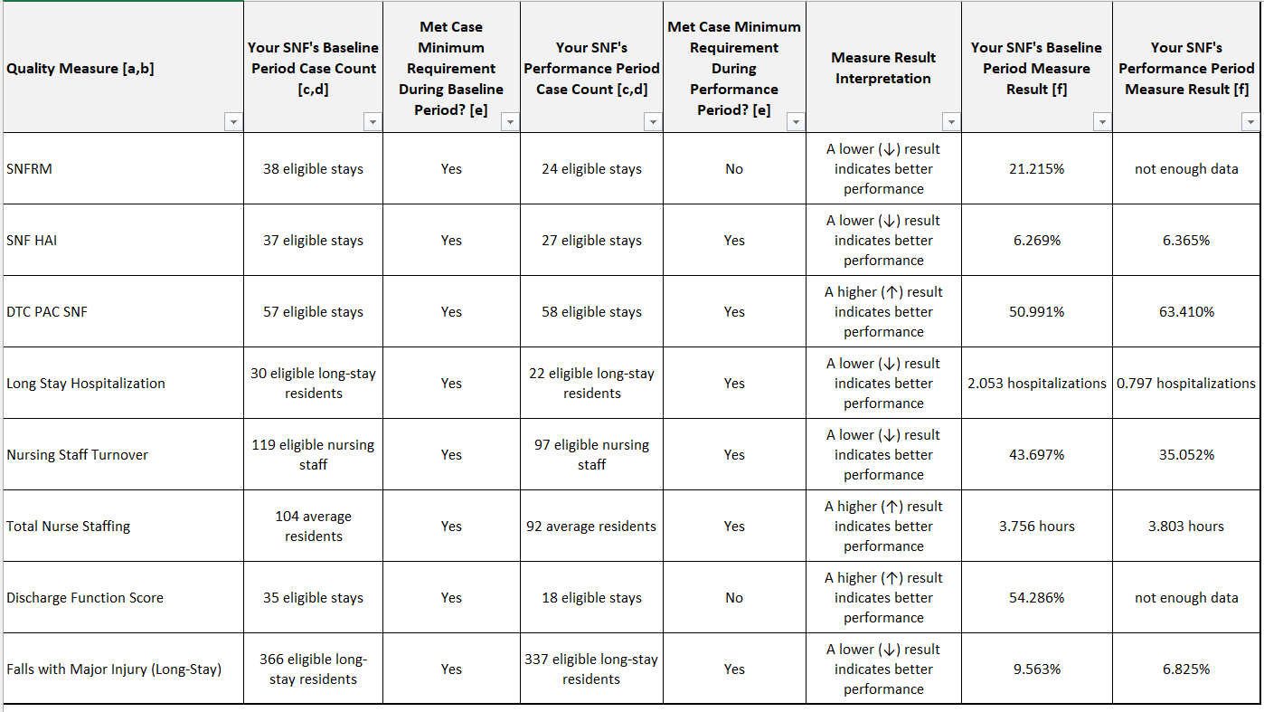
SNF VBP Reports
Measure Results

Slide 83
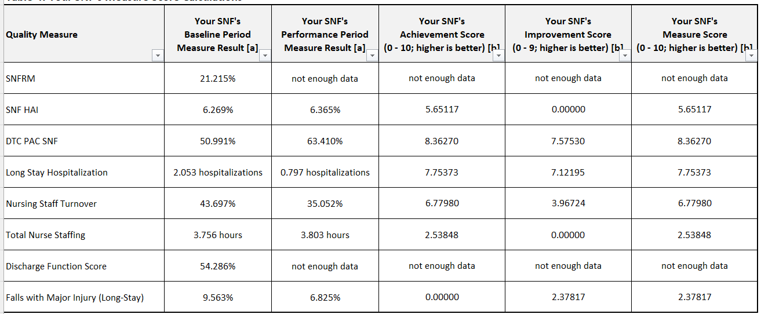
SNF VBP Reports
Measure Scores

Slide 84
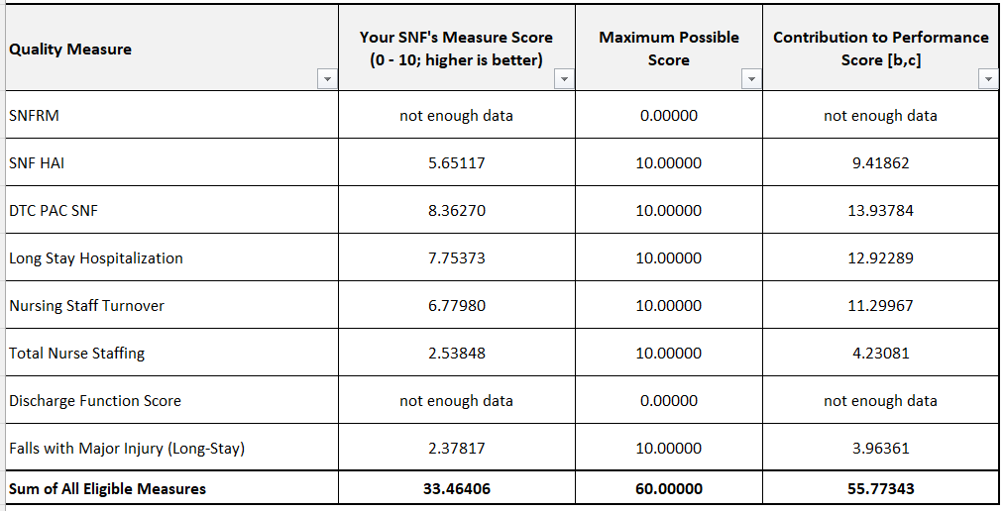
SNF VBP Reports
Performance Scores

Slide 85
SNF Validation Program

Slide 86
SNF Validation Program
SNF Validation Program
  Audit based program established to assess the accuracy of MDS-based quality measures used in the SNF VBP and SNF QRP programs
  Eligible SNFs are those that have submitted at least one MDS assessment in the previous calendar year and at least one in the current fiscal year
    May only be selected once per fiscal year
  Contracted to be done by Healthcare Management Solutions, LLC (HMS)
  Notices started going out on January 12, 2026
    Will have 5 days from notification to submit a point of contact
  Will be looking at Calendar Year information

Slide 87
SNF Validation Program
SNF Validation Program – Measures
  Fall with major injury in SNF stay (long and short stay)
  Drug regimen review with follow up
  Discharge self-care
  Discharge mobility
  Transfer of Health Information
  Discharge Function
  New/worsened pressure ulcers
  Resident COVID vaccine up to date

Slide 88
SNF Validation Program
SNFs will be selected randomly – Can only be selected once within a fiscal year
  Up to 1500 SNFs per fiscal year
  Notified thru iQIES MDS 3.0 Provider Preview Reports folder
    Skilled Nursing Facility Validation Process – Initial Selection Notification
    Skilled Nursing Facility Validation Process – Second Selection Notification

Slide 89
SNF Validation Program
Validation Audit Requirements
  Request to submit medical record documentation to support validation of MDS assessment records
    Instructions for documentation submission
      No face sheets should be included
      Redacted social security numbers
      Bundled per resident – one PDF per resident
      PDF arranged in special order and bookmarked
      No other formats accepted – check with software
    List of requested sampled residents with detailed data requests for the medical records
    Contact information for the contractor
  Information must be submitted within 45 calendar days of the audit notification or SNF will be consider non-compliant

Slide 90
SNF Validation Program
Validation Audit Results
  Will receive a Summary Audit Scoring Report vis iQIES
    Within 3 month following submission deadline
    Audit results for each measure and MDS item
    Detailed results from each sampled assessment
Validation Audit Penalties
  No penalty for audit results – informational purposes
  SNFs in non-compliance will be subject to a 2% reduction of their APU
    Non-compliant letter from MAC
    May file for reconsideration within 30 days of the date of the non-compliance record
    Summary Audit Scoring Report

Slide 91
SNF Validation Program
CMS website information on program
  “Data Validation Process”
  Frequently Asked Questions (FAQ) with update of December 2025
    https://www.cms.gov/files/document/snf-validation-program-frequently-asked-questions-faqs.pdf

Slide 92
SNF Quality Reporting Program
Must meet 3 Thresholds to keep from losing 2% APU
  90% compliance with MDS assessments
  100% NHSN reporting
  100T submission of validation audit information with in 45 days of notification

Slide 93

Questions?

Slide 94
Deborah Lake
Deborah.Lake@us.forvismazars.com
Alex Craig
Alex.Craig@us.forvismazars.com

