Slide 1



In aging services,
progress
is never
made
2026 Fall Conference
August 25-26, 2026
alone.

Slide 2

Lessons Learned After an
Immediate Jeopardy Citation
Sarah Starcher
COO/ED @ Byron Health Center

Slide 3
Learning Objectives
Understand what constitutes an Immediate Jeopardy (IJ)
Recognize system failures that contributed to our IJ
Decision Tree Development
Strengthen interdisciplinary communication
Personal reflection and preventing burnout

Slide 4
Let’s set the scene…
  Resident moved in mid-May 2025. She moved in due to short term memory loss but we moved her to an open neighborhood as she had been living at her own apartment by herself. Her son had initiated the process because she was found wandering at night.
  We have secured and open neighborhoods, usually folks who have extensive cognitive decline are best for our secured neighborhoods.
  We felt moving this resident onto a secured neighborhood was not the best place for her given what we knew about her upon admission.

Slide 5
Let’s set the scene…
  The Phone Call and subsequent State Reported Incident
    Per the policy to report when a resident is assisted back to the facility by police and their whereabouts were unknown it is a SRI
    Resident didn’t have any adverse outcome, was pleasant upon arrival back, knew where she was upon return
    Moved her to the secured neighborhood because we had not known her whereabouts
  Previous elopement examples at our community

Slide 6
State entered
  They came in on 6/17/25 and said they would be in and out, just wanted to check off what all happened with the situation.
  The surveyor left around noon and came back to let us know that we were be given an Immediate Jeopardy because of the potential for adverse outcome related to the resident’s BIMS score.
  Her BIMS Score was a 3.0, this was clearly an issue
  We argued that she didn’t aimlessly wander but went to her old apartment and then asked for assistance back to the building, clearly able to navigate the situation.
  Surveyor argued the potential for adverse event.

Slide 7
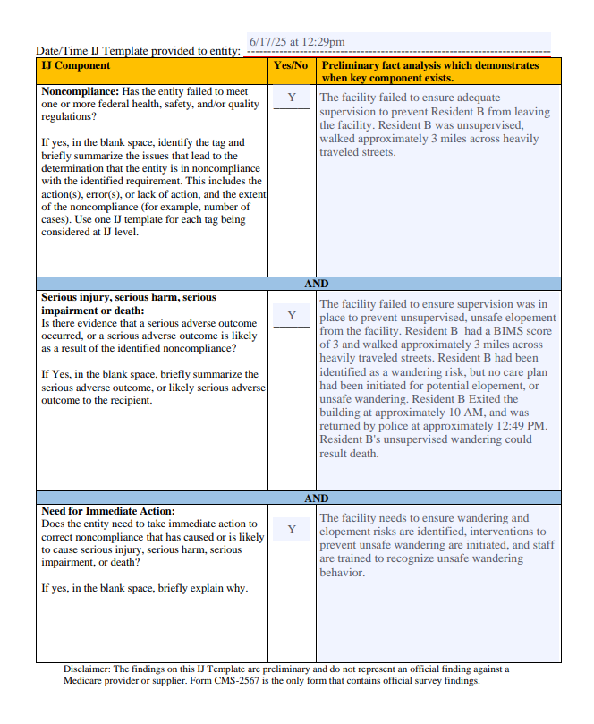
What is an IJ?
A situation in which the provider's noncompliance has caused, or is likely to cause, serious injury, harm, impairment, or death.
An IJ citation related to elopement means:
A resident left the facility unsupervised
The resident was placed at serious risk
Systems designed to protect vulnerable residents failed

Slide 8
Root Causes We Identified
Care plans not reflecting current behaviors
Inconsistent staff communication
Assumptions instead of verification, assessments creating a different picture
Wandering was intentional vs. cognitive decline

Slide 9
The Swiss Cheese Model
Resident Assessment
↓
Care Planning
↓
Communication
↓
Staff Observation
↓
Leadership Oversight
When the holes align, an elopement can occur.
The goal is multiple reliable layers—not relying on one safeguard.

Slide 10
Lessons Learned
She was masking quite a bit of her cognitive decline
She didn’t make repeated statements of wanting to leave but had noted that she would like to go back home.
Her BIMS showed impairment
She wandered around the building and figured out how best to leave
Never occurred to me it would be a tag so it never occurred to me to do additional assessments to obtain past non-compliance

Slide 11
Lessons Learned
Documentation alone does not keep residents safe.
  Questions leaders should ask:
    Does every caregiver know?
    Is the information actionable?
    Is everyone responding consistently?
Knowledge must move beyond the chart.

Slide 12
Lessons Learned
Leaders should ask:
  Are audits meaningful?
  Are near misses reviewed?
  Are trends discussed?
  Are barriers removed quickly?
  Do staff feel comfortable speaking up?
Leadership presence prevents problems.

Slide 13
Culture Matters
Reactive Culture:
Blame
Fear
Silence
High Reliability Culture
Curiosity
Reporting
Learning
Accountability
Continuous improvement
The goal is learning—not blaming.

Slide 14
Changes we made
Some practical, some not
Decision Tree for new admissions coming from home
  We have said no to quite a few move-ins
Locked the front door and no one can come in or out without being permitted
Daily resident review for all open neighborhood residents for 9 months
1:1 for residents who were at high-risk for elopement

Slide 15
Questions everyone should ask
Who are our highest-risk residents?
Are interventions individualized?
Could agency/temporary staff identify them?
Would night shift answer the same way?
Are exits secure?
What assumptions are we making?

Slide 16
Steps to take to avoid burnout
One of the most overlooked aspects of an Immediate Jeopardy citation is the toll it takes on leaders. Administrators, Directors of Nursing, department heads, and clinical leaders often spend weeks or months managing regulatory expectations, supporting staff, communicating with families, implementing corrective actions, and worrying about resident safety—all while trying to maintain normal operations. Burnout is common if leaders don't intentionally care for themselves during the recovery process.
Prioritize Ruthlessly
Accept Progress over Perfection
Schedule Recovery Time
Don’t Bottle it Up
Celebrate Small Wins
Resilience vs. Restlessness
An Immediate Jeopardy is an event—not your identity as a leader.

Slide 17

CONCLUSION
What will you do differently tomorrow?

Slide 18
THANK YOU

