Slide 1
Initiative 3: Improving Patient Outcomes through Enhanced Interoperability and Technology
Bob Davis, Chief Public Health Intelligence and Transformation Officer, Indiana Department of Health
Brian Wikle – Interoperability Stakeholder Engagement Manager
Susan Clark – Interoperability HIE Modernization Project Manager
This Rural Health Transformation Program is supported by the Centers for Medicare & Medicaid Services (CMS) of the U.S. Department of Health and Human Services (HHS) as part of a financial assistance award totaling $206,927,896.80 with 100 percent funded by CMS/HHS. The contents are those of the author(s) and do not necessarily represent the official views of, nor an endorsement, by CMS/HHS, or the U.S. Government.

Slide 2
What is the Rural Health Transformation Program?
Federal Grant Program
Indiana's Plan
The One Big Beautiful Bill Act created a $50 billion fund called the Rural Health Transformation Program (RHTP), which empowers states to strengthen their rural communities by improving healthcare access, quality, and outcomes by transforming the healthcare delivery ecosystem.
The funds are allocated to approved States over five fiscal years (FY), with $10 billion of funding available each fiscal year, beginning in FY 2026 and ending in FY 2030.
The State of Indiana was awarded approximately $207 million in December 2025 for the Indiana Rural Health Transformation Program that is designed to address growing challenges in health care access and worsening health outcomes across rural communities in Indiana.
Indiana is pursuing 12 RHTP initiatives that align with CMS’s strategic goals for the program through efforts that support rural communities and engage local stakeholders as they tackle specific community needs.

Slide 3
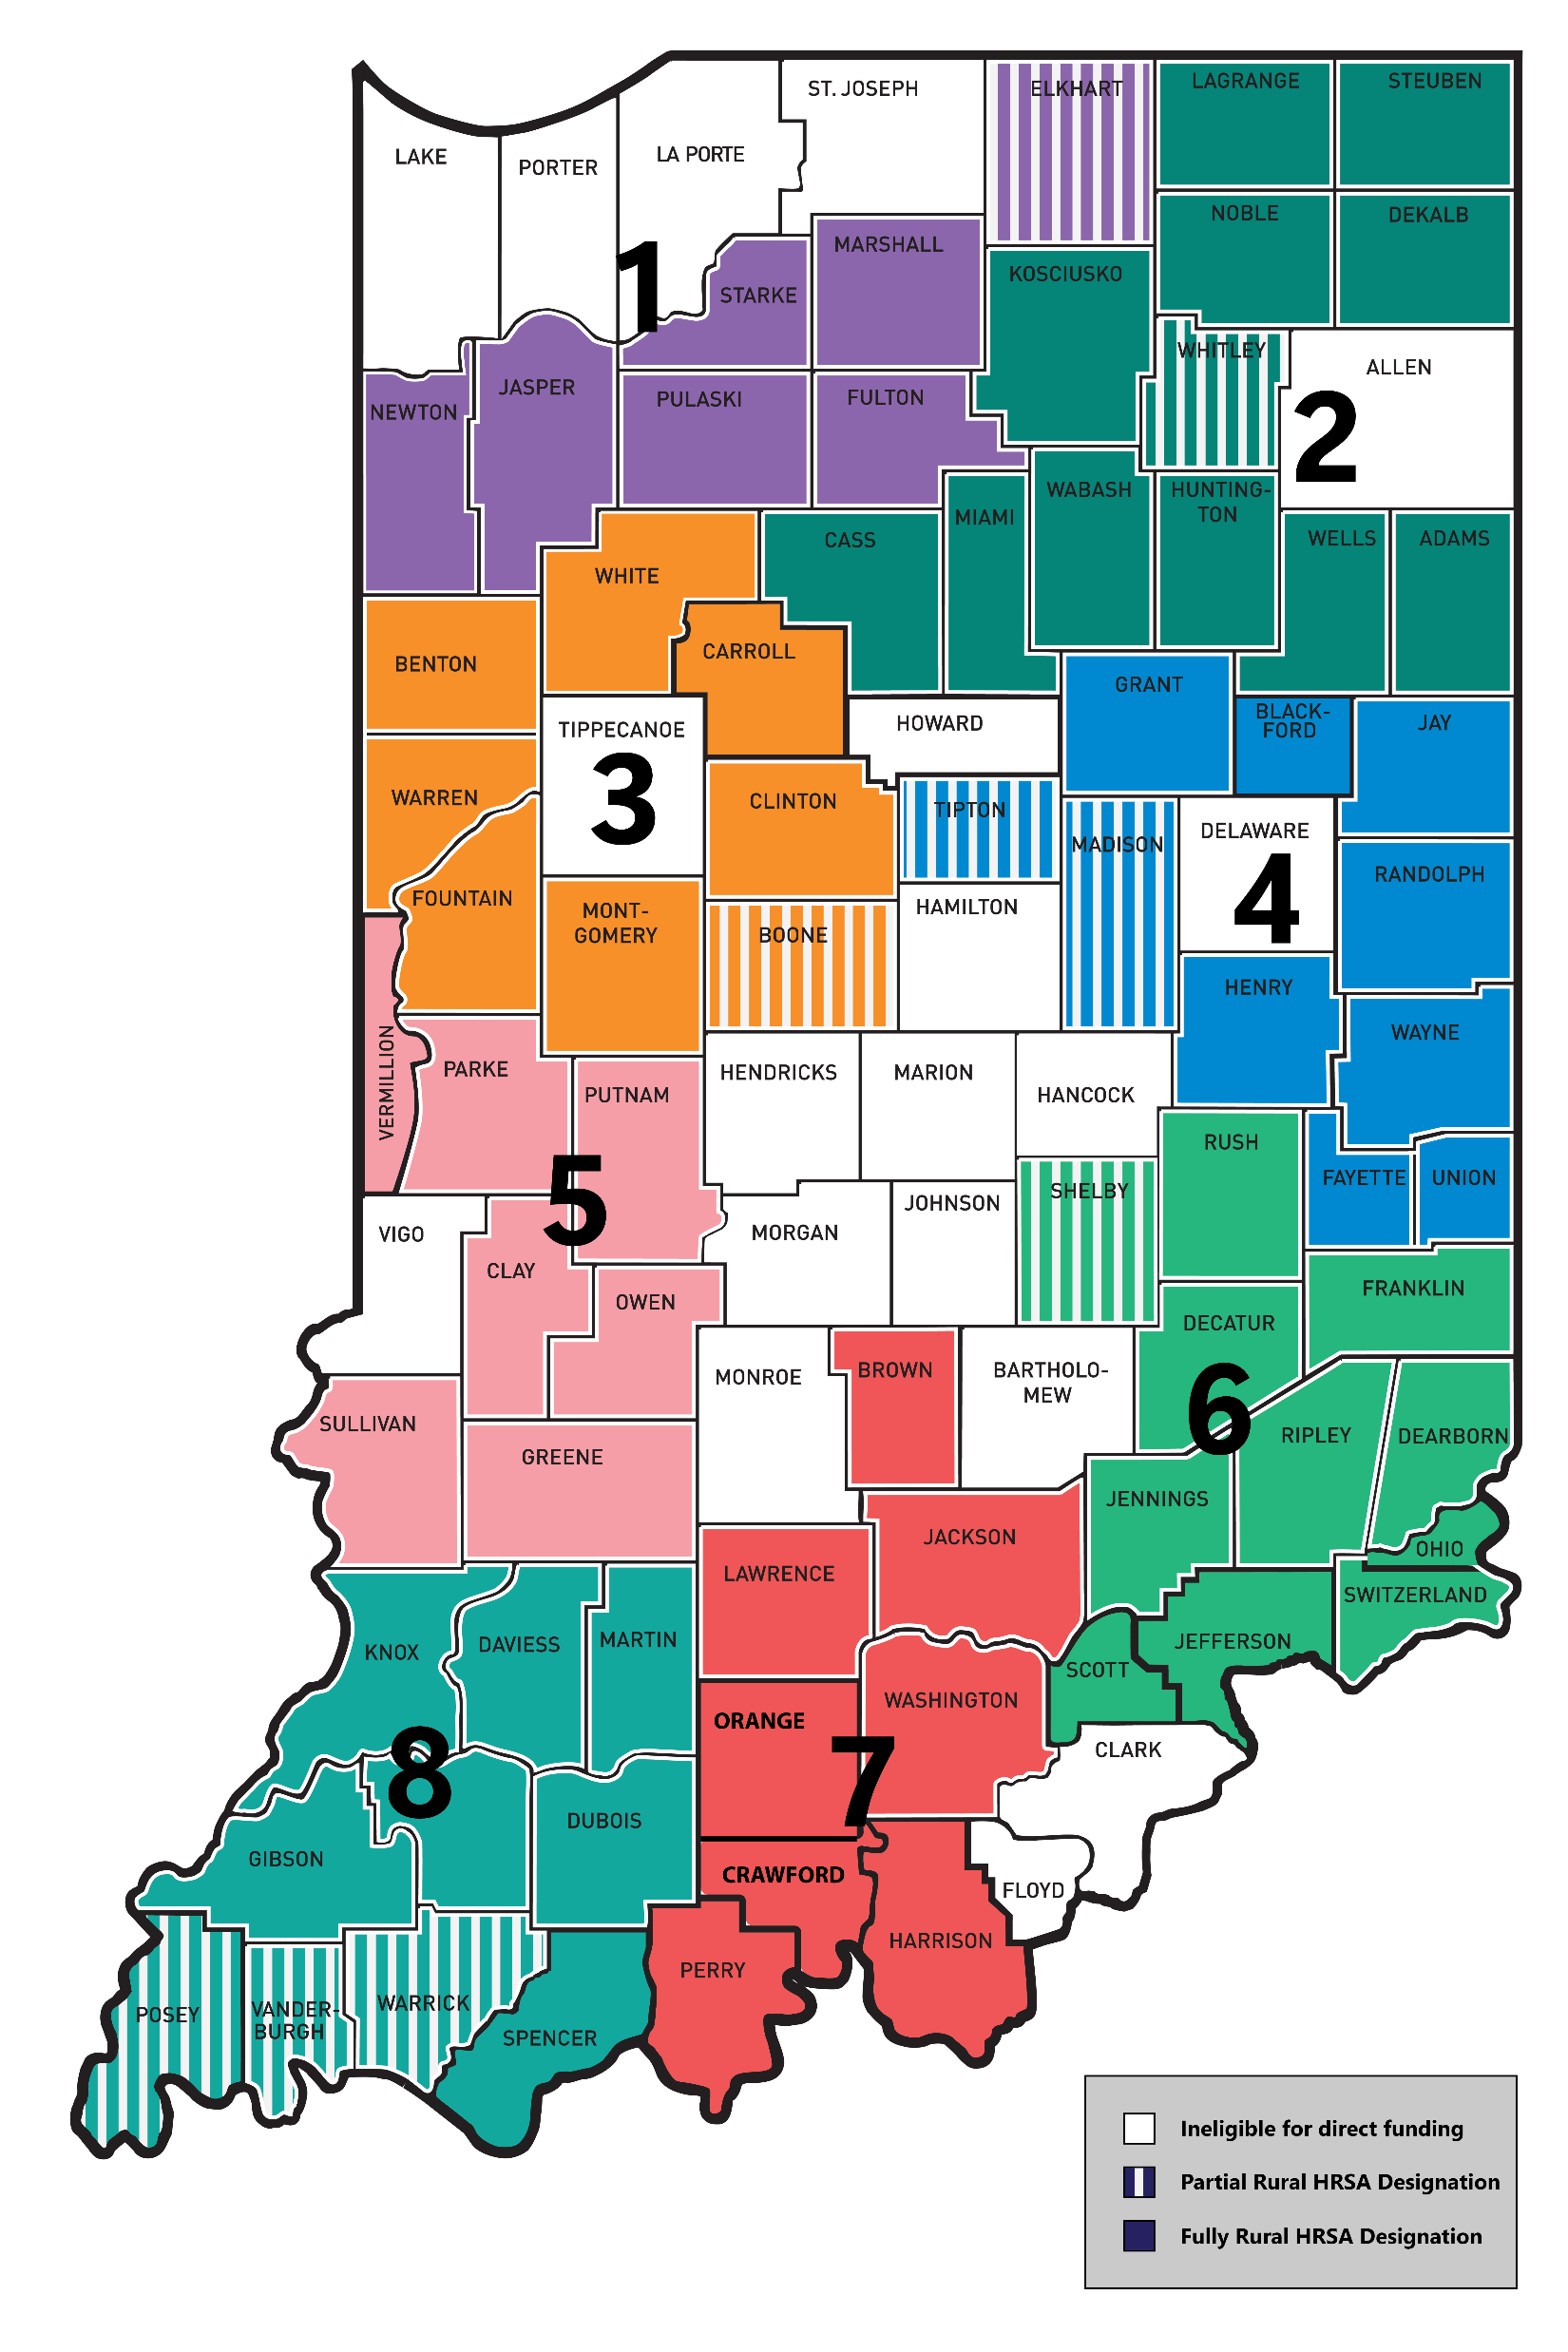
Rural Health Transformation Technical Assistance Network (RHT-TAN)
Regions 1, 2, 3
Andy VanZee
Indiana Hospital Association (IHA)
avanzee@ihaconnect.org
Regions 4, 6
Ben Harvey
Indiana Primary Health Care
Association (IPHCA)
bharvey@indianapca.org
Regions 5, 7, 8
Dr. Cara Veale
Indiana Rural Health Association
(IRHA)
cveale@indianarha.org

Slide 4
HIE Expansion
To connect over 450 facilities/organizations to the Indiana Health Information Exchange (IHIE) enabling the secured sharing/access of patient health information.
Key BP1 Activities
  Conduct Readiness Assessment (survey) for HIE Connectivity.
    Timeframe: August 21– September 4; not all organizations
  Connect Long-Term Care facilities, initially focused on SNFs/NFs.
  Assess patient consent management / infrastructure with respect to 42 CFR Part 2.
  Connect a limited number of other prioritized cohorts such as hospitals, FQHCs, CMHCs, CCBHCs.

Slide 5
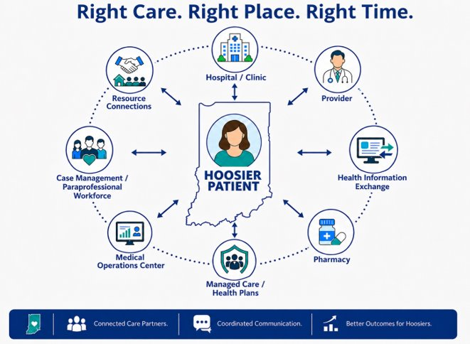
Transitions of Care
Strengthen care coordination
Improve quality of care
Enhance patient safety
Increase efficiency
Reduce healthcare costs
Support public health activities
And …

Slide 6
Overview of Provider Readiness Survey for RHTP
IDOH is launching a statewide (rural) Provider Readiness Survey to better understand how patient information is shared across providers and where additional support may be needed.
Input will help inform future IDOH decision-making regarding targeted funding, technical assistance, and statewide improvement efforts to the health information exchange ecosystem.
What the Survey will Assess
Key Details for Providers
How IDOH Will Use the Input
Health IT & EHR capabilities
Data-sharing practices
Data quality and reporting
Interoperability challenges and opportunities
Operational readiness and workflows
Workforce and governance capacity
Voluntary participation, but strongly encouraged
Survey invitations distributed by email
Best completed by someone(s) familiar with EHRs, clinical workflows, data sharing, operations, or reporting
Prioritize interoperability improvements
Inform future funding and technical assistance
Identify provider needs and barriers
Guide future years’ RHTP initiatives
Respondents may be any role type: Having a shared perspective from across an organization between executive, clinical, technical and business creates a complete picture of the impacts of gaps in information sharing and resources to support it.

Slide 7
Connecting Rural LTC Providers to the Health Information Exchange (HIE)
Key Year 1+ Activities (through July 31, 2027)
  Partnering with Indiana Health Information Exchange (IHIE), Point Click Care, and MatrixCare
  Initial focus is on SNFs/NFs
  Targeting 120+ facilities
  State funded (plan is for all years of RHTP program)
Year 2+ Activities
  Continue to connect other LTC facilities (rural based)
  Connecting Mobile Integrated Health (MIH) network members and EMS
  Other provider facility types

Slide 8
Thank you! - Questions
Brian Wikle – Interoperability Stakeholder Engagement Manger
bwikle@health.in.gov

Slide 9
RHTP Initiative 3: Improved Interoperability
LAIN August 25, 2026

Slide 10

Our Mission
Through information exchange, we improve health and healthcare.
Board Composition:
  Hospital systems
  Physicians
  Payors
  State government
  Public health
  Long-term care
  Life sciences
  Healthcare Associations
  Academia/Research
Regenstrief Institute partnership
A 501(c)(3) supporting organization

Slide 11


One of the Nation’s Largest HIEs
123
38
95%
HOSPITALS
HEALTH SYSTEMS
INDIANA POPULATION
19K
54K
20M
PRACTICES
PROVIDERS
PATIENTS
Notes:
I always explain the 20M patients, as ‘unique’ patients over time and reference the difference between the IN population v. 20+ years of accumulating unique patients.

Slide 12











How OUR HIE
Produces Value
Health Data Sources
Value-Added Services
Clinical Data Repository (INPC™)
MPI & Record Locator Service
Longitudinal Patient View
SSO with Patient Context
Patient Query Search and Return
Condition-specific FHIR based application
Clinical Results Delivery (D4D)
Web-based Access or EMR Delivery
ACO & Population Health Mgmt.
Clinical Event Notifications (ADT Alerts)
Clinical Value Report
Immunization Report
Public Health Integration and Automation
Bio-surveillance
Communicable Disease Reporting
Newborn Screening Results
Federal Government Services
SSA Disability Determination
VA’s VLER Program
Continuity of Care Services
Emergency Downtime Access
Clinical Consultation
National Network Exchange
Hospitals
Providers
Physician Offices
Labs/
Imaging Centers
Patient
Providers
Public Health
Data Repository
Data Stewardship
Providers
Payers
SECURE
Skilled Nursing Facilities

Slide 13
RHTP, Rural SNFs, and IHIE
Direct connections with your EMR vendor -- PCC or MatrixCare
Access to a web-based patient record search tool that gives clinicians access to statewide longitudinal clinical data
Training and ongoing support for facility staff

Slide 14
Workflow/Process/Next Steps
Present to each organization with demonstration
Execute agreements with the parent organization
Activate data flow from EMR vendor to IHIE
Implement access to clinical data portal
Activate and train users

Slide 15
How Will This Benefit Skilled Nursing Facilities?
Quality Metrics and Star Rating
Medical Director alerts with fewer chart requests
Cost of care
Reduced need to ‘chase’ data by DOMAs and Clinical Liaisons
Reduce readmissions
Improvement in care coordination
Early intervention information
Referral support

Slide 16


Let’s Connect!
Need help? A Solution Center specialist is available for support 24/7/365.
317-644-1752
jwilliams@ihie.org
www.ihie.org
846 N Senate Ave, Suite 110
Indianapolis, IN 46202
IndianaHIE
Indiana Health Information Exchange

