Slide 1

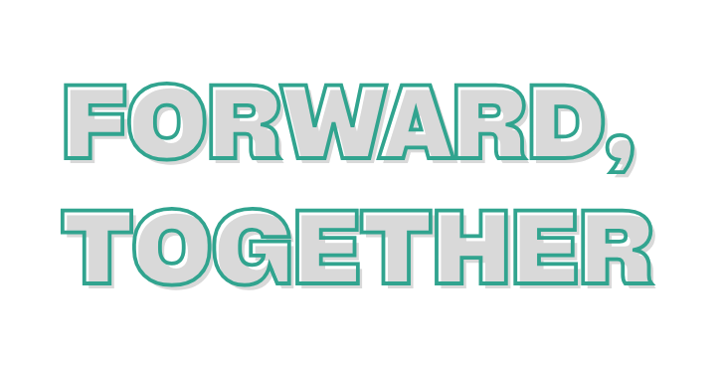

In aging services,
progress
is never
made
2026 Fall Conference
August 25-26, 2026
alone.

Slide 2
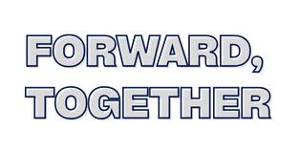
The 5 Languages of
Workplace Appreciation
Sarah Starcher
COO/ED @ Byron Health Center

Slide 3
Building a Culture Where Everyone Feels Valued
Understand why appreciation matters
Identify the five appreciation languages
Recognize that people receive appreciation differently
Learn practical ways to appreciate coworkers
Develop a personal appreciation action plan

Slide 4
Let’s put it to the test
Complete the quiz for yourself
"People don't leave jobs—they often leave environments where they don't feel valued."

Slide 5
Why Appreciation Matters
Enjoy coming to work
Stay with the organization
Communicate better
Help teammates
Deliver better resident care
Experience less burnout

Slide 6
Appreciation vs Recognition
Recognition
Usually based on performance
Often public
Usually from leadership
Happens occasionally
Recognition says: "You did a great job."
Appreciation
Values the person
Can come from anyone
Can happen daily
Builds relationships
Appreciation says: "I'm grateful for you."

Slide 7
Words of Affirmation
Examples
Thank you
Great job today
I appreciate your patience
You handled that resident well
Your hard work doesn't go unnoticed
Best Practices
Be specific
Be sincere
Give feedback promptly

Slide 8
Quality Time
Examples
Listening without distractions
Checking in
Mentoring
Eating lunch together
Walking the neighborhood together
People often spell appreciation...
T-I-M-E

Slide 9
Acts of Service
Examples
Helping answer call lights
Covering a coworker
Assisting with a difficult transfer
Helping clean up
Offering assistance before being asked
Sometimes the greatest appreciation is simply helping.

Slide 10
Tangible Gifts
Examples
Coffee
Favorite snack
Small thank-you card
Birthday treat
Team celebration
It isn't about cost.
It's about thoughtfulness.

Slide 11
Physical Touch
Appropriate Physical Touch
Examples
Handshake
High five
Fist bump
Shoulder pat (only when welcomed)
Always:
Respect boundaries
Be culturally sensitive
Never force physical contact

Slide 12
Appreciation Mistakes
❌ Generic compliments
❌ Only appreciating high performers
❌ Assuming everyone likes public recognition
❌ Waiting until Employee Appreciation Week
❌ Saying "good job" without specifics

Slide 13
Appreciation in Healthcare
Residents notice when staff appreciate one another.
Benefits include:
Better teamwork
Better communication
Less conflict
Better resident experience
Higher staff morale
Reduced burnout

Slide 14
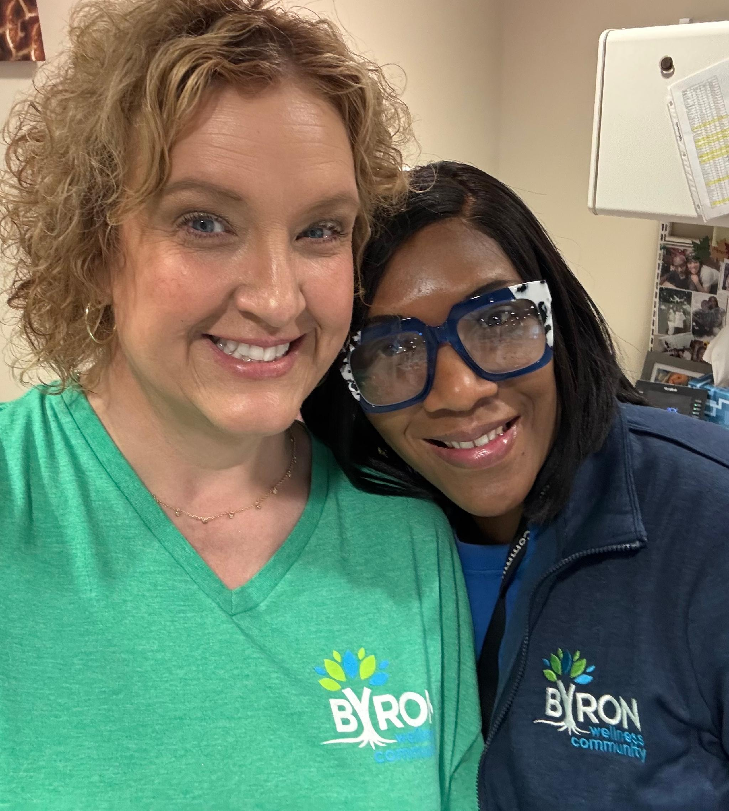
CONCLUSION
Everyone deserves to feel:
Seen
Valued
Respected
Appreciated
Small acts of appreciation create extraordinary workplaces.

Slide 15
Sarah Starcher
sstarcher@byronhealth.org
THANK YOU

