Slide 1
Discussion With ODH and Long-Term Care (LTC) Facilities on COVID-19 Reporting Requirements
Bill Storm, MPH
ELR and eCR Coordinator
Bureau of Infectious Diseases
Ohio Department of Health
Last Updated: Sept. 20, 2020

Slide 2
Agenda
Review of HHS Guidance Released June 4, 2020 and CMS QSO Released Aug. 26, 2020.
Review of Ohio Reporting Requirements for COVID-19.
LTCF Aggregate Count Registration and Reporting Process.
LTCF Case Reporting Process.
Review of Electronic Laboratory Reporting (ELR) Submission Option and Process.
Q&A.

Slide 3
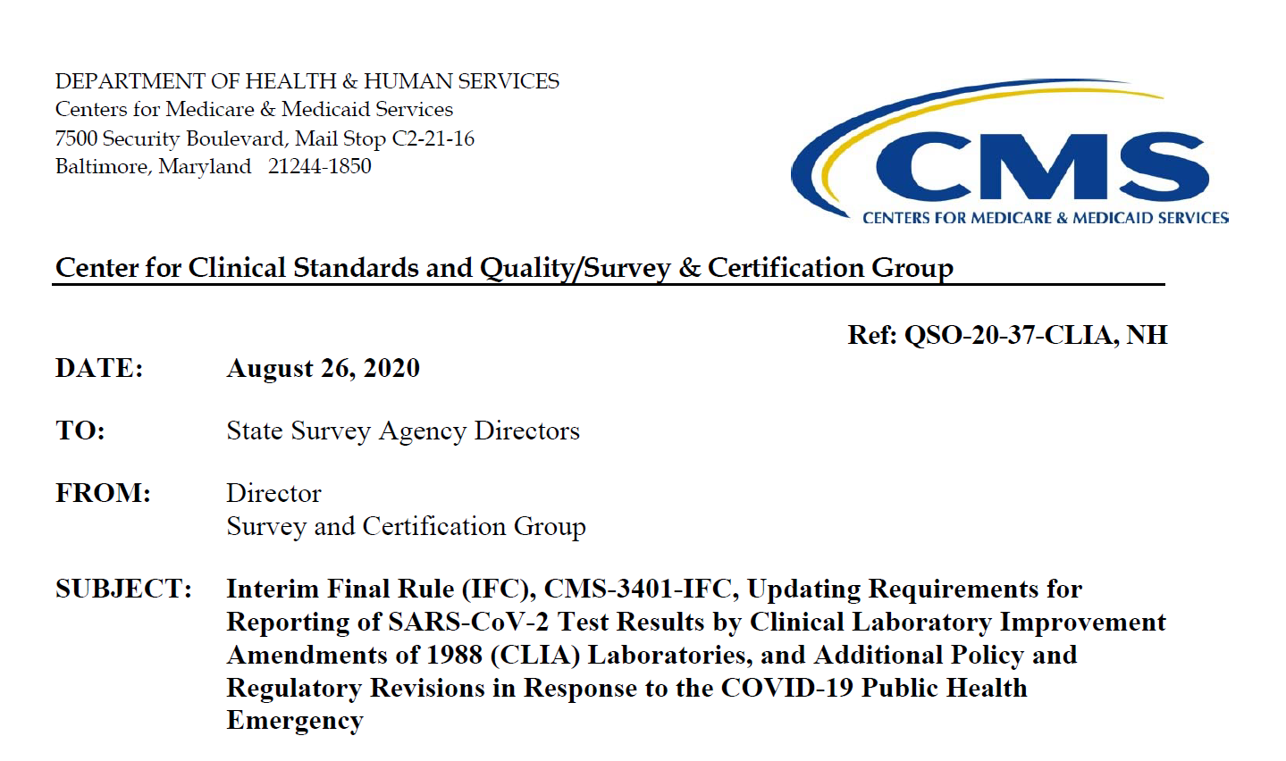
Review of CMS QSO-20-37-CLIA, NH Released Aug. 26, 2020

Slide 4
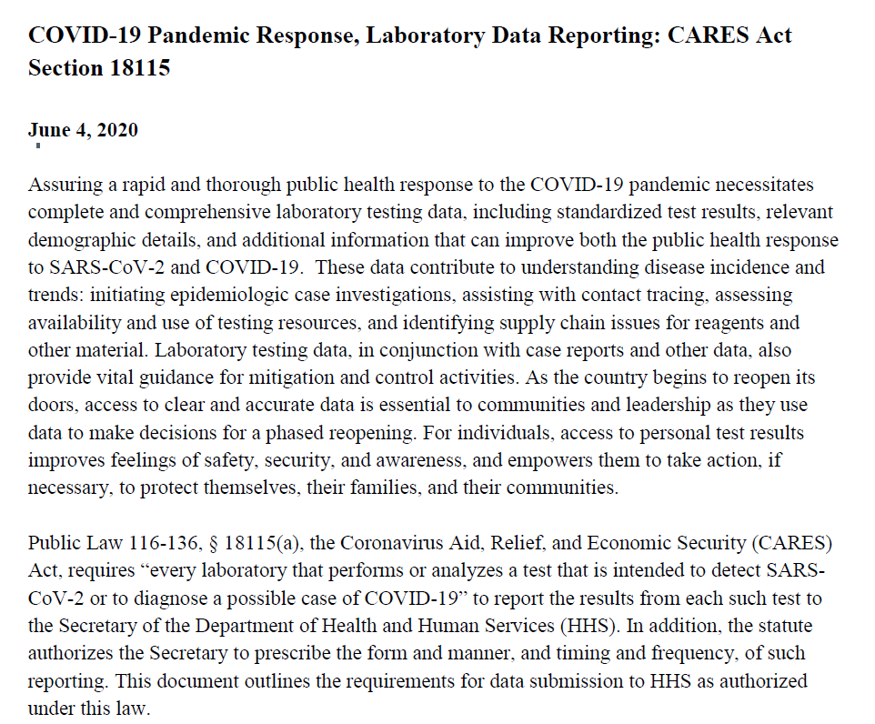
Review of HHS Guidance Released June 4, 2020

Slide 5
Agenda
Review of HHS Guidance Released June 4, 2020 and CMS QSO Released Aug. 26, 2020.
Review of Ohio Reporting Requirements for COVID-19.
LTCF Aggregate Count Registration and Reporting Process.
LTCF Case Reporting Process.
Review of Electronic Laboratory Reporting (ELR) Submission Option and Process.
Q&A.

Slide 6
Review of Ohio Reporting Requirements for COVID-19
  COVID-19 test results must be reported at both the case/line level AND the aggregate count level.
  Line level results must be reported to the local health department (LHD) where the patient resides within 24 hours of case identification.
  Aggregate counts must be reported daily by 11 a.m. ET for the previous day of testing.

Slide 7
Review of Ohio Reporting Requirements for COVID-19

Slide 8
Agenda
Review of HHS Guidance Released June 4, 2020 and CMS QSO Released Aug. 26, 2020.
Review of Ohio Reporting Requirements for COVID-19.
LTCF Aggregate Count Registration and Reporting Process.
LTCF Case Reporting Process.
Review of Electronic Laboratory Reporting (ELR) Submission Option and Process.
Q&A.

Slide 9
LTCF Aggregate Count Registration and Reporting Process
Register your LTCF here.
  Registration will initiate engagement at ODH.
Report your LTCF point-of-care (POC) antigen device COVID-19 testing results daily by 11 a.m. ET here.
Notes:
LTCFs should only report those tests that they perform in-house at their facilities. Do not report PCR test results that you have sent to a reference lab. That reference lab is required to report those counts

Slide 10
LTCF Aggregate Count Registration and Reporting Process
Two reporting tabs exist for aggregate count reporting.
  Diagnostic (PCR) COVID-19 Aggregate Test Results – Not performed at LTCFs.
  “Non-Diagnostic” (Antigen and Antibody) COVID-19 Aggregate Test Results.
  BOTH tabs must be completed before submission is accepted.
Pending Tests and Tests Not Performed only refer to specimens collected, not people yet to be swabbed.
10
Notes:
There are two tabs for reporting. The default tab is Diagnostic (PCR). LTCFs do not perform this type of testing in-house, so just enter 0’s on that tab. LTCFs should enter their POC device counts on the Non-Diagnostic (Antigen and Antibody) tab.
Total Positive
Total Indeterminate/Invalid
Total Negative
Total Pending (refers to backlog of specimens collected but LTCF didn’t have time to run the specimens that day; this will likely be 0 normally).
Total Tests Not Performed (refers to specimen quality issues, such as leaked during transport, transported in incorrect viral media, etc.; this will likely be 0 normally).

Slide 11
Agenda
Review of HHS Guidance Released June 4, 2020 and CMS QSO Released Aug. 26, 2020.
Review of Ohio Reporting Requirements for COVID-19.
LTCF Aggregate Count Registration and Reporting Process.
LTCF Case Reporting Process.
Review of Electronic Laboratory Reporting (ELR) Submission Option and Process.
Q&A.

Slide 12
LTCF Case Reporting Process
Negative COVID-19 test results must be reported at the case/line level per CMS QSO and HHS requirements.
  ODH is not yet ready to accept negative test results at the case/line level as of Sept. 20, 2020.
  ODH anticipates GO LIVE of new IT system by end of September 2020 to start accepting negative test results.
12
Notes:
Should a LTCF be surveyed or inspected on transmitting negative test results to the state, please refer them to ELR@odh.ohio.gov. ODH will provide information on the development of the new IT solution to accept and process negative COVID-19 test results and transmit said data to CDC via the COVID ELR (CELR) project. ODH will request leniency on behalf of any reporting entity given best faith effort by that entity and ODH’s development timeline and readiness to accept negative test results.

Slide 13
LTCF Case Reporting Process
LTCFs must report positive and inconclusive/indeterminate test results to the local health department.
  Manual reporting option – Faxing results using the confidential case report form or other similar report format.
  Electronic submission reporting option – Electronic laboratory reporting (ELR) using a CSV-supported schema.
Notes:
CSV = Comma separated values file, where a comma is used as the delimiter to parse columns of data.

Slide 14
Agenda
Review of HHS Guidance Released June 4, 2020 and CMS QSO Released Aug. 26, 2020.
Review of Ohio Reporting Requirements for COVID-19.
LTCF Aggregate Count Registration and Reporting Process.
LTCF Case Reporting Process.
Review of Electronic Laboratory Reporting (ELR) Submission Option and Process.
Q&A.

Slide 15
Review of Electronic Laboratory Reporting (ELR) Submission Option and Process
ODH recommends LTCFs report COVID-19 test results using an electronic submission method directly to ODH.
CSV – Comma separated values file schema format is available.
  An update to the standard CSV format will be coming to address more HHS required data fields.

Slide 16
Review of Electronic Laboratory Reporting (ELR) Submission Option and Process
Establish secure connection with ODH to submit COVID-19 testing results using secure file transfer protocol (SFTP).
Begin setting up the CSV template for your LTCF to send a TEST file to ODH for review and approval.
Participate in a brief acceptance testing period to validate the results prior to moving to PRODUCTION.
Notes:
During the SFTP connection process, your LTCF will work with ODH network IT personnel to create a SFTP account, provide the LTCF contact with user credentials, and provide a job aid to install a SFTP client, like FileZilla.
Once CSV file formatting is approved, your LTCF will participate in a brief parallel validation testing. During this time, the LTCF will continue sending positive test results to the LHD; however, a copy will also be sent to ELR@odh.ohio.gov or faxed to 614-564-2418. ODH personnel will validate that, for each faxed paper report, there is a matching row of data sent in the ELR CSV file. Once ODH completes the validation period, the LTCF will be considered LIVE in PRODUCTION and will cease sending faxes manually to the LHD.

Slide 17
Review of Electronic Laboratory Reporting (ELR) Submission Option and Process
LIVE demo of setting up a CSV file.
17

Slide 18
Agenda
Review of HHS Guidance Released June 4, 2020 and CMS QSO Released Aug. 26, 2020.
Review of Ohio Reporting Requirements for COVID-19.
LTCF Aggregate Count Registration and Reporting Process.
LTCF Case Reporting Process.
Review of Electronic Laboratory Reporting (ELR) Submission Option and Process.
Q&A.

Slide 19
ELR Contacts
Bill Storm, ELR & eCR coordinator
William.Storm@odh.ohio.gov, 614-728-3343
John Hubbard, ELR & eCR informatician
Johnathan.Hubbard@odh.ohio.gov, 614-387-2612
David Crawford, ELR informatician for CSV reporting
David.Crawford@odh.ohio.gov
ELR general questions
Email: ELR@odh.ohio.gov
Parallel testing fax: 614-564-2418

