Slide 1
Local Public Health in Massachusetts
Where We Are & Where We Need to Go
A resource guide provided by the Coalition for Local Public Health

Slide 2
This presentation was supported by funds made available from the Centers for Disease Control and Prevention, Office for State, Tribal, Local and Territorial Support, under B01OT009024.
The content of this presentation are those of the authors and do not necessarily represent the official position of or endorsement by the Centers for Disease Control and Prevention.
CDC Prevention Block Grant
Acknowledgements & Disclaimers
Notes:
Speaker Notes: Thanks to our funders and the CLPH member organizations: MAHB, MPHA, MAPHN, WMPHA and MEHA.

Slide 3
Notes:
Speaker Notes: The following slides relate to the structure, authority and roles/responsibilities of Public Health in Massachusetts.

Slide 4
What is Public Health?
Public health is defined as the science of protecting the safety and improving the health of communities through education, policy making, research, communicable disease surveillance and injury prevention.
Community Health: Public health is concerned with the health of every member of the community; public health is community health.
Wellness: The primary mission of public health is to support community wellness and to prevent hazards and illness from spreading through the community.
Prevention: The purpose of public health is to prevent disease.
Notes:
Speaker Notes: Public health has many definitions, as is evident from this slide. The definition that many use is one that comes from a decision of the Massachusetts Supreme Judicial Court in a case from 2006. The Court said that public health was about protecting every member of the community. It is done through implementing all of the above-described strategies.

Slide 5
The structure of Local Public Health in Massachusetts:
Local Public Health in Mass is decentralized. There are 351 independent boards of health, all of whom have the legal authority to enact local public health laws.
Unlike other states, MA has no dedicated state funding for local public health, leaving funding decisions and allocations to the discretion of each municipality.
Notes:
Note to speaker: In case it is asked in FY21, the state budget set aside 11.7 million for public health cross jurisdictional sharing. In FY22 that was increased to 13 million. But these are for competitive grants, not core function support for every town. This information will be covered in depth later in the presentation.
Speaker Notes:

Slide 6
Where do Boards of Health get their legal authority?
Federal law
Minimum standards are set in federal law and by the CDC
State
The State Legislature and state agencies can enact public health laws and regulations.
They are usually minimum standards for Massachusetts that can be made stricter through local public health laws.
Local boards have the authority to enact reasonable regulations pursuant to state law.
Local regulations are equal to state statutes, by-laws, and ordinances
Courts will only strike a board of health regulation when the challenger proves, on the record, “the absence of any conceivable ground upon which [the regulation] may be upheld.” (case from the Supreme Judicial Court).
Notes:
Note to speaker: Courts in Massachusetts have consistently upheld board of health authority to enact reasonable regulations. The Court will not substitute its judgment for the judgement of the board of health.
Speakers Notes:

Slide 7
Boards of Health &
Health Departments
Boards of Health
Each board is made up of 3 to 5 elected or appointed members.
Vast majority are volunteers, some receive stipends.
They set policies and make regulations.
They hold hearings and issue orders.
Health Departments (can be regional or stand-alone)
Staff can include health directors, inspectors/sanitarians, nurses, and community health workers.
Staff work under the legal authority of the Board of Health to do the work of ensuring code compliance and protecting public health.
Notes:
Speaker Notes:
It is important to differentiate between Boards of Health, who oversee the public health work for a town and Health Departments, which are made up of staff working under their authority.
However, in many parts of Massachusetts state law, both are referred to as “Board of Health” since the authority comes from the appointed/elected board.
Note that in at least 70-80 BOH elected members are also doing the work of health departments in areas of the State that have small or virtually no budgets for public health.

Slide 8
How are Health Depts Funded Funded?
Municipal Taxpayer funds
Licensing and permitting fees
Ticketing revenue
Grants: Federal, State, Local Foundation
Notes:
Speaker Notes:
Some ways that Health Departments fund their work include:
Municipal Taxpayer funds allocated at Town Meeting or City Council in the municipal budgeting process
Licensing and permitting fees paid by businesses like camps or restaurants
Fine and ticket revenue (rare)
Grants: Federal such as the FDA, State grants like SAPHE or Mass in Motion, Local Foundation grants

Slide 9
Role of Local Public Health
Ensure food safety
​Perform infectious disease investigation, reporting, and follow-up
Hold local vaccine clinics, wellness clinics, public education
Respond to Housing Code violations ​and ensure compliance with tobacco and lead laws​
License and inspect summer camps, campgrounds, pools, and short term lodging.
Prepare for and respond to public health emergencies
Environmental protection: respond to pollution, protect drinking water and groundwater through private wells and septic systems
Notes:
Note: you will need to decide how much detail you want to give about what we do, depending on your audience. If you only want a brief overview you can use just this slide. For more detail, add the next two slides. For even more, by area (food, housing, etc), there are more slides with more details at the end of the presentation that you can move up here if needed.
Speaker Notes: Some of the well known responsibilities of boards of health include:
Ensure food safety at restaurants, schools, fairs, food trucks, farmers markets, and more.
​Perform infectious disease investigation, reporting, and follow-up (75 tracked diseases in MA require BOH attention at varying levels)
To prevent disease, health departments hold local vaccine clinics, wellness clinics, and public education events
In response to complaints from residents, respond to housing code violations ​and ensure compliance with tobacco and lead laws
License and inspect summer camps and pools to keep kids safe.
Licence and inspect short term lodging (hotels, motels, campgrounds, Airbnd)
Prepare for and respond to public health emergencies in the community. In MA lately that has been covid, drought, Eastern Equine Encephalitis, ice storms, tornados, and more. ​
Environmental protection: respond to pollution, protect drinking water and groundwater through licensing private wells and reviewing plans for new and repaired septic systems, as well as determining where the groundwater is when a septic system is going to go in (called a perc test)

Slide 10
Responsibilities: Licensing and Inspecting
Recreational Camps for Children
Including buildings, emergency procedures, health procedures, vaccination records, background checks for staff, food preparation, waterfront and pool safety, and much more. Must be inspected each session.
Public & Semi-Public Swimming Pools & Hot Tubs
Inspections twice yearly, including appropriate use of chemicals for sanitation, safety of equipment and facility, safety procedures.
Body Art/Tattoo parlors and practitioners
Tanning Facilities
Cannabis establishments (if there is a local regulation)
Short term and temporary lodging
Includes Hotels, Motels, Airbnb, and Campgrounds
Septage and Garbage Haulers
Public and Semi-Public Bathing Beaches
Including weekly testing in season, closure when necessary
Indoor Ice Skating Rinks
Mobile Home Parks
Family Campgrounds
Notes:
Use these slides or the additional ones at the end if you want to go into more detail on the responsibilities.
Speaker Notes:
One of the most important functions of local public health is to issue licenses and inspection operations that pose a potential risk to the public’s health.
Local health departments provide governance, education and support to assist operators with compliance to sanitary regulations. Administrative actions include orders of correction and hearings. When imminent health hazards exist, closures, suspension of permits and revocation may be required. A license can be revoked if the establishment is found to violate minimum safety standards.

Slide 11
Other Responsibilities:
Communicable Disease Investigation, Isolation and Quarantine
Addressing Community Health Needs
Wellness clinics, community coalition work, chronic disease and substance use disorder prevention
Air Quality Complaints
Emergency Preparedness Planning
Including Emergency Dispensing Sites (EDS), hazmat, radiation, sheltering, public information/risk communication.
Hazardous, Medical and Biological Waste
Solid Waste & Recycling
Some Transfer Stations are run by local health departments
Beaver control
Tobacco Control
Other Animals & Vectors
Mosquito control and education about tickborne illnesses
Other miscellaneous work done in some towns:
Including pesticides, funeral director licensing, burial permits, kennels, animal inspector, etc.
Notes:
Note to speaker: See the previous slides notes.
Speaker Notes:
Environmental, epidemiologic and laboratory staff play vital roles in the investigation of disease within the community and control of disease spread. There are multiple other emergencies that require a response. As professionals, there is a need to stay informed and current with evolving public health issues.

Slide 12
Notes:
Speaker Notes: The following slides discuss the challenges of a decentralized system, how this can reflect in life outcomes, and how these gaps impacted the COVID-19 response.

Slide 13
Structural challenges of a decentralized system:
Local health department funding per population size varies​
Small towns struggle to fund their local health department​
Education and credentialing of board members and staff vary, with no set standards
Data reporting is inconsistent
Notes:
Notes to speaker:
This section can be modified to suit your specific needs. Talk about the parts that affect you most and consider modifying the slide with some of the suggested notes bellow.
Speaker Notes:
Funding is at the local municipality’s discretion, meaning LBOH are perennially underfunded and health disparities and inequities are created between municipalities.
No required workforce training or credentials means public health work is often undervalued, leading to underfunding compared to other municipal departments.
No required training or credentials means in some communities unqualified personnel – including elected BOH members – are conducting BOH work, including inspections.
Transition to inspectional services model separates environmental responsibilities from epidemiology and infectious and chronic disease control, undermining prevention efforts.
Multiple and varied responsibilities make it difficult to be fully qualified and knowledgeable in all areas. Every year BOH are expected to do more, with no additional funding or training.
Many board of health staff are retiring or about to retire, with few workers in the pipeline.
Little oversight to determine if LBOH are meeting their mandated services.
Climate change, leading to increased flooding and other environmental issues and emergencies, as well as emerging diseases (e.g., increasing tickborne illness across the state).
No time to concentrate on chronic disease or wellness. Moving the needle on Social Determinants of Health.
Lack of understanding about what public health does/what its value is. If public health is doing its job right, no one notices it.

Slide 14
Many health departments struggle to perform statutorily required services.
​Few health departments are prepared to meet nationally recommended foundational public health services.
​Inequitable public health protections across communities.
Spending tied to the finances of municipalities and not to public health needs
Results of a Decentralized System
Notes:
Speaker Notes: Years of not funding local public health has resulted in inequities across the Commonwealth. Often our most vulnerable communities do not have the capacity to perform some of the basic requirements to ensure protecting the public. Because of this food inspections may not be done as necessary and not every resident has access to a public health nurse who provides a broad scope of functions to the community.

Slide 15
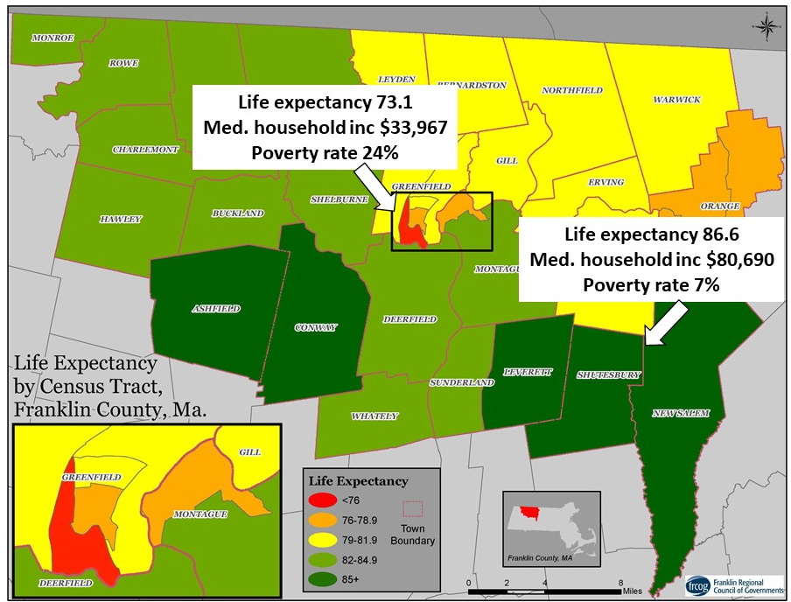
Why
Funding
Matters
Notes:
Notes to Speaker:
Use this slide or the next depending on which area of the state you are addressing.
Speaker Notes:
Life expectancy can be influenced by poverty rate, income, ability to safely do recreational activities, access to nutritious meals etc. A well funded public health program is an integral part of addressing health inequities in Massachusetts
Further reading:
https://pubmed.ncbi.nlm.nih.gov/27513279/
https://www.rwjf.org/en/library/interactives/whereyouliveaffectshowlongyoulive.html

Slide 16
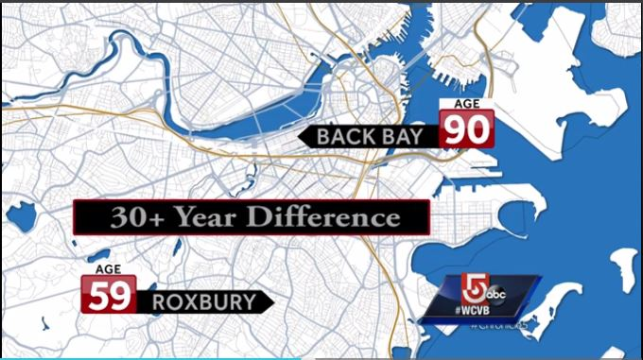
The difference in life expectancy between Boston neighborhoods:
Notes:
Notes to Speaker:
Use this slide or the previous depending on which area of the state you are addressing.
Speaker Notes:
Life expectancy can be influenced by poverty rate, income, ability to safely do recreational activities, access to nutritious meals etc. A well funded public health program is an integral part of addressing health inequities in Massachusetts

Slide 17
Local Public Health During COVID-19​
Issuing and enforcing isolation orders​ and supporting those in isolation
Investigating suspected cases and making testing recommendations ​
Tracing contacts​ and issuing them quarantine orders and supporting them to stay home
Enforcing essential business orders and re-opening guidance
Working with school districts and school committees
Coordinating with town officials, first responders, businesses and residents and serving as a communications hub between local residents and state officials​
Responding to resident and business complaints regarding COVID orders
Inspection/approval of new childcare “co-operatives”
Notes:
Speaker Notes: What was the role of local public health during the pandemic?
Issuing and enforcing isolation orders to people who had contracted COVID and supporting them to stay home and stay safe
​Investigating suspected COVID cases and making testing recommendations ​
Tracing contacts​ and issuing them quarantine orders; checking in with these people regularly to see how they were doing, and releasing them from quarantine when the required time was over.
Enforcing essential business orders & re-opening guidance and providing input to businesses on safe operating procedures​
Working with school districts and school committees on safe reopening plans
Coordinating with town officials, first responders, businesses and residents & serving as a communications hub between local residents and state officials​
Responding to resident and business complaints regarding unsafe practices, mask wearing, gatherings and events working with municipal officials to inspect and approve new childcare cooperatives.
Public Health Nurses were able to keep residents out of the hospital due to their clinical expertise in working with individuals and families.

Slide 18
COVID-19 Strained an Already Stretched System
The COVID-19 pandemic has shown that our local public health system is not adequately structured, staffed, or financed to meet large scale public health challenges.
COVID-19 spread more quickly due to:
Lack of public health nurse capacity for contact tracing
Inconsistent enforcement of orders from municipality to municipality.
Notes:
Speaker Notes: COVID19 highlighted the need for a better state system. As future public health emergencies occur, we need a strengthened workforce which has the immediate capacity to address the needs at hand. More Public Health Nurses and Health Agents are needed throughout the Commonwealth so that their functions can shift to dealing with the health issues of the emergency. Having greater workforce capacity would reduce inconsistent enforcement between communities.

Slide 19
Advocating for Systems Change:
The History and Legislative Response
Notes:
Speaker Notes: The following slides discuss the Special Commission on Local and Regional Public Health- it’s findings and the goals the commision set out for the commonwealth to improve public health delivery.

Slide 20
The Special Commission on Local and Regional Public Health​
The Special Commission on Local and Regional Public Health was established in August 2016 to:​
Assess the effectiveness and efficiency of municipal and regional public health systems
Make recommendations regarding how to strengthen the delivery of public health services​
The multi-sector commission included the following organizations in addition to 4 legislators, 8 appointees by the Governor, and 4 Executive Branch departments:​
Massachusetts Taxpayers Foundation​
Massachusetts Municipal Association​
Massachusetts Public Health Regionalization Working Group​
Massachusetts Health Officers Association​
Massachusetts Environmental Health Association​
Massachusetts Public Health Nurses Association​
The Western Massachusetts Public Health Association
Notes:
Speaker Notes:
MEMBERSHIP OF THE COMMISION: The Commission had representation from nearly everyone with a stake in the local public health system. Members included
4 executive branch representatives (DPH—with Commissioner Bharel as chair, the Department of Environmental Protection, Department of Agricultural Resources, and Executive Office of Administration and Finance) -- DEP, DPH, MDAR, A and F
4 legislators appointed by legislative leadership, both republican and democratic
8 appointments by the Governor representing different size communities local health departments and
representatives of 9 named organizations including public health trade associations, the Massachusetts Municipal Association, and Massachusetts Taxpayers Foundation.

Slide 21
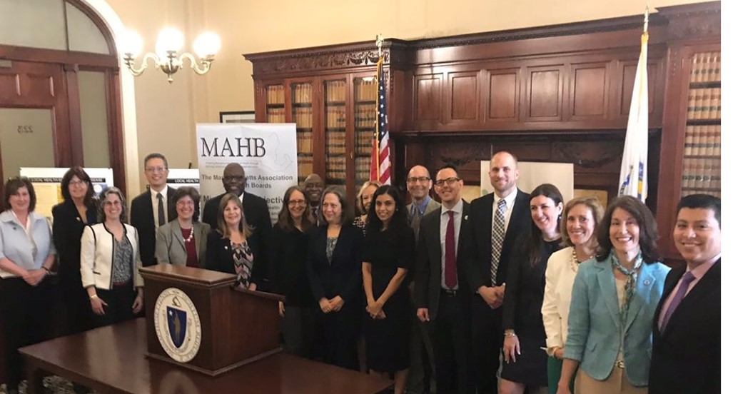
Notes:
Speaker notes: Photo shows the members of the special commission at the report release at the state house in spring of 2019
The Commission was established by Chapter 3 of the Acts of 2016 to “assess the effectiveness and efficiency of municipal and regional public health systems and … make recommendations regarding how to strengthen the delivery of public health services and preventive measures.”
CHARGE OF COMMISSION: The key elements of the Commission’s charge are listed here. The Commission was charged with assessing:
the current capacity of the local public health system to meet national standards and to carry out their statutory powers and duties
Resources available for the local public health system
Credentials of the local public health workforce
Capacity of the Office of Local and Regional Health
Approaches to shared public health services
Progress towards achieving the 2009 public health recommendations of the Regional Advisory Commission Submit a report of its findings and recommendations
The Commission was also required to submit a report of its findings and recommendations to the Governor and legislature.
RESULTS: The Special Commission on Local and Regional Public Health completed its work with the approval of its final report—Blueprint for Public Health Excellence: Recommendations for Improved Effectiveness and Efficiency of Local Public Health Protections—at its June 2019 meeting. The Commission made recommendations in six areas. While each of the individual measures recommended in the report is beneficial by itself, they are intended to be implemented as an interlocking set, reinforcing and magnifying each other.
Let’s look a little more at what the Commission Recommended.

Slide 22
Notes:
Commission Finding: The Commission found that the Massachusetts local public health system was not meeting national public health standards. These standards have evolved over the past three decades – beginning with the ten essential public health services promoted by the U.S. Centers for Disease Control and Prevention in the 1990s to the rigorous voluntary accreditation standards set by the Public Health Accreditation Board a decade ago.
The Commission also found that many Massachusetts cities and towns struggle to carry out statutory duties and responsibilities. It recommended a two-step approach – bring municipalities to the capacity to meet statutory obligations and move the Commonwealth toward a system in which all cities and towns meet national standards. The focus of the work in meeting national standards will be on implementing the Foundational Public Health Services —a national framework that defines foundational capabilities and programs that everyone should expect from the public health system.
Commision Recommendations:
Elevating the standards by:​
Identifying ways for cities & towns to meet statutory requirements​
Assessing implementation of Foundational Public Health Services​
Setting education and training standards by:​
Making training accessible​Implementing workforce credentialing standards adopted by SCLRPH​eveloping a system to ensure compliance

Slide 23
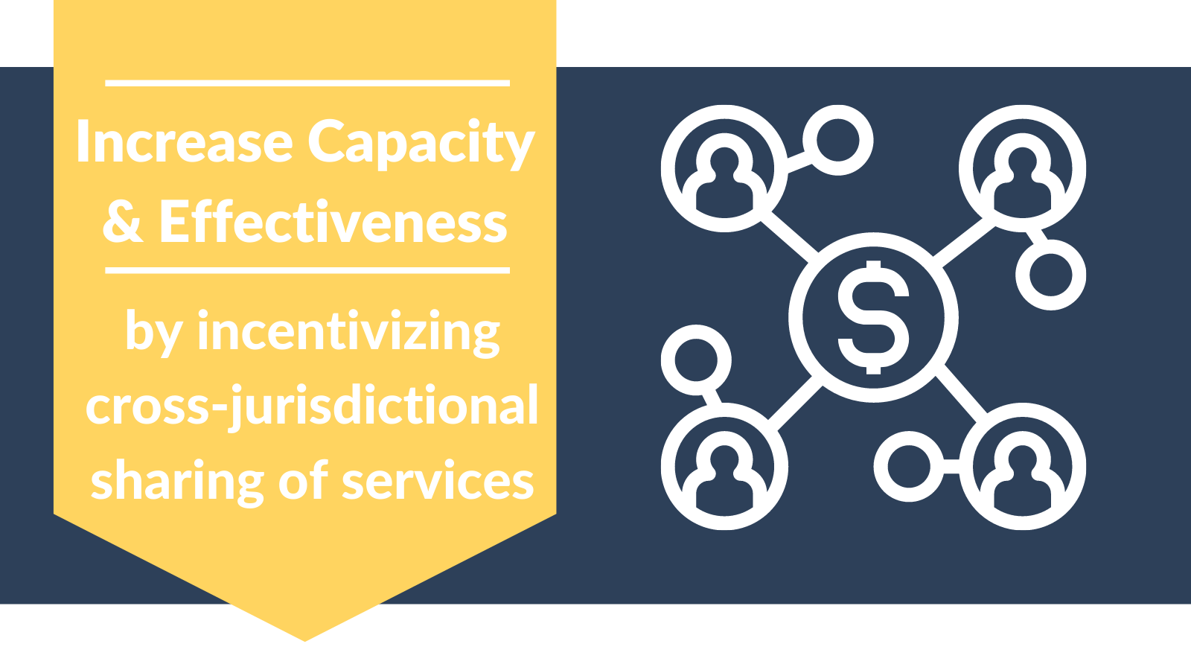
Notes:
Commission Finding
Massachusetts has more local public health jurisdictions than any other state (351)—one for each city and town—and cross-jurisdictional sharing of services is limited despite evidence that it improves effectiveness and efficiency.
Recommendation:
¨Increase cross-jurisdictional sharing of LPH services in towns of all sizes.
¨Increase the scope and size of existing public health districts & formal shared services agreements.

Slide 24
Notes:
Commission Findings: Data to measure local public health system performance is limited. While other states have a formal process by which local public health jurisdictions report on a variety of system measures to the state department of public health, Massachusetts has a patchwork system of categorical reporting requirements—and reporting for those categorical program areas is limited. The Commission recommended taking steps to improve the data collection system to approach the kinds of systems in place in other states. The result of such a system could be a report card on the status of the system as a whole as well as that of each public health district, city, or town.
Commission Recommendation: Improving data reporting by:
Creating a standardized public health reporting system​
Strengthening DPH, DEP, and local public health capacity to collect and share data​

Slide 25
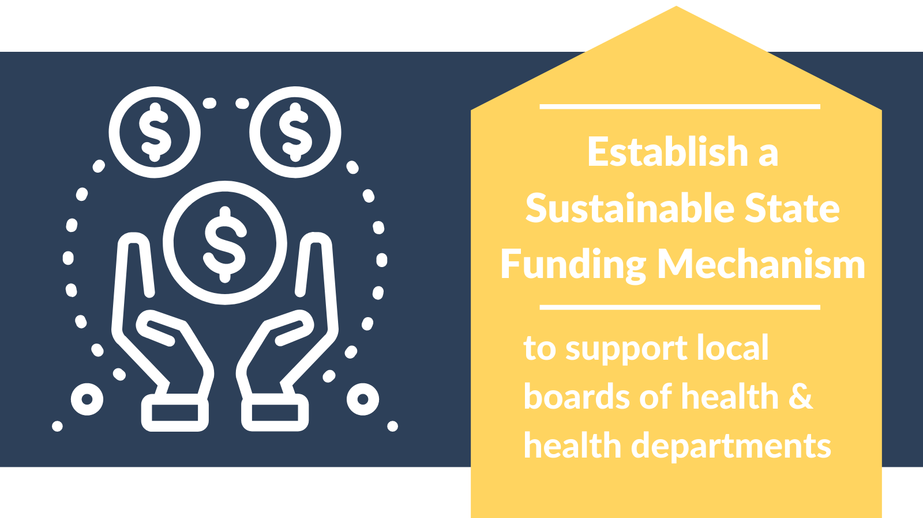
Notes:
Commission Finding
Funding for local public health is inconsistent and inequitable in its ability to meet the current mandates and the needs of a 21st century system
The depth and breadth of local public health protections, like many other municipal services that are supported largely by local tax revenue, varies from municipality to municipality. The Commission recognized early in its deliberations that investing more funding to achieve equity in system capacity across municipalities is not the solution. Not only is the appropriate use of existing resources a necessary step but also the system needs to be designed for greater efficiency. The interlocking nature of the Commission’s recommendations is evident in looking at resources to meet system needs.
Commission Recommendation
Commit appropriate resources to the local public health system changes proposed by the commission
So that is a quick summary of the findings and recommendations of the Special Commission. Now lets look at what has been done with them since!

Slide 26
January 2019 - Representatives Kane & Garlick and Senator Lewis filed legislation based on the special commission recommendations
April 2020 - SAPHE Act signed into law by Governor Baker as Chapter 72 of the Acts of 2020, An Act Relative to Strengthening the Local and Regional Public Health System
Notes:
Speaker Notes:
The first legislative action on the recommendations of the Special Commission was the SAPHE 1.0 Act.
The bill advanced the goals of the Commission by:
Improving access to essential training for members of the local public health workforce
Creating an incentive program to support more effective and efficient delivery of services through cross-jurisdictional sharing
Moving Massachusetts toward national local public health standards

Slide 27
Recent Local Public Health Wins
$1.7 million for the SAPHE Program in the FY20 and FY21 state budgets
First state funding for local public health:
$11.7 million in the FY21 state budget
$15 million in FY22 state budget
Distribution of cross-jurisdictional sharing grants in FY20, FY21, FY22
Filing of SAPHE 2.0 legislation
Notes:
Speaker Notes:
As of June 21, 2021 recent wins for Local Public Health include:
$1.7 million for the SAPHE Program in the FY20 and FY21 state budgets
The first dedicated line item to local and regional Boards of Health
$11.7 million in the FY21 state budget
$10 million in the Governor's House 1 FY22 budget
$15 million in FY22 state budget
Distribution of cross-jurisdictional sharing grants in FY20, FY21, and FY22
Legislative Champions filed the SAPHE 2.0 Bill (more on this next), and there was an early Hearing by the Joint Committee on Public Health for SAPHE 2.0 legislation
Over 130 people rallied at the state house to ask for the investment of some of Massachusetts federal COVID recovery funds in local public health.
The next slides give a little more information about each of these wins.

Slide 28
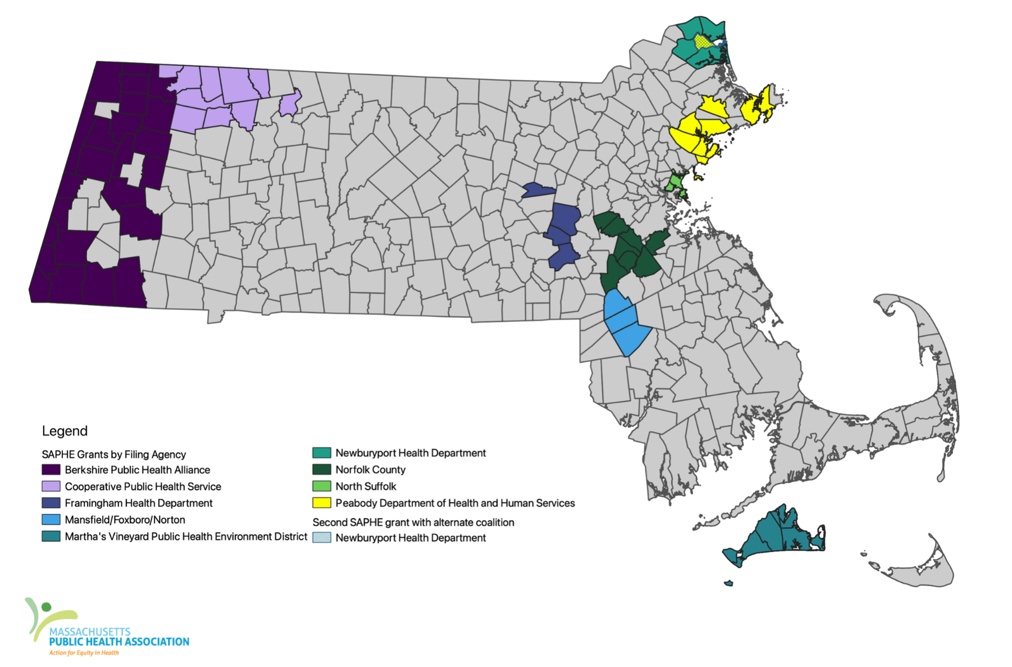
SAPHE Grants Awarded as of January 2021
Notes:
Speaker Notes:
This map shows the initial grants distributed as a result of SAPHE 1.0. Grants were awarded to groups of towns working on sharing various services such as online permitting, health inspection, abandoned and distressed housing work, tick borne disease prevention, and more.

Slide 29
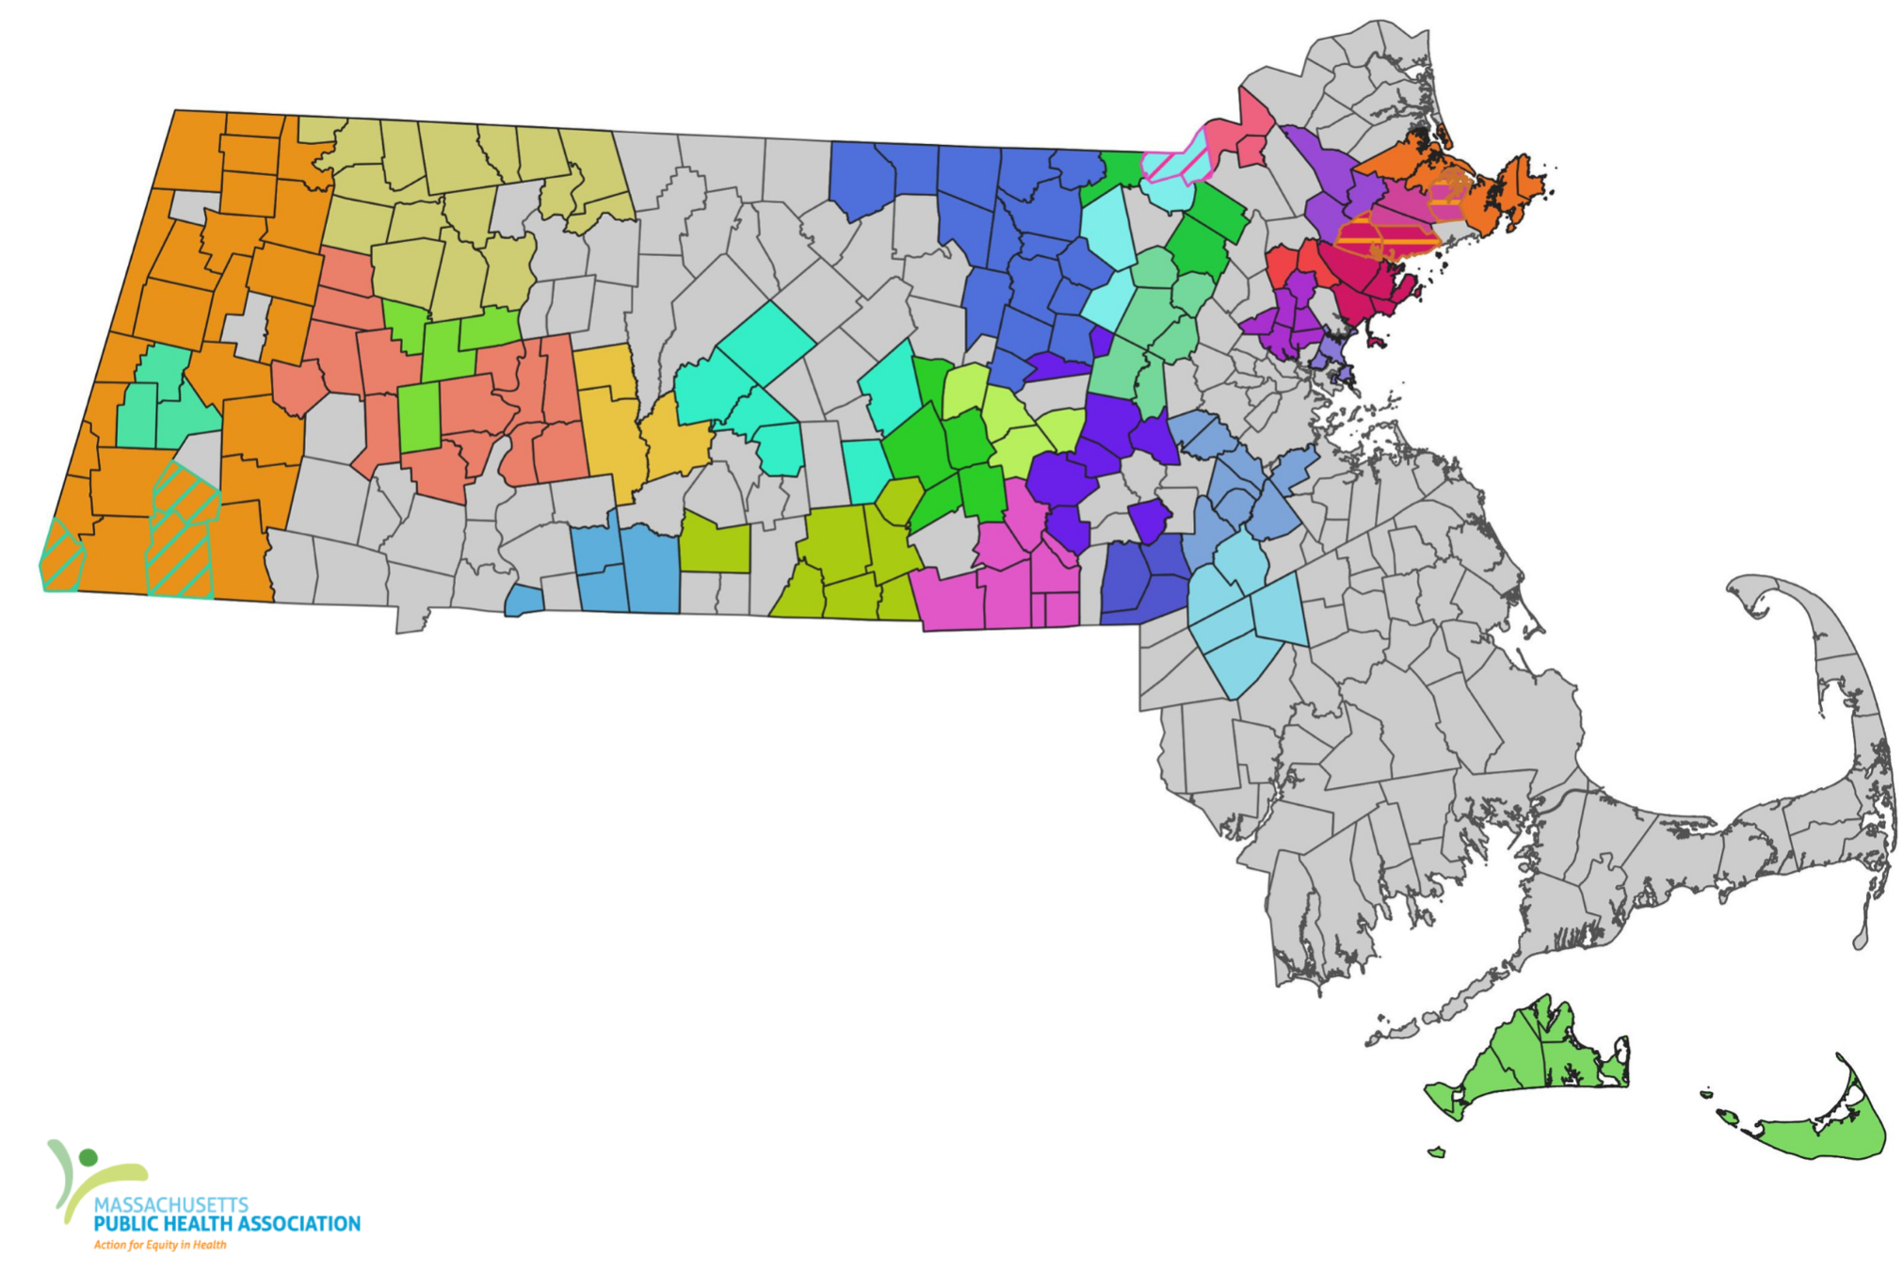
Public Health Excellence Awards
May 2021
Notes:
Speaker Notes:
After the success of the initial SAPHE grants other organizations applied for the expanded funding. In its first grant cycle 28 shared service grant awards were made covering 189 cities and towns.
Most of these towns are using the shares service grants for public health nursing, health inspection, and/or resource coordination

Slide 30
Public Health Excellence Awards
July 2021
Cohasset, Hingham, Hull, Weymouth
Fall River, Seekonk, Swansee
Dover, Medfield, Needham
Fairhaven, Freetown, New Bedford
Arlington, Medford, Somerville
Blandford, Granville, Southwick, Tolland
Athol, Clinton, Fitchburg, Gardner, Hubbardston, Leominster, Phillipston, Princeton, Royalston, Sterling, Templeton, Westminster, Winchendon
Notes:
Note to speaker: This map was made in May of 2021 and the grant application period was reopened. As of August there is an expectation that there will be several more towns and service agreements added. Please make sure you have the latest map.
Speaker Notes:
After the success of the initial SAPHE grants other organizations applied for the expanded funding. In its first grant cycle 28 shared service grant awards were made covering 189 cities and towns.
Most of these towns are using the shares service grants for public health nursing, health inspection, and/or resource coordination

Slide 31
What’s Next:
Local Public Health Fall Advocacy Efforts
Notes:
Speaker Notes: The following slides discuss the Special Commission on Local and Regional Public Health- it’s findings and the goals the commision set out for the commonwealth to improve public health delivery.

Slide 32
Timely Legislative Action Needed
SAPHE 2.0 Bill
Legislation that builds off SAPHE 1.0 law to accelerate improvements to the local public health system, in alignment with the Special Commission recommendations
ARPA
Request for $250.9 million over 5 years from federal COVID relief funds controlled by the MA legislature (of $5B+ total)

Slide 33
Notes:
Speakers Notes:
The next round of legislation filed by legislative champions and the Coalition for Local Public Health is the SAPHE 2.0 Bill. SAPHE 2.0 further addresses the goals of the Special Commision, with next steps toward making these vital protections mandatory.

Slide 34
A standardized, integrated, and unified public health reporting system
Workforce education and credentialing standards
Ongoing and robust training and educational opportunities provided by the state
Direct funding to Local Boards of Health
Technical Assistance for Local Boards of Health
Notes:
Speakers Notes:
The next round of legislation filed by legislative champions and the Coalition for Local Public Health is the SAPHE 2.0 Bill. SAPHE 2.0 further addresses the goals of the Special Commision, with next steps toward making these vital protections mandatory.

Slide 35
What You Can Do Now (as of 9/9/21)
Sign onto the ARPA funding request by Fri 9/17:
tinyurl.com/ARPAforLPH
Ask your town managers, mayors, colleagues, and networks to sign-on
Contact your state Rep and state Senator
Ask them to support our ARPA request and SAPHE 2.0 legislation
malegislature.gov/Search/FindMyLegislator
Sign-up for SAPHE 2.0 email list
To receive campaign updates and action alerts at critical moments
tinyurl.com/SAPHEforMA

Slide 36
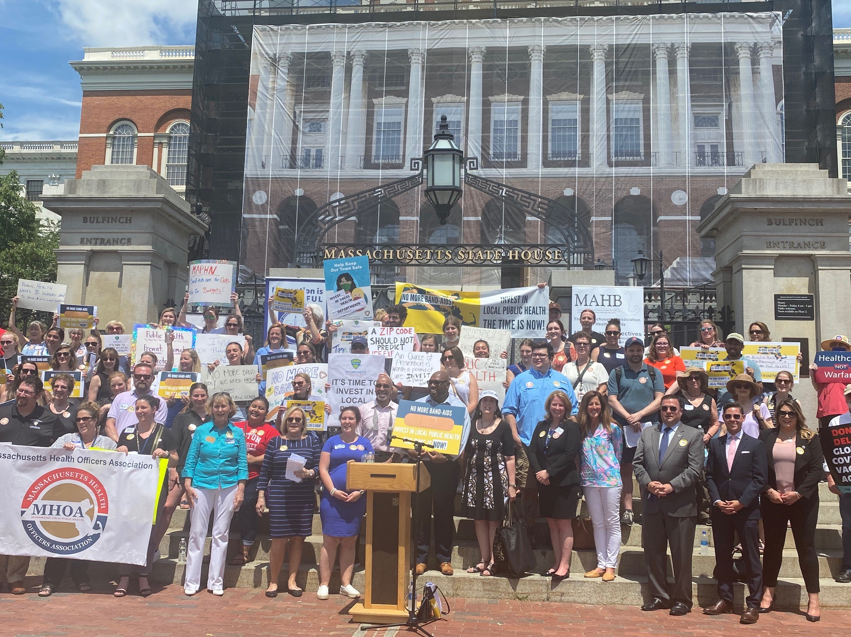
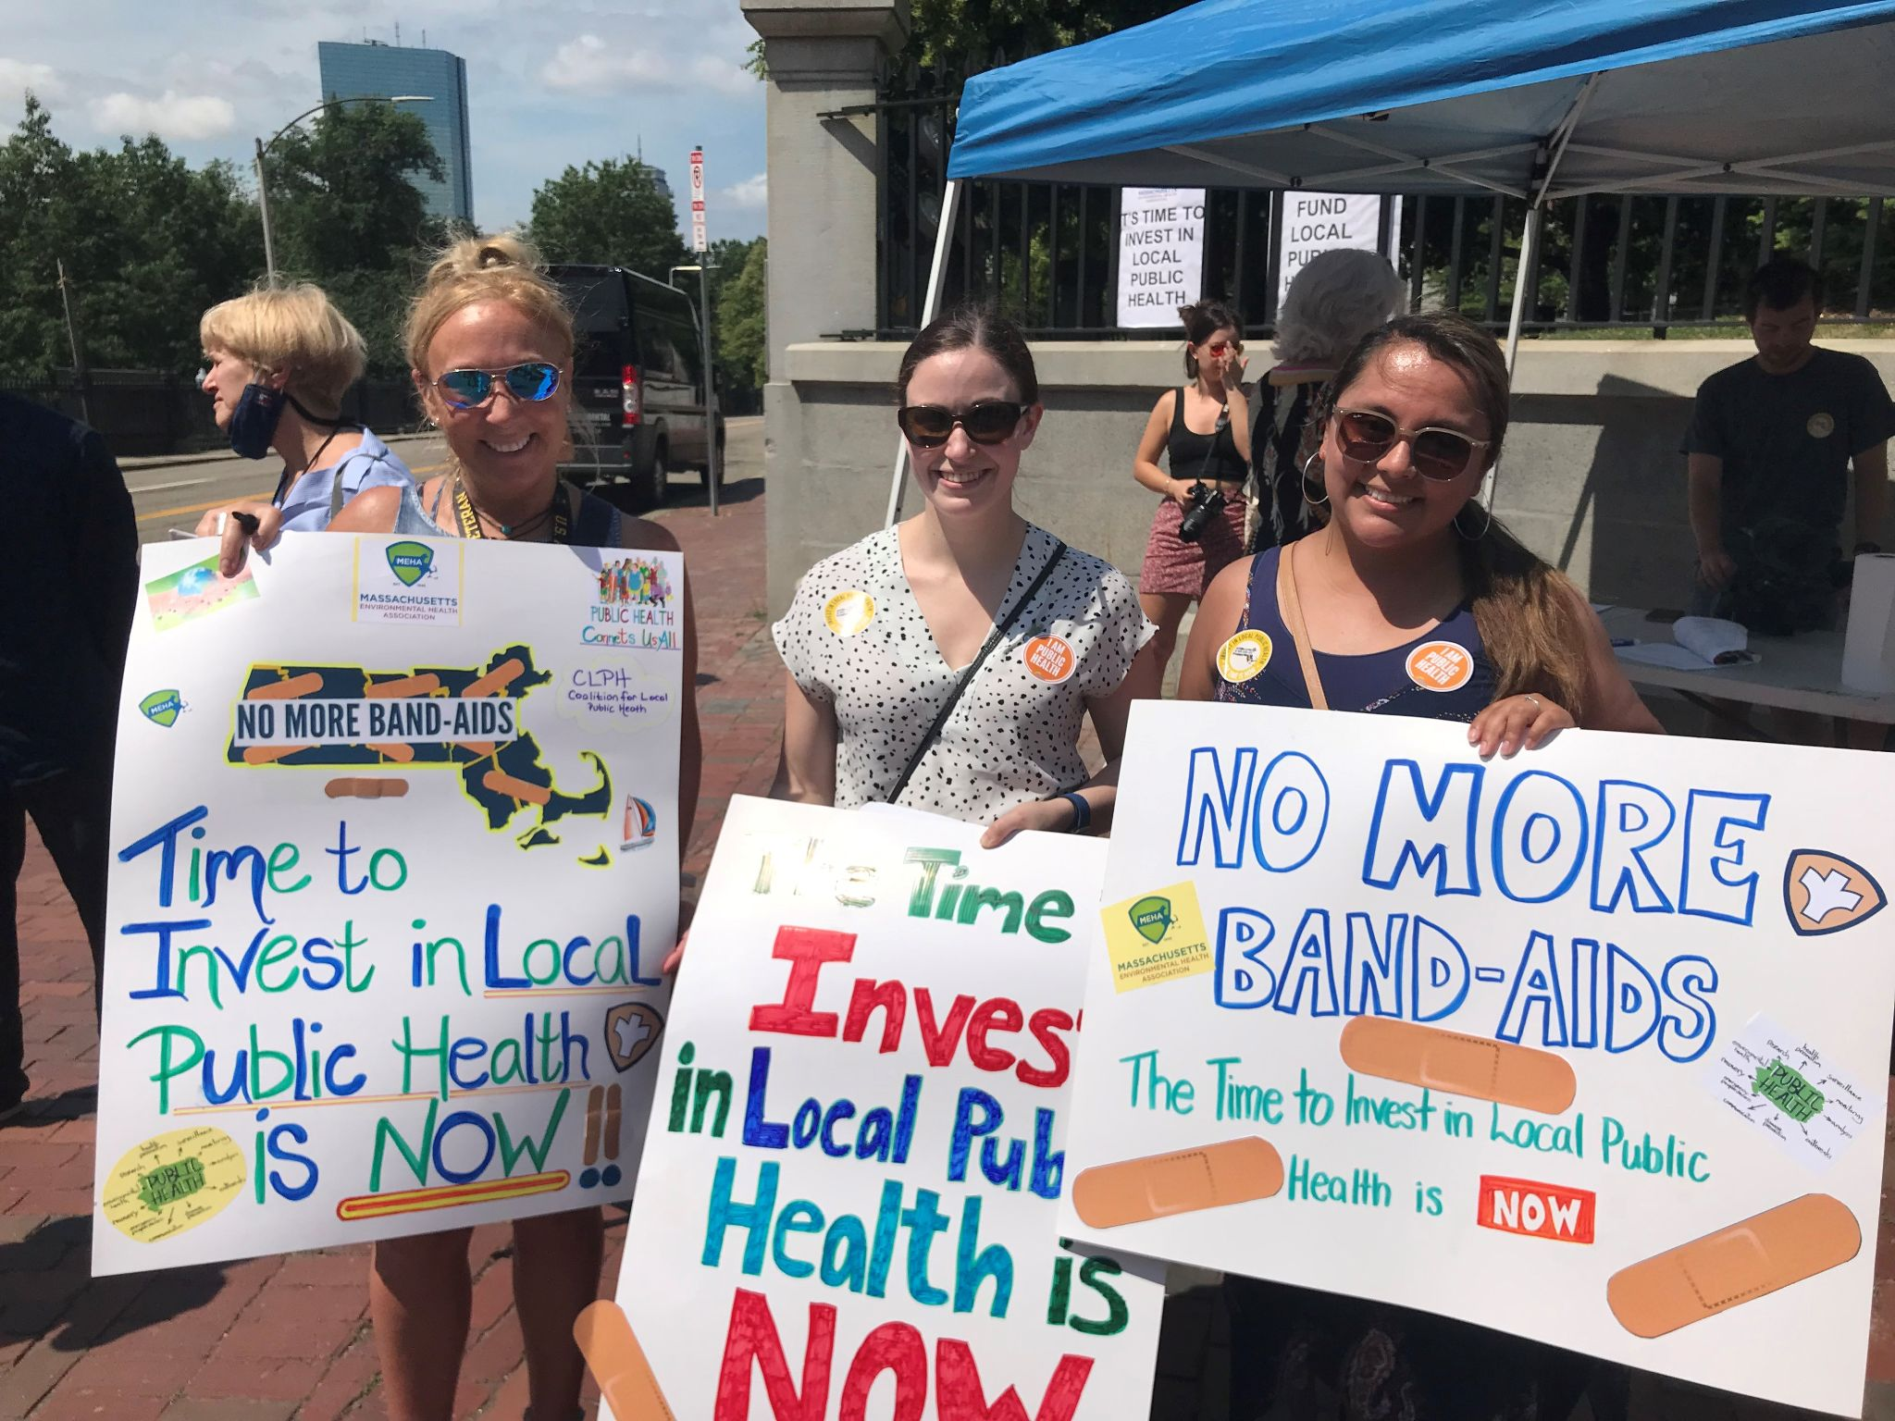
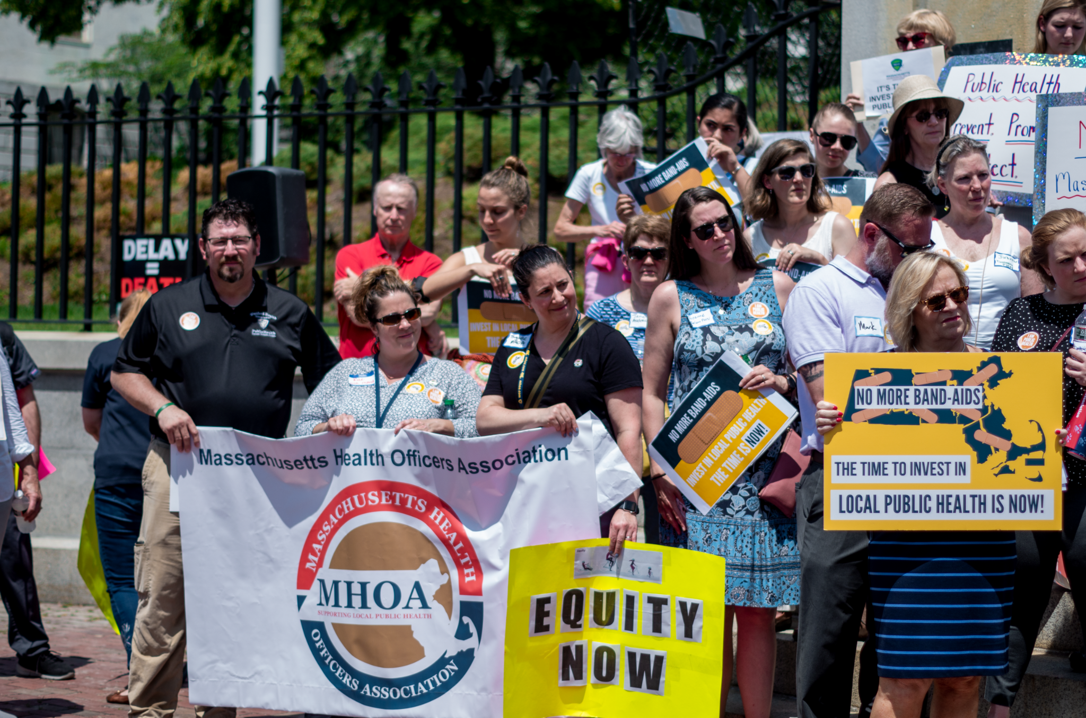
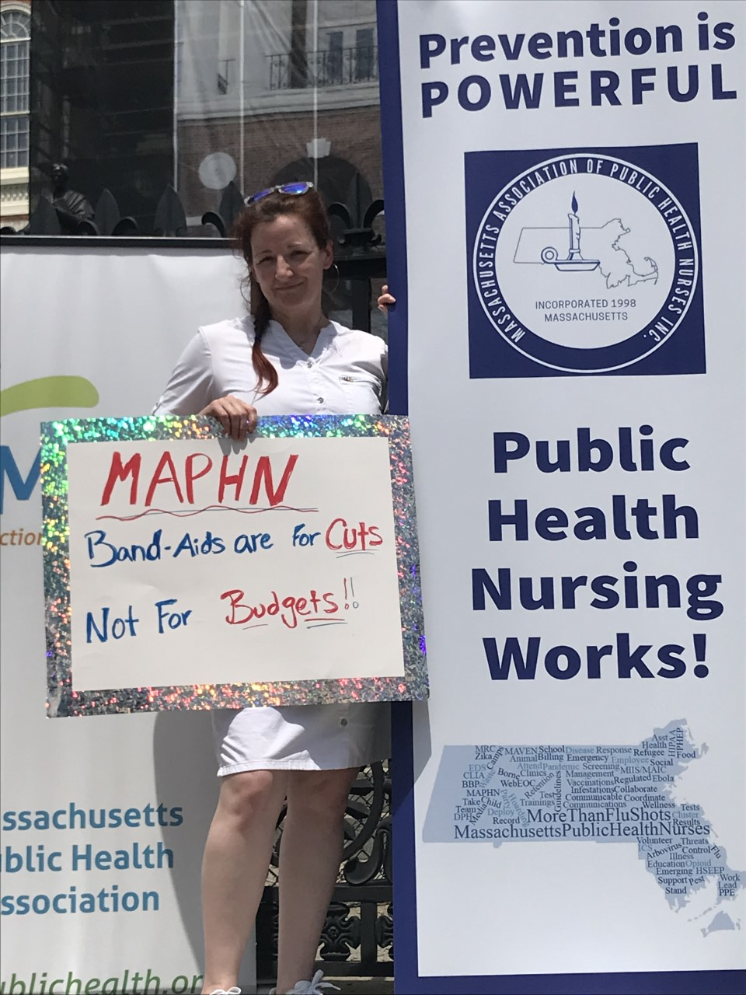
Notes:
Speaker Notes: In addition to the SAPHE 2.0 bill, current organizing to support local public health includes a request for significant federal funds invested in local public health.
Here are folks from across the state at the State House for the “no more bandaids” rally in June 2021.

Slide 37
Questions or More Information: Maddie Ribble, MA Public Health Association mribble@mapublichealth.org, 617-697-2107 Meghan Russell, MA Public Health Association, mrussell@mapublichealth.org
Notes:
The following slides can be used to enhance the presentation depending on audience.

Slide 38
Additional Resource Slides Follow
Notes:
The following slides can be used to enhance the presentation depending on audience.

Slide 39
Local Public Health:
Food Safety Responsibilities
Restaurants, institutional kitchens (schools, camps, nursing homes, etc.) and retail stores that sell food are licensed and inspected every 6 months by the local Board of Health, with further follow-up, as needed. BOH also confirm that food workers are properly trained in food safety.
Temporary food events, such as street fairs or church suppers, that do not take place in a licensed kitchen, are licensed & inspected by the BOH.
Processed food at farmers markets, caterers, mobile food vendors, and seasonal frozen dessert vendors.
Foodborne illness reports are investigated and if a food establishment is implicated, it is inspected.
Inspections in response to complaints about cleanliness or illness.
Food safety if an emergency shelter is set up.
Notes:
Speakers Notes:
Why is food safety important?
CDC estimates that each year roughly 1 in 6 Americans (48 million people) gets sick, 128,000 are hospitalized, and 3,000 die of foodborne diseases. Some estimates are even higher.
The U.S. Department of Agriculture (USDA) estimates that foodborne illnesses cost $15.6 billion each year.
About a third of all meals are eaten outside of the home and almost 1/2 of all consumer food expenditures go toward food made in the retail setting (restaurants, delis, etc.).
53% of known sources of foodborne illness occur from food produced in the retail setting.

Slide 40
Local Public Health:
Housing Safety
Responsibilities
Local Boards of Health inspect housing upon complaint, upon referral from first responders/social service agencies, due to obvious poor conditions visible from the street or periodically (e.g., pre-rental programs in some municipalities).
In addition to poor conditions/complaints, the BOH will be involved in situations involving hoarders or fires/structural damage.
A comprehensive inspection includes bathroom facilities, kitchen facilities, water supply, hot water facilities, heating facilities, lighting and electrical facilities, metering, installation and maintenance of facilities, asbestos, smoke/CO detectors, exits, maintenance of structural elements, pests, including insects, rodents & skunks, garbage and rubbish removal and storage, security and lead paint.
Housing cases often involve multiple orders, negotiations with landlords and owners, BOH hearings, condemnations, orders to vacate and housing court. Complaints generally must be responded to within 24 hours.
BOHs also inspect hotels and motels, dormitories and farm labor camps under the Housing Code.
BOH also investigate “nuisance complaints” which encompass noise, construction debris, air quality, overgrown grass/shrubs, trash, etc.
Notes:
Speaker Notes: A wide array of public health nuisances are routinely reported, investigated and resolved. The public can feel reassured that issues will be addressed to improve their health and safety.

Slide 41
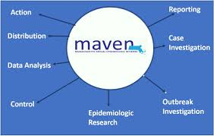
Local Public Health: Infectious Disease Responsibilities
More than 90 diseases are directly reportable to the LBOH in Massachusetts.
Each BOH must check the Massachusetts Virtual Epidemiologic Network (MAVEN) daily for reports.
Most reportable diseases require telephone call follow-up with healthcare providers and/or the patient.
If an outbreak is suspected or possible, local BOH, with DPH, must provide appropriate prophylaxis to the public (Hepatitis A in a food handler, vaccine preventable disease outbreak).
The LBOH is responsible for following up on all suspected TB cases, and for providing or overseeing medication administration to active cases for 6-9 months.
Many LBOH sponsor public flu vaccination clinics leading to higher vaccination rates in their communities.
Working with the Animal Control Officer, BOH must help manage rabies exposure in their municipality.
LBOH are responsible to enforce any isolation or quarantine orders in their municipality (e.g., Ebola in 2014).
Notes:
Speaker Notes: Medical, environmental and administrative staff work as a collaborative to eliminate or reduce risks and prevent safety concerns on several levels.

Slide 42
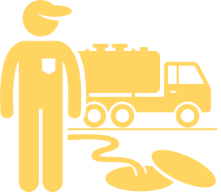
Local Public Health: Environmental Health Responsibilities
As the local arm of the Department of Environmental Protection (DEP) LBOH regulate onsite individual and group septic systems through enforcement of Title 5. Title 5 regulates the proper siting, construction, upgrade, and maintenance of on-site sewage disposal systems and appropriate means for the transport and disposal of septage.
The LBOH must review the Title 5 inspection report prior to the sale or transfer of property. Many BOH witness the inspection to ensure the report is accurate.
The LBOH also witnesses and reviews results from “perc” (percolation) tests to determine the proper siting of a new system, reviews and approves design plans for a new or rebuilt system prior to construction, and inspects the system during construction to ensure it is built in compliance with approved plans.
LBOH also regulate new wells and the decommission of old wells.
Investigate other environmental contamination issues, such as industrial discharges
Notes:
Speaker Notes:
It is critical that potable water and waste-water systems are properly designed, regulated and installed. This is essential to protect public health and the environment from contamination and the spread of disease.

Slide 43
Finding More Funding
Grant Finding Resources
Community Specific Granting Organizations
Other Granting Organizations
Community Grant Finder: Environment – Governor’s Office (State grants)
Community Grant Finder: Health – Governor’s Office (State grants)
Grants.gov (Search for federal grant funding opportunities)
Massachusetts Community Health & Healthy Aging Funds
NACCHO
Robert Wood Johnson Foundation
Kresge Foundation
Health Foundation of Central MA
MetroWest Health Foundation
Toxics Use Reduction Institute
The Blue Cross Blue Shield of Massachusetts Foundation
St. Francis Community Healthcare Foundation
Berkshire Taconic Community Foundation
The Boston Foundation
Brookline Community Foundation
Cape Cod Foundation
Community Foundation for Nantucket
Community Foundation of North Central MA
Community Foundation of Western MA
Essex County Community Foundation
Foundation for MetroWest
Greater Lowell Community Foundation
Greater Worcester Community Foundation
Permanent Endowment for Martha’s Vineyard
SouthCoast Community Foundation
Watertown Community Foundation
Notes:
MHOA toolkit includes additional resources to help local public health professionals on a broad range of topics, including funding and budgeting: https://lphguide.mhoa.com/

Slide 44
HOW DOES OUR FUNDING COMPARE?
THE CASE FOR LOCAL HEALTH
AVERAGE 2008 SPENDING
AVERAGE 2019 SPENDING
$80
$56
2008 mean per capita spending on Local Public Health*
2019 mean per capita spending on Local Public Health*
Our municipal spending on public health is ######
Per capita municipal spending is $0.00 per person
We need xxx funding to meet the nationwide average
Population of xxxxxx
*Per capita spending based on NACCHO's 2019 National Profile of Local Health Departments, pg 69
Notes:
Notes to Speaker:
This slide is intended to be edited by you to show how your municipality compares to the average municipality in the United States.
In order to use this slide you need to enter your municipalities name, its most recent population, municipal spending on public health, and calculate and enter the per capita spending.
You can find the 2019 NACHHO report at https://www.naccho.org/uploads/downloadable-resources/Programs/Public-Health-Infrastructure/NACCHO_2019_Profile_final.pdf
Speaker notes:
Prior to the recession in 2008 average municipal spending in all areas was higher than it currently is. One area that experienced large cuts was spending on public health. This slide shows average spending for local health departments across the US in 2008 and 2019. It also shows what our municipality is currently spending in comparison. Our local population was xxxxxx in 20xx and our municipal spending on public health, not including grants or other outside sources was $xxxxxxx. This means we are currently spending $x.xx per person, xx bellow the national average and xx bellow 2008 funding levels.

Slide 45
“Massachusetts requires more training and certifications for hair cutters than Board of Health Agents.”
-Gina Armstrong, Berkshire County Boards of Health Association & Pittsfield Health Department

Slide 46
“Local health has always been asked to do more with less and needs an infrastructure that maintains a level of staffing and funding that is adequate to serve all of the residents of Massachusetts.”
-Dawn Carmen Sibor, Executive Director MHOA

Slide 47
"Rarely will you find an adequately resourced health department in Massachusetts. Instead, you will find a health department applying band-aids to situations that require much more. This has been happening for decades..."
-Cheryl Sbarra, J.D. Executive Director &
Senior Staff Attorney MAHB

Slide 48
"Without cohesion, we are only as responsive as our least responsive surrounding community which perpetually sticks us in a place of reactivity rather than proactivity. The lack of support and appreciation for my role or any mechanisms to grow within it, have led to me submitting my resignation in December (2020)."
-Jennifer Meyer, BSN, RN, Public Health Nurse, Formerly of City of Northampton

Slide 49
"The Whately’s board of health annually operates on a budget of under $3,000. Until the Cares Act funding arrived, we had no public health nursing available to handle Covid case investigation and contact tracing.
-Francis Fortino, Chair, Whately Board of Health

Slide 50
Questions?

Slide 51
CLPH membership organizations are here to support your presentations.
The Massachusetts Association of Health Boards (MAHB)
MAHB’s mission is to support boards of health through legal education and technical assistance.
This includes providing direct support in the form of attending board of health meetings, providing testimony at hearings, assistance with drafting regulations and providing training needs for board members.
MAHB has offered to do the presentation for your municipalities.
Contact Cheryl Sbarra at sbarra@mahb or 781-572-5639 for more information.
Notes:
Note:
All CLPH member organizations are here to support your presentation. Cheryl Sbarra and Mike Hugo are offering direct support in the form of doing the presentation for your municipalities but other CLPH members are here to address any other needs that may arise.

Slide 52
Reference Materials
Blueprint For Public Health Excellence​ | https://www.mass.gov/doc/blueprint-for-public-health-excellence-recommendations-for-improved-effectiveness-and/download​
SAPHE Act 2.0 Fact Sheet​ | https://mapublichealth.org/wp-content/uploads/2020/10/10.2_Final_SAPHE-2.0-Fact-Sheet-.pdf​
SAPHE 2.0 Coalition Information | https://mapublichealth.org/saphe2-0/​
Massachusetts Environmental Health Association | http://maeha.org​
Massachusetts Association of Public Health Nurses | https://www.maphn.org
Massachusetts Association of Health Boards | https://www.mahb.org
Western Massachusetts Public Health Association | https://www.wmpha.org
Massachusetts Health Officers Association | https://mhoa.com
Massachusetts Public Health Association | https://mapublichealth.org

Slide 53
This Toolkit is provided by the Coalition for Local Public Health

