Slide 1
FDA Rulemaking process
Submitting Public Comments

Slide 2
FDA’s Proposed Rule
Ban the sale of menthol cigarettes. The sale of cigarettes with any other characterizing flavor, except tobacco, already is prohibited.
Ban the sale of cigars with any characterizing flavors other than tobacco.
The proposed rule does not cover e-cigarettes/vape products, chew/dip tobacco, and dissolvable products are not covered by FDA’s proposed.
https://www.fda.gov/media/158015/download?utm_medium=email&utm_source=govdelivery

Slide 3
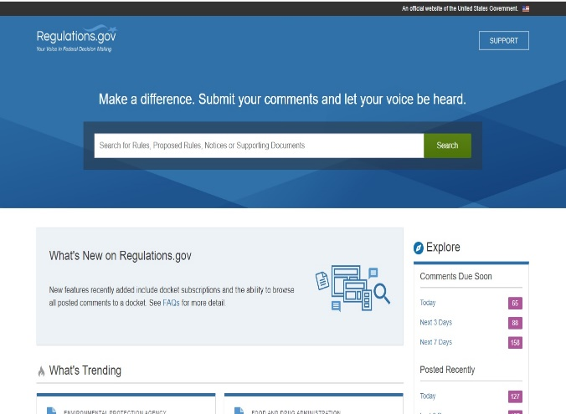
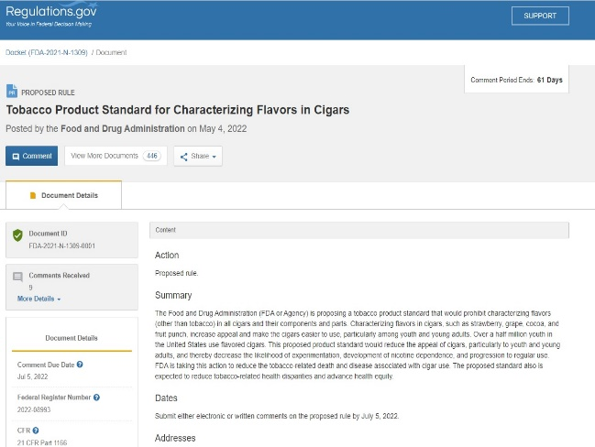
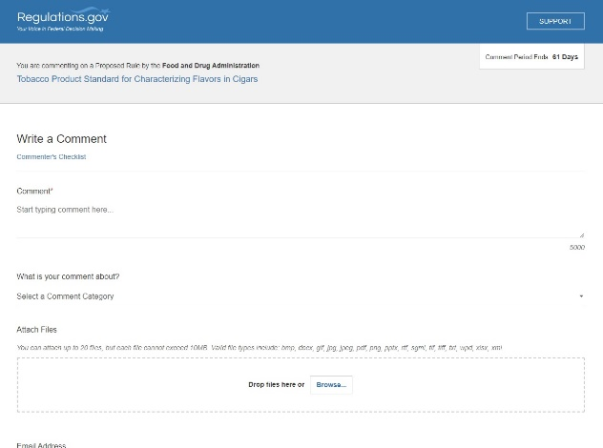
How do I submit comments?
Prepare your comments.
Go to “regulations.gov”.
Type “FDA-2021-N-1349-0001” for proposed ban on menthol cigarettes. Type “FDA-2021-N-1309-0001” for proposed ban on menthol cigars.
Press “Comment” button.
Type in your information and upload your comments.
Last day to comment is July 5, 2022.

Slide 4
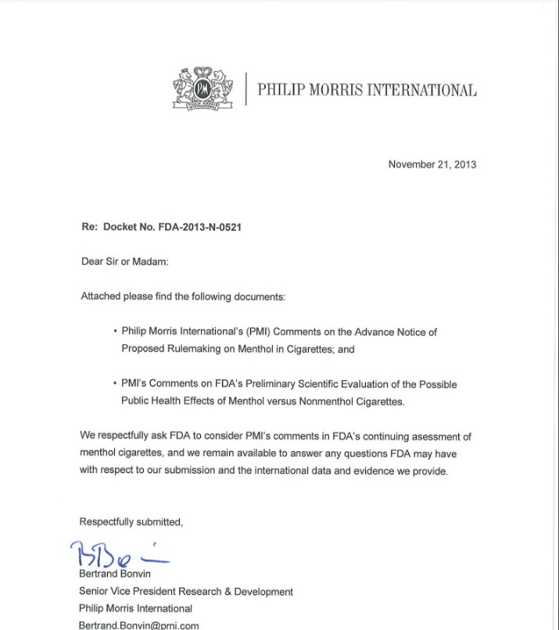
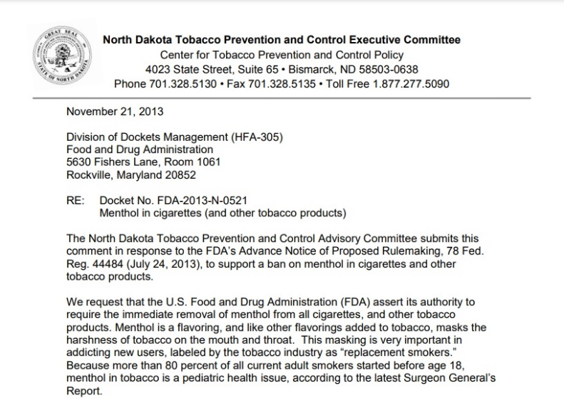
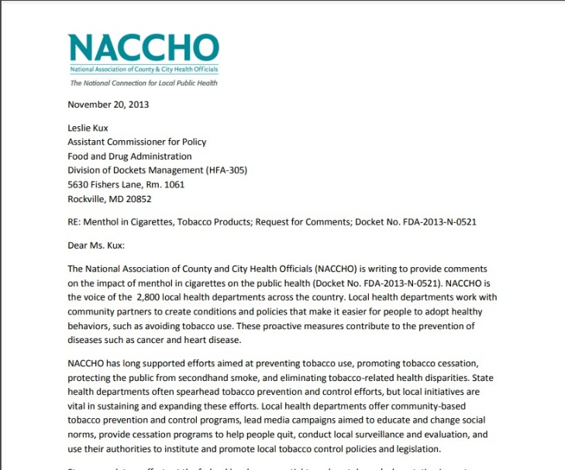
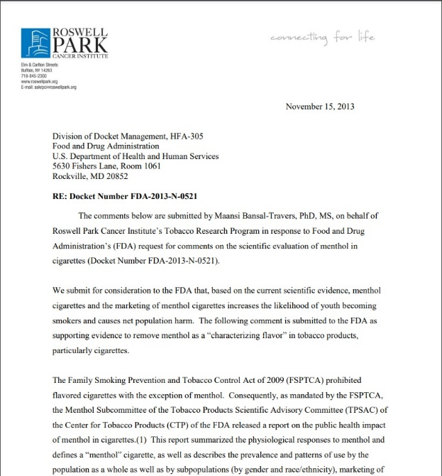
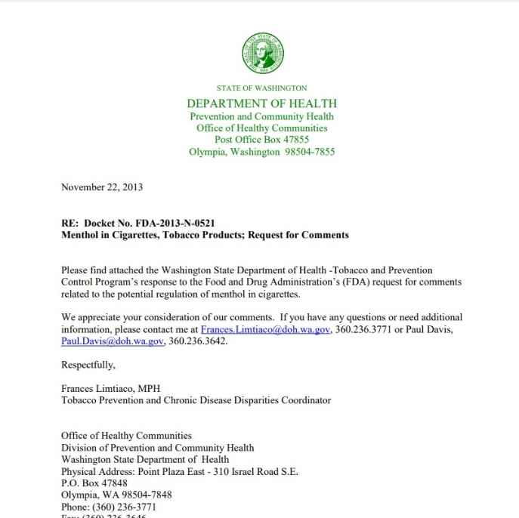
Is there a correct form for comments?

Slide 5
Tips for public comments.
FDA looks for logic, good science, and other evidence in the comments..
Tell the FDA who you are because you are an expert.
When possible, support your comment with substantive data, facts, or expert opinions. Provide personal experience, as may be appropriate.
There is no minimum or maximum length.
The comment process is not a vote – one well supported comment is better than a thousand form letters.
Check with other town or city officials about joining in on the comments.
Your public comments will be publically available.

Slide 6
What the FDA can learn from us!
Schools
Racial equity
Concept flavors
Enforcement
Anti-preemption
Local and state data
Timing and rollout
Healthcare costs
Border communities
Addiction
Industry tactics
Retailer education
Anti-possession
Industry always says to wait for FDA to act

Slide 7
Advocacy/education vs. education
Slides from Cheryl Sbarra, JD – sbarra@mahb.org

Slide 8
Advocacy/Education vs. Lobbying
Advocacy/Education is at the core of public health.
Advocacy includes educating policymakers and the public about evidence-based policy.
Without advocacy we wouldn’t have laws prohibiting smoking; safe drinking water; nutrition labeling, etc.
Definition of lobbying:
Providing written or oral testimony for or against a specific bill or proposed regulation.
Proposed “rule/regulation”
Prohibiting menthol in cigarettes and all flavors in cigars
Alternate definition of lobbying:
Your civic duty
But not while you are on the job pursuant to a state contract
Are a state or federal employee
Work for a non-profit organization that “frowns upon it” as a policy
Notes:
Cheryl to review

Slide 9
Advocacy/Education v. Lobbying
Cannot lobby while “on the job”
Lunch
Weekends
Cannot ask the FDA to pass the “rule” (regulation).
Specific FDA regulation
Cannot ask a legislator (federal or state) to support any bill or proposed regulation.
Specific legislation

Slide 10
Advocacy/Education v. Lobbying - Examples
Educate FDA about your experience enforcing different regulations in different municipalities.
Describe the higher concentration of flavored tobacco products in communities of color.
Explain strategies local health departments are using to reduce tobacco use.
Local regulatory work in MA
Cessation services
Describe the advantages of enforcing uniform regulation now that MA has a statewide law.
Explain advantages of reducing availability of flavored products on youth use.

