Slide 1
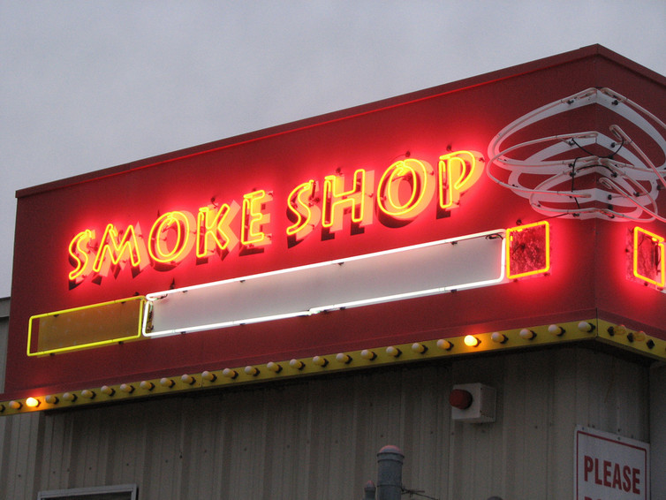
Adult-only retail tobacco stores State law calls them “retail tobacco stores”
Primary purpose is to sell or offer for sale tobacco/vape products and/or paraphernalia.
No longer required to possess a food service permit if they sell only prepackaged, non-temperature-controlled food.
Twinkies and Coke.
Entry of persons under 21 is prohibited, at all times.
Employees must be 21 or older.
Signage must be posted.
Must not share space with another business.

Slide 2
AORTS (continued)
There should be a bright line between an AORTS and a convenience store.
Can only sell “incidental products.”
Must NOT possess an alcohol, restaurant or lottery license.
Not incidental.
Flavored products PROHIBITED.
Can sell UNFLAVORED vape products with more than 35 mg/ml of nicotine.
ONLY BENEFIT OF BEING AN AORTS!

Slide 3
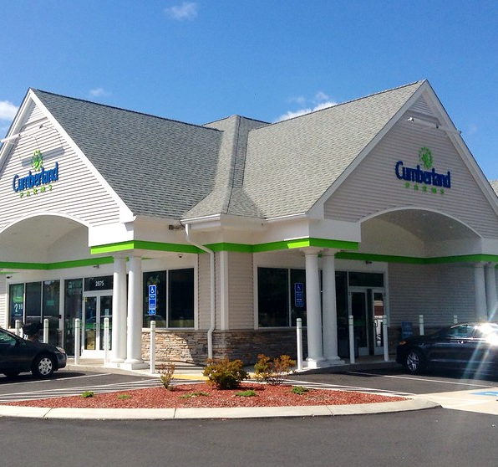
Store claiming to be 2 separate stores a convenience store and an adult-only retail tobacco store
Factors to consider include, but are not limited to the following:
Separate business filings;
Separate tax filings;
Federal and state
Separate list of employees;
Separate DOR approval to collect sales tax;
No capacity for customers to access one store from another.

Slide 4
Smoking bars
Must meet the definition of “smoking bar”
Percentage of sales from tobacco must be more than 50%
Boston – more than 60%
Must possess DOR Smoking Bar Permit.
And other state licenses and local tobacco sales permit.
No one under 21 may enter.
EXEMPT FROM FLAVORED TOBACCO/VAPE BAN AND LIMITS ON NICOTINE STRENGTH.
Approximately 24 Smoking Bars licensed in MA.

Slide 5
First sale to person under 21 state law enforcement requirements
105 CMR 665.000
105 CMR 665.010: Sale of Tobacco Products and Electronic Nicotine Delivery Systems
(A) No person shall sell or provide a tobacco product to any individual younger than 21 years old, as verified by said person’s valid government-issued photographic identification.
EVERYONE who purchases tobacco must present an ID at each sale.
Penalties:
$1000 for first offense.
Mandatory suspension for up to 30 days or longer if local regulation requires it.
Best practice: Request that BOH adopt a policy designating number of day for suspension.
3 days?

Slide 6
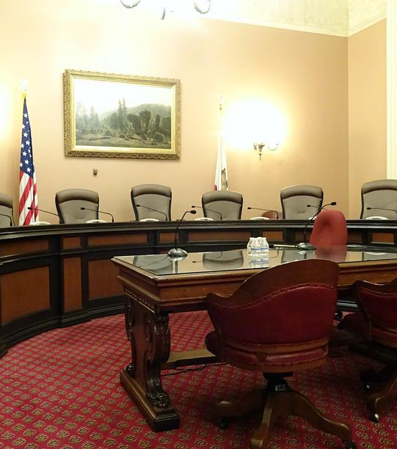
Process when retailer requests a hearing before the board of health
Open meeting law applies.
Can occur at a regularly scheduled board of health meeting.
Must be on the posted agenda.
Can be scheduled for a meeting on another date and time.
Must be properly posted.
Can hold several hearings at the same meeting.

Slide 7
Hearing process (Continued)
Chair calls the meeting to order, stating the time, date and name of meeting (Board of Health).
Asks for roll call vote and opens the meeting.
Chair (or designee) asks for a Motion to Open the Hearing.
Motion made and seconded.
Members vote on Motion.
If there are multiple hearings, the Chair should explain that each establishment will have a separate hearing.
Chair can set time limit for each hearing at the beginning of the hearing.
Time should be the same for each establishment’s hearing.
Chair opens the hearing.
Do not open the hearing before the time designated on the posted agenda.
Chair introduces BOH members, health director/agent/inspector/tobacco control director to those in attendance.

Slide 8
Hearing Process (Continued)
Chair asks retailer to introduce themselves and, if relevant, their attorney.
Chair should ask all those who intend to testify at the hearing to stand up and swear that their testimony will be the truth.
Chair should state that the only question before the BOH is whether a sale took place to someone under the age of 21.
Or whether a flavor product was sold (or whether any other state violation took place).
Chair should state that if the violation occurred, the penalty is mandated by state law.
The BOH does not have the legal authority to lower state penalties.
Including the mandated suspension for a sale to someone under 21.
Chair turns hearing over to tobacco control inspector or health inspector.

Slide 9
Inspector testimony
Inspector should have the following information in the retailer’s file:
Copies of inspection report, if available;
Copies of Correction/Cease and Desist Order;
The tobacco product tagged and labelled;
Copies of any previous violations;
Any applicable POST information if the municipality uses POST;
Copies of 105 CMR 664.040 and .045;
Copies of all the above are for the establishment and the establishment’s attorney.

Slide 10
Inspector testimony (continued)
Actual testimony should include:
Time and date of compliance check;
Tobacco product purchased;
Procedure followed;
If a second or third offense, date of previous offense(s);
Fine issued and permit suspension length at issue;
Reiterate that these are mandated by state law.

Slide 11
Retailer’s testimony
When inspector completes testimony, Chair should ask the retailer and retailer’s attorney to testify.
Chair should reiterate that the only question before the BOH is whether a sale (or another violation of state law) occurred.
No one should comment on the retailer’s testimony.
At the conclusion of retailer’s testimony, the Chair should ask if there is any other testimony.
If there have been any misstatements, the inspector should clarify the facts at this time.
Chair should ask for a Motion to Close the Hearing.

Slide 12
Post hearing process
Board member makes Motion to Close the Hearing.
Member seconds Motion.
Members vote on Motion.
Board holds a discussion on the hearing.
No attendees can comment.
Board votes to either:
Affirm or dismiss the penalty
Take the matter under advisement for a vote at a subsequent meeting.

Slide 13
Post hearing process (continued)
If affirmed, written notice of board’s decision and the penalties assessed must be sent to the retailer.
If taken under advisement, written notice of decision and penalties assessed must be sent to the retailer after vote is taken.
Vote needs to be at a future board meeting and is subject to the open meeting law.
If board requires additional information from the retailer before making its decision, board should set a deadline for receiving the information.
Chair opens next hearing.

Slide 14
Enforcement strategies when retailer refuses to comply
Non-criminal disposition process cannot be used for state law penalties.
More than $300.
Administrative Order is issued.
Correction/Cease and Desist Order template is available.
Order usually states that retailer has 21 days to request a hearing before the board or pay the fine.
What happens if the retailer does not pay and does not request a hearing?
Use standard operating procedure for failure to pay fines.
Another letter sent to retailer.

Slide 15
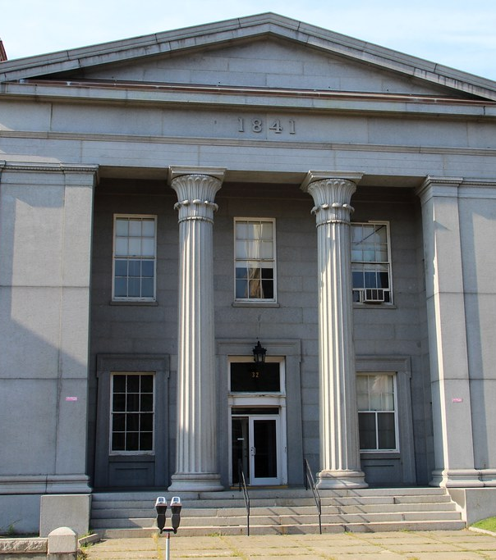
Still refuses to pay/comply
Application for Criminal Complaint for failing to comply with an Administrative Order and failure to comply with state law.
Hearing will be scheduled by Clerk’s office.
Attend hearing and present testimony.
See previous slides on board of health hearings.
Clerk rules in favor of board of health and upholds fine.
Can clerk lower the fine?
If retailer still does not comply, Clerk will issue the Criminal Complaint and schedule an arraignment.
A pre-trial hearing will also be scheduled at arraignment.

