Slide 1
Hoarding Situations and Solutions
Erika Woods, MS, RS
Paul Halfmann MPH, RS

Slide 2
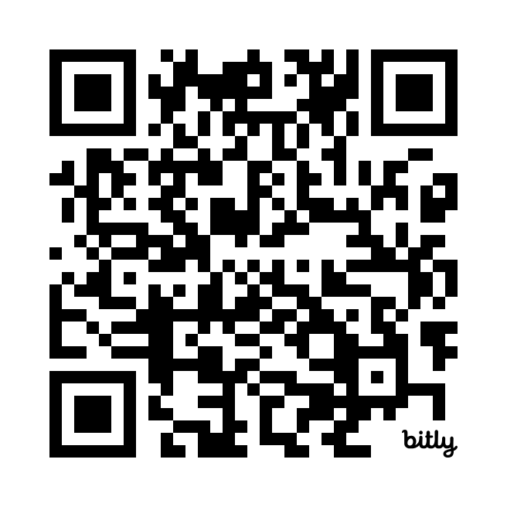
QR code for environmental scan of hoarding services across the Commonwealth
Building an Effective Massachusetts Hoarding Resource Network (MHRN): Which Services are Available or Needed in your community?
An estimated 2 to 5% of the population in MA struggles with hoarding behaviors. Their clutter creates health and safety hazards for themselves, those they live with, neighbors, and emergency responders. The acquiring and saving behaviors are not a lifestyle choice, they are the result of a mental health challenge that can be addressed and treated --- people can and do recover when help is available! With your input we will learn what services are available, and which services are lacking in your community. This information will inform the priorities set forth by the MHRN as we advocate for the funding and implementation of best practices across the commonwealth. You may respond anonymously or include your contact information.

Slide 3
Topic overview
Hoarding 101-What you need to understand when encountering an individual exhibiting hoarding behaviors
The Housing Code & other regulatory options
Assessment & planning
Putting it all together
Resources
Spoiler Alert: There is no one single solution
Note: Stories and scenarios in this presentation are fictional with fictional characters but are based on real life situations

Slide 4
The story begins
Flo is a relatively new assistant health agent for Anytown Massachusetts. Her boss Eduardo is away for a little over 2 weeks on African safari and has left Flo in charge. Eduardo knows that he needs to get away occasionally to support his own mental and physical health, and he is confident that he has left Flo with the knowledge and resources she needs to be successful.
Eduardo left for vacation on a Thursday; Around mid-day Friday, a staff member from the Water Dept. came over to talk to Flo about a home that he had just gone to. His description:
He only saw the basement while replacing a water meter which he could barely get to because of the stacked boxes, bags and other “junk”.
He also said that it smelled badly of urine a feces from the 4 cats that he saw wandering the basement.
He is concerned that the property owner is a hoarder and is living in squalor.
What should Flo do?
Flo decides to do some research on hoarding and squalor

Slide 5
Definition
Hoarding is a Mental Health Disorder as defined in the DSM V (Diagnostic and Statistical Manual of Mental Disorders) 2013 American Psychiatric Association
Persistent difficulty discarding or parting with possessions, regardless of their actual value.
This difficulty is due to a perceived need to save the items and distress associated with discarding them. (items seen as a friend, a part of identity or memory, wastefulness, process/ decision making too cumbersome
The symptoms result in the accumulation of possessions that congest and clutter active living areas and substantially compromise their intended use.(shower, bed, fridge may be inaccessible)
Specifiers
Is there excessive acquiring
Level of insight
Notes:
We all have stuff!! It becomes an issue when we can’t use our homes/ room/ facilities for the use intended
DSM- designation as a mental illness makes it tough because of HIPPA regs.- We need to look into details of how we are affected-if at all

Slide 6
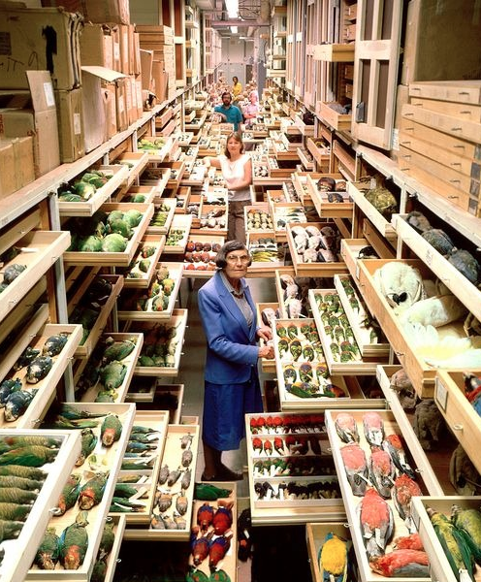
Is it hoarding?
Ask yourself these 3 questions:
Is there a failure to discard a large volume of items?
Does the clutter make it hard to use rooms for their intended use?
Is there stress or impaired functioning caused by the clutter?
NOTE: We are not here to diagnose, but to understand.
Notes:
Can be confused with individual who recently downsized
Unable to organize and make decisions to properly care

Slide 7
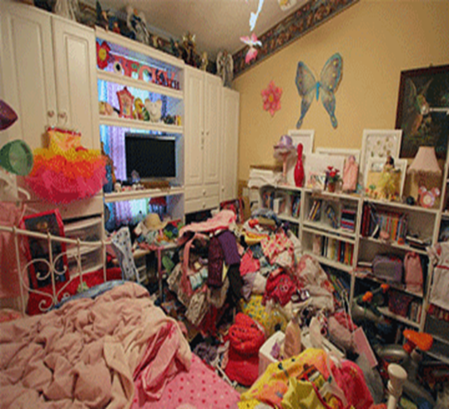
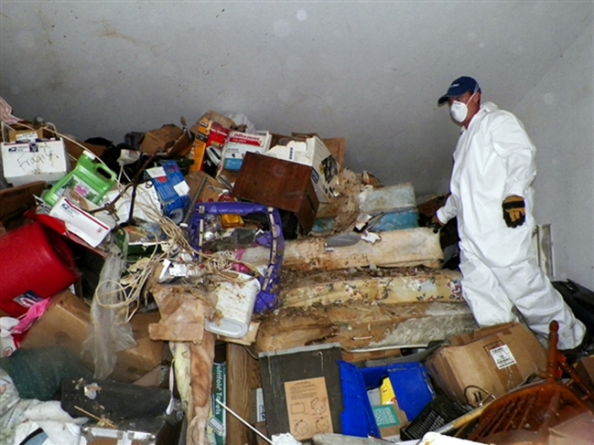
Hoarding vs Squalor
Hoarding and squalor are not the same
Squalor is defined as filthiness or degradation from neglect: Two forms– domestic and personal
Hoarding is related to the volume of clutter in the home, not the cleanliness
Squalor is often accompanied by hoarding; however the reverse is seldom the case.

Slide 8
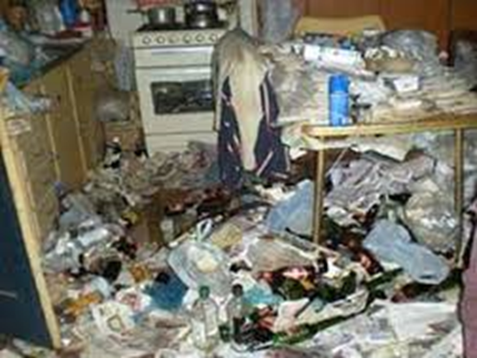
Squalor
Complex condition-not recognized as a standalone diagnosis in DSM-5
Generally, overlaps with:
Depression
Anxiety
Cognitive impairment
Personality disorders
Squalor component may be a result of hoarding food or inability to properly store food due to hoarding
Notes:
CCHTF deals only with squalor associated with hoarding
Concerns for health and safety are increased with squalor
Severe neglect – bring on themselves usually results in physical collapse or mental breakdown
Most who suffer do not get identified until they face this stage of collapse, due to predilection to refuse help from others

Slide 9
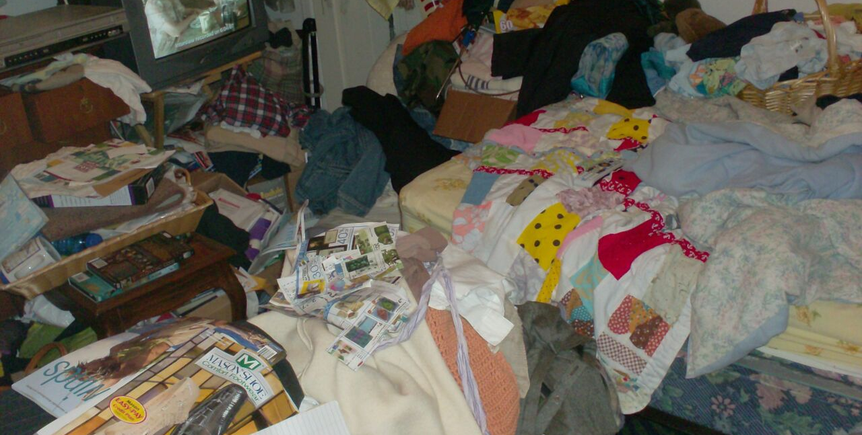

Slide 10
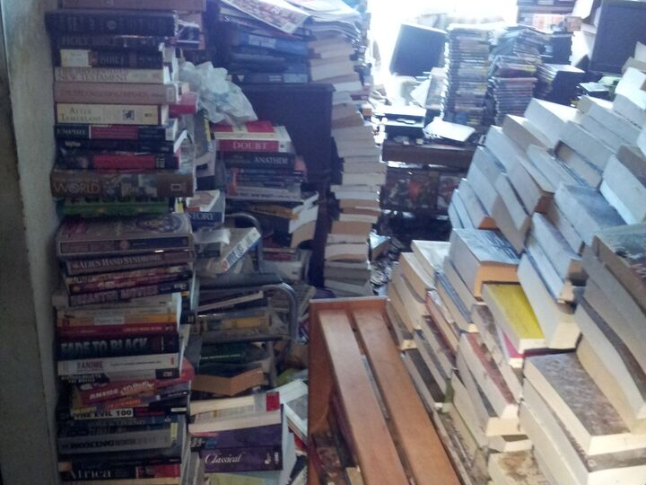

Slide 11
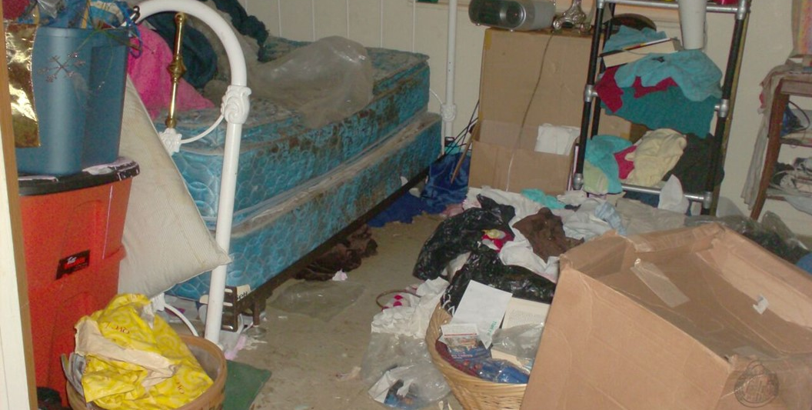

Slide 12
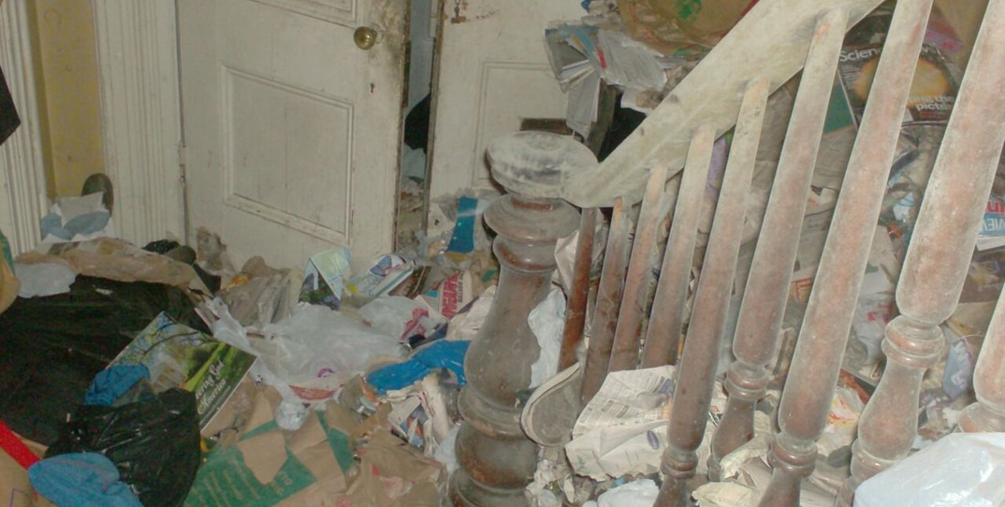

Slide 13
Do we have to worry about animal hoarding?
The pathological accumulation of animals was first described in 1981 and animal hoarding was formally defined in the public health literature in 1999 using the following criteria:
Having more than the typical number of companion animals.
Failing to provide even minimal standards of nutrition, sanitation, shelter, and veterinary care, with this neglect often resulting in illness and death from starvation, spread of infectious disease, and untreated injury or medical condition.
Denial of the inability to provide this minimum care and the impact of that failure on the animals, the household, and human occupants of the dwelling.
Persistence, despite this failure, in accumulating and controlling animals.
HOARDING OF ANIMALS RESEARCH CONSORTIUM

Slide 14
What does it look like?
Strong smell of ammonia ​
Broken furniture, holes in walls and floors​
Floors may be covered with feces, urine, vomit, etc.​
Squalid conditions​
animals may not be well socialized, lethargic and emaciated​
fleas and vermin present​
May not know the total number​ of animals
Individual feels they can care for the animals better than others
May insist they are an animal shelter

Slide 15
Now what?
Flo needs to follow-up, but how?
What is her legal authority?

Slide 16
Regulatory Process
Before you pick up the phone, understand the
Local Authority’s
Responsibilities
Enforcement of the regulations
Owner-occupied & rental units are treated the same
Limitations
Must operate within the regulations
Minimum Standards of Fitness for Human Habitation
Regulatory patience
Assign timeframes for correction of violations

Slide 17
Legal Authority
What gives you the right to . . .
Massachusetts General Laws
Chapter 111, Section 3
Gives Public Health Council authority to promulgate regulations
Chapter 111, Section 127A
DPH to promulgate the State Sanitary Code
Defines enforcement & jurisdiction authority
Chapter 111, Section 127B
Provisions for dwellings unfit for human habitation

Slide 18
Hoarding becomes a legal problem when…
It violates housing health and safety standards
It endangers vulnerable people as defined by state law:
Children
Elders
Persons with disabilities
Massachusetts State Codes:
State Sanitary Code 105 CMR 410
State Building Code 780 CMR
State Fire Prevention regulations 527 CMR
Uniform State plumbing Code 248 CMR 10
State Electrical Code 527 CMR 12
Animal Cruelty Laws, as defined in MGL, Chapter 272, Section 77 (felony)
Notes:
Violates housing health and safety standards including those for animals

Slide 19
Gaining Access
Gaining access to a unit is not an issue when the occupant requests the inspection.
When some other person complains
Inspector needs to investigate the complaint to determine if an inspection is warranted.
Site Visit
Phone Call
Letter
Record Review

Slide 20
Site visit
Flo isn’t really sure what she can do about this but decides to visit the property. This is what she encounters/observes:
Upon entering the driveway, she observes a 2-story structure at the end of the driveway and a small driveway off to the side, leading to a small cottage.
The yard has a few empty planting pots, a wheelbarrow, and wood pile that is neatly stacked with the exception of one end that has fallen over into a pile.
The home is in generally good shape from the exterior.
Flo decides to knock on the door but there is no answer. She observes 2 cats playing in the front window and can see some clutter inside the home, but she doesn’t really have a good clear view. She decides to leave her business card in the door and as she is walking back to the car, the occupant of the cottage comes up to Flo. During the discussion, she tells Flo that she often takes care of Doug’s cats and offers to let Flo into the home since she has a key.
What should Flo do?

Slide 21
Access onto Property
Plain View Doctrine
From the street
A direct path to front door
Cannot peek into windows
Cannot walk around property
View from a neighbor’s property
In plain view if occupant opens the door

Slide 22
Legal Constraints
The local authority may conduct an inspection upon receiving
Occupant’s consent
Administrative Search Warrant
Temporary Restraining Order (TRO)
An inspector may not enter a dwelling under the authority of
Fire department
Police department
Property owner
Condo association

Slide 23
Now what?
What is our overall goal with this case?
The health and safety of the occupant and the larger community.
Flo goes back to the office and decides that she needs to do some
more research about individuals with HD.

Slide 24
Reasons to be concerned….
Health and safety of the individual
Trip/ fall hazards, Is MOBILITIY AN ISSUE?
Fire, BLOCKED EGRESS, HIGH FUEL LOAD, COMBUSTIBLE ITEMS NEAR HEAT SOURCE, OVERLOADED EXTENSION CORDS
Access to basic living needs-bathing, food, heat
Indoor air quality
Structural hazards
Pest infestation
Health and safety of family members
Children/Elders/pets
Public health
Disease
Pests
Indoor air quality

Slide 25
Greenfield, MA 2013- 2014- Apartment
Fire fueled by abundance of paper and other clutter caused damage to 16 apartments, required 19 residents (from 11 apartments) to be temporarily housed in hotels, only 1 resident had renter’s insurance.
Summary of Expenses: Vendor Services – police detail during fire, electrical repairs, sprinkler and fire alarm repair, fire damage repair/restoration, supplies, hotel for residents, elevator repair, mold remediation, lighting replacement,
Total: $384,511.37
Framingham, MA 2014-Apartment
Hoarding of paper bags, books, magazines other items, unsanitary conditions, resident also had hygiene issues
Summary of Expenses: Legal Fees, court fees, movers
Total: $4,500.00
Barnstable County, MA 2015-Condo Unit
Hoarding of miscellaneous items, unsanitary conditions
Summary of Expenses: Cleanout company hired to abate nuisance conditions.
Person returned to unit and continued to collect-Trust was lost
Total: (Not all expenses accounted for) $40,423.34

Slide 26
General Information
Affects 2-5% (up to 6% elders) of the population.
Onset- ~13 years old, seek help ~50
Cleanouts near 100% recidivism rate without any type of behavioral health treatment
Study shows individuals more likely to seek help for other mental health problems than hording disorder.
Individuals more likely to suffer from chronic medical conditions and obesity.
92% of individuals who hoard have 1 or more other mental health issue (e.g., depression, generalized anxiety. OCD, social phobia)
Very often well educated
Family history of hoarding is common
Notes:
By comparison, HD affects almost 2x as many people as Alzheimer’s
Study in 2010 showed only 2 in 18 individuals sought help for HD even though they had sought help in the past for other mental illness

Slide 27
Why do people save?
Value of possessions is in the eyes of the individual saving them
Intrinsic- (aesthetic)
Sentimental
Instrumental
Beliefs-safety, responsibility
Not all clutter is hoarding. It could be due to downsizing or other issues
Passive vs active acquiring

Slide 28
Cognitive Functioning
Personality features:
Excessively high standards & perfectionism
Seeing the narrow categories at the cost of the big picture
Indecisiveness and procrastination
Difficulty trusting others
Difficulty regulating emotions
Difficulty taking another perspective
Executive functioning:
Attention
Perception
Decision making
Categorization/ association
Prospective memory

Slide 29
Challenges
Insight
Non-insightful
Insightful but not motivated
Insightful & motivated but non-compliant
Motivation Enhancers
Carrot/Stick approach
Support
Home visitors
Connection to what’s important/ values
Addressing co-occurring illness

Slide 30
Now what?
Flo receives a call from the homeowner, Doug
Who says that he will meet her outside of the home.
This is a good start but how should Flo act when meeting with Doug?

Slide 31
Interactive Lesson
Listen to instructions but do not do anything until told
Take out your wallet and place it on the table in front of you.
WHEN I TELL YOU TO: Trade your wallet with the person next to you, preferably not a co-worker.
Take 3 items from that wallet that you think they do not need and throw them in the trash.
DO NOT FOLLOW THROUGH WITH INSTRUCTIONS
How much anxiety did those instructions cause you?
Now imagine someone coming into your home and telling you it’s a mess and telling you what to throw away.

Slide 32
Do’s:
Imagine yourself in the hoarding client’s shoes.
Match the person’s language.
Use encouraging language.
Highlight strengths.
Focus the intervention initially on safety and organization of possessions and later work on discarding.
The individual/family is more likely to accept help and work with you if you gain their trust.
Notes:
Example of someone touching your possessions.
Refer to items as they do- treasures, collection,
Don’t get picky about how neat a place is-Story of too many pillows on a bed after getting a unit cleaned and organized

Slide 33
Don’ts:
Use judgmental language
Use words that devalue or negatively judge possessions
Let your non-verbal expression say what you’re thinking
Make suggestions about the person’s belongings.
Try to persuade or argue with the person.
Touch the person’s belongings without explicit permission
Notes:
Example of someone touching your possessions.
Refer to items as they do- treasures, collection,
Don’t get picky about how neat a place is-Story of too many pillows on a bed after getting a unit cleaned and organized

Slide 34
Inspection Responsibility
If an inspection reveals a dwelling unit is not in compliance with 150 CMR 410.000
Issue an Order to Correct Violations
Within 12 hours for violations described in 410.640(A)
Within 7 days for violations described in 410.640(A) Maximum of 30 days
Conduct a re-inspection
Within 5 days of compliance requirements stated in order

Slide 35
Inspection Responsibility
Inspectors should conduct a comprehensive inspection
Document all violations of the code
Determine most critical issues
Develop a plan/schedule to achieve compliance
Serves as a checklist in monitoring and documenting progress

Slide 36
Enforcement Options:
Written Orders to abate nuisance conditions and/ or violations to the Sanitary Code
Specific timeframe for compliance
Deemed to Endanger-24 hours
Other items up to 30 days - “Good Faith Effort.”
BOH may be able to impose fines
BOH may conduct cleaning and then bill the occupant.
Condemnation
eventual tear down

Slide 37
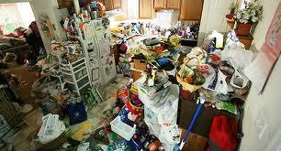
Hoarding
The process may involve a condemnation
When is this really necessary?
NOTE: Cleanouts very traumatic & near 100% recidivism rate

Slide 38
Unfit for Human Habitation
15
410.650 Dwellings Unfit for Habitation
Issue written finding of condition
Description of the conditions resulting in the finding
Notification of finding
To occupant & owner
Include provision for hearing
Hearing to determine fitness
Unless immediate danger to life or health

Slide 39
Unfit for Human Habitation
16
410.831continued,
Condemnation
Order condemning dwelling or portion
Order to vacate dwelling or portion
MGL Chapter 79A, Section 13 Relocation responsibilities
Documented moving expenses
Order to secure dwelling or portion
Demolition
No compliance after 1 year

Slide 40
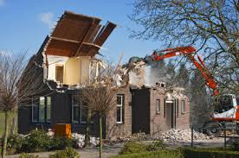
Limitations:
Condemnation-
Individual out on the street
Cost town money to relocate the individual
Town cost clean/ tear down-how do they recover cost
It doesn’t help the individual get better
Recidivism
Notes:
Some communities have gotten creative with the concern of access. Teams at the door-
Some local regulations may allow for entry
Have individual looking for housing that has been evicted and is in the system- she is still ordering from QVC & HSN and having delivered to nursing home and her former home

Slide 41
Hoarding – The End?
When is clean “clean enough?”
Consider violations cited in order
Specific violations cited must be corrected
Important to be thorough in citing violations
Additional codes that impact safety
Local fire inspector will have combustion/rescue concerns
Building inspector will have structural concerns
Periodic follow-up
Is someone available to check in

Slide 42
How do we respond once we have a general idea of what’s going on?
Design appropriate response based on assessment and availability of resources
What legal entities are involved
Common code violations
What needs to be done to come into compliance
Communication key to a good outcome
Team approach to response

Slide 43
Working Together
No overnight solution, no 1-800 number to call
Preparation:
Network with local agencies and departments ahead of time
Learn abilities and limitations
What information can be shared-HIPAA may apply
Assess roles and responsibilities
Begin the communication process
Assessment tools-HOMES
Inspection tools-CIR
Notes:
Who to call, when, what information will they need
May have to find a way to work within HIPAA
Learn who to talk to and how to communicate-

Slide 44
Community Partnerships
Benefits
Coordinated care for person who hoards
Sharing and maximizing resources
Cost-effective
Networking (across professional lines)
Common language, assessments
Model types
Resource Network
Education
Case consultation
Direct intervention
Intervention Teams
Case management

Slide 45
Build Your Response Team
Health
PCP
Safety
Building dept.
Housing
Professional Organizers
Individual support
Family
Mental health
EMS
Public health
Management
Reasonable accommodations
Police
Fire
VNA
Substance use
Protective services
Animal care
Pet care
OT
Task Force
Who else might be a part of your team?

Slide 46
Communication with Service providers:
Assessment Tools
HOMES-multi-disciplinary risk assessment
Uniform Inspection Checklist
Clutter Image Rating Scale-CIR
It may be helpful to consider other observations while conducting the inspection. These tools will help you to communicate with others on your team.
Notes:
Tools help us to assess the severity and to help us communicate between individuals involved in a case

Slide 48
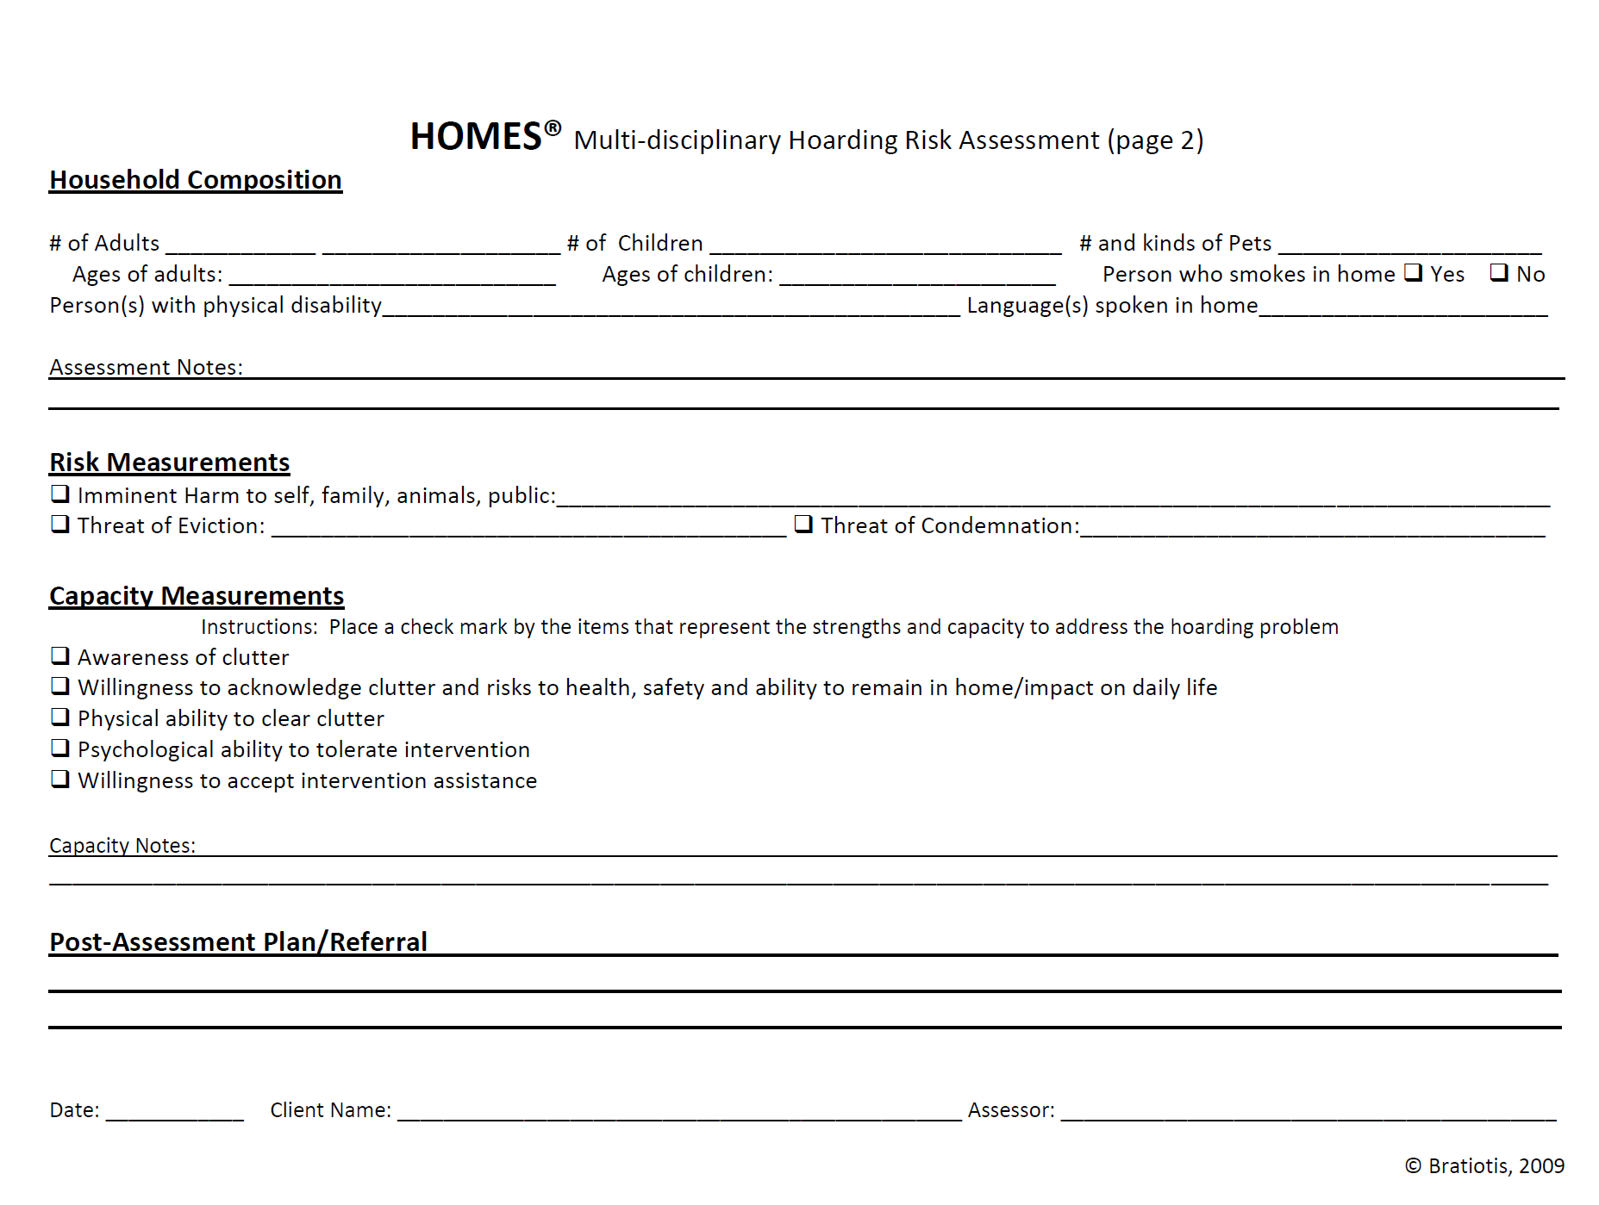

Slide 49
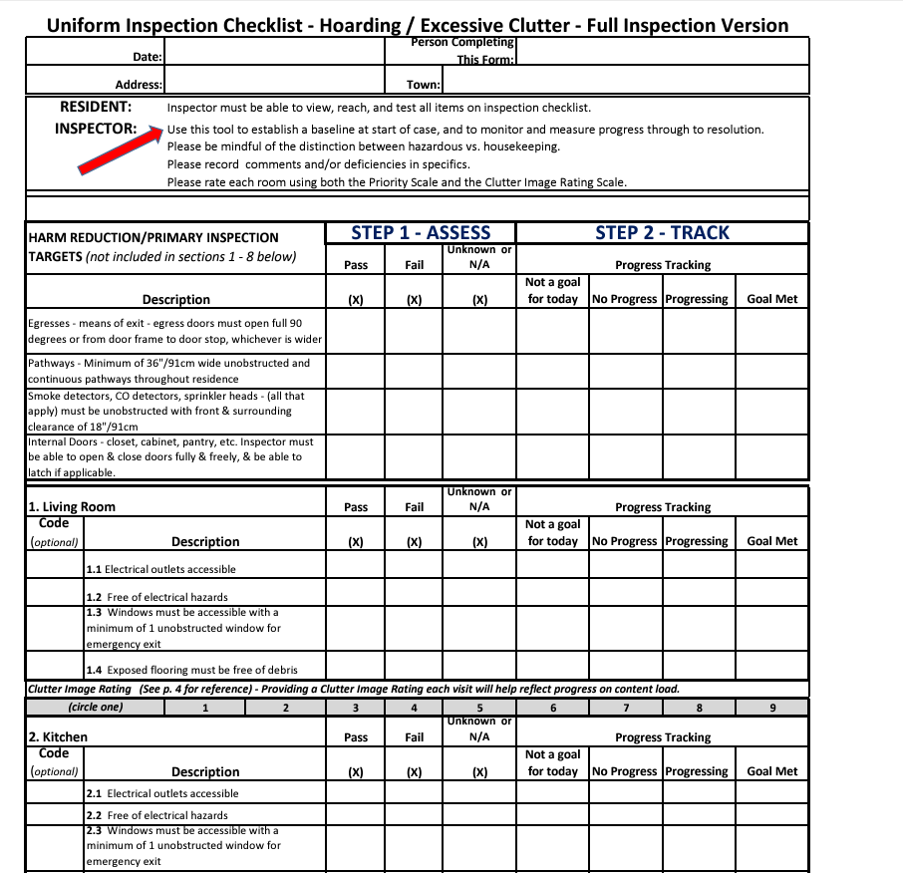
Uniform inspection checklist
Resident: Ensure housing is safe, sanitary, and in good repair.
Inspector:
Distinction between hazardous vs. housekeeping;
Document deficiencies in specifics;
Rate each room.
https://www.centerforhoardingandcluttering.com/
https://www.centerforhoardingandcluttering.com/uniform-inspection-checklist-2/

Slide 50
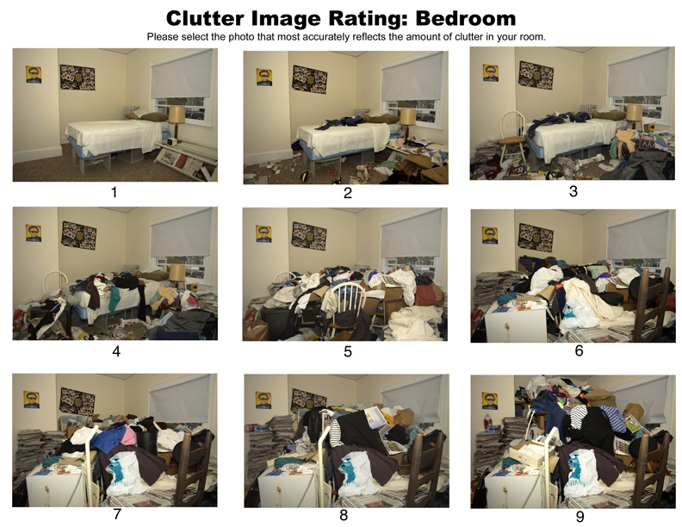
Clutter Image Rating Scale
Source: Steketee & Frost (2007). Compulsive Hoarding and Acquiring Therapist Guide. NY: Oxford University Press.
https://hoarding.iocdf.org/about-hoarding/do-i-have-hoarding-disorder/
Notes:
As part of a diagnosis (along with other factors) hoarding considered if CIR of 4 or above

Slide 51
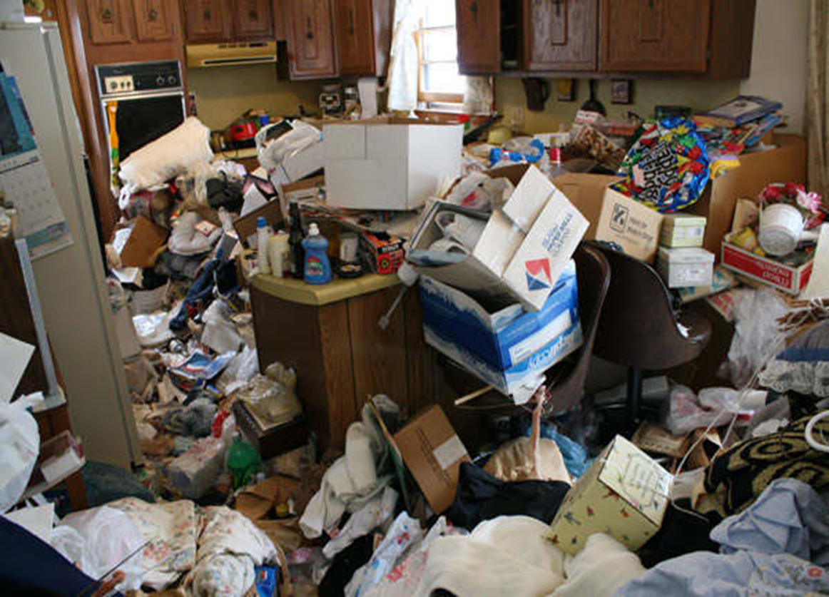

Slide 52
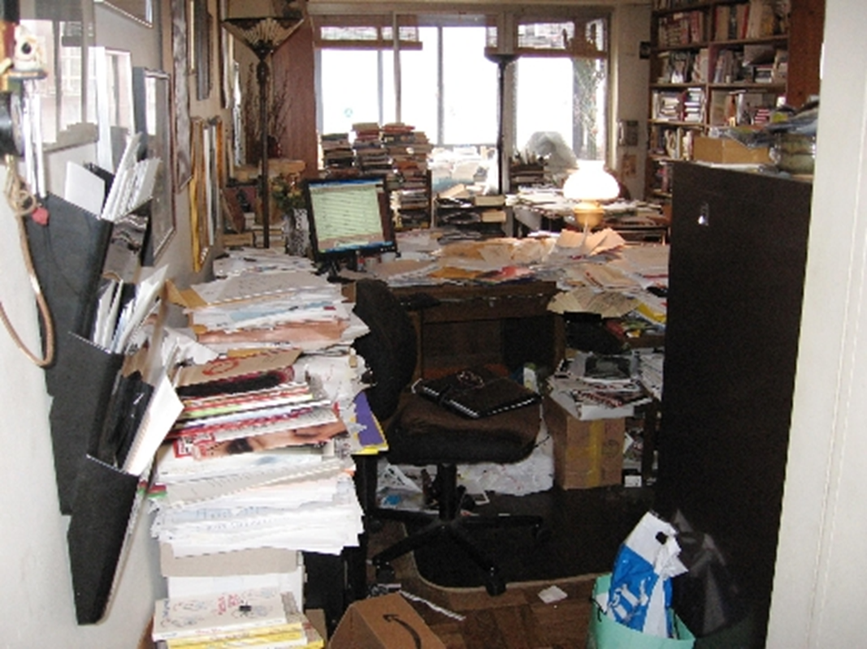
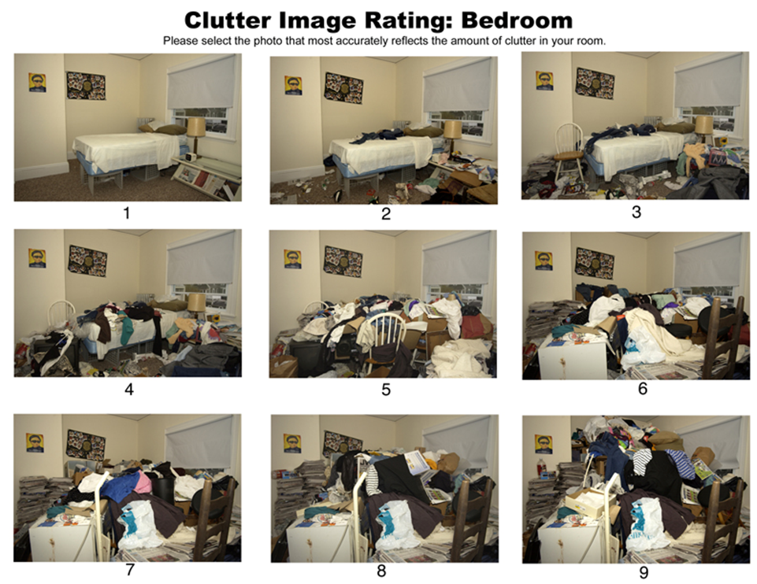

Slide 53
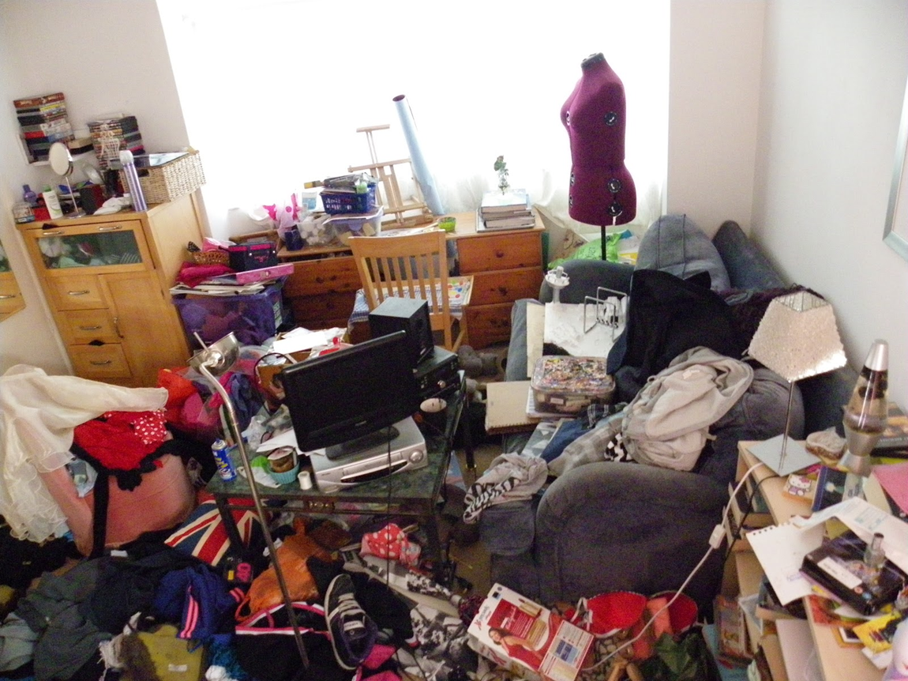

Slide 54
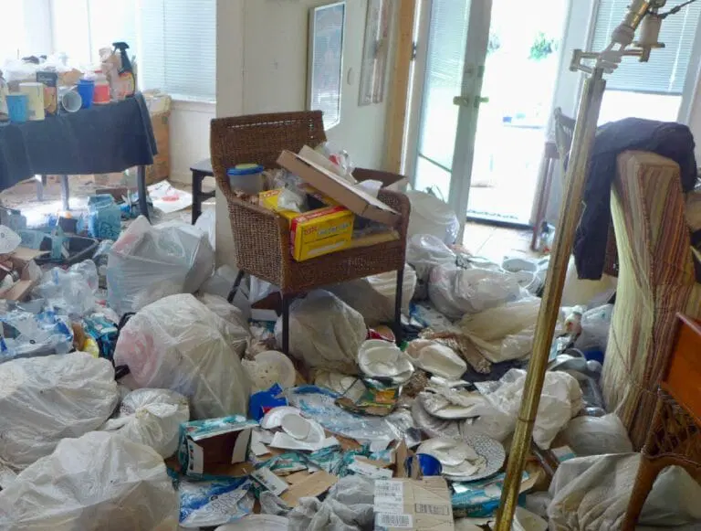

Slide 55
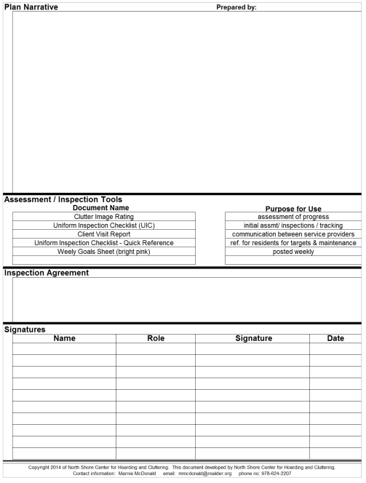
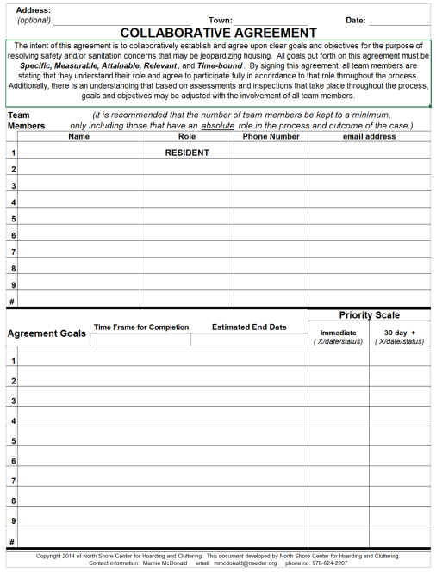
Collaborative Agreement

Slide 56
Inspection report will help with planning
Living room must be cleaned
Or
Living room currently full with bags of clothes, stacks of magazines and other items blocking access to rear egress; item piles up to 5’. Window is blocked by items stacked on the couch tipping onto windowsill. Must have paths to egress a minimum of 3’ width. Items on couch must be removed to gain access to window. Pile height must be reduced to maximum 2’.

Slide 57
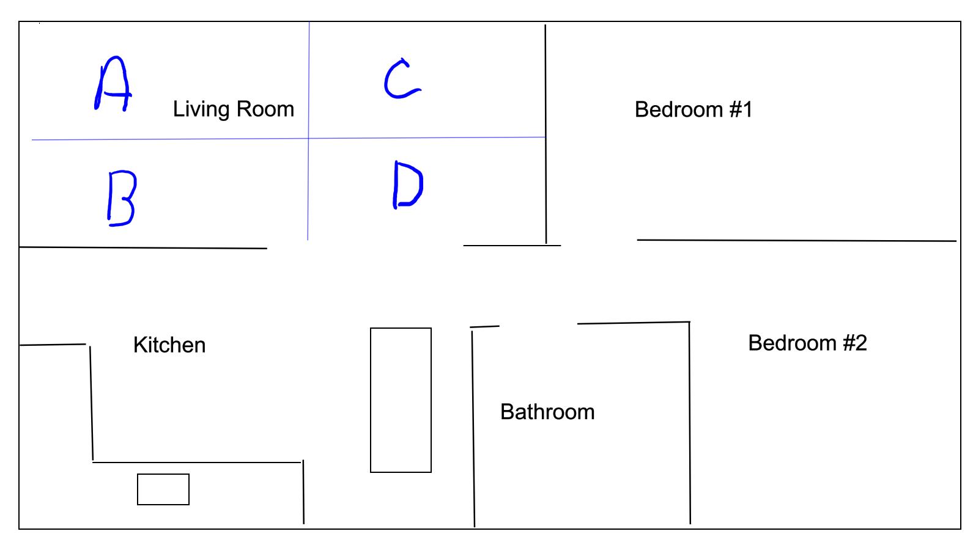
Room mapping
Notes:
Use CIR to assess areas and track progress. Set reasonable timeframes and stick to them.

Slide 58
Tiered approach
IMMINENT RISK
• Clear egress path 24”
MUST BE CORRECTED TO PASS INSPECTION
• Reduce clutter by 25%
NOT REQUIRED BUT MAY IMPROVE QUALITY OF LIFE
• Clear bed for sleeping
• Remove items from top of stove
• Remove items from near heating system
• Egress paths 36”
• Stacks no higher than 4’
• Put sheets/ towels in linen closet

Slide 59
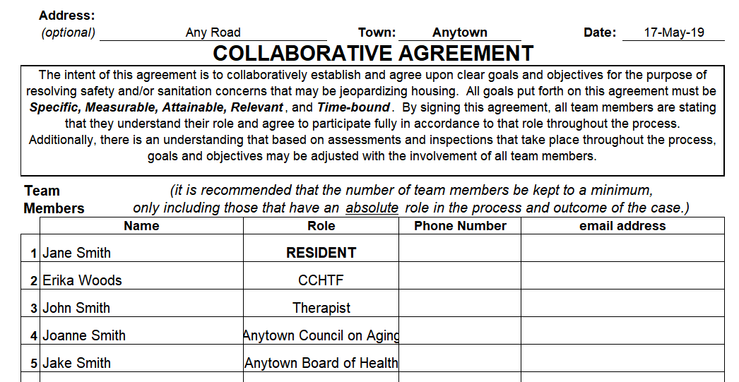

Slide 60
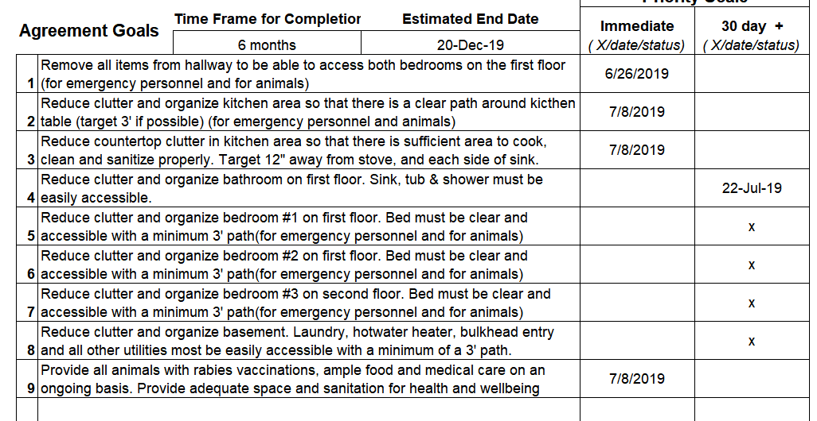

Slide 61
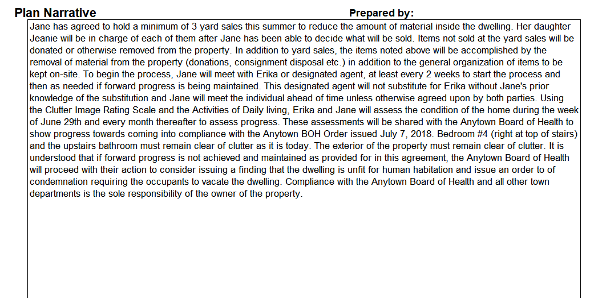

Slide 62
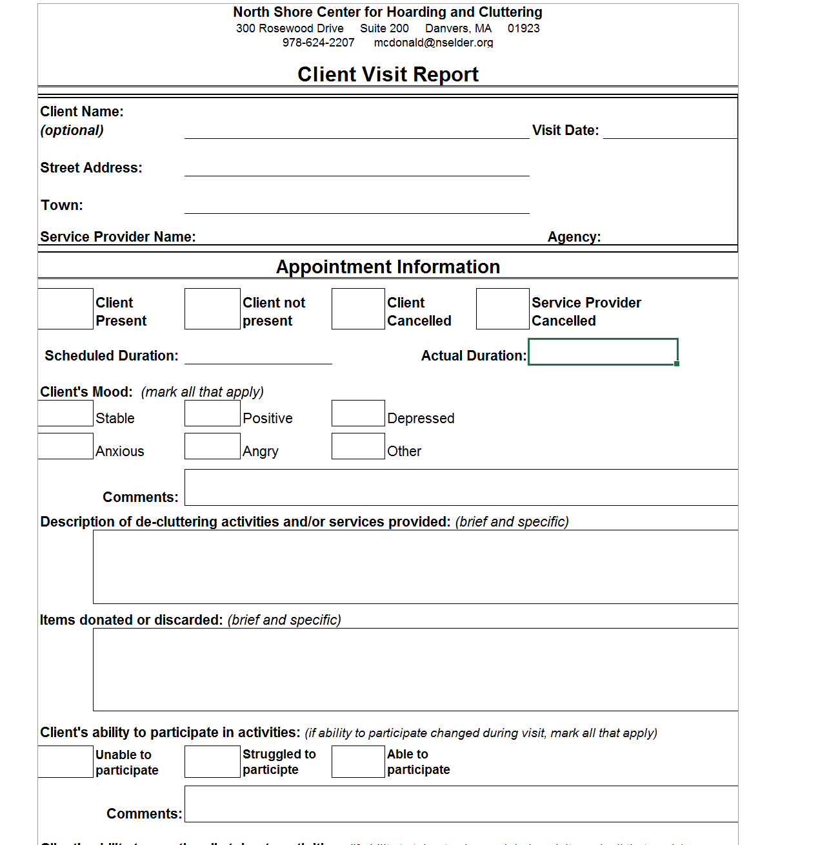
Communicating Progress

Slide 63
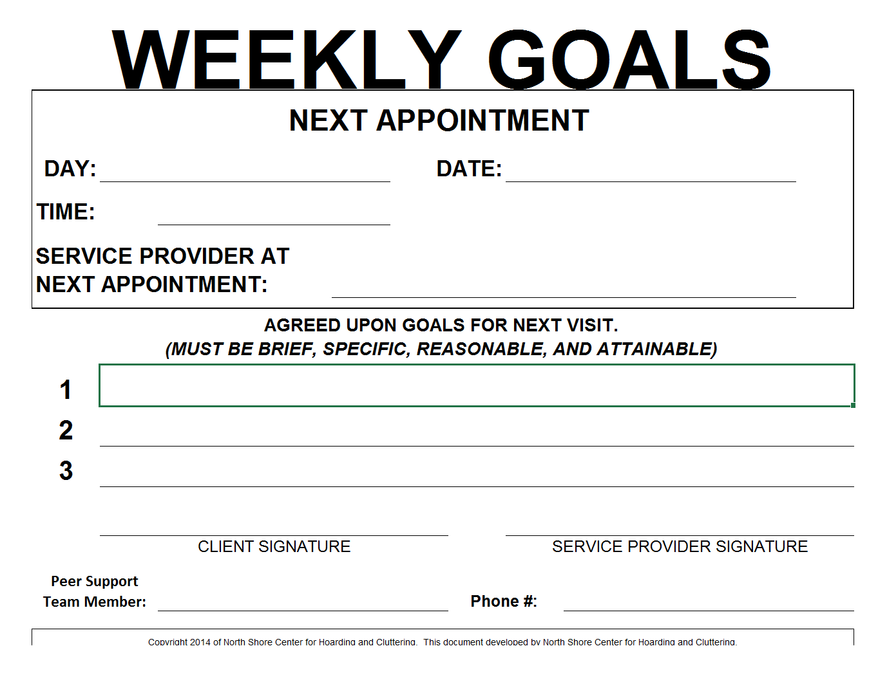
Goal Setting

Slide 64
Treatment: there is no “one size fits all”
Medication alone does not alleviate hoarding behavior
Intervention - cleanout not recommended
Cognitive behavior therapy (CBT)
The core principles of CBT are identifying negative or false beliefs and testing or restructuring them. Skills training:
Organizing
Decision making
Problem solving
Self help groups
Buried in treasures
Clutterers’ Anonymous
Harm reduction
Notes:
Insight vs Motivation
Clean-outs-My Mother’s Garden

Slide 65
Resources
Massachusetts Hoarding Resource Network
https://www.mamh.org/education/older-adult-behavioral-health/mhrn
MassHousing
www.masshousing.com/programs- outreach/housing-stability/partnership- programs/hoarding
International OCD Foundation
https://iocdf.org/
National alliance on mental illness
www.Nami.org

Slide 66
ANIMAL HOARDING RESOURCES
ANIMAL LEGAL DEFENSE FUND
WWW.ALDF.ORG/ANIMAL-HOARDING
American society for the prevention of cruelty to animals
www.aspca.org/helping-people-pets/animal-hoarding
MSPCA
https://www.mspca.org/
Animal Rescue League of Boston
https://www.arlboston.org/

Slide 67
Questions?
Erika Woods MS, RS Erika.woods@capecod.gov 508.375.6620
Paul Halfmann MPH, RS Halfmannphc@gmail.com 508.340.6590

