Slide 1

Governance for Tomorrow
Stephanie Marcus
Manager, Cloud Transformation and Change Management
KBACE, a Cognizant Company
Stephanie_Marcus@yahoo.com - (847) 899-9439

Slide 2
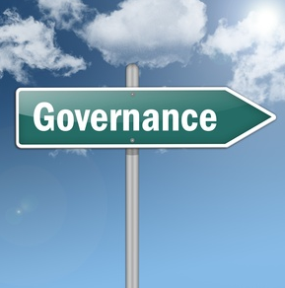
Agenda
Governance
Stakeholders
Directors
Making a Change
Communication and Engagement
Additional Information
  PCI
  Web Conferencing Options
Final Thoughts . . . .

Slide 3
Governance

Slide 4
Governance Defined
Governance refers to
  All of the processes of governing and leadership
  The processes of interaction and decision-making among the people involved in a collective problem that lead to the creation, reinforcement, or reproduction of social norms and culture
What is the value of “governance” for us?
Enables us to achieve our organization's social mission, ensures our organization is both viable and consistently growing.
Builds on our foundation (history) to achieve our future goals.

Slide 5
Common Types of “Governance”
Operational Model: The board manages, governs and performs the work of the organization
Collective Model: The board and staff operate as a single team when making decisions about governance and the work of the organization - Board members work with services and operations teams to manage functions
Management Model: The board manages operations through functional committees that may or may not have a staff coordinator
Representational Model: An approach used by elected officials who have the primary responsibility of balancing the interests of their constituents with the best interests of the organization
Traditional Model: The board governs and oversees operations through committees established along functional lines (finance, human resources, programs) but delegates the management functions to the CEO

Slide 6
In its simplest form, “GOVERNANCE” is shared decision-making based on the principles of partnership, equity, accountability, ownership and leadership at the point of service for all stakeholders

Slide 7
Governance Components
SHARED
More than one person, team, role or location is involved in decision making and delivering services
PARTNERSHIP
Open and collaborative interactions to identify, resolve and confirm resolution of an issue, question or problem
EQUITY
Fair, impartial, unbiased, objective and even-handed actions and responses to all customers, potential customers and the organization’s teams
ACCOUNTABILITY
Being fully responsible for those obligations, actions and tasks which you (in your formal role) have agreed to perform
OWNERSHIP
The services, processes, deliverables and activities you are tasked with supervising, or those for which you have custody or guardianship
LEADERSHIP
Management of assigned duties and staff; guidance of the desired culture and behaviors; responsibility for making and upholding decisions; and ultimate answerability to customers

Slide 8
What does MY organization look like?
Leadership
(Salaried, Volunteer)
President
Member Facing
(Office, Events, Shows, Awards)
Service and Operations Teams
Marketing/ Potential New Members/ Organization Growth
Operations
(“Running the Business”)
ERP/Back Office
Board
Cross-Over
Office Management/ ERP
Shows and Events
Awards
Special Events
Expanded Registrations
Operations
IT
Processes
Infrastructure
Publicizing the Organization

Slide 9
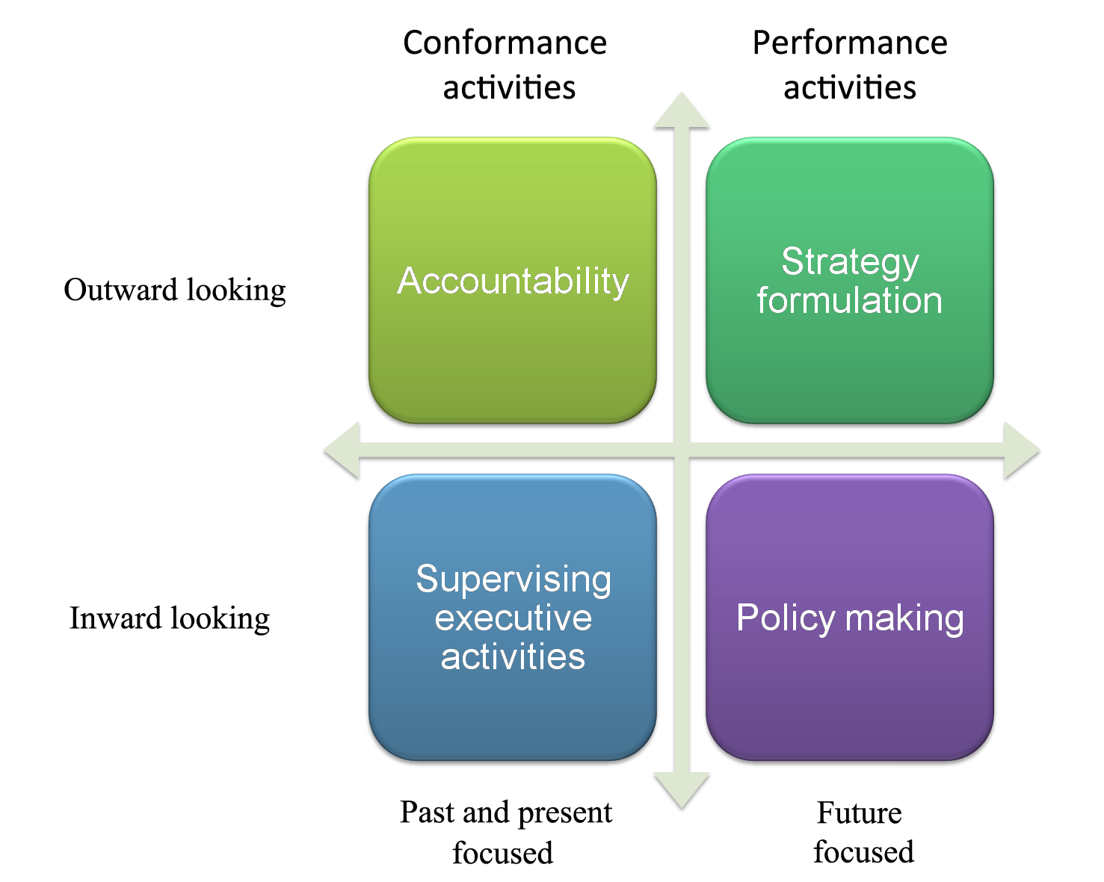
Governance . . .Keys to Success
Understanding and validation of the owner, and type of ownership of solutions
Leveraging the Vision
Focus on Stakeholders
Building Strategies
Collaboration
Sharing Success
Communication!
Supporting Goals
Focus on Member Value

Slide 10
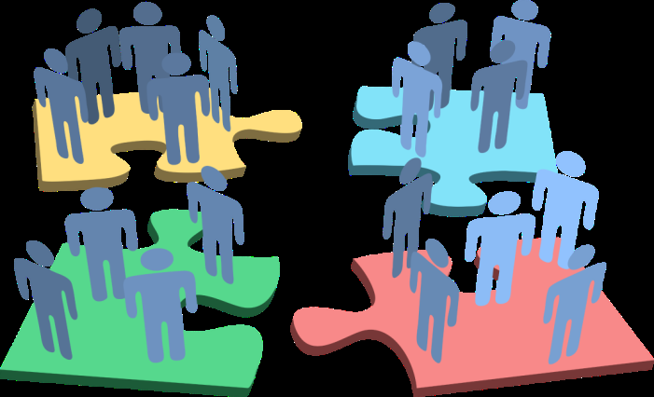
Another key to successful governance is Stakeholder Management
A “Stakeholder” is any person or organization with an interest in, or who is impacted by, the operations of your organization

Slide 11
Who are our Stakeholders?
Other Special Groups
Business Leadership
Customers (Members)
Board of Directors/ Other “Directors”
Potential Members
Paid, Employees/ Volunteer Staff
Sponsors,
Potential Sponsors
Suppliers, Vendors,
Partners
Regulatory
Assoc.,
Legal Entities

Slide 12
What do we need to know about our Stakeholders?
What they are impacted by:
The organization’s future business goals
Current situations and challenges
Upcoming changes
Existing processes, rules, activities, communications and
Level of impact:
Directly Impacted
  Changes and business operations significantly affect this group/individual
Indirectly Impacted
  Changes and business operations affect this group in an ancillary manner
Informational
  This group needs to be kept informed but is not affected

Slide 13


Understanding the Stakeholder Experience
An exercise to visualize stakeholder interactions
Example Scenario: Member calls in with a question about their membership
  Member Calls → Call Answering System → Routing to team → Additional Information Needed → New Team Involved → Solution Needs Further Investigation → Member Call Back Needed → New Individuals/Teams Involved → Resolution Requires Validation → Notification to all Impacted Teams/Individuals → Documentation Updated → Call Back to Member
How many teams/individuals are involved in a typical Stakeholder Interaction?

Slide 14
Board of Directors
Roles, Responsibilities, Elections,
Task Force and Committees

Slide 15
Director Role
Generally defined in the by-laws, and includes:
Nomination criteria
Responsibilities to members and involvement in the organization
Requirements for representation of members
Clear understanding of actions required to retain the role
Guidelines for working on committees and task forces
Term limits
Campaigning rules and framework
Touch-points across the organization
  Internal operations
  Members
  Other Groups (e.g. Sponsors, Other Organizations, etc.)

Slide 16
Director Responsibilities
Commitment to the organization’s Mission and Vision
Support the work of the organization
Act as an advocate for members
Be a collaborative partner with the CEO and organization leaders
Qualifications
  Extensive experience/membership in the organization
  Business acumen and understanding of the rules and goals of the organization
  Diplomatic skills and the ability for cultivating relationships and building consensus among diverse individuals
  Personal qualities of integrity, credibility, and a passion for improving the lives of all of the organizations members
Term Limits
  Generally two to three years

Slide 17
Internal and External Facing Directors
INTERNAL: Interface primarily within the organization’s leadership and operations teams
  By-laws and Rules
  Organizational and Business Goal input/planning
EXTERNAL: Interface primarily with external sources as an advocate
  Regional Clubs
    Champion for the clubs (support their ideas/needs not just your own)
    Formal engagement (club representatives, attendance at club events, etc.)
    Committees (e.g. increasing membership and animal registrations, awards)
    Task Forces (e.g. negotiations with show facilities, local sponsors, etc.)
  Information sharing
    Conference calls, “WebEx” type meetings, Director’s newsletter

Slide 18
Leveraging Director Experience and Expertise
On-boarding for new Directors
  Role and Responsibilities
  Rule book/By-Law review
  Understanding of previous pitfalls/lessons learned
  Clear connection to member representation
Director Mentoring programs
  Pairing experienced/lifetime Directors with new Directors
Multi-organization Director’s Working Sessions
  Common challenges and solutions

Slide 19

Electing your Board of Directors
Members determine Directors through a voting process
  Provides non-political , democratic control and representation of all member groups
  Since voting members have legal rights, it is essential to clarify membership criteria, privileges, and obligations, including those related to voting eligibility
Bylaws of the organization provide
  The roles and responsibilities of the Directors
  Methods for which candidates cans share his/her beliefs and platforms
  The foundation for the voting process
Voting can either be “Push” or “Pull”
  Paper Ballots sent to members
  On-line websites for voting
  Electronic (email) surveys

Slide 20

Managing Votes for an Impartial Result
With the wide range of ages and cultures of your membership, it is critical that all members are engaged in the election process
  Know your members
    Query them about their preferred method of communication
      Mail, email, on-line web sites/surveys
    Provide a confidential method for voting
Example: Send a letter/mail notification to members and ask them if they would prefer to receive information about the organization in the mail, by email, or go to the organization’s web site. Ask them to respond using a post-card, email address or go to the organization’s web site to respond. Send ballots based on the member’s response.

Slide 21
Electronic Voting
Voting Software:
myDirectVote: Survey & Ballot Systems (SBS) online voting tool for elections of 5,000 voters or more
Polyas: Make ballots online, upload the electoral roll, distribute voting credentials and receive election results - all at the push of a button
Ballotbin: secure votes, vote from anywhere, results available during and/or after elections, abilitity to vote for more than one candidate
Multiple other tools available based on the organization’s individual needs
Survey Tools

Slide 22
Task Forces and Committees

Slide 23
Task Forces and Committees
Task forces are generally organized to deal with a specialized task such as by-law changes, organizational changes (e.g. number of regions/territories, etc.) and are disbanded when the task has been completed
Committees are usually appointed for a specific function, and would include only some of the Directors with expertise in that area
  For example, a Board of Directors would appoint some of the members to a Judges Committee whose special function would be to interface with the Show Office Team, Judge’s Organizations and Regional Clubs to gather questions/issues, advise on rules, make recommendations, and review changes impacting the judging faction for the organization
Committees are “standing” organizations and Task Forces are temporary with a focus on a specific deliverable or issue
  “Task Forces” are sometimes referred to as “Ad hoc Committees”

Slide 24
Task Force Structure and Tenure
Defined task that needs to be addressed quickly
  Short term > 30 days
  Mid-term = 30 to 60 days
  Long-term = 60 to 90 days
Criteria for completing the task have been defined, and it is clear/easy to understand when the task has been completed
Driven by an agreed upon leader
Additional non-Director subject experts may be included
All task force members are equal and must agree to meet the requirements for resolution
Minutes are recorded for all Task Force meetings and shared as applicable

Slide 25
Committee Structure and Tenure
Establish committees when it's apparent that issues are too complex and/or numerous to be handled by the entire board
Standing committees should be included in the by-laws of the organization
Committees recommend policy for approval by the entire board
Committees make full use of board members' expertise, commitment, and ensure diversity of opinions on the board
  Additional non-Director subject experts may be included
All Committee agree to meet the requirements for being a member of the committee
Minutes are recorded for all Committee meetings and shared as applicable

Slide 26
Making a Change

Slide 27

Are Changes Needed?
How Much Change?
How Quickly?
For Whom?
What is the Benefit?
How do we make it happen?
…..in a period of upheaval, such as the one we are living in, change is the norm."
- Peter F. Drucker

Slide 28

Drivers for Identifying When to Change
Changes in the economy
Business goals are not on track or are not being achieved
Feedback from membership and other stakeholders
Financial drivers
Changes in sponsorship
Cultural changes
Change IS Hard!

Slide 29
Ensuring Change is Effective
Change Traits
Ineffective Effective
  In conflict with goals
  Ad hoc
  Expensive
  Time consuming
  Not connected to market demands
  Unpleasant / Stressful
  Disruptive to business operations
  Interrupts business operations
  Change does not “stick”
  Aligned to goals
  Intentional and planned
  Cost effective
  Time appropriate
  Responsive to market & member demands
  Low stress levels
  Does not interrupt business operations
  Change “sticks” and becomes the “new normal”
A decision to undertake change carries with it the responsibility to ensure that the change is effective and adds value to the organization and members

Slide 30
What changes could I focus on?
Business Operations
Employee Skills
Board of Directors Role
Membership “Delight”
Sponsorship Engagement
Regulatory Association Requirements
By-Laws Updates
Potential Members
Possible Sponsors
Other Special Groups
Sponsors
Increased Alliances
Donations
Processes Currently In Place
Possibilities for Expansion

Slide 31
Diagnostic Questions to Manage Change
Strategy
Internalization
Focus
Sustainability
What is the vision? What’s the roadmap? Is there a project plan? How will we know if we’ve succeeded or failed? | Is there the right sponsorship and buy-in for the objectives from membership? How are we using directors, members and other stakeholders feedback? What are leaders thinking, saying, asking, doing? | How will members be impacted? What’s the message—why, what, how, and ultimate goal? How and when are we communicating? Do we know how to best customize our messages? How will we know the message has been heard and understood? | Are we clear on how processes should work inside departments, between departments, with our Board and members? Are changes being utilized? Did we share the benefits of having this change in place? Did all stakeholders receive all they needed to adopt the change and make it the “new” norm?

Slide 32
Planning for the Change
Change Strategy
  Develop a tactical plan of action designed to achieve a particular goal
  Avoid “strategies” that are not specific (e.g. “get people engaged”, etc.)
  Use the strategy to make the problem or problems easier to solve
  Provide a common level of understanding
Resistance Strategy
  Proactively seek out what types of resistance you might encounter
  Don’t wait until after resistance is engaged
  Study and learn what types of resistance can be expected
  Work with those impacted to determine why they would resist
Operational Change Tactics
  Define and execute specific actions with resources identified and approved
  Key messages drafted, reviewed and approved including delivery method and feedback process

Slide 33
Change Management Tools
Assess your Stakeholders and the impact to them
Assess the impact of the change
Communications
  Plan and scheduled
  Communications “look & feel”
  Review and approval process
  Audience analysis
  Publication methods
Support for the change and feedback loop
Sustainability for the future

Slide 34
Next Steps – Where to Focus?
High
High Value,
Highly Achievable
Goals
Identify the “Best” changes!
Low
High

Slide 35
Communications and Engagement

Slide 36
Keys to Effective Communication
Design and deliver the Communication
Ensure the message was understood and can be acted upon
Ensure that required actions have been taken and feedback collected
Ensure the Communication was received and read

Slide 37

Information Sharing and Understanding
Share information effectively and extensively
  “Push” to audience and allow audience to “Pull” from a central source
  3x3 – three times, three different ways is good
  5x5 – five times, five different ways is better
Communication methods
  Email
  Hard copy/”snail” mail
  Website
  Posters/Flyers at events
  Town Hall/Conference Calls
  From Directors to Regional Clubs to Members
  In-person events (e.g. Membership Meetings, etc.)
Ensure a feedback loop is in place to measure for understanding and engagement

Slide 38
Additional Information

Slide 39
PCI Compliance
PCI DSS stands for Payment Card Industry Data Security Standard, which sets the requirements for organizations and sellers to safely and securely accept, store, process, and transmit cardholder data during credit card transaction to prevent fraud and data breaches
Who needs PCI DSS compliance certification?
  Although there is technically no such thing as “PCI certification,” sellers of all sizes, service providers, banks, and any other organizations that process credit card payments need to prove they are PCI compliant
What are the PCI DSS compliance levels?
  There are four levels of PCI compliance; each level has unique requirements for a business to validate its compliance. The level under which your business falls is based on your total transaction volume, annually
What does it cost to be PCI DSS compliant?
  The fees to become PCI compliant, and maintain that standing annually, can range from approximately $1,000 annually to over $50,000 annually, depending on the size of your business
Who is responsible for a PCI DSS Compliance Self-Assessment Questionnaire (SAQ)?
  The PCI DSS Self-Assessment Questionnaire is a checklist ranging from 19 to 87 pages, created and distributed by the PCI Security Standards Council.
  It’s used as a mechanism for sellers to self-validate their PCI DSS compliance. Square sellers are not responsible for this SAQ, or for self-validating, since Square’s hardware and software complies with the Payment Card Industry Data Security Standard (PCI DSS) on your behalf
Is there a PCI noncompliance fee?
  Yes, there are typically fees associated with PCI noncompliance
  If your business does not comply with PCI standards, you could be at risk for data breaches, fines, card replacement costs, costly forensic audits and investigations into your business, brand damage, and more

Slide 40
On-Line/Web Conferencing Software
Free web-meeting software for small meetings
  Fuze
  Go To Meeting
  MeetingBurner
WebEx
  Free up to three people
  Paid version supports extremely large groups
Wikipedia Comparison of Web Conferencing Software
  (click here to go to web site)
Capterra Comparison of Web Conferencing Software
  (click here to go to web site)

Slide 41
What are the five things everyone in your organization needs to know in order to ensure that they remain engaged?
What is an . . . . ?
Why is it of benefit for me to belong to this organization?
What does this organization do to make my livestock more valuable?
How can my organization help me to share what I love about this organization with others?
. . . . . .

Slide 42
Governance for Tomorrow
Stephanie Marcus
Manager, Cloud Transformation and Change Management, KBACE a Cognizant Company

