Slide 1

COPA Pharmacy & PBM Updates
Ricky Newton, CPA
Treasurer & Director of Financial Services and Operations
Community Oncology Alliance
October 13, 2017
10:30 to 11:30am

Slide 2
Oral’s Drug Revenue Facts
Infusion Gross Drug Revenue in Physician Practice = 60 to 70% of total gross revenue depending on whether practice has services such as radiation and imaging revenue (Drug admin codes make up 7 to 8% and E&M codes 6 to 7% of total gross revenue)
Drug Revenue from physician oral dispensing pharmacy = 10 to 13% of total gross revenue
This equates to oral drug gross revenue equaling about 15% of all gross drug revenue

Slide 3
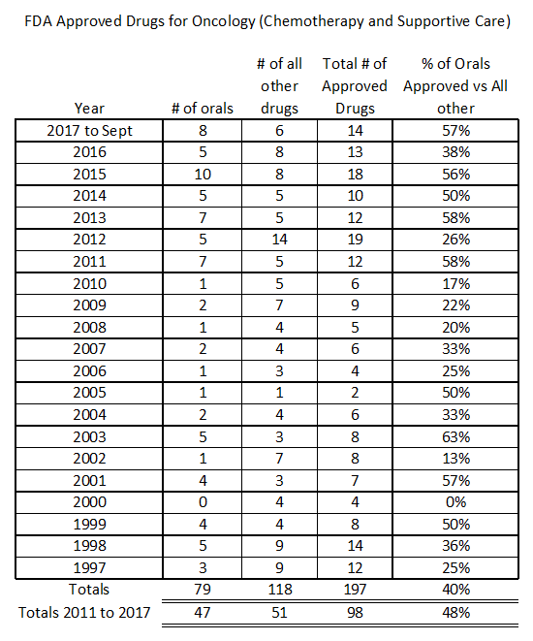
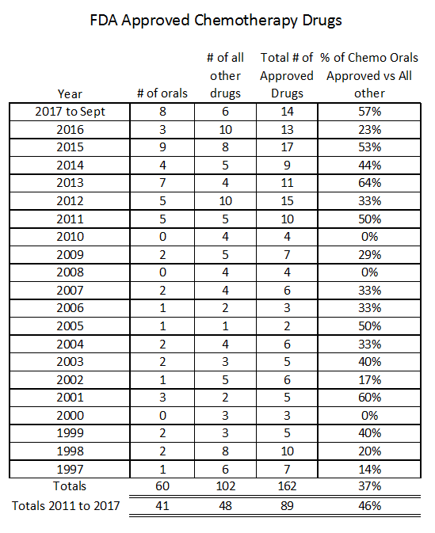
Orals vs IV drug FDA approvals by year

Slide 4
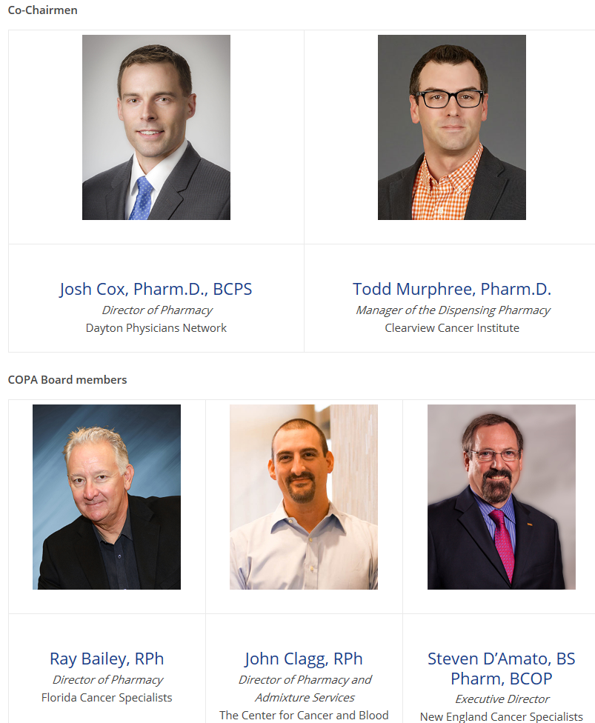
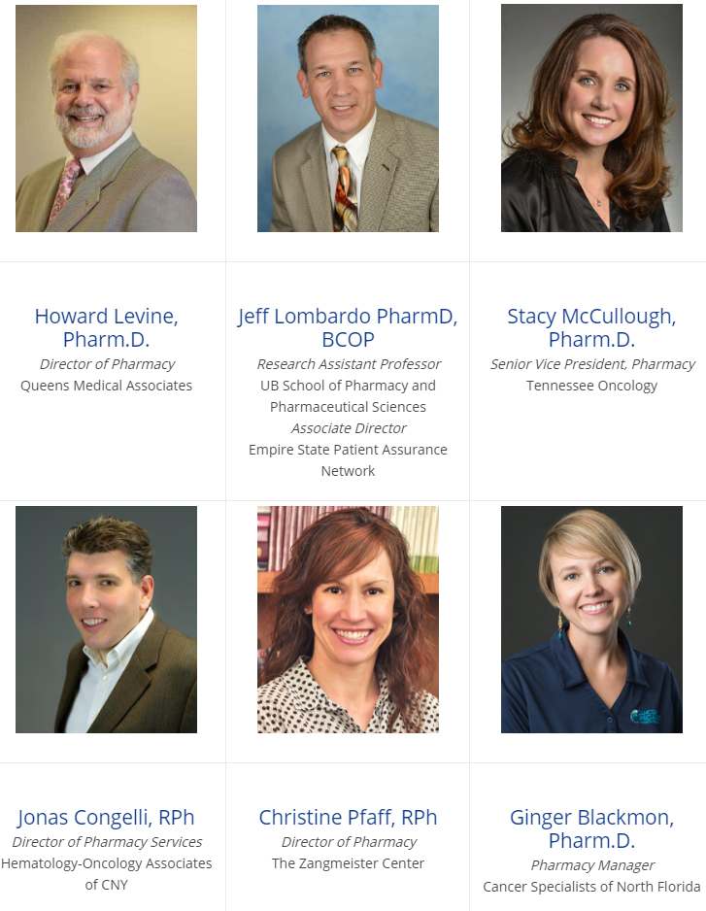
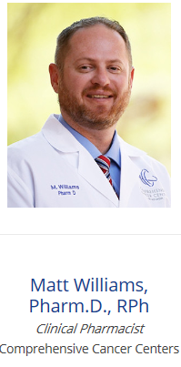
COPA Board

Slide 5
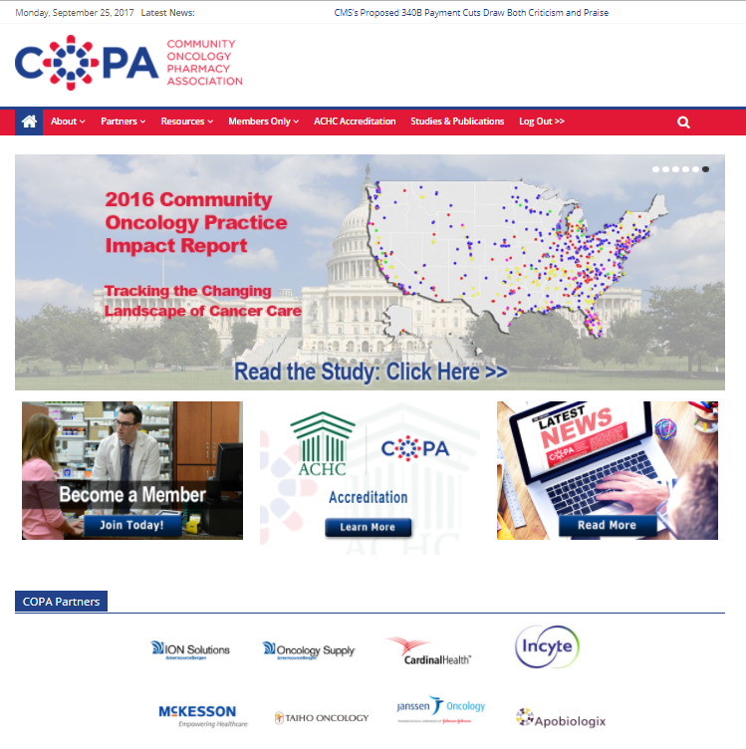
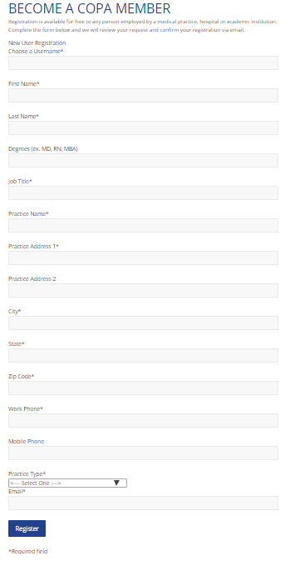
COPA Website & Becoming a Member

Slide 6
CVS/Caremark Update
CVS opened up their networks as of July 1, 2017 to physician dispensing pharmacies (No one has been approved to date)
Not allowing a physician dispensing pharmacy in Utah
Making onerous requirements
Process goes well beyond scope of standard credentialing processes
COA will send a letter sent to Seema Verma, administrator of CMS
If anyone gets approved please let us know ASAP

Slide 7
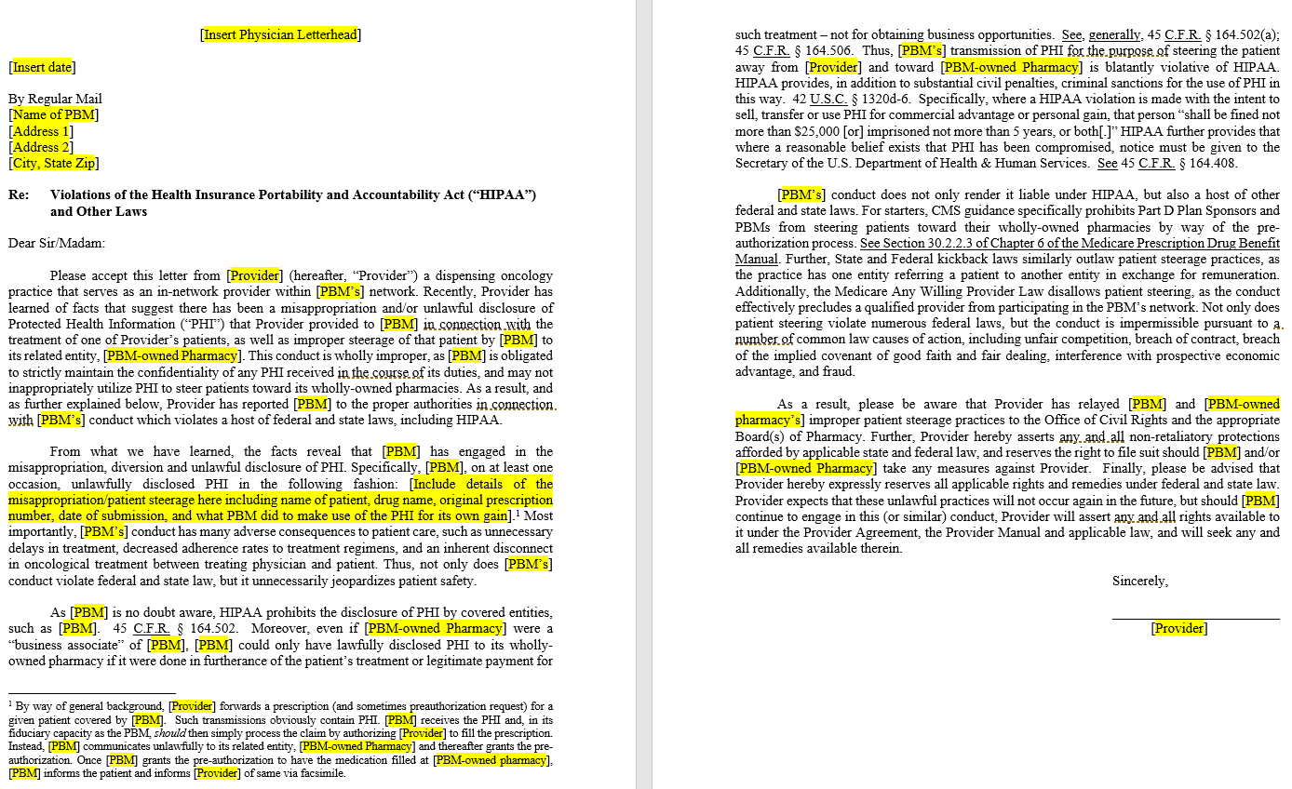
PBM Trolling Template Letter

Slide 8
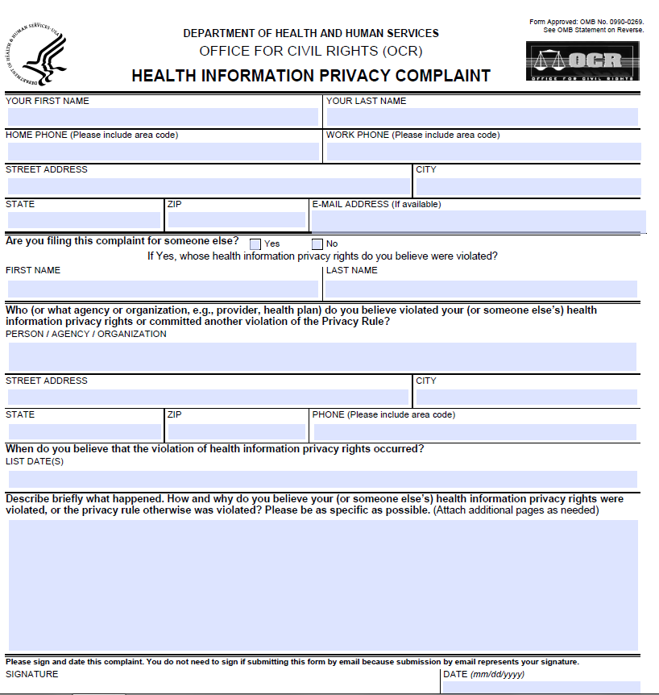
HIPAA Privacy Complaint Form

Slide 9
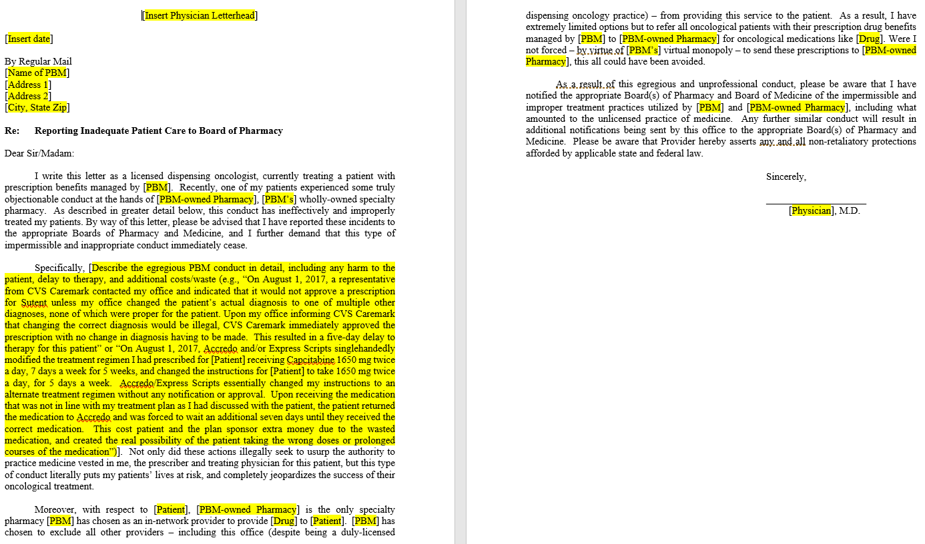
Template Letter Regarding Egregious PBM Conduct

Slide 10
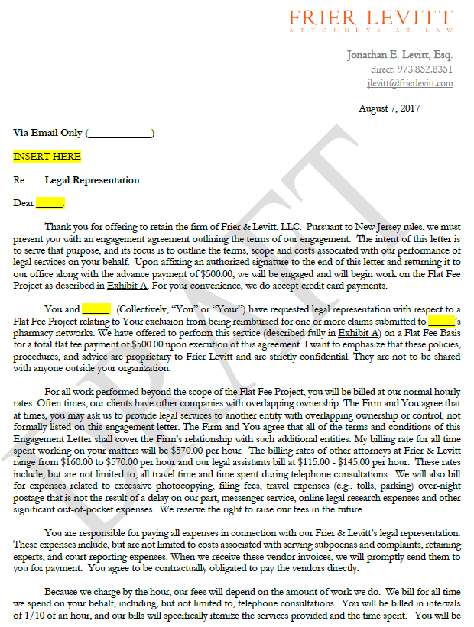
Express Scripts Update
Frier Levitt wrote letters on behalf of a few practices that sent us proof regarding no longer being able to dispense Imbruvica or Venclexta as of November 15, 2016 as of August 8, 2017
Frier Levitt to represent practices when ESI or other PBM’s exclude you from network
  Discounted fee of $500
  FL will contact PBM by telephone
  FL will write letter to PBM

Slide 11
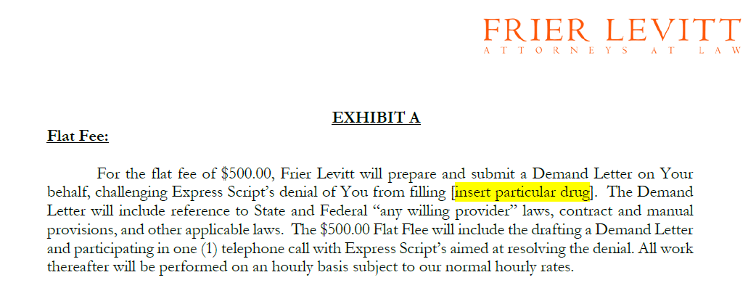
Express Scripts Update
Frier Levitt to represent practices when PBM/Plans only allow you to dispense initial fills
  Discounted fee of $500
  FL will contact PBM by telephone
  FL will write letter to PBM

Slide 12
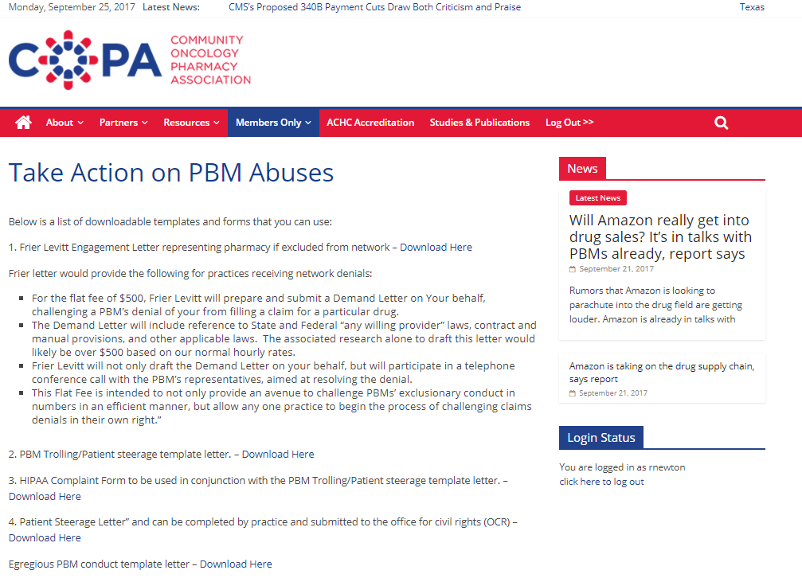
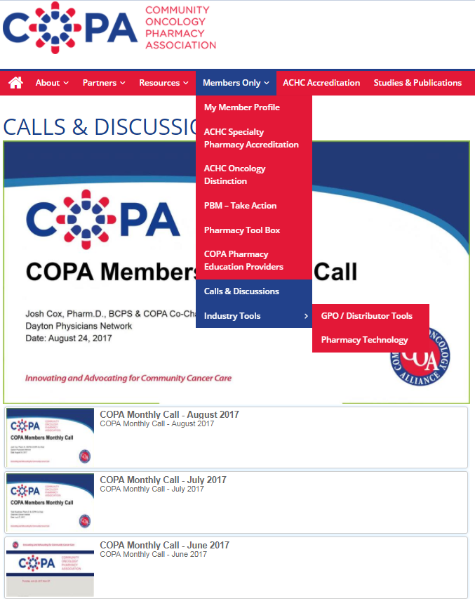
Member Resources

Slide 13
DIR Fees Update
H.R. 1038 (Griffith Bill) and S.413–COA supports eliminating DIR fees altogether but could not support this bill as written because it would have not accomplished the goals of eliminating DIR fees but could have actually done the opposite based on our report back from Frier Levitt
HR 1316 “Prescription Drug Price Transparency Act” Rep Collins (GA) – COA supports which would not allow PBM’s that own the distribution arm to close distribution of a drug to only their pharmacy distribution system that they own
COA is working on a quality measures bill
  Have positive and negative payment adjustments for quality metrics
  Quality measures would be applied based on the drugs being prescribed
  Be communicated at the claim level
  Be communicated as to how to understand your score and how to improve on it

Slide 14
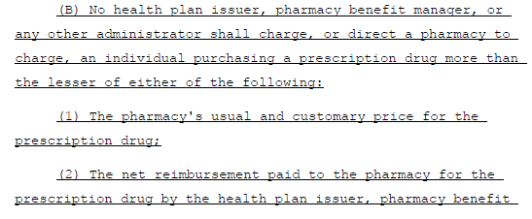
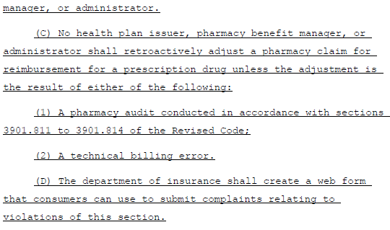
Ohio Amendment Being Introduced

Slide 15
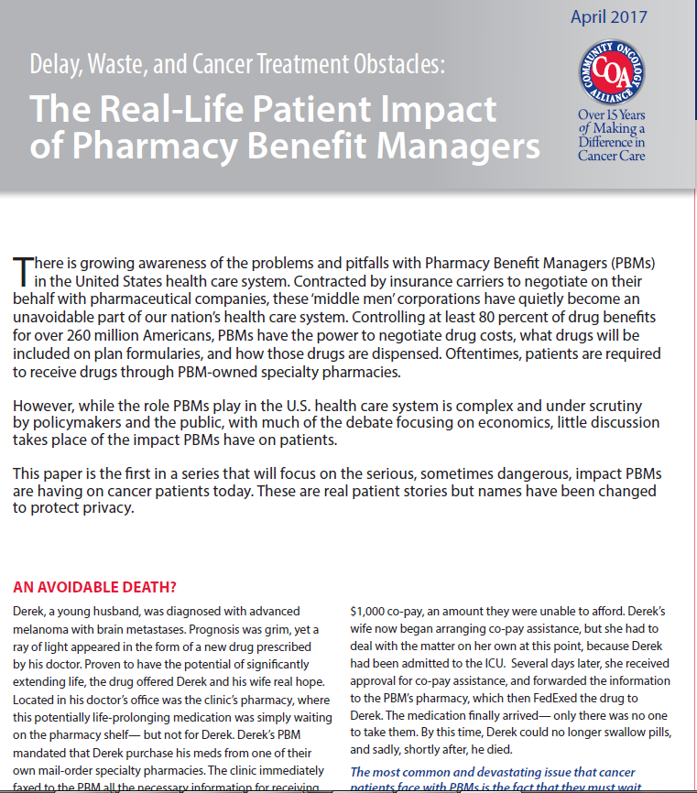
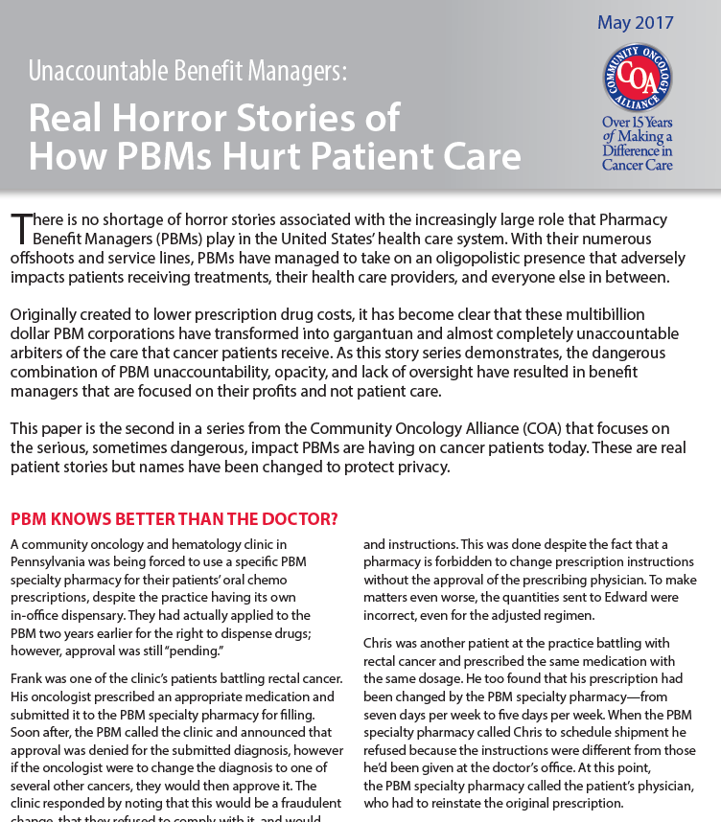
Patient Stories and Assistance
PBM horror stories volume 1 was released in April
PBM horror stories volume 2 was released in May 2017
PBM horror stories volume 3 was released in September 19, 2017
Papers with stories are found at www.coapharmacy.com under Studies and Publications
Please continue to email stories from patients and practice to rnewton@coacancer.org
Stories used by Ted on hill to open up discussions all the time

Slide 16
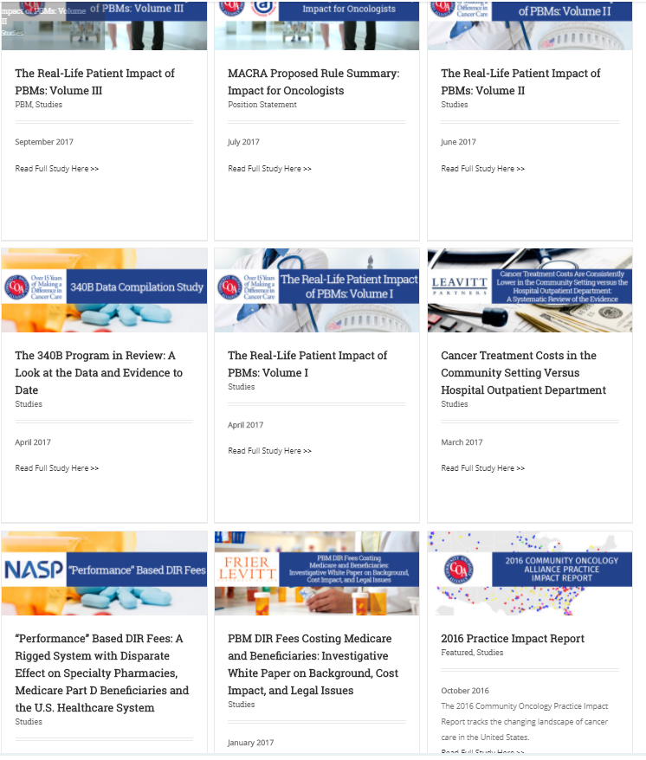
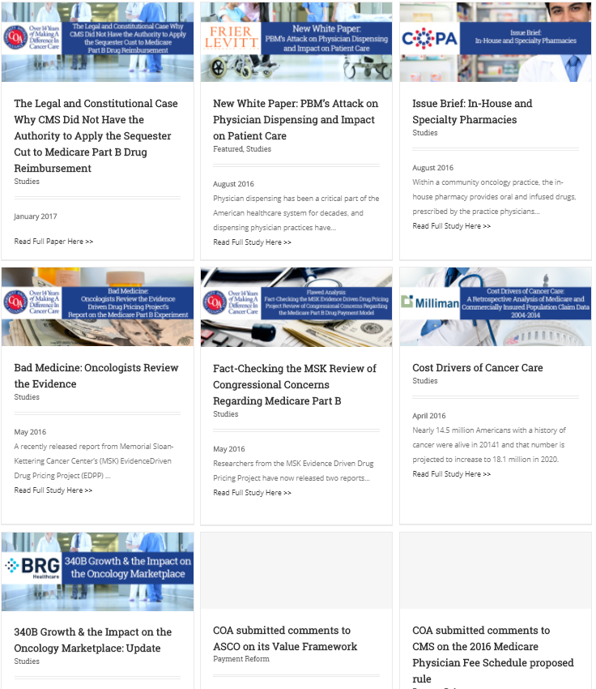
https://www.communityoncology.org/home/studies/

Slide 17
Trinity Data Study
  Data study for all dispensing physician pharmacies from Amerisource Bergen, Cardinal, McKesson
  Adherence (PDC & MPR), Average Length of Therapy, Refill Lag. Average Time to Dose Change and Waste were calculated
  The following drugs were followed for the time period of July 1, 2016 to June 30, 2017
    Gleevac
    Revlimid
    Tarceva
    Temodar
    Xeloda
    Zytiga
  Final meeting being set up with all distributors partners to determine next steps with current data and where we go from here

Slide 18
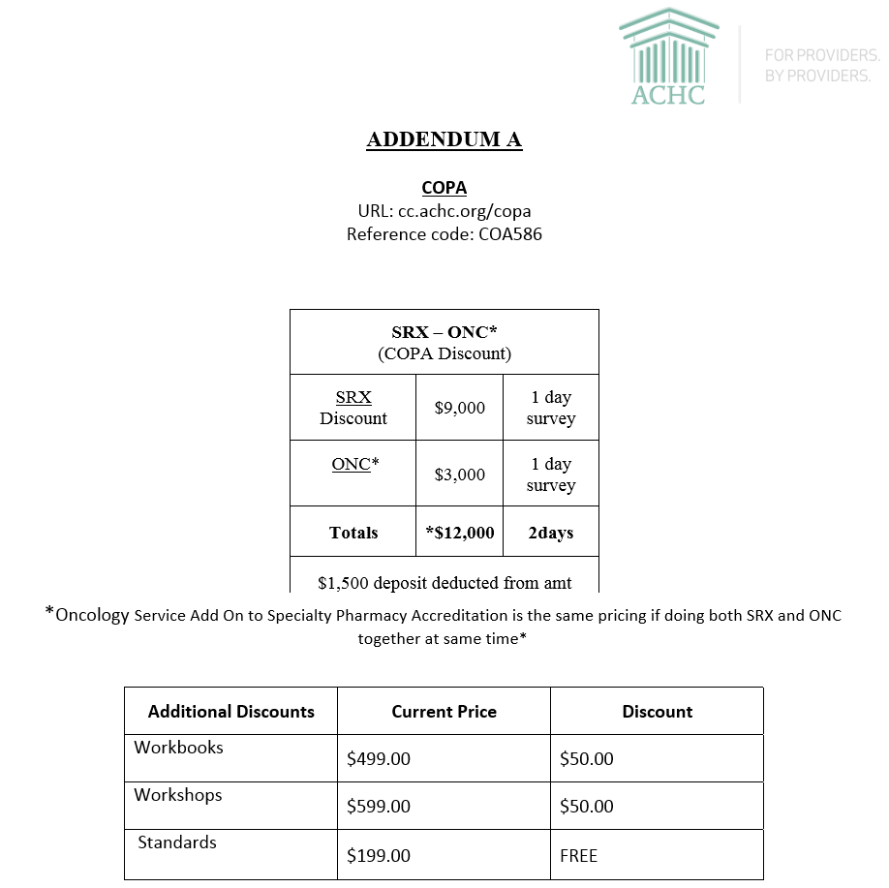
ACHC Accreditation
  Contract renewed as of June 20, 2017 between ACHC and COA for another 2 year contract between organizations for discounts previously offered as shown here
  20 COPA practices have been accredited or are getting accredited currently with ACHC
  COPA website www.coapharmacy.com has all the tools/policies and procedures to help pharmacies achieve both the specialty and oncology accreditation with ACHC
  Webinar was done on February 23 with ACHC which was recorded and is on COPA website to help answer questions and go over tools on website
  Cardinal personnel have access to our ACHC COPA tools in order to help practices achieve accreditation

Slide 19
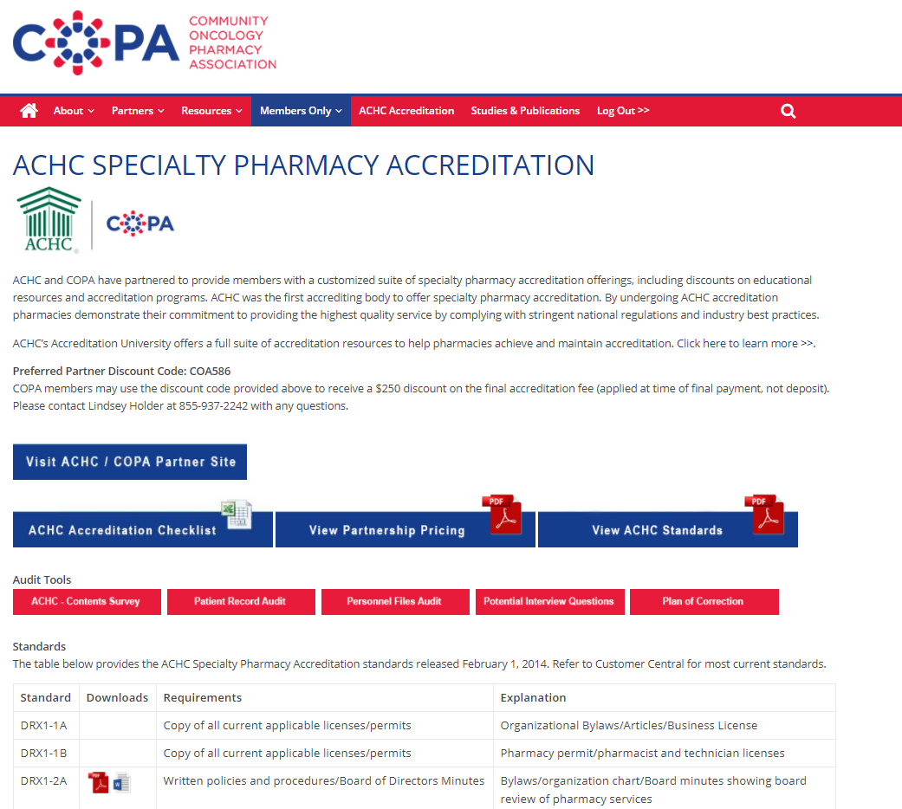
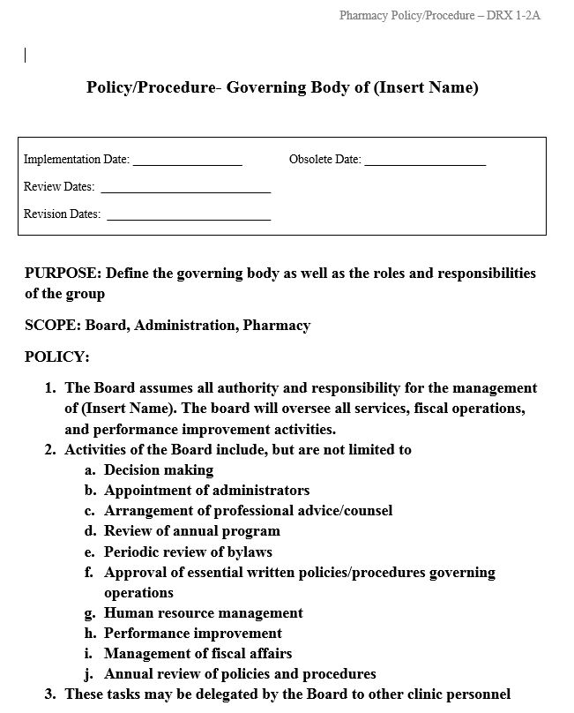
ACHC Online Tools at www.coapharmacy.com

Slide 20
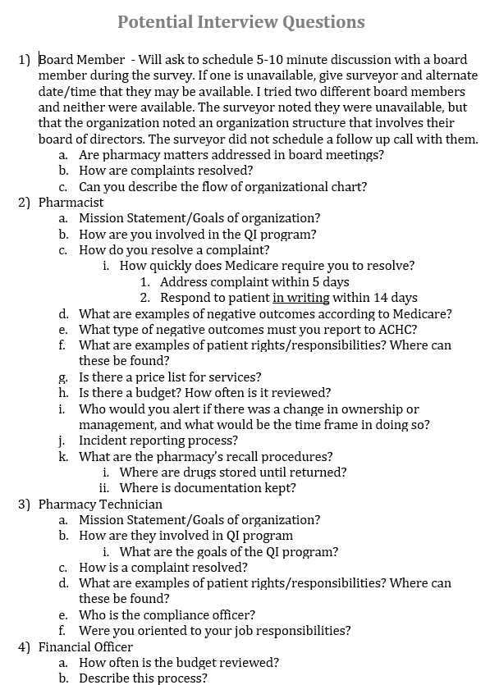
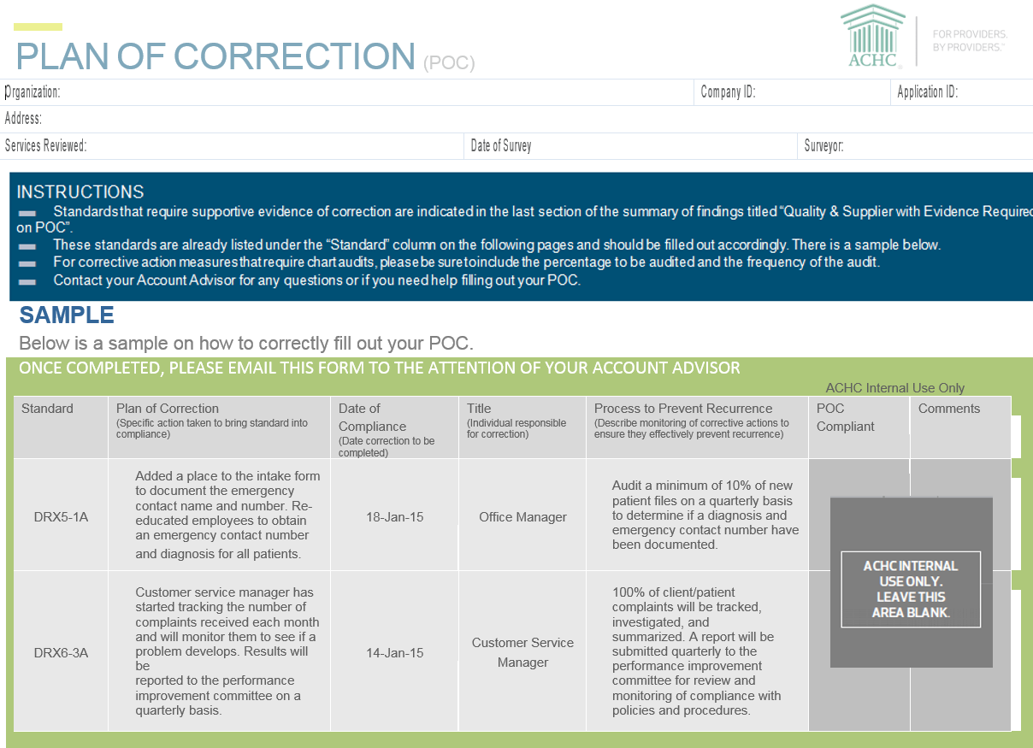
ACHC Accreditation Online Tools

Slide 21

  Data Collection Tool that produces practice benchmarks
  FREE to all COA practices
  Real Time results for practices
  Practice Dashboards
  COA will have access to aggregated data
  Practice can choose to submit only data for which they wish to see results
  Data scrubbed regularly for accuracy
  All data is confidential
  Practices will see the 25th percentile, median, mean, 75th percentile plus the practice’s exact percentile
  Results will be saved so that practice data will show trending results compared to national results
  Listserv for those utilizing AnalyzeIt
  Regular webinars discussing data and results
  Face-to-face meeting

Slide 22


Slide 23


Slide 24


Slide 25


Slide 29
Option to Choose which Role to Display

Slide 31
Infusion Trends

Slide 32

2018 Community Oncology Conference
We had 70 to 85 attendees in each of our breakout sessions in 2017
13.25 continuing education credits provided to each attendee.
We will have a full pharmacy track in 2018
We need your input as to what topics you would like for the pharmacy break out sessions in 2018

Slide 33
Questions????

