Slide 1
Expanding Business Operations
Explore New Methods
Jeff Sergent
Marketing & Business Development
Dayton Physicians Network- Cancer Care and Urology

Slide 2
2016 Company Profile
Multi-Specialty Group Practice
14 Practice Locations:
4 Urology offices
1 Radiation Oncology office
1 Medical Oncology Offices
1 Pathology Office
1 Business Office
6 Comprehensive Cancer Centers
Advanced
Prostate
Cancer
Clinic
Urology
Clinical
Research
Radiation
Dayton
Physicians
Network
Hem/Onc
45 Physicians and Mid Level Providers
325 Employees
35,769 Individual Patients
229,842 Patient Visits
457,272 Phone Calls
Pharmacy
Imaging
Pathology
Notes:
How successful we have been
Large healthcare provider in the region

Slide 3
Radiation Oncology
7 Linear Accelerator
4 High Dose Rate(HDR) Brachytherapy
2 Positron Emission Tomography (PET)
5 Computerize Tomography

Slide 4
Urology and Robotics
General Urology
Surgery
Kidney Stones
MR/US Fusion Guided Biopsy
UROLIFT –Benign Prostatic Hyperplasia (BPH)

Slide 5
Pathology
Bone Marrow & Prostate biopsy
Direct contact to Pathologist
Quicker turnaround time on specimen results

Slide 6
Radiology- Imaging
Computerize Tomography (CT)
Magnetic Resonance Imaging (MRI)
Positron Emission Tomography (PET)
Ultrasound (US)
Dual Energy X-ray Absorptiometry (DEXA )

Slide 7
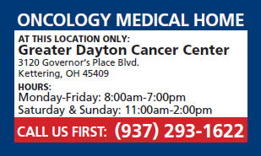
“Come Home” after Hours Care
2016 Totals
Office Visits 627
Labs 107
Injections 166
Treatments 428
New Patient Consults 6
Acute Care 2,114
Call Volume 4,805
ER Diversion 549

Slide 8
Pharmacy Services
Allows patients to gain rapid and convenient access to a robust suite of pharmacy products.
Provides patients with a patient-centered clinical program focused on optimizing outcomes through patient education, medication adherence, and toxicity management.
Allows practice to provide longitudinal care to patients, thereby enabling a more comprehensive approach to care.

Slide 9
Accreditations
Commission on Cancer (CoC) Oncology Medical Home
National Committee for Quality Assurance (NCQA) Oncology Medical Home & Patient-Centered Specialty Practice
Accreditation Commission for Health Care (ACHC) Specialty Pharmacy Services
American Society of Radiation Oncology (ASTRO)- Accreditation Program Of Excellence (APEx)
American College of Radiology (ACR) - Positron Emission Tomography (PET) & Computed Tomography (CT)

Slide 10
Collaborative Relationships (win/win) Increased market share Maximize patient experience Reduce out migration – from competition

Slide 11
Quality Care and Innovation
CMMI Grant Funded Oncology Medical Home Practice 1 of 7
United Health Care, Episode Fee Payment Program Participant 1 of 5
Anthem Quality Care Program Participant large payer in market
Aetna OMH Pilot Program Participant 1 of 4
National Radiation Oncology Registry Program Participant 1 of 30
CMMI Oncology Care Model
Creates: additional revenues, access to patients, shared savings & patient management
Prepares for: Value base health care and payer models “learn how they work”

Slide 12
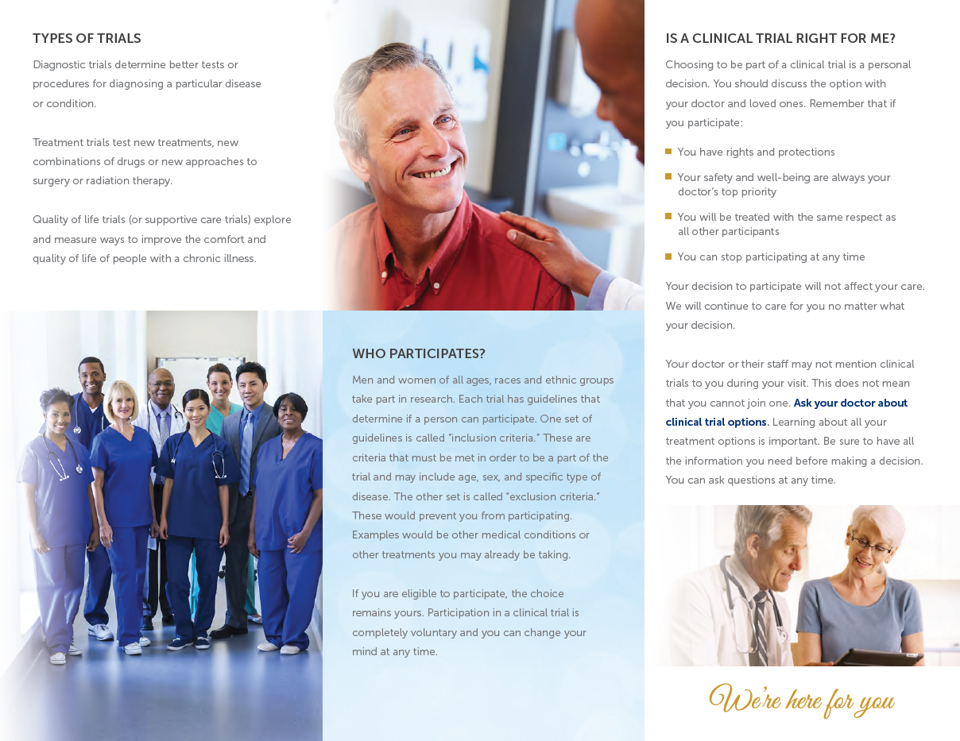
Clinical Research Center

Slide 13
Clinical Research Center
Offers patients the opportunity to participate in late-breaking research close to home.
Helps to foster a culture of innovation within the practice
Fosters relationships with industry, which may aid in shaping the drug channel

