Slide 1
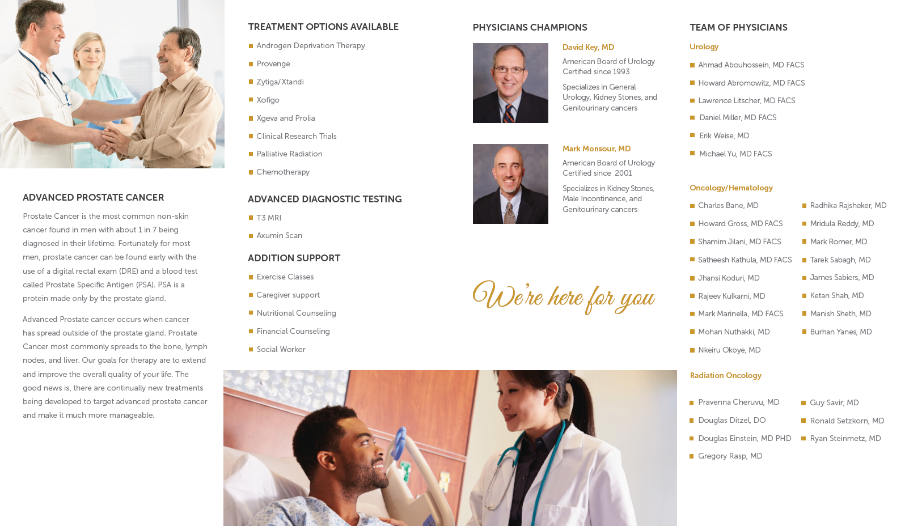
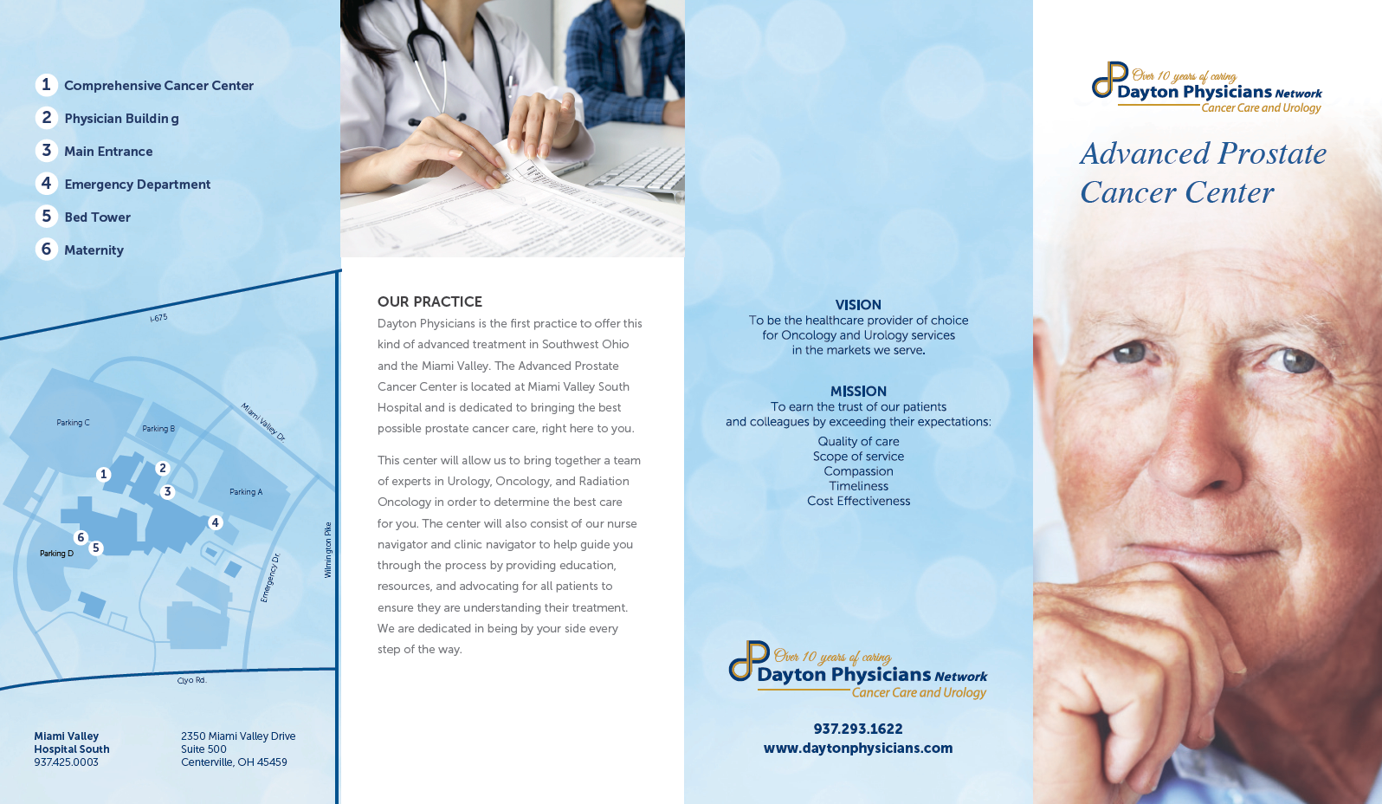
Advanced Prostate Cancer Care

Slide 2
Advanced Prostate Cancer Center
Improved patient care: More proactive management, protocol driven, comprehensive/ integrated approach, coordinated care and convenient care.
Patient retention: Remain in the Urologist’s care longer and patients are not transferred to other practices and locations
Service expansion and practice sustainability: PCa treatment is a significant revenue generator, new therapies and clinical research opportunities with no or low cost of care to patients.

Slide 3


CANCER SURVIVORSHIP

Slide 4
CANCER SURVIVORSHIP
Patient completes the NCCN Survivorship assessment any other disease specific screens.
Confirmation of primary care provider and review of individualized Survivorship Care Plan (SCP)
Review risk factors and healthy lifestyle behaviors that can contribute to development to reduce disease recurrence or the development of other cancers (Tobacco, alcohol, diet, exercise, emotion and spiritual).
Challenges… Getting patients to schedule. We have found that cold calling for the visit results in a higher no show and rescheduling rate. Clearly, provider endorsed visits seem to be better attended.
Benefits-overwhelming positive comments from the patients at the completion of the visit. Focused effort to get survivorship information to primary care providers (who also may be a referral source).
Additionally, by sharing and showing patients they are being cared for by “state of the art” guidelines it may improve confidence in your office and team. We are currently having a doctor of nursing practice evaluate the survivorship work for 2017.

Slide 5
Marketing/Branding
Sponsorships/ Community Outreach
Physicians Relations
Newspapers
Magazines
TV
Radio
Website
Digital- search engine marketing (SEM) & search engine optimization (SEO)
Billboard
Long Form Video Production

Slide 6
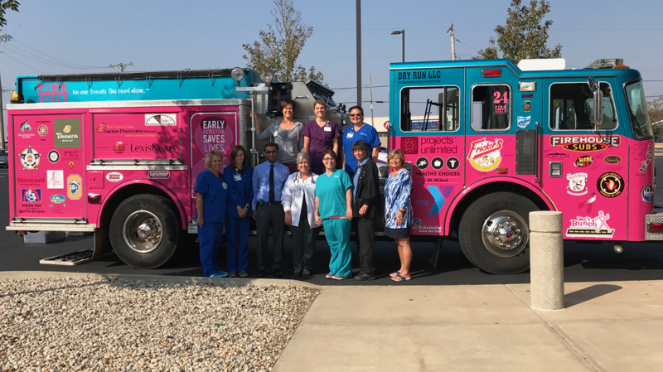
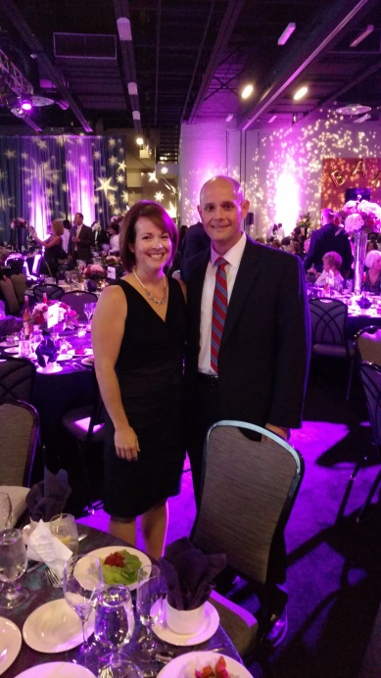
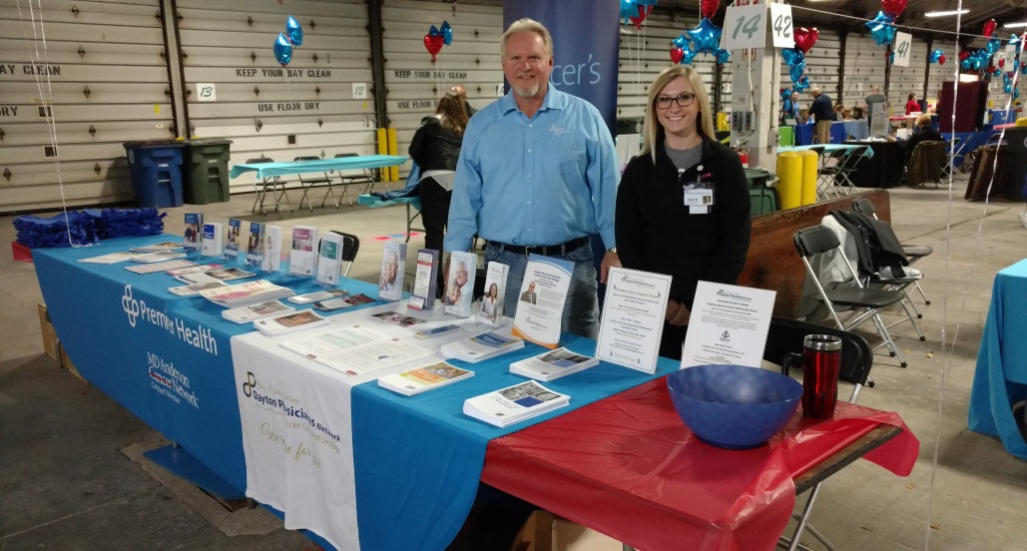
Sponsorships/Community Outreach
Sponsorships:
Local Hospital Foundations
Hospice Foundations
Local cancer support programs
Golf Outings
Community Outreach:
Health Fairs
5K Run/Walks
Open House

Slide 8



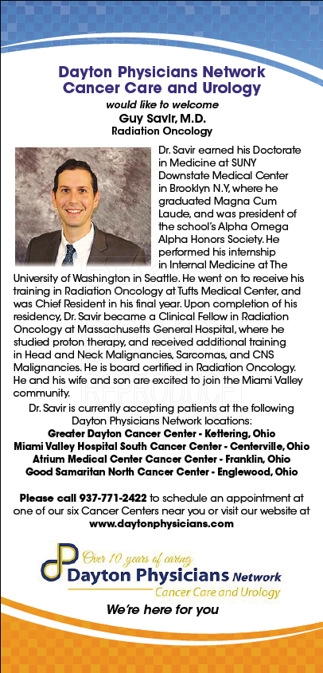

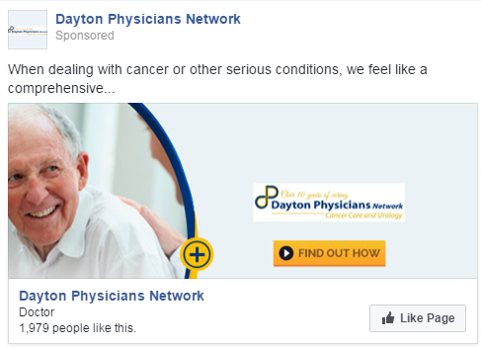
Marketing

Slide 9
Native Content Pieces –running 1 piece per month

Slide 10
Radio Advertising
609 total 30-second announcements on all 3 radio stations

Slide 11

Save The Date

Slide 12

Why do we do this?
Co-Branding Opportunities
Enhanced Image in the Community
Access to New Patients and
Patient Engagement
Value-Added Resources
Established National Platform
Internal Team/Morale Building

Slide 13
Thank You

