Slide 1
The Power of Gratitude: A New Perspective for Optimum Care
Todd Jamrose, D.O.

Slide 2
Objectives
Understand how gratitude can lead to resiliency.
Understand how gratitude changes behavior.
How to use radical acceptance to change your mindset.
How to help patients understand radical acceptance as a coping skill.
Have access to tools to utilize gratitude

Slide 3
Physician Burnout
https://www.ahrq.gov/prevention/clinician/ahrq-works/burnout/index.html

Slide 4
Physician Burnout
Exhaustion
Physical and emotional energy levels are extremely low and in a downward spiral
“I’m not sure how much longer I can keep going like this”
Depersonalization
Cynicism, sarcasm, and the need to vent about your patients or your job
Compassion fatigue
Emotional energy is “tapped dry”
Lack of efficacy
Doubt the meaning and quality of your work.
“What’s the use?”

Slide 5
What Contributes Most to Burnout? (Medscape)
Too many bureaucratic tasks (paperwork, charting) – 55%
Spending too many hours at work – 33%
Lack of respect from administrators, employers, colleagues or staff – 32%
Increasing computerization of practice (EHR) – 30%
Insufficient compensation, reimbursement – 29%
Lack of control, autonomy – 24%
Feeling like a cog in the wheel – 22%
Decreasing reimbursements – 19%
Lack of respect from patients – 17%
Government regulation – 16%
Other 7%

Slide 6
How Do Physicians Cope with Burnout? (Medscape)
Isolate myself from others – 45%
Exercise – 45%
Talk with family members/close friends – 42%
Sleep – 40%
Eat junk food – 33%
Play or listen to music – 32%
Drink alcohol – 24%
Binge eat – 20%
Smoke cigarettes/Use products containing nicotine – 3%
Use prescription drugs – 2%
Smoke marijuana/Consume marijuana products – 1%
Other – 12%
None of the above – 3%

Slide 7
Gratitude
Thankfulness

Slide 8
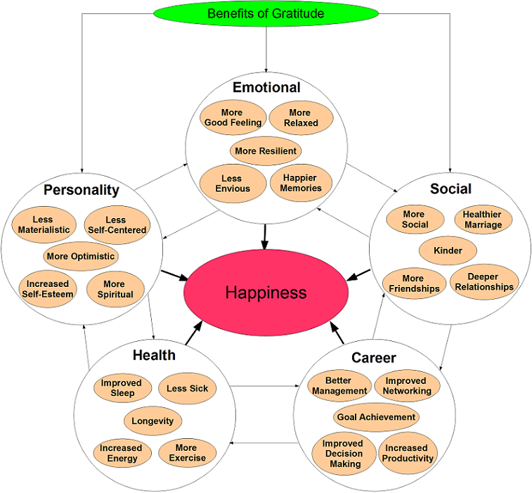
http://happierhuman.com/wp-content/uploads/2012/07/Benefits-of-Gratitude5.png

Slide 9
Emotional
More Resiliency
More relaxed
More Good Feeling
Less Envious
Happier Memories

Slide 10
Social
More social
Healthier marriage
Kinder
More friendships
Deeper Relationships

Slide 11
Personality
Less materialistic
Less Self-centered
More optimistic
Increased Self-Esteem
More spiritual

Slide 12
Health
Improved Sleep
Less Sick
Longevity
Increased Energy
More Exercise

Slide 13
Career
Better Management
Improved Networking
Goal Achievement
Improved Decision Making
Increased Productivity

Slide 14
Radical Acceptance

Slide 15
Dialectical Behavioral Therapy
Behavioral therapy that was developed to treat Borderline Personality Disorder by Marsha Linehan, PhD.
Developed this therapy to treat herself!!!
Combines standard cognitive behavioral therapy techniques for emotional regulation
It is notably used to treat suicidal ideation and behaviors.

Slide 16
Dialectical Behavioral Therapy
https://www.psychiatrictimes.com/sites/default/files/1603PTHarned_SR_F2.jpg

Slide 17
Radical Acceptance
Looking at yourself and the situation and seeing it as it really is.
Acknowledge your present situation, whatever it is, without judgement or criticizing yourself.
Recognize that your present situation exists because of a long chain of events that began far in the past.
Does not mean that you condone or agree with bad behavior in others, but it does mean you stop trying to change what has happened by getting angry and blaming the situation…..

Slide 18
What it really means to practice Radical Acceptance……
Acknowledge Reality

Slide 19
You can’t help the way you feel,
You can help the way you act!

Slide 20
Radical Acceptance Coping Statements
“This is the way it has to be.”
“All the events have led up to now”
“I can’t change what’s already happened.”
“Its no use fighting the past.”
“The present is only the moment I have control over.”

Slide 21
Blocks to Radical Acceptance
I don’t want to let them off the hook.
Accepting means I agree; I will never agree.
I need to be angry to protect myself.

Slide 22
Distract Yourself from Self-Destruction
New hobby
Bubble Bath or shower
Gardening
Make time everyday for YOU!!!!

Slide 23
http://happierhuman.com/wp-content/uploads/2012/07/Benefits-of-Gratitude5.png

Slide 25
How do we Practice Gratitude?
Gratitude Journal
Gratitude Apps
Tell someone you love them and how much you appreciate them
Nurture friendships you have, good friends do not come along every day.
Avoid negative media and movies with destructive content.
Don’t gossip or speak badly about anyone.
Compliment your friends, co-workers and family.
Be thankful when you learn something new.
Share a gratitude each day by posting a tweet, Facebook post or other social media.

Slide 26
Gratitude Journal
Tool to keep track of the good things in life.
Regular journaling about the good things in your life can help prepare and strengthen you to deal with the rough patches when they pop up.
What do you do to regularly remind yourself what is good in your life?

Slide 27
Ideas for Items in Your Gratitude Log
What is there about a challenge you are experiencing right now that you can be thankful for?
What activities or hobbies would you miss if you were unable to do them?
What are you taking for granted about your day to day that you can be thankful for?
List 5 people in your life who are hard to get along with – write down at least one quality for each that you are grateful for.
What is something you are grateful to have learned this week?

Slide 28
Oprah’s Gratitude Journal (October 12, 1996)
A run around Florida’s Fisher Island with a slight breeze that kept me cool;
Eating cold melon on a bench in the sun;
A long and hilarious chat with Gayle about her blind date with Mr. Potato Head;
Sorbet in a cone, so sweet that I literally licked my finger;
Maya Angelou calling to read me a new poem (Winfrey, “What Oprah Knows for Sure About Gratitude”).

Slide 29
Tips
Plan to write in your journal every night for 15 minutes before bed. Set an alarm reminder.
Keep your gratitude journal by your nightstand so you will see it before going to sleep and remember to jot down what you are thankful for.
Write as many things down as you want. 5-10 is a good number to aim for.
Doesn’t have to be deep. Can be as simple as the book you are reading or family.
Timing is up to you. Sometimes it is nightly, sometimes it is every other night.
Focus on people rather than things.

Slide 30
Gratitude Apps
365 Gratitude: Journal, Self-Care Community (Subscription)
Gratitude Journal – The Life-Changing App (iTunes)
Gratitude (iTunes)
Gratitude Journal (Android)
Presently: A gratitude Journal (Android)
Gratitude: Personal Growth and Affirmations (Android)

Slide 31
References
Drummond, D. (2015, October 1). Physician Burnout: Its Origin, Symptoms, and Five Main Causes. Retrieved from https://www.aafp.org/fpm/2015/0900/p42.html
Gratitude. (n.d.). Retrieved from https://www.merriam-webster.com/dictionary/gratitude
Gratitude. (n.d.). Retrieved from https://www.psychologytoday.com/us/basics/gratitude
Gratitude Journal: 67 Templates, Ideas, and Apps for Your Diary. (2020, February 18). Retrieved from https://positivepsychology.com/gratitude-journal
Hall, K. (2013, December 15). Three Blocks to Radical Acceptance. Retrieved from https://www.psychologytoday.com/us/blog/pieces-mind/201312/three-blocks-radical-acceptance
Linehan, Marsha M. (University of Washington, USA). (2014). DBT (R) Skills Training Manual, Second Edition. New York: Guilford Publications.
McKay, M., & Wood, J. C. (2019). The dialectical behavior therapy skills workbook: practical DBT exercises for learning mindfulness, interpersonal effectiveness, emotion regulation, and distress tolerance. Oakland: New Harbinger Publications.
Science and Practice of Gratitude Project, Greater Good Science Center, & John Templeton Foundation. (n.d.). Does gratitude writing improve the mental health of psychotherapy clients? Evidence from a randomized controlled trial. Retrieved from https://www.tandfonline.com/doi/abs/10.1080/10503307.2016.1169332?scroll=top&needAccess=true&journalCode=tpsr20
(n.d.). Retrieved from https://www.medscape.com/slideshow/2020-lifestyle-burnout-6012460
Tartakovsky, M. (2018, July 8). What It Really Means to Practice Radical Acceptance. Retrieved from https://psychcentral.com/blog/what-it-really-means-to-practice-radical-acceptance/
31 Benefits of Gratitude: The Ultimate Science-Backed Guide. (2020, February 28). Retrieved from https://www.happierhuman.com/benefits-of-gratitude/
Wong, J., & Brown, J. (n.d.). How Gratitude Changes You and Your Brain. Retrieved from https://greatergood.berkeley.edu/article/item/how_gratitude_changes_you_and_your_brain

