Slide 1
Mental Wellness for the Attending Physician: Focus on Suicide Prevention
Sallie Wilson, D.O., FAOCA
Anesthesiologist, retired
Board Member, Ohio Chapter
American Foundation for Suicide Prevention

Slide 2
Goals for presentation:
To focus on the aspects of mental health in physicians
Suicide risk and statistics
Promoting resilience among physicians
Identify most common mental illnesses
Statistics regarding mental illness in physicians
Barriers to treatment
Ways to help colleagues who may be suffering

Slide 3
My motivation for getting involved
Became a member of club I didn’t ask to join-survivor of suicide loss
Family history
Being a physician
Knowledge of suicide statistics and resources

Slide 4
Notes:
So let’s establish a baseline of shared language on this topic.
We avoid using the phrase “committed suicide” as it can have a negative connotation. Instead, we encourage the phrases “died by suicide”, “ended his/her life” or “killed himself/herself.”
When talking about suicide and suicide attempts, we avoid referring to suicide attempts as “failed” or “successful.” Not only is it unnecessary, these words imply judgment. Instead, we encourage the use of phrases such as “suicide attempt” “suicide” “death by suicide.”
Educating the public about suicide is critical for encouraging help-seeking, raising awareness of risk in vulnerable populations, and advocating for new interventions and prevention strategies for those at risk. When suicide is talked about safely and accurately, we can help reduce the likelihood of its occurrence.
We want to change how society understands mental health and suicide – because when we open up and connect, talk saves lives.

Slide 5
Notes:
Suicide is a significant issue that affects individuals, families and communities worldwide.
So let’s start with some statistics that demonstrate the scope of the problem.

Slide 6
Notes:
Suicide is a global problem.
According to the World Health Organization, each year, over 800,000 people die by suicide worldwide.
While this is the most accurate data available, we estimate the numbers to be higher – since suicide is underreported in many countries.

Slide 7
Notes:
That works out to a suicide every 40 seconds worldwide.

Slide 8
Notes:
In the United States, suicide rates are recorded by the Centers for Disease Control and Prevention.
According to the CDC, 47,173 people died by suicide in 2017.
This makes suicide the 10th leading cause of death.
Suicide takes more lives in the U.S. than homicide, war and natural disasters combined.
These high numbers are one of many reasons that it is important to talk about suicide like any other cause of death. The more we talk, the less stigmatized the idea that we all face struggles and need support becomes.

Slide 9
Ohio 2019 stats

Slide 10
2019 Ohio Statistics- general population
11th overall leading cause of death in Ohio
2nd leading cause in ages 15-34 and 5th in ages 45-54
Over 1700 lives lost in Ohio 2017
Ohio ranks 33 in all states
Montgomery County ranks middle of state
SE Ohio has largest number of counties with higher rates of suicide
Notes:
Statistics are typically 2 years old.

Slide 11
Notes:
For every death by suicide…
It’s estimated that 25 others attempt.
That’s about a million Americans each year who survive a suicide attempt.

Slide 12
Notes:
When you think about any loss, it impacts many people in the community. Suicide is no different. The loss affects family, friends, coworkers, neighbors, schools, faith communities, etc.
It is estimated that the majority of Americans will experience a suicide loss over the course of their lifetime.

Slide 13
Notes:
In addition to the devastating toll that suicide has on families and communities – both emotionally and socially - there is a fiscal impact on our society as well.
The Centers for Disease Control and Prevention estimates that for the year 2016, suicidal behavior (including both suicide attempts and suicide deaths) cost the United States $69 billion, costs due primarily to lost wages and productivity.

Slide 14
10 Facts about physician suicide and mental health( afsp.org)
Suicide is generally caused by convergence of multiple risk factors, the most common being untreated or inadequately managed mental health conditions
Estimated 300 physicians die by suicide/year (probably higher)
Depression significant risk factor and less likely to be receiving treatment
Male physicians 1.41 x higher than gen pop, females 2.27x higher
2nd leading cause of death in 24-34 age
28% residents vs 7-8% gen pop major depressive episode
Risk increases with untreated mental health and self medication
23% interns suicidal ideation, after cognitive behavioral therapy, 50% fewer had SI
Drivers of burnout include work load, lack of autonomy, work/home balance
In long run, unaddressed mental health conditions more like to negatively impact one’s professional reputation and practice than reaching out for help early

Slide 15
Burnout and Psychological Distress in Surgeons
2008 Academic College of Surgeons survey, N=8000, 14 surgical specialties
Burnout, depression, SI, career satisfaction
Alcohol Abuse/Dep
13.9% males and 25.6% female surgeons
50% reported signif current work-home conflict
Only 36% felt work schedule left enough time for personal/family life
Balch CM, Shanafelt TD, Sloan JA, Satele DV, Freischlag JA. Ann Surg 2011
Notes:
Depersonalization was the burnout component that showed greatest elevation among trainees. Particularly concerning as depersonalization has been associated with lower quality pt care
Little/no change in burnout rates between their pilot study which was pre- 2003 ACGME work hours restriction, however psychiatric symptoms rates halved from pilot to current study post-duty hours

Slide 16
Risk and Protective Factors for Distress in Surgeons
Top RF for Burnout
Work/home conflict
>80 hr/week
>2 nights on call/week
Incentive based pay (v. salaried)
Trauma, Urologic, ENT Surg
Protective Factors
Having children
Greater hours in OR
Male
Balch CM, Shanafelt TD, Sloan JA, Satele DV, Freischlag JA. Ann Surg 2011
Sargent MC, Sotile W, Rubash H, Barrack RL. J Bone Joint Surg Am 2009
Hutter MM, Kellogg KC, Ferguson CM, Abbott WM, Warshaw AL. Ann Surg 2006
Notes:
Residents were much more likely to seek support from colleagues and mate, e.g. majority of residents “talk to colleagues or partner/family/friends about my concerns”

Slide 17
Risk Factors for Burnout/Distress
Sleep deprivation
High level work/life conflict (feels torn between)
Interrupts work with personal concerns
High level anger, loneliness, or anxiety
Stressed by work relationships
Anxious about own competency
Has problems “unplugging” after work
Uses alcohol regularly
Sargent MC, Sotile W, Rubash H, Barrack RL. J Bone Joint Surg Am 2009
Notes:
The listed risk factors correlate with incr burnout and diminished marital happiness (p<0.05)

Slide 18
A Promising Study: Mayo Clinic’s Peer Group
Rationale:
Burnout is common
Affects patient care and workforce turnover
Therefore, a shared individual and institutional responsibility
Design and Results:
Randomized, controlled trial (n=74)
Each group received 1 hour paid time off every other week x 9 mos
Facilitated discussion group focusing on mindfulness, reflection, shared experiences, and small-group learning
Vs. just time off
Active peer support group superior by 3 months and sustained over 1 year
Less emotional exhaustion
Less exhaustion
Less burnout
More meaning, empowerment and engagement in work
West et al, JAMA Intern Med 2014
Notes:
Time away from work, humor, passion for one’s work, and remembering pts
Sept 2009 Mayo group

Slide 19
Protective Factors for Orthopaedic Residents
Leaves personal concerns out of workplace
Support from other medical families
Has an in-program mentor
Speaks frequently with mentor
Draws on religion or faith
Makes time for exercise/hobbies/vacation
Low level alcohol use
Makes time regularly to be alone with mate
Perceives help from program for mate’s adjustment
Sargent MC, Sotile W, Rubash H, Barrack RL. J Bone Joint Surg Am 2009
Notes:
The listed protective factors correlate with decreased burnout and increase marital happiness (p<0.05)

Slide 20
Increasing Resilience
Realistic recognition (Overcoming denial)
Proactive Self-Care
Exercise, sleep, nutrition, limit EtOH
Schedule non-negotiables
Some better than none
Supportive professional relat’s
Talking things out with others
Hobbies outside medicine
Personal relationships
Boundaries
Humor
Swetz, J Palliative Med 2009
Notes:
Time away from work, humor, passion for one’s work, and remembering pts
Sept 2009 Mayo group

Slide 21
Notes:
So let’s move on to research.
Only in the past several decades have scientists been studying suicide. Research is shedding light on many critical areas, what drives up risk and what that amounts to effective suicide prevention, and we still have more to learn.
This section provides an overview of suicide prevention research, key research findings, and future goals in the field.

Slide 23
Notes:
One of the main questions research explores is: why do people take their own lives?
Through research we have learned that there is no single cause for suicide. Suicide most often occurs when several stressors and health issues converge to create an experience of hopelessness and despair.

Slide 24
Notes:
Research has consistently shown that the large majority of people who die by suicide have a mental health condition at the time of their death.
It may or may not have been recognized by the person or their loved ones, may not have been diagnosed or adequately treated.

Slide 25
Notes:
That said, research has also made clear that mental health conditions cannot be the whole story.
Mental health conditions are common, and the vast majority of people who suffer from these illnesses do not die by suicide.

Slide 26
Notes:
In addition to mental health conditions, there are many other factors that increase risk as well.
We’ve learned that the brains of people who die by suicide differ from those who die from other causes in terms of structure and function, specifically in the areas related to stress response and impulse-control.

Slide 27
Notes:
We’ve also learned that most people who are suicidal are ambivalent about taking their life: part of them wants to live, part of them wants to die.
This research has informed key strategies in suicide prevention that involve engaging the part of the person that wants to stay alive and helping to create distance from the part of them that wants to die.
One way we do that is to help the person connect with reasons for living while at the same time, decreasing the visibility and presence of things around them that may facilitate their desire to die.

Slide 28
Notes:
One of the many important things we have learned from research is about the perspective of a suicidal person.
That a crisis point has been reached.
For a suicidal person, the pain seems unbearable, whether it’s emotional pain, physical pain or sometimes both.
For a moment, I’d like you to think back to the most physically painful experience of your life. At that moment, would you have been able to give someone clear and accurate directions to your house? Probably not.
The pain makes ordinary thinking nearly impossible.
For a suicidal person, thinking becomes constricted at that moment of crisis — a state of intense tunnel vision where other options seem unavailable. Someone who considers suicide cannot foresee a time when that unbearable pain will end.
Understanding the perspective of the suicidal person has also helped us to learn that suicidal feelings are often temporary. They can come on intensely and can sometimes pass in minutes or hours. Keeping people safe and helping them feel supported can get them through those critical moments.
There is evidence that putting time and distance between an individual who is suicidal and the means to take their life can be a life saving action. This is why it is so important that we take steps when we know someone is struggling to help keep them safe.

Slide 29
Notes:
Risk factors are defined as characteristics or conditions that increase the chance a person may take their life.
Risk factors are important to know to understand the big picture of someone who is considering suicide.
Just like someone who is at risk for heart disease because of high blood pressure, or a history of heart disease in the family, some people are at higher risk for suicide than others.
The main risk factors, shown here, can be grouped into three categories: health factors, historical factors, and environmental factors.
These risk factors can converge at different times in life and increase a person’s risk for suicidal behavior at particular points in time.
Let’s look a little closer…

Slide 30
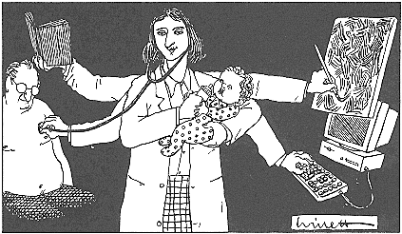
The Clinician’s Balancing Act
Jean E. Wallace (Department of Sociology) and Jane Lemaire
(Department of Medicine) University of Calgary, 2005

Slide 31
The Challenge of Work-Life Balance
A Balanced Life
Imbalance: Many Trainees and Clinicians
Work

Slide 32
Meta-Analysis: Epidemiology of Depression in Residents
Meta-analysis 1963-2015
54 studies, 17,560 residents
Summary prevalence 28.8% (range 20.9-43.2%)
No signif differences: study design, U.S./non, surg/non, intern/R2+
Increasing rates over years-decades
Sharp increase following start of training
Higher than general population (6.7-8% current or past year MDE)
Male and female residents
Mata DA…Sen S. Prevalence of depression and depressive symptoms among resident physicians: A systematic review and meta-analysis. JAMA 2015
Notes:
31 Cross sectional and 23 longitudinal studies
Secondary analysis of 7 long studies showed rise in depr symptoms by average of 16% after the start of training.
No stat signif differences between study type (cross v. long), interns v higher levels of training, between specialties (surgical v non-surg).
Age range- means of 26-30 year old.
Our meta-analysis was not well-suited to identify gender differences because we did not have access to individual level data. In our Intern Health Study data, we do see a gender difference and have a manuscript in the pipeline on the topic. Men and women have similar levels of depression before internship and in the later years of residency. But women have twice the increase in depression during internship compared to men.
NIMH 2014- Prev of MDE in past year for all age adults 6.7% http://www.nimh.nih.gov/health/statistics/prevalence/major-depression-among-adults.shtml
CDC Current Depression for 18-39 yo 8% overall: 6% males/11% females http://www.cdc.gov/mmwr/preview/mmwrhtml/mm6051a7.htm?s_cid=mm6051a7_w#x2013; United States, National Health and Nutrition Examination Survey, 2007-2010</a>
The higher lifetime prevalence of depression among women physicians, as compared with the general population, is an important factor in their higher suicide rate.

Slide 33
Aspects unique to attending physicians
Becomes more complex going from student-resident-attending
“More to lose”
Potential referral loss from other doctors
Collegial esteem
Possibly not considered for election to hospital office
Therefore may not seek formal treatment

Slide 34
Regulatory Expectations
What happens when a physician suffers from a mental health condition in regards to their license?
In 2016 at urging of Ohio Academy of Family Physicians, Ohio State Medical Board removed question #22 and amended #23
OAFP urged medical board to do this so as to not discourage physicians from seeking treatment for mental health issues

Slide 35
Ohio license
Question #22 which was eliminated stated:
22.a Within the last ten years , have you been diagnosed with or have you been treated for, bipolar disorder, schizophrenia, paranoia or any other psychotic disorder
22.b Have you since attaining the age of eighteen or within the last ten years, whichever period is shorter been admitted to a hospital or other facility for the treatment of bipolar disorder, schizophrenia, paranoia or any other psychotic disorder?

Slide 36
Ohio license
#23 In the past five years, have you been diagnosed as having or been hospitalized for a medical condition which in any way impairs or limits your ability to practice medicine with reasonable skill and safety?

Slide 37
Massachusetts State Medical License
CONFIDENTIAL INFORMATION
If answering “yes” to any of the questions, provide details on the supplemental pages for questions 15 - 17
15. Do you have a medical or physical condition that
currently impairs your ability to practice medicine?
16. Have you engaged in the use of any substance(s)
with the result that your ability to practice medicine YES___ NO___
is currently impaired?
17. Have you ever refused to submit to a test to YES___ NO___
determine whether you had consumed and/or were
under the influence of chemical substances?
YES___ NO___

Slide 38
Characteristics of Physicians that Increase Risk
Perfectionism/ Compulsiveness
Need for control: “If I just push myself harder, get more disciplined…”
High need for achievement
Exaggerated sense of responsibility
Need to please everyone: “How do I say no?”
Difficulty asking for help: “I’m self-sufficient and have always managed on my own before.”
Excessive, unrealistic guilt
Suppression of feelings
Difficulty taking time for oneself
Gabbard G JAMA 1985, Myers M & Gabbard G “The Phys as Patient” 2008
Notes:
Many traits identified as being characteristics of good doctors, ironically, can also play a major role in the stress that leads to emotional exhaustion which leads to burnout.
Medical students and physicians, as a group, tend to be perfectionists, rigid in their thinking, compulsive, and skeptical. Medical students have a need for interpersonal dominance and control. Compulsiveness may drive students to overwork as a mechanism to cope with feelings of guilt of not doing enough. Students are inclined to deny their own personal problems and weaknesses. Burnout is pervasive among physicians, but, for many, the condition is stigmatized and the rule is “you just don’t talk about it.”

Slide 39
Notes:
The first type of risk factors include health factors, such as biological and psychological medical conditions, the most significant of which are mental health conditions.
As we said before, most people who die by suicide have an active mental health problem at the time of their death.
Depression is the most common mental health condition and the one that is most associated with suicide.
Bipolar disorder is also shown to be high risk, although the disorder is less common than depression.
Because these conditions put a person at greater risk for suicide, detecting the presence of a mental health condition is critically important.
The best way to be sure, when you feel concerned or detect a possible change in you or your loved one’s mental health, is for the person at risk to seek a professional evaluation and effective treatment.
Many people may not realize that their distress has actually become a health problem. Providing information about how to access mental healthcare or a crisis number if their distress is high can be a solid step in helping them connect to the help they need.
We will talk more about this later in the discussion when we directly address prevention.

Slide 40
What is Major Depression?
Major Depression is not:
Major Depression is:
“Normal”
Laziness
Weakness
Stress
Unhappiness
Burnout
Though depression makes someone feel lazy, weak, stressed, unhappy (usually) and may be associated with burnout
An illness
With mental anguish and physical pain
Disabling
Chronic and recurring
Potentially fatal
Lack of appropriate diagnosis and well delivered care can have tragic results
And is more common in trainees and clinicians than in the general population

Slide 41
Notes:
Mental health conditions are not the only health factors that are associated with suicide risk.
Serious or chronic health conditions can increase risk, especially when the person also has mental health issues.
Chronic pain and serious head injuries have also been found to increase suicide risk.

Slide 42
Consider this:
Physicians have an overall longer life span and lower rates of death due to many medical causes (COPD, liver disease, pneumonia) compared to other professionals and general population.
Suicide as a cause of death is overrepresented in physicians compared with other professionals.

Slide 43
Notes:
The second type of risk factors include historical factors such as a family history of suicide, a family history of mental health conditions, or past trauma such as sexual abuse or combat stress.
Research has also found that a history of childhood abuse can contribute to suicide risk.
And while most people who attempt suicide do not go on to die by suicide, previous suicide attempts are also considered historical risk factors for suicide and also put a person at increased risk.

Slide 44
Notes:
The third type of risk factors are environmental factors that involve the circumstances of a person’s life.
Often, there are aspects of a person’s environment that can contribute to their overall level of risk. Let’s look at a few of the most common:
Having access to a way of killing oneself is referred to as access to lethal means. This includes having access to a variety of things, such as firearms, drugs, a bridge, a car, etc.
Research has shown that contagion – the exposure to another person’s suicide, or to graphic or sensationalized accounts of suicide – especially among those with other risk factors, can increase a person’s risk of suicide.
Prolonged stress may include harassment, bullying, relationship problems, legal problems, and unemployment.
Stressful life events, which vary across the lifespan, include experiences like divorce, legal problems or job loss.

Slide 45
Environmental Factors
Exposure to suffering, chronic illness
“Secondary trauma”
Tension between 1:1 connection and professional distance
Frustrations in clinical work→ cynicism
Work environment
Communication style between staff members
Culture of respect v. disrespect
The rewards of our work diminished
Less time with patients
Workload increased
Sense of accomplishment
System limitations
Budgetary
Access to care

Slide 46
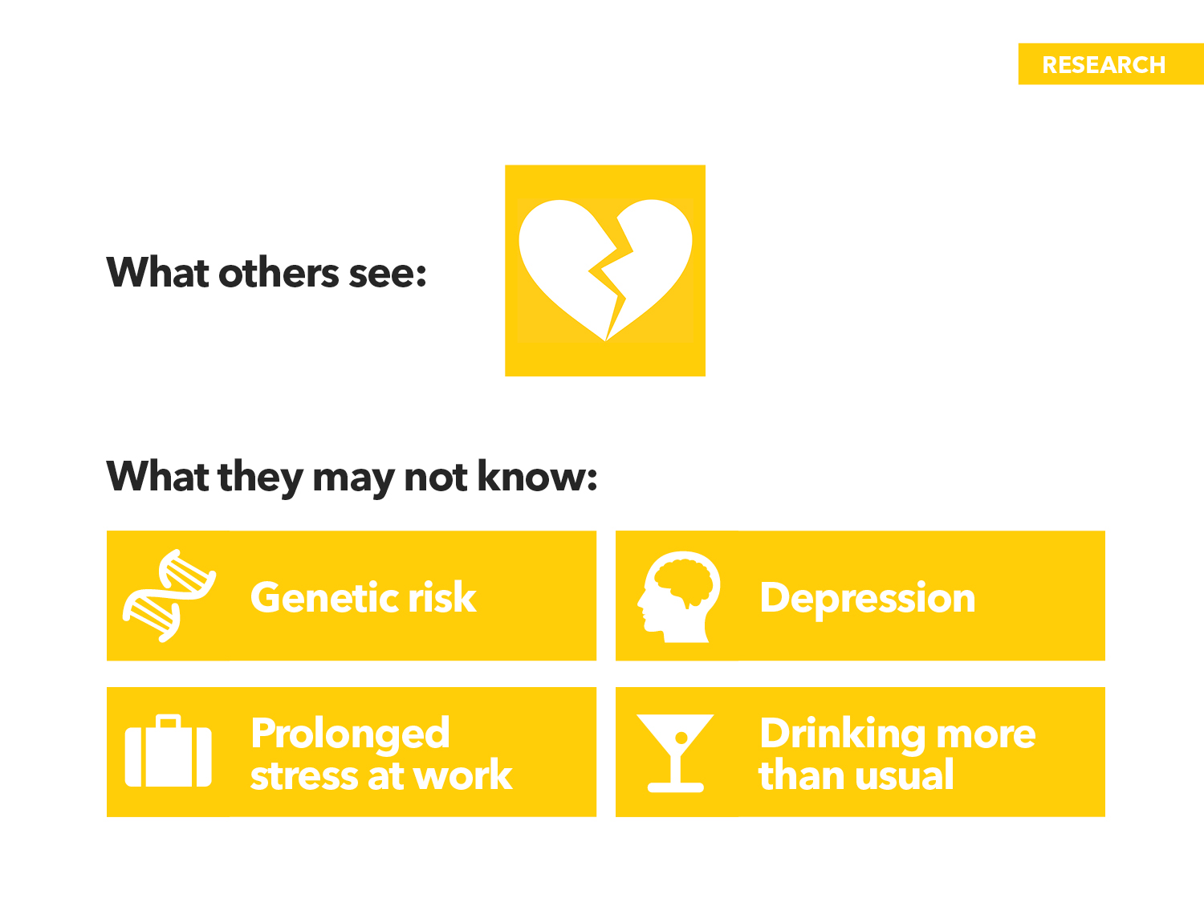
Notes:
To better understand suicide risk, here is an example of a set of risk factors that could converge in a person who is suicidal.
This example shows what is often the public perception of suicide. When someone dies by suicide, often the story only talks about the environmental factors. People see a life event, like a breakup, or bullying, or a job loss, and then they see the person die by suicide, so they might assume the person killed themselves because of that stressful life event.
But that’s never the full story. What others don’t know is that the person who died may have had genetic risks for suicide. Maybe they were suffering from depression and anxiety disorders, and their work life had become increasingly stressful. Their underlying depression and anxiety could have made the situation at work even worse, or the work stress could have made their depression worse. Perhaps they’d also been drinking more than normal.
The key is that the combination of risk factors could have contributed to the suicide death.
Therefore, while a life event can play a precipitating role for suicidal behavior, without other underlying risk factors, life events alone aren’t thought to cause suicide.

Slide 47
Picture of physician suicide
And details specific to them vs. general population
Mental disorders (depression)- is highly prevalent as in other suicide deaths, substance abuse lower 14% v 23%
Methods- OD/poisoning 23.5% v 18% and more lethal: attempt/death ratio much lower
Mental Health conditions same to slightly elevated, but lower rates antidepressant medication
Psychosocial: Job problem 3x higher, crisis/bereaved lower
Toxicology- much higher presence of BZD, barb, antipsychotics
Gold, Sen, Schwenk. Details on suicide among US physicians: Data from the Natl Violent
Death Reporting System, Gen Hosp Psych 2013

Slide 48
Notes:
Looking to the future, research will help us find the best ways to fight suicide.
Research is looking for biomarkers — for example, something testable in a blood sample — that would help us to identify those at risk.
A number of clinical treatments, like particular types of therapy, are effective for suicidal people and more need to be developed and studied. The good news is that, through research, we are learning more and more about what helps those who are in a suicidal crisis.
Research can also help us to identify the most effective interventions to reduce suicide rates and to reduce risk in those suffering from mental health conditions.

Slide 49
Notes:
Just like people can find strategies that optimize their physical health, people can do the same for their mental health.
In addition to professional mental health care, proactive self care strategies like good sleep habits, exercise, nutrition, and stress management can also play a critical role in protecting mental health and promoting resilience.

Slide 50
Risk and Protective Factors for Suicide
RISK FACTORS
PROTECTIVE FACTORS
Mental illness
Previous suicide attempt
Serious physical illness/pain
Specific symptoms
Impulsivity/aggression
FH suicide
H/O childhood trauma
Shame/despair
Triggering event
Access to lethal means
Suicide exposure
Social support
Connectedness
Strong therapeutic alliance
Accessing MH care
Coping skills
Problem solving skills
Cultural/religious beliefs
Biological/psychological resilience

Slide 51
Best Strategy to Prevent Suicide
Destigmatize help-seeking
Provide prompt and targeted assessment
Treat effectively
Remove barriers to care.
Use education and policy to impact culture.
Inform entire community- how to recognize and refer.

Slide 52
Notes:
For people who are at a crisis point, the most important thing you can put between a suicidal person and their way of ending their life is TIME.
Research shows that by temporarily reducing a suicidal person’s access to lethal means, we give suicidal individuals time – time for the intense suicidal risk to diminish and time for someone to intervene with mental health support and resources.
For the majority of people who experience a suicidal crisis, if unable to access their chosen method even temporarily, they are unlikely to engage in another action to end their lives.

Slide 53
Notes:
In most cases, when a suicidal person doesn’t have current access to the means that has been on their mind, they don’t substitute with another method.
Therefore, a clear way to prevent suicide is to limit access to lethal means.

Slide 54
Notes:
During a period of high risk, the safer their environment is, the better chance a suicidal person has of living through that crisis period. Suicide prevention research has looked at a number of ways to create safer environments.
Installing an inexpensive carbon monoxide sensor that would automatically shut cars off if carbon monoxide levels reach unsafe levels, would save lives.
We’ve learned through research that installing barriers on bridges deters suicides and in many cases, bridge barriers actually lowered the suicide rate for the entire region.
Restricting access to potentially lethal medications reduces suicides and can be as simple as requiring lethal drugs to be sold in blister packaging.
Firearm safety is critical to reducing suicide rates. In the United States, firearms are used in roughly half of all suicides, making suicide prevention an important part of gun safety education.
As noted already and contrary to what you may think, when access to lethal means are limited, most people who are suicidal do not find other means; therefore, the suicide death does not occur in that moment, allowing more time for the person in crisis to get connected to help.

Slide 55
Public Health: Healthcare Professionals as Leaders
Smoking
Heightened attention to problem
Smoking-related deaths have declined 40%–60% since 1960
Mortality rates from smoking related cancer, heart disease and stroke are now lower than the general population
Suicide
Little attention to problem
Suicide rates in physicians are not changing
Suicide rate is higher than among the general population, especially among women physicians
Depression is the major risk factor
Notes:
Slides 2–7 commentary:
Physicians practice what they preach when it comes to (not) smoking; however, physicians as a group neglect their mental health. This contributes to their high suicide rate. Untreated depression is the major risk factor for suicide in physicians, especially among women.

Slide 56
Recognizing the need to address mental health
Our country at a point where mental health issues are finally being addressed
We need to reduce the stigma about mental health disorders
Almost 15 million people suffer from depression, but only 2 in 5 seek treatment for mental health disorders
Notes:
People don’t ask for this just like they don’t ask to get cancer, etc

Slide 57
Barriers to treatment:
Stigma
Shame/embarrassment
Time away from practice
Perceived potential for punitive consequences (on record)
Fear of losing license

Slide 58
Access and Barriers to Care
35 percent of physicians do not have a regular source of health care
Among practicing physicians, barriers to mental health care include:
discrimination in medical licensing
hospital privileges
health insurance
malpractice insurance
Miles SH, JAMA 1998; APA, Am J Psych 1984

Slide 59
Crazysocks4docs Day
June 1 a day to wear crazy socks to show support for physician mental health
Started in Australia in 2017 to bring awareness to physician mental health
Dr. Jeff Toogood-cardiologist experiencing his own mental illness

Slide 60
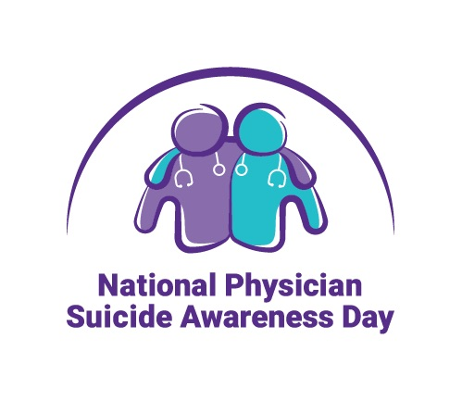
SEPTEMBER 17, 2020
COUNCIL OF EMERGENCY MEDICINE RESIDENCY DIRECTORS (CORD)
”Shine a Light. Speak its name.”

Slide 61
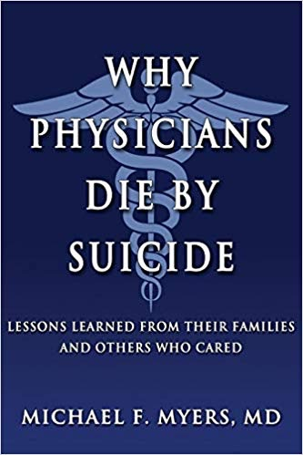

Slide 62
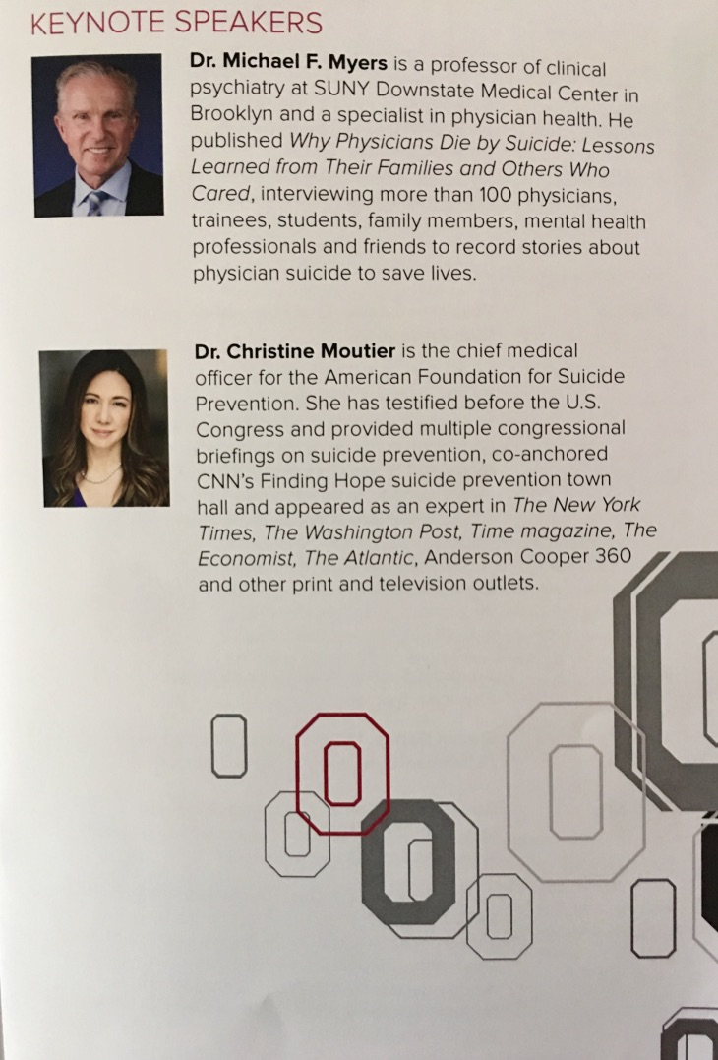

Slide 63
Out of the Straitjacket
Michael S. Weinstein, M.D., M.B.E.
Isee him, maybe not so clearly. He is in isolation, in a strait- jacket. He’s just been committed, given a shot of haloperidol after he resisted going to the locked ward. He kicked, screamed, yelled, threatened . . . and now he cries.
NEJM 3/1/18

Slide 64
September 2020
SUICIDE PREVENTION WEEK-SEPT 6-12
WORLD SUICIDE PREVENTION DAY SEPT 10
PHYSICIAN SUICIDE PREVENTION DAY SEPT 17
SUICIDE PREVENTION MONTH SEPTEMBER

Slide 65
Notes:
Now that we have reviewed key suicide prevention efforts, let’s talk about what we all can do to help prevent suicide.

Slide 66
Notes:
It’s important to have a caring, supportive conversation with someone you might be worried about to allow them to share what they are experiencing. A conversation is a way to show you care, and allows you to gain more information about their level of distress.

Slide 67
What Can You Do For a TRAINEE or COLLEAGUE You Think Is Suicidal?
Not so helpful
Helpful
Minimize the situation or depth of despair
Lecture or debate on the value of life
Being heroic or taking on more than can be delivered
Promise secrecy
Ignore one’s limitations
Fail to refer
Care in word and deed
Listen
Take person seriously (80% of suicides provide some warning)
Talk about suicide openly and directly
Help them remove lethal means
Take charge and call or escort them to ER, counseling service or psychiatrist
Call for help

Slide 68
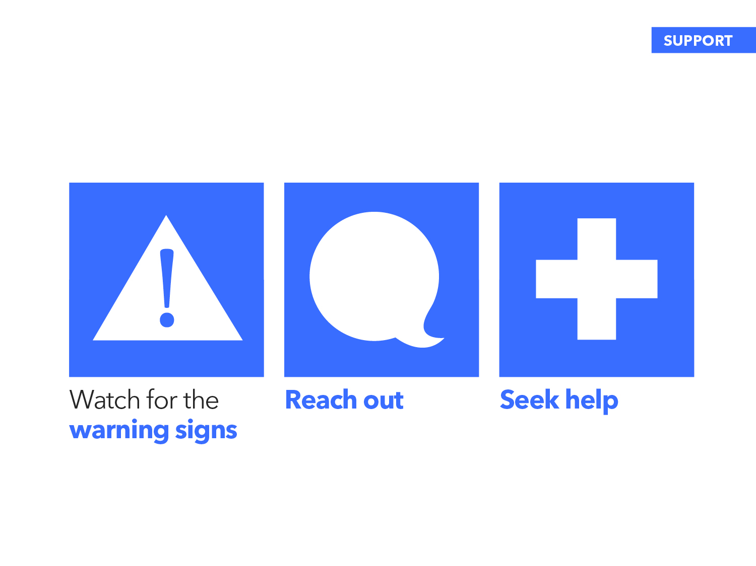
Notes:
Let’s start by talking about suicide warning signs. Watch for the warning signs, in yourself and others.
While many of the suicide risk factors we discussed endure over a longer period of time, warning signs are observable signs that signal suicidal risk in the near future.
It is important to pay attention to both the risk factors discussed earlier and the warning signs we are talking about now.
If you see warning signs, reach out to individuals in your life you’re concerned about, and reach out to others if you’re struggling.
Seek mental health services if you are depressed or if your anxiety regularly interferes with your daily life, and encourage others to do the same.

Slide 69
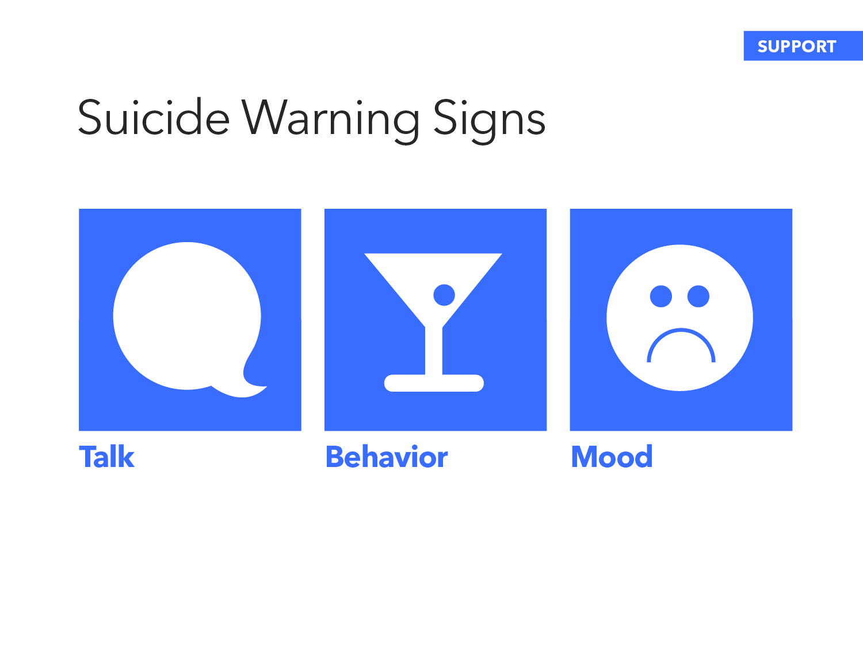
Notes:
Suicide warning signs are typically displayed in three main ways that we can detect: Talk, Behavior, and Mood.
We will discuss each one of these ways in more detail.

Slide 70
Notes:
Many people who are suicidal talk about ending their lives. This may be directly or indirectly. A person might say it outright, or they might joke about it. Take it seriously.
Some people say they have no reason to live.
Others say things that let you know they may feel trapped, or that they are a burden to others.
Or they might talk about feeling overwhelmed or being in unbearable pain.

Slide 71
Notes:
Behaviors that are atypical for an individual should also encourage you to speak to the person about what you are noticing.
People thinking about suicide can display certain behaviors.
There may be an increased use of alcohol or drugs.
They may have trouble sleeping – either experiencing insomnia or sleeping too much.
They may start acting more recklessly.
They might withdraw from activities, especially from activities they normally enjoy.
They might isolate themselves from family and friends.
They also might look for a way to kill themselves, such as searching online for methods, or shopping for a firearm.
They may also give away their possessions or show a related behavior – reckless spending.

Slide 72
Notes:
People at risk for suicide can display — often quite subtly — any of the following moods.
Depression, apathy, rage, irritability, impulsivity, humiliation, anxiety. Moods one would expect of someone who feels overwhelmed and desperate.
We all have ups and downs in our mood, but when you notice a change that seems uncharacteristic or concerning, it is important to speak to the person about what you are noticing.
For example, sudden, unexplained happiness can indicate the individual has decided on a plan and is relieved they will no longer be in pain.

Slide 73
Notes:
That’s a lot of things to look for, so to sum it up: look for changes in behavior and trust your instincts.
Assume you are the only one who is going to reach out. In too many instances, people talked about their concern for someone amongst themselves, but hesitate to reach out to the person directly.
So here’s a rule of thumb: if you are wondering if someone is depressed, or overly anxious: that’s a sure sign you should reach out.
Same goes for you. If you are having suicidal thoughts, that’s a sure sign you need to seek help.
If you have reached out before, reach out again. The first time the person may not be receptive – keep trying. Try talking to someone else or with a professional.
And even if suicide turns out not be a concern, they may still be in distress, and they may feel comforted and supported just by knowing you care and are taking the time to listen.

Slide 74
Notes:
So how do you reach out to someone?
Talk to them in private.
Listen to their story.
Express concern and caring.
Ask directly about suicidal thoughts. Don’t be afraid to ask the question: “Are you thinking of ending your life?”
Encourage them to seek mental health services.
If in crisis, take them to help.

Slide 75
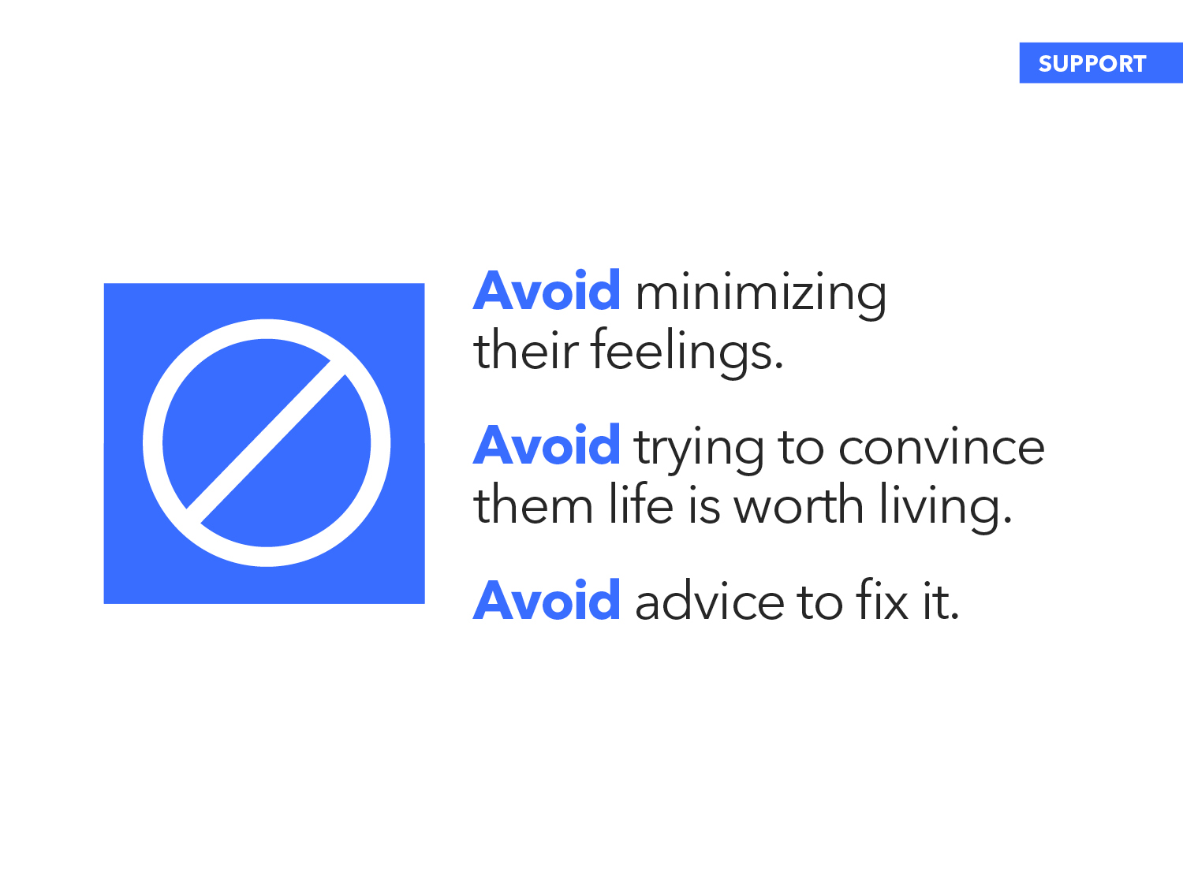
Notes:
There are some things to avoid when talking with someone who may be suffering from depression or anxiety.
Avoid minimizing their feelings. Those of us who have never experienced major depression literally cannot imagine what it feels like.
Avoid trying to convince them life is worth living. If a person is nearing a crisis point, they are not thinking clearly. Philosophical debates about life being worth living tend not to be helpful.
Avoid advice to fix it. If the person is having a heart attack, you wouldn’t tell them to start exercising or to eat a healthier diet.
If they are in crisis, what they need is to be heard and then led to help. Listen to their story, and offer to help them find a health professional. Help them take active steps toward keeping their environment safe.

Slide 76
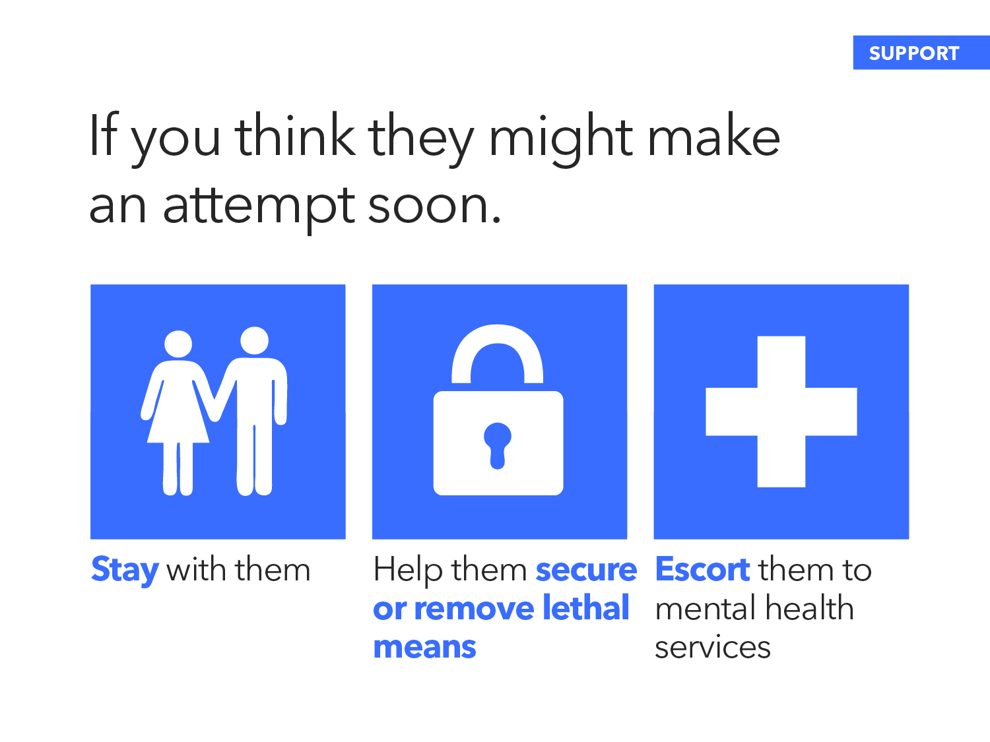
Notes:
If you think they might make an attempt on their life soon:
Stay with them. Do not leave them alone. However, if the situation puts your own safety at-risk, leave the area immediately and call 911.
Help them remove lethal means, or remove themselves from the potentially dangerous area.
Escort them to mental health services or an emergency room.

Slide 77
Notes:
Help them to call the Lifeline, or call the Lifeline yourself and a trained counselor will tell you what you should do to help the person in distress. If they don’t feel comfortable speaking to a counselor on the phone, they can also text TALK to the Crisis Text Line at 741741.
[ASK AUDIENCE TO TAKE OUT THEIR PHONES]
Now would be a great time to take out your phones, and add both the Lifeline and Crisis Text Line as contacts. Even if you never use these resources for yourself, you may need them to help a friend. They’re both open. 24/7, 365.

Slide 78
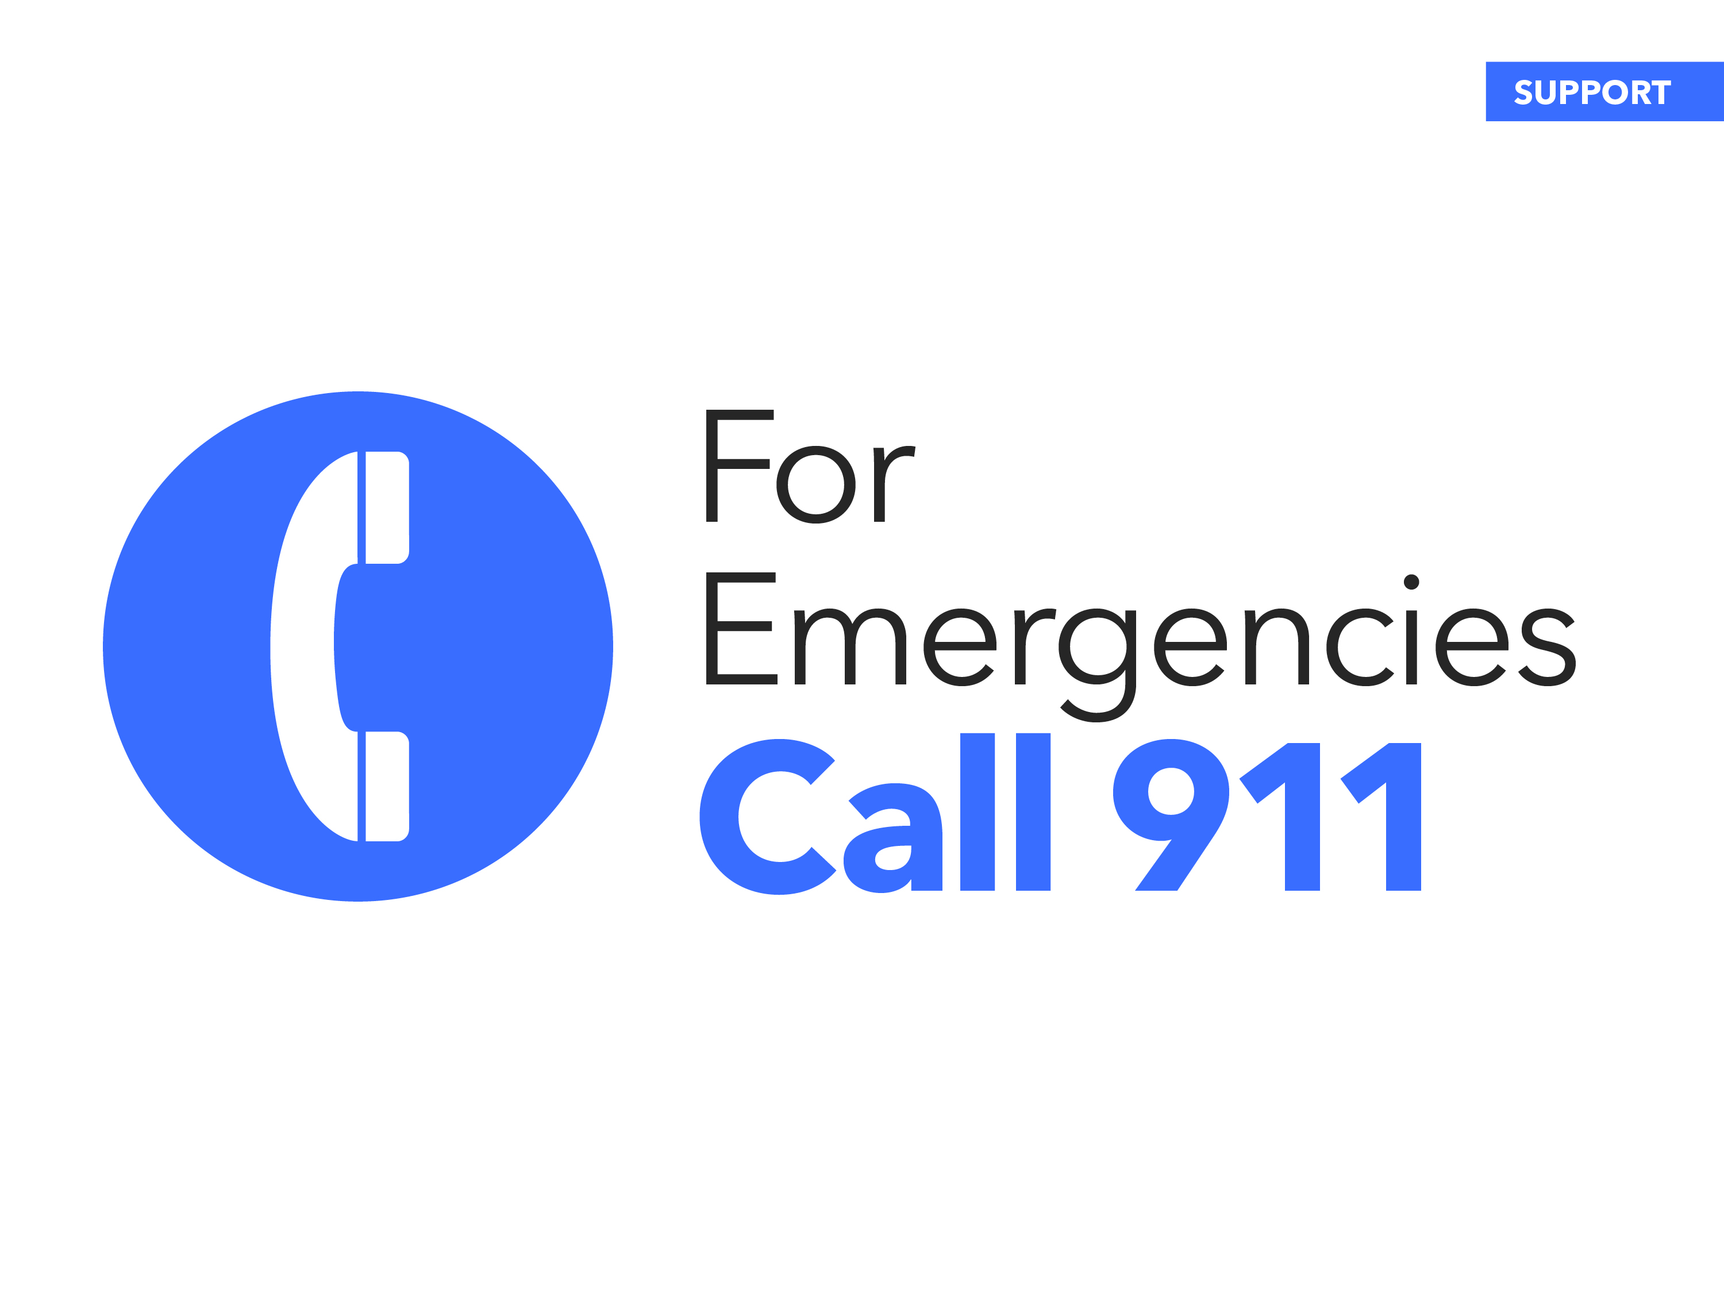
Notes:
If it’s an emergency, such as a suicide attempt in progress, call 911.

Slide 79
Notes:
Together we can create a culture that’s smart about mental health. We’ll save lives, and vastly improve the lives of many more.

Slide 80
Notes:
It’s a simple idea TALK SAVES LIVES. By caring and reaching out we can all play a part in suicide prevention.

Slide 81
Notes:
The American Foundation for Suicide Prevention is dedicated to saving lives and bringing hope to those affected by suicide. With 75 chapters across all 50 states, AFSP creates a culture that’s smart about mental health through education and community programs, develops suicide prevention through research and advocacy, and provides support for those affected by suicide.

Slide 82
Up to 45% of people who die by suicide visit their primary care physician in the month prior to their death.
HEALTHCARE SYSTEMS
Notes:
Healthcare systems, including primary care, are a critical area of Project 2025. Up to 45% of people who die by suicide visit their primary care physician in the month prior to their death.

Slide 83
39% of 39% of people who die by suicide make an Emergency Department visit in the year prior to their death.
EMERGENCY DEPARTMENTS
Notes:
39% of people who die by suicide make an Emergency Department visit in the year prior to their death. Emergency Departments therefore present another key setting with a tremendous opportunity to save lives.

Slide 84
Credits:
Dr. Christine Moutier, M.D. Chief Medical Officer, American Foundation for Suicide Prevention
American Foundation for Suicide Prevention , www.afsp.org
Resources on website that include a 4 min video developed by AFSP and Mayo, postvention toolkits for both medical schools and residency programs.
https://afsp.org/our-work/education/healthcare-professional-burnout-depression-suicide-prevention/

Slide 85
Notes:
You can learn more at afsp.org, or by following us on Facebook, Twitter, and Instagram.
[if you have a personal connection to suicide, you have the option of taking no more than two minutes to share your story here. Please review safe messaging guidelines]
Thank you for listening.
If you have any questions about our local chapter, our current initiatives, and how you can get involved, please see me after the presentation concludes. Again, thank you for being here today. Together we can save lives.

Slide 86
Thank You
Sallie Wilson, D.O.

Slide 87
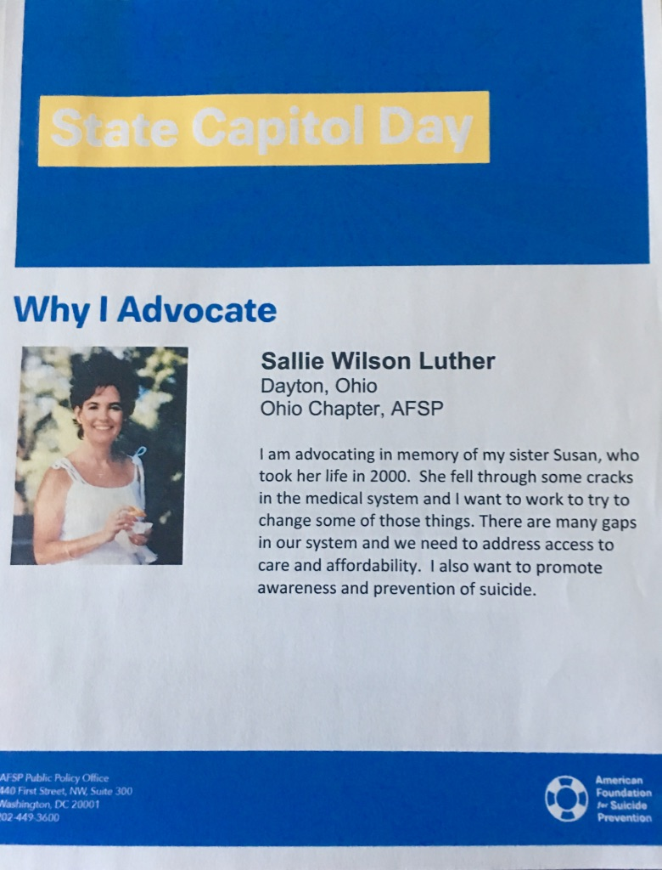
Thank
You!
Notes:
For more information, please visit our Project 2025 website at www.afsp.org/project2025
Thank you for your time and attention.

Slide 88
Film “Struggling in Silence”
Brought to you by American Foundation for Suicide Prevention

