Slide 1
Improving Adherence in Type 2 Diabetes Mellitus
Allison Petznick DO
NOMS Family Medicine
Sandusky, OH

Slide 2
Objectives
Evidence for importance of tight glucose control
Barriers preventing glucose control
Interventions for improving glucose control

Slide 3
UKPDS Trial

Slide 4
ACCORD, ADVANCE, VADT

Slide 5
Barriers to achieving glucose control
Physican related | Patient related
Concern for side effects Time constraints Insurance denial of medication use | Difficulty with transportation Cost of medications Lack of education or understanding Stress in social/work life Inconvenience or complexity of regimen Side effects from medications Memory issues and lack of routine Depression Lack of trust with their provider or medications

Slide 6
Impact of treatment non-compliance on mortality
15,984 patients with type 2 diabetes
39% patients missed at least one appointment
Currie CJ. The impact of treatment non-compliance on mortality in people with type 2 diabetes mellitus. Diabetes Care. 2012; 35: 1279-1284

Slide 7
Clinical Inertia
Khunti K. Clinical inertia in people with type 2 diabetes. Diabetes Care. 2013;

Slide 8
DAWN study
85% patients experience severe stress at the time of diagnosis and 50% still have considerable stress 15 years after diagnosis
Only 19.4% (DM-1) patients and 16.2% (DM-2) report they completely carried out all recommendations the provider had given them
However 88.8% rated quality of relationship with physician as good
SO WHAT IS THE PROBLEM????
Funnell MM. The diabetes attitudes, wishes, and needs (DAWN) study. Clinical Diabetes. 2006; 24: 154-155.

Slide 9
Too much is not a always a good thing…..
Overwhelming physicians and patients with goal oriented care
A1c < 7%
Exercise
Eye exam
Smoking cessation
BP < 140/80
Healthy diet
Foot exam
Influenza vaccine
LDL < 100
Pneumonia vaccine
Weight
PVR
HDL > 40 (male) > 50 female)
Depression screening
Cost

Slide 10
Health literacy
The degree to which individuals have the capacity to obtain, process, and understand basic health information needed to make appropriate health decisions and services needed to prevent or treat illness.
Schillinger D et al. Association of health literacy with diabetes outcomes. JAMA. 2002; 288: 475-482.
CDC US adults literacy scale 2003

Slide 11
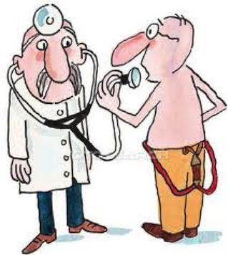
Patient centered approach
“Providing care that is respectful of and responsive to individual patient preferences, needs, and values and ensuring that patient values guide all clinical decisions”
Inzucchi et al. Management of hyperglycemia in type 2 diabetes: a patient centered approach. Diabetes Care. 2012; 35: 1364-1379.

Slide 12
Patient centered measures
Health behaviors
Healthy eating, medication taking, physical activity, not smoking
Quality of life
Emotional and physical health
Self management goals
Set specific goals
Patient centered care
Patient engagement, shared decision making, patient preferences
Glasglow et al. Where is the patient in diabetes performance? The case for including patient centered and self management measures. Diabetes Care. 2008; 31: 1046-1050.

Slide 13
5C Intervention
Construct a problem definition
What is the patient’s concern/problem area?
Collaborative goal setting
Set specific, measurable, action oriented, and realistic goals
Collaborative problem solving
Identify barriers and formulate a strategy for success
Contracting for change
Track outcomes and reward successes
Continuing support
Peyrot M et al. Behavioral and psychosocial interventions in diabetes: a conceptual review. Diabetes Care 2007: 30; 2433-2440

Slide 14
Motivations, Goals, Barriers
Focus on ACTIONS, not outcomes
Define barriers
Verbalize goals
Provide reinforcement and follow up
Funnell MM et al. The diabetes attitudes, wishes, and needs study (DAWN). Clinical Diabetes. 2006; 24: 154-155.

Slide 15
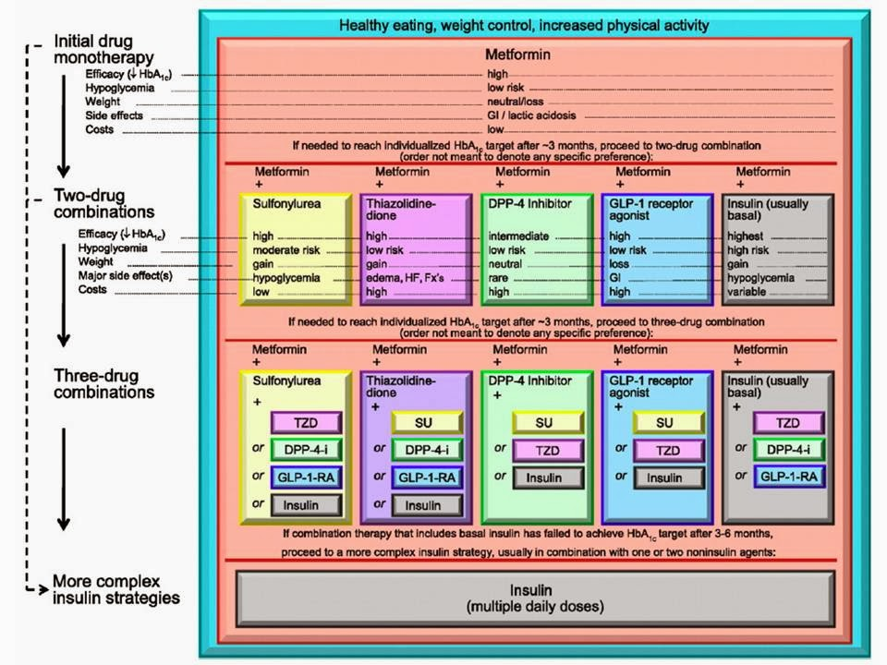
Simplify the regimen

Slide 16
New classes of diabetes medications
Weight gain
Sulfonylurea
TZD
Insulin
Weight neutral
Metformin
Glinides
DPP 4 inhibitor
Alpha glucosidase inhibitor
Weight loss
GLP-1 agonist
SGLT 2 inhibitor

Slide 17
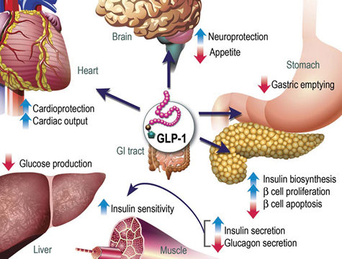
GLP-1 agonists

Slide 18
SGLT 2 inhibitors

Slide 19
Take home points
Intensive glucose control is associated with decreased risk for diabetes related complications
Goal should be tailored to the patient (A1c 6-8%)
This is only effective if the patient understands and adheres to treatment plan
Don’t allow yourself or the patient to be overwhelmed by health measures
Focus on ACTIONS… Not outcomes
Simplify the treatment regimen if possible

