Slide 1
Pennsylvania Counseling Association Advocacy Day 2018
Preparation for convening in Harrisburg

Slide 2
Overview
Advocacy for counseling.
Effective forms of advocacy.
What to expect in Harrisburg.
Suggestions for a good meeting with your representative.
Next steps in getting prepared for April.

Slide 3
Advocacy for counseling
Advocacy means “actively working for, supporting, or espousing a cause…counselors advocate for the welfare of their clients and the profession of counseling” (Gladding, 2001, p.5).
“Every occupational group must be proactive in the marketplace or they will become extinct over time. Counselors must not only believe in their profession’s preparation standards, graduate programs, credentialing requirements, and scope of services, but they must educate, inform, and promote them to legislators, employers, third party payers, and the public at large.” (Chi Sigma Iota, 1998)

Slide 4
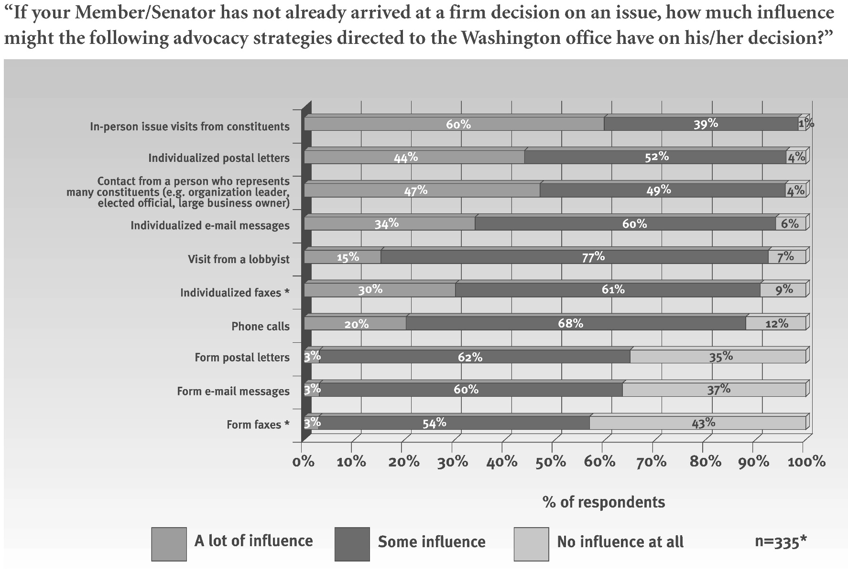
Effective forms of advocacy
source: “Communicating With Congress,” Congressional Management Foundation, 2005 (as cited in “Communicating with Congress: Why do it? And how?” American Counseling Association, N.D.)

Slide 5
What to expect in Harrisburg
9am-1pm
Arrive/park
Utilize map
1:30-3:30pm
Converge at Messiah College.
Speaker.
Follow-up
Email/letter.
Follow schedule
Meet with representatives.
Celebrate and share experiences.
Phone call.
Track legislative issues.

Slide 6
Suggestions for your meeting
1. Bring enough copies of your agenda to your meeting, so that everyone is attendance has one
2. If applicable, acknowledge the member’s support for your issue
3. When talking, be direct and to the point
4. When talking about specific legislation, refer to it by its official title and number or if there is not a specific piece of legislation, then be direct how you the member can help your cause
You will be provided with talking points and agenda items for your meeting.
This is particularly relevant with SB 530, which we will have more information about at that time.
These meetings are brief and we need to be brief too.
This will all be present for you in the talking points provided.
Harp, N.D.

Slide 7
Suggestions continued
5. During your meeting, be sure to add personal accounts of how this piece of legislation affects: you, your family, or someone that you know
7. At any point in the meeting feel free to ask any questions that you may have
8. At the end make sure and thank the member or their staffer for their time and leave information behind.
6. YOU are the EXPERT on this issue and you will know more about it than the Senator or their staffer
Take time to think about the talking points and how they impact you and your work as a counselor.
You are a counselor and you are talking about counseling! This is the perfect match!
Whether it be about the legislative process or the representative’s experience – feel free to ask.
You will be provided with information to leave with the representatives about our profession.

Slide 8
Next steps
Talking points
Individual schedules
T-shirts and buttons
Reminders

Slide 9
Questions?
Please feel free to reach out to Travis Schermer (twschermer@Carlow.edu) if you have questions about this process.

Slide 10
References
Harp, D. (N.D.). What to do before, during, and after a meeting with a member or their staff. Retrieved: https://www.counseling.org/docs/default-source/default-document-library/what-to-do.pdf?sfvrsn=a1b1442c_0

