Slide 1
Premier Oncology Hematology Management Society (POHMS) Medicare Updates and Advanced Evaluation and Management Coding and Documentation
October 28, 2016

Slide 2
Disclaimer
All Current Procedural Terminology (CPT) only are copyright 2015 American Medical Association (AMA). All rights reserved. CPT is a registered trademark of the American Medical Association. Applicable Federal Acquisition Regulation/ Defense Federal Acquisition Regulation (FARS/DFARS) Restrictions Apply to Government Use. Fee schedules, relative value units, conversion factors and/or related components are not assigned by the AMA, are not part of CPT, and the AMA is not recommending their use. The AMA does not directly or indirectly practice medicine or dispense medical services. The AMA assumes no liability for data contained or not contained herein.
The information enclosed was current at the time it was presented. Medicare policy changes frequently; links to the source documents have been provided within the document for your reference. This presentation was prepared as a tool to assist providers and is not intended to grant rights or impose obligations.
Although every reasonable effort has been made to assure the accuracy of the information within these pages, the ultimate responsibility for the correct submission of claims and response to any remittance advice lies with the provider of services.
Novitas Solutions employees, agents, and staff make no representation, warranty, or guarantee that this compilation of Medicare information is error-free and will bear no responsibility or liability for the results or consequences of the use of this guide.
This presentation is a general summary that explains certain aspects of the Medicare program, but is not a legal document. The official Medicare program provisions are contained in the relevant laws, regulations, and rulings.
Novitas Solutions does not permit videotaping or audio recording of training events.

Slide 3
Agenda
Comprehensive Error Rate Testing (CERT) Program
Medicare Updates
Preventive Services
“Incident to” guidelines
Scoring Medical Records
Important Updates and Reminders
Self-Service Options

Slide 4
Objectives
Review pertinent Medicare Updates
Review “incident to” guidelines
Apply principles of proper documentation to the scoring process

Slide 5
Acronym List
Acronym | Definition
CERT | Comprehensive Error Rate Testing
CPT | Current Procedural Terminology
E/M | Evaluation and Management
HPI | History of Present Illness
IVR | Interactive Voice Response
MACRA | Medicare Access and CHIP Reauthorization Act of 2015
MDM | Medical Decision Making
NPP | Non-Physician Practitioner
PFSH | Past Medical, Family, and Social History
ROS | Review of Systems

Slide 6
Comprehensive Error Rate Testing (CERT) Program

Slide 7
Comprehensive Error Rate Testing (CERT)
Program developed by Centers for Medicare & Medicaid Services (CMS) to monitor the accuracy of claims processing
Designed to protect the Medicare trust fund and determine error rates nationally and regionally
Random audits conducted on a monthly basis
AdvanceMed request medical records for claims selected as part of the monthly random sample
Medical record documentation supporting claim must be returned in designated time frame
JL CERT page:
http://www.novitas-solutions.com/webcenter/spaces/CERT_JL

Slide 8
Trending Errors- Part B
Insufficient documentation:
Procedure/service billed
Missing or illegible documentation and/or physician signature
No valid physician’s order
No physical therapy certified plan of care/treatment plan
Incorrect coding errors:
Evaluation and Management (E/M) codes
Critical care, discharge day management, physical therapy
Units of medication/infusion services
Laboratory services

Slide 9
Medical Record Signature Reminders
Categorized as “Insufficient Documentation” errors:
Missing signatures
Illegible handwritten signatures
Electronic signatures not dated
Attestation statements do not match the date of service
Records must be signed and dated
Include signature logs to determine handwritten signatures
Complete attestation statements when records are not signed
Do not add late signatures
CMS Complying with Medicare Signature Requirements:
https://www.cms.gov/Outreach-and-Education/Medicare-Learning-Network-MLN/MLNProducts/downloads/Signature_Requirements_Fact_Sheet_ICN905364.pdf

Slide 10
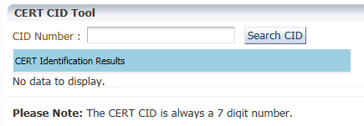
CERT Identification Online Tool
Provides status information for sampled claims using CID number where a decision has been made by the CERT contractor:
Claim in Error- CERT error was assessed or not
Status Date- last date that CERT updated/reviewed the case
Status Decision- where the claim is with the CERT Review Contractor
Appealed- if an appeal was initiated and the appeal status
Error Code- errors assessed

Slide 11
Evaluation and Management
CPT Code- 99232 Subsequent hospital care:
Missing documentation:
Documentation does not support a face to face interaction between the patient and the physician
Documentation received:
Documentation is a review of a lab study and possible plans to discharge the next day:
Submitted an authenticated hospital visit progress note for the billed DOS but does not support a face to face
CERT error:
Insufficient documentation
Current Procedural Terminology (CPT) only copyright 2015 American Medical Association. All rights reserved.

Slide 12
Lab Test
CPT code 80053 – Comprehensive metabolic panel:
Missing Documentation:
The order for the billed lab work or the intent to order the billed comprehensive metabolic panel, complete blood count with differential
Documentation received:
Results:
Progress notes that support the necessity
No specific orders
CERT Error:
Insufficient documentation
Current Procedural Terminology (CPT) only copyright 2015 American Medical Association. All rights reserved.

Slide 13
Venipuncture
CPT code 36415- Venipuncture:
Missing Documentation:
Medical record documentation supporting the medical necessity for billed service
Received Documentation:
Unauthenticated note documenting intent/plan to order labs
Lab results as a result of services which are not covered under Medicare
Medication record
CERT Error:
Medically Unnecessary
Current Procedural Terminology (CPT) only copyright 2015 American Medical Association. All rights reserved.

Slide 14
Medicare Updates

Slide 15
What is a CR?
Change Request (CR)- guidelines from CMS

Slide 16
How Do I Know if a New CR Has Been Released?
Make sure you are signed up for electronic mailing list
CRs will be listed on Novitas website:
Home page/Top News/All News:
http://www.novitas-solutions.com/webcenter/portal/MedicareJL/pagebyid?contentId=00003494

Slide 17
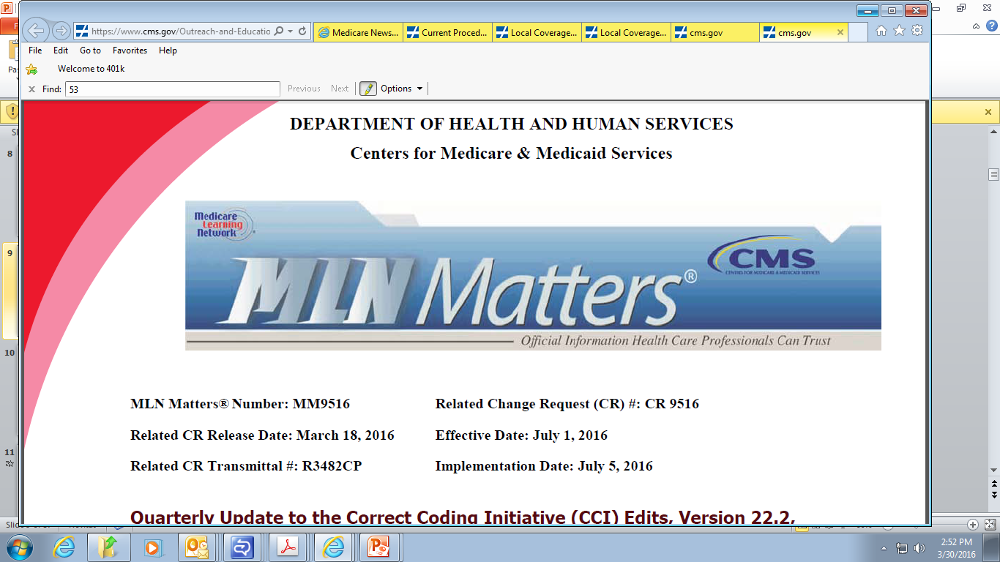
So What is a MLN?
Medicare Learning Network (MLN)- are national articles designed to inform health care professionals about the latest changes to CMS programs

Slide 18
Where to Find MLN Articles
On our website we list MLN Articles:
Publication/MLN Articles:
http://www.novitas-solutions.com/webcenter/portal/MedicareJL/pagebyid?contentId=00002956
CMS website:
Outreach and Education-MLN articles:
https://www.cms.gov/Outreach-and-Education/Medicare-Learning-Network-MLN/MLNMattersArticles/index.html

Slide 19
Expiration of CMS ICD-10-CM Grace Period
The grace period CMS and American Medical Association (AMA) announced providing Flexibility Guidance to help providers transition to ICD-10-CM ended October 1, 2016:
CMS has updated their FAQs August 18, 2016:
https://www.cms.gov/Medicare/Coding/ICD10/Clarifying-Questions-and-Answers-Related-to-the-July-6-2015-CMS-AMA-Joint-Announcement.pdf
Be sure to check out the 2017 ICD-10-CM Guidance:
https://www.cms.gov/Medicare/Coding/ICD10/2017-ICD-10-CM-and-GEMs.html
CMS ICD-10-CM Center:
https://www.cms.gov/medicare/coding/icd10/index.html

Slide 20
Sequestration Update
Mandatory Payment Reduction of 2% continues until further notice for the Medicare Fee For Service Program
Applied to all claims after determining coinsurance, any applicable deductible, and any applicable Medicare Secondary Payment adjustments
For more information:
https://www.cms.gov/Outreach-and-Education/Outreach/FFSProvPartProg/Provider-Partnership-Email-Archive-Items/2016-03-03-Enews.html
Frequently Asked Questions:
http://www.novitas-solutions.com/webcenter/portal/MedicareJL/page/pagebyid?contentId=00106360

Slide 21
Coding Revisions to National Coverage Determinations (NCDs)
Change Request # 9631:
Effective: October 1, 2016
Implementation: October 3, 2016
Key Point:
Many NCDs will be updated with revisions to ICD-10 coding:
20.4 – Implantable Automatic Defibrillators
20.7 – Percutaneous Transluminal Angioplasty (PTA)
20.9 – Artificial Hearts
20.29 – Hyperbaric Oxygen Therapy
Reference:
https://www.cms.gov/Outreach-and-Education/Medicare-Learning-Network-MLN/MLNMattersArticles/Downloads/MM9631.pdf

Slide 22
JW Modifier: Drug Amount Discarded/Not Administered to Any Patient
Change Request # 9603:
Effective: January 1, 2017
Implementation: January 3, 2017
Key Points:
Use of the JW modifier is required to identify unused drugs or biologicals that are appropriately discarded
Providers are required to document the discarded drug or biological in the patient's medical record
Reference:
https://www.cms.gov/Outreach-and-Education/Medicare-Learning-Network-MLN/MLNMattersArticles/Downloads/MM9603.pdf

Slide 23
Interest Rate for Overpayments and Underpayments- 4th Qtr. FY 2016
Change Request # 9750:
Effective: July 18, 2016
Implementation: July 18, 2016
Key Point:
Implement interest rate of 9.625% for Medicare overpayments and underpayments
Reference:
https://www.cms.gov/Regulations-and-Guidance/Guidance/Transmittals/Downloads/R270FM.pdf

Slide 24
Medicare Policy Clarified for Prolonged Drug and Biological Infusions
Special Edition Article SE1609
Key Points:
In some instances, a hospital outpatient department or physician office may:
Purchase the drug for a medically reasonable and necessary prolonged drug infusion
Begin the drug infusion in care setting using an external pump
Send the patient home for a portion of the infusion
Have the patient return at the end of the infusion period
Bill A/B MAC for drug or biological, administration, and external infusion pump
Reference:
http://collaborate.novitas-solutions.com/novitas/poedu/Lists/2013%20CR%20Tracking/Attachments/1220/Issued%20(04-25-16)%20TDL-160312.pdf

Slide 25
Medicare Coverage of Diagnostic Testing for Zika Virus
Special Edition Article SE1615:
Key Points:
Medicare Part B pays for clinical diagnostic laboratory tests for diagnosis and treatment of a person’s illness or injury
No specific HCPCS code for testing Zika virus
Provide resources and cost information as requested by MAC to establish appropriate payment amounts for the tests
Reference:
https://www.cms.gov/Outreach-and-Education/Medicare-Learning-Network-MLN/MLNMattersArticles/Downloads/SE1615.pdf

Slide 26
Medically Unlikely Edits (MUE) Tips
CMS developed the MUE program to reduce the paid claims error rate for certain services
Review these important points:
The MUE for a procedure code is the maximum units of service a provider would report for a single patient on a single date of service
MUEs do not exist for all HCPCS/CPT codes
When requested, the records should explain why the patient required more than the approved MUE for any service
While the majority of MUEs are publicly available on the CMS website, CMS will not publish all MUE values because of fraud and abuse concerns
For more tips:
http://www.novitas-solutions.com/webcenter/portal/MedicareJL/pagebyid?contentId=00088725

Slide 27
Medicare Part B Quarterly Updates
Quarterly Update to the Medicare Physician Fee Schedule Database (MPFSDB) - July CY 2016 Update:
https://www.cms.gov/Outreach-and-Education/Medicare-Learning-Network-MLN/MLNMattersArticles/Downloads/MM9633.pdf
Healthcare Common Procedure Coding System (HCPCS) Codes Subject to and Excluded from Clinical Laboratory Improvement Amendments (CLIA) Edits, April 4, 2016:
http://www.cms.gov/Outreach-and-Education/Medicare-Learning-Network-MLN/MLNMattersArticles/Downloads/MM9502.pdf
Quarterly Update to the Correct Coding Initiative (CCI) Edits, Version 22.2, Effective July 1, 2016:
http://www.cms.gov/Outreach-and-Education/Medicare-Learning-Network-MLN/MLNMattersArticles/Downloads/MM9516.pdf
July 2016 Update of the Ambulatory Surgical Center (ASC) Payment System:
https://www.cms.gov/Outreach-and-Education/Medicare-Learning-Network-MLN/MLNMattersArticles/Downloads/MM9668.pdf

Slide 28
More Quarterly Updates
October Quarterly Update to 2016 Annual Update of HCPCS Codes Used for Skilled Nursing Facility Consolidated Billing Enforcement:
http://www.cms.gov/Outreach-and-Education/Medicare-Learning-Network-MLN/MLNMattersArticles/Downloads/MM9688.pdf
Remittance Advice Remark and Claims Adjustment Reason Code, Medicare Remit Easy Print and PC Print Update-July, 2016:
http://www.cms.gov/Outreach-and-Education/Medicare-Learning-Network-MLN/MLNMattersArticles/Downloads/MM9466.pdf
July 2016-Average Sales Price (ASP) Medicare Part B Drug Pricing Files and Revisions to Prior Quarterly Pricing Files:
https://www.cms.gov/Outreach-and-Education/Medicare-Learning-Network-MLN/MLNMattersArticles/Downloads/MM9612.pdf
Influenza Vaccine Payment Allowances - Annual Update for 2015-2016 Season:
https://www.cms.gov/Outreach-and-Education/Medicare-Learning-Network-MLN/MLNMattersArticles/Downloads/MM9299.pdf

Slide 29
Preventive Services

Slide 30
Preventive Services and Screenings Covered by Medicare
Abdominal Aortic Aneurysm Screening
Alcohol Misuse Screening and Behavioral counseling Intervention in Primary Care
Annual Wellness Visit (Including Personalized Prevention Plan Services)
Bone Mass Measurements
Cancer Screenings
Breast Cancer (mammograms and clinical breast exam)
Cervical and Vaginal Cancer (pap test and pelvic exam [includes the clinical breast exam])
Colorectal Cancer
Fecal Occult Blood Test
Flexible Sigmoidoscopy
Colonoscopy
Barium Enema
Prostate (Prostate Specific Antigen blood test and Digital Rectal Exam)
Lung Cancer
Cardiovascular Disease Screening
Depression Screening in Adults
Diabetes Screening
Diabetes Self-Management Training
Glaucoma Screening
Hepatitis C
Human Immunodeficiency Virus (HIV) Screening
Immunizations (Seasonal Influenza, Pneumococcal, and Hepatitis B)
Initial Preventive Physical Examination (IPPE) (also commonly referred to as the “Welcome to Medicare” Preventive Visit)
Intensive Behavioral Therapy for Cardiovascular Disease
Intensive Behavioral Therapy for Obesity
Medical Nutrition Therapy (for beneficiaries with diabetes or renal disease)
Sexually Transmitted Infections (STIs) Screening and High-Intensity Behavioral Counseling (HIBC) to prevent STIs
Tobacco-Use Cessation Counseling

Slide 31
Updated Diagnosis Code List for Colorectal Cancer Screening
CMS is adding 44 ICD-10 diagnosis codes to NCD 210.3, Colorectal Cancer Screening that were originally in CR 8691 and inadvertently omitted in CR 9252 Coding Revision to NCD:
All of these CRs are ICD-10 coding and other changes contained in NCDs
Colorectal Cancer Screenings performed for any of the additional codes effective for claims with dates of services on and after October 1, 2015 are payable under NCD 210.3 and other policy guidelines
Reference:
https://www.cms.gov/medicare-coverage-database/details/ncd-details.aspx?NCDId=281&ver=3

Slide 32
Screening for Cervical Cancer With Human Papillomavirus (HPV) Testing
Change Request # 9434:
Effective: July 9, 2015
Implementation: January 3, 2017
Key Points:
For individuals entitled to benefits under Medicare Part A and Medicare Part B
Adding HPV testing under specified conditions:
Reasonable and necessary for the prevention or early detection of cervical cancer
Testing allowed once every five years as an additional preventive service
Applies to beneficiaries aged 30 to 65 years in conjunction with the Pap smear test
Reference:
https://www.cms.gov/Outreach-and-Education/Medicare-Learning-Network-MLN/MLNMattersArticles/Downloads/MM9434.pdf

Slide 33
Preventive Services
Quick Reference Chart for Medicare Preventive Services:
https://www.cms.gov/Medicare/Prevention/PrevntionGenInfo/Downloads/MPS_QuickReferenceChart_1.pdf

Slide 34
2016 Novitas Solutions Medicare Symposiums
Register at:
http://www.novitas-solutionslearning.com
Date | City, State | Location
November16, 2016 | Langhorne, PA 19047 | Sheraton Bucks County Hotel 400 Oxford Valley Road

Slide 35
“Incident To” Guidelines

Slide 36
“Incident To”
Commonly furnished in physician’s offices or clinics
Integral although incidental:
Course of treatment initiated by physician
Physician involvement reflects continuing active participation in and management of care
Commonly rendered without charge or included in the physician's bill
Direct Supervision:
Supervising physician can be a member of the group
Must be present in the office suite, or within an institution, and immediately available
Does not have to be in the same room

Slide 37
“Incident To” Documentation Requirements
Identify who rendered the service
Indicate supervision requirement is met
Show physician’s initiation and continued involvement in treatment
Reasonable and necessary
Within scope of practice for non-physician practitioner

Slide 38
Billing 99211
May not require the presence of a physician
Documentation must support:
Face-to-face encounter
Evaluation and management of patient
Requires direct physician supervision
Modifier 25 not appropriate
Not paid with drug administration services, therapeutic, or diagnostic injection codes:
Includes flu and pneumonia injections and chemotherapy and non-chemotherapy drug infusion codes
https://www.cms.gov/Regulations-and-Guidance/Guidance/Manuals/downloads/clm104c12.pdf
Current Procedural Terminology (CPT) only copyright 2015 American Medical Association. All rights reserved.

Slide 39
Frequently Asked Question #1
Question:
Can a Non-Physician Practitioner (NPP) see a new patient and bill the service “incident to”?
Answer:
No. The physician must personally treat the patient first before “incident to” services may be billed. The NPP may bill for a new patient visit.

Slide 40
Frequently Asked Question #2
Question:
How often must the physician/non-physician practitioner (NPP) personally see the patient when services are performed “incident to”?
Answer:
During the course of treatment, a physician/NPP must personally see the patient often enough to assess the course of treatment and the patient’s progress and, where necessary, to change the treatment regimen.

Slide 41
Frequently Asked Question #3
Question:
If the physician is not in the office, but available by phone, can the Non-Physician Practitioner (NPP) bill under the “incident to” guidelines?
Answer:
No, there must be direct physician supervision. The NPP would bill for the service under his/her provider number.

Slide 42
Points to Remember
New patient visits can never be billed as “incident to” services
“Incident to” cannot be furnished in a hospital setting (inpatient, outpatient, or emergency room)
Non-physician practitioners may direct bill if “incident to” requirements are not met

Slide 43
“Incident To” Self-Service Tool
New “Incident To” self-service tool:
Series of questions
Assist providers with understand the coverage criteria
http://www.novitas-solutions.com/webcenter/portal/MedicareJL/IncidentTool
Article on “Incident To” Services:
http://www.novitas-solutions.com/webcenter/portal/MedicareJL/pagebyid?contentId=00004947

Slide 44
Scoring Medical Records

Slide 45
Medical Necessity
All E/M services must clearly/adequately document
Overarching criteria for payment in addition to the individual requirements of CPT
Federal Law requires that Medicare not pay for services that are not medically necessary
Not medically necessary or appropriate to bill higher level of E/M when lower level of service is warranted
References:
CMS Internet Only Manual Medicare Claims Processing Manual, Publication 100-04, Chapter 12, Section 30.6.1 A:
https://www.cms.gov/Regulations-and-Guidance/Guidance/Manuals/Downloads/clm104c12.pdf
The Social Security Act 1862 (a)(1)(A):
https://www.ssa.gov/OP_Home/ssact/title18/1862.htm

Slide 46
New and Established Defined
New Patient- a patient who has not received any professional services, i.e., evaluation and management service or other face-to-face service (e.g., surgical procedure) from the physician or physician group practice (same physician specialty) within the previous three years
Established Patient - patient has had a professional face-to-face service from the practitioner or from a practitioner of the same specialty in the group within three previous years
Reference:
IOM 100-04, Chapter 12 Section 30.6.7:
http://www.cms.gov/manuals/downloads/clm104c12.pdf

Slide 47
E/M Interactive Score Sheet
This interactive score sheet was created as a tool to assist providers in selecting a code and is not intended as a replacement for the 1995 and 1997 E/M documentation guidelines published by the Centers for Medicare & Medicaid Services (CMS):
http://www.novitas-solutions.com/webcenter/portal/MedicareJL/EMScoreSheet

Slide 48
Medical Record 1 – Established Patient Office Visit Billed at 99215
Current Procedural Terminology (CPT) only copyright 2015 American Medical Association. All rights reserved.

Slide 49
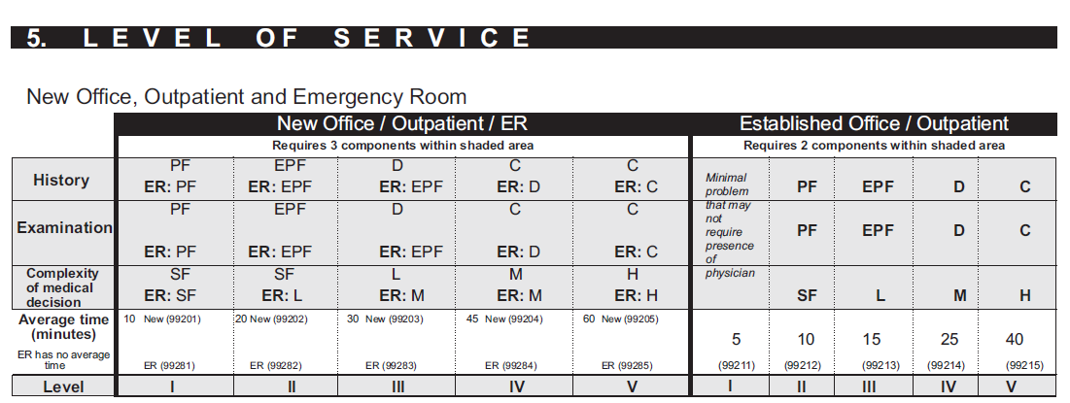
Established Patient Office Requires 2 of 3 Key Components
Current Procedural Terminology (CPT) only copyright 2015 American Medical Association. All rights reserved.

Slide 50
Medical Record 1 Page 1
Chief complaint/Primary problem:
Malignant neoplasm of bronchus and lung, unspecified
Anemia in chronic kidney disease
Mrs. X is a pleasant 93 year old female who was originally seen here in consultation 2 years ago. She presented today with shortness of breath and right midlung lesion which was confirmed to be primary bronchogenic carcinoma (the patient has a prior history of breast cancer). Her histology is squamous and the patient is being treated with carboplatinum AUC 5 on week 1, Abraxane 90 mg/m on week 1, 2, and 3 repeating every 28 days with doses adjusted given her age. After completing cycle #5, she underwent a repeat CT scan of the chest which revealed continued response and last year was placed on Tarceva 25 mg twice per day. CT in June showed (polycystic ovarian disease) POD and started Abraxane once again, 3 weeks on, 1 off initially. She finished cycle #4 and had a repeat CT showing a good response. We decided Abraxane should continue but on a reduced schedule every 2 weeks. Last week and today she felt sick. Complaints of abdominal distention.
HPI: Patient presents for continued follow up of squamous cell. She continues on Tarceva 25 mg PO BID plus Abraxane, now every 2 weeks. States she is a type II diabetic on Levemir and better controlled

Slide 51
Medical Record 1 Page 2
Review of Systems:
Constitutional: No complaint of fever or night sweats. Good hydration and nutritional intake. Reports some fatigue.
Head and Eyes: Patient denies visual changes
Ear/Nose/Throat: No complaints of ear pain. No complaints of mouth or throat soreness
Respiratory: Reports non-productive cough, chronic shortness of breath and dyspnea on exertion. On O2 at 2 L
Cardiovascular: No complaint of chest pain or palpitations
Gastrointestinal: Complaints of abdominal distention and discomfort
Neurologic: Patient denies dizziness and no reports of neuropathy
Dermatologic: No complaint of rash, itching, or new skin abnormalities. No complains of bruising or bleeding
Musculoskeletal: Patient denies new back, joint or extremity pain

Slide 52
Medical Record 1 Page 3
Physical Examination:
Vital Signs: Height is 60.0 inches; Temp - 99.2; B/P - 132/54; Pulse – 61; Weight 139 pounds
Constitutional: Patient appears well nourished, well developed and hydrated. Weight is stable
Eyes: Conjunctiva and lids are benign in appearance
Nose/Throat: Nose, mouth, tongue, and oropharynx are benign in appearance
Lungs: Normal to inspection. O2 at 2L nasal cannula, rales in RRL only today
Heart: Regular rate and rhythm. No murmurs, gallops, or rubs
Skin: The skin in unremarkable. No rashes seen, No suspicious lesions
Musculoskeletal: Ambulates with a walker due to unsteady gait
Extremities: No evidence of edema, cyanosis, or clubbing
Psych: No unusual anxiety or evidence of depression
Neuro: No motor or sensory deficits.

Slide 53
Medical Record 1 Page 4
Assessment/Plan
Assess: Anemia
Plan: APPRISE document signed. Procrit prn (60,000 U given today)
Assess: Non-small cell lung cancer is stable
Plan: Maintain Tarceva, start single agent Abraxane every 2 weeks
Comment/Summary: Mrs. X is responding to treatment clinically. Last CEA trending up at 18.4. Her primary doctor has rescheduled her for an abdominal x-ray and I have added a chest X-ray and I will meet with her next week to discuss results. Today with a hemoglobin of 9.9 she received Procrit 60,000 units. She is having an abdominal and chest x-ray later today. Please have the results available at her next visit.

Slide 54
Medical Record 1 Page 1
Chief complaint/Primary problem:
Malignant neoplasm of bronchus and lung, unspecified
Anemia in chronic kidney disease
Mrs. X is a pleasant 93 year old female who was originally seen here in consultation 2 years ago. She presented today with shortness of breath (HPI Assoc Signs and symptoms and resp ROS) and right midlung lesion (HPI location and resp ROS) which was confirmed to be primary bronchogenic carcinoma (HPI Location) (the patient has a prior history of breast cancer - Past history). Her histology is squamous and the patient is being treated with carboplatinum AUC 5 on week 1, Abraxane 90 mg/m on week 1, 2, and 3 repeating every 28 days with doses adjusted given her age. After completing cycle #5, she underwent a repeat CT scan of the chest which revealed continued response (Amt & Complex of data radiology) and last year was placed on Tarceva25 mg twice per day. CT in June showed (polycystic ovarian disease) POD and started Abraxane once again, 3 weeks on, 1 off initially. She finished cycle #4 and had a repeat CT showing a good response. (Amt & Complex of data radiology) We decided Abraxane should continue but on a reduced schedule every 2 weeks.(modifying factor). Last week and today she felt sick (HPI duration). Complaints of abdominal distention (HPI assoc signs and symptoms and ROS GI).
HPI: Patient presents for continued follow up of squamous cell. She continues on Tarceva 25 mg PO BID plus Abraxane, now every 2 weeks (HPI Modifying factor). States she is a type II diabetic ( ROS endocrine) on Levemir and better controlled.

Slide 55
Medical Record 1 Page 2
Review of Systems:
Constitutional: No complaint of fever or night sweats. Good hydration and nutritional intake. Reports some fatigue.
Head and Eyes: Patient denies visual changes
Ear/Nose/Throat: No complaints of ear pain. No complaints of mouth or throat soreness
Respiratory: Reports non-productive cough, chronic shortness of breath and dyspnea on exertion. On O2 at 2 L
Cardiovascular: No complaint of chest pain or palpitations
Gastrointestinal: Complaints of abdominal distention and discomfort
Neurologic: Patient denies dizziness and no reports of neuropathy
Dermatologic: No complaint of rash, itching, or new skin abnormalities. No complains of bruising or bleeding
Musculoskeletal: Patient denies new back, joint or extremity pain

Slide 56
History

Slide 57
Medical Record 1 Page 3
Physical Examination:
Vital Signs: Height is 60.0 inches; Temp - 99.2; B/P - 132/54; Pulse – 61; Weight 139 pounds (Constitutional)
Constitutional: Patient appears well nourished, well developed and hydrated. Weight is stable
Eyes: Conjunctiva and lids are benign in appearance
Nose/Throat: Nose, mouth, tongue, and oropharynx are benign in appearance
Lungs: Normal to inspection. O2 at 2L nasal cannula, rales in RRL only today
Heart: Regular rate and rhythm. No murmurs, gallops, or rubs
Skin: The skin in unremarkable. No rashes seen, No suspicious lesions
Musculoskeletal: Ambulates with a walker due to unsteady gait
Extremities: No evidence of edema, cyanosis, or clubbing
Psych: No unusual anxiety or evidence of depression
Neuro: No motor or sensory deficits.

Slide 58
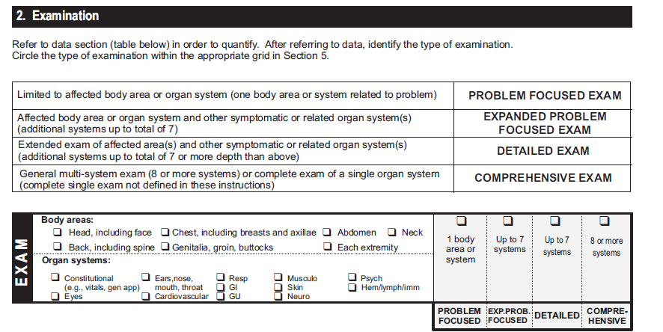
Exam Scoring

Slide 59
Medical Record 1 Page 4
Assessment/Plan
Assess: Anemia
Plan: APPRISE document signed. Procrit prn (60,000 U given today)
Assess: Non-small cell lung cancer is stable
Plan: Maintain Tarceva, start single agent Abraxane every 2 weeks
Comment/Summary: Mrs. X is responding to treatment clinically. Last CEA trending up at 18.4. Her primary doctor has rescheduled her for an abdominal x-ray and I have added a chest X-ray and I will meet with her next week to discuss results. Today with a hemoglobin of 9.9 she received Procrit 60,000 units. She is having an abdominal and chest x-ray later today. Please have the results available at her next visit.

Slide 60
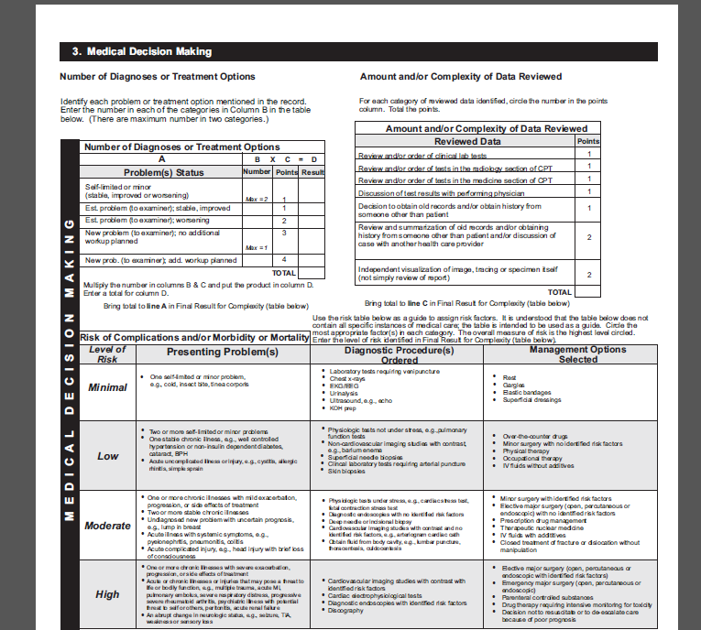
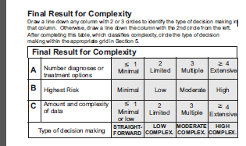
Medical Decision Making Scoring
1
1
1
2
3
2

Slide 61
Final Score
This was billed as a 99215
Final result is a 99214
Current Procedural Terminology (CPT) only copyright 2015 American Medical Association. All rights reserved.

Slide 62
Medical Record 2 – New Patient Office Visit Billed at 99205
Current Procedural Terminology (CPT) only copyright 2015 American Medical Association. All rights reserved.

Slide 63
New Patient Office Requires all 3 Key Components
Current Procedural Terminology (CPT) only copyright 2015 American Medical Association. All rights reserved.

Slide 64
Medical Record 2 Page 1
Billed as a 99205 Chief Complaint: 85 year old woman with episode of dizziness, SOB, left arm pain
This is an 85 year old woman who is new to our practice. Her previous doctor was a solo practitioner and he recently retired. Her daughter was present in the examination room. The patient has an elevated BP and pain in her deltoids and knees.
She fell 3 months ago due to severe dizziness Prior to the fall she indicated she had horrible headaches. Lately, when the phone rings she gets “tachy”.
Her daughter indicated that she had blood work done by her previous doctor who indicated it was normal.
She did mention that she had sand in her urine, and is now drinking more water. She does not feel thirsty and she drinks lactose free milk. Previously she had a CT scan of the head and it was normal.
Current Procedural Terminology (CPT) only copyright 2015 American Medical Association. All rights reserved.

Slide 65
Medical Record 2 Page 2
BP was low all her life 100/80. Stable weight, normal cholesterol , had colonoscopy in March of 2014 and had a small polyp which was benign. She has infrequent heart burn. At times she has mild edema from Amlodipine. Lately she has charley horses in her calves at night. She eats well, lots of vegetables and stays away from fried foods. She did break her leg two years ago from a fall.
She worked in an adult day care center in the office and She doesn’t smoke or drink alcohol.
Family History - Both her parents were very healthy. Her father died of a trauma to his leg. Her brother died when a tree fell on top of him. She has two children and 3 great grandchildren.
Medications: Amlodipine 2.5mg Meclizine 12.5 mg Vitamin D

Slide 66
Medical Record 2 Page 3
Exam Const. General status – appears her age, well developed, no distress, well nourished
Eyes – Pink conjunctiva ENT - Nose – Nasal Mucosa moist Hem/Lymph - Lymph nodes – no cervical LAD Respiratory - Lungs – B/L Clear to auscultation; no rubs, no wheezes, no distress Abdomen – Non-distended; non-tender, no hepatosplenomegaly Skin – No rashes, dry, warm Neurological – Alert and oriented x 3 face symmetrical, speech normal

Slide 67
Medical Record 2 Page 4
Assessment and Plan As documented in her notes from previous physician, patient three months ago had Vertigo with associated palpitations. Her symptoms resolved with Meclizine and time. Her left arm discomfort is as well as her musculoskeletal. She has no Cardio risk factors other than her age. Her HDL is 90 which is excellent. I will review the EKG when it’s available. Her fatigue is from stress, labs and echo were reviewed and echo was normal. CT reported was normal. She has chronic insomnia and likely some anxiety but controlling with valerian root. No need for routine cardiology to follow up. I will request as needed.
I refilled her Amlodipine 2.5mg and Meclizine 12. 5 mg.

Slide 68
History of Present Illness
Billed as a 99205 Chief Complaint: 85 year old woman with episode of dizziness, SOB, (HPI Associated Signs and Symptoms ROS respiratory and neuro) left arm pain (HPI Location/ ROS musculoskeletal)
This is an 85 year old woman who is new to our practice. Her previous doctor was a solo practitioner and he recently retired. Her daughter was present in the examination room. The patient has an elevated BP and pain in her deltoids and knees. (HPI Location/ ROS musculoskeletal)
She fell 3 months ago (HPI duration ) due to severe dizziness (HPI Severity). Prior to the fall she indicated she had horrible headaches. (HPI severity, ROS neuro) Lately, when the phone rings she gets tachy (HPI associated S/S/ ROS Cardio) Her daughter indicated that she had blood work done by her previous doctor who indicated it was normal. (MDM Obtaining history from someone other than the patient) (2 points since he documented the information he received from her daughter)
She did mention that she had sand in her urine, and is now drinking more water (HPI Modifying factors, ROS GU) . She does not feel thirsty and she drinks lactose free milk. Previously she had a CT scan of the head and it was normal (MDM Amt of Comp Radiology 1 point).
Current Procedural Terminology (CPT) only copyright 2015 American Medical Association. All rights reserved.

Slide 69
ROS and PFSH
BP was low all her life 100/80. Stable weight, normal cholesterol (ROS Const), had colonoscopy in March of 2014 and had a small polyp which was benign (past history). She has infrequent heart burn.(ROS GI) At times she has mild edema (ROS Integ, Skin) from Amlodipine. Lately she has charley horses in her calves at night. (ROS Musculo) She eats well, lots of vegetables and stays away from fried foods. She did break her leg two years ago from a fall. (Past History)
She worked in an adult day care center in the office and She doesn’t smoke or drink alcohol. (Social History)
Family History - Both her parents were very healthy. Her father died of a trauma to his leg. Her brother died when a tree fell on top of him. She has two children and 3 great grandchildren.
Medications: (Past History) Amlodipine 2.5mg Meclizine 12.5 mg Vitamin D

Slide 70
History

Slide 71
Exam
Exam Const.- General status – appears her age, well developed, no distress, well nourished (Organ Systems – Const) Eyes – Pink conjunctiva (Organ Systems – Eyes) ENT - Nose – Nasal Mucosa moist (Organ Systems – ENT) Hem/Lymph - Lymph nodes – no cervical LAD (Organ Systems – Hem/Lymph) Respiratory - Lungs – B/L Clear to auscultation; no rubs, no wheezes, no distress (Organ Systems Resp) Abdomen – Non-distended; non-tender, no hepatosplenomegaly (Organ Systems – GI/Body Areas Abdomen) Skin – No rashes, dry, warm (Organ Systems – Skin) Neurological – Alert and oriented x 3 face symmetrical, speech normal (Organ Systems – Neuro)

Slide 72
Exam Scoring

Slide 73
Medical Decision Making
Assessment and Plan As documented in her notes from previous physician, patient three months ago had Vertigo with associated palpitations. Her symptoms resolved with Meclizine and time. Her left arm discomfort is as well as her musculoskeletal. She has no Cardio risk factors other than her age. Her HDL is 90 which is excellent. (MDM Amt of Comp Labs) I will review the EKG when it’s available. Her fatigue is from stress, labs and echo were reviewed and echo was normal (MDM Amt of Comp Medicine section) CT reported was normal (MDM Amt of Comp X-ray). She has chronic insomnia and likely some anxiety but controlling with valerian root. No need for routine cardiology to follow up. I will request as needed.
I refilled her Amlodipine 2.5mg and Meclizine 12. 5 mg. (Table of Risk – Prescription Drug Management)
__________________________________________________________________________
Previous information from the history section:
85 year old woman with episode of dizziness, SOB (MDM New Problem to the Examiner no additional workup planned)
Her daughter indicated that she had blood work done by her previous doctor who indicated it was normal. (2 points Amt of Complexity of data reviewed, obtaining history from someone other than the patient.)

Slide 74
Medical Decision Making Scoring
3
3
5

Slide 75
Final Score
This was billed as a 99205
Final result is a 99203
Current Procedural Terminology (CPT) only copyright 2015 American Medical Association. All rights reserved.

Slide 76
Resources
MLN Matters Article MM6698 - Signature Requirements:
http://www.cms.gov/Outreach-and-Education/Medicare-Learning-Network-MLN/MLNMattersArticles/downloads/MM6698.pdf
MLN Matters Article MM6740—Revisions to Consultation Services Payment Policy:
http://www.cms.gov/Outreach-and-Education/Medicare-Learning-Network-MLN/MLNMattersArticles/downloads/MM6740.pdf
MLN Matters Article SE1010— Questions and Answers on Reporting Physician Consultation Services:
http://www.cms.gov/Outreach-and-Education/Medicare-Learning-Network-MLN/MLNMattersArticles/downloads/SE1010.pdf
CMS Internet Only Manual, Publication 100-4, Chapter 12, Section 30.6:
http://www.cms.gov/Regulations-and-Guidance/Guidance/Manuals/downloads/clm104c12.pdf

Slide 77
Summary
Discussed the CERT program
Discussed “incident to” rules
Reviewed CERT medical records
Stay up to date with the latest Medicare changes by visiting the Novitas Solutions website
Take advantage of the various self-service options available to the provider community

Slide 78
Important Updates and Reminders

Slide 79
Centers for Medicare & Medicaid Services (CMS)
CMS Internet Only Manuals (IOMs):
Offers day-to-day operating instructions, policies, and procedures based on statutes and regulations, guidelines, models, and directives
Medicare Learning Network (MLN) Matters Articles:
Your destination for health care professional education products
Open Door Forums:
Provides an opportunity for live dialogue between CMS and the stakeholder community at large
Quarterly Provider Updates:
Published quarterly for providers, suppliers, and the general public
http://www.cms.gov/

Slide 80
Increasing Your Bottom Line: How Much Does Rework Cost?
Cost savings for providers by reducing the need for Clerical Error Reopening requests:
Correct minor errors
Omissions of claim specific information
Education initiatives:
Articles published to assist with proper use of specific modifiers
New web page dedicated to help you reduce rework and increase your bottom line:
http://www.novitas-solutions.com/webcenter/portal/MedicareJL/pagebyid?contentId=00092539

Slide 81
Stay Up-to-Date
Visit our website at http://www.novitas-solutions.com
News and website Updates
Electronic Mailing List:
Weekly emails listing the most recent updates
On-Demand Education:
Frequently Asked Questions
Novitas Educational Tips and Tools (NETTs)
Podcasts
Educational Videos and Tutorials:
Watch and learn about the Medicare program and our website's features
http://www.novitas-solutions.com/webcenter/portal/MedicareJL/pagebyid?contentId=00082787

Slide 82
Website Satisfaction Surveys

Slide 83
Self-Service Options

Slide 84
Electronic Data Interchange (EDI)
Electronic billing and reports
Electronic Funds Transfers (EFT)
Direct Data Entry (DDE) to the claims processing systems
Electronic Remittance Advices
Advantages of EDI:
Improved cash flow with a 14 day payment floor
Added security, All electronic billers have a unique submitter identification (ID) and login ID
Free software programs (ABILITY|PC-ACE, PC-Print, and MREP)
Free support
Lower administrative, postage, and handling costs
EDI Website:
http://www.novitas-solutions.com/webcenter/spaces/ElectronicBillingEDI_JL

Slide 85
Novitasphere
Free Web-based portal
Access to Eligibility, Claim Information and Remittance Advice, Claim Submission with File Status, Electronic Remittance Advice (ERA), Claim Correction, Secure Messaging and a MailBox
Available to JH and JL Part B providers, billing services and clearinghouses servicing Part B practitioners
Dedicated Help Desk- 1-855-880-8424
For demonstrations and more information:
http://www.novitas-solutions.com/webcenter/spaces/MedicareJL/page/pagebyid?contentId=00024648

Slide 86
Novitasphere Claim Correction Feature
Common clerical errors can be corrected on finalized claims:
Number of services or units
Diagnosis code (Primary)
Eligible modifiers
Procedure code
Date of service
Place of service
Billed amount
JL Novitasphere Claims Correction Guide:
http://novitas-solutions.com/cs/idcplg?IdcService=GET_FILE&RevisionSelectionMethod=LatestReleased&dDocName=00086496&allowInterrupt=1

Slide 87
JL Customer Contact Information
Providers are required to use the IVR unit to obtain:
Claim Status
Patient Eligibility
Check/Earning
Remittance inquiries
Customer Contact Center- 1-877-235-8073
Provider Teletypewriter- 1-877-235-8051
JL Self-Service Tools:
http://www.novitas-solutions.com/webcenter/portal/CustomerServiceCenter_JL/Self-Service+Tools
Patient / Medicare Beneficiary:
1-800-MEDICARE (1-800-633-4227)
http://www.medicare.gov/index.html

Slide 88
Thank you!
Denise Church:
Manager Provider Outreach and Education
412-802-1739
Denise.church@novitas-solutions.com
Greg Hart:
Supervisor Provider Outreach and Education
501-690-2931
gregory.hart@novitas-solutions.com

