Slide 1

ELCA ChurchWide Assembly
August 12-17, 2013
Pittsburgh, PA

Slide 2
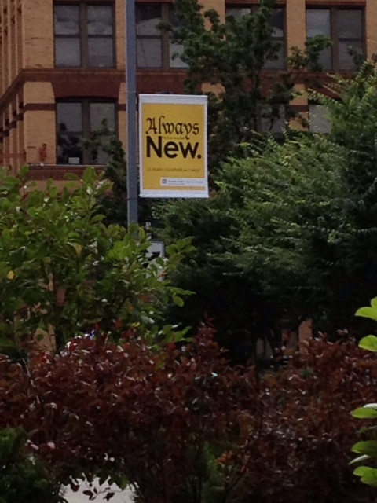
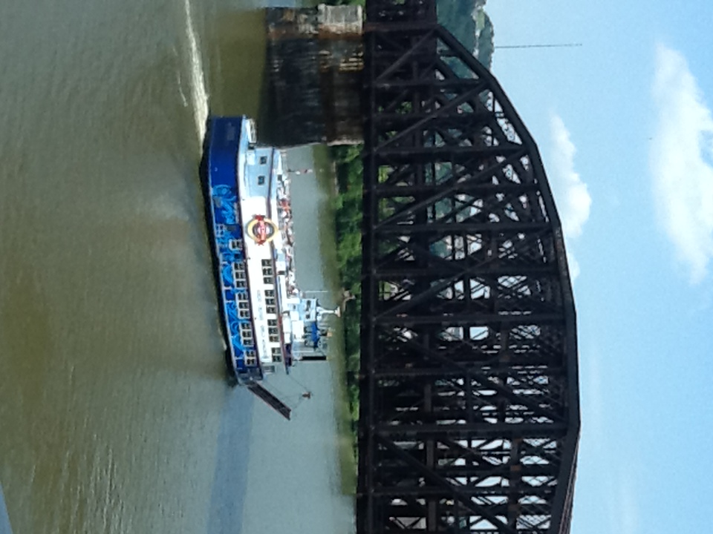
Welcome to Pittsburgh

Slide 3
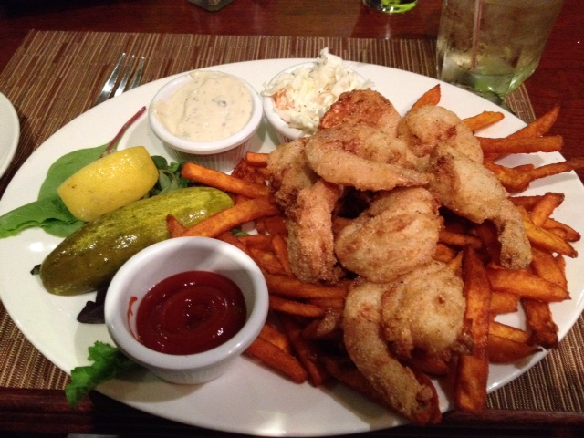
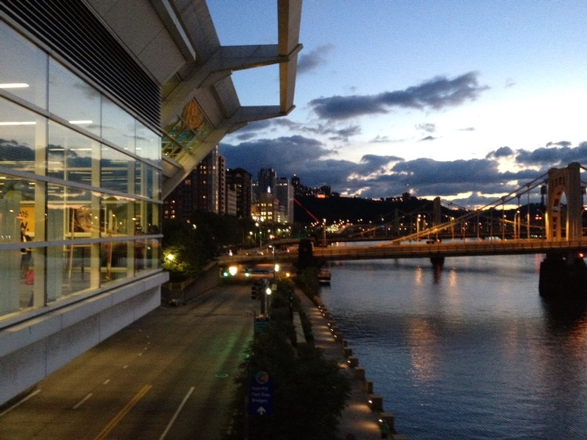
Beautiful City

Slide 4
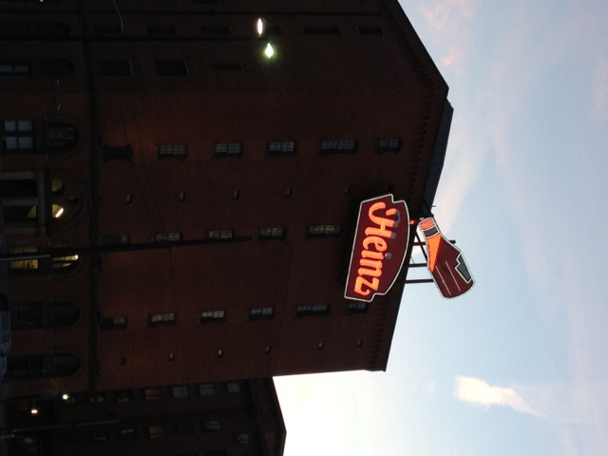
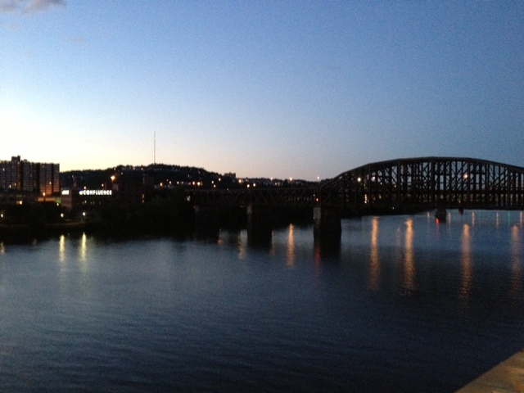

Slide 5
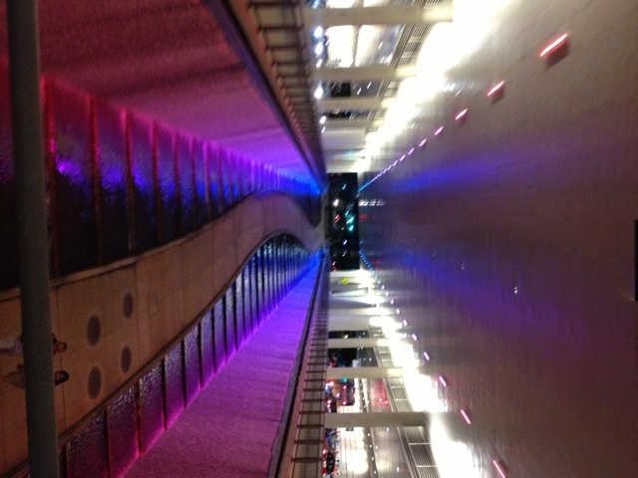
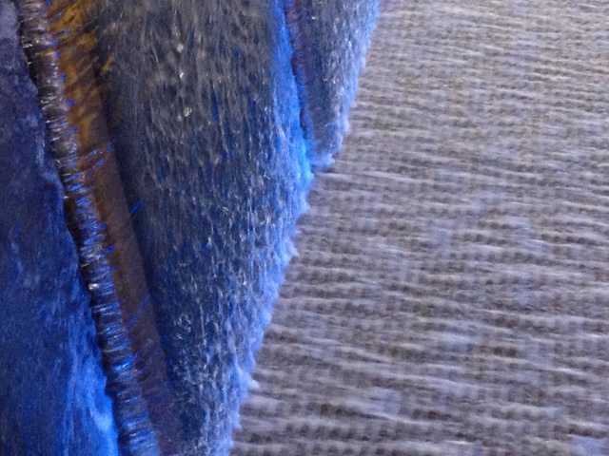
Truly a place to refresh

Slide 6
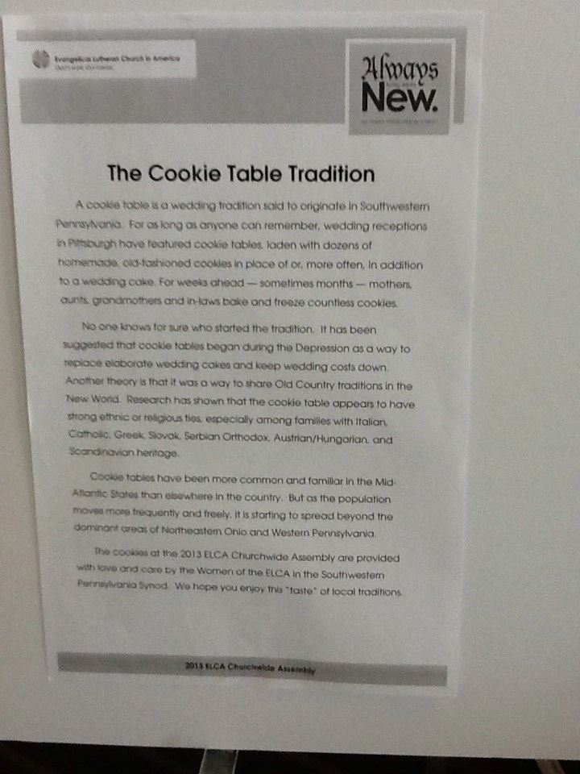
Cookie Ladies – A Pennsylvania Tradition
227 dozen cookies – were delivered daily. 2724 homemade cookies – made by loving hands –
Approximately 11,000 cookies for the Assembly
It was a shame to let them go to waste, so we all did our part!

Slide 7
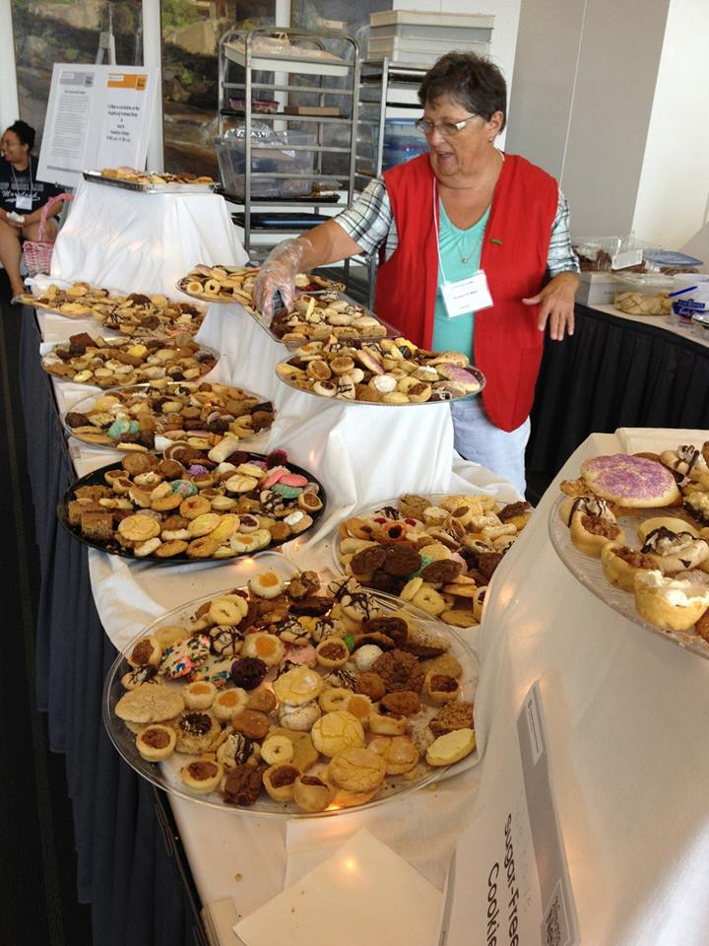
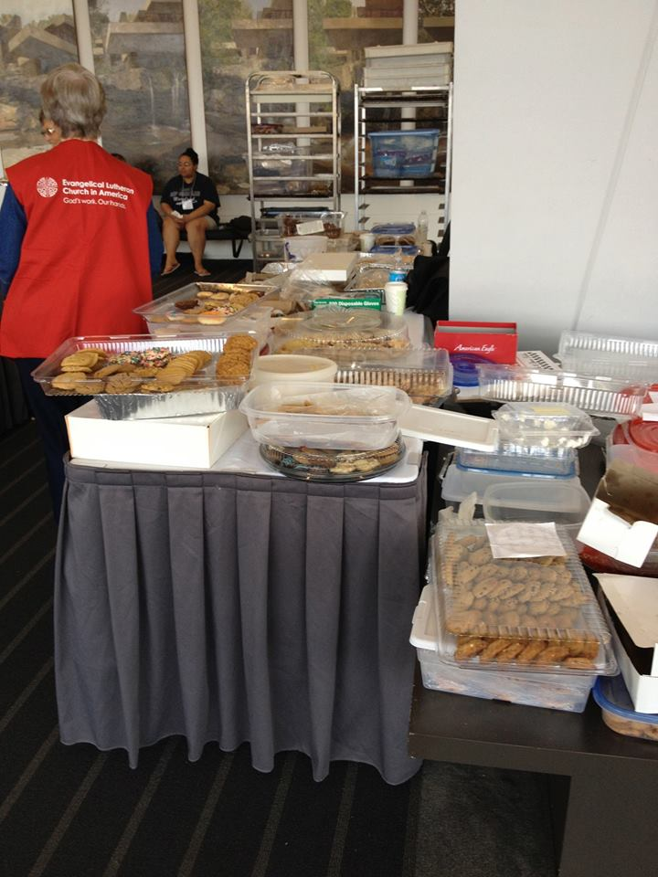

Slide 8
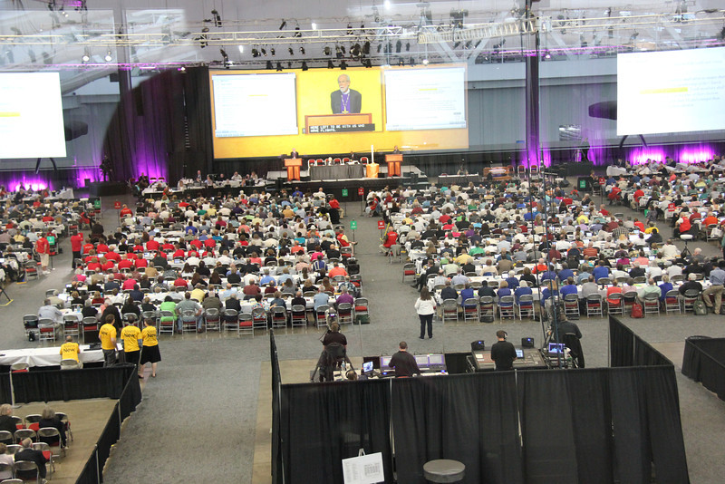
Home for Six Days ….

Slide 9
Daily Schedule
Monday 3:30 - 5:45 Plenary Session One
            6:00 -7:15 Dinner
            7:30 - 9:00 Opening Worship
            9:45 - Fall Asleep Exhausted
Tuesday 8:00 - 10:30 Plenary Session Two
            11:00 - 12:00 Worship
            12:00 - 12:45 Assembly Choir Rehearsal
            12:45 - 1:00 Lunch onsite
              1:15 - 2:00 Bible Study
                2:15 - 4:30 Plenary Session Three
              5:00 - 6:00 Hearings
            6:00 - 7:00 Dinner onsite
            7:00 - 8:00 Hearings

Slide 10
Daily Schedule
Wednesday 8:00 – 10:30 Plenary Session Four
                11:00 -12:00 Worship [Sing in Assembly Choir]
                12:00 -1:00 Lunch Onsite
                1:15 - 2:00 Bible Study
2:15-6:00 Plenary Session Five
                Synod Dinner
                College/Seminary President Reception

Slide 11
Daily Schedule
Thursday 8:00 – 10:30 Plenary Session Six
            11:00 – 12:00 Worship
            12:00 – 12:45 Assembly Choir Rehearsal
            12:45 – 1:00 Lunch Onsite
            1:15 – 2:00 Bible Study
Thursday 2:15 – 6:00 Plenary Session Seven
            6:00 - Dinner on your own

Slide 12
Daily Schedule
Friday 8:00 – 10:30 Plenary Session Eight
            11:00 – 12:00 Worship (Sing with Assembly Choir)
            12:00 – 1:00 Lunch Onsite
            1:15 – 2:00 Bible Study
Friday 2:15 – 6:00 Plenary Session Nine
            6:00 – 8:30 Celebration of the 25th Anniversary of the ELCA Dinner
                Saturday 8:00 – 10:30 Plenary Session Ten *ran later
            11:00 – 12:00 Closing Worship
            Lunch Onsite
                Saturday 1:45 – 4:00 Plenary Session Eleven
                *Not needed

Slide 13
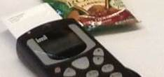
Summary of Actions
Election of Presiding Bishop. We voted …

Slide 14
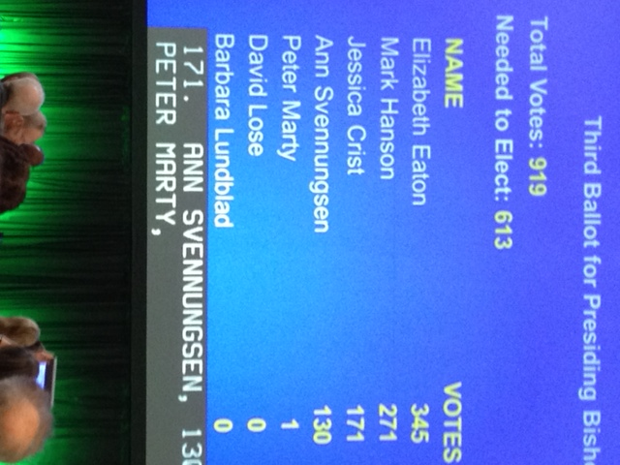
… And voted …

Slide 15
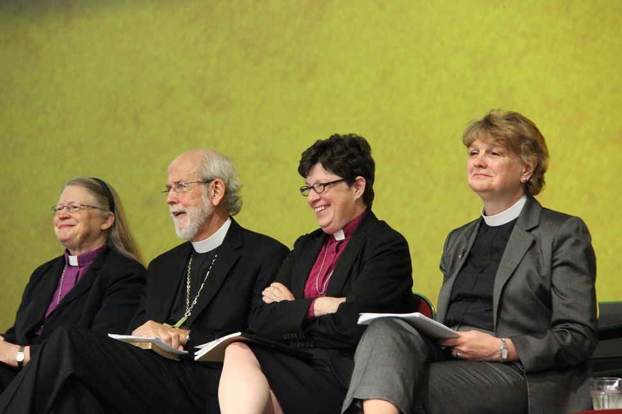
Top Four Candidates
Crist – Montana
Eaton – Northeastern Ohio
Hanson – Presiding
Svennungsen – Minneapolis

Slide 16
Question and Answer Period
Each nominee was allowed 90 seconds to answer the following five questions:
Tell us a faith story.
What major challenges are facing the ELCA and what gifts do you bring to meet those challenges?
How would you lift up and equip the Youth and Young Adults of the ELCA?
Comment on “Making All Things New” in light of the decline in mainline denominations.

Slide 17
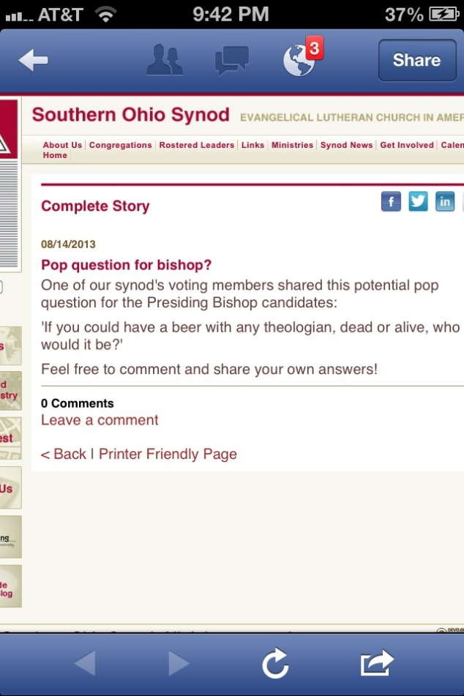
Including, from the audience:
Answers:
Hanson – My father in law
(a pastor)
Crist – the woman who washed Jesus’ feet
Eaton – my mother
Svennungsen – Martin Luther

Slide 18
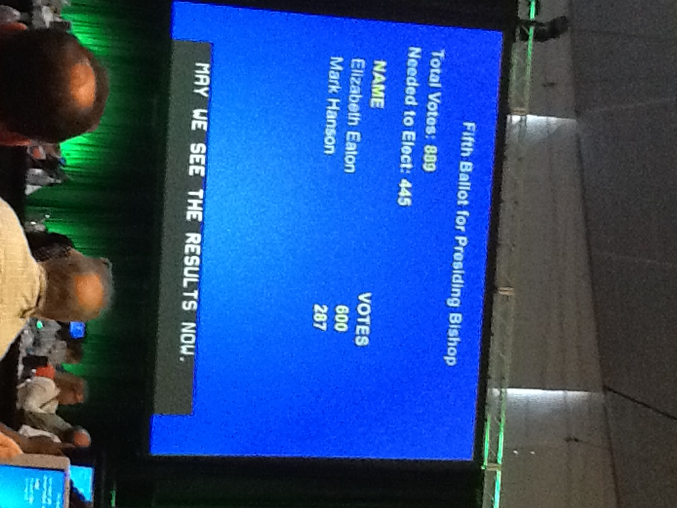
And voted – 5 total ballots …..

Slide 19
Other Actions
On the Fifth Ballot Elected Rev. Chris Boerger as ELCA Secretary
Approved a proposal for the first major fundraising campaign
Approved the ELCA churchwide organization budget for fiscal years 2014-2016.
  If every ELCA member gave $40 per year, the budget would be met.

Slide 20
Other Actions, continued
Elected members to serve on various committees
Adopted a series of amendments to the ELCA Constituions, Bylaws and Continuing Resolutions
Moved to continue the Book of Faith initiative

Slide 21
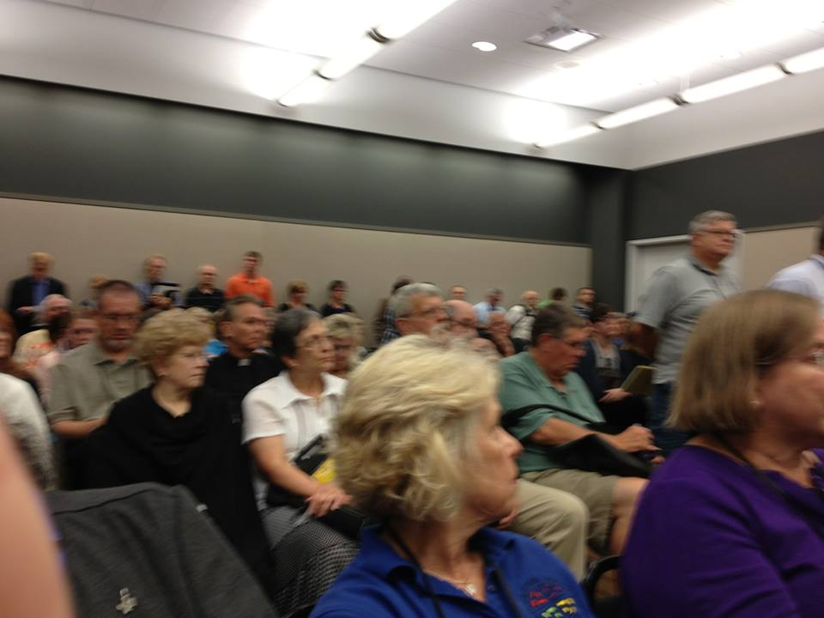
Social Statement – The Church and Criminal Justice: Hearing the Cries - PASSED
Packed House on the Criminal Justice Memorial – no one spoke in opposition during the hearings

Slide 22
Considered memorials – resolutions from the 65 synods. Topics included
Holy Communion
Immigration Reform
The Middle East
Pastoral Ministry to same-gender couples and their families
The Uniting American Families Act

Slide 23
And ….
Community Violence
Gender Identity
Immigration Issues
Hydraulic fracturing
Fossil Fuels
Voters Right Act
…. And more.

Slide 24
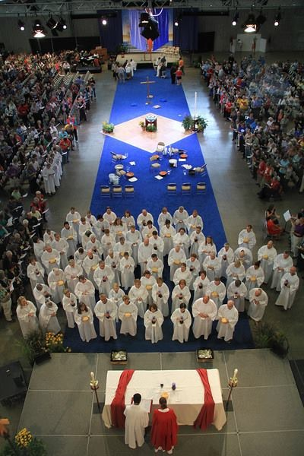
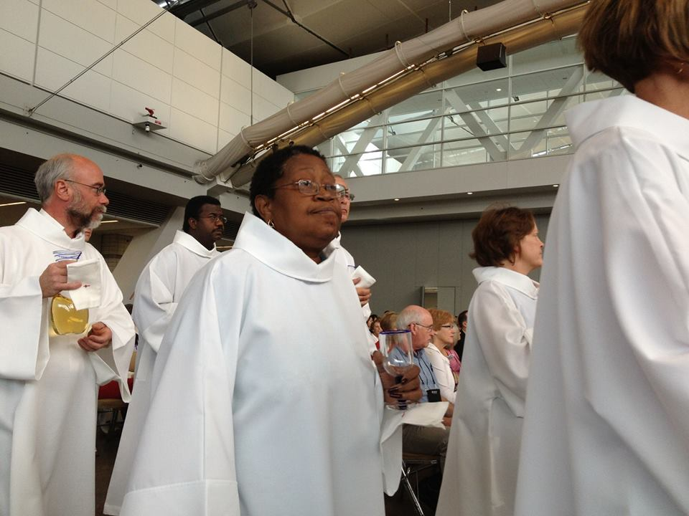
Worship

Slide 25
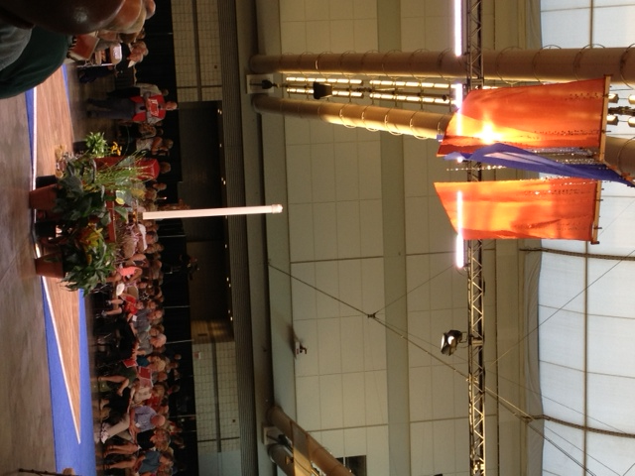
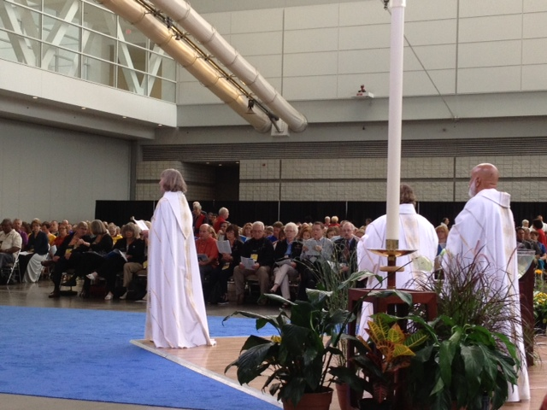

Slide 26
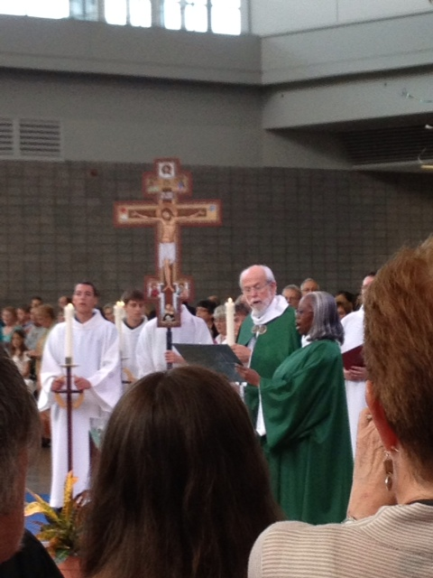
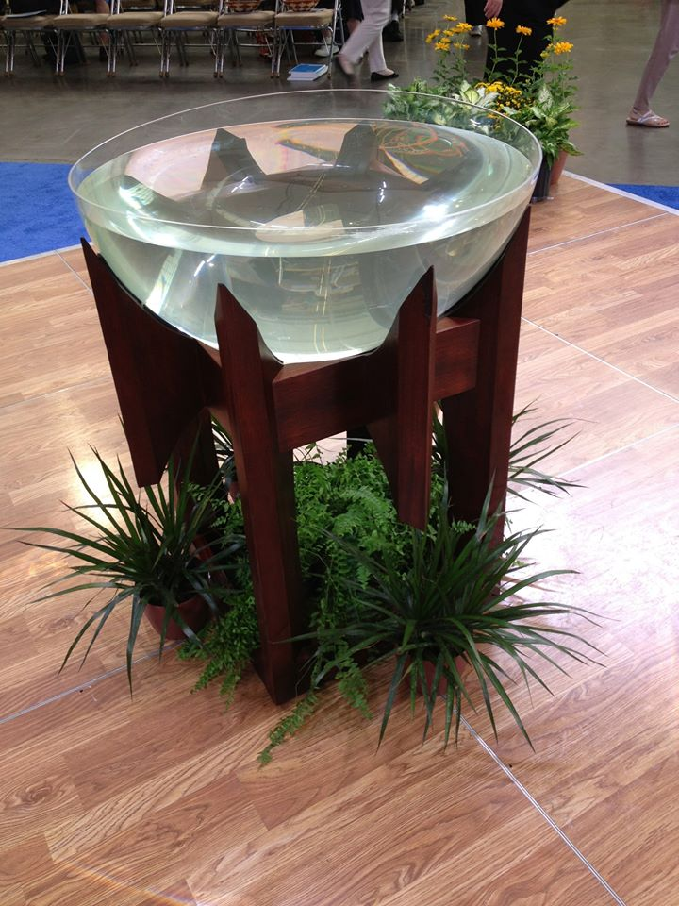

Slide 27
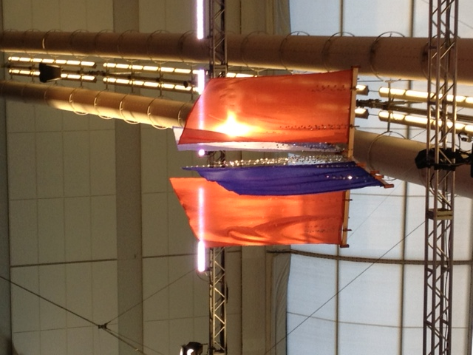
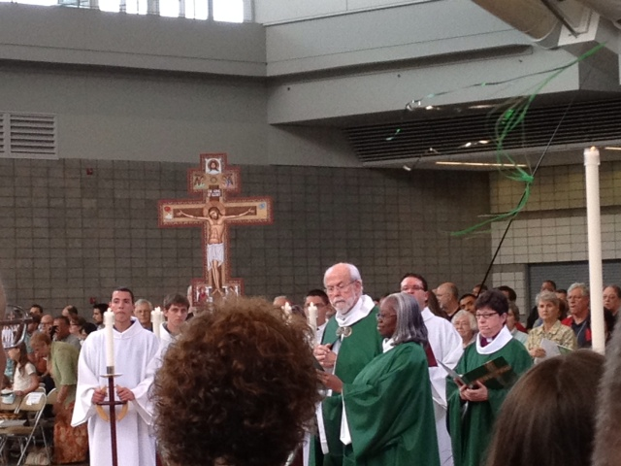

Slide 28
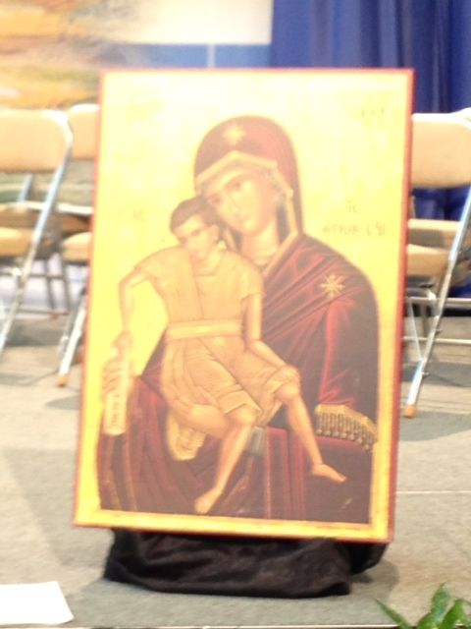
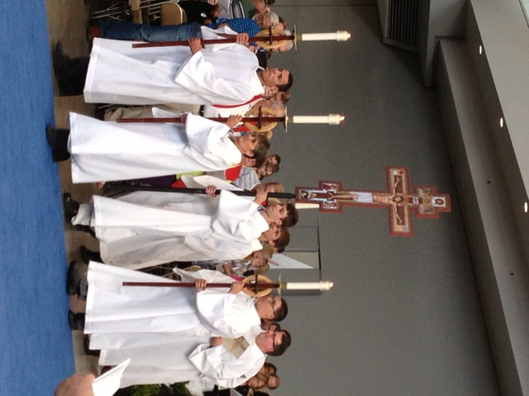

Slide 29
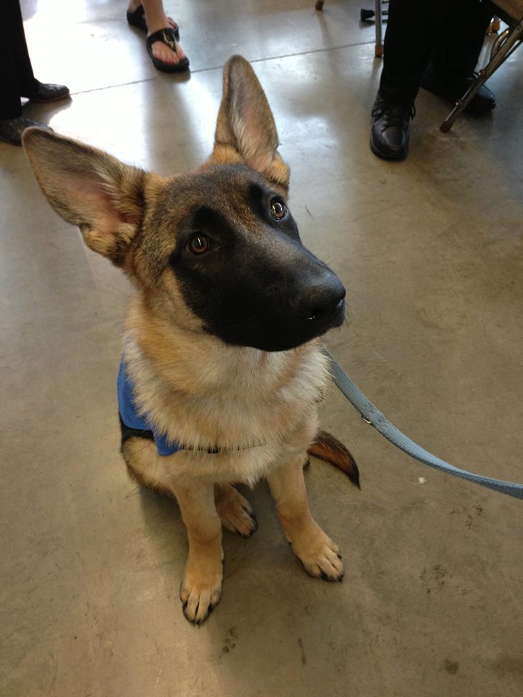
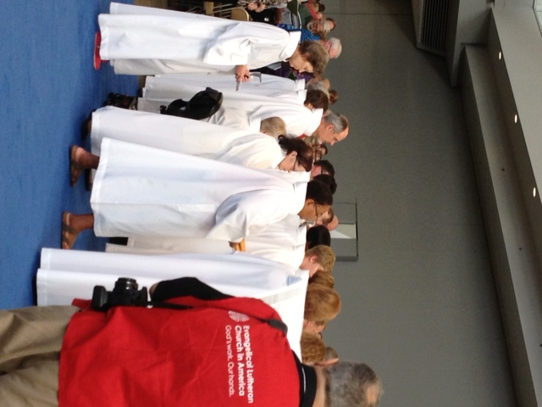

Slide 30
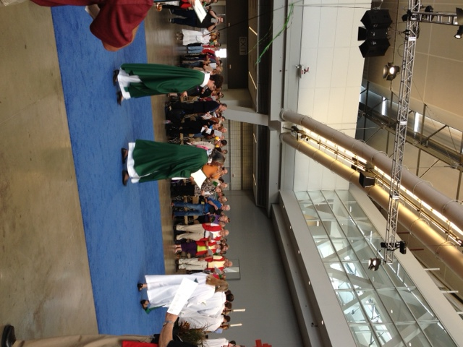
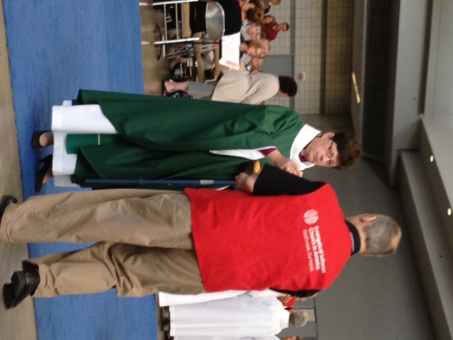

Slide 31
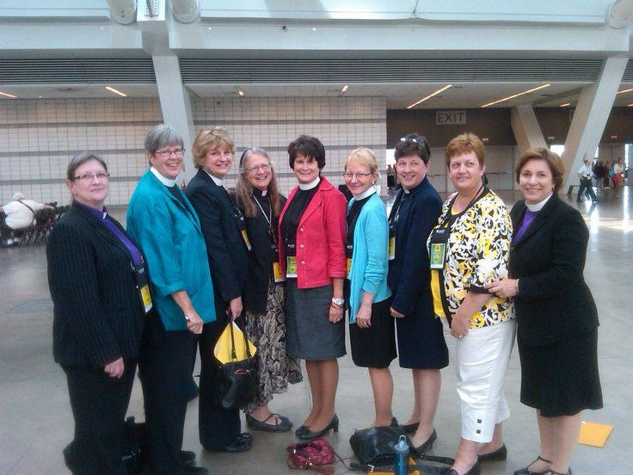
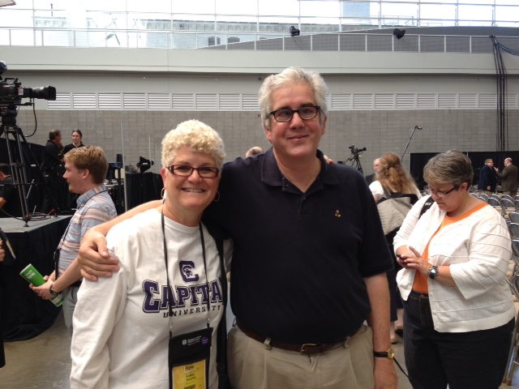
Bishops
Our 9 Female Bishops
Old Friend from Gahanna – Bishop Elect Satterlee

Slide 32
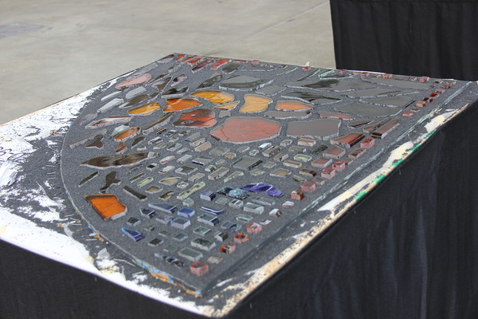
Craft Time – With Our Hands!
This window was designed for Elk River Lutheran Church in Elk River, Minn - a congregation under development that was formed when Central Lutheran Church in Elk River voted to leave the ELCA. This dedicated group that chose to remain in the ELCA moved quickly to establish worship and keep an ELCA presence in Elk River. Initially, the group of just over 100 people met at Holy Trinity Episcopal Church for worship on Sunday evenings, but they outgrew that space within a matter of months...

Slide 33
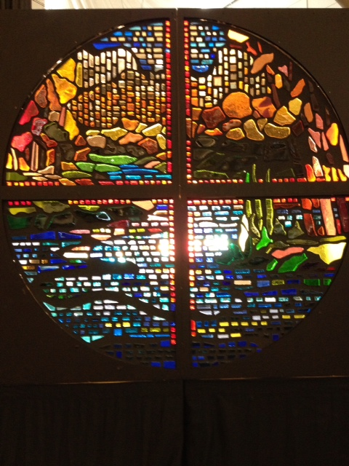
With Our Hands
And now have a dedicated building. We assembled a window at the Assembly – piece by piece by piece
Elk River a new and renewed congregation

Slide 34
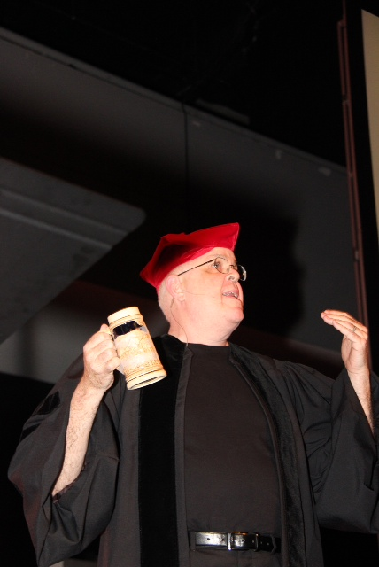
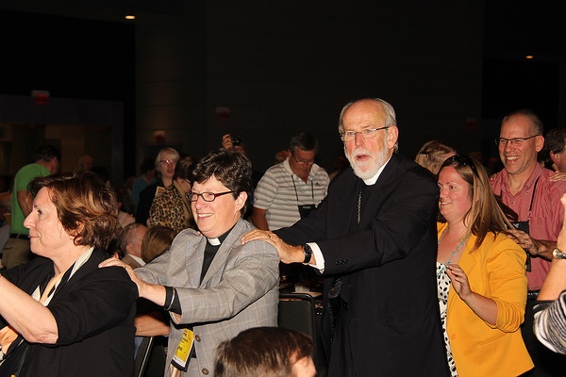
25th Anniversary Celebration

Slide 35
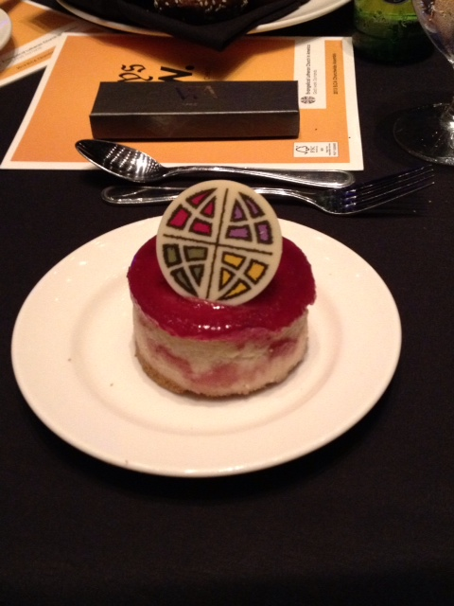
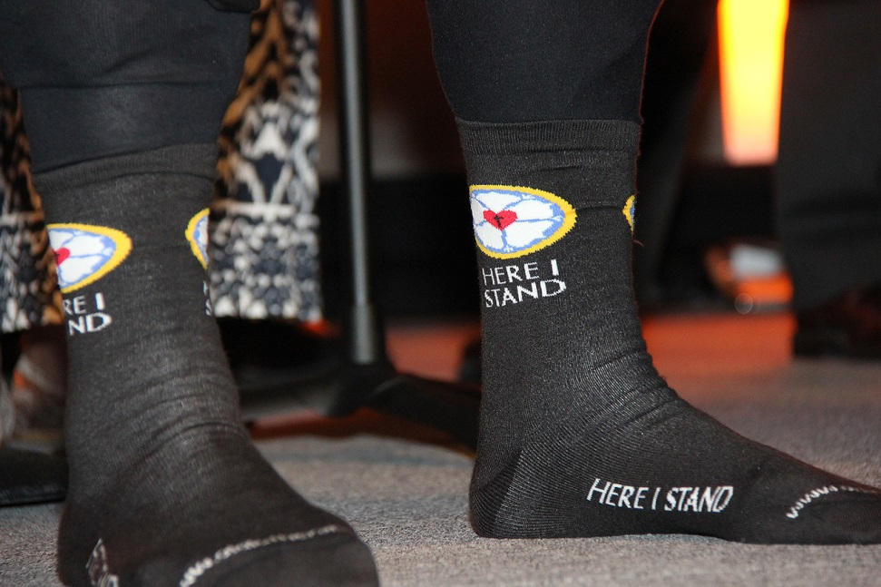
Lutheran Marketing

Slide 36
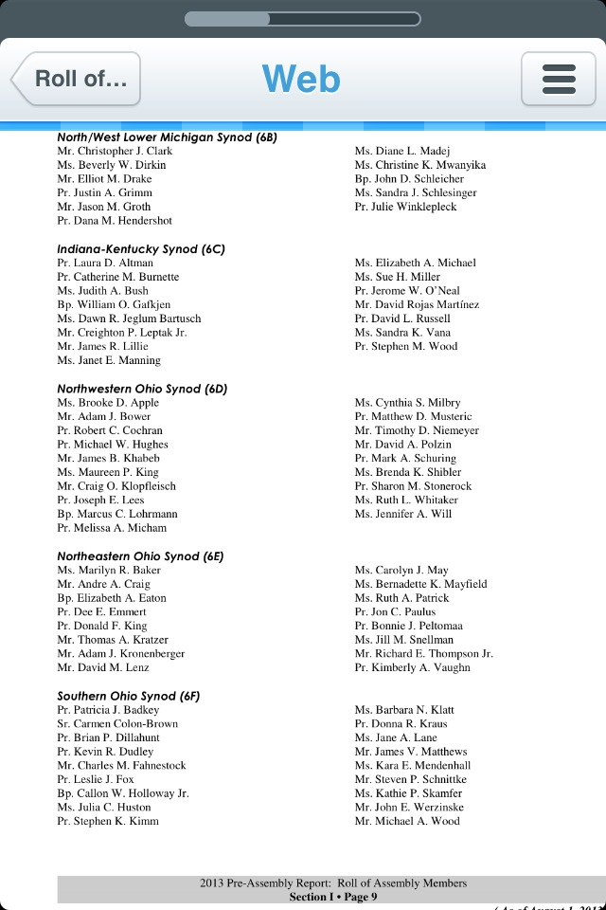
Ohio Synod Delegates
Bishop Suzanne Dillahunt will be installed at Wittenburg Saturday, October 26, 2013. ALL are welcome

Slide 37
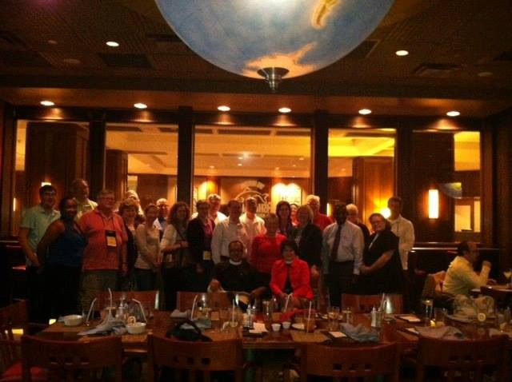
Southern Ohio Synod Delegates

Slide 38
Demographics of Voting Members
Total voting members: 950 checked in out of 952 voting members allocated which includes the 4 ELCA officers
525 lay members (61.58%) (must number 60% or higher)
52.48% were female/47.52 were male
(the goal is to get 50% gender as equal as possible)
365 ordained persons (38.42%)
First time voting members 626 or 65.89%

Slide 39
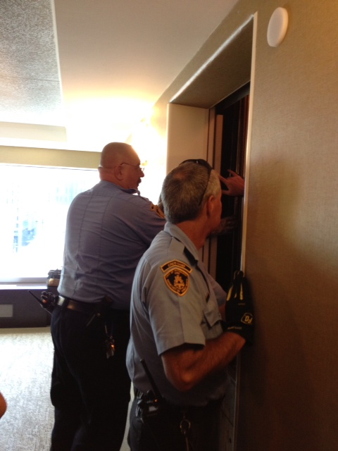
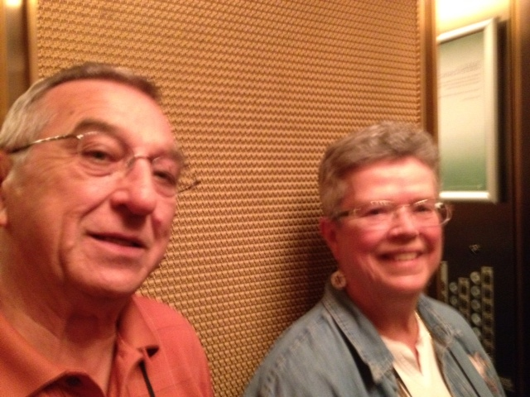
And it was not all work …. We made new friends from Wisconsin and Pittsburgh

Slide 40
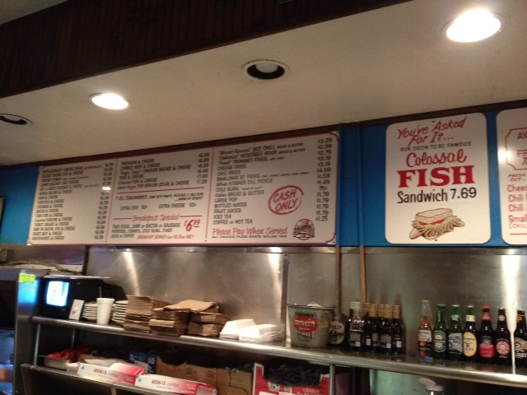
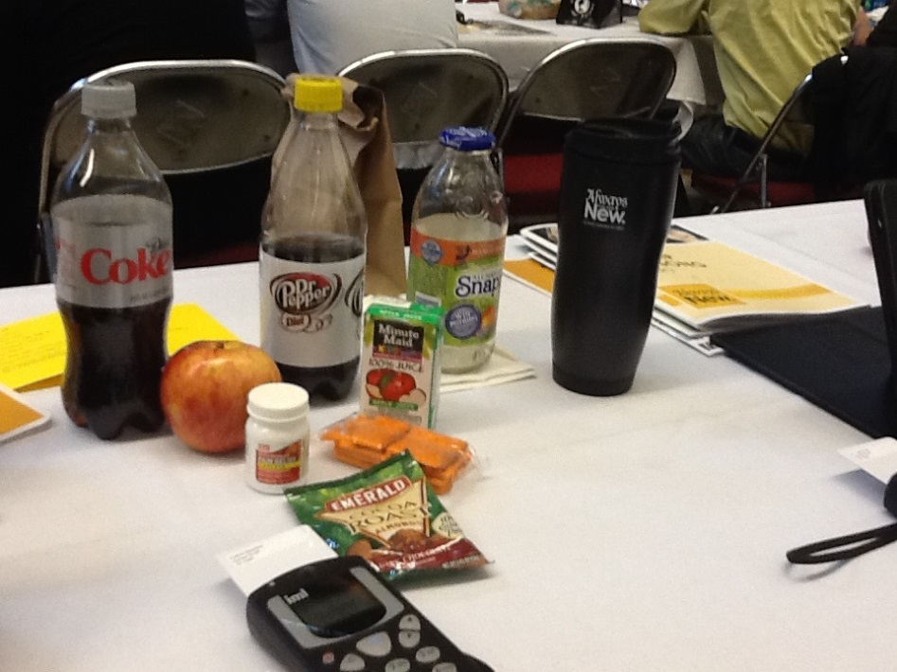

Slide 41
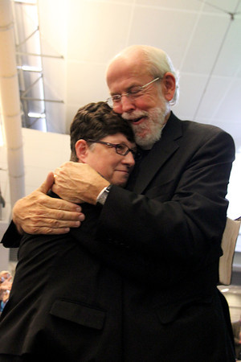
Our Church

