Slide 1
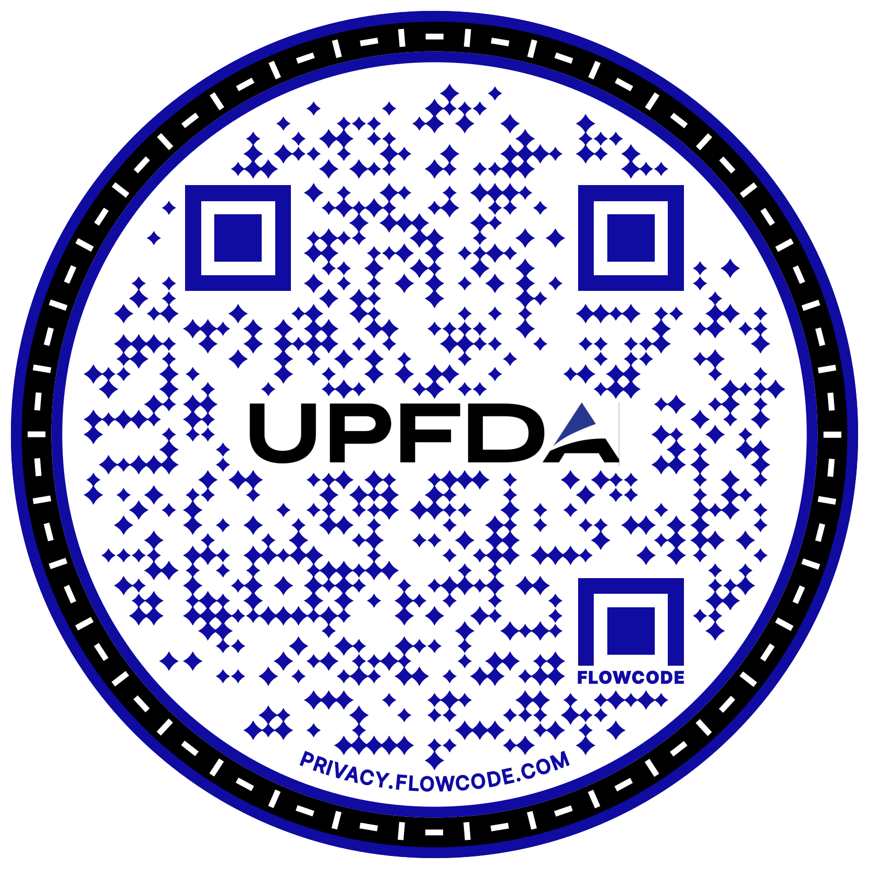

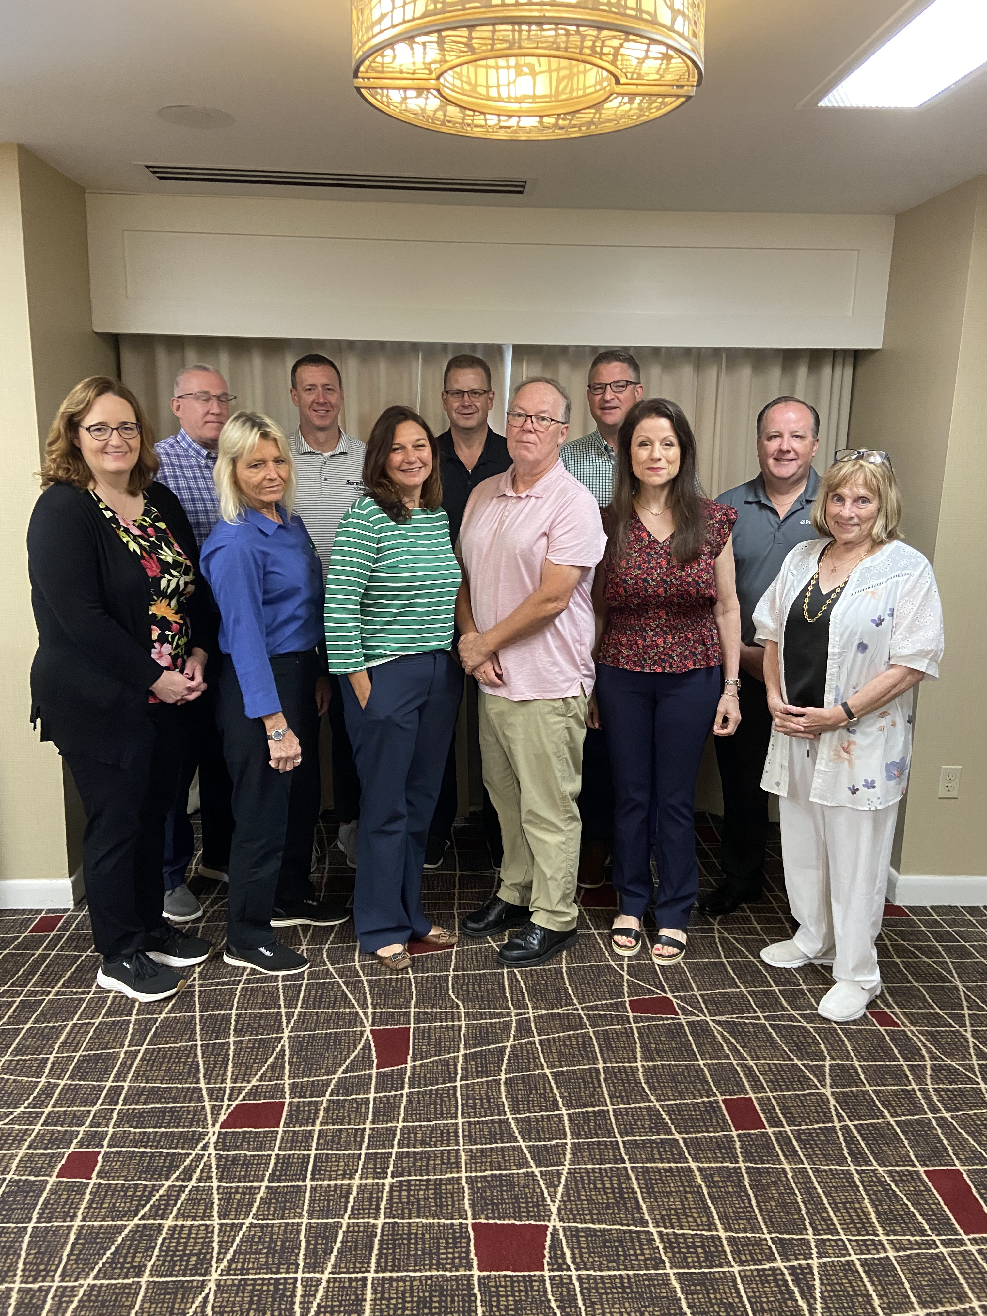
UPFDA is an association of pest management industry product and service suppliers.
We come together to support professional growth, strengthen industry connections, and ensure ethical business practices.
We achieve this by meeting at PestWorld, our Spring Conference, regular communications, and important initiatives, like the UPFDA Charitable Partner Program.
Notes:
Founded in 1968, the United Producers, Formulators and Distributors’ Association—UPFDA—was created to give suppliers to the pest management industry a unified voice.
For more than 57 years, UPFDA has supported collaboration on key industry issues and helped advance the needs of suppliers and professionals alike.
Today, UPFDA brings members together to support professional growth, strengthen industry connections, and promote ethical business practices.
If you’re a supplier, we invite you to get involved—and if you’re an industry professional, UPFDA stands ready to support your success.

Slide 2
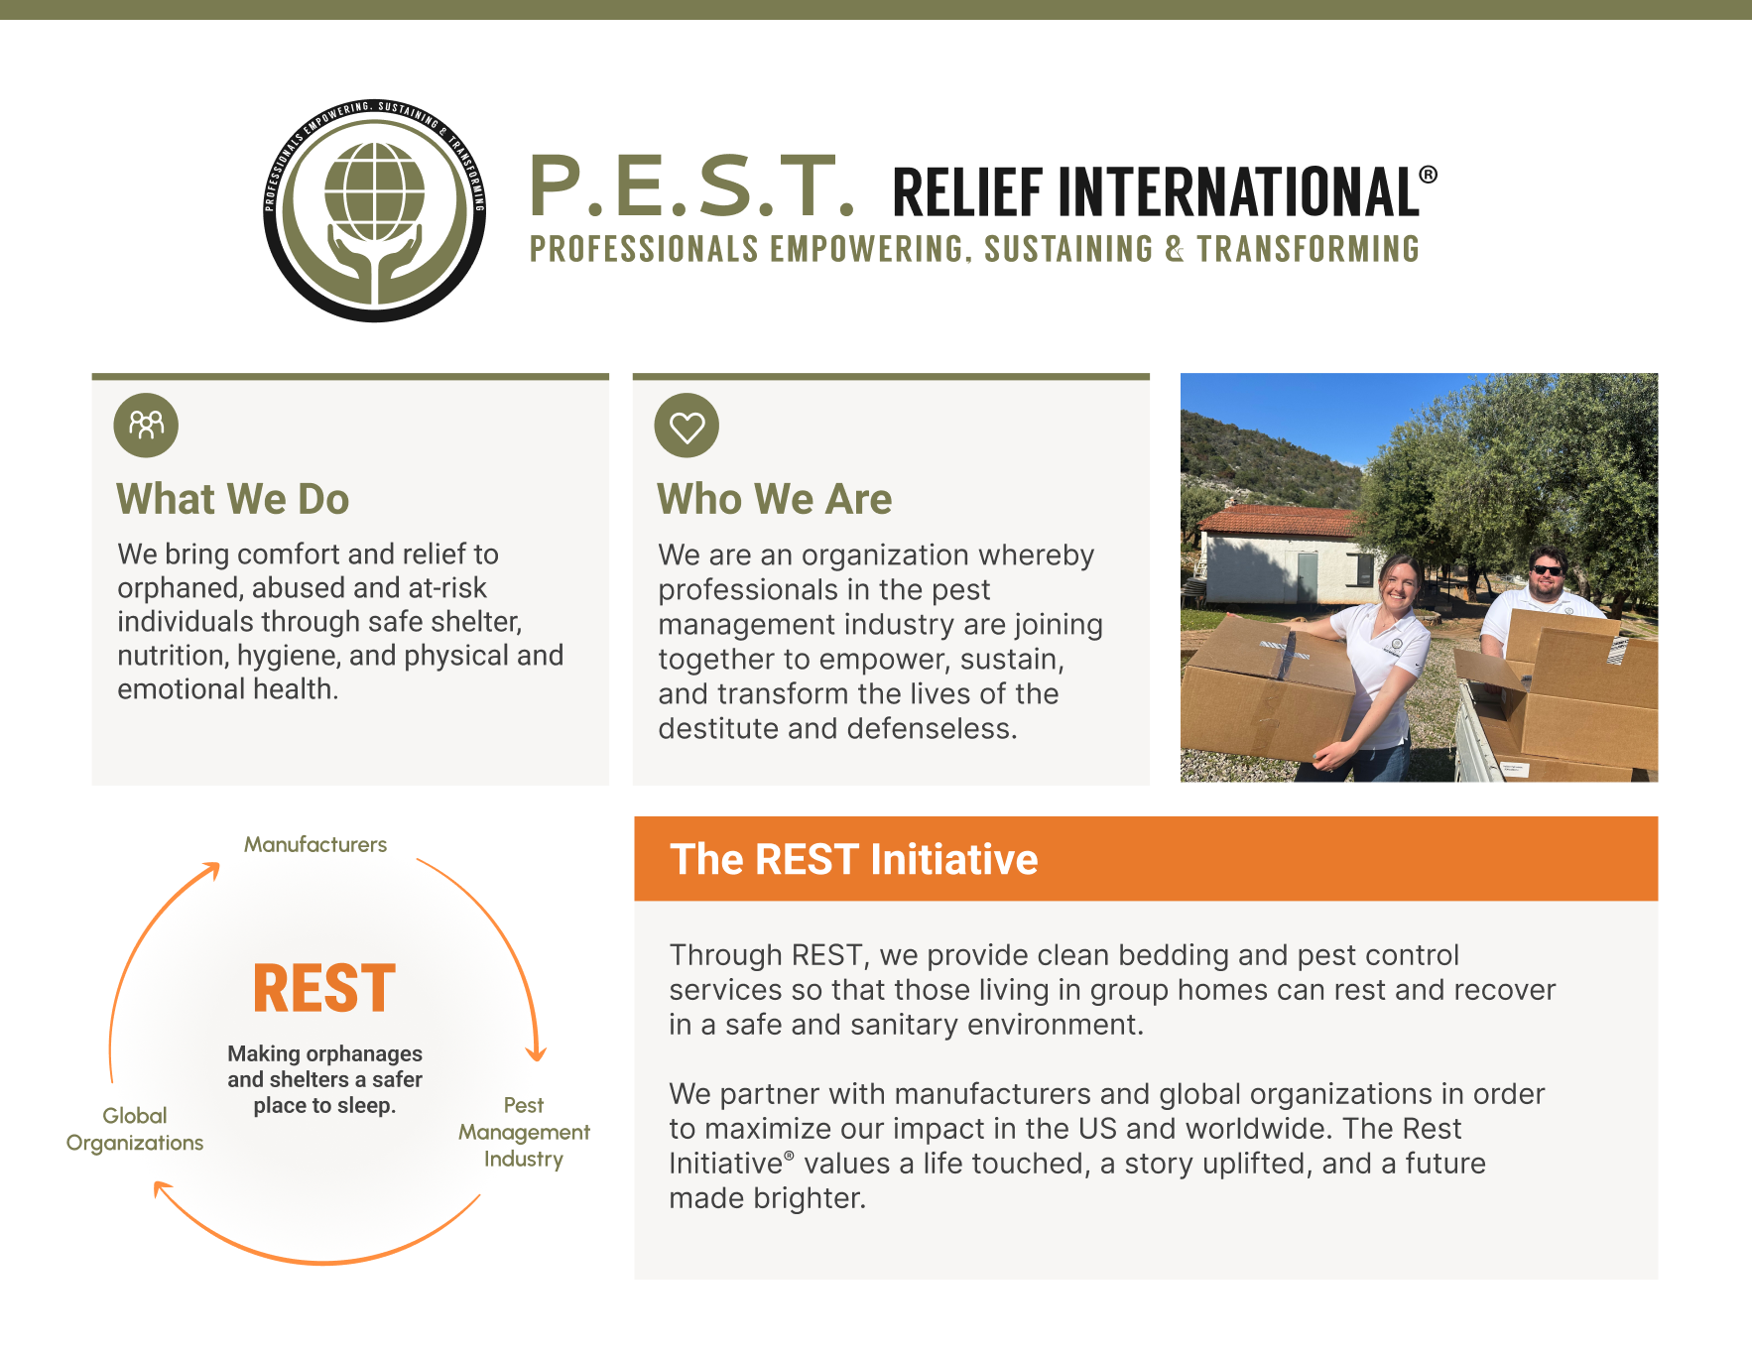
UPFDA
Charitable Partner
Visit
UPFDA.com/charitable
Notes:
In 2025, UPFDA launched a Charitable Partnership Program to support causes that align with our industry’s values and commitment to giving back.
Our first charitable partner is P.E.S.T. Relief International, an organization of dedicated to helping orphaned, abused, and at-risk individuals.
Through their REST Initiative, they work to make orphanages and shelters safer places to sleep by providing clean bedding, pest control services, and support for overall health and well-being.
UPFDA is proud to contribute $5,000 to this effort and encourages our members to get involved through service, time, or additional support. Learn more about this cause at UPFDA.com/charitable.

